Slide 1
Comp 3311 Database Management Systems
15. Other Indexes, Selection Processing
External Sorting
Exercises

Slide 2
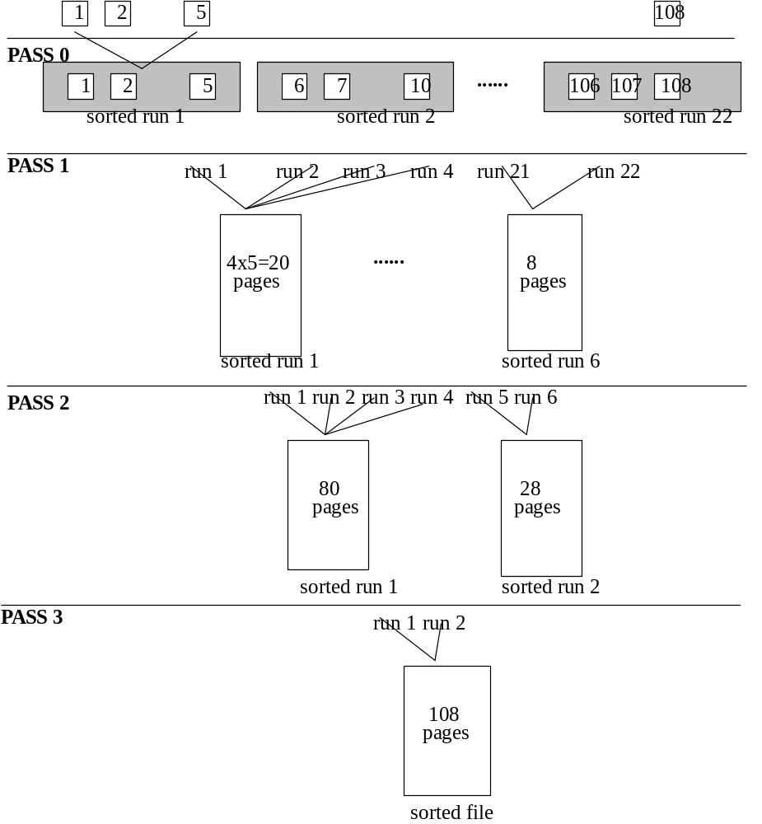
External Sorting 1
What is the cost of sorting a file that has 108 pages, using only 5 pages of main memory?

Slide 3
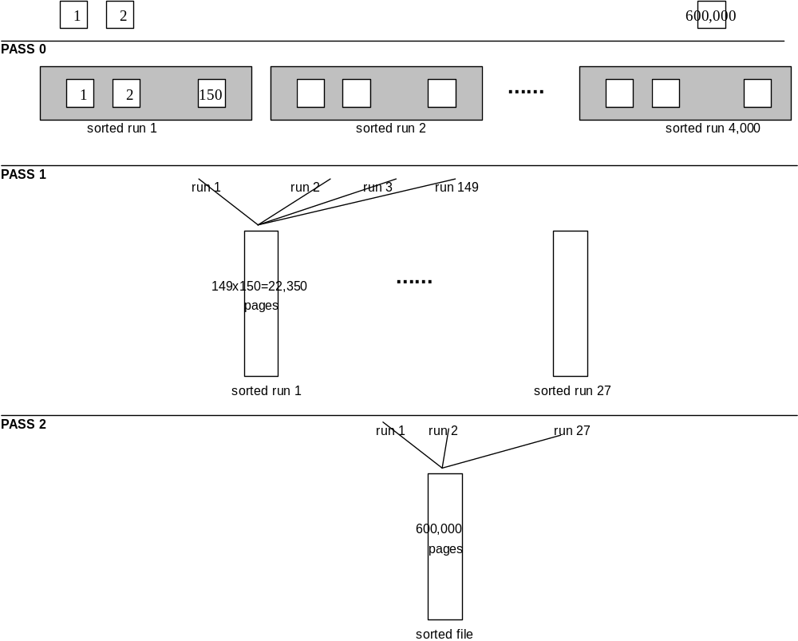
External Sorting Example 2
How to sort a file that has 600,000 pages, using only 150 pages of main memory?

