Slide 1
Comp 3311 Database Management Systems
17. Exercises on Query Processing

Slide 2
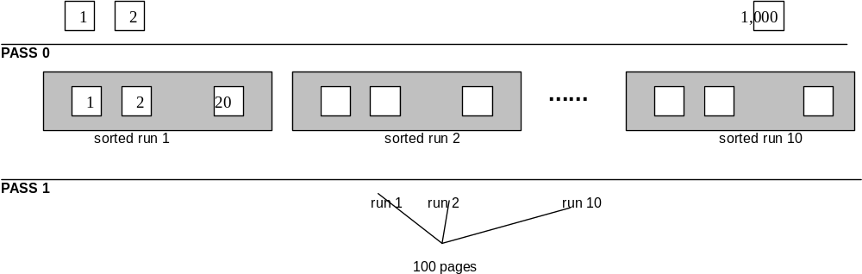
Projection Example – External Sorting
Consider a file of 10,000 students sorted on student id. Each student has 5 attributes, each 20 bytes. The page size is 1000 bytes.
What is the cost of processing the query using external sorting
SELECT DISTINCT name FROM student
Assume that the available main memory is 100 pages and that there are 5,000 different student names. There is no index
I can store 10 records per page and the file contains 1000 pages.
At pass 0, I read 100 pages for each sorted run, but I write back 20 because I only keep the name (the other attributes are not needed). Thus I have 10 sorted runs, each with 20 pages. Cost of pass 0 = 1000+200
At pass 1, I read and merge the 200 pages. Cost of pass 1=200.
Total cost = 1200+200 (without considering the cost of writing the final output).
The output is only 100 pages because each name is assumed to appear twice.

Slide 3
Projection Example - Hashing
Consider a file of 10,000 students sorted on student id. Each student has 5 attributes, each 20 bytes. The page size is 1000 bytes.
What is the cost of processing the query using hashing and 20 buckets
SELECT DISTINCT name FROM student
Assume that the available main memory is 100 pages and that there are 5,000 different student names.
I read the file page by page and assign each record to a bucket. For each record I keep only the name attribute, i.e., I read 1000 pages but I only write back 200. The cost of partitioning is 1000+200.
The average bucket size is 1000/20 * 1/5 = 10 pages. Thus, at the next step I load each bucket in memory, build the in-memory hash table and perform duplicate elimination within the bucket.
Total cost 1200+200 (without considering the cost of writing the final output)
Optimization: given the large memory that I have I can keep 8 full buckets in memory (i.e., 80 pages) and have 12 pages as output buffers for the remaining buckets.
In this way, I avoid writing and reading again the 8 buckets, i.e.,
total cost = 1400 – 80*2=1240

Slide 4
Query Processing Exercise
Consider two files Student(s_id, name, dept_id, address), Enroll(class_id, s_id, semester, grade).
The Student file contains 10,000 records in 1,000 pages and the Enroll file contains 50,000 records in 5,000 pages. There are 10 different departments and 25 different classes. All attributes have the same length. Each index, wherever available, is a tree with 3 levels. For non-clustering indexes, each pointer is assumed to lead to a different page. Our goal is to process the query:
  SELECT S.name
  FROM Student S, Enroll E
  WHERE S.dept_id="COMP" AND E.class_id=“231" and S.S_id=E.S_id
Some useful statistics:
A student enrolls on the average in 5 classes
A department contains on the average 1,000 students
Each class contains an average of 2,000 enrolment records

Slide 5
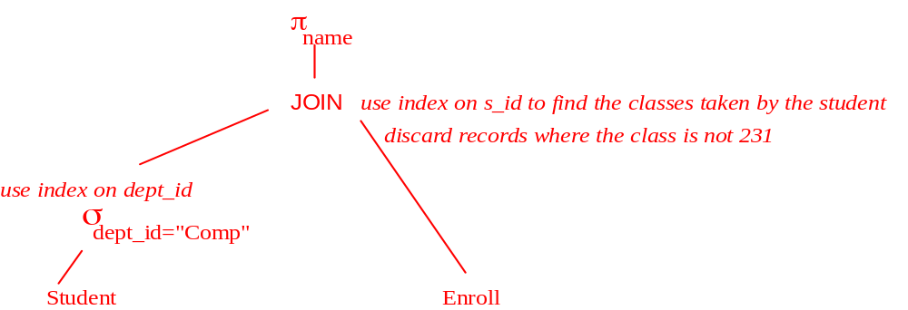
Question
Consider that the Student file contains a clustered index on dept_id, and the Enroll file contains a non-clustered index on student_id. Describe a fully pipelined plan (i.e., do not materialize anything) for processing the query by using Students as the outer relation and taking advantage of both indexes.

Slide 6
Question (cont)
Estimate the approximate cost of your plan.
Selection needs to read 3+100 pages of Students (clustered index on dept_id) and will return 1,000 student ids and names.
For each (of the 1,000) student we use the index on s_id (for Enroll) to find the corresponding record: cost=1,000 (3+5)=8,000 (for each s_id we retrieve 5 records in classes).
Total cost= 8103 pages. (this cost does not include an extra level of indirection for the non-clustered s_id index - if we also include this the cost becomes 9103)
For this and the following questions, assume that there are no indexes. Using the above file sizes, estimate the cost of block nested loops with a main memory buffer of 102 pages (for each case explain briefly):
i] Student as the outer relation:
1,000+5,000*10 = 51,000
ii] Enroll as the outer relation:
5,000+1,000*50 = 55,000
How can you optimize assuming that you have the clustered index on Student.dept_id of the previous question?

Slide 7
Question (Cont)
Describe sort-merge join and its cost, assuming that neither file is sorted on s_id, and that you have a buffer of 100 pages. Minimize the total cost (hint: discard attributes and records that are not needed).
For sorting Student, pass 0 reads 100 pages at a time, but writes back only the ids and names of students in COMP, i.e., 1/10*1/2 of 100= 5 pages (i.e., 10% of the records and for each record only half the attributes). Thus, the result of pass 0 contains 10 sorted runs with total size 50 pages. Cost of pass 0 for Students = 1000+50.
For sorting Enroll, pass 0 reads 100 pages at a time, but writes back only the sids of students who took class 231, i.e., 1/25*1/4 of 100=1 page (i.e., 4% of the records and for each record only one attribute). Thus, the result of pass 0 for Classes contains 50 sorted runs with a total size 50 pages. Cost of pass 0 for Classes = 5000+50.
We allocate another 60 pages as input buffers for the sorted runs of both files and now we can merge directly.
Total cost: 1050 (pass 0 of Students) + 5050 (pass 0 of Classes) + 100 (merging all passes) = 6200.

Slide 8
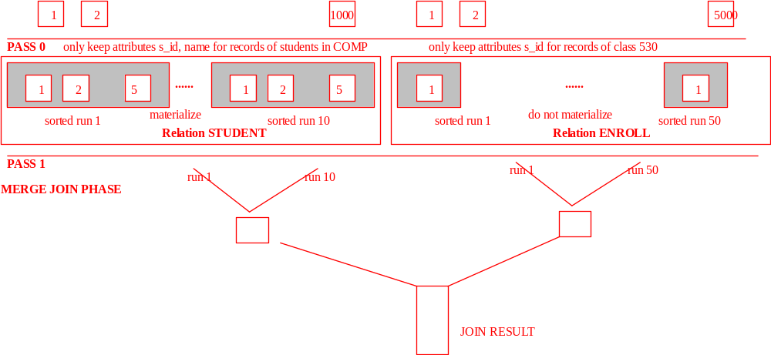
Diagram

Slide 9
Question (Cont)
Describe hybrid hash join and its cost, using a buffer of 101 pages and Students as the build input. Minimize the total cost (hint: discard attributes and records that are not needed) assuming that records are evenly distributed in the buckets.
Since I have 101 pages, I can use 100 buckets to partition. After discarding the records of students not in COMP and the extra attributes, the size of the file is 50 pages (see previous answer). Therefore, each bucket is less than 1 page and I can keep ALL buckets of Students in memory. Then, I read the Classes file page by page. For each record, I find directly the matching records in the corresponding bucket of Students and output the result. Total cost = 1,000 + 5,000 (just reading the files).

