Slide 1
Comp 3311 Database Management Systems
2. Entity Relationship (ER) Model

Slide 2
Basic Concepts of ER
ER is a model for the logical level
it describes the structure of the database at a high abstraction level
A database can be modeled as
a collection of entities
relationships among entities
An entity is an object that exists independently and is distinguishable from other objects.
an employee, a company, a car, a student, a class etc.
color, age, etc. are not entities

Slide 3
An entity set is a set of entities of the same type.
E.g., a set of employees, a set of departments → also called entity types
Entity Type :
Employee
A general specification
e₁
The actual employees
Entity set:
e₂
e₃
…

Slide 4
Attributes
Properties of an entity or a relationship
name, address, weight, height are properties of a Person entity.
date of marriage is a property of the relationship Marriage.

Slide 5
Types of Attributes
Simple attribute: contains a single value.
EmpNo
Employee
Name
Address

Slide 6
Composite attribute: consists of several components (e.g., address)
EmpNo
Name
Employee
Street
Address
City
Country

Slide 7
Multivalued attribute: contains more than one value
Phone
Employee
Email

Slide 8
Derived attribute: computed from other attributes (e.g., age can be computed from the date of birth and the current date)
Age
Employee
Date of birth

Slide 9
Key Attributes
A set of attributes that can uniquely identify an entity
EmpNo
Employee
Name

Slide 10
Key Attributes
An entity may have more than one key
A minimal set of attributes that uniquely identifies an entity is called a candidate key.
Question: what are possible candidate keys of HKUST students?
Only one candidate key is selected to be the primary key.
Question: what attribute(s) would you use as the primary key of HKUST students?
Sometimes artificial keys maybe created
Example: assume that we want to store information about the current offering of COMP 3311. We can select a unique number (e.g., 1235) to serve as the key.
Question: what alternatives are there for this example, without introducing additional attributes?
Composite Key: contains two or more attributes

Slide 11
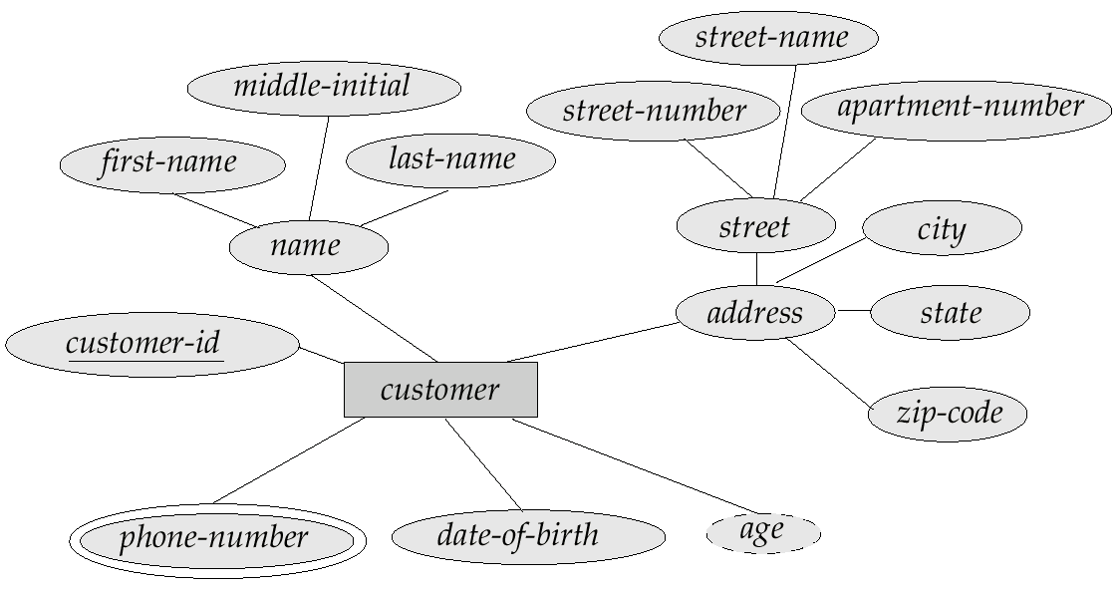
Example Entity (Customer)

Slide 12
Relationship
A relationship is an association among entities.
The degree refers to the number of entity sets that participate in a relationship set.
Relationship sets that involve two entity sets are binary (or degree two).
Relationships among more than two entity sets are rare.

Slide 13
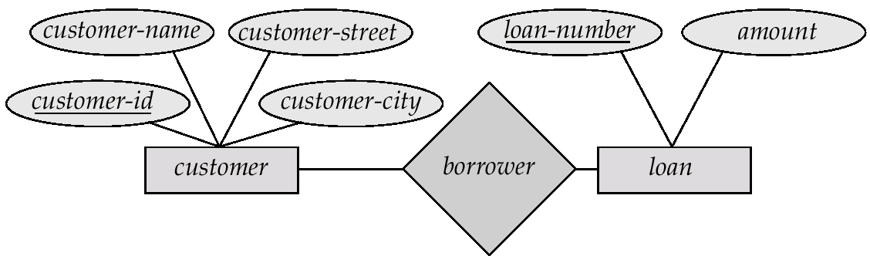
Example of Binary Relationship
Borrower is a relationship between Customers and Loans (it means that a customer can be associated with zero or more loans and vice versa).

Slide 14
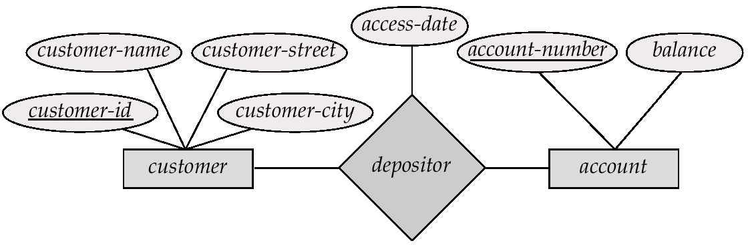
Relationship Sets with Attributes
Depositor is a relationship between Customers and Accounts
Access-date is an attribute of Depositor

Slide 15
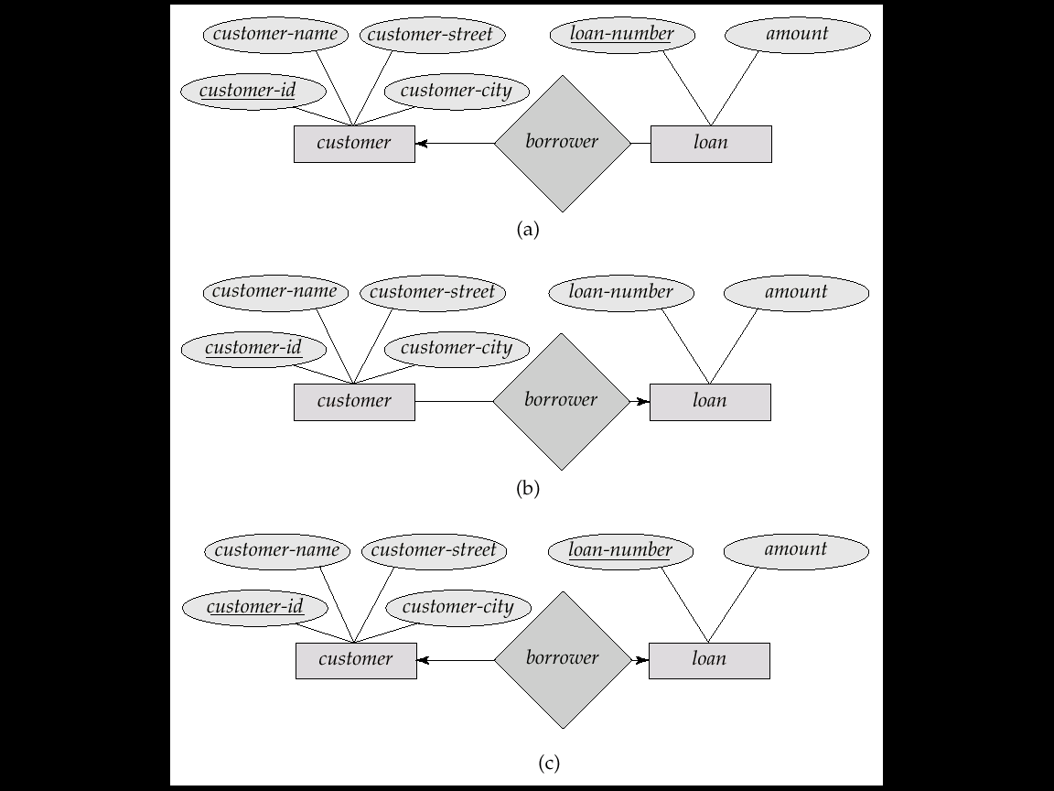
Cardinality Constraints
We express cardinality constraints by drawing either a directed line (→), signifying “one,” or an undirected line (—), signifying “many,” between the relationship set and the entity set.
E.g.: One-to-one relationship:
A customer is associated with at most one loan via the relationship borrower
A loan is associated with at most one customer via borrower

Slide 16
One-To-Many Relationship
In the one-to-many relationship
a loan is associated with at most one customer via borrower,
a customer is associated with zero or more loans via borrower

Slide 17
Many-To-One Relationships
In a many-to-one relationship
a loan is associated with zero or more customers via borrower,
a customer is associated with at most one loan via borrower

Slide 18

Many-To-Many Relationship
A customer is associated with zero or more loans via borrower
A loan is associated with zero or more customers via borrower

Slide 19
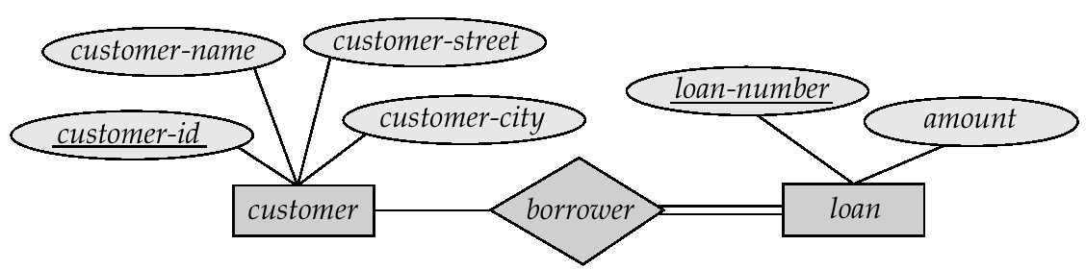
Participation of an Entity Set in a Relationship Set
Total participation (indicated by double line): every entity in the entity set participates in at least one relationship in the relationship set
E.g. participation of loan in borrower is total:
every loan must have at least a customer associated to it via borrower
Partial participation: some entities may not participate in any relationship in the relationship set
E.g. participation of customer in borrower is partial:
some customers may not have any loan

Slide 20
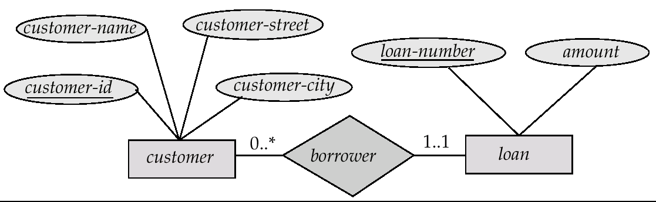
Alternative Notation for Cardinality Limits
Cardinality limits can also express participation constraints
This notation is only for your reference; we will not use it in this course.

Slide 21
Cardinality Limits
The edge between loan and borrower has a cardinality constraint of 1..1,
meaning the minimum and the maximum cardinality are both 1.
each loan must have exactly one associated customer.
The limit 0..∗ on the edge from customer to borrower indicates that a customer can have zero or more loans.
Thus, the relationship borrower is
one to many from customer to loan,
the participation of loan in borrower is total.

Slide 22
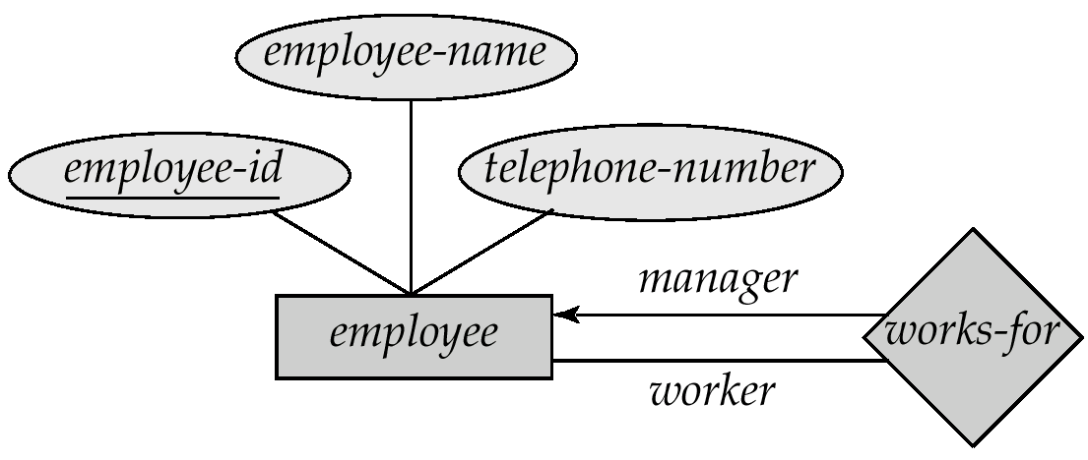
Roles
Entity sets of a relationship need not be distinct.
The labels “manager” and “worker” are called roles; they specify how employee entities interact via the works-for relationship set.
Roles are indicated in E-R diagrams by labeling the lines that connect diamonds to rectangles.
Role labels are optional, and are used to clarify semantics of the relationship

Slide 23
Keys for Relationship Sets
The combination of primary keys of the participating entity sets forms a super key of a relationship set.
(customer-id, account-number) is the super key of depositor
This means that a pair of entities can have at most one relationship in a particular relationship set.
E.g. if we wish to track all access-dates to each account by each customer, we cannot assume a relationship for each access. Solution: use a multivalued attribute for access dates.
Must consider the cardinality constraints when deciding the candidate keys for a relationship set
Many to many, one to many, many to one

Slide 24
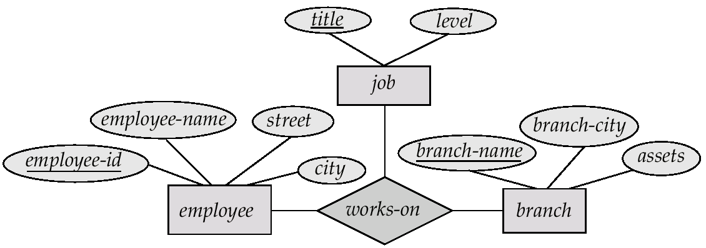
E-R Diagram with a Ternary Relationship
Suppose employees of a bank may have jobs (responsibilities) at multiple branches, with different jobs at different branches. Then there is a ternary relationship set between entity sets employee, job and branch

Slide 25
Binary Vs. Non-Binary Relationships
Some relationships that appear to be non-binary may be better represented using binary relationships
E.g. A ternary relationship parents, relating a child to his/her father and mother, is best replaced by two binary relationships, father and mother
Using two binary relationships allows partial information (e.g. only mother being known)
But there are some relationships that are naturally non-binary
E.g. works-on

Slide 26
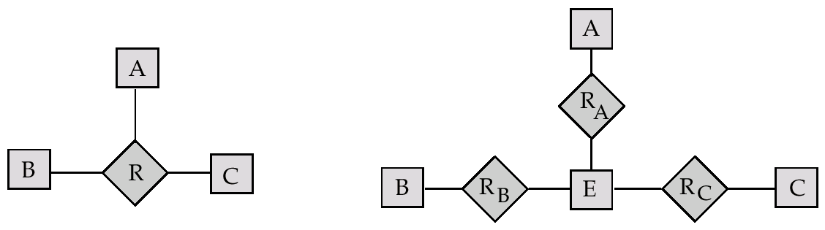
Converting Non-Binary Relationships to Binary Form
In general, any non-binary relationship can be represented using binary relationships by creating an artificial entity set.
Replace R between entity sets A, B and C by an entity set E and three relationship sets: R_{A} relating E and A, R_{B} relating E and B and R_{C} relating E and C
Create a special identifying attribute for E
Add any attributes of R to E
For each relationship (a_{i} , b_{i} , c_{i}) in R, create (i) a new entity e_{i} in the entity set E , (ii) add (e_{i} , a_{i} ) to R_{A} , (iii) add (e_{i} , b_{i} ) to R_{B},(iv) add (e_{i} , c_{i} ) to R_{C}

Slide 27
Example of Conversion
R
a1 | b1 | c1
a2 | b1 | c1
a2 | b1 | c2
a2 | b2 | c2
e1
e2
e3
e4
R_{a}
R_{b}
R_{c}
a1 | e1
a2 | e2
a2 | e3
a2 | e4
b1 | e1
b1 | e2
b1 | e3
b2 | e4
c1 | e1
c1 | e2
c2 | e3
c2 | e4

Slide 28
Weak Entity Sets
An entity set that does not have a primary key is referred to as a weak entity set.
The existence of a weak entity set depends on the existence of an identifying entity set
it must relate to the identifying entity set via a total, one-to-many relationship set from the identifying to the weak entity set
Identifying relationship is depicted using a double diamond
The discriminator (or partial key) of a weak entity set is the set of attributes that distinguishes among all the entities of a weak entity set.
The primary key of a weak entity set is formed by the primary key of the strong entity set on which the weak entity set dependends, plus the weak entity set’s discriminator.

Slide 29
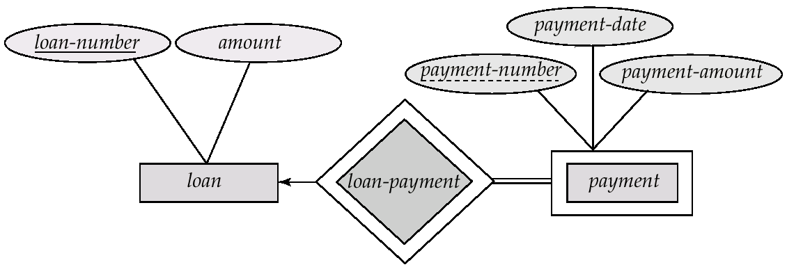
Weak Entity Sets (Cont.)
We depict a weak entity set by double rectangles.
We underline the discriminator of a weak entity set with a dashed line.
payment-number – discriminator of the payment entity set
Primary key for payment – (loan-number, payment-number)

Slide 30
Another Example of Weak Entity Set
EmpNo
Name
Age
Employee
Emp_Dep
Dependent
A dependent child may not be old enough to have a HKID number
Even if he/she has a HKID number, the company may not be interested in keeping it in the database.

Slide 31
ISA (`is a’) Hierarchies
name
ssn
lot
Employees
As in C++, or other PLs, attributes are inherited.
If we declare A ISA B, every A entity is also considered to be a B entity.
hours_worked
hourly_wages
ISA
contractid
Hourly_Emps
Contract_Emps
Overlap constraints: Can Joe be an Hourly_Emps as well as a Contract_Emps entity? (Allowed/disallowed)
Covering constraints: Does every Employees entity have to be either an Hourly_Emps or a Contract_Emps entity? (Yes/no)
Reasons for using ISA:
To add descriptive attributes specific to a subclass.
To identify subsets of entities that participate in a relationship.
Notes:
12

Slide 32
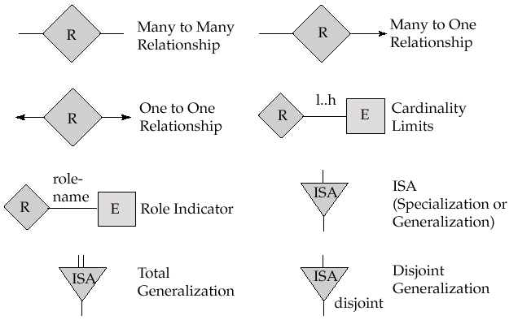
Summary of Symbols (Cont.)
Total Participation

Slide 33
ER Design Decisions - Attribute vs Entity
For each employee we want to store the office number, location of the office (e.g., Building A, floor 6), and telephone.
Several employees share the same office

Slide 34
ER Design Decisions - Entity vs Relationship
Account example
Can you see some differences? (e.g., can you have accounts without a customer?)

Slide 35
ER Design Decisions - Entity vs Relationship
You want to record the period that an employ works for some department.
from
to
name
dname
ssn
lot
did
budget
Employees
Works_In2
Departments
name
dname
ssn
lot
did
budget
Employees
Works_In3
Departments
from
Duration
to

Slide 36
ER Design Decisions - Strong vs. Weak Entity
Example: What if in the accounts example
an account must be associated with exactly one branch
two different branches are allowed to have accounts with the same number.

