Slide 1
Comp 3311 Database Management Systems
3. Relational Data Model

Slide 2
Basic Concepts
Entities and relationships are stored in tables
Well-defined semantics and languages for manipulating the tables
Ease of implementation – write queries on tables without caring about the physical level and optimization issues
All popular DBMSs today are based on relational data model (or an extension of it, e.g., object-relational data model)

Slide 3
Terminology
Relation  table; denoted by R(A₁, A₂, ..., A_{n}) where R is a relation name and (A₁, A₂, ..., A_{n}) is the relation schema of R
Attribute (column)  denoted by A_{i}
Tuple (Record)  row
Attribute value  value stored in a table cell
Domain  legal type and range of values of an attribute denoted by dom(A_{i})
Attribute: Age Domain: [0-100]
Attribute: EmpName Domain: 50 alphabetic chars
Attribute: Salary Domain: non-negative integer

Slide 4
An Example Relation
Relation Name/Table Name
Attributes/Columns (collectively as a schema)
Tuples/Rows

Slide 5
Some Formal Definitions
A relation schema is denoted by: R(A₁, A₂, ..., A_{n})
STUDENT(Name, Student-id, Age, CGA)
Degree of a relation: the number of attributes n in the relation.
Tuple t of R(A₁, A₂, ..., A_{n}): An ordered set of values <v₁,v₂,...,v_{n}> where each v_{i} is an element of dom(A_{i}).
Relation instance r(R): A set of tuples in R.
r(R) = {t₁, t₂, ..., t_{m}}, or alternatively
r(R)  dom(A1)  dom(A2)  ...  dom(An)

Slide 6
Relation and Cartesian Product
A relation is any subset of the Cartesian product of domains of values
Example: Let Dom(Name) = { Lee, Cheung } Dom(Grade) = { A, B, C }
Then the Cartesian product of the domains is
Dom(Name)  Dom(Grade) = { Lee, A, Lee, B , Lee, C, Cheung, A, Cheung, B, Cheung C }
A relation StudentGrade (Name, Grade) can be defined as any subset of the Cartesian product Dom(Name)  Dom(Grade)
r(StudentGrade) = { Lee, A, Cheung C }  Dom(Name)  Dom(Grade)

Slide 7
Characteristics of Relations
Tuples in a relation are not considered to be ordered, even though they appear to be in a tabular form. (Recall that a relation is a set of tuples.)
All attribute values are considered atomic. Multivalued and composite attribute values are not allowed in tables, although they are permitted by the ER diagrams
A special null value is used to represent values that are:
Not applicable (phone number for a client that has no phone)
Missing values (there is a phone number but we do not know it yet)
Not known (we do not know whether there is a phone number or not)

Slide 8
Keys
Let K ⊆ R (I.e., K is a set of attributes which is a subset of the schema of R)
K is a superkey of R if K can identify a unique tuple in a given relation r(R)
Student(SID, HKID, Name, Address, …) where SID and HKID are unique. Possible superkeys: SID HKID {SID, Name} {HKID, Name, Address} plus many others
K is a candidate key if K is minimal
In the above example there are two candidate keys: SID and HKID
Every relation must have at least one candidate key.
If there are multiple, one is chosen as the primary key.

Slide 9
Need for Multiple Tables
Storing all information as a single relation such as bank(account-number, balance, customer-name, ..) results in
repetition of information (e.g. repeat the customer info for each of his/her accounts)
the need for null values (e.g. represent a customer without an account)
That is why we need the ER diagrams (and some additional normalization techniques discussed later) to break up information into parts, with each relation storing one part. E.g.: account : stores information about accounts depositor : stores information about which customer owns which account customer : stores information about customers

Slide 10
Reduction of an E-R Schema to Relations
A database which conforms to an E-R diagram can be represented by a collection of tables.
Converting an E-R diagram to a table format is “automatic”.
For each entity set there is a unique table which is assigned the name of the corresponding entity set.
Each table has a number of columns (generally corresponding to attributes), which have unique names.

Slide 11
Composite and Multivalued Attributes
Composite attributes are flattened out by creating a separate attribute for each component attribute
E.g. given entity set customer with composite attribute name with component attributes first-name and last-name the customer table has two attributes name.first-name and name.last-name
A multivalued attribute M of an entity E is represented by a separate table EM
Table EM has attributes corresponding to the primary key of E and an attribute corresponding to multivalued attribute M
E.g. Multivalued attribute phone-number of employee is represented by a table employee-phone(employee-id, phone-number)
Each value of the multivalued attribute maps to a separate row of the table EM
E.g., an employee with primary key 19444 and phones 23580000, 95555555 maps to two rows: (19444, 23580000) and (19444, 95555555)

Slide 12
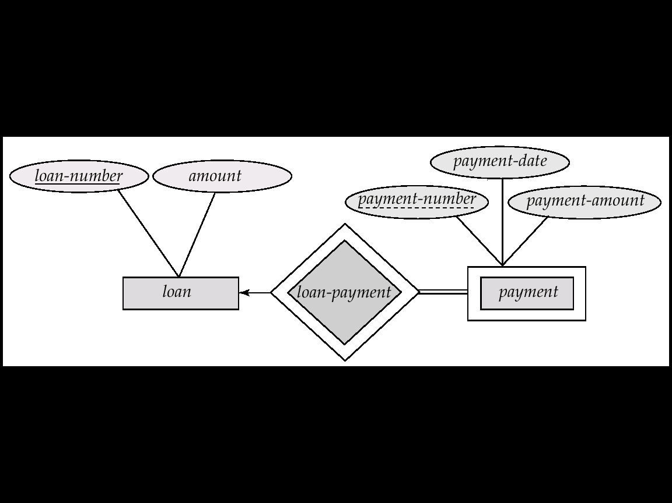
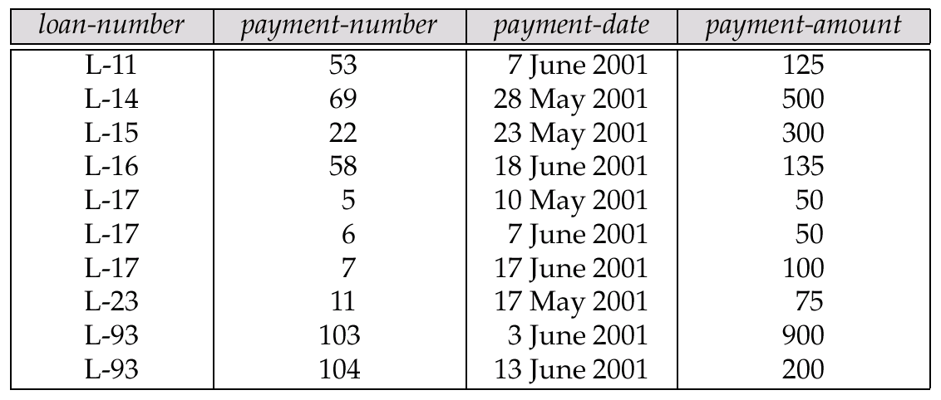
Representing Weak Entity Sets
A weak entity set becomes a table that includes a column for the primary key of the identifying strong entity set

Slide 13
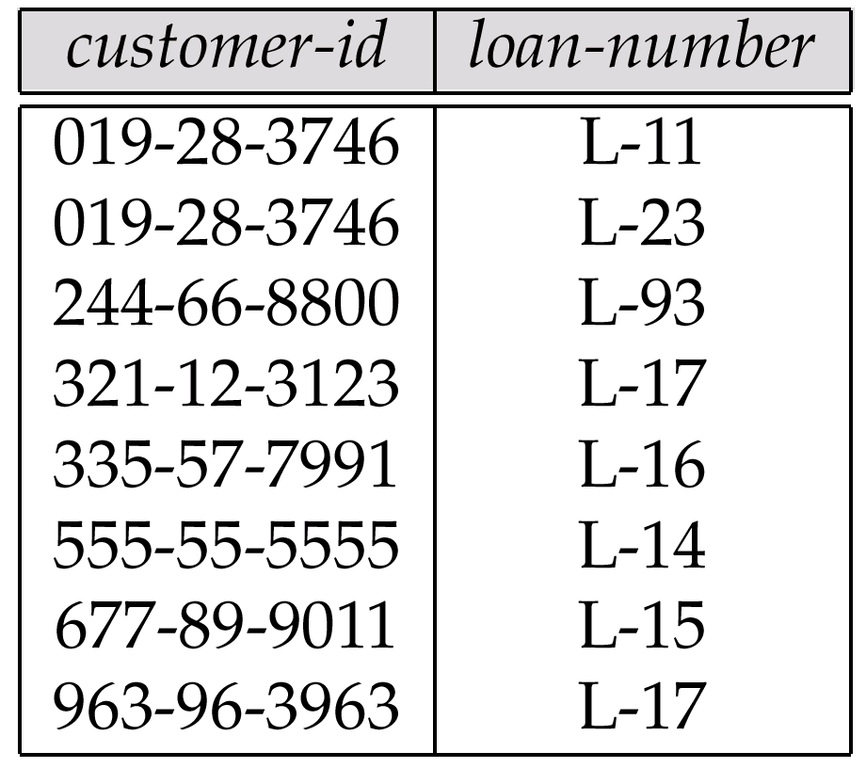
Representing Relationship Sets as Tables
A many-to-many relationship set is represented as a table with columns for the primary keys of the two participating entity sets, and any descriptive attributes of the relationship set.
E.g.: table for relationship set borrower

Slide 14
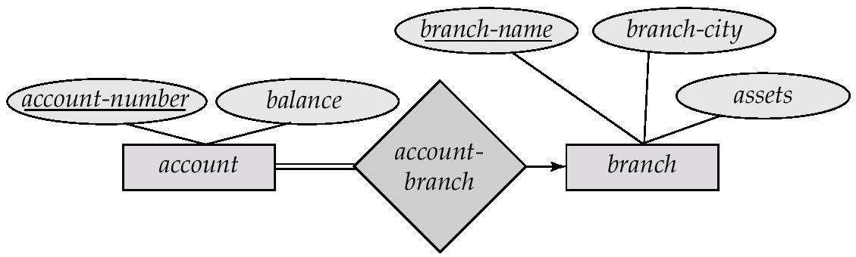
Redundancy of Tables
Many-to-one and one-to-many relationship sets that are total on the many-side can be represented by adding an extra attribute to the many side, containing the primary key of the one side
Instead of creating a table for relationship account-branch, add the key of branch (branch-name) to the entity set account
branch-name in account is a foreign key

Slide 15
Redundancy of Tables (Cont.)
For one-to-one relationship sets, either side can be chosen to act as the “many” side
That is, extra attribute can be added to either of the tables corresponding to the two entity sets
If participation is partial on the many side, replacing a table by an extra attribute in the relation corresponding to the “many” side could result in null values
The table corresponding to a relationship set linking a weak entity set to its identifying strong entity set is redundant.
E.g. The payment table already contains the information that would appear in the loan-payment table (i.e., the columns loan-number and payment-number).

Slide 16
Representing Specialization as Tables
Method 1:
Form a table for the higher level entity
Form a table for each lower level entity set, include primary key of higher level entity set and local attributes table table attributes person id, name, street, city customer id, credit-rating employee id, salary
Drawback: getting information about, e.g., employee requires accessing two tables

Slide 17
Specialization as Tables (Cont.)
Method 2:
Form a table for each entity set with all local and inherited attributes table table attributes person id, name, street, city customer id, name, street, city, credit-rating employee id, name, street, city, salary If specialization is total, no need to create table for generalized entity (person)
Drawback: street and city may be stored redundantly for persons who are both customers and employees

