Slide 1
Comp 3311 Database Management Systems
11. Midterm Review

Slide 2
Main Topics
ER model
Relational model
SQL
Database design

Slide 3
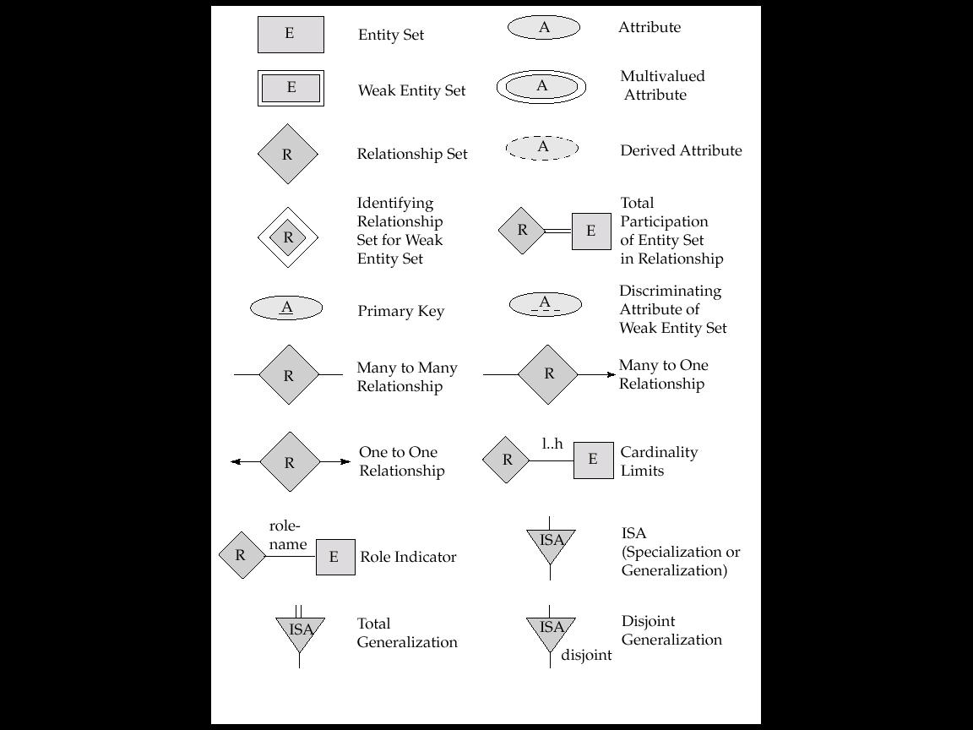
Symbols of ER Diagram

Slide 4
Symbols of ER Diagram (Cont.)
Total Participation

Slide 5
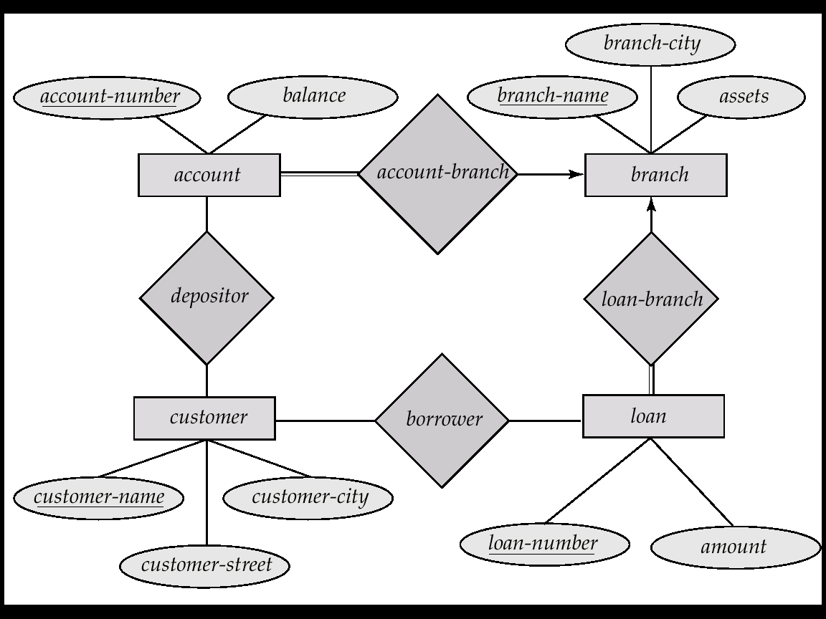
E-R Diagram of a Bank

Slide 6
Relational Model
Relations: schema and instances
Attributes: single-valued, domain, keys
Set of records: no duplicates, no order
Formal query languages:
Relational algebra (RA)
Automatic conversion between relational and ER

Slide 7
Relational Schema of the Bank
branch (branch-name, branch-city, assets)
customer (customer-name, customer-street, customer-city)
account (account-number, branch-name, balance)
loan (loan-number, branch-name, amount)
depositor (customer-name, account-number)
borrower (customer-name, loan-number)
Keys are underlined and foreign keys are in italics.

Slide 8
Relational Algebra
Basic operations:
Selection ( σ )
Projection ( π )
Cross-product ( x )
Set-difference ( - )
Union ( ∪ )
renaming ( ρ )
Additional operations:
Intersection, join, division
Notes:
6

Slide 9
SQL Query Block
SELECT select-clause
FROM from-clause
[WHERE where-clause]
[ORDER BY order-by-expression]
[GROUP BY group-by-attributes
[HAVING condition-for-each-group]]
Query blocks may be nested in FROM and WHERE; may be connected using UNION, INTERSECT, and EXCEPT.

Slide 10
SQL Features
Duplicate removal: DISTINCT.
An aggregation function (e.g., MAX, SUM) returns a single value without GROUP BY. If there is a GROUP BY, it returns a single value for each group.
All non-aggregation attributes in SELECT with a GROUP BY must also appear in GROUP BY.
If an attribute appears in GROUP BY, it may not necessarily appear in SELECT.

Slide 11
Functional Dependencies
The functional dependency X → Y holds on R if and only if for any legal relations r(R), whenever any two tuples t₁ and t₂ of r agree on the attributes X, they also agree on the attributes Y.
The set of all functional dependencies logically implied by F is the closure of F.
For computing the closure we use Armstrong’s axioms
if Y ⊆ X, then X → Y (reflexivity)
if X → Y, then ZX → ZY (augmentation)
if X → Y, and Y → Z, then X → Z (transitivity)
Given a set of attributes X, the closure of X under F (denoted by X ⁺) is the set of attributes that are functionally determined by X under F
If X determines all attributes, then it is a superkey. If it is also minimal, then it is a candidate key.
A canonical cover of F is a “minimal” set of functional dependencies equivalent to F, without any redundant dependencies or redundant attributes.

Slide 12
Database Design
Goal
remove redundancy & preserve constraints
Major normal forms
BCNF: for every non-trivial FD without useless attributes X  → Y, X is a candidate key.
3NF: a table in BCNF also satisfies 3NF. In addition, 3NF allows FDs where every attribute in Y is prime.
2NF: a table in 3NF also satisfies 2NF. In addition, 2NF allows FDs where X is not a proper subset of a candidate key.
1NF: every relational table is 1NF because all attribute values are atomic.

Slide 13
BCNF Decomposition Algorithm
Compute F⁺;
Result = {R};
While (any X→Y in F⁺ on a schema R_{i} in Result violates BCNF) {
Create a new table (X,Y);
Result = (Result-{R_{i}}) U {(R_{i} - Y)} U {(X,Y)};
}
The final tables are in BCNF. The decomposition is lossless-join, does not have redundancy, but may not preserve dependencies.

Slide 14
3NF Decomposition Algorithm
Let F_{c} be a canonical cover for F
for each X → Y in canonical cover F_{c}
create (X,Y)
if none of the created tables contains a candidate key
create a table with any candidate key for R;
The final tables are in 3NF. The decomposition is both lossless-join and dependency-preserving, but the tables may have redundancy.

