Slide 1
Comp 3311 Database Management Systems
12. Memory Hierarchy and File Structures

Slide 2
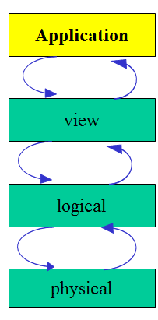
Memory Hierarchy and File Structures
Physical Storage
Organization of Records in Pages
Heap File
Sequential File
Hashing File Organization
Data Dictionary

Slide 3
Storage Hierarchy
Typical storage hierarchy:
Main memory (RAM) for currently used data
Disk for the main database (secondary storage)
Tapes for archiving older versions of the data (tertiary storage)
Why Not Store Everything in Main Memory?
Less capacity
Cost more money
Main memory is volatile but database should be saved
Notes:
19

Slide 4
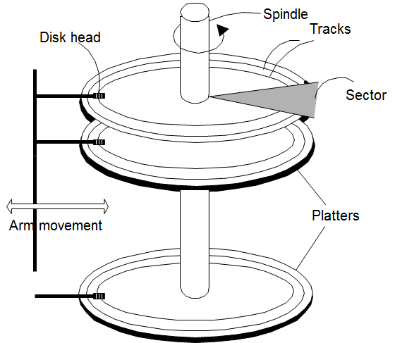
Magnetic Disks
Most common secondary storage device.
Main advantage over tapes: random access vs. sequential.
Data is stored and retrieved in units called blocks or pages (typically a disk block is 1K-16Kbytes)
DBMS operations on disks
READ: transfer data from disk to main memory (RAM).
WRITE: transfer data from RAM to disk.
Both are much slower than in-memory operations.
Unlike RAM, time to retrieve a disk page varies depending upon location on disk.
Need a buffer in RAM and replacement policy for updating pages
Relative placement of pages on disk has major impact on DBMS performance!
Block size is a multiple of sector size (which is fixed)
Notes:
20
The platters spin. The arm assembly is moved in or out to position a head on a desired track. Tracks under heads make a (imaginary!) cylinder. Only one head reads/writes at any one time.

Slide 5
File Organization
A database is stored as a collection of files.
Each file is a sequence of records
A record is a sequence of fields
A simple approach to store records:
Record size is fixed in a block/page
Each file has records of one particular type only
Different files are used for different relations

Slide 6
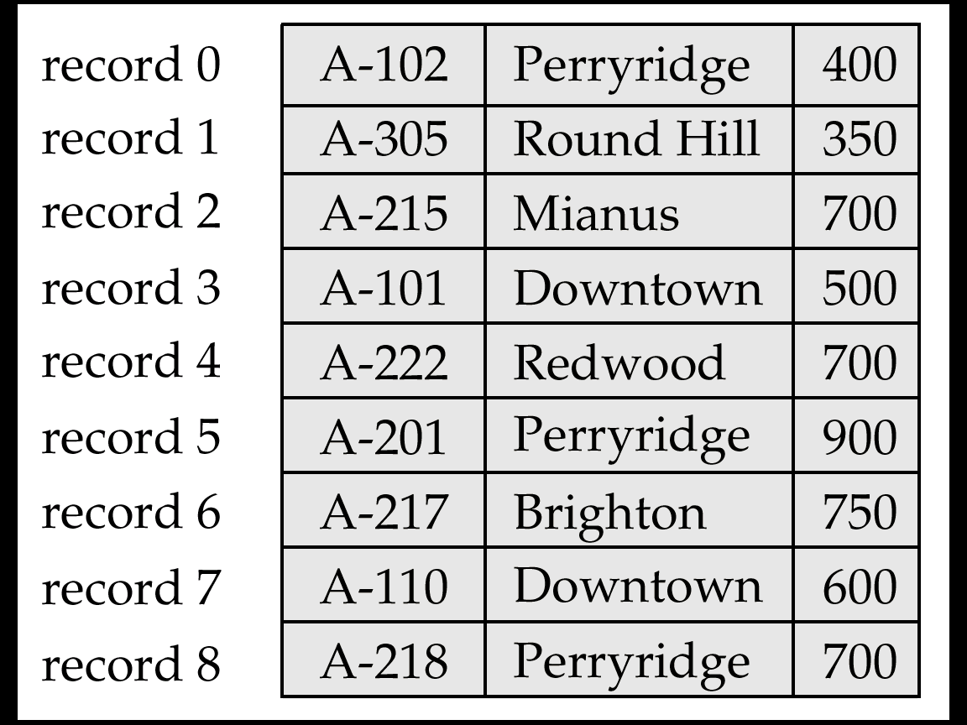
Fixed-Length Records
Simple approach:
In each page/block, store record i starting from byte n ∗ (i – 1), where n is the size of each record
Record access is simple
Do not allow records to cross block boundaries (i.e. there is some empty space at the end of the page)
Deletion of record i: shift up subsequent records
Disadvantage: moving records inside a page not good when records are pointed by:
other records (foreign keys)
index entries

Slide 7
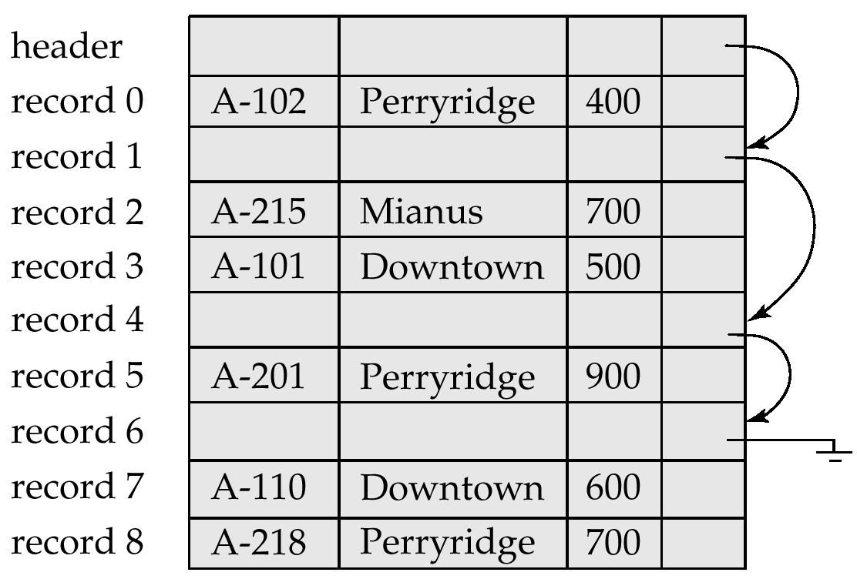
Fixed-Length Records - Free Lists
Do not move records in page. Store the address of the first deleted record in the file header.
Use this first record to store the address of the second deleted record, and so on
Can think of these stored addresses as pointers since they “point” to the location of a record.
More space efficient representation: reuse space for normal attributes of free records to store pointers. (No pointers stored in in-use records.)

Slide 8
Variable-Length Records Byte String Representation
Variable-length records arise in database systems in several ways:
Storage of multiple record types in a file.
Record types that allow variable lengths for one or more fields.
Record types that allow repeating fields.
Simple (but bad) solution: Byte string representation
Attach an end-of-record (⊥) control character to the end of each record
Difficulty with deletion (fragmentation of free space)
Difficulty with growth (movement of records is difficult).

Slide 9
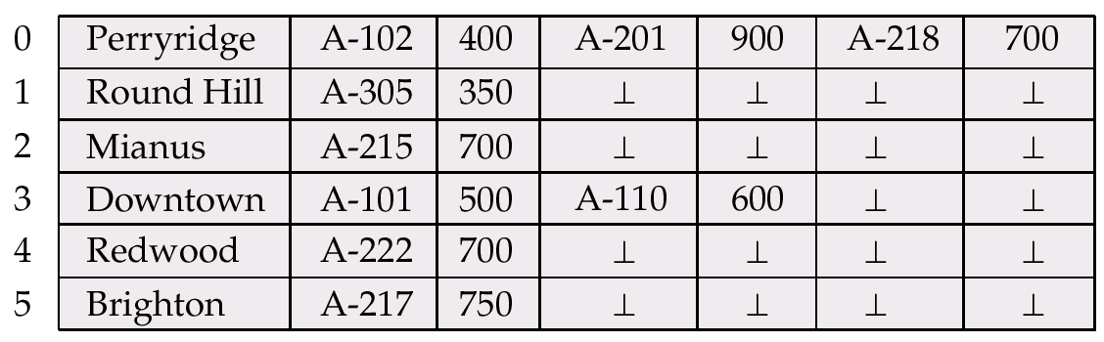
Variable-Length Records Reserved space
Reserved space – can use fixed-length records of a known maximum length; unused space in shorter records filled with a null or end-of-record symbol.

Slide 10
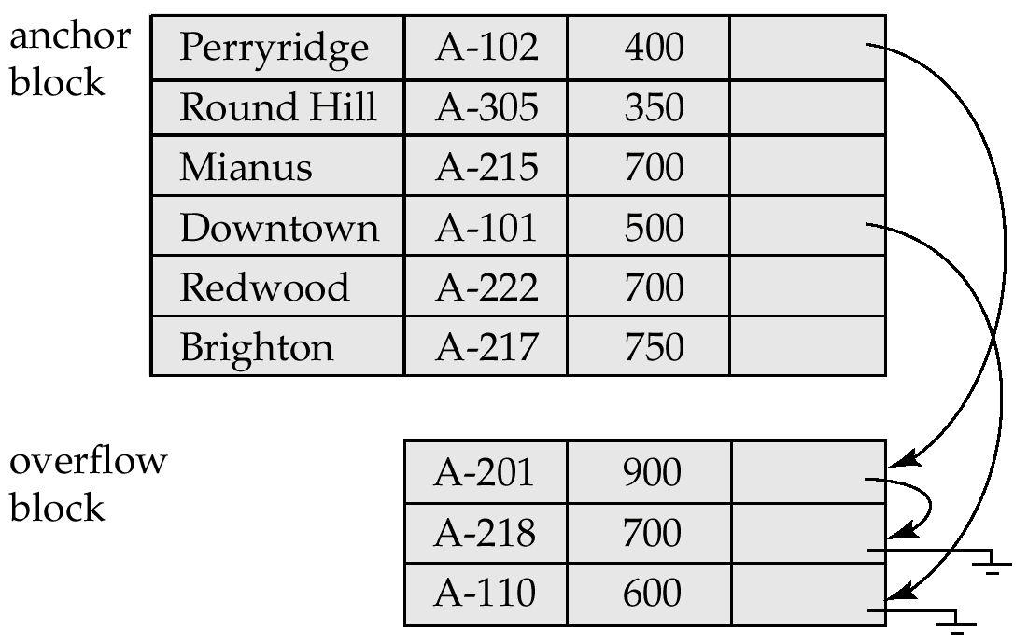
Variable-Length Records Pointer Method
Useful for certain types of records with repeating attributes. Two kinds of block in file:
Anchor block – contains the first records of chain
Overflow block – contains records other than those that are the first records of chairs.

Slide 11
Organization of Records in Files
Heap – a record can be placed anywhere in the file where there is space
Sequential – store records in sequential order, based on the value of a search key
Hashing – a hash function computed on a search key of each record; the result specifies in which block of the file the record should be placed

Slide 12
Unordered (Heap) Files
Simplest file structure contains records in no particular order
As file grows and shrinks, disk pages are allocated and de-allocated
To support record level operations, we must:
keep track of the pages in a file
keep track of free space in pages
keep track of the records in a page
Notes:
14

Slide 13
Heap File Using a Page Directory
Data
Page 1
Header
Page
Data
Page 2
Data
Page N
DIRECTORY
The entry for a page can include the number of free bytes on the page.
The directory is a collection of pages; linked list implementation is just one alternative.
Notes:
16

Slide 14
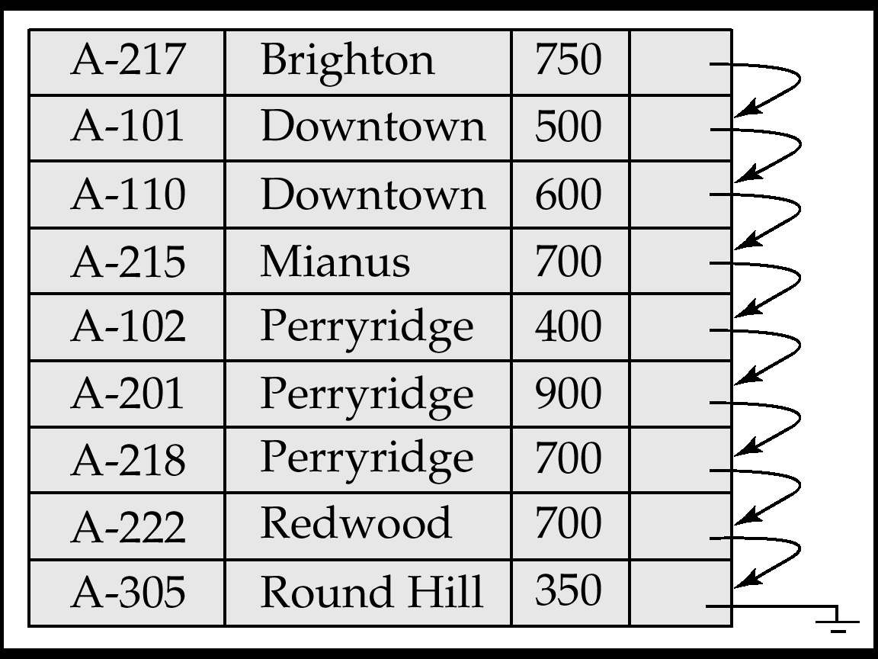
Sequential File Organization
Suitable for applications that require sequential processing of the entire file
The records in the file are ordered by a search key (may or may not be the primary key of the relation)

Slide 15
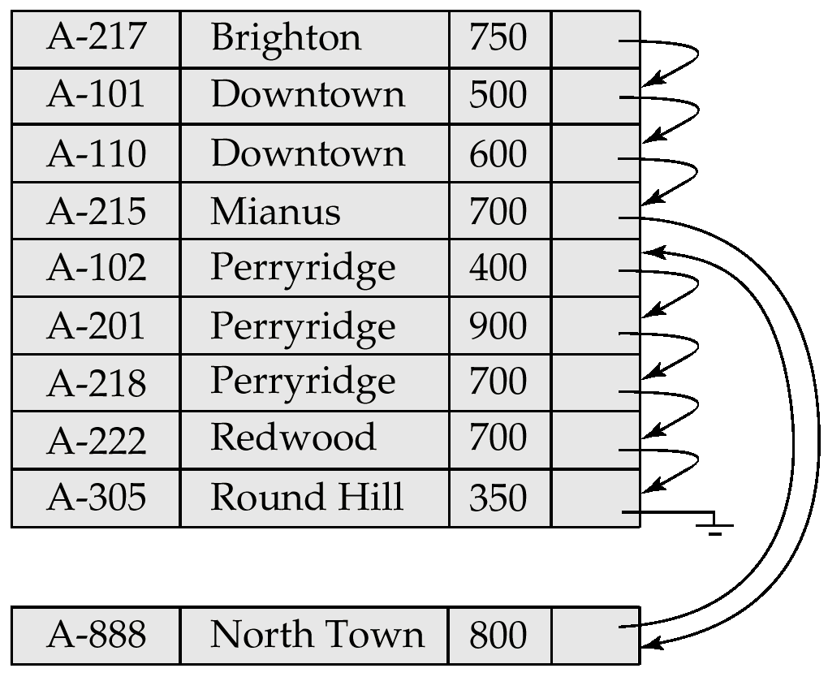
Sequential File Organization (Cont.)
Deletion – use pointer chains
Insertion –locate the position where the record is to be inserted
if there is free space insert there
if no free space, insert the record in an overflow block
In either case, pointer chain must be updated
Need to reorganize the file from time to time to restore sequential order

Slide 16
Hashing as a file organization
Assume there are 100,000 employee records and we can put 100 records per page. Then we need 1,000 pages.
We allocate 1,200 buckets (pages) for the table so there is some space for future insertions.
The hash function will have the form h(salary)=(a*salary+b) modulo 1,200
Advantage: one simple computation to obtain the right page in a file

Slide 17
Hashing as a file organization (cont)
bucket 1
bucket 2
hash function
overflow page
bucket for salary 15,000
bucket 1200
When we insert a new record we compute the hash function of the salary and insert the record in the corresponding bucket.
If the bucket is full we create an overflow page/bucket and insert the new record there.

Slide 18
Hashing as a file organization (cont)
This organization can efficiently answer queries of the form: "find all employees whose salary is 15,000".
In order to answer this query we compute the hash value of 15,000 and then search only in the corresponding bucket.
A bucket may contain records of employees with different salaries that produce the same hash value (e.g., employees with salary 30,000). This is not a problem because since we read the page, we can check all its records and select only the ones that satisfy the query condition.
If there are no overflow buckets, answering the query requires just a single read.
If there are overflow buckets, we have to read all of them.
Hashing is not good for range search ("find all employees with salaries between 15,000 and 16,000") because the records of these employees may be distributed in totally different buckets.

Slide 19
Cost Analysis of File Organizations
Ignore CPU costs for simplicity:
Measuring number of page I/O’s and ignoring gains of prefetching blocks of pages
Average-case analysis and it is based on several simplistic assumptions of single record insert and delete
Heap Files:
Equality selection on key; exactly one match
Insert always at end of file
Sorted Files:
Files compaction happens after a record deletion
Selections on sort field(s)
Hashed Files:
No overflow buckets, 80% page occupancy
Notes:
3

Slide 20
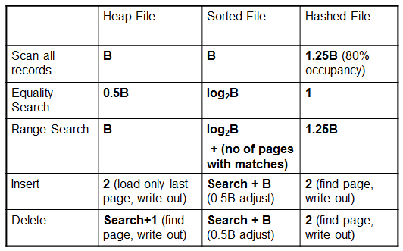
Cost of Operations
B: number of data pages in the file
Notes:
6

Slide 21
Data Dictionary Storage
Data dictionary (also called system catalog) stores metadata:
Information about relations
names of relations
names and types of attributes of each relation
names and definitions of views
integrity constraints
User account information, including passwords
Statistical and descriptive data
number of tuples in each relation
Physical file organization information
How relation is stored (sequential/hash/…)
Physical location of relation
operating system file name or
disk addresses of blocks containing records of the relation
Information about indices

Slide 22
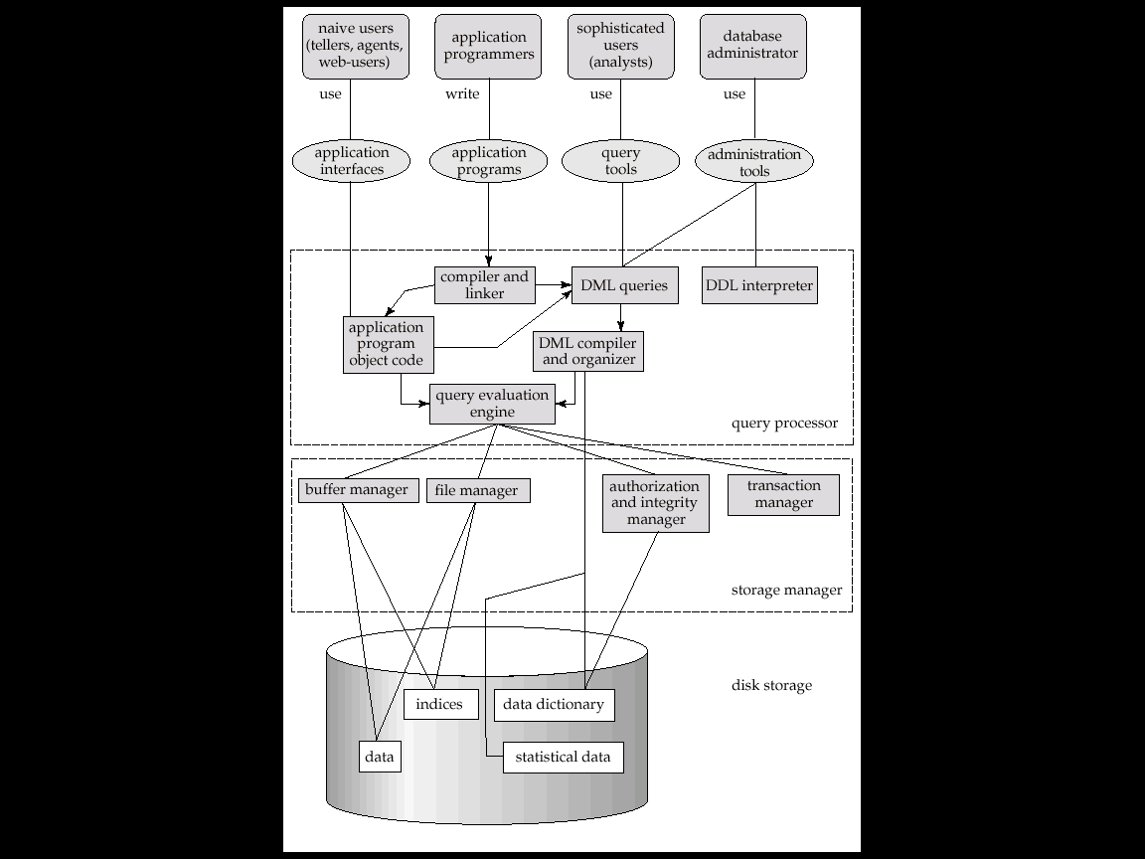
Data Dictionary Storage (Cont.)
A possible catalog in relational schema representation:
Relation-metadata(relation-name, number-of-attributes, storage-organization, location)
Attribute-metadata(attribute-name, relation-name, domain-type, position, length)
User-metadata(user-name, encrypted-password, group)
Index-metadata(index-name, relation-name, index-type, index-attributes)
View-metadata = (view-name, definition)

