Slide 1
Comp 3311 Database Management Systems
13. Introduction to Indexing

Slide 2
Main Content
Indexing Concepts
Ordered Indexes
Sparse and Dense Indexes
Multi-level Indexes
Primary and Secondary Indexes
Hash Indexes
Index Evaluation

Slide 3
Indexing Concepts (1)
A database maintaining the records of 10 million people HK residents
The record of each resident contains the HKID, address, telephone etc.
People can retrieve the records of persons given their HKID
i.e., "show me the record of person with HKID: 5634569“
Without the help of computer and database
the records can printed in a catalog
suppose 10 records per printed page, and the catalog will be 1 million pages (10⁶)

Slide 4
Indexing Concepts (2)
How would you arrange the records in the catalog?
Goal: minimize the effort of finding records
Measurement: the cost as the number of pages you have to "open" before finding the record in the worst case
Solution 1 - random order
If the catalog contains records in random order of HKID,
Worst case: search the entire catalog (cost = 10⁶) before finding a record, or to determine that the HKID does not exist in the catalog
Solution 2 - records sorted on HKID
Apply binary search with cost ⎡log₂10⁶⎤ = 20
For DBMS,
Have disk pages (e.g., size 8 KB)
An entire page is brought in main memory for every read
The cost counts only page read because disk operations are much more expensive than CPU operations
Can you find records in a DBMS even faster?

Slide 5
Indexing Concepts (3)
Keep the sorted file and build an additional index (e.g., at the beginning of the catalog).
Each index entry is a small record <HKID, Page No>
containing a HKID and the page where you can find the HKID
e.g., <5634569, 259> means that HKID 5634569 is on page 259
HKID is called the search key of the index
The index entry is much smaller than the record!
Assume that we can fit 100 entries per page
The index entries are also sorted on HKID
Do we need an entry for each of the 10,000,000 records?
No: we only need an entry for the first record of each page
Given two consecutive entries <5634569, 259>, <5700000, 260> in the index, I know that every HKID between 5634569 and 5700000 must be on page 259.
Only need 1,000,000 (10⁶) index entries (one for each page)

Slide 6
Indexing Concepts (4)
Given that I can fit 100 entries per page, and I have 1,000,000 entries, my index is 10,000 (10⁴) pages
How I can use the index to speed up search for a record?
Use binary search on the index to find the largest HKID that is smaller or equal to the input HKID. The cost is ⎡log₂10⁴ ⎤= 14.
Then, follow the pointer from that entry to the actual page (cost 1)
Total cost: 14+1 = 15

Slide 7
Indexing Concepts (5)
Can I drop the cost even further?
Yes: Build an index on the index
The second level index contains 10,000 (10⁴) entries (one for each page of the first index) in 100 pages!
Use binary search on the second level index to find the largest HKID that is smaller or equal to input HKID. The cost is ⎡log₂10² ⎤ = 7.
Then, follow the pointer from that entry to first level index and finally to the actual data page (cost 2)
Total cost: 7+2 = 9

Slide 8
Indexing Concepts (6)
Finally build a third level index containing 100 entries, one for each page of the second level index.
These entries fit in one page. Read this page to find the largest HKID that is smaller or equal to input HKID (1) and follow the pointers to second level index (1), first level index (1) and data page (1)
Total cost: 4

Slide 9
Basic Concepts of Indexing
Indexes speed up access to desired data
Search Key - attribute to set of attributes are used to look up records in a file on the disk
A search key may or may not be a primary key or a candidate key
In the previous slides the search key was HKID - we can find the record given a HKID value
If we want to find records given a name (or some other attributes) we need to build additional indexes
An index file consists of records (called index entries) of the form <search key, pointer>
Index files are typically much smaller than the original data file (coz they skip most attributes)

Slide 10
Ordered Indexes
The index that we built is ordered - also called tree-indexed
Because the index entries are sorted on the search key (e.g., HKID)
There are other types of indexes (e.g., hash indexes, bitmaps)
Good for equality and range search
When looking up for a record, we always start from the root, and follow a single path to the leaf that contains the search key of the record. Then, we perform an additional access to get the record from the data file
The cost, in terms of page accesses, is the height of the tree (number of levels) plus 1 (for a single record)
An index page is also called index node
The number of children (pointers) of a node is called the fanout
In our example, the fanout is 100
The height of the tree is ⎡log_{fanout}(#index entries)⎤
In our first example, the height is ⎡log₁₀₀(10⁶)⎤ = 3

Slide 11
Primary vs. Secondary Indexes
Primary index (also called clustering index): when the data file is sorted on search key of the index (e.g., index on HKID)
Index-sequential file: ordered sequential file with a primary index (also called ISAM - indexed sequential access method)
Secondary index (also called non-clustering index): when the file is not sorted on search key of the index

Slide 12
Sparse vs. Dense Indexes
Sparse Index: contains index records for some search-key values only
Only applicable to primary indexes
In our HKID index, we only have index entries for the first record in each page of the file
In general, we have an index entry for every file page, corresponding to the minimum search-key value in the page.
To locate a record with search-key value K we:
Find index record with largest search-key value <= K
Search file sequentially starting at the record to which the index record points
Less space and less maintenance overhead for insertions and deletions
An index that has an entry for every search key value is called dense

Slide 13
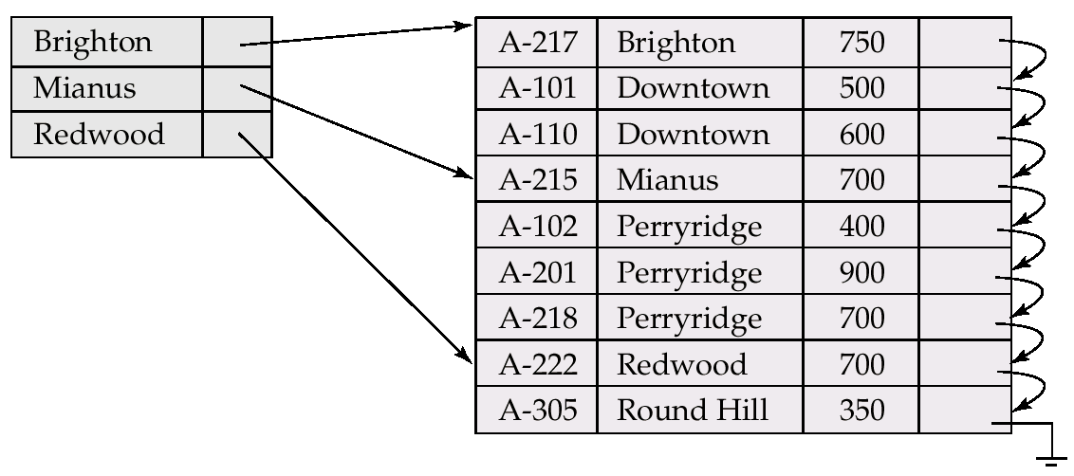
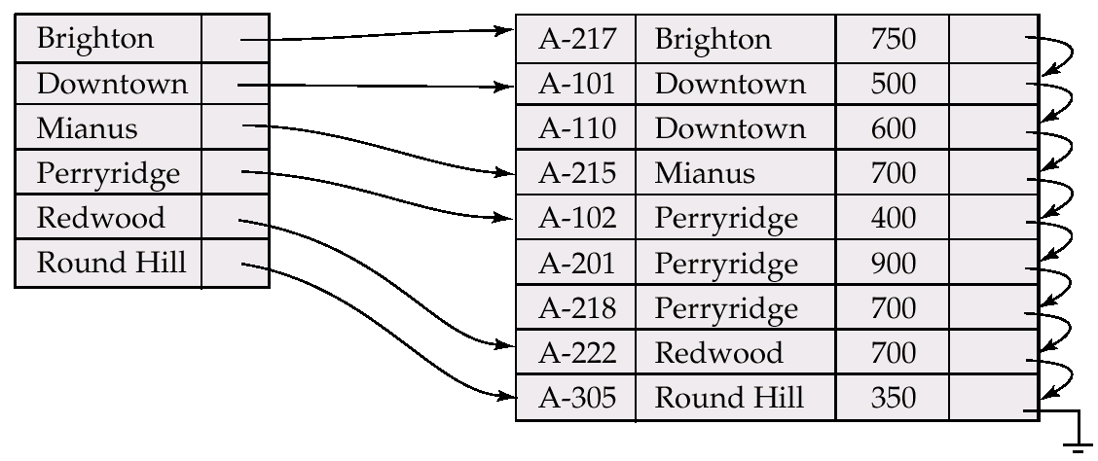
Sparse vs. Dense Indexes

Slide 14
Multilevel Index
If primary index does not fit in memory, access becomes expensive!
To reduce number of disk accesses to index records, treat primary index kept on disk as a sequential file and construct a sparse index on it
outer index – a sparse index of primary index
inner index – the primary index file
If even outer index is too large to fit in main memory, yet another level of index can be created, and so on
Indexes at all levels must be updated on insertion or deletion from the file

Slide 15
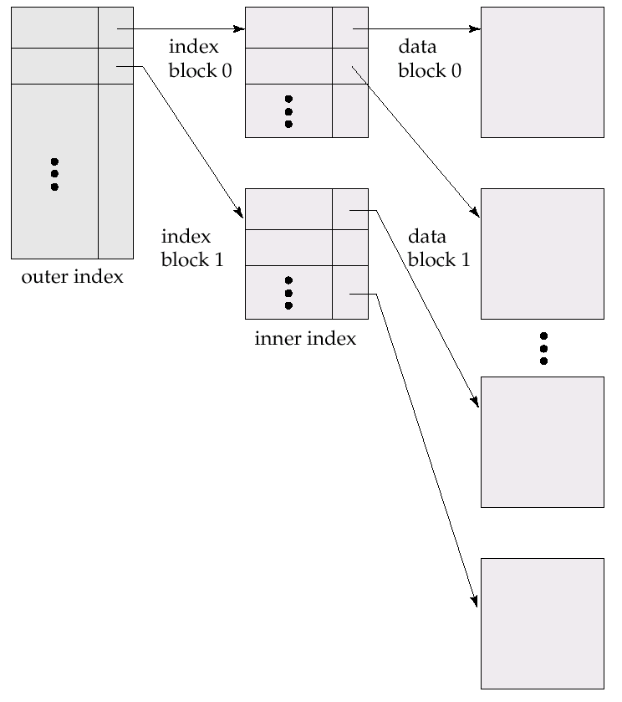
Multilevel Index (Cont.)

Slide 16
Example of Secondary Dense Index
How to find records given the name in our HK resident database? (We have primary index on HKID)
Answer: build another index on the name
Since the file is sorted on the HKID, the new index must be secondary and dense.
Assuming that all names are distinct, your index will contain 10 million entries.
Assuming that the fanout is again 100, cost of finding a record index given the name is ⎡log₁₀₀(10⁷)⎤ = 4
Secondary index almost as good as primary index (in terms of cost) when retrieving a single record
However, maybe very expensive when retrieving many records (e.g., for range queries)

Slide 17
Ordered Indexes on Non-Candidate Keys
Given an index on the name, it may happen several people have the same name! (If the index is primary and sparse, this is not a problem)
Option 1: use variable length index entries
Each entry contains a name, and pointers to all records with this name
Example: <Wilfred Ng, pnt1, pnt2, …., pntn>
Problem: complicated implementation as it needs a file organization that supports records of variable length.
Option 2: use multiples index entries per name
There is an entry for every person, if he/she shares the same name with other people
Example: <Wilfred Ng, pnt1>, <Wilfred Ng, pnt2>,…., <Wilfred Ng, pntn>
Problem: Redundancy - you repeat the name many times
Option 3: use an extra level of indirection (most common option)
Index entry points to a bucket that contains pointers to all the actual records with that particular name

Slide 18
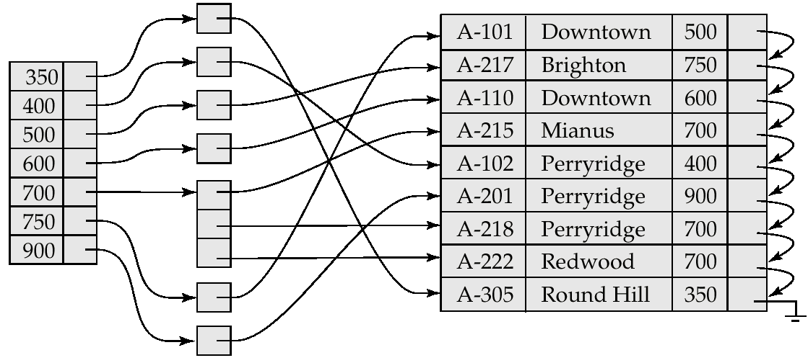
Secondary Index on balance field of account

Slide 19
Hash Indices
Hashing can be used not only for file organization, but also for index-structure creation
A hash index organizes the search keys, with their associated record pointers, into a hash file structure.
Strictly speaking, hash indices are always secondary indices
if the file itself is organized using hashing, a separate primary hash index on it using the same search-key is unnecessary!
The version that we discuss is for relatively static datasets
We want to build a hash index for an existing dataset - we expect the number of records not to change too much!

Slide 20
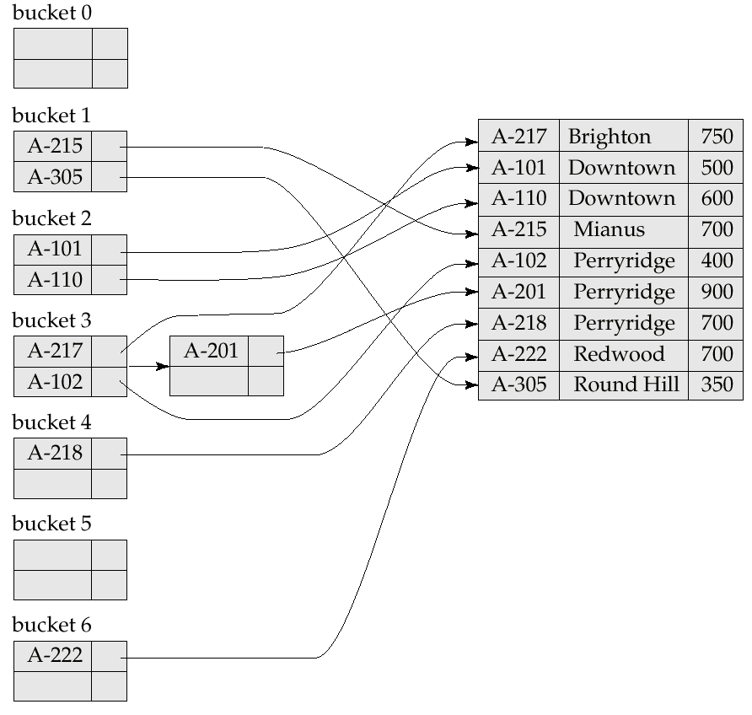
Example of Hash Index

Slide 21
Hash Functions
In the worst case, the hash function maps all search-key values to the same bucket; this makes access time proportional to the number of search-key values in the file
Ideal hash function is random, so each bucket will have the same number of records assigned to it irrespective of the actual distribution of search-key values in the file
Typical hash functions perform computation on the internal binary representation of the search-key
For example, for a string search-key, the binary representations of all the characters in the string could be added and the sum modulo the number of buckets could be returned.

Slide 22
Handling of Bucket Overflows
Bucket overflow can occur because of
Insufficient number of buckets
Skew in distribution of records. This can occur due to two reasons:
multiple records have same search-key value
chosen hash function produces non-uniform distribution of key values
Although the probability of bucket overflow can be reduced, it cannot be eliminated; it is handled by using overflow buckets.
Overflow chaining – overflow buckets are chained together in a linked list. Long chains degrade performance because a query has to read all buckets in the chain

Slide 23
Index Evaluation Metrics
Access types supported efficiently
E.g., Hash indexes are in general good for equality selection queries, but do not support ranges
Secondary ordered indexes are not good for queries that retrieve many records
Update time
When a file is modified, every index on the file must be updated
Space overhead
The index should be in general much smaller than the data file

Slide 24
Index Update: Deletion
If deleted record was the only record in the file with its particular search-key value, the search-key is deleted from the index also
Single-level index deletion:
Dense indices − similar to file record deletion

Slide 25
Index Update: Deletion
Sparse indexes − if an entry for the search key exists in the index, it is deleted by replacing the entry in the index with the next search-key value in the file (in search-key order). If the next search-key value already has an index entry, the entry is deleted instead of being replaced
Downtown
Pointers must be updated
(not shown in animation)

Slide 26
Index Update: Insertion
Single-level index insertion:
Perform a lookup using the search-key value appearing in the record to be inserted
Dense indices - if the search-key value does not appear in the index, insert it
Sparse indices - if index stores an entry for each block of the file, no change needs to be made to the index unless a new block is created. In this case, the first search-key value appearing in the new block is inserted into the index.
Multilevel insertion (as well as deletion) algorithms are simple extensions of the single-level algorithms

