Slide 1
Comp 3311 Database Management Systems
14. B+-trees and Dynamic Hashing

Slide 2
Main Content
B+-trees
Static Hashing
Dynamic Hashing

Slide 3
Index Structures
Problem: Given a value, how to find from disk the database records containing the value?
Solution: An index structure (hopefully all) in memory!
Conventional indices: e.g. ordered indices and hash indices
Recall other basic concepts: Index sequential file, search key (not primary key!), primary index, secondary index, dense index (all search key values in), sparse index, multi-level index
How about the maintenance cost?
Conventional indices are high. E.g. keeping an ordered index or avoiding overflow buckets is difficult in long term
Need to develop better index structures and better hashing schemes

Slide 4
B⁺-Tree Index
The default implementation of ordered index used in all commercial DBMS products
Disadvantage of indexed-sequential files:
  Performance degrades as file grows, since many overflow blocks get created
  Periodic reorganization of entire file is required
Advantage of B⁺-tree index:
  automatically reorganizes itself despite changes due to insertions or deletions
  Reorganization of entire file is not required to maintain performance
Disadvantage of B⁺-trees index:
  extra insertion and deletion overhead, space overhead
Advantages outweigh disadvantages

Slide 5
B⁺-Tree Index (Cont)
A B⁺-tree is a rooted tree satisfying the following properties:
  All paths from root to leaf are of the same length (a balanced tree)
  Each node has between ⎡n/2⎤ and n pointers
  Each leaf node stores between ⎡(n–1)/2⎤ and n–1 data values
  n is called fanout (the maximum number of pointers/children).
  The value ⎡(n-1)/2⎤ is called order (the minimum number of data values)
Special cases
  If the root is not a leaf, it has at least 2 children
  If the root is a leaf (that is, there are no other nodes in the tree), it can have between 0 and (n–1) data values

Slide 6
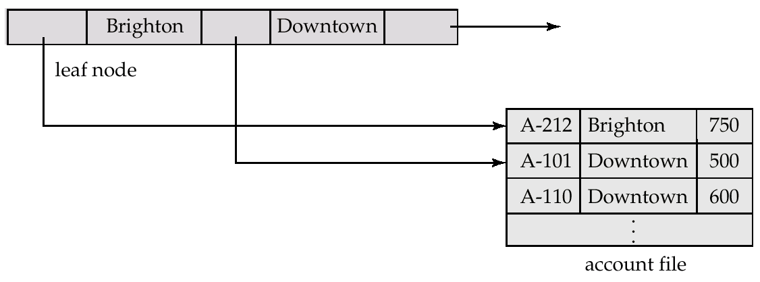
Leaf Nodes in B⁺-Trees
A leaf node [(P₁, K₁), (P₂, K₂), …, (P_{n-1}, K_{n-1}), P_{n}]
  For i = 1, 2,…, n–1
    P_{i} points to a bucket of records (at least one) with search-key value K_{i}. If L_{i}, L_{j} are leaf nodes and i < j, K_{i} < K_{j}
    P_{n} points to next leaf node in search-key order (right sibling node)
(P1,K1)
P3
Right sibling node
n = 3

Slide 7
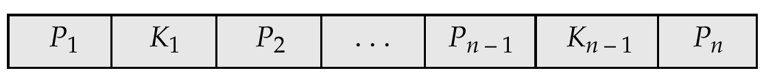
Non-Leaf Nodes in B⁺-Trees
Non leaf nodes form a multi-level sparse index on the leaf nodes
A non-leaf node [P₁, K₁, P₂, K₂, …, P_{n-1}, K_{n-1}, P_{n}]
  All the search-keys in the subtree pointed by P₁ are less than K₁
  For 2 ≤ i ≤ n – 1, all the search-keys in the subtree pointed by P_{i} have values within the range of [K_{i–1}, K_{i})
Example: P₂ points to a node where the value v of each key is
K₁ ≤ v < K₂
v < K₁
K₁ ≤ v < K₂
K_{n-2} ≤ v < K_{n-1}
K_{n-1} ≤ v

Slide 8
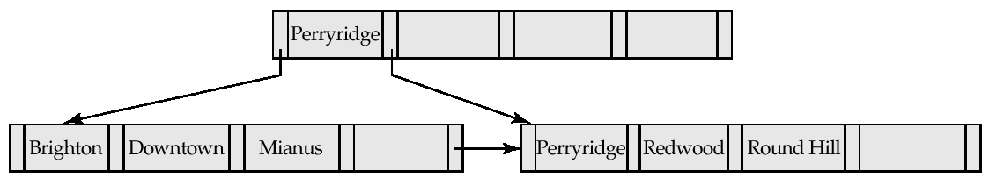
A B⁺-tree Example
A B⁺-tree built for account file with n = 5
  Leaf nodes must have between 2 and 4 data values
    I.e. ⎡(n–1)/2⎤ and n –1, with n = 5
  Non-leaf nodes other than root must have between 3 and 5 children
    I.e. ⎡(n/2)⎤ and n, with n =5
  Root must have at least 2 children

Slide 9
Observations about B⁺-trees
The inter-node connections are done by pointers
  Thus, the close blocks need not be “physically” close
  That is, no need for sequential storage
The non-leaf levels of the B⁺-tree form a hierarchy of sparse indices
The B⁺-tree contains a relatively small number of levels
  Equal to the logarithmic in the size of the main file
  If there are K search-key values in the file, the height is no larger than ⎡log_{⎡n/2⎤}(K)⎤
Insertions and deletions can be handled efficiently
  Since the index can be restructured in logarithmic time (see later slides)

Slide 10
Queries on B⁺-Trees
Find all records with a search-key value of k
  Non-leaf nodes contain m pointers
Start with the root node
  If find an entry with key K_{j} = k, follow pointer P_{j+1};
  Otherwise, if k < K_{m–1}, follow pointer P_{j}, where K_{j} is the smallest search-key value > k;
  Otherwise, if k ≥ K_{m–1}, follow P_{m} to the child node
If the current tree node is not a leaf node
  repeat the above procedure on the node;
  follow the corresponding pointer
  Eventually reach a leaf node
    If find an entry with key K_{i} = k, follow pointer P_{i} to the desired record(s);
    Else no record with key value k exists

Slide 11
Queries on B⁺⁻Trees (Cont)
When processing a search query,
  We traverse the tree from the root to some leaf node
Cost estimation: a node is generally the same size as a disk block, typically 4KB; fanout n is typically around 100 if 40B per index entry (key k + pointer)
  If there are 1 million key values
  n/2 = 50
    Access at most log₅₀(1,000,000) ~ 4 nodes for a query
    1 root page residing in buffer and 3 block/page accesses are needed
In contrast, a balanced binary tree with 1 million key values
  Access around log₂(1,000,000) ~ 20 nodes for a search query
  B+-trees are short and fat, while binary trees are long and thin

Slide 12
Insertion to B+ Tree
Insert a data entry with search-key k
  Search the tree using k
  Find the correct leaf node L
  Insert data entry into L
    If L has enough space, done!
    Else, split L (into L and a new node L2)
      Redistribute entries evenly, copy up middle key
      Update the parent of L by insert index entry pointing to L2
Updating can happen recursively
  To split index node, redistribute entries evenly, but push up middle key
Splits “grow” tree; root split increases height
  Tree growth: gets wider or one level taller at top
Notes:
6

Slide 13

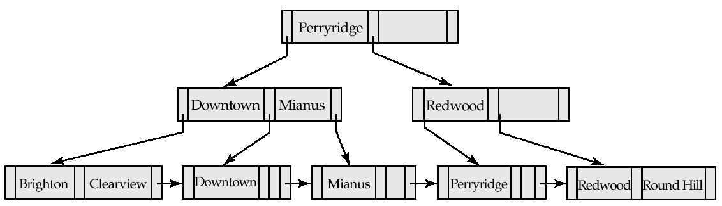
Updates on B⁺-Trees: Insertion (Cont)
Insertion of “Clearview”
Before insertion
After insertion
Split into two leaf nodes

Slide 14
Deletion from B⁺-Tree
Delete a data entry with search-key k
  Search the tree with k
  Find the leaf node L where entry belongs
  Remove the entry
    If L is at least half-full, done!
    If L is less than half-full,
      re-distribute, borrowing from sibling (adjacent node to the right)
      If re-distribution fails, merge L and its sibling
If merge occurred,
  Delete entry (pointing to L or sibling) from parent of L
Merge could propagate to the root, decreasing height

Slide 15
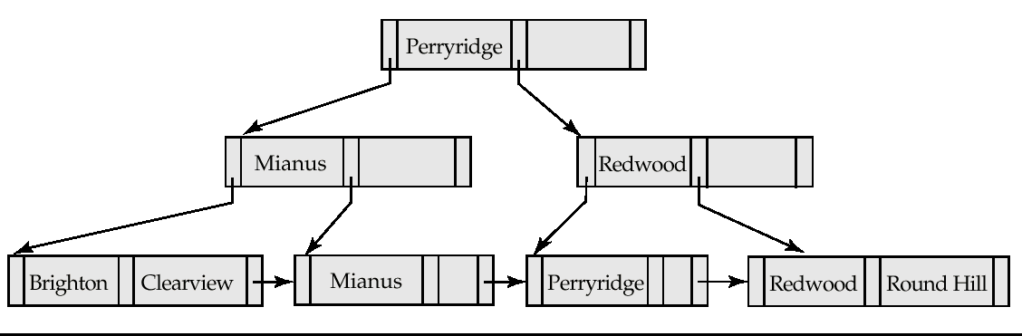
Examples of B⁺-Tree Deletion
Before deletion
After deletion
Deleting “Downtown”
The removal does not result in its parent having too few pointers. So the cascaded deletions stopped with the deleted leaf node’s parent

Slide 16
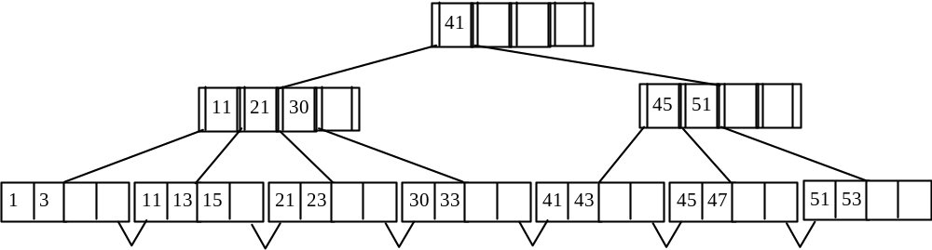
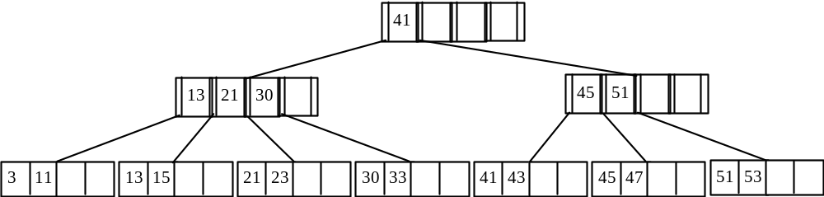
B+-tree Update Examples
Consider the B+-tree below with order 2 (each node except the root must contain at least two key values and 3 pointers)
Show the tree that would result after successively applying each of the following operations
Remove 1
After removing 1
Remove 41

Slide 17
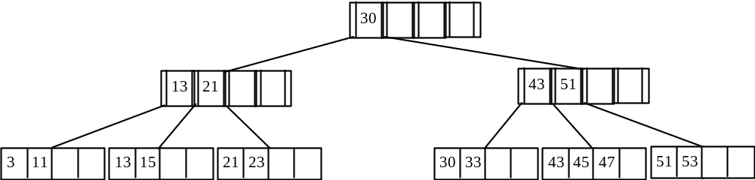
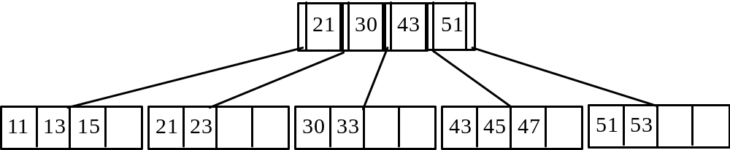
B+-tree problem (Cont)
After removing 41
Remove 3
Insert 41

Slide 18
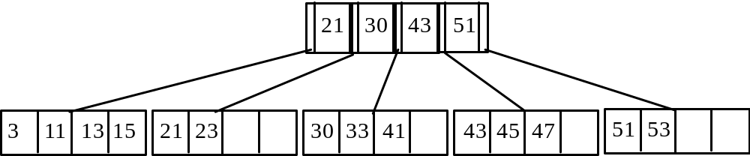

B+-tree problem (Cont)
After inserting 41
Insert 1

Slide 19
B⁺-Tree File Organization
Index file degradation problem is solved by using B⁺-Tree indices
Data file degradation problem is solved by using B⁺-Tree File Organization.
  Require: the leaf nodes in a B⁺-tree file organization store records, instead of pointers
Since records are larger than pointers
  the maximum number of records that can be stored in a leaf node is less than the number of pointers in a non-leaf node
Leaf nodes are still required to be half full
  Insertion and deletion are handled in the same way as insertion and deletion of entries in a B+-tree index

Slide 20
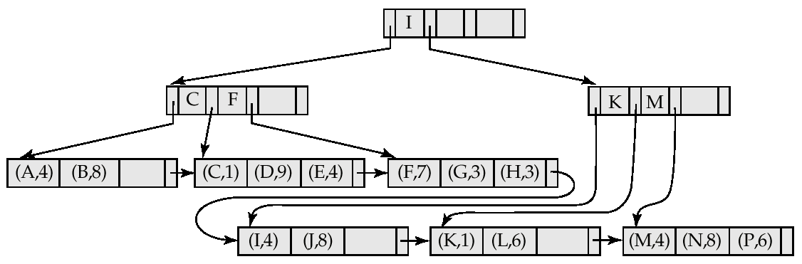

B⁺-Tree File Organization (Cont)
Example of B⁺-tree File Organization
Good space utilization is important
  Since records use more space than pointers
To improve space utilization
  Involve more sibling nodes in redistribution during splits and merges
  Involving 2 siblings in redistribution results in each node having at least entries (i. e. raise min capacity)

Slide 21
Static Hashing
Recall the concepts
  A hash method includes a hash function and a collision handling mechanism
  A hash file consists of M buckets of the same size: bucket₀, bucket₁,..,. bucket_{M-l}
  Collisions occur when a new record hashes to a bucket that is already full
    A new bucket is created and chained to the overflowed bucket
  To reduce overflow records, a hash file is typically kept 70-80% full (called load factor)
The hash function h should distribute the records uniformly among the buckets to avoid many overflow records.
  An ideal hash function will assign roughly the same number of records to each bucket
  irrespective of the actual distribution of search-key values in the file
The number of buckets M must be fixed when the file is created; not good when the file size changes widely

Slide 22
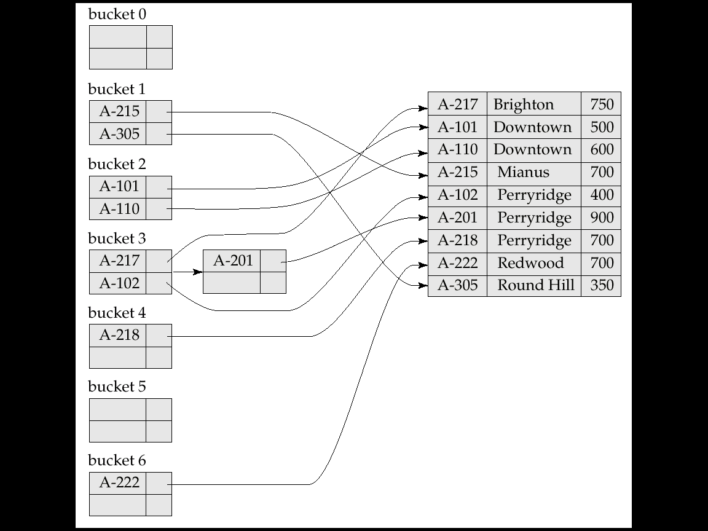
Static Hashing
Secondary
index
Primary index
A hash index organizes the search keys, with their associated record pointers, into a hash file structure.
Hash indices are always secondary indices – the file itself may be organized as an external hash file, with secondary hash indices.
Overflow
bucket
Hash Index on account-number

Slide 23
Dynamic Hashing
Static hashing:
  Function h maps search-key values to a fixed set of B of bucket addresses
  Databases grow with time
    If initial number of buckets is too small, performance will degrade due to too much overflows
  May allocate more buckets as anticipated but waste space
  If database shrinks, again space will be wasted
  Periodic re-organization of the file with a new hash function, but it is very expensive
Dynamic hashing:
  Allows the number of buckets to be modified dynamically

Slide 24
Extendible Hashing
Situation:
  Bucket (primary page) becomes full
  Why not re-organize file by doubling # of buckets?
    Reading and writing all pages are expensive!
Use directory of pointers to buckets, double the number of buckets by doubling the directory, splitting just the overflowed bucket!
Directory is much smaller than file, so doubling it is much cheaper
  Only one page of data entries is split. No overflow page!
Important: how hash function is adjusted?
Notes:
5

Slide 25
Example
LOCAL DEPTH
2
4*
12*
32*
16*
Bucket A
GLOBAL DEPTH
Directory is an array of size 4 (2 bits)
To find bucket for the search key r, take last `global depth’ # bits of h(r); we denote r by h(r)* in buckets.
  If h(r) = 5 = 101(binary), it is in the bucket pointed by 01 (i.e. 5* in Bucket B)
  Why is 13* also in B?
Note: Buckets A and B are full
2
2
00
1*
5*
21*
13*
Bucket B
01
10
2
10*
Bucket C
11
DIRECTORY
2
15*
7*
19*
Bucket D
DATA PAGES
Insert: If bucket is full, split it (allocate new page, re-distribute)
If necessary, double the directory. (Splitting a bucket does not
always require doubling – decision by comparing global depth
with local depth)
Notes:
6

Slide 26
Insert h(r)=20 (10100)
LOCAL DEPTH
2
Bucket A
LOCAL DEPTH
3
4*
12*
32*
16*
GLOBAL DEPTH
32*
16*
Bucket A1
GLOBAL DEPTH
Bucket B
3
2
2
2
000
1*
5*
21*
13*
Bucket B
00
1*
5*
21*
13*
001
01
010
2
2
Bucket C
A → A1,A2
10*
Bucket C
10
011
11
10*
100
101
2
Bucket D
110
15*
7*
19*
Bucket D
DIRECTORY
2
111
15*
7*
19*
3
DIRECTORY
4*
12*
20*
Bucket A2
(`split image'
of Bucket A)
Notes:
7

Slide 27
Points to Note
20 = binary 10100. Last 2 bits (00) tell us r belongs in A1 or A2.
  Last 3 bits needed to decide to go to A2
  (Why do 4* and 12* go to A2? )
    Global depth of directory: max number of bits needed to tell which bucket an entry belongs to
    Local depth of a bucket: number of bits used to determine if an entry belongs to this bucket
When does bucket split cause directory doubling?
  Before insert, local depth of bucket = global depth
  Insert causes local depth to become > global depth!
  Directory is doubled by copying it over and `fixing’ pointers to split image page. (Use of least significant bits enables efficient doubling via copying of directory!)
Notes:
8

Slide 28
Example of Extendible Hashing
Assume the following hash index where the hash function is determined by the least significant bits
Insert 18 (10010), 32 (100000)
local depth
2
global depth
8
16
64
2
00
2
01
1
5
9
13
10
11
2
6
10
DIRECTORY
2
7
DATA PAGES

Slide 29
Example of Extendible Hashing (Cont)
After the insertion of records with search keys: 18 (10010), 32 (100000).
Insert: 3 (11), 4 (100)
local depth
2
global depth
8
16
64
32
2
00
2
01
1
5
9
13
10
11
2
6
10
18
2
7

Slide 30
Example of Extendible Hashing (Cont)
After the insertion of records with search keys: 3 (11), 4 (100).
Insert: 19 (10011), 17 (10001)
local depth
3
global depth
8
16
64
32
3
000
2
001
1
5
9
13
010
011
2
100
6
10
18
101
110
111
2
7
3
3
4

Slide 31
Example of Extendible Hashing (Cont)
After the insertion of records with search keys: 19, 17.
Insert 24 (11000)
local depth
3
global depth
8
16
64
32
3
000
3
001
1
9
17
010
011
2
100
6
10
18
101
110
111
2
7
3
19
3
4
3
5
13

Slide 32
Example of Extendible Hashing (Cont)
After the insertion of record with search key: 24 (11000)
local depth
4
global depth
16
32
4
0000
3
0001
1
9
17
0010
0011
2
0100
6
10
18
0101
0110
0111
2
1000
7
3
19
1001
1010
3
1011
4
1100
1101
3
1110
5
13
1111
4
8
24

Slide 33
Comments on Extendible Hashing
If directory fits in memory, equality search answered with one disk access; else two
  Assume 100MB file and 4KB/page (holding data entries). Thus, 25,000 directory elements are needed. The directory fits in memory well
  Directory grows in spurts (double!), and, if the distribution of hash values is skewed, directory can grow large
  Multiple entries with same hash value cause problems
Delete: Reverse the “insert process”:
If removal of data entry makes bucket empty, can be merged with “split image”
If each directory element points to same bucket as its split image, can halve the directory (n bits → (n-1) bits)
Notes:
9

Slide 34
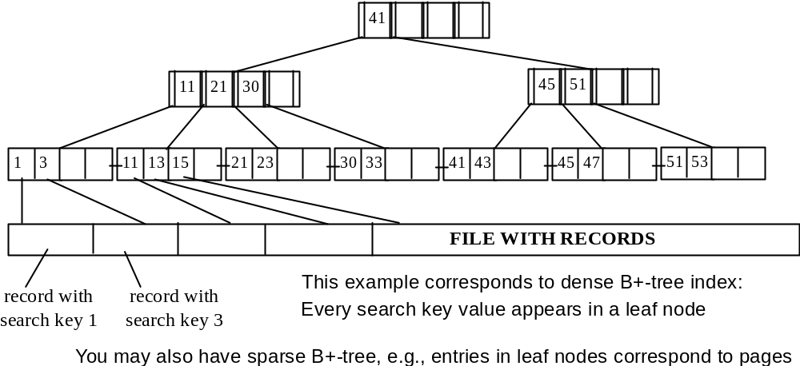
Example of clustering (primary) B+-tree on candidate key

Slide 35
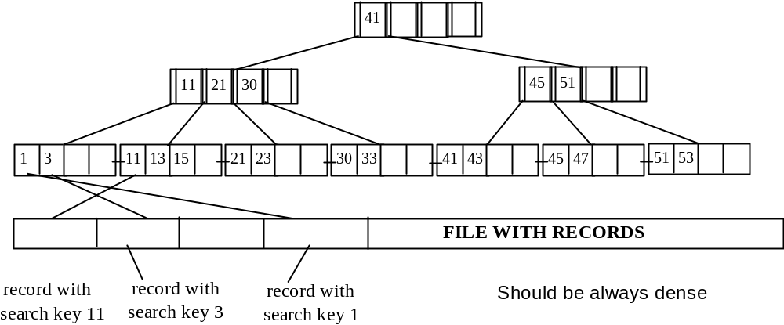
Example of non-clustering (secondary) B+-tree on candidate key

Slide 36
Example of B+ tree size
Suppose size of K = 32 bytes, size of pointer = 8 bytes, 1 million records. Page size = 4KB.
What is the size of B+ index file?
Assume 1 node takes 1 page.
n = 4K/(32+8)=100
log₅₀(1,000,000) =3.7!
Cost of searching a key:
Assume the root node in buffer. We need at most 3 page access!

