Slide 1
Comp 3311 Database Management Systems
15. Other Indexes, Selection Processing
External Sorting

Slide 2
Main Content
Multiple Keys
Bitmaps
Grid Files
Measures of Query Cost
Selection Operation
External Sorting

Slide 3
Multiple Key Access
How to speed the processing of the following query?
Select loan-number
From account
Where branch-name < “Perryridge” and balance = 1000
Multiple search-key queries: possible strategies
Index on branch-name - First retrieve all tuples satisfying branch-name < “Perryridge”. Then Check each such tuple about balance. The problem is: many tuples satisfying branch-name < “Perryridge” but do not satisfy balance = 1000 but need to be checked anyway
Index on balance – similar problem as above
Index on branch-name and Index on balance - we can do pointer intersection (before retrieving the actual records). Still we may need to scan a large number of pointers for only few results
Index on (branch-name, balance) – each record is likely to be in a different block, because of the ordering of records in the file, leading to many I/O
Not satisfactory!

Slide 4
Bitmap Indices
Bitmap indices are a special type of index designed for efficient querying on multiple keys
Records in a relation are numbered sequentially (R₀, R₁ , R₂ ,…)
  Given a number n it must be easy to retrieve R_{n}
Applicable on attributes that take on a relatively small number of distinct values
  E.g. gender, country, state, …
  E.g. income-level (income broken up into a small number of levels such as 0-9999, 10000-19999, 20000-50000, 50000- infinity)
A bitmap is simply an array of bits

Slide 5
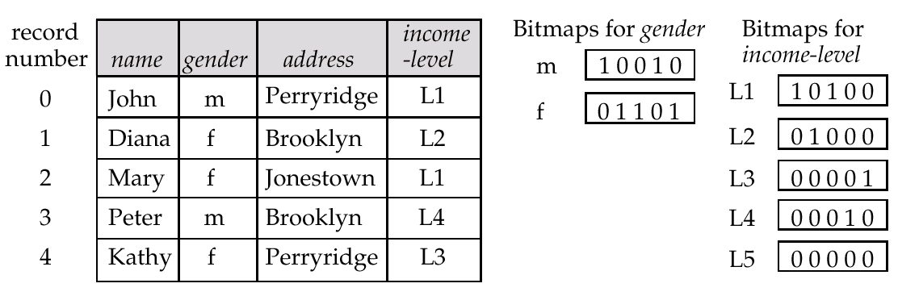
Bitmap Indices (Cont)
In its simplest form a bitmap index on an attribute has a bitmap for each value of the attribute
  Bitmap has as many bits as records
  In a bitmap for value v, the bit for a record is 1 if the record has the value v for the attribute, and is 0 otherwise
Customer-info

Slide 6
Bitmap Indices (Cont)
Bitmap indices are useful for queries on multiple attributes
  not particularly useful for single attribute queries
Queries are answered using bitmap operations
  Intersection (and)
  Union (or)
  Complementation (not)
Each operation takes two bitmaps of the same size and applies the operation on corresponding bits to get the result bitmap
  Query: Males with income level L1: 10010 AND 10100 = 10000
  Can then retrieve required tuples. (I.e. the 0th record as the answer)
  Counting number of matching tuples is even faster! (especially useful for aggregation queries) (count = 1 as the answer)

Slide 7
Bitmap Indices (Cont)
Bitmap indices generally very small compared with relation size.
  Consider a million record relation: need only 128KB! 1% of relation
How to handle insertion and deletion of records?
  deletion - turn off the bits for deleted records in all bitmaps but not shifting records (expensive!)
    Existence bitmap to note if there is a valid record at a record location
    Needed for doing correct complementation
    not(A=v): (NOT bitmap-A-v) AND ExistenceBitmap
  Insertion of records by appending records to the end or by replacing deleted records but not change the record sequence (expensive!)
Should keep bitmaps for all values, even null values
  To correctly handle SQL null semantics for NOT(A=v)
  Intersect above result with (NOT bitmap-A-Null)

Slide 8
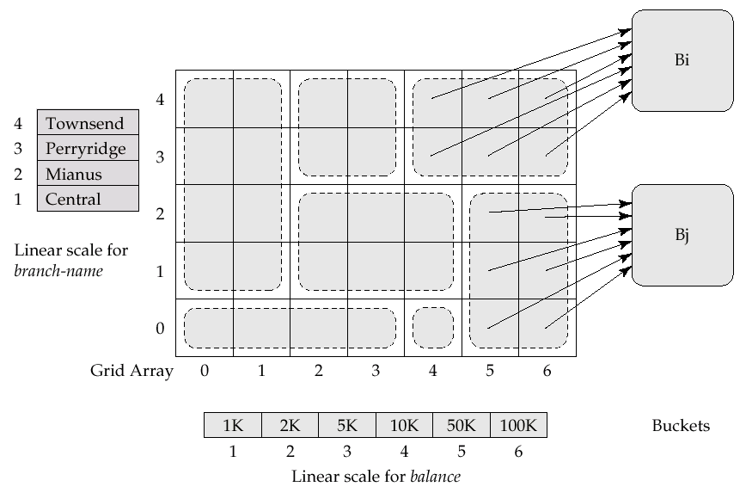
Grid Files
The grid file has a single grid array and one linear scale for each search-key attribute.
The grid array has number of dimensions equal to number of search-key attributes

Slide 9
Queries on a Grid File
Special case: 2D grid array - branch-name x balance
  Eg row 1: Central ≤ B-name < Mianus
  Eg col 2 : 2K ≤ balance < 5K
Multiple cells of grid array can point to same bucket
To find the bucket for a search-key value, locate the row and column of its cell using the linear scales and follow bucket pointers to Bi, Bj, …
To answer (a₁ ≤ A < a₂ ∧ b₁ ≤ B < b₂), use linear scales to find corresponding candidate grid array cells, and look up all the buckets pointed to from those cells
Example
A grid file on two attributes (branch-name, balance) can handle queries of all following forms with reasonable efficiency
(=“Brighton”, =500K) → row 0, column 6 → Bucket Bj
(=“Downtown”, =60K) → row 1, column 5 → Bucket Bj
(< “Perryridge”, 1000) → rows 0,1,2, column 1→ 2 buckets
  The grid structure is also suitable for single search key queries
(= “Perryridge”) → row 3, all columns → 3 buckets (Bi + 2 others)

Slide 10
Grid Files (Cont)
During insertion, if a bucket becomes full, new bucket can be created if more than one cell points to it
  Idea similar to extendible hashing, but on multiple dimensions
  If only one cell points to it, either an overflow bucket must be created or the grid size must be increased
Linear scales must be chosen to uniformly distribute records across cells
  Otherwise there will be too many overflow buckets
Periodic re-organization to increase grid size will help
  But reorganization can be very expensive
Space overhead of grid array can be high

Slide 11
Index Definition in SQL
SQL DDL allows users to create an index
  create index <index-name> on <relation-name>
  (<attribute-list>)
  E.g.: create index b-index on branch(branch-name)
Can use create unique index to indirectly specify and enforce the condition that the search key is a candidate key
  Not really required if SQL unique integrity constraint is already supported
  Some DBMS allows to specify the type of index (B+, hashing) or clustered indices
To drop an index
  drop index <index-name>

Slide 12

Basic Steps in Query Processing
Step 1 Parsing and translation
  Translate the SQL query into its internal form - relational algebra (RA)
  Parser checks syntax and verifies relations
Step 2 Evaluation
  The query-execution engine takes a query-evaluation plan, executes that plan, and returns the answers to the query
  Need statistical data to optimize

Slide 13
Optimization and Cost Measure
An RA expression may have many equivalent expressions
  E.g. σ_{balance<2500}(∏_{balance}(account)) is equivalent to
  ∏_{balance}(σ_{balance<2500}(account))
Each RA operation can be evaluated using one of several different algorithms
  I.e. an RA expression can be evaluated in many ways
Annotated expression specifying detailed evaluation strategy is called an evaluation-plan
  E.g. can use B+-tree index on balance to find accounts with balance < 2500
  can perform complete relation scan and discard accounts with balance ≥ 2500

Slide 14
Optimization and Cost Measure (Cont.)
Query Optimization: Amongst all equivalent evaluation plans choose the one with the (expected) lowest cost
  Cost is estimated using statistical information from the
  database catalog, e.g. number of tuples in each relation, size of tuples, etc.
Just use number of page transfers from disk as the cost measure
  Ignore the difference in cost between sequential and random I/O (ignore seek)
  Ignore CPU costs
  Ignore the cost of writing the final output to disk
Cost depends on the size of the buffer in main memory
  Having more memory reduces need for disk access
  We often use worst case estimates - assuming only the minimum amount of memory needed for the operation is available
Real systems take into account additional factors such as CPU cost, difference between sequential and random I/O

Slide 15
Selection Operation
Search algorithms that locate and retrieve records that fulfill a selection condition
Algorithm A1 (linear search). Scan each file page and test all records to see whether they satisfy the selection condition
  Cost estimate (number of disk pages scanned) = b_{r}
    b_{r} denotes number of pages containing records in relation r
  If selection is on a key attribute, average cost = (b_{r} /2), worst cost = b_{r} , stop on finding the record
Linear search can be applied regardless of
    selection condition
    ordering of records in the file
    availability of indices

Slide 16
Selection Operation (Cont.)
Algorithm A2 (binary search). Applicable if selection is an equality comparison on the attribute on which file is ordered
  Assume that the pages of a relation are stored contiguously
  Cost estimate (number of disk pages to be scanned):
    ⎡log₂(b_{r})⎤ — cost of locating the first tuple by a binary search on the pages
    Plus (estimated) number of pages also containing records that satisfy selection condition (if non-key attribute is used in comparison)

Slide 17
Selections Using Indices
Index scan – search algorithms that use an index (recall the difference between primary index and secondary index)
  Assume selection condition using search-key of index
Algorithm A3 (primary tree index on candidate key, equality)
Retrieve a single record that satisfies the corresponding equality condition
  Cost = HT_{i} + 1 (HT_{i} is the height of the tree index - if hash index HT_{i} = 1 or HT_{i} = 1.2 if we assume that there exist overflow buckets)
Algorithm A4 (primary tree index on non-key, equality)
Retrieve multiple records
  Records will be on consecutive pages
  Cost = HT_{i} + number of pages containing retrieved records
Algorithm A5 (equality on search-key of secondary index)
Retrieve a single record if the search-key is a candidate key
    Cost = HT_{i} + 1
Retrieve multiple records if search-key is not a candidate key
    Cost = HT_{i} + number of records retrieved
    But records may be on different pages - Can be very expensive!
    Worst case: one page access for each retrieved record

Slide 18
Selections Involving Comparisons
Can implement selections of the form σ_{A≤V} (r) or σ_{A ≥ V}(r) by using
  a linear file scan or binary search
  indices
Algorithm A6 (primary index, comparison). (Relation is sorted on A)
    For σ_{A ≥ V}(r) use index to find first tuple ≥ v and scan relation sequentially from there
    For σ_{A≤V} (r) just scan relation sequentially till meeting first tuple > v; do not use index
Algorithm A7 (secondary index, comparison). (Relation is not sorted on A)
    For σ_{A ≥ V}(r) use index to find first index entry ≥ v and scan index sequentially from there, to find pointers to records
    For σ_{A≤V} (r) just scan leaf pages of index finding pointers to records, till first entry > v
    In either case, retrieve records that are pointed to
      Requires an I/O for each record in the worst case
      Linear file scan may be cheaper if many records are to be fetched!

Slide 19
Implementation of Complex Selections
Conjunction: σ_{θ1}∧ _{θ2}∧. . . _{θn}(r)
Algorithm A8 (conjunctive selection using one index)
  Select a combination of θ_{i} and Algorithms A1 to A7 that results in the least cost for σ_{θi} (r)
  Test other conditions on tuple after fetching it into memory buffer
Algorithm A9 (conjunctive selection using multiple-key index)
  Use appropriate composite (multiple-key) index if available
Algorithm A10 (conjunctive selection by intersection of identifiers)
  Requires indices with record pointers
  Use corresponding index for each condition, and take intersection of all the obtained sets of record pointers
  Then fetch records from file
  If some conditions do not have appropriate indices, apply test in memory

Slide 20
Algorithms for Complex Selections
Disjunction:σ_{θ1}∨ _{θ2} ∨. . . _{θn} (r).
Algorithm A11 (disjunctive selection by union of identifiers)
  Applicable if all conditions have available indices
    Otherwise use linear scan
  Use corresponding index for each condition, and take union of all the obtained sets of record pointers
  Then fetch records from file
Negation: σ_{¬θ}(r)
  Use linear scan on file
  If very few records satisfy ¬θ, and an index is applicable to θ
    find satisfying records using index and fetch from file

Slide 21
External Sorting (disk-resident files)
Sorting of relations that do not fit in memory – external sorting
Merging Sorted Files with 3 pages of main memory buffer
sorted file 1
sorted file 2
merged file
(1,…)
(5,…)
(7,…)
(11,…)
(2,…)
(4,…)
(6,…)
(9,…)
(1,…)
(2,…)
(4,…)
(5,…)
(12,…)
(15,…)
(20,…)
(21,…)
(10,…)
(14,…)
(17,…)
(18,…)
(6,…)
(7,…)
(9,…)
(11,…)
…

Slide 22
External Sorting (disk-resident files)
sorted file 1
sorted file 2
merged file
(1,…)
(5,…)
(7,…)
(11,…)
(2,…)
(4,…)
(6,…)
(9,…)
(1,…)
(2,…)
(4,…)
(5,…)
write page
to disk
bring next page of file 1
bring next page of file 2
(6,…)
(12,…)
(15,…)
(20,…)
(21,…)
(10,…)
(14,…)
(17,…)
(18,…)
(7,…)
(9,…)
(10,…)
write page
to disk
(11,…)

Slide 23
External Sorting (disk-resident files)
Continuing the previous example:
Question: I assumed that each file is already sorted. If the file is not sorted, how do I sort it (using only my 3 buffer pages?)
Answer: Each file in the example is only 2 pages. Therefore, I can bring the entire file in memory, and sort it using any main-memory algorithm
Question: The previous example assumes two separate files. How do I apply this idea to sort a single file?
Answer: You can split the file in two parts and merge them as if they were separate files
Question: Can I do better if I have M>3 main memory pages?
Answer: Yes, instead of 2 you can merge up to M-1 files (because you need 1 page for writing the output)

Slide 24
External Sort-Merge
Let M denote memory size (in pages)
Create sorted runs. Let i be 0 initially
Repeat the following till the end of R:
1. Read M pages of R into memory
2. Sort the in-memory M pages
3. Write sorted data to run R_{i}; increment i
Let the final value of i be N. I.e. Sorted Runs = {R₀ ,…,R_{N-1}}
Merge the runs (N-way merge). We assume (for now) that N < M
  Use N pages of memory to buffer input runs, and 1 page to buffer output
  Read the first page of each run into its buffer page
  repeat
    Select the first record (in sort order) among all buffer pages
    Write the record to the output buffer. If the output buffer is full write it to disk
    Delete the record from its input buffer page
    If the buffer page becomes empty then
    read the next page (if any) of the run into the buffer
  until all input buffer pages are empty

Slide 25
External Sort-Merge (Cont.)
If N ≥ M, several merge passes are required
  In each pass, contiguous groups of M -1 runs are merged
  Step 1 A pass reduces the number of runs by a factor of M -1, and creates runs longer by the same factor
    E.g. If M = 11, and there are 90 runs, one pass reduces the number of runs to 9, each 10 times the size of the initial runs
  Step 2 Repeated passes till all runs are merged into one
  Total cost = b_{r}(2⎡log_{M-1}(b_{r}/M)⎤+1) where b_{r} is the file size in pages
  E.g. assuming 1 record per page and 3 buffer pages for 12 records in a relation (see next slide)
  We then have b_{r} =12, M=3, 4 runs, 2 merge passes and 12x(4+1) = 60 blocks/pages transfer

Slide 26
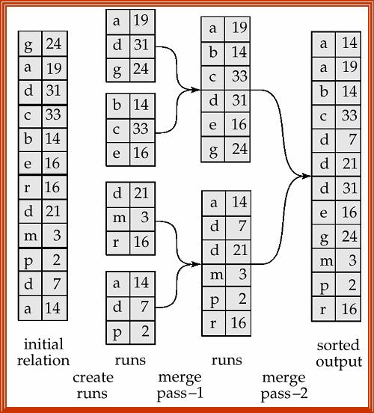
Example of External Sort-Merge
assuming 1 record per page and 3 buffer pages

