Slide 1
Comp 3311 Database Management Systems
16. Join Algorithms

Slide 2
Main Content
Block Nested Loop Join
Indexed Nested Loop Join
Merge-Sort Join
Hash Join

Slide 3
Join Processing
Several different algorithms to implement joins
Cost estimate only take into account the I/O operations (reads and writes of blocks/pages)
Notation:
  r s – two relations to be joined
  n_{r} n_{s} - number of records in r, s
  b_{r} b_{s} - number of pages in r, s
  M - available memory in pages
Assume equijoins on the following tables
  Customer: n_{customer} = 10,000 records, b_{customer} = 400 pages
  Depositor: n_{depositor} = 5,000 records, b_{depositor} = 100 pages
The join attribute is the customer-name, which is the key of Customer

Slide 4
Block Nested-Loop Join
We wish to compute r s
r is called the outer relation and s the inner relation of the join
Block nested loop join requires no indices and can be used with any kind of join condition
for each block B_{r} of r do begin
for each block B_{s} of s do begin
for each tuple t_{r} in B_{r} do begin
for each tuple t_{s} in B_{s} do begin
if (t_{r},t_{s}) satisfies the join condition
add (t_{r},t_{s}) to the result

Slide 5
Block Nested-Loop Join (Cont.)
Worst case estimate: b_{r} ∗ b_{s} + b_{r} page accesses.
  Each page in the inner relation s is read once for each page in the outer relation
Best case: b_{r} + b_{s} block accesses (Why?)
Improvements to nested loop and block nested loop algorithms:
  In block nested-loop, use M-2 disk pages as blocking unit for outer relation r, where M = memory size in pages; use remaining two pages to buffer inner relation s and output
  Cost = ⎡b_{r} / (M-2)⎤ ∗ b_{s} + b_{r}
Further Optimizations:
  If equi-join attribute forms a key on inner relation s, stop inner loop on first match
  Scan inner loop forward and backward alternately, to make use of the previously scan pages remaining in buffer
  Use an index on the inner loop’s equi-join attribute

Slide 6
Example of Block Nested-Loop Costs
Compute depositor JOIN customer, with depositor as the outer relation
  Number of pages of b_{depositor}= 100, b_{customer}=400
Worst case cost of block nested-loop
  100*400 + 100 = 40,100 page accesses
  How many main memory pages you need to apply block nested-loop?
Best case cost of block nested-loop join
  100 + 400 = 500 page accesses
  How many main memory pages you need to achieve this cost?
Cost of block nested loops join with 52 main memory pages
  2*400 + 100 = 900 page accesses

Slide 7
Indexed Nested-Loop Join
Index lookups can replace file scans if
  join is an equi-join or natural join and
  an index is available on the inner relation’s join attribute
  Can construct an index just to compute a join
For each tuple t_{r} in the outer relation r, use the index to look up tuples in s that satisfy the join condition with tuple t_{r}
Cost of the join: b_{r} + n_{r} ∗ c
  Where c is the cost of traversing index and fetching all matching s tuples for one tuple or r (n_{r} tuples in total)
  c can be estimated as cost of a single selection on s using the join condition
If indices are available on join attributes of both r and s, use the relation with fewer tuples as the outer relation

Slide 8
Example of Indexed Nested-Loop Costs
Compute depositor JOIN customer, with depositor as the outer relation
Let customer have a primary B⁺-tree index with 4 levels on the join attribute customer-name (which is the primary key of customer)
Number of pages b_{depositor}= 100
Number of records n_{depositor}= 5000
Cost of indexed nested loops join
  100 + 5000 * 5 = 25,100 disk accesses (compared with the case of block nested-loop join which needs 40,100 disk accesses)

Slide 9
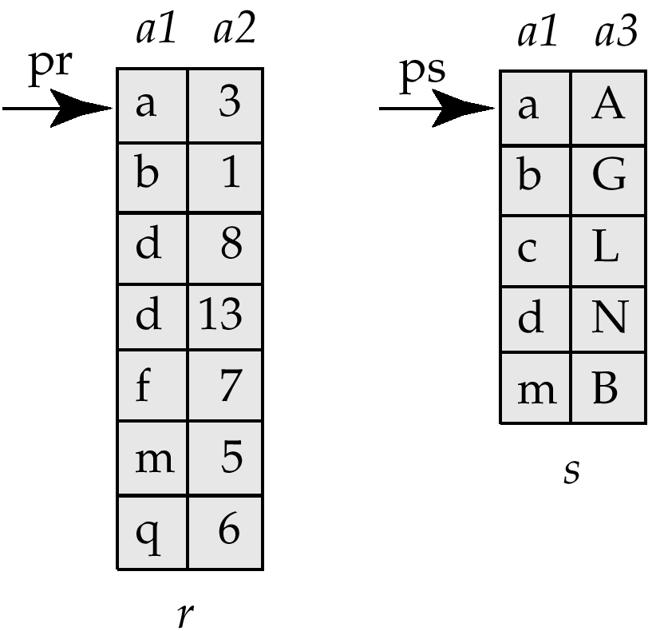
Merge-Join
Sort both relations on their join attribute (if not already sorted on the join attributes)
Merge the sorted relations to join them
  Join step is similar to the merge stage of the sort-merge algorithm
  Main difference is handling of duplicate values in join attribute — every pair with same value on join attribute must be matched
Used only for equi-joins and natural joins
Each block needs to be read only once (assuming all tuples for any given value of the join attributes fit in memory)
Thus number of page accesses for merge-join is b_{r} + b_{s} + the cost of sorting if relations are unsorted (recall external sort-merge)

Slide 10
Hash-Join
Applicable for equi-joins and natural joins
A hash function h is used to partition tuples of both relations into n buckets (i.e., a hash file organization)
h maps JoinAttrs values to {0, 1, ..., n-1}, where JoinAttrs denotes the common attributes of r and s used in the natural join
  r₀, r₁, . . ., r_{n-1} denote partitions of r tuples
    Each tuple t_{r} ∈ r is in partition r_{i} where i = h(t_{r} [JoinAttrs])
  s₀,, s₁. . ., s_{n-1} denote partitions of s tuples
    Each tuple t_{s} ∈s is in partition s_{i}, where i = h(t_{s} [JoinAttrs])

Slide 11
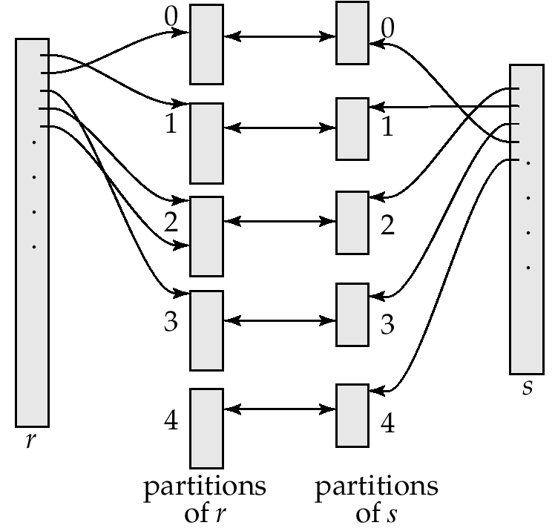
Hash-Join (Cont.)
Benefit: r tuples in bucket/partition r_{i} need only to be compared with s tuples in s_{i}
(I.e. comparison within the same bucket/partition but not others)
Reasons:
  r tuple and s tuple that satisfy the join condition will have the same value for the join attributes
  If that value is hashed to some value i, the r tuple has to be in r_{i} and the s tuple in s_{i}

Slide 12
Hash-Join Algorithm
Partition the relation r using hashing function h. When partitioning a relation, one page of memory is reserved as the output buffer for each partition (Can it be a problem?)
Partition s similarly
For each i:
  Load bucket r_{i} into memory and build an in-memory hash index on it using the join attribute. This hash index uses a different hash function than the earlier one h. Relation r is called the build input
  Read the tuples in bucket s_{i} from the disk page by page. For each tuple t_{s} locate each matching tuple t_{r} in r_{i} using the in-memory hash index Relation s is called the probe input
Cost estimation: Partition: 2(b_{r} + b_{s}) + build and probe: (b_{r} + b_{s}) = 3(b_{r} + b_{s})

Slide 13
Hash-Join algorithm (Cont.)
Condition 1: Each bucket of the build input r should fit in memory buffer
M ≥ ⎡b_{r} / n⎤
(M = no of memory buffer pages, b_{r} = no of pages of r, n=no of buckets)
Condition 2: Each bucket we have one buffer page (plus one page for input buffer) for partitioning
M ≥ n+1
In order to satisfy these conditions: M > sqrt(b_{r}) approx.
  The probe relation partitions need not fit in memory (why?)
Recursive partitioning required if number of partitions n is greater than M (how?)
  Rarely necessary: e.g., With page size of 4KB, recursive partitioning not needed for relations of 1GB or less with memory size of sqrt(1G/4K)x4K, approx 2MB

Slide 14
Example of Hash-Join
Use the relations customer and depositor again
Assume that memory size is M=25 pages b_{depositor}= 100 and b_{customer} = 400
depositor is the build input
  Partition depositor into 5 buckets, each of size 20 pages. This partitioning can be done in one pass.
customer is the probe input
  Partition customer into 5 buckets, each of size 80 pages. This is also done in one pass
Read each bucket in turn of the build input in memory, and probe against records of the corresponding probe bucket
Therefore total cost: 3(100 + 400) = 1500 page transfers
  ignores cost of writing partially filled pages

Slide 15

Further optimization of hash-join: Hybrid hash-join
Useful when memory sized are relatively large and the build input is bigger than memory
Main feature of hybrid hash join:
Keep the first partition of the build relation in memory
E.g. With memory size of 25 pages, depositor can be partitioned into five partitions, each of size 20 pages
  Division of memory:
    The first depositor partition occupies 20 pages of memory
    1 page is used for input, and 1 page each for buffering the other 4 partitions
customer is similarly partitioned into five partitions each of size 80
  The first customer is used right away for probing, instead of being written out
Cost = 3(80 + 320) + 20 +80 = 1300 page transfers for hybrid hash join, instead of 1500 pages with plain hash-join
Hybrid hash-join most useful if M >>

Slide 16
APPENDIX

Slide 17
More Sort-Merge Join Illustration
R and S are only scanned once
Even if the relations are not sorted, it is better to sort them first and do sort-merge join then doing double-loop join
if R and S are sorted, cost =n + m
if not sorted, cost = m + n + n log(n) + m log(m)
R
S
0001
0002
0002
0002
0002
0002
0002
0003
0004
0005
0005
0005
0005
Notes:
2
2
Connect to tutorial oriented presentation, and emphasize our approach

Slide 18
More Hash-Join Illustration
  R and S are both hashed to the same hash file based on the join attributes. Tuples in the same bucket are then “joined”
R
0001
0002
0002
0002
0001
0002
0003
0004
0005
0004
0002
0005
0005
S
0002
0005
0005
0002
0005
0002
0002
0002
0002
0002
0003
0005
0005
Notes:
2
2
Connect to tutorial oriented presentation, and emphasize our approach

