Slide 1
Comp 3311 Database Management Systems
18. Statistics Estimation

Slide 2
Main Content
Catalog Information for Cost Estimation
Estimation of Statistics

Slide 3
Catalog Information for Cost Estimation
Every database system has a system catalog (or otherwise called data dictionary) that stores metadata.
Metadata includes statistics about the stored tables. For each relation R it stores:
n_{R}: number of tuples in R
b_{R}: number of blocks storing R
Additional information
f_{R}: blocking factor of R, i.e., the number of R tuples fitting into one block (b_{R} = ⎡n_{R} / f_{R}⎤)
size of each attribute
V(A,R): number of distinct values that appear in attribute A of R, same as the size of π_{A}(R)

Slide 4
Catalog Information about Indices
For each index i it stores
HT_{i}: number of levels in i , i.e., the height of i
  For a balanced tree index (such as B+-tree) on attribute A of relation R, HT_{i} = ⎡log_{fi}(V(A,R))⎤
  For a hash index, HT_{i} is 1, or 1.2 if we assume overflow buckets
Additional Information
  f_{i}: average fan-out of internal nodes of index i, for
  tree-structured indices such as B+-trees
  LB_{i}: number of lowest-level index blocks in i — i.e, the number of blocks at the leaf level of the index

Slide 5
Selection Size Estimation
The output size of an operation determines the cost of the operation and the cost of subsequent operations
Its accurate estimation is important for optimization
Equality selection σ_{A=v}(R): Example: σ_{rating=8}(SAILORS)
Need to define SC(A, R): selection cardinality of attribute A of relation R
  Average number of records that satisfy equality on A
    SC(A, R)= n_{R} /V(A, R)
  ⎡SC(A,R)/f_{R}⎤ — number of pages/blocks to store these records if these records are ordered on attribute A
  If the records are not ordered on A, each record may reside in a different page
  Special case: if A is a key attribute: SC(A,R) = 1

Slide 6
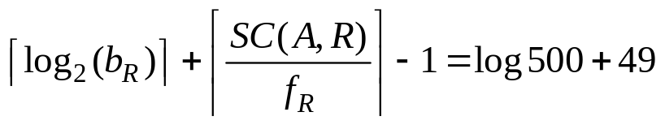
Example
SELECT S.sid
FROM Sailors S
WHERE S.rating=8
Assume sailors file with n_{sailors}=40000 tuples in b_{sailors}=500 pages
If we have V(rating, sailors)=10 different ratings, then the condition “rating=8” is expected to retrieve
SC(rating, sailors)=n_{sailors}/V(rating, sailors)=4000 tuples
Estimated cost using Clustered index on rating: 1/10*500=50 page accesses
Estimated cost using Unclustered index on rating: 4000 page accesses (each tuple is assumed to lead to page access)
In both cases we do not consider the cost of accessing the index because the index contains only 10 entries for 10 ratings (negligible!)
Estimated cost using a file scan: 500 page accesses
Estimated cost using a binary search provided that the file is sorted on rating:
Notes:
14

Slide 7
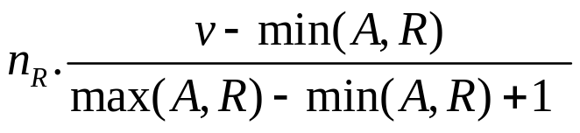
Selections Involving Comparisons
Selections of the form σ_{A<v}(R) (case of σ_{A >v}(R) is symmetric)
Let C denote the estimated number of tuples satisfying the condition
  min(A,R) and max(A,R) are available in catalog
    C = 0 if v < min(A,R) or v > max(A,R)
    C =
Example:
σ_{rating<2}(SAILORS) = # records in sailors * (2-1)/(10-1+1)
= # records in sailors /10
More accurate estimation using histograms

Slide 8
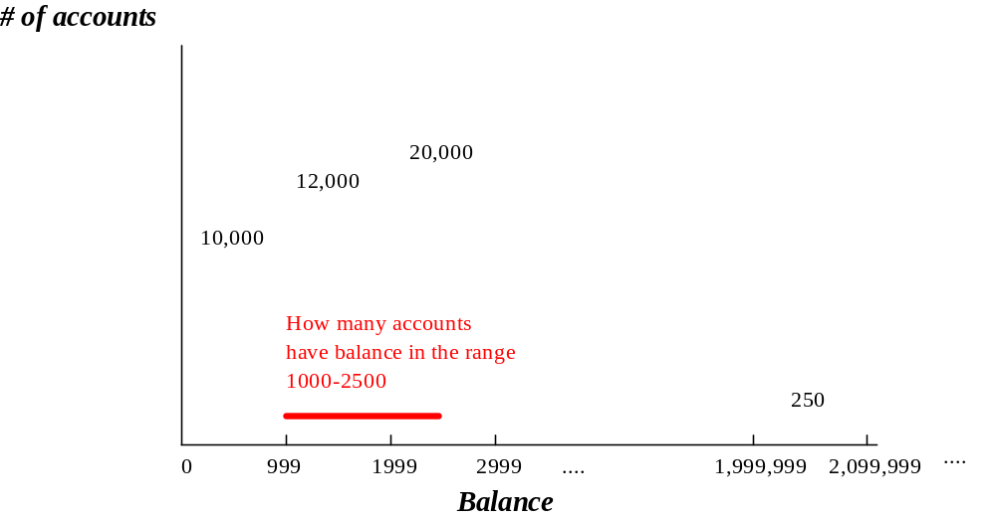
Histograms
The previous estimates are based on the assumption that each value of A has the same probability
This uniformity assumption rarely holds in practice. Commercial systems use histograms
In histograms, we assume local uniformity within each bucket (but not global uniformity)
#acc = 12000 +
20000x500/1000
=22000

Slide 9
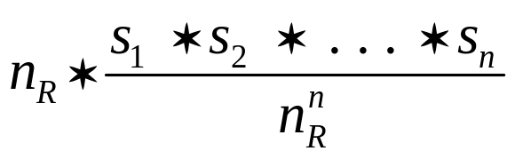
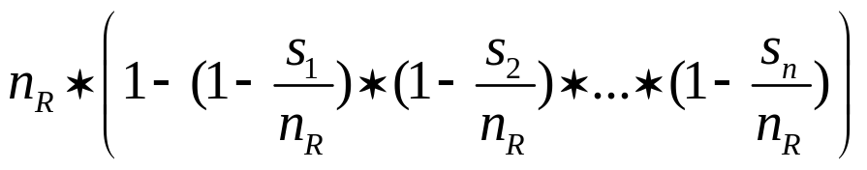

Implementation of Complex Selections
The selectivity of a condition θ_{i} is the probability that a tuple in the relation R satisfies θ_{i} . If s_{i} is the number of satisfying tuples in R, the selectivity of θ_{i} is given by sel(θ_{i}) = s_{i} /n_{R}
Conjunction: σ_{θ1∧ θ2∧. . . ∧ θn} (R). The estimate for number of
tuples in the result is:
Disjunction:σ_{θ1∨} _{θ2 ∨. . . ∨} _{θn} (R). Estimated number of tuples:
based on the logical equivalence:
Negation: σ_{¬θ}(R). Estimated number of tuples:
n_{R} – size(σ_{θ}(R))

Slide 10
Attribute Independence
The previous estimates are based on the assumption that values of attributes are independent
This attribute independence assumption rarely holds
Consider for instance the sailor table, and assume that the rating of a sailor increases with his experience. We have histograms on both the rating and the age rating. Furthermore, the number of sailors with age 20 and 50 are equal
The two queries below are estimated to have the same SC
  Select *
  From Sailors
  Where Rating = 10 and Age = 20
  Select *
  From Sailors
  Where Rating = 10 and Age = 50
Which query is expected to retrieve more record?
Better to use multidimensional histograms for estimation

Slide 11
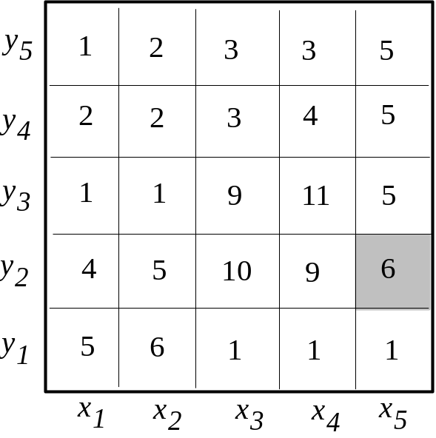
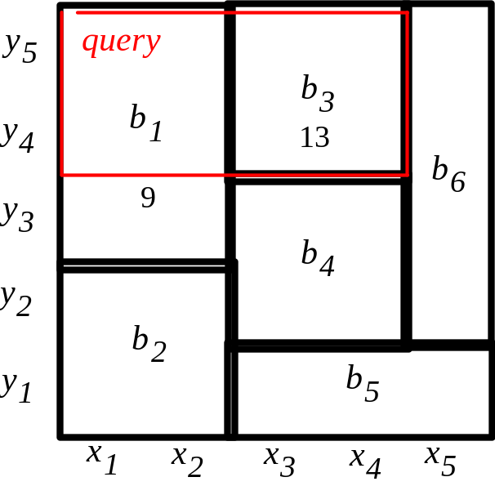
Multi-dimensional Histograms
Main idea:
  Divide the space (e.g., age-rating) in buckets, so that data in each bucket are almost uniform
  Keep in memory the bucket extents and the number of records per bucket
  Use this information to estimate the number of objects in query window. Example: “where y₄<y<y₅ and x₁<x<x₄”
Size est for the query
=b₁x4/6 +b₃
=6+13 =19

Slide 12
Estimation of the Size of Joins
The Cartesian product R x S contains n_{R} xn_{S} tuples; each tuple occupies s_{R} + s_{S} bytes
If R ∩ S = ∅, then R S is the same as R x S
If R ∩ S is a key for R, then a tuple of S will join with at most one tuple from R
  therefore, the number of tuples in R S is no greater than the number of tuples in S
If R ∩ S in S is a foreign key referencing R, then the number of tuples in R S is exactly the same as the number of tuples in S
The case for R ∩ S being a foreign key referencing S is symmetric
In the example query sailor reserves, sid in reserves is a foreign key of sailor
  hence, the result has exactly n_{reserves} tuples, which is 5000

Slide 13
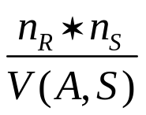
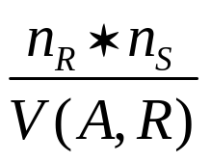
Estimation of the Size of Joins (Cont.)
If R ∩ S = {A} is not a key for R or S
If we assume that every tuple r in R produces n_{S}/V(A,S) tuples in R S, the number of tuples in R S is estimated to be:
If the reverse is true, the estimate obtained will be:
The lower of these two estimates is probably the more accurate one

Slide 14
Estimation of the Size of Joins (Cont.)
Example two tables with information about sailors and reserves. The join attribute is the sailor id, i.e., sid in reserves is a foreign key on sailor
Catalog information for join examples:
n_{sailor} = 10,000
n_{reserves} = 5000
V(sid, reserves) = 2500, which implies that only 2500 sailors have boat reservations
Compute the size estimates for reserves sailor without using information about foreign keys:
  V(sid, reserves) = 2500, and
  V(sid, sailor) = 10000
  The two estimates are 5000 * 10000/2500 = 20,000 and 5000 * 10000/10000 = 5000
  We choose the lower estimate, which in this case, is the same as our earlier computation using foreign keys

Slide 15
Size Estimation for Other Operations
Projection: estimated size of ∏_{A}(R) = V(A,R)
Aggregation : estimated size of Group-by A = V(A,R)
Set operations
  For unions/intersections of selections on the same relation: rewrite and use size estimate for selections
    E.g. σ_{θ1} (R) ∪ σ_{θ2} (R) can be rewritten as σ_{θ1 ∨θ2} (R)
  For operations on different relations:
    estimated size of R ∪ S = size of R + size of S
    estimated size of R ∩ S = minimum (size of R , size of S)
    estimated size of R – S = R
  All the three estimates may be quite inaccurate, but provide upper bounds on the sizes

Slide 16
Estimation of Number of Distinct Values
Selections: σ_{θ} (R)
If the selection condition θ is on attribute A
estimated V(A,σ_{θ} (R)) = V(A,R) * sel(θ)
where sel(θ) is the selectivity of the selection
e.g., V(rating, σ_{rating=2} (sailors)) =10/10=1 (recall sel(rating=x)=1/10)
In all the other cases (e.g., selection on another attribute) use the rough estimate
min(V(A,R), n_{σθ (R)} )
e.g.,: V(Age, σ_{rating=8} (sailors)) =
min(# different age values, # records in σ_{rating=8} (sailors)
Joins: R Join S
estimated V(A, R Join S) = min (V(A,R), n_{R join S})) (A is from R)
Example V(sailor-name, sailor join reserves) =
min(V(sailor-name, sailor), output size of join)

Slide 17
Estimation of Distinct Values (Cont.)
Estimation of distinct values is straightforward for projections
  They are the same in ∏_{A}(R) as in R
The same holds for grouping attributes of aggregation
For aggregated values
  For min(A) and max(A), the number of distinct values can be estimated as min(V(A,r), V(G,r)) where G denotes grouping attributes
  Example SELECT max(age)
  FROM Sailors
  GROUP-BY rating
  Estimated (V(age,Sailors), V(rating,Sailors))=
  min(#different age values, #different rating values)
  It is equal to #different rating values if we assume each rating we will get a different max(age) value
  For other aggregates (sum, count, avg), we simply assume all values are distinct, and use V(G,r)

