Slide 1
Comp 3311 Database Management Systems
19. Query Optimization

Slide 2
Main Content
Equivalent RA Rules
Heuristic Optimization
Transformation of Relational Expressions
Cost-based Optimization
Dynamic Programming

Slide 3
Equivalence of Relational Expressions
Two relational algebra expressions are said to be equivalent if the two expressions generate the same set of tuples on every legal database instance
  Note: order of tuples is irrelevant
An equivalence rule says that expressions of two forms are equivalent
  Can replace expression of first form by second, or vice versa

Slide 4



Equivalence Rules
1. Conjunctive selection operations can be deconstructed into a sequence of individual selections
2. Selection operations are commutative
3. Only the last in a sequence of projection operations is needed, the others can be omitted
Selections can be combined with Cartesian products and theta joins
  σ_{θ}(E₁ X E₂) = E₁ _{θ} E₂
  σ_{θ1}(E₁ _{θ2} E₂) = E₁ _{θ1∧ θ2} E₂

Slide 5
Equivalence Rules (Cont.)
5. Theta-join operations (and natural joins) are commutative
E_{1 θ} E₂ = E₂ _{θ} E₁
6. (a) Natural join operations are associative:
(E₁ E₂) E₃ = E₁ (E₂ E₃)
(b) Theta joins are associative in the following manner:
(E_{1 θ1} E₂) _{θ2∧ θ3} E₃ = E_{1 θ1∧ θ3} (E₂ _{θ2} E₃)
where θ₂ involves attributes from only E₂ and E₃

Slide 6
Equivalence Rules (Cont.)
7. The selection operation distributes over the theta join operation under the following two conditions:
(a) When all the attributes in θ₀ involve only the attributes of one
of the expressions (E₁) being joined
σ_{θ0}(E₁ _{θ} E₂) = (σ_{θ0}(E₁)) _{θ} E₂
(b) When θ₁ involves only the attributes of E₁ and θ₂ involves
only the attributes of E₂
σ_{θ1}∧_{θ2} (E₁ _{θ} E₂) = (σ_{θ1}(E₁)) _{θ} (σ_{θ2} (E₂))

Slide 7

Pictorial Depiction of Equivalence Rules

Slide 8
Choice of Evaluation Plans
Practical query optimizers incorporate elements of the following two broad approaches:
  Uses heuristic to choose a plan – HEURISTIC OPTIMIZATION
      GENERAL IDEA:
      Perform the cheap operations first (i.e., push selections down)
      Try to utilize existing indexes
      Remove the useless attributes early
  Search all the plans and choose the best plan in a
  cost-based fashion – COST BASED OPTIMIZATION
      GENERAL IDEA:
      Generate “all” possible evaluation plans
      Estimate the cost of each plan
      Execute the plan with the minimum expected cost

Slide 9
Heuristic Optimization
Cost-based optimization is expensive, even with dynamic programming
Systems may use heuristics to reduce the number of choices that must be made in a cost-based fashion
Heuristic optimization transforms the query-tree by using a set of rules that typically (but not in all cases) improve execution performance:
  Perform selections early (reduces the number of tuples)
  Perform projections early (reduces the number of attributes)
  Perform most restrictive selections and join operations before other similar operations
Some systems use only heuristics, others combine heuristics with partial cost-based optimization

Slide 10
Common Algebra Equivalences
Used in Heuristic Optimization
Cascading of selections: σ_{c1∧c2..∧cn}(R) = σ_{c1}(σ_{c2}..(σ_{cn}(R))..)
Example: σ_{Age=20∧Rating>7}(Sailors) = σ_{Rating>7}(σ_{Age=20}(Sailors))
Commutativity of selections: σ_{c1}(σ_{c2}(R)) = σ_{c2}(σ_{c1}(R))
Example: σ_{Rating>7}(σ_{Age=20}(Sailors)) = σ_{Age=20}(σ_{Rating>7}(Sailors))
Cascading of projections: π_{a1}(R) = π_{a1}(π_{a2}…(π_{an}(R))…)
where a1 ⊆ a2…⊆ an
Example: π_{Name}(Sailors) = π_{Name}(π_{Name, Sid}(Sailors))
Commutativity of joins (and cross products): R S = S R
Associativity of joins (and cross products):
(R S) T = R (S T)
From these two properties of joins (and cross products):
R (S T)=(T R) S
That is, we can take any order of joins
Sailors(sid, sname, rating, age)
Reserves(sid,bid,date)
Boats(bid,bname,color)

Slide 11
Common Algebra Equivalences
Used in Heuristic Optimization
Commute selections with projections:π_{a}(σ_{c}(R))=σ_{c}(π_{a}(R))
Only if the selection condition includes only attributes of the projection list
Legal Example:
π_{Name, Age}(σ_{Age=20}(Sailors))=σ_{Age=20} (π_{Name, Age}(Sailors))
Illegal Example:
π_{Name, Rating}(σ_{Age=20}(Sailors))=σ_{Age=20}(π_{Name, Rating}(Sailors))
Commute selections with joins (Cartesian products):
σ_{c}(R S)=(σ_{c}R) S
Applicable if c involves only attributes of R
Legal Examples:
σ_{Name=Joe ∧ Rating=7} (Sailors Reserves) = (σ_{Name=Joe ∧ Rating=7} Sailors) Reserves
σ_{Name=Joe ∧ Bid=100} (Sailors Reserves) = (σ_{Name=Joe}Sailors) (σ_{Bid=100} Reserves)
Sailors(sid, sname, rating, age)
Reserves(sid,bid,date)
Boats(bid,bname,color)

Slide 12
Common Algebra Equivalences
Used in Heuristic Optimization
π_{a}(R S)=π_{a}((π_{a1}R) (π_{a2}S))
(i) a1 is the subset of projected attributes a that belong to R + the join attributes
(ii) a2 is the subset of a that belong to S + the join attributes
Example:
π_{Name, Date} (Sailors Reserves) =
π_{Name, Date}((π_{Name,Sid} Sailors) (π_{Date,Sid}Reserves))
If the join attribute is included in the list of projected attributes a, then: π_{a}(R S)=(π_{a1}R) (π_{a2}R)
Example:
π_{Sid, Date} (Sailors Reserves) = (π_{Sid} Sailors) (π_{Date,Sid}Reserves)
Sailors(sid, sname, rating, age)
Reserves(sid,bid,date)
Boats(bid,bname,color)

Slide 13
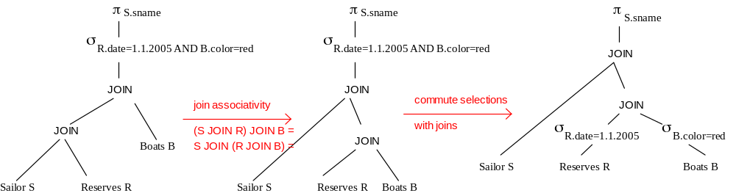
Example of Heuristic Optimization
SELECT sname
FROM Sailor S, Reserves R, Boats B
WHERE S.sid=R.sid and R.bid = B.bid and R.date=1.1.2005 and B.color=red
Sailors(sid, sname, rating, age)
Reserves(sid,bid,date)
Boats(bid,bname,color)

Slide 14
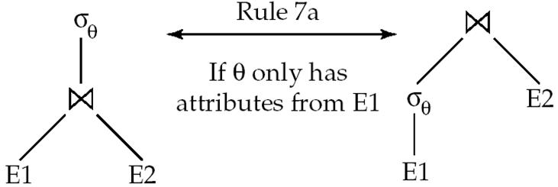
Transformation Example: Pushing Selections
Query: Find the names of all customers who have an account at some branch located in Brooklyn
Π_{customer_name}(σ_{branch_city = “Brooklyn”}
(branch (account depositor)))
Transformation using rule 7a
Π_{customer_name}
((σ_{branch_city =“Brooklyn”} (branch))
(account depositor))
Performing the selection as early as possible reduces the size of the relation to be joined
Branch(branch_name, branch_city,asserts)
Account(branch_name,account_number, balance)
Depositor(customer_name, account_number)

Slide 15
Example with Multiple Transformations
Query: Find the names of all customers with an account at a Brooklyn branch whose account balance is over $1000
Π_{customer_name(}(σbranch_city = “Brooklyn” ∧ balance > 1000
(branch (account depositor)))
Transformation using join associatively (Rule 6a):
Π_{customer_name}((σbranch_city = “Brooklyn” ∧ balance > 1000
(branch account)) depositor)
Second form provides an opportunity to apply the “perform selections early” rule, resulting in the subexpression
σ_{branch_city = “Brooklyn”} (branch) σ _{balance > 1000} (account)
Thus a sequence of transformations can be useful
Branch(branch_name, branch_city,asserts)
Account(branch_name,account_number, balance)
Depositor(customer_name, account_number)

Slide 16
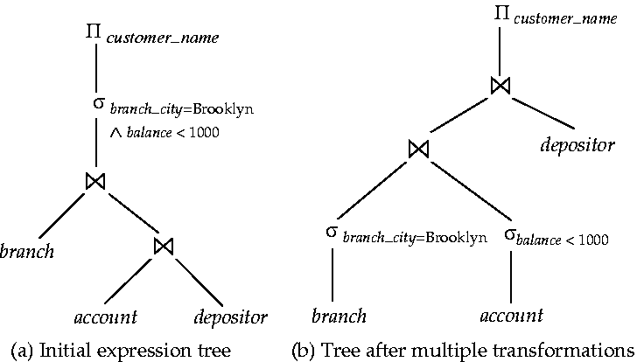
Multiple Transformations (Cont.)
Branch(branch_name, branch_city,asserts)
Account(branch_name,account_number, balance)
Depositor(customer_name, account_number)

Slide 17
Transformation Example: Pushing Projections
Π_{customer_name}((σ_{branch_city = “Brooklyn”} (branch) account) depositor)
When we compute
(σ_{branch_city = “Brooklyn”} (branch) account )
we obtain a relation whose schema is:
(branch_name, branch_city, assets, account_number, balance)
Eliminate unneeded attributes from intermediate results to get:
Π_{customer_name} ((
Π_{account_number} ( (σ_{branch_city = “Brooklyn”} (branch) account ))
depositor )
Performing the projection as early as possible reduces the size of the relation to be joined
Branch(branch_name, branch_city,asserts)
Account(branch_name,account_number, balance)
Depositor(customer_name, account_number)

Slide 18
Cost-based Optimization
Number of Join Orders
Consider finding the best join-order for r₁ r₂ . . . r_{n}
There are (2(n – 1))!/(n – 1)! different join orders for the above expression
Can be found by number of binary tree with n nodes Catalan number: (2n)!/((n)!(n + 1)!)
E.g.
n = 7, the number is 665280
n = 10, the number is greater than 176 billion!
Impossible to plan even without considering other operations (e.g., selections) in the query
No need to generate all the join orders
Using dynamic programming, the least-cost join order for any subset of {r₁, r₂, . . . ,r_{n}} is computed only once and stored for future use

Slide 19
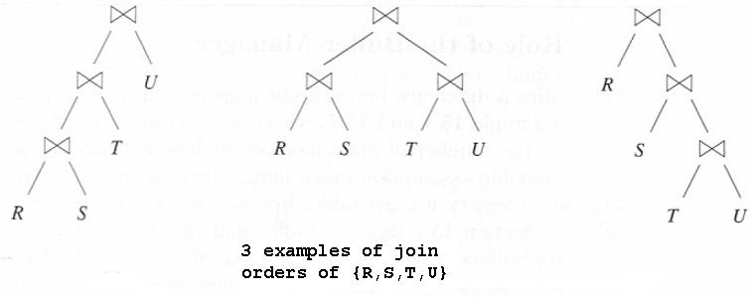
Number of Join Orders
Example: suppose R, S, T, and U, being joined. What are the join trees?
There are (2(4– 1))!/((4– 1)!4!) = 6!/(4!3!)= 5 possible shapes for the tree. (below shows 3 and sketch other 2!)
Each of these trees can have the four relations in any order. So, the total number of tree is 5*4! =5*24 = 120 different trees!!
bushy tree
left-deep tree
All right children are leaves
right-deep tree
All left children are leaves

Slide 20
Dynamic Programming
To find best join tree for a set of n relations:
  To find best plan for a set S of n relations, consider all possible plans of the form: S₁ (S – S₁) where S₁ is any non-empty subset of S
  Recursively compute costs for joining subsets of S to find the cost of each plan. Choose the cheapest of the 2^{n} – 1 alternatives
  When plan for any subset is computed, store it and reuse it when it is required again, instead of recomputing it
Using Dynamic Programming (DP) to select the best join order and grouping!

Slide 21
Join Order Optimization Algorithm
procedure findbestplan(S)
if (bestplan[S].cost ≠ ∞)
return bestplan[S]
// else bestplan[S] has not been computed earlier, compute it now
for each non-empty subset S1 of S such that S1 ≠ S
P1= findbestplan(S1)
P2= findbestplan(S - S1)
A = best algorithm for joining results of P1 and P2
cost = P1.cost + P2.cost + cost of A
if cost < bestplan[S].cost
bestplan[S].cost = cost
bestplan[S].plan = “execute P1.plan; execute P2.plan;
join results of P1 and P2 using A”
return bestplan[S]
Notes:
We construct a table with an entry for each subset of one or more of the n relations. In that table we put:
The estimated size of the join of these relations. (We know the formula for this – V(att, rel))
The least cost of computing the join of these relations.
The expression that yields the least cost.

Slide 22
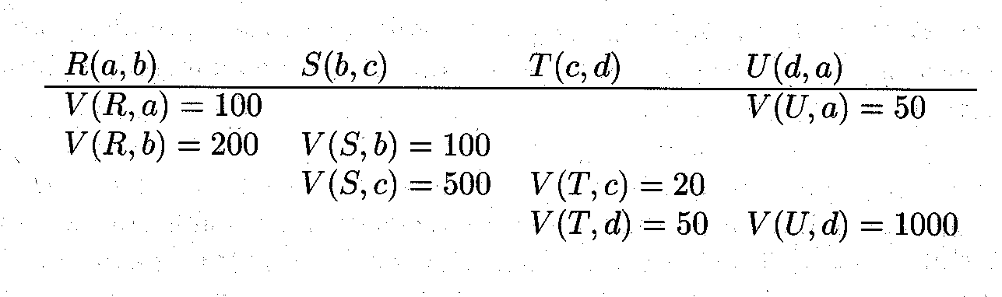
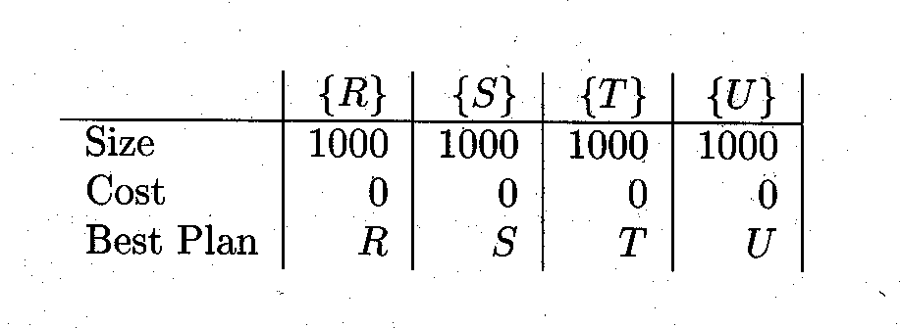
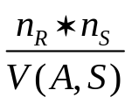
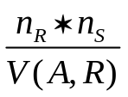


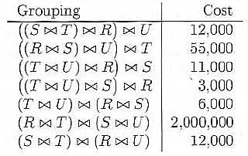
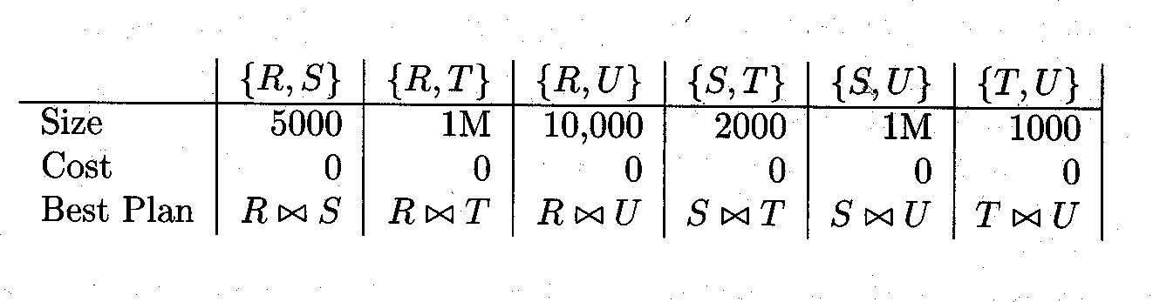
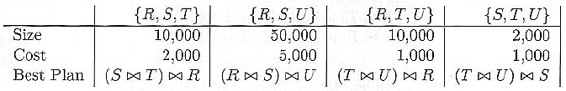
Example of Dynamic Programming
Statistical Data
Table for singleton sets
Join groupings and their costs
Table for pairs
Table for triples

Slide 23
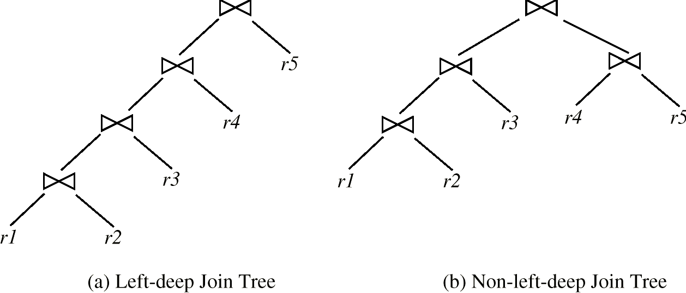
Left Deep Join Trees
In left-deep join trees, the right-hand-side input for each join is a relation, not the result of an intermediate join. Some optimizers only consider left-deep plans (they facilitate pipelining)

Slide 24
Cost of Optimization
With dynamic programming time complexity of optimization with bushy trees is O(3^{n})
  With n = 10, this number is 59000 instead of 176 billion!
Space complexity is O(2^{n})
To find best left-deep join tree for a set of n relations:
  Consider n alternatives with one relation as right-hand side input and the other relations as left-hand side input
  Modify optimization algorithm:
    Replace “for each non-empty subset S1 of S such that S1 ≠ S”
    By: for each relation r in S
    let S1 = S – r
If only left-deep trees are considered, time complexity of finding best join order is O(n 2^{n})
  Space complexity remains at O(2^{n})
Cost-based optimization is expensive, but worthwhile for queries on large datasets (typical queries have small n, generally < 10)

