Slide 1
Comp 3311 Database Management Systems
20. Transactions

Slide 2
Main Content
ACID properties
Transaction State
Concurrent Executions
Serializability
Recoverability
Implementation of Isolation
Testing for Serializability

Slide 3
Transaction Concept
A transaction is a unit of program execution that accesses and possibly updates various data items
  read(X) to read a database item X
  write(X) to write a value into the database item X
Two main issues to deal with:
  Failures of various kinds, such as hardware failures and system crashes
  Concurrent execution of multiple transactions
We need to establish and maintain integrity for database transactions!
Database in a consistent state
Database may be temporarily in an inconsistent state during execution
Database in a consistent state
Begin Transaction
Execution of Transaction
End Transaction
Notes:
Before a transaction: a consistent database
During transaction: execution the database may be inconsistent
When the transaction is committed, the database must be consistent

Slide 4
ACID Properties
To preserve integrity of data, the database system must ensure ACID:
Atomicity Either all operations of the transaction are properly reflected in the database or none are
Consistency Execution of a transaction in isolation preserves the consistency of the database
Isolation Although multiple transactions may execute concurrently, each transaction must be unaware of other concurrently executing transactions. Intermediate transaction results must be hidden from other concurrently executed transactions
  That is, for every pair of transactions T_{i} and T_{j}, it appears to T_{i} that either T_{j}, finished execution before T_{i} started, or T_{j} started execution after T_{i} finished
Durability After a transaction completes successfully, the changes it has made to the database persist, even if there are system failures

Slide 5
Example of Fund Transfer
Transaction to transfer $50 from account A to account B:
  1. read(A)
  2. A := A – 50
  3. write(A)
  4. read(B)
  5. B := B + 50
  6. write(B)
Consistency requirement – the sum of A and B is unchanged by the execution of the transaction
Atomicity requirement — if the transaction fails after step 3 and before step 6, the system should ensure that its updates are not reflected in the database, else an inconsistency will result

Slide 6
Example of Fund Transfer (Cont.)
Durability requirement — once the user has been notified that the transaction has completed (i.e., the transfer of the $50 has taken place), the updates to the database by the transaction must persist despite failures
Isolation requirement — if between steps 3 and 6, another transaction is allowed to access the partially updated database, it will see an inconsistent database
(the sum A + B will be less than it should be)
Can be ensured trivially by running transactions serially, that is one after the other. However, executing multiple transactions concurrently has significant benefits

Slide 7
Transaction State
Active, the initial state; the transaction stays in this state while it is executing
Partially committed, after the final statement has been executed
Failed, after the discovery that normal execution can no longer proceed
Aborted, after the transaction has been rolled back and the database restored to its state prior to the start of the transaction. Two options after it has been aborted:
  restart the transaction – only if no internal logical error
  kill the transaction
Committed, after successful completion

Slide 8

Transaction State (Cont.)
commit
Read/Write
End
transaction
Begin
transaction
fail
fail
rollback

Slide 9
Concurrent Executions
Multiple transactions are allowed to run concurrently in the system.
Advantages are:
  increased processor and disk utilization, leading to better transaction throughput: one transaction can be using the CPU while another is reading from or writing to the disk
  reduced average response time for transactions: short transactions need not wait behind long ones
Concurrency control schemes – mechanisms to achieve isolation, i.e., to control the interaction among the concurrent transactions in order to prevent them from destroying the consistency of the database (problems occur when concurrent transactions access the same items)
T2
T1
T3
T4

Slide 10
Schedules
Schedules – sequences that indicate the chronological order in which instructions of concurrent transactions are executed
  a schedule for a set of transactions must consist of all instructions of those transactions
  must preserve the order in which the instructions appear in each individual transaction
  read(A)
  A := A – 50
  write(A)
  read(B)
  B := B + 50
  write(B)
  read(A)
  temp := A * 0.1
  A := A – temp
  write(A)
  read(B)
  B := B + temp
  write(B)
T₁
T₂

Slide 11

Example Schedules
Let T₁ transfer $50 from A to B, and T₂ transfer 10% of the balance from A to B. The following is a serial schedule, in which T₁ is followed by T₂
Lets start with A=100 B=200
A=100
A=50
B=200
B=250
A=50
temp=5
A=45
B=250
B=255
We end with A=45 B=255

Slide 12

Example Schedule (Cont.)
Let T₁ and T₂ be the transactions defined previously. The following schedule is not a serial schedule, but it is equivalent to the previous serial schedule
Lets start with A=100 B=200
A=100
A=50
A=50
temp=5
A=45
B=200
B=250
B=250
B=255
We end again with A=45 B=255. Both schedules preserve the sum A + B

Slide 13

Example Schedules (Cont.)
The following concurrent schedule does not preserve the value of the the sum A + B – The schedule is wrong and should not be allowed
Lets start with A=100 B=200
A=100
A=100
temp=10
A=90
B=200
A=50
B=200
B=250
B=210
We end with A=50 B=210

Slide 14
Serializability
Basic Assumption – Each transaction preserves database consistency
Thus serial execution of a set of transactions preserves database consistency
A (possibly concurrent) schedule is serializable if it is equivalent to a serial schedule
Our simplified schedules consist of only read and write instructions
We ignore other operations and assume that transactions perform arbitrary computations on data in local buffers in between reads and writes
Definition. A schedule of a set of transactions {T₁,…,T_{n}} is serialisable
if it yields exactly the same result as a serial schedule.

Slide 15
Conflict Serializability
Instructions l_{i} and l_{j} of transactions T_{i} and T_{j} respectively, conflict if and only if there exists some item Q accessed by both l_{i} and l_{j}, and at least one of these instructions writes Q
1. l_{i} = read(Q), l_{j} = read(Q). l_{i} and l_{j} don’t conflict
2. l_{i} = read(Q), l_{j} = write(Q). They conflict
3. l_{i} = write(Q), l_{j} = read(Q). They conflict
4. l_{i} = write(Q), l_{j} = write(Q). They conflict
Example: T₁:<read1(x), x = x+1, write1(x), C₁> and T₂:<read2(x), x = x+1, write2(x), C₂>. Conflicting operations between T₁ and T₂: (read1(x), write2(x)) , (read2(x), write1(x)) , (write1(x), write2(x))
Intuitively, a conflict between l_{i} and l_{j} forces a (logical) temporal order between them. If l_{i} and l_{j} are consecutive in a schedule and they do not conflict, their results would remain the same even if they had been interchanged in the schedule

Slide 16
Conflict Serializability (Cont.)
If a schedule S can be transformed into a schedule S’ by a series of swaps of non-conflicting instructions, we say that S and S’ are conflict equivalent
We say that a schedule S is conflict serializable if it is conflict equivalent to a serial schedule
Example of a schedule that is not conflict serializable:
T₃ T₄
read(Q)
write(Q)
write(Q)
We are unable to swap instructions in the above schedule to obtain either the serial schedule < T₃, T₄ >, or the serial schedule < T₄, T₃ >
Theorem A schedule is serialisable if it can be transformed
via permutations into a serial schedule

Slide 17

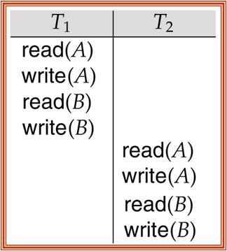
Conflict Serializability (Cont.)
The following schedule is equivalent to a serial schedule where T₂ follows T₁, by a series of swaps of non-conflicting instructions
Therefore it is conflict serializable
Swapping non-conflicting pairs such as write(A) and write(B)

Slide 18
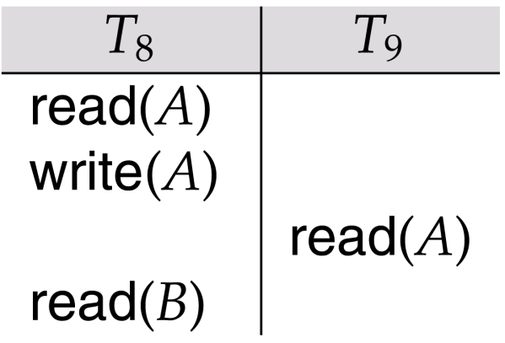
Recoverability
Need to address the effect of transaction failures on concurrently
running transactions
Recoverable schedule — if a transaction T_{j} reads a data item previously written by a transaction T_{i} , the commit operation of T_{i} appears before the commit operation of T_{j}
The following schedule is not recoverable if T₉ commits immediately after the read- violates durability property
If T₈ should abort, T₉ would have read (and possibly shown to the user) an inconsistent database state. Hence T₈ should commit before T₉. In case T₈ fails read(B) T₉ rolls back
Commit!
Abort!

Slide 19
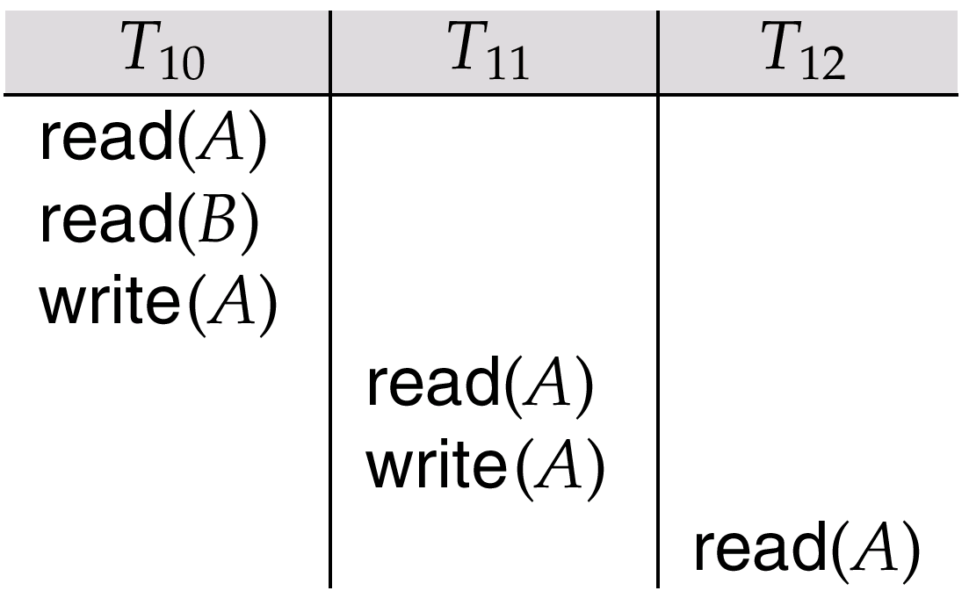
Recoverability (Cont.)
Cascading rollback – a single transaction failure leads to a series of transaction rollbacks
Consider the following schedule where none of the transactions has yet committed (so the schedule is recoverable)
If T₁₀ fails, T₁₁ and T₁₂ must also be rolled back
Can lead to the undoing of a significant amount of work

Slide 20
Recoverability (Cont.)
Cascadeless schedules — cascading rollbacks cannot occur in a strict schedule:
for each pair of transactions T_{i} and T_{j} such that T_{j} reads (or writes) a data item previously written by T_{i}, the commit or abort operation of T_{i} appears before the read operation of T_{j}
Every cascadeless schedule is also recoverable!
Cascadeless schedules are desirable
Consider the schedule <write₁(X=5), write₂(X=8), abort₁ > (suppose original value of X is 9)
  If T₁ aborts (i.e. abort₁), the system rolls back the value of X to 9
  T₂ loses write₂(X=8)
  A strict schedule would not have allowed write₂(X) before T₁ commits or aborts

Slide 21
Implementation of Isolation
Schedules must be serializable, and recoverable, for the sake of database consistency, and preferably cascadeless for efficiency reason
Conflict between isolation and degree of concurrency
Concurrency-control schemes tradeoff between the amount of concurrency they allow and the amount of overhead that they incur
Alow only conflict-serializable schedules to be generated
Allow view-serializable schedules that are not conflict-serializable

Slide 22
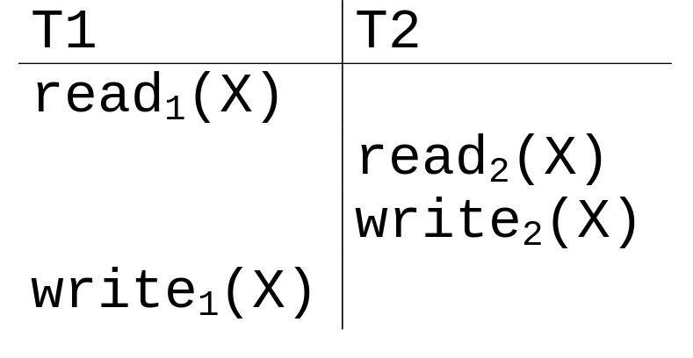
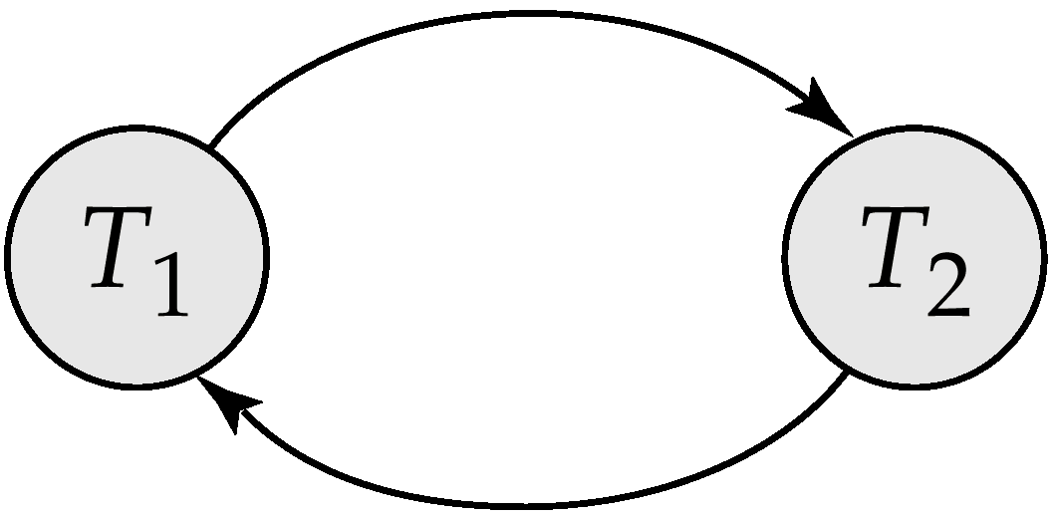
Testing for Serializability
Consider some schedule of a set of transactions:
T₁, T₂, ..., T_{n}
Precedence graph — a direct graph where the vertices are the transactions (names)
We draw an arc from T_{i} to T_{j} if the two transaction conflict, and T_{i} accessed the data item on which the conflict arose earlier
We may label the arc by the item that was accessed
Example
x
y
Precedence graph

Slide 23
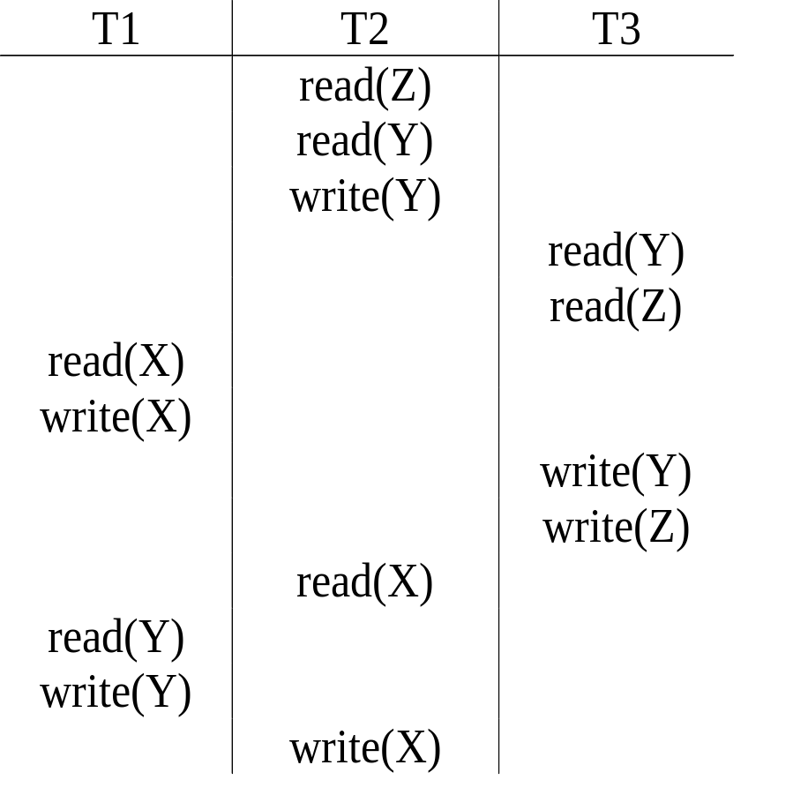
Example Schedule (Schedule A)
Precedence graph
T1
T2
T3
Schedule is NOT serializable
Notes:
2
2

Slide 24
Concurrency Control vs. Serializability Tests
Testing a schedule for serializability after it has executed is a little too late!
Goal – to develop concurrency control protocols that will assure serializability
  They will not examine the precedence graph as it is being created
  A protocol will impose a discipline that avoids nonseralizable schedules instead
  Lock-based and Timestamp-based

