Slide 1
Comp 3311 Database Management Systems
21. Locking Protocols

Slide 2
Main Content
Lock-Based Protocols
2PL
Deadlock Handling

Slide 3
Lock-Based Protocols
A lock is a mechanism to control concurrent access to a data item
Data items can be locked in two modes :
1. exclusive (X) mode. Data item can be both read as well as
written. X-lock is requested using lock-X instruction
2. shared (S) mode. Data item can only be read. S-lock is
requested using lock-S instruction
Lock requests are made to concurrency-control manager. Transaction can proceed only after request is granted

Slide 4

Lock-Based Protocols (Cont.)
Lock-compatibility matrix
A transaction may be granted a lock on an item if the requested lock is compatible with locks already held on the item by other transactions
Any number of transactions can hold shared locks on an item, but if any transaction holds an exclusive on the item no other transaction may hold any lock on the item
If a lock cannot be granted, the requesting transaction is made to wait till all incompatible locks held by other transactions have been released. The lock is then granted

Slide 5

Lock-Based Protocols (Cont.)
Original: A=100 B=200
Transaction T₂ displays A+B:
T₂: lock-S(A);
read (A);
unlock(A);
lock-S(B);
read (B);
unlock(B);
display(A+B)
Locking as above is not sufficient to guarantee serializability — if A and B get updated in-between the read of A and B, the displayed sum would be wrong
A locking protocol is a set of rules for requesting and releasing locks
All transactions follow
Locking protocols restrict the set of possible schedules
Update A and B!
A=50 B=100
A+B=200
A+B should be either 300 or 150!

Slide 6

Pitfalls of Lock-Based Protocols-Deadlock
Consider the partial schedule
Neither T₃ nor T₄ can make progress — executing lock-S(B) causes T₄ to wait for T₃ to release its lock on B, while executing lock-X(A) causes T₃ to wait for T₄ to release its lock on A
Such a situation is called a deadlock. The potential for deadlock exists in most locking protocols. Deadlocks are a necessary evil
To handle a deadlock one of T₃ or T₄ must be rolled back and its locks released
Deadlock between
T₃ and T₄ !

Slide 7
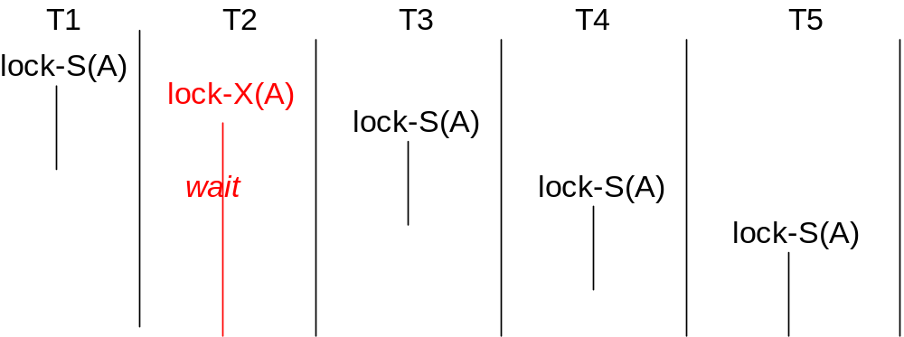
Pitfalls of Lock-Based Protocols - Starvation
Starvation is also possible if concurrency control manager is badly designed
For example: A transaction may be waiting for an X-lock on an item, while a sequence of other transactions request and are granted an S-lock on the same item
The same transaction is repeatedly rolled back due to deadlocks

Slide 8
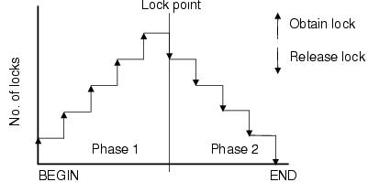
The Two-Phase Locking (2PL) Protocol
This is a protocol which ensures conflict-serializable schedules
Phase 1: Growing Phase
  A transaction may obtain locks
  A transaction should not release locks
Phase 2: Shrinking Phase
  A transaction may release locks
  A transaction should not obtain locks
The protocol assures serializability. It can be proved that the transactions can be serialized in the order of their lock points (i.e. the point where a transaction acquired its final lock)
If a schedule is executed by 2PL it must be conflict serializable
If a schedule is conflict serializable it may or may not be executed by 2PL

Slide 9
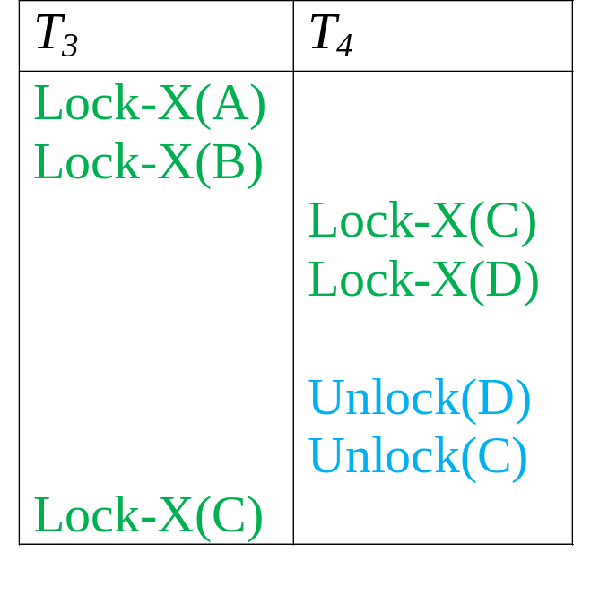
Lock Conversions
2PL with lock conversions:
– First Phase:
  can acquire a lock-S on item
  can acquire a lock-X on item
  can convert a lock-S to a lock-X (upgrade)
– Second Phase:
  can release a lock-S
  can release a lock-X
  can convert a lock-X to a lock-S (downgrade)
This protocol assures serializability (T₄ → T₃). But still relies on the programmer to insert the various locking instructions
T₄ → T₃

Slide 10
Implementation of Locking
A lock manager can be implemented as a separate process to which transactions send lock and unlock requests
The lock manager replies to a lock request by sending a lock grant message (or a message asking the transaction to roll back, in case of a deadlock)
The requesting transaction waits until its request is answered
The lock manager maintains a data structure called a lock table to record granted locks and pending requests
The lock table is usually implemented as an in-memory hash table indexed on the name of the data item being locked

Slide 11
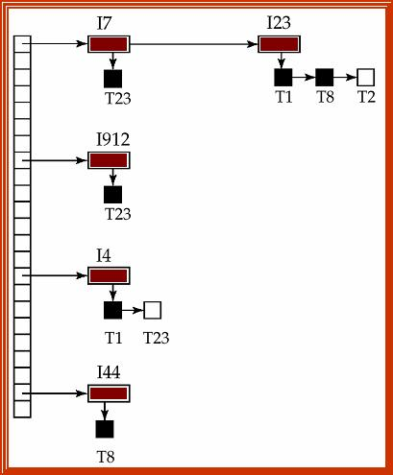
Lock Table
Black rectangles indicate granted locks, white ones indicate waiting requests (E.g. T₂₃ asking I7; T₁ and T₈ asking I23)
Lock table also records the type of lock granted or requested
New request is added to the end of the queue of requests for the data item, and granted if it is compatible with all earlier locks
Unlock requests result in the request being deleted, and later requests are checked to see if they can now be granted
If transaction aborts, all waiting or granted requests of the transaction are deleted
Lock manager keep a list of locks held by each transaction to implement this table efficiently

Slide 12
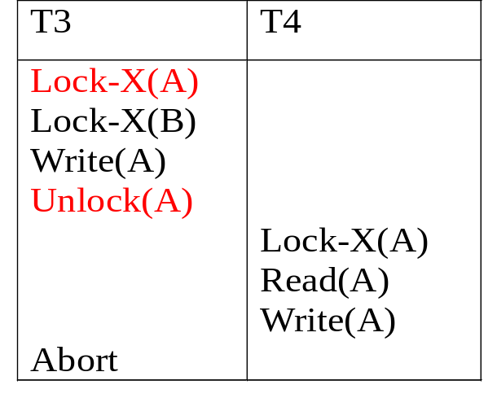
Strict 2PL
Cascading roll-back is possible under two-phase locking
To avoid this, follow a modified protocol called strict 2PL. Here a transaction must hold all its exclusive locks till it commits/aborts
Rigorous two-phase locking is even stricter: here all locks are held till commit/abort. In this protocol transactions can be serialized in the order in which they commit
Keep all excl locks
Acquire locks
Number of locks acquired
Release locks
time

Slide 13
Deadlock Detection
Deadlocks can be described as a wait-for graph G = (V,E)
  V is a set of vertices (all the transactions in the system)
  E is a set of edges; each element is an ordered pair T_{i} →T_{j} , implying that T_{i} is waiting for T_{j} to release a data item. This edge is removed only when T_{j} is no longer holding a data item needed by T_{i}
The system is in a deadlock state if and only if G has a cycle
Must invoke a deadlock-detection algorithm periodically to look for cycles

Slide 14


Deadlock Detection (Cont.)
Wait-for graph without a cycle
Wait-for graph with a cycle

Slide 15
Deadlock Recovery
When deadlock is detected, some transaction will have to rolled back (made a victim) to break deadlock
Select that transaction as victim that will incur minimum cost
Rollback - determine how far to roll back transaction
    Total rollback: Abort the transaction and then restart it
    More effective to roll back transaction only as far as necessary to break deadlock
    Starvation happens if same transaction is always chosen as victim
    Include the number of rollbacks in the cost factor to avoid starvation

