Slide 1
COMP 3511
Operating Systems
Lab 06

Slide 2
Outline
Deadlocks
Resource-Allocation Graph
Banker’s Algorithm
Logical vs. Physical Address Space
Segmentation
Paging

Slide 3
The Deadlock Problem
A set of blocked processes each holding a resource while waiting to acquire a resource held by another process in the set.
Example 1
  A system has 2 tape drives.
  P₁ and P₂ each hold one tape drive and each needs another one.
Example 2
  semaphores A and B, initialized to 1
        P₀ P₁
        wait (A); wait(B)
        wait (B); wait(A)

Slide 4
Deadlock Characterization
Deadlock can arise if four conditions hold simultaneously
Mutual exclusion
  only one process at a time can use a resource.
Hold and wait
  a process holding at least one resource is waiting to acquire additional resources held by other processes.
No preemption
  a resource can be released only voluntarily by the process holding it, after that process has completed its task.
Circular wait
  there exists a set {P₀, P₁, …, P_{n}} of waiting processes such that P₀ is waiting for a resource that is held by P₁, P₁ is waiting for a resource that is held by P₂, …, P_{n–1} is waiting for a resource that is held by P_{n}, and P_{n} is waiting for a resource that is held by P₀.
Notes:
Think about apply these four condition to philosopher problem in homework

Slide 5
Outline
Deadlocks
Resource-Allocation Graph
Banker’s Algorithm
Logical vs. Physical Address Space
Segmentation
Paging

Slide 6
Resource-Allocation Graph
A set of vertices V and a set of edges E.
V is partitioned into two types:
  P = {P₁, P₂, …, P_{n}}, the set consisting of all the processes in the system.
  R = {R₁, R₂, …, R_{m}}, the set consisting of all resource types in the system
Each resource type R_{i} has W_{i} instances.
Each process utilizes a resource as follows: request, use, release
Request edge – directed edge P_{i} → R_{j}
Assignment edge – directed edge R_{j} → P_{i}
Notes:
How tos olve: detect and prevent
2 kinds of node, 2 kinds of edge

Slide 7



Resource Allocation Graph: Examples
A resource allocation graph with no cycle no deadlock
A resource allocation graph with a cycle but no deadlock
A resource allocation graph with a deadlock
Notes:
If there is a way out, there is no deadlock
Deadlock means no way out

Slide 8
Outline
Deadlocks
Resource-Allocation Graph
Banker’s Algorithm
Logical vs. Physical Address Space
Segmentation
Paging

Slide 9
Banker’s Algorithm
Multiple instances
Each process must in priori claim maximum use
When a process requests a resource it may have to wait
When a process gets all its resources it must return them in a finite amount of time

Slide 10
Data Structures for the Banker’s Algorithm
Let n = number of processes, m = number of resources types.
Available: Vector of length m. If available [j] = k, there are k instances of resource type R_{j} available
Max: n x m matrix. If Max [i,j] = k, then process P_{i} may request at most k instances of resource type R_{j}
Allocation: n x m matrix. If Allocation[i,j] = k then P_{i} is currently allocated k instances of R_{j}
Need: n x m matrix. If Need[i,j] = k, then P_{i} may need k more instances of R_{j} to complete its task
Need [i,j] = Max[i,j] – Allocation [i,j]

Slide 11
Safety Algorithm
1. Let Work and Finish be vectors of length m and n, respectively. Initialize:
      Work = Available
      Finish [i] = false for i = 0, 1, …, n- 1
2. Find an i such that both:
  (a) Finish [i] = false
  (b) Need_{i} ≤ Work
  If no such i exists, go to step 4
3. Work = Work + Allocation_{i}
Finish[i] = true
go to step 2
4. If Finish [i] == true for all i, then the system is in a safe state

Slide 12
Resource-Request Algorithm for Process P_{i}
Request = request vector for process P_{i}.
If Request_{i} [j] = k then process P_{i} wants k instances of resource type R_{j}
  1. If Request_{i} ≤ Need_{i} go to step 2. Otherwise, raise error condition, since process has exceeded its maximum claim
  2. If Request_{i} ≤ Available, go to step 3. Otherwise P_{i} must wait, since resources are not available
  3. Pretend to allocate requested resources to P_{i} by modifying the state as follows:
      Available = Available – Request;
      Allocation_{i} = Allocation_{i} + Request_{i};
      Need_{i} = Need_{i} – Request_{i};
    If safe ⇒ the resources are allocated to Pi
    If unsafe ⇒ Pi must wait, and the old resource-allocation state is restored

Slide 13
Example of Banker’s Algorithm
5 processes P₀ through P₄;
3 resource types: A (10 instances), B (5 instances), and C (7 instances)
Snapshot at time T₀:
Allocation Max Available
A B C A B C A B C
P₀ 0 1 0 7 5 3 3 3 2
P₁ 2 0 0 3 2 2
P₂ 3 0 2 9 0 2
P₃ 2 1 1 2 2 2
P₄ 0 0 2 4 3 3

Slide 14
Example (Cont.)
The content of the matrix Need is defined to be Max – Allocation
Need
A B C
P₀ 7 4 3
P₁ 1 2 2
P₂ 6 0 0
P₃ 0 1 1
P₄ 4 3 1
The system is in a safe state since the sequence < P₁, P₃, P₄, P₂, P₀> satisfies safety criteria

Slide 15
Example: P₁ Request (1,0,2)
Check that Request ≤ Available (that is, (1,0,2) ≤ (3,3,2) ⇒ true
Allocation Need Available
A B C A B C A B C
P₀ 0 1 0 7 4 3 2 3 0
P₁ 3 0 2 0 2 0
P₂ 3 0 2 6 0 0
P₃ 2 1 1 0 1 1
P₄ 0 0 2 4 3 1
Executing safety algorithm shows that sequence < P₁, P₃, P₄, P₀, P₂> satisfies safety requirement
Can request for (3,3,0) by P₄ be granted? Can request for (0,2,0) by P₀ be granted?

Slide 16
Outline
Deadlocks
Resource-Allocation Graph
Banker’s Algorithm
Logical vs. Physical Address Space
Segmentation
Paging

Slide 17
Motivation of virtual memory
Should an entire process be in memory before it can execute?
  In fact, real programs show us that, in many cases, the entire program is not needed
    e.g., figure in the next slide
  Even in those cases where the entire program is needed, it may not all be needed at the same time

Slide 18
A Program
Initialization
…
Array M[100][100]
…
…
Code to handle unusual error conditions
…
Arrays, lists, and tables are often allocated more memory than actual need, e.g., maybe only 10×10 elements are actually used.
Since these errors seldom, if ever, occur in practice, this code is almost never executed.

Slide 19
Motivation of virtual memory
Virtual memory benefits both the system and the user
  Logical address space can be much larger than physical address space
  A program would no longer be constrained by the amount of available physical memory

Slide 20
Logical vs. Physical Address Space
Logical address (also referred to as virtual address)
  address seen by the CPU (application on the CPU)
Physical address
  actual address seen by the memory unit
The user program deals with logical addresses; it never sees the real physical addresses
  They are the same for compile-time and load-time address binding
  They are different for execution-time address-binding

Slide 21
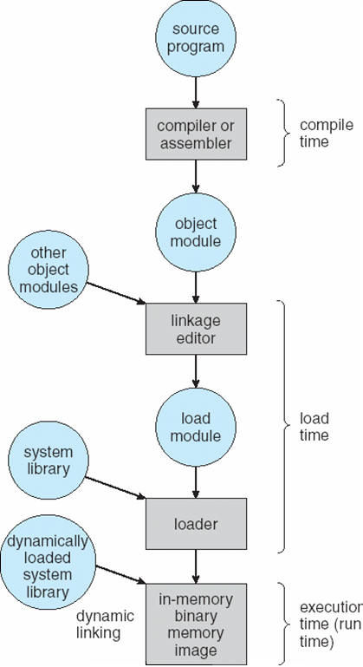
Address binding can happen at three different stages
Compile time:
Address in the source program are generally symbolic, e.g., count.
A compiler typically bind these symbolic addresses to relocatable addresses, e.g., “14B from the beginning of this module”.
Load time:
Bind the relocatable addresses to absolute address, e.g., 74014.
Execution time:
Binding delayed until run time if the process can be moved during execution from one memory segment to another.

Slide 22

Base and Limit Registers
Two special registers, base and limit are used to prevent user from straying outside the designated area
During context switch, OS loads new base and limit register from TCB
User is NOT allowed to change the base and limit registers (privileged instructions)

Slide 23
Contiguous memory allocation
Each process is contained in a single contiguous section of memory
  Hole: block of available memory
    holes of various size are scattered throughout memory
  Operating system maintains information about
    a) allocated partitions
    b) free partitions (hole)

Slide 24
Contiguous memory allocation
When a process arrives, it is allocated memory from a hole large enough to accommodate it
OS
OS
OS
OS
process 5
process 5
process 5
process 5
process 9
process 9
process 8
process 10
process 2
process 2
process 2
process 2

Slide 25
An example of First-fit, Best-fit, and Worst-fit
First-fit
  Allocate the first hole that is big enough
Best-fit
  allocate the smallest hole that is big enough
  must search entire list, unless ordered by size
  produces the smallest leftover hole
Worst-fit
  allocate the largest hole; must also search entire list
  produces the largest leftover hole

Slide 26
An example of First-fit, Best-fit, and Worst-fit
Given five memory partitions of 100 KB, 500 KB, 200 KB, 300 KB, and 600 KB (in order)
How would each of the first-fit, best-fit, and worst-fit algorithms place processes of 212 KB, 417 KB, 112 KB, and 426 KB (in order)?
Which algorithm makes the most efficient use of memory?

Slide 27
First-fit
100KB
212KB
500KB
new partition
288K =
500K-212K
417KB
200KB
300KB
112KB
426KB
600KB
Must wait

Slide 28
Best-fit
100KB
212KB
500KB
417KB
200KB
300KB
112KB
426KB
600KB

Slide 29
Worst-fit
100KB
212KB
500KB
417KB
200KB
300KB
112KB
426KB
600KB
Must wait

Slide 30
Outline
Deadlocks
Resource-Allocation Graph
Banker’s Algorithm
Logical vs. Physical Address Space
Segmentation
Paging

Slide 31

Segmentation
Memory-management scheme that supports user view of memory
A program is a collection of segments of different sizes
A segment is a logical unit
1
2
user space
3
4
1
4
physical memory space
2
3

Slide 32
Segmentation
Logical address consists of a two tuple:
<segment-number, offset>
Segment table: maps two-dimensional physical addresses
  base – contains the starting physical address
  limit – specifies the length of the segment
Problems with segmentation
  Must fit variable-sized segments into physical memory
  Might need to move process multiple times in order to fit everything

Slide 33
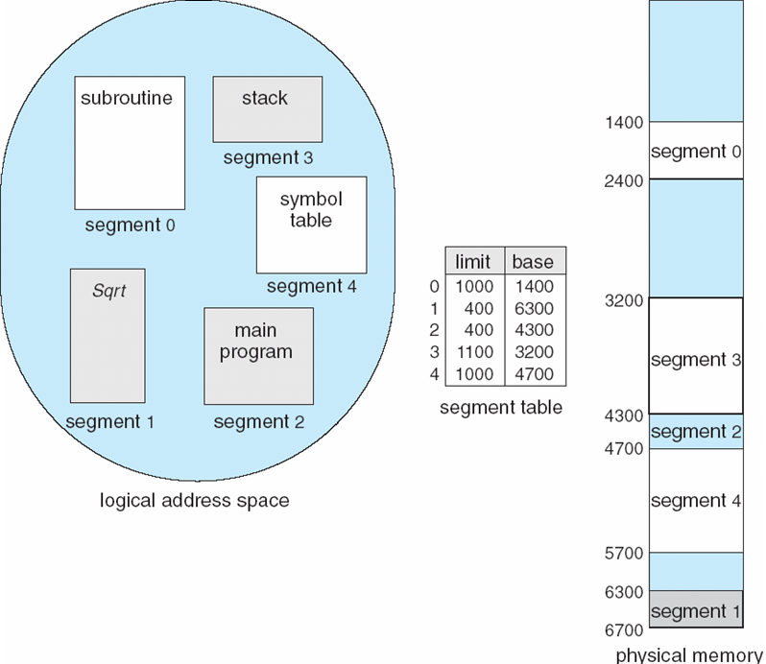
Example of Segmentation
Logical view:
multiple separate segments
Each segment is allocated with a contiguous memory
External fragmentation

Slide 34
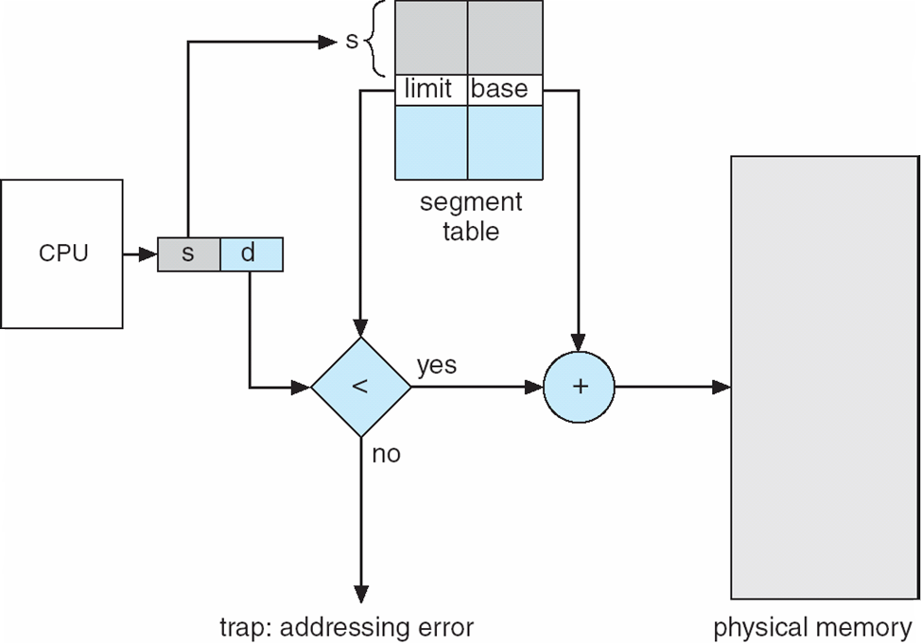
Address Translation

Slide 35
Example of Segmentation
Consider the following segment table
What are the physical addresses for the following logical addresses?
a. 0,430 b. 1,10
c. 2,500 d. 3,400 e. 4,112
Segment | Base | Length
0 | 219 | 600
1 | 2300 | 14
2 | 90 | 100
3 | 1327 | 580
4 | 1952 | 96

Slide 36
Example of Segmentation
Answer
a. 219 + 430 = 649
b. 2300 + 10 = 2310
c. Illegal reference, trap to operating system
d. 1327 + 400 = 1727
e. Illegal reference, trap to operating system

Slide 37
Outline
Deadlocks
Resource-Allocation Graph
Banker’s Algorithm
Logical vs. Physical Address Space
Segmentation
Paging

Slide 38
Paging
Physical address space of a process can be noncontiguous; process is allocated physical memory whenever the latter is available
  Avoids external fragmentation
  Avoids problem of varying sized memory chunks
Divide physical memory into fixed-sized blocks called frames
  Size is power of 2, between 512 bytes and 16 Mbytes
Divide logical memory into blocks of same size called pages
Keep track of all free frames
To run a program of size N pages, need to find N free frames and load program
Set up a page table to translate logical to physical addresses
Still have Internal fragmentation

Slide 39
Address Translation Scheme
Address generated by CPU is divided into:
  Page number (p) – used as an index into a page table which contains base address of each page in physical memory
  Page offset (d) – combined with base address to define the physical memory address that is sent to the memory unit
  For given logical address space 2^{m} and page size 2^{n}
page number
page offset
p
d
m - n
n

Slide 40

Paging Hardware

Slide 41

Paging Model of Logical and Physical Memory

Slide 42

Paging Example

Slide 43
Paging (Cont.)
Calculating internal fragmentation
  Page size = 2,048 bytes
  Process size = 72,766 bytes
  35 pages + 1,086 bytes
  Internal fragmentation of 2,048 - 1,086 = 962 bytes
  Worst case fragmentation = 1 frame – 1 byte
  On average fragmentation = 1 / 2 frame size
  So small frame sizes desirable?
  But each page table entry takes memory to track
  Page sizes growing over time
    Solaris supports two page sizes – 8 KB and 4 MB

Slide 44
COMP 3511
Operating Systems
Project #2

Slide 45
Objectives and Tasks
Run Nachos with Pre-implemented Scheduling System Skeleton
Implement SJF and Non-preemptive Priority Scheduling Algorithms
Explain the Results
You are strongly recommended to use the servers in this lab for this project.
ssh `username`@csl2wk01(~csl2wk40).cse.ust.hk

Slide 46
Task 1
Task 1: Run Nachos with Pre-implemented Scheduling System Skeleton
  Step 1: Download Nachos source code of this project
  Step 2: Extract the source code
  Step 3: Compile the code
  Step 4: Run nachos
  Step 5: Read the code

Slide 47
Task 1
Three scheduling algorithms
  First Come First Serve (FCFS)
  Shortest Job First (SJF)
  Non-Preemptive Priority (NP_Priority)

Slide 48
Task 1
Executable File | Source File | Corresponding Algorithm | Already Implemented?
test0 | test.0.cc | FCFS | Yes
test1 | test.1.cc | SJF | No
test2 | test.2.cc | NP_Priority | No

Slide 49
Task 1
Read the codes
ReadyToRun()
  decides the policy of placing a thread into ready queue (or multilevel queues) when the thread gets ready
FindNextToRun()
  decides the policy of picking one thread to run from the ready queue
ShouldISwitch()
  decides whether the running thread should preemptively give up to a newly forked thread

Slide 50
Task 2
Implement SJF and NP_Priority
Only modify scheduler.cc
  Scheduler::ReadyToRun
  Scheduler::FindNextToRun
  Scheduler::ShouldISwitch

Slide 51
Task 2
Shortest Job First
  the thread with the shortest burst time in the ReadyList should be scheduled for running after the current thread is done with burst.
  Return first thread when scheduler needs to pick one thread to run
  Hint: insert the thread to ReadyList according to its burst time when a thread gets ready.
    Make use of the function SortedInsert() in List.cc
    Example:
      list->SortedInsert(thread,thread->getBurstTime());
      this line of code insert the thread into the list based on its burst time.

Slide 52
Task 2
Non-Preemptive Priority Scheduling
  the thread with the highest priority in the ReadyList should be scheduled for running after the current thread is done with burst.
  Return first thread when scheduler needs to pick one thread to run
  Hint: insert the thread to ReadyList according to its burst time when a thread gets ready.(Mind the order!)
    Make use of the function SortedInsert() in List.cc
    Example:
    list->SortedInsert(thread,thread->MAX_PRIORITY- thread->getPriority());
    this line of code insert the thread into the list based on its priority.

Slide 53
Task 2
Compile and Run
Save your outputs to project2_test1.txt and project2_test2.txt, respectively,
Keep your source code scheduler.cc

Slide 54
Task 3
Explain the Results
Understand the output of test0 (FCFS scheduling) , test1 (SJF scheduling) and test2 (NP_Priority). Then calculate the following performance metrics of each scheduling algorithms:
  Average waiting time;
  Response time;
  Turn-around time.
Compare the performance among the first two scheduling algorithms (FCFS and SJF) in the aspects mentioned in question 1, then discuss the pros and cons of each scheduling algorithms. (Note: you are strongly encouraged to change the input threads in test.0.cc and test.1.cc in order to make your discussion more convincing. However, when submitting the outputs of test1, please do submit the outputs with the original input threads.)

Slide 55
Outputs
Please generate a single file using ZIP and submit it through CASS
Name of the ZIP: "proj2_********.zip" (* as student ID)
Inside the ZIP file:
File Name | Description
scheduler.cc | Source code you have accomplished by the end of Task2
project2_test1.txt | Output of test1
project2_test2.txt | Output of test2
project2_report.txt | The answer to the questions in Task 3

