Slide 1
COMP 3511
Operating Systems
Lab 07

Slide 2
Demand Paging
Bring a page into memory only when it is needed
  Less I/O needed
  Less memory needed
  Faster response
  More users
Page is needed → reference to it
  Invalid reference → abort
  Not-in-memory → bring to memory

Slide 3

Steps in Handling a Page Fault
If there is a reference to a page, first reference to that page will trap to operating system: page fault

Slide 4
An example of demand-paged memory
Assume we have a demand-paged memory
  The page table is held in registers
  It takes 8 milliseconds to serve a page fault if an empty page is available or the replaced page is not modified
  It takes 20 milliseconds if the replaced page is modified
  Memory access time is 100 nanoseconds

Slide 5
An example of demand-paged memory
Assume that the page to be replaced is modified 70 percent of the time.
What is the maximum acceptable page-fault rate for an effective access time of no more than 200 nanoseconds ?

Slide 6
An example of demand-paged memory
0.2μsec = (1 − P) × 0.1μsec + (0.3P) × 8 millisec + (0.7P) × 20 millisec
0.1 = −0.1P + 2400 P + 14000 P
0.1 ≈ 16,400 P
P ≈ 0.000006

Slide 7
Hardware support for demand paging
For every memory access operation, the page table needs to be consulted:
  check whether the corresponding page is resident or not
  check whether the program has read or write privileges for accessing the page.

Slide 8
Hardware support for demand paging
These checks would have to be performed in hardware.
For example, a TLB could serve as a cache and improve the performance of the lookup operation.

Slide 9
Page Replacement
If there is no free frame
Page replacement – find some page in memory, but not really in use, swap it out
  Replacement algorithm
  Performance requirement – want an algorithm which will result in minimum number of page faults

Slide 10
Page Replacement
Find the location of the desired page on disk
Find a free frame inside the memory:
- If there is a free frame, use it
- If there is no free frame, use a page replacement algorithm to select a victim frame
Read the desired page into the (newly) free frame. Update the page and frame tables.
Restart the process

Slide 11
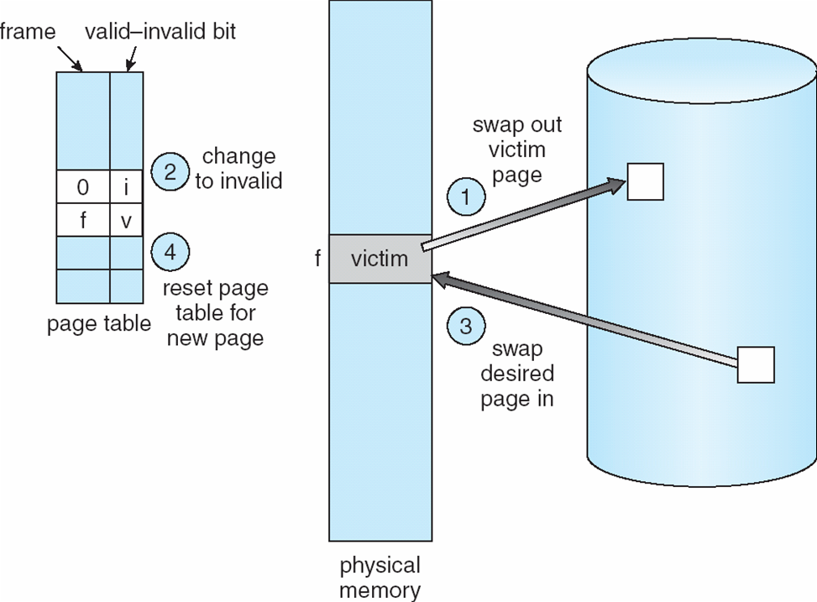
Page Replacement

Slide 12
First-In-First-Out (FIFO) Algorithm
Reference string: 1, 2, 3, 4, 1, 2, 5, 1, 2, 3, 4, 5
3 frames (3 pages can be in memory at a time per process)
4 frames
1
1
4
5
2
2
1
3
9 page faults
3
3
2
4
Belady’s Anomaly:
more frames → more page faults
1
1
5
4
2
2
1
5
10 page faults
3
3
2
4
4
3

Slide 13
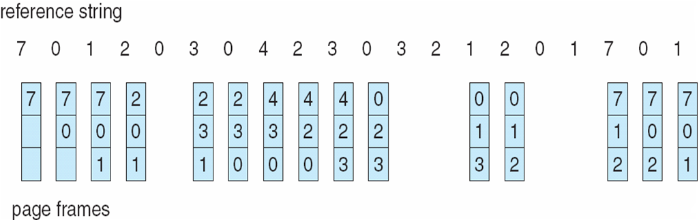
FIFO Page Replacement

Slide 14
Optimal page replacement algorithm
Replace page that will not be used for longest period of time
Problem
  Can’t read the future
Used for measuring how well your algorithm performs

Slide 15
Algorithms for approximating optimal page replacement
LRU (Least Recently Used) algorithm
  Use the recent past as an approximation of the near future
    Replace the page that has not been used for the longest period of time
  Considered to be good, but hard to implement
    Few computer systems provide sufficient hardware support for true LRU
    LRU-approximation: Reference bits, Second chance

Slide 16
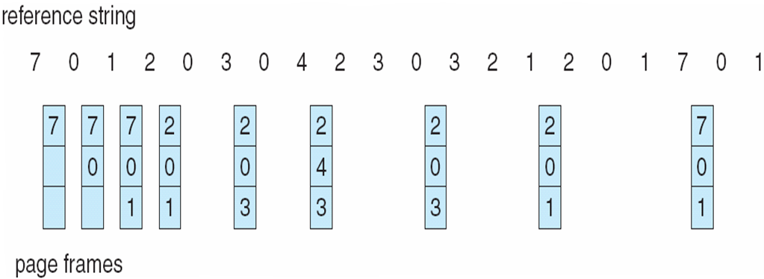

Optimal page replacement (9 page faults)
LRU page replacement (12 page faults)

Slide 17
LRU Approximation Algorithms
Reference bit
  Each page is associate a reference bit, initially = 0.
  When page is referenced, the reference bit set to 1.
  We can determine which pages have been used or not used by examining the reference bits and replace the page whose reference bit is 0 (if one exists).
  However, we do not know the order of use.
Second chance
  When a page is selected, check the reference bit.
  If the value is 0, this page is replaced.
  If the value is 1, set the bit to 0, then move on to select another page (FIFO). This page gets a second chance.

Slide 18
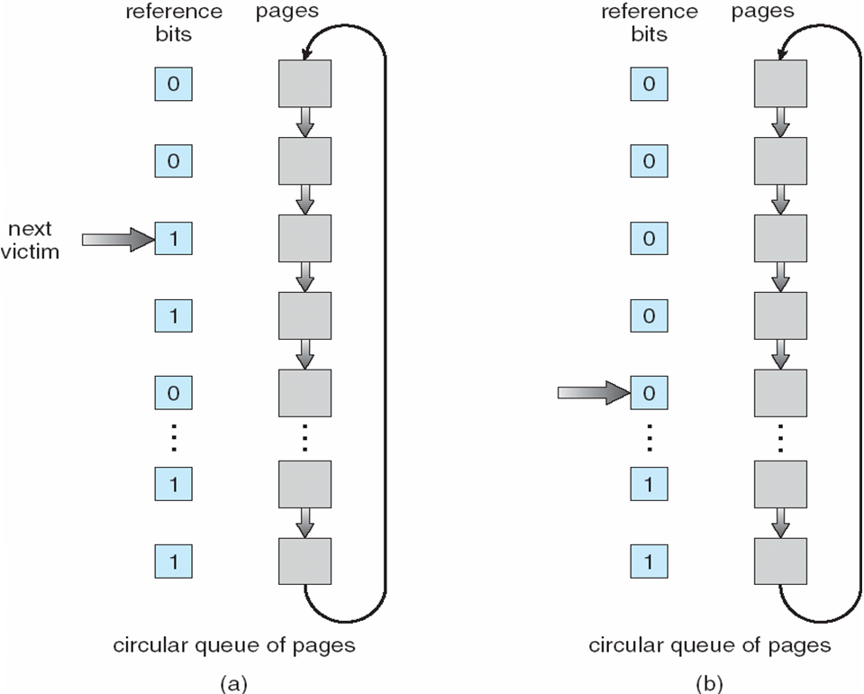
Second chance algorithm

Slide 19
Algorithms for approximating optimal page replacement
Keep a counter of the number of references that have been made to each page
  LFU (Least Frequently Used) algorithm
    an actively used page should have a large reference count
    replaces page with smallest count
  MFU (Most Frequently Used) algorithm
    the page with the smallest count was probably just brought in and has yet to be used
  The implementation of these algorithms is expensive, and they do not approximate OPT replacement well

Slide 20
An example of page-replacement algorithm
(a) Under which situations, the MFU generates fewer page faults than the LRU ? Please give an example.
(b) Under what circumstance does the opposite holds ?
MFU: most frequently used page-replacement algorithm
VS.
LRU: least recently used page replacement algorithm

Slide 21
Example 1: MFU & LRU
(a) Consider the sequence in a system that holds four pages in memory: 1 2 3 4 4 4 5 1
  the MFU evicts page 4 while fetching page 5
  the LRU evicts page 1 while fetching page 5, then another page fault for fetching page 1 again
(b) For the sequence “1 2 3 4 4 4 5 4,” the LRU algorithm makes the right decision

Slide 22
Example 2: LFU & LRU
Consider the following sequence of memory accesses in a system that can hold four pages in memory: 1 1 2 3 4 5 1
Which of the following page replacement algorithms generates fewer page faults?
  a) LRU: least recently used page replacement
  b) LFU: least frequently used page replacement

Slide 23
Example 2: LFU & LRU
memory accesses: 1 1 2 3 4 5 1
four pages in memory
The LRU evicts page 1 while fetching page 5
The LFU evicts a page other than 1 while fetching page 5
  No page fault when page 1 is accessed again
  fewer page faults

