Slide 1
Spring 2015 - COMP3511
Final Exam Review

Slide 2
Outline
Deadlock and Banker Algorithm
Paging and Segmentation
Page Replacement Algorithms and Working-set Model
File Allocation
Disk Scheduling

Slide 3
Deadlock Characterization
Deadlock can arise if four conditions hold simultaneously
Mutual exclusion
  only one process at a time can use a resource.
Hold and wait
  a process holding at least one resource is waiting to acquire additional resources held by other processes.
No preemption
  a resource can be released only voluntarily by the process holding it, after that process has completed its task.
Circular wait
  there exists a set {P₀, P₁, …, P_{n}} of waiting processes such that P₀ is waiting for a resource that is held by P₁, P₁ is waiting for a resource that is held by P₂, …, P_{n–1} is waiting for a resource that is held by P_{n}, and P_{n} is waiting for a resource that is held by P₀.

Slide 4
Resource-Allocation Graph
A set of vertices V and a set of edges E.
V is partitioned into two types:
  P = {P₁, P₂, …, P_{n}}, the set consisting of all the processes in the system.
  R = {R₁, R₂, …, R_{m}}, the set consisting of all resource types in the system
Each resource type R_{i} has W_{i} instances.
Each process utilizes a resource as follows: request, use, release
Request edge – directed edge P_{i} → R_{j}
Assignment edge – directed edge R_{j} → P_{i}

Slide 5
Safe State
When a process requests an available resource, system must decide if immediate allocation leaves the system in a safe state
System is in safe state if there exists a safe sequence of all processes:
  Sequence <P₁, P₂, …, P_{n}> is safe if for each P_{i}, the resources that P_{i} can still request can be satisfied by currently available resources + resources held by all the P_{j}, with j<i
    If P_{i} resource needs are not immediately available, then P_{i} can wait until all P_{j} have finished
    When P_{j} is finished, P_{i} can obtain needed resources, execute, return allocated resources, and terminate
    When P_{i} terminates, P_{i+1} can obtain its needed resources, and so on

Slide 6
Banker’s Algorithm
Each resource can have multiple instances.
Each process must a priori claim maximum use.
When a process requests a resource it may have to wait.
When a process gets all its resources it must return them in a finite amount of time.
Let n = number of processes, and m = number of resources types.
Available: Vector of length m. If available [j] = k, there are k instances of resource type R_{j} available.
Max: n x m matrix. If Max [i,j] = k, then process P_{i} may request at most k instances of resource type R_{j}.
Allocation: n x m matrix. If Allocation[i,j] = k then P_{i} is currently allocated k instances of R_{j.}
Need: n x m matrix. If Need[i,j] = k, then P_{i} may need k more instances of R_{j} to complete its task
Need [i,j] = Max[i,j] – Allocation [i,j].

Slide 7
Safety Algorithm
1. Let Work and Finish be vectors of length m and n, respectively. Initialize:
      Work = Available
      Finish [i] = false for i - 1,3, …, n.
2. Find and i such that both:
  (a) Finish [i] = false
  (b) Need_{i} ≤ Work
  If no such i exists, go to step 4
3. Work = Work + Allocation_{i}
Finish[i] = true
go to step 2
4. If Finish [i] == true for all i, then the system is in a safe state

Slide 8

Base and Limit Registers
Two special registers, base and limit are used to prevent user from straying outside the designated area
During context switch, OS loads new base and limit register from TCB
User is NOT allowed to change the base and limit registers (privileged instructions)

Slide 9
Contiguous memory allocation
Each process is contained in a single contiguous section of memory
  Hole: block of available memory
    holes of various size are scattered throughout memory
  Operating system maintains information about
    a) allocated partitions
    b) free partitions (hole)

Slide 10
Contiguous Memory Allocation
Each process is contained in a single contiguous section of memory
  Degree of multiprogramming limited by number of partitions
  Variable-partition sizes for efficiency (sized to a given process’ needs)
  Hole – block of available memory; holes of various size are scattered throughout memory
  Operating system maintains information about:
  a) allocated partitions b) free partitions (hole)
OS
OS
OS
OS
process 5
process 5
process 5
process 5
process 9
process 9
process 8
process 10
process 2
process 2
process 2
process 2

Slide 11
Paging
Physical address space of a process can be noncontiguous
  Divide physical memory into fixed-sized blocks called frames,
  Divide logical memory into blocks of same size called pages.
  Keep track of all free frames
Set up a page table to translate logical to physical addresses

Slide 12
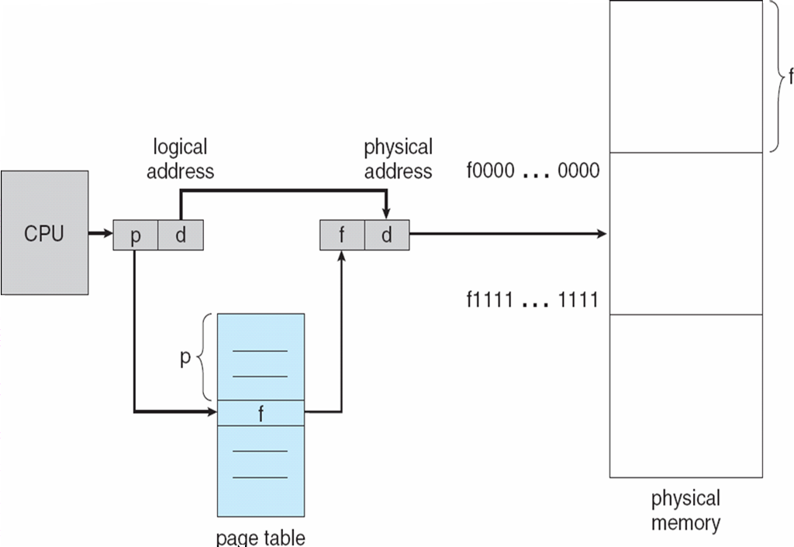
Address Translation
Address generated by CPU is divided into:
  Page number (p) – used as an index into a page table which contains base address of each page in physical memory
  Page offset (d) – combined with base address to define the physical memory address that is sent to the memory unit

Slide 13
Page Table Implementation
Implementation of Page Table
  Page table is kept in main memory
  Page-table base register (PTBR) points to the page table
  Page-table length register (PRLR) indicates size of the page table
  In this scheme every data/instruction access requires two memory accesses.
    One for the page table and one for the data/instruction

Slide 14
TLB
The two memory access problem can be solved by using TLB (translation look-aside buffer)
  a special, small, fast-lookup hardware cache
  each entry in the TLB consists of a key (or tag) and a value
  page number is presented to the TLB, if found, its frame number is immediately available to access memory
  fast but expensive

Slide 15

Paging Hardware With TLB
Can be very large,
e.g. 1M entries

Slide 16
TLB miss and Hit ratio
TLB miss:
  If the page number is not in the TLB, a memory reference to the page table must be made
Hit ratio:
  percentage of times that a page number is found in the TLB.
For example:
  Assume TLB search takes 20ns; memory access takes 100ns
  TLB hit → 1 memory access; TLB miss → 2 memory accesses

Slide 17
Effective Access Time (EAT)
If Hit ratio = 80%
  EAT = (20 + 100) * 0.8 + (20 + 200) * 0.2 = 140ns
If Hit ratio = 98%
  EAT = (20 + 100) * 0.98 + (20 + 200) * 0.02 = 122ns

Slide 18

Segmentation
Memory-management scheme that supports user view of memory
A program is a collection of segments of different sizes
A segment is a logical unit
1
2
user space
3
4
1
4
physical memory space
2
3

Slide 19
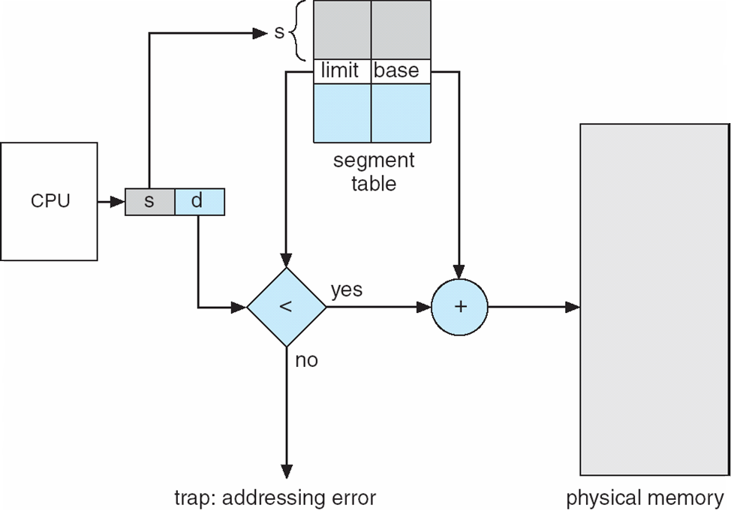
Address Translation

Slide 20
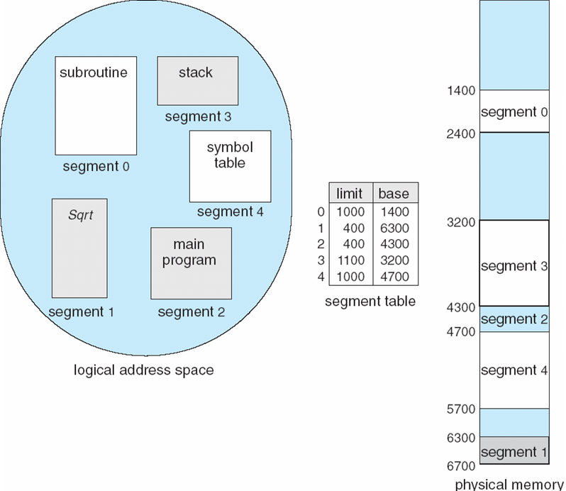
Example of Segmentation
Logical view:
multiple separate segments
Each segment is allocated with a contiguous memory
External fragmentation

Slide 21
Paging-Segmentation Combination
Segmentation and Paging are often combined in order to improve upon each other
Segmented paging is helpful when the page table becomes very large
  e.g., a large contiguous section of the page table that is unused can be collapsed into a single segment table entry with a page table address of zero

Slide 22
Motivation of virtual memory
Should an entire process be in memory before it can execute?
  In fact, real programs show us that, in many cases, the entire program is not needed
  Even in those cases where the entire program is needed, it may not all be needed at the same time
  More programs could run concurrently, increasing CPU utilization and throughput
  Less I/O would be needed to load or swap each user program into memory, so each user program would run faster
  Allow processes to share files easily and to implement shared memory

Slide 23
Page Replacement
If there is no free frame
Page replacement – find some page in memory, but not really in use, swap it out
  Replacement algorithm – local replacement
  performance – want an algorithm which will result in minimum number of page faults
  Same page may be brought into and out of memory several times

Slide 24
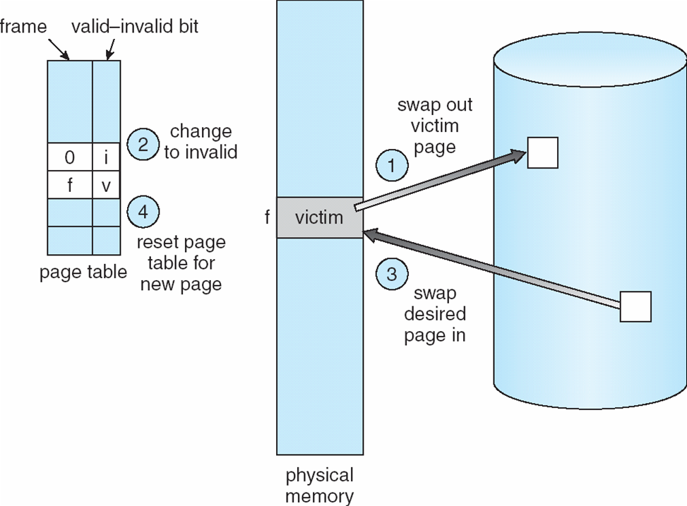
Page Replacement

Slide 25
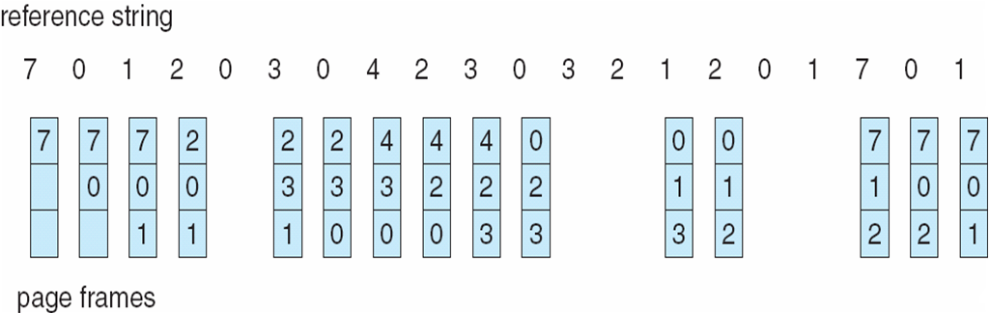
FIFO Page Replacement

Slide 26
Algorithms for approximating optimal page replacement
LRU (Least Recently Used) algorithm
  Use the recent past as an approximation of the near future
    Replace the page that has not been used for the longest period of time, to approximate optimal replacement or OPT algorithm, which selects a page that will not be used in the longest amount of time in the future.
  Considered to be good, but how to implement
    Few computer systems provide sufficient hardware support for true LRU
    LRU-approximation: Reference bits, Second chance

Slide 27
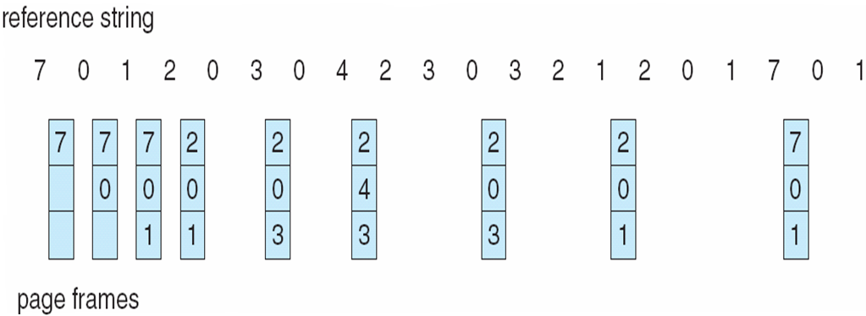

Optimal page replacement (9 page faults)
LRU page replacement (12 page faults)

Slide 28
Working-Set Model
Working-Set model is based on the locality of memory access
Δ ≡ working-set window ≡ a fixed number of page references
Example: 10,000 instructions
WSS_{i} (working set of Process P_{i}) = total number of pages referenced in the most recent Δ (varies in time)
  if Δ too small will not encompass entire locality
  if Δ too large will encompass several localities
  if Δ = ∞ ⇒ will encompass entire program
D = Σ WSS_{i} ≡ total demand for frames (by all processes)
  if D > m ⇒ Thrashing (m is the available frames)
  Policy if D > m, then suspend one of the processes; the process pages are swapped out, and its frames are re-allocated to other processes. The suspended process can be re-started later

Slide 29
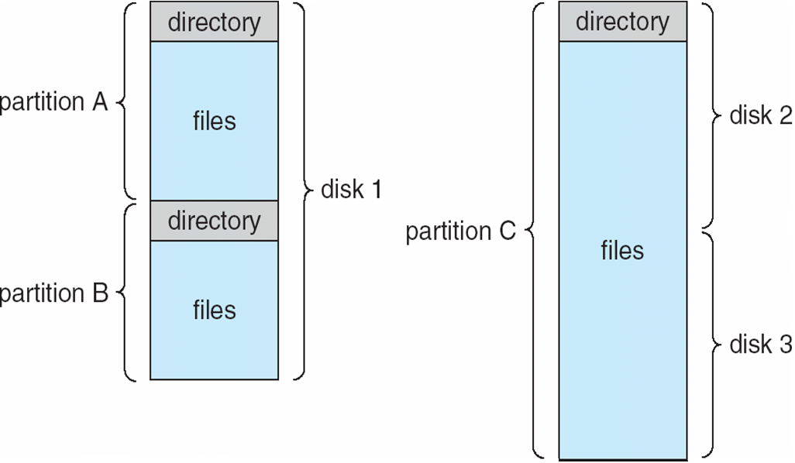
A Typical File-system Organization

Slide 30
Allocation Methods
An allocation method refers to how disk blocks are allocated for files – Objectives:
  Maximize sequential performance
  Easy random access to file
  Easy management of file (growth, truncation, and etc)
Contiguous allocation
Linked allocation
Indexed allocation

Slide 31

Combined Scheme: UNIX (4K bytes per block)
Multi-level index file, key idea:
  Efficient for small files, still allow large files
File header format are:
  First 10 pointers are to data blocks
  Pointer 11 points to “indirect block” containing 256 block ptrs
  Pointer 12 points to “doubly indirect block” containing 256 indirect block pointers for total of 64K blocks
  Pointer 13 points to a triply indirect block (16M blocks)
Pointers get filled in dynamically

Slide 32
Free-Space Management
0
1
2
n-1
Bit vector (n blocks)
…
1 ⇒ block[i] free
0 ⇒ block[i] occupied
bit[i] =

Linked list (free list) (previous block contains a pointer to the next free block)
  Cannot get contiguous space easily
  No waste of space
Grouping (stores the addresses of n free blocks in the first free block)
Counting
  Several contiguous blocks may be allocated and freed simultaneously <first free block, number of free contiguous blocks>

Slide 33
Disk Scheduling
The operating system is responsible for using hardware efficiently — for the magnetic disk drives, this means having a fast access time and disk bandwidth.
Access time has two major components
  Seek time is the time for the disk are to move the heads to the cylinder (tracks) containing the desired sector.
  Rotational latency is the additional time waiting for the disk to rotate the desired sector to the disk head.
Minimize seek time
Seek time ≈ seek distance
The disk bandwidth is the total number of bytes transferred, divided by the total time between the first request for service and the completion of the last transfer.

Slide 34
Disk Scheduling
When a process needs I/O to or from a disk, it issues a system call to the OS containing the following pieces of information
  Whether the operation is input or output
  What the disk address for the transfer is
  What memory address for the transfer is
  What the number of sectors to be transferred is
The question is, when one request is completed, the OS needs to choose which pending requests to service next? How does the OS make this choice?
  We need disk scheduling algorithms
  FCFS, SSTF, SCAN and LOOK, C-SCAN and C-LOOK

