Slide 1
COMP 3511 Operating System

Slide 2
Lectures and Tutorials
L-1
  Instructor: Bo Li
  Lectures: Tuesday and Thursday 10:30 am – 11:50 am
  Venue: Room 2502
Lab sessions:
  Lab 1A Monday 3:00 pm - 4:50 pm Room 4214
  Lab 1B Wednesday 10:30 am - 12:20 pm Room 4214
Web site: http://course.cs.ust.hk/comp3511/

Slide 3
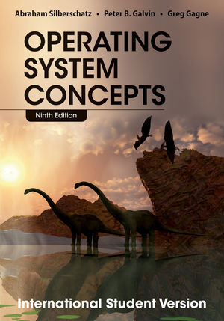
Textbook
Operating System Concepts, A. Silberschatz, P. B. Galvin and G. Gagne, 9th Edition

Slide 4
Lecture, Tutorials and Grading Scheme
Lecture notes and tutorial materials
  Download course materials before class
  Homework and programming assignments will be put online
Grading is based on
  Four Written Assignments – 20% (5% each)
  Two Programming Assignments – 25% (10% and 15%)
  Midterm Exam - 20%
  Final Exam - 35%

Slide 5
Plagiarism Policy
There are differences between collaborations, discussions and copy!
1st time: all involved get ZERO marks, and will be reported to ARR
2nd time: need to terminate (Fail grade)
Cheating in Midterm or Final exam results in automatic Fail grade

Slide 6
Course Prerequisite
COMP 2611 or equivalent
  Basic computer organization knowledge, computer system, CPU, memory hierarchy, interrupt, DMA, storage, I/O devices
Programming
  UNIX environment
  C/C++ programming

Slide 7
Lecture Format
Lectures:
  Slides are available before class
  It is important to attend the lectures (not all materials and concepts can be covered in slides)
  If you miss any lectures, learn from the lecture notes and textbook
Tutorials
  Supplement the lectures with more examples
  Some exercises
  Unix environment, editor, how to compile and run programs, Makefile
  Nachos
Reading the corresponding materials in the textbook
  Slides do not cover everything
Chapter summary
  Comprehensive summary at the end of each chapter

Slide 8
Assignments
Written assignments
  Due by time specified
  Contact TAs directly for any disputes on the grading
  Re-grading requests will only be granted within one week after the homework grades are released
  Late policy: 15% reduction, only one day delay is allowed.
Programming assignments
  Individual projects
  Due by time specified
  Run on Unix
  Submit it using CASS – You need to register for an account
  Re-grade policy will be announced
  Late policy : 15% reduction, only one day delay is allowed.

Slide 9
Midterm and Final Examinations
Midterm Exam
  March 31, 2015 (Week #9, Tuesday) 7:00 pm - 8:30 pm
  Venues: 3006 and 3007
Final Exam
  TBD
All exams are closed-book, closed-notes
No make-up exams will be given unless
  under very unusual circumstances, e.g., sickness, with letters of proof
  Instructor must informed beforehand

Slide 10
Tips for Learning
Attend lectures
  Download lecture notes prior to lectures
  Important concepts are explained
Complete homework alone
  This is an exercise to test your knowledge
Spend 30 minutes each week to review the content
  Weekly summary can help
  This will save you lots of time later when you prepare for exams
  You can not expect to learn everything two days before exams no matter how smart you are
  Knowledge is accumulated incrementally
Start your project earlier
  Have a plan for the project
Raise questions!
  Do not delay your questions until exams

Slide 11
What you are suppose to learn
Define the fundamental principles, strategies and algorithms used in the design and implementation of operating systems
Analyze and evaluate operating system functions
Analyze the structure of an operating system kernel, and identify the relationship between the various subsystems
Identify the typical events, alerts, and symptoms indicating potential operating system problems
Recognize and evaluate the source code of the NACHOS operating system
Design and implement programs for basic operating system functions and algorithms

Slide 12
Course Outline
Overview (1.5 week)
  Basic OS concept
  System architecture
Process and Thread (6 weeks)
  Process and thread (2 weeks)
  CPU scheduling (1 week)
  Synchronization (2 weeks)
  Deadlock (1 week)
Memory and storage (5 weeks)
  Memory management (1.5 weeks)
  Virtual memory (1.5 weeks)
  File system (1 week)
  Secondary storage and I/O (1 weeks)

Slide 13
Chapter 1: Introduction

Slide 14
Chapter 1: Introduction
Computer-System Architecture
What Operating Systems Do
Operating-System Structure
Operating-System Operations
Computing Environment

Slide 15
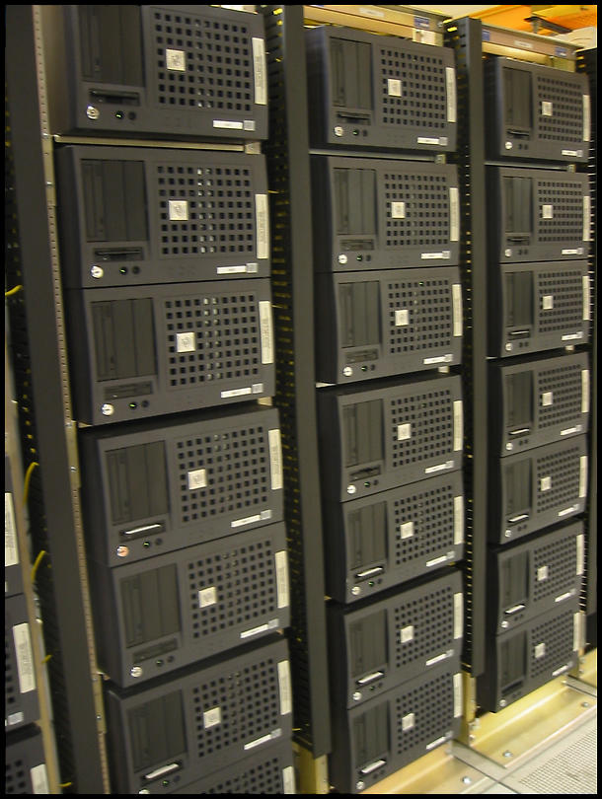
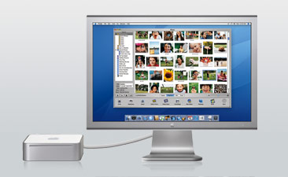
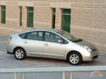
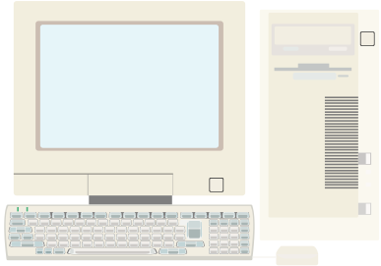
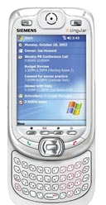

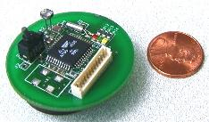
Computing Devices Everywhere

Slide 16
Computer System Structure
Computer system can be divided into four components
  Hardware – provides basic computing resources
    CPU, memory, I/O devices
  Operating system
    Controls and coordinates use of hardware among various applications and users
  System and application programs – define the ways in which the system resources are used to solve the computing problems of the users
    Word processors, compilers, web browsers, database systems, video games
  Users
    People, machines, other computers

Slide 17

Four Components of a Computer System

Slide 18
Computer Startup
Bootstrap program is loaded at power-up or reboot time
  Typically stored in ROM or EPROM, generally known as firmware
  Initializes all aspects of the system
  Loads operating system kernel and starts execution

Slide 19

Computer System Organization
Computer-system operation
  One or more CPUs, device controllers connect through common bus providing access to shared memory
  Concurrent execution of CPUs and devices competing for memory cycles

Slide 20
Computer-System Operation
I/O devices and the CPU can execute concurrently
Each device controller is in charge of a particular device
Each device controller has a local buffer
CPU moves data from/to main memory to/from local buffers
I/O is from the device to local buffer of controller
Device controller informs CPU that it has finished its operation by causing an interrupt

Slide 21
Interrupts
Interrupt transfers control to the interrupt service routine generally, through the interrupt vector, which contains the addresses of all the service routines or called interrupt handlers
Interrupt architecture must save the address of the interrupted instruction
Determines which type of interrupt has occurred:
  polling
  vectored interrupt system
Incoming interrupts are disabled while another interrupt is being processed to prevent a lost interrupt
A trap or an exception is a software-generated interrupt caused either by an error (e.g., division by zero) or a user request for operation system service
Operating systems are interrupt driven

Slide 22

Interrupt Timeline
When the CPU is interrupted, it stops what it is
doing and immediately transfer execution to a
fixed location
The fixed location usually contains the starting
address where the service routine for the
interrupt is located

Slide 23
Storage Definitions and Notation Review
The basic unit of computer storage is the bit. A bit can contain one of two values, 0 and 1. All other storage in a computer is based on collections of bits. Given enough bits, it is amazing how many things a computer can represent: numbers, letters, images, movies, sounds, documents, and programs, to name a few. A byte is 8 bits, and on most computers it is the smallest convenient chunk of storage. For example, most computers don’t have an instruction to move a bit but do have one to move a byte. A less common term is word, which is a given computer architecture’s native unit of data. A word is made up of one or more bytes. For example, a computer that has 64-bit registers and 64-bit memory addressing typically has 64-bit (8-byte) words. A computer executes many operations in its native word size rather than a byte at a time.
Computer storage, along with most computer throughput, is generally measured and manipulated in bytes and collections of bytes. A kilobyte, or KB, is 1,024 bytes; a megabyte, or MB, is 1,024 KB; a gigabyte, or GB, is 1,024 MB; a terabyte, or TB, is 1,024GB; and a petabyte, or PB, is 1,024 TB. Computer manufacturers often round off these numbers and say that a megabyte is 1 million bytes and a gigabyte is 1 billion bytes. Networking measurements are an exception to this general rule; they are given in bits (because networks move data a bit at a time).

Slide 24
Direct Memory Access
The problem with interrupt-based I/O operations
  The speed mismatch between CPU, memory and I/O device
Used for high-speed I/O devices able to transmit information at close to memory speeds
Device controller transfers blocks of data from buffer storage directly to main memory without CPU intervention
Only one interrupt is generated per block, rather than the one interrupt per byte, so CPU can be released to execute instructions for other process or program

Slide 25
Storage Hierarchy Structure
Storage systems organized in hierarchy
  Speed
  Cost
  Volatility
Cache – fast memory close to CPU
Main memory – only large storage media that the CPU can access directly
Secondary storage – extension of main memory that provides large nonvolatile storage capacity
Magnetic disks – rigid metal or glass platters covered with magnetic recording material
Main memory is a volatile storage device that
loses its contents when power is turned off

Slide 26

Storage-Device Hierarchy

Slide 27
Caching
Important principle, performed at many levels in a computer (in hardware, operating system, software)
Information in use copied from slower to faster storage temporarily
Faster storage (cache) first checks to determine if information is there
  If it is, information used directly from the cache (fast)
  If not, data copied from slower storage to cache and used there
Cache smaller than storage being cached
  Cache management important design problem
  Cache size and replacement policy

Slide 28

Performance of Various Levels of Storage
The performance data is updated constantly

Slide 29
How do We Tame Complexity?
Every piece of computer hardware is different
  Different CPU
    Pentium, PowerPC, ColdFire, ARM, MIPS
  Different amounts of memory, disk, …
  Different types of devices
    Mice, Keyboards, Sensors, Cameras, Fingerprint readers
  Different networking environment
    Cable, DSL, Wireless, Firewalls,…
Questions:
  Does every program have to be altered for every piece of hardware?
  Does a faulty program crash everything?
  Does every program have access to all hardware?
  ……

Slide 30
What is an Operating System?
A program that acts as an intermediary between a user of a computer and computer hardware
Operating system goals:
  Control and coordinate the use of system resources (hardware and software)
  Make the computer system convenient to use for users
  Use the computer hardware in an efficient and protected manner

Slide 31
What does Operating System Do?
OS is a resource allocator
  Manages all resources
  Decides between conflicting requests for efficient and fair resource use
  Prevent errors and improper use of the computer
OS is a facilitator
  Provides facilities that everyone needs
  Standard Libraries, Windowing systems
  Make application programming easier, faster, less error-prone

Slide 32
Operating System Definition
No universally accepted definition
“Everything a vendor ships when you order an operating system” is good approximation
  But varies wildly
“The one program running at all times on the computer” is the kernel
  Everything else is either a system program (ships with the operating system) or an application program

Slide 33
Operating System Structure
Multiprogramming needed for efficiency
  Single user cannot keep CPU and I/O devices busy at all times
  Multiprogramming organizes jobs (code and data) so CPU always has one to execute
  A subset of total jobs in system is kept in memory
  One job selected and run via job scheduling
  When it has to wait (for I/O for example), OS switches to another job
Timesharing (multitasking) is logical extension in which CPU switches jobs so frequently that users can interact with each job while it is running, creating interactive computing
  Response time should be < 1 second
  Each user has at least one program executing in memory process
  If several jobs ready to run at the same time  CPU scheduling
  If processes don’t fit in memory, swapping moves them in and out to run
  Virtual memory allows execution of processes not completely in memory

Slide 34

Memory Layout for Multiprogrammed System

Slide 35
Operating-System Operations
Dual-mode operation allows OS to protect itself and other system components
  User mode and kernel mode, or supervisor mode, system model
  Mode bit provided by hardware
    Provides ability to distinguish when system is running user code or kernel code
    Some instructions designated as privileged, only executable in kernel mode
    System call changes mode to kernel, return from call resets it to user

Slide 36

Dual-mode Operation
Transitions from user mode to kernel mode:
  System Calls, Interrupts, Other exceptions
The dual mode of operation provides us with a rudimentary means for protecting the operating system from errant users and errant users from one another

Slide 37
Timer
Must ensure the OS maintains control over the CPU
Must prevent a user program from getting stuck in an infinite loop or never returning control to the OS
Timer is used to prevent infinite loop / process hogging resources
  Set interrupt after specific period
  Operating system decrements counter
  When counter zero generate an interrupt
  Set up before scheduling process to regain control or terminate program that exceeds allotted time

Slide 38
Computer-System Architecture
Most systems use a single general-purpose processor (PDAs through mainframes)
  Most systems have special-purpose processors as well
Multiprocessors systems growing in use and importance
  Also known as parallel systems, tightly-coupled systems
  Advantages include:
    Increased throughput
    Economy of scale
    Increased reliability – graceful degradation or fault tolerance
  Two types:
    Asymmetric Multiprocessing – one master CPU distributes tasks among multiple slave CPUs
    Symmetric Multiprocessing

Slide 39

Symmetric Multiprocessing Architecture

Slide 40

A Dual-Core Design
UMA and NUMA architecture variations
  Uniform Memory Access and Non Uniform Memory Access Architectures
Multi-chip and multicore

Slide 41
Clustered Systems
Like multiprocessor systems, but multiple systems working together
  Usually sharing storage via a storage-area network (SAN)
  Provides a high-availability service which survives failures
    Asymmetric clustering has one machine in hot-standby mode
    Symmetric clustering has multiple nodes running applications, monitoring each other
  Some clusters are for high-performance computing (HPC)
    Applications must be written to use parallelization
  Some have distributed lock manager (DLM) to avoid conflicting operations

Slide 42
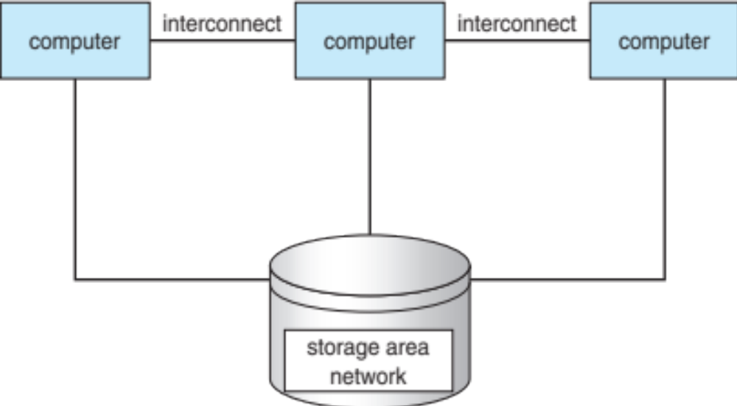
Clustered Systems

Slide 43
Computing Environments - Traditional
Stand-alone general purpose machines
But blurred as most systems interconnect with others (i.e. the Internet)
Portals provide web access to internal systems
Network computers (thin clients) are like Web terminals
Mobile computers interconnect via wireless networks
Networking becoming ubiquitous – even home systems use firewalls to protect home computers from Internet attacks

Slide 44
Computing Environments - Mobile
Handheld smartphones, tablets, etc
What is the functional difference between them and a “traditional” laptop?
Extra feature – more OS features (GPS, gyroscope)
Allows new types of apps like augmented reality
Use IEEE 802.11 wireless, or cellular data networks for connectivity
Leaders are Apple iOS and Google Android

Slide 45
Computing Environments – Distributed
Distributed
  Collection of separate, possibly heterogeneous, systems networked together
    Network is a communications path, TCP/IP most common
      Local Area Network (LAN)
      Wide Area Network (WAN)
      Metropolitan Area Network (MAN)
      Personal Area Network (PAN)
  Network Operating System provides features between systems across network
    Communication scheme allows systems to exchange messages
    Illusion of a single system

Slide 46

Computing Environments – Cloud Computing
Cloud compute environments composed of traditional OSes, VMMs (virtual machine management), plus cloud management tools
  Internet connectivity requires security like firewalls
  Load balancers spread traffic across multiple applications

Slide 47
Computing Environments – Cloud Computing
Delivers computing, storage, even apps as a service across a network
Logical extension of virtualization as based on virtualization
  Amazon EC2 has thousands of servers, millions of VMs, PBs of storage available across the Internet, pay based on usage
Many types
  Public cloud – available via Internet to anyone willing to pay
  Private cloud – run by a company for the company’s own use
  Hybrid cloud – includes both public and private cloud components
  Software as a Service (SaaS) – one or more applications available via the Internet (i.e. word processor)
  Platform as a Service (PaaS) – software stack ready for application use via the Internet (i.e a database server)
  Infrastructure as a Service (IaaS) – servers or storage available over Internet (i.e. storage available for backup use)

Slide 48
Open-Source Operating Systems
Operating systems made available in source-code format rather than just binary closed-source
Counter to the copy protection and Digital Rights Management (DRM) movement
Started by Free Software Foundation (FSF), which has “copyleft” GNU Public License (GPL)
Examples include GNU/Linux, BSD UNIX (including core of Mac OS X), and Sun Solaris

Slide 49
End of Chapter 1

