Slide 1
Chapter 4: Multithreaded Programming

Slide 2
Chapter 4: Multithreaded Programming
Overview
Multicore Programming
Multithreading Models
Threading Issues
Operating System Examples

Slide 3
Objectives
To introduce the notion of a thread—a fundamental unit of CPU utilization that forms the basis of multithreaded computer systems
To discuss the APIs for the Pthreads, Windows, and Java thread libraries
To examine issues related to multithreaded programming
To cover operating system support for threads in Windows and Linux

Slide 4
Motivation
Most modern applications are multithreaded
Threads run within application
Multiple tasks with the application can be implemented by separate threads
  Update display
  Fetch data
  Spell checking
  Answer a network request
Process creation is heavy-weight while thread creation is light-weight
Can simplify code, increase efficiency
Kernels are generally multithreaded

Slide 5
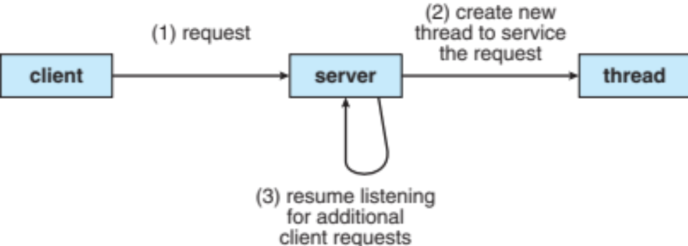
Multithreaded Server Architecture

Slide 6
Benefits
Responsiveness – may allow continued execution if part of process is blocked, especially important for user interfaces
Resource Sharing – threads with a process share resources of the process, easier than shared memory or message passing
Economy – thread creation is much cheaper than process creation, thread switching also has much lower overhead than context switching (switching to a different process)
Scalability – A process can take advantage of multiprocessor architectures by running multiple threads of the process simultaneously on different processors (CPUs).

Slide 7
Multicore Programming
Multicore or multiprocessor systems putting pressure on programmers, challenges include:
  Dividing activities
  Balance
  Data splitting
  Data dependency
  Testing and debugging
Parallelism implies a system can perform more than one task simultaneously
Concurrency supports more than one task making progress
  Single processor / core, scheduler providing concurrency
Types of parallelism
  Data parallelism – distributes subsets of the same data across multiple cores, same operation on each
  Task parallelism – distributing threads across cores, each thread performing unique operation

Slide 8
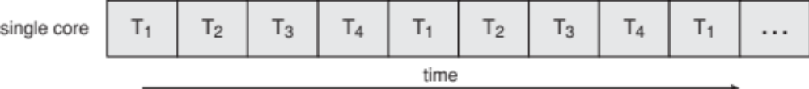

Concurrency vs. Parallelism
Concurrent execution on single-core system:
Parallelism on a multi-core system:

Slide 9

Single and Multithreaded Processes

Slide 10
Thread State
Each Thread has a Thread Control Block (TCB)
  Execution State: CPU registers, program counter, pointer to stack
  Scheduling info: State (more later), priority, CPU time
  Accounting Info
  Various Pointers (for implementing scheduling queues)
  Pointer to enclosing process? (PCB)?
In Nachos: “thread” is a class that includes the TCB
OS Keeps track of TCBs in protected memory
  Array, or Linked List, or …

Slide 11
Thread State (Cont.)
State shared by all threads in process/address space
  Contents of memory (global variables, heap)
  I/O state (file system, network connections, etc)
State “private” to each thread
  Kept in TCB ≡ Thread Control Block
  CPU registers (including, program counter)
  Execution stack – what is this?
Execution Stack
  Parameters, temporary variables
  Keep program counters while called procedures are executing

Slide 12

Lifecycle of a Thread
As a thread executes, it changes state:
  new: The thread is being created
  ready: The thread is waiting to run
  running: Instructions are being executed
  waiting: Thread waiting for some event to occur
  terminated: The thread has finished execution
“Active” threads are represented by their TCBs
  TCBs organized into queues based on their state

Slide 13


Ready Queue And Various I/O Device Queues
Thread not running ⇒ TCB is in some scheduler queue
  Separate queue for each device/signal/condition
  Each queue can have a different scheduler policy
Ready
Queue
Head
Other
State
TCB₉
Link
Other
State
TCB₆
Link
Other
State
TCB₁₆
Link
Tail
Registers
Registers
Registers
Tape
Unit 0
Head
Tail
Disk
Unit 0
Head
Other
State
TCB₂
Link
Other
State
TCB₃
Link
Tail
Registers
Registers
Disk
Unit 2
Head
Tail
Other
State
TCB₈
Ether
Netwk 0
Link
Head
Tail
Registers

Slide 14

Amdahl’s Law
Identifies performance gains from adding additional cores to an application that has both serial and parallel components
S is serial portion
N processing cores
I.e. if application is 75% parallel / 25% serial, moving from 1 to 2 cores results in speedup of 1.6 times
As N approaches infinity, speedup approaches 1 / S
Serial portion of an application has disproportionate effect on performance gained by adding additional cores

Slide 15
Examples of Multithreaded Programs
Embedded systems
  Elevators, Planes, Medical systems, Wristwatches
  Single Program, concurrent operations
Most modern OS kernels
  Internally concurrent to deal with concurrent requests by multiple users
  But no protection needed within kernel
Database Servers
  Access to shared data by many concurrent users
  Also background utility processing must be done
Network Servers
  Concurrent requests from network
  Again, single program, multiple concurrent operations
  File server, Web server, and airline reservation systems
Parallel Programming (More than one physical CPU)
  Split program into multiple threads for parallelism
  This is called Multiprocessing

Slide 16
User Threads and Kernel Threads
User threads - management done by user-level threads library
Three primary thread libraries:
  POSIX Pthreads
  Win32 threads
  Java threads
Kernel threads - Supported by the Kernel
Examples – virtually all general purpose operating systems, including:
  Windows
  Solaris
  Linux
  Tru64 UNIX
  Mac OS X

Slide 17
Multithreading Models
Many-to-One
One-to-One
Many-to-Many

Slide 18

Many-to-One
Many user-level threads mapped to single kernel thread
One thread blocking causes all to block
Multiple threads may not run in parallel on muticore system because only one may be in kernel at a time
Few systems currently use this model
Examples:
  Solaris Green Threads
  GNU Portable Threads

Slide 19
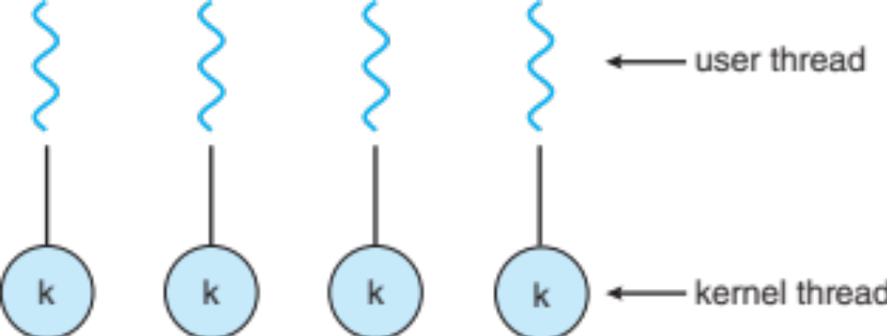
One-to-One
Each user-level thread maps to kernel thread
Creating a user-level thread creates a kernel thread
More concurrency than many-to-one
Number of threads per process sometimes restricted due to overhead
Examples
  Windows NT/XP/2000
  Linux
  Solaris 9 and later

Slide 20
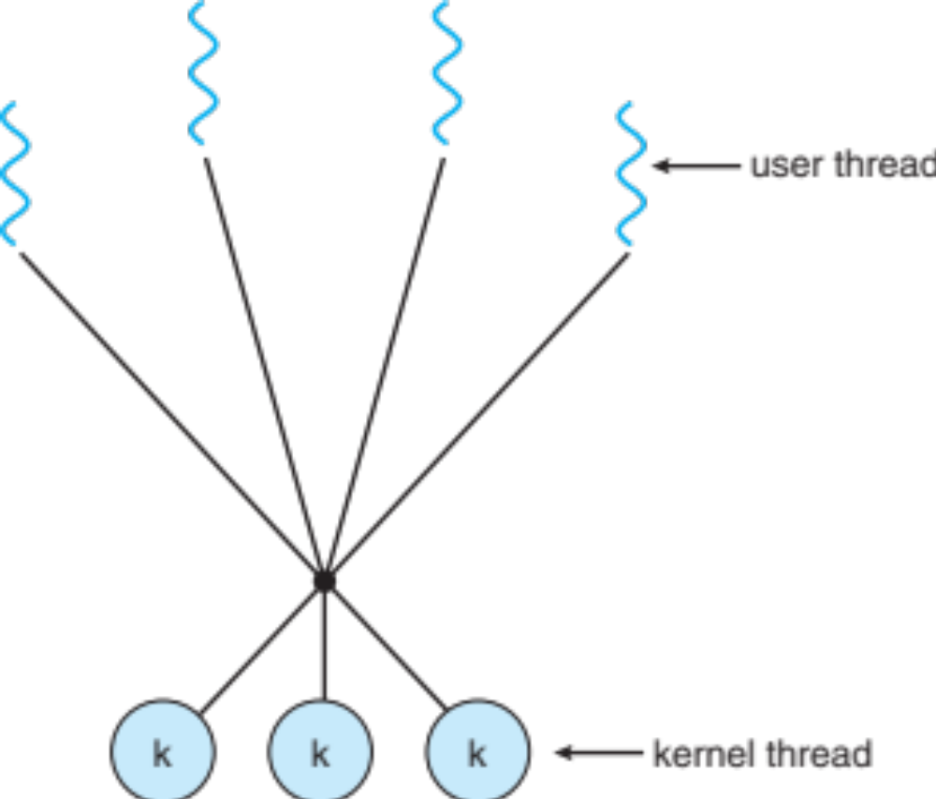
Many-to-Many Model
Allows many user level threads to be mapped to many kernel threads
Allows the operating system to create a sufficient number of kernel threads
Solaris prior to version 9
Windows NT/2000 with the ThreadFiber package

Slide 21

Two-level Model
Similar to M:M, except that it allows a user thread to be bound to kernel thread
Examples
  IRIX
  HP-UX
  Tru64 UNIX
  Solaris 8 and earlier

Slide 22
Threading Issues
Semantics of fork() and exec() system calls
Signal handling
  Synchronous and asynchronous
Thread cancellation of target thread
  Asynchronous or deferred
Thread-local storage

Slide 23
Semantics of fork() and exec()
Does fork()duplicate only the calling thread or all threads?
  Some UNIXes have two versions of fork
Exec() usually works as normal – replace the running process including all threads

Slide 24
Signal Handling
Signals are used in UNIX systems to notify a process that a particular event has occurred.
A signal handler is used to process signals
  Signal is generated by particular event
  Signal is delivered to a process
  Signal is handled by one of two signal handlers:
    default
    user-defined
Every signal has default handler that kernel runs when handling signal
  User-defined signal handler can override default
  For single-threaded, signal delivered to process
Where should a signal be delivered for multi-threaded?
  Deliver the signal to the thread to which the signal applies
  Deliver the signal to every thread in the process
  Deliver the signal to certain threads in the process
  Assign a specific thread to receive all signals for the process

Slide 25

Thread Cancellation
Terminating a thread before it has finished
Thread to be canceled is target thread
Two general approaches:
  Asynchronous cancellation terminates the target thread immediately
  Deferred cancellation allows the target thread to periodically check if it should be cancelled
Pthread code to create and cancel a thread:

Slide 26
Thread-Local Storage
Thread-local storage (TLS) allows each thread to have its own copy of data
Useful when you do not have control over the thread creation process (i.e., when using a thread pool)
Different from local variables
  Local variables visible only during single function invocation
  TLS visible across function invocations
Similar to static data
  TLS is unique to each thread

Slide 27
Operating System Examples
Windows XP Threads
Linux Thread

Slide 28
Windows Threads
Windows implements the Windows API – primary API for Win 98, Win NT, Win 2000, Win XP, and Win 7
Implements the one-to-one mapping, kernel-level
Each thread contains
  A thread id
  Register set representing state of processor
  Separate user and kernel stacks for when thread runs in user mode or kernel mode
  Private data storage area used by run-time libraries and dynamic link libraries (DLLs)
The register set, stacks, and private storage area are known as the context of the thread
The primary data structures of a thread include:
  ETHREAD (executive thread block) – includes pointer to process to which thread belongs and to KTHREAD, in kernel space
  KTHREAD (kernel thread block) – scheduling and synchronization info, kernel-mode stack, pointer to TEB, in kernel space
  TEB (thread environment block) – thread id, user-mode stack, thread-local storage, in user space

Slide 29

Windows XP Threads Data Structures

Slide 30

Linux Threads
Linux refers to them as tasks rather than threads
Thread creation is done through clone() system call
clone() allows a child task to share the address space of the parent task (process)
  Flags control behavior
struct task_struct points to process data structures (shared or unique)

