Slide 1
COMP 3711 Design and Analysis of Algorithms
Lecture 1: Introduction
Instructor: Ke Yi
Dept CSE, HKUST

Slide 2
Where are we so far?
Advanced Topics: Database, Networking, Graphics, AI, Data Mining, Machine Learning, …
COMP 3111: Software Engineering
COMP 2012: OOP
COMP 3711: Algorithms
COMP 2011: C++ Programming
COMP 2711: Discrete Math
COMP 1021/1022P/1022Q: Intro to Computing

Slide 3
Course Organization
Lectures: Tue & Thu 9:00-10:20am, Room 3008.
Lecture videos will be provided
Textbook:
(Required) T. Cormen, C. Leiserson, R. Rivest, C. Stein. Introduction to Algorithms, Third Edition, MIT Press.
Library has e-version
Tutorials: (Starting from week 2)
T1: Tue 6-6:50pm 1033, LSK Bldg
T2: Fri 11-11:50am 1033, LSK Bldg
Grading:
4 Written assignments: 5% * 4 = 20%
4 Programming assignments: optional, but may help for “boundary cases”
Midterm exam: 30%
Final exam: 50%

Slide 4
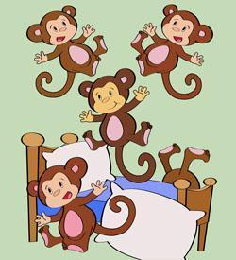
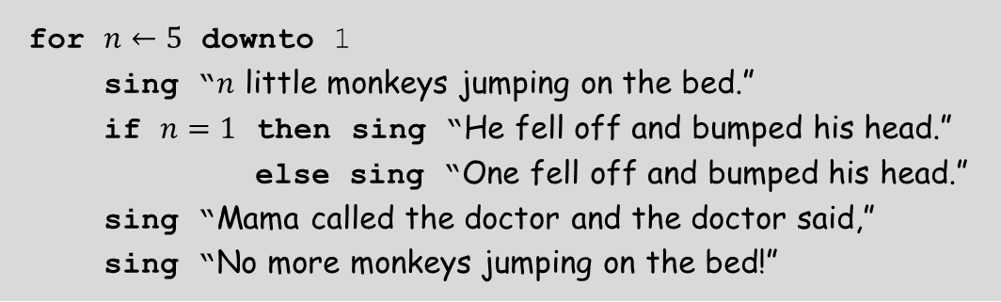
What is an Algorithm?
Definition: An algorithm is an explicit, precise, unambiguous, mechanically-executable sequence of elementary instructions.
Example: How to sing “5 little monkeys jumping on the bed”
for $n←5$ downto 1
sing “$n$ little monkeys jumping on the bed.”
if $n=1$ then sing “He fell off and bumped his head.”
else sing “One fell off and bumped his head.”
sing “Mama called the doctor and the doctor said,”
sing “No more monkeys jumping on the bed!”

Slide 5


Adding Two Numbers
Input: Two numbers $x$ and $y$ (potentially very long), each consisting of $n$ digits: $x=\overline{x_{n}x_{n−1}…x_{1}},y=\overline{y_{n}y_{n−1}…y_{1}}$
Output: A number $z=\overline{{z_{n+1}z}_{n}…z_{1}},$ such that $z=x+y$.
$$c←0$$
for $i←1$ to $n$
$z_{i}←x_{i}+y_{i}+c$
if $z_{i}≥10$ then $c←1$, $z_{i}←z_{i}−10$
else $c←0$
$z_{n+1}←c$
529501233
+612345678
1241846911

Slide 6
This is NOT an algorithm
Problem: How to pass COMP 3711.
Contains ambiguous instructions
Not (always) correct
don’t go to lectures
copy other students’ homework
give best shot at the exam
if score > cutoff then
say “yippee!”
else
cry and beg the instructor

Slide 7
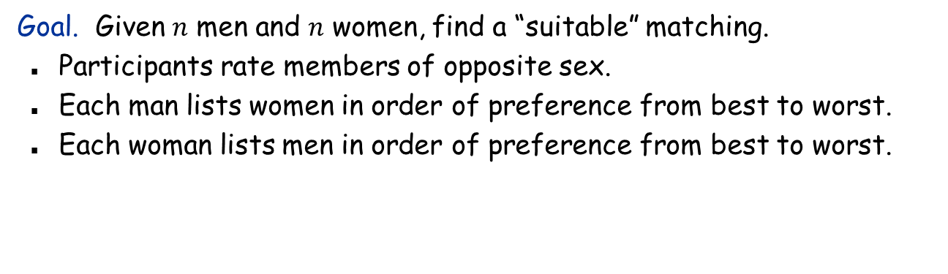
A Complete Example: The Stable Marriage Problem
Goal. Given $n$ men and $n$ women, find a “suitable” matching.
Participants rate members of opposite sex.
Each man lists women in order of preference from best to worst.
Each woman lists men in order of preference from best to worst.
favorite
least favorite
favorite
least favorite
1st
2nd
3rd
1st
2nd
3rd
David
Alice
Betty
Carol
Alice
Erik
David
Frank
Erik
Betty
Alice
Carol
Betty
David
Erik
Frank
Frank
Alice
Betty
Carol
Carol
David
Erik
Frank
Men’s Preference Profile
Women’s Preference Profile

Slide 8
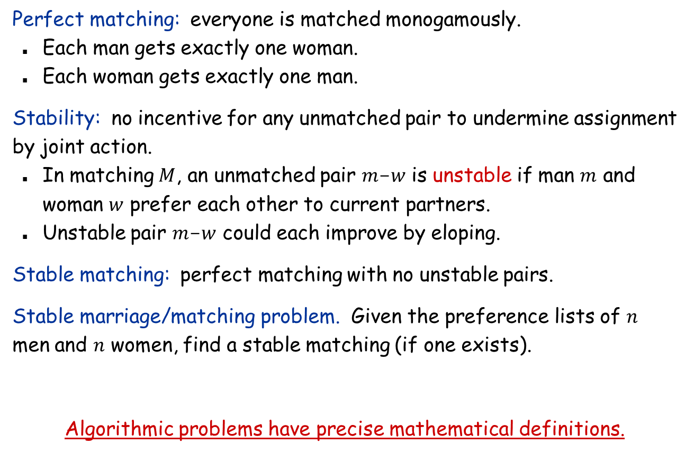
The Stable Marriage Problem
Perfect matching: everyone is matched monogamously.
Each man gets exactly one woman.
Each woman gets exactly one man.
Stability: no incentive for any unmatched pair to undermine assignment by joint action.
In matching $M$, an unmatched pair $m$-$w$ is unstable if man $m$ and woman $w$ prefer each other to current partners.
Unstable pair $m$-$w$ could each improve by eloping.
Stable matching: perfect matching with no unstable pairs.
Stable marriage/matching problem. Given the preference lists of $n$ men and $n$ women, find a stable matching (if one exists).
Algorithmic problems have precise mathematical definitions.

Slide 9
Stable Matching Problem
Q. Is assignment David-Carol, Erik-Betty, Frank-Alice stable?
favorite
least favorite
favorite
least favorite
1st
2nd
3rd
1st
2nd
3rd
David
Alice
Betty
Carol
Alice
Erik
David
Frank
Erik
Betty
Alice
Carol
Betty
David
Erik
Frank
Frank
Alice
Betty
Carol
Carol
David
Erik
Frank
Men’s Preference Profile
Women’s Preference Profile

Slide 10
Stable Matching Problem
Q. Is assignment David-Carol, Erik-Betty, Frank-Alice stable?
A. No. Betty and David will hook up.
favorite
least favorite
favorite
least favorite
1st
2nd
3rd
1st
2nd
3rd
David
Alice
Betty
Carol
Alice
Erik
David
Frank
Erik
Betty
Alice
Carol
Betty
David
Erik
Frank
Frank
Alice
Betty
Carol
Carol
David
Erik
Frank
Men’s Preference Profile
Women’s Preference Profile

Slide 11
Stable Matching Problem
Q. Is assignment David-Alice, Erik-Betty, Frank-Carol stable?
A. Yes.
Q. Do stable matchings always exist?
A. Yes. (This is not obvious; we will prove later)
Q. Is there always a unique stable matching?
A. There can be more than one stable matching.
favorite
least favorite
favorite
least favorite
1st
2nd
3rd
1st
2nd
3rd
David
Alice
Betty
Carol
Alice
Erik
David
Frank
Erik
Betty
Alice
Carol
Betty
David
Erik
Frank
Frank
Alice
Betty
Carol
Carol
David
Erik
Frank
Men’s Preference Profile
Women’s Preference Profile

Slide 12

Propose-And-Reject Algorithm
Propose-and-reject algorithm. [Gale-Shapley 1962] Intuitive algorithm that guarantees to find a stable matching.
initialize each person to be free
while (some man is free and hasn't proposed to every woman)
choose such a man $m$
$w←$1st woman on $m$'s list to whom $m$ has not yet proposed
if $w$ is free
assign $m$ and $w$ to be engaged
else if ($w$ prefers $m$ to her fiancé $m′$)
assign $m$ and $w$ to be engaged, and $m′$ to be free
else
$w$ rejects $m$
Erik
David
Betty
Alice

Slide 13

Proof of Correctness: Termination
Claim. Algorithm terminates after at most $n2$ iterations of while loop.
Pf. A man never proposes to the same woman again. There are only $n2$ possible proposals. ▪

Slide 14
Proof of Correctness: Perfection
Observation 1. Men propose to women in decreasing order of preference.
Observation 2. Once a woman is matched, she never becomes unmatched; she only “trades up”.
Claim. All men and women get matched.
Pf. (by contradiction)
Suppose, for sake of contradiction, that Z is not matched upon termination of algorithm.
Then some woman, say A, is not matched upon termination.
By Observation 2, A was never proposed to.
But, Z must have proposed to everyone, since he ends up single. ▪

Slide 15
Proof of Correctness: Stability
Claim. No unstable pairs.
Pf. (by contradiction)
Suppose A-Z is an unstable pair: each prefers each other to partner in Gale-Shapley matching S*.
Case 1: Z never proposed to A. ⇒ Z prefers his GS partner to A. ⇒ A-Z is stable.
Case 2: Z proposed to A. ⇒ A rejected Z (right away or later) ⇒ A prefers her GS partner to Z. ⇒ A-Z is stable.
In either case A-Z is stable, a contradiction. ▪
men propose in decreasing order of preference
S*
A-Y
B-Z
. . .
women only trade up
Algorithms must be proved to be correct.

Slide 16
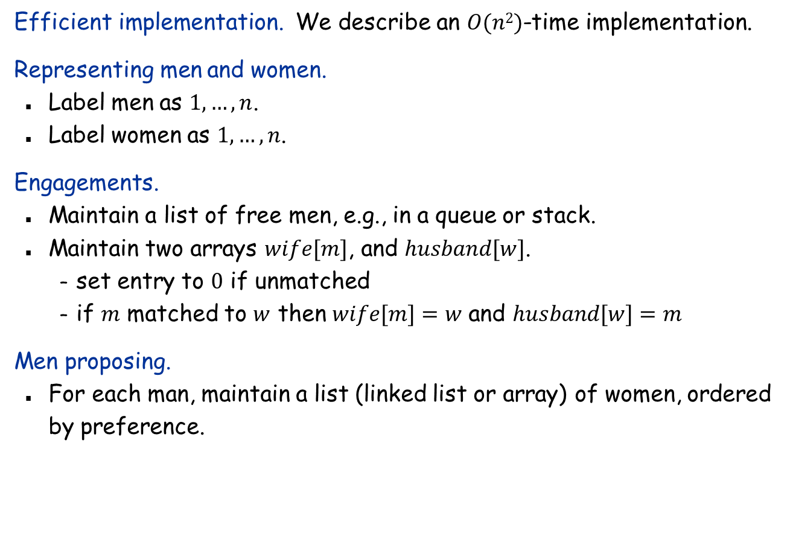
Efficient Implementation
Efficient implementation. We describe an $O(n2)$-time implementation.
Representing men and women.
Label men as $1, …, n$.
Label women as $1, …, n$.
Engagements.
Maintain a list of free men, e.g., in a queue or stack.
Maintain two arrays $wife[m]$, and $husband[w]$.
set entry to $0$ if unmatched
if $m$ matched to $w$ then $wife[m]=w$ and $husband[w]=m$
Men proposing.
For each man, maintain a list (linked list or array) of women, ordered by preference.

Slide 17

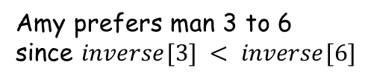

Efficient Implementation
Women rejecting/accepting.
Does woman $w$ prefer man $m$ to man $m′$?
Naïve implementation requires $O(n)$ time for this comparison.
For each woman, create inverse preference list of men.
Constant time access for each query after $O(n)$ preprocessing.
Woman 1
1st
2nd
3rd
4th
5th
6th
7th
8th
Pref
8
3
7
1
4
5
6
2
Woman 1
1
2
3
4
5
6
7
8
Inverse
4th
8th
2nd
5th
6th
7th
3rd
1st
Amy prefers man 3 to 6 since $inverse[3] < inverse[6]$
for $i←1$ to $n$
$inverse\left[pref\left[i\right]\right]←i$
2
7
Running time of algorithms depends on the underlying data structures.

Slide 18
Understanding the Solution
Q. For a given problem instance, there may be several stable matchings. Do all executions of Gale-Shapley yield the same stable matching? If so, which one?
A. Yes, it returns the (unique) matching that is optimal for the men (proof omitted).
Optimal for the men: each man gets his best possible partner in any stable matching.
Lesson learned: Ladies, ask out the guys!

Slide 19
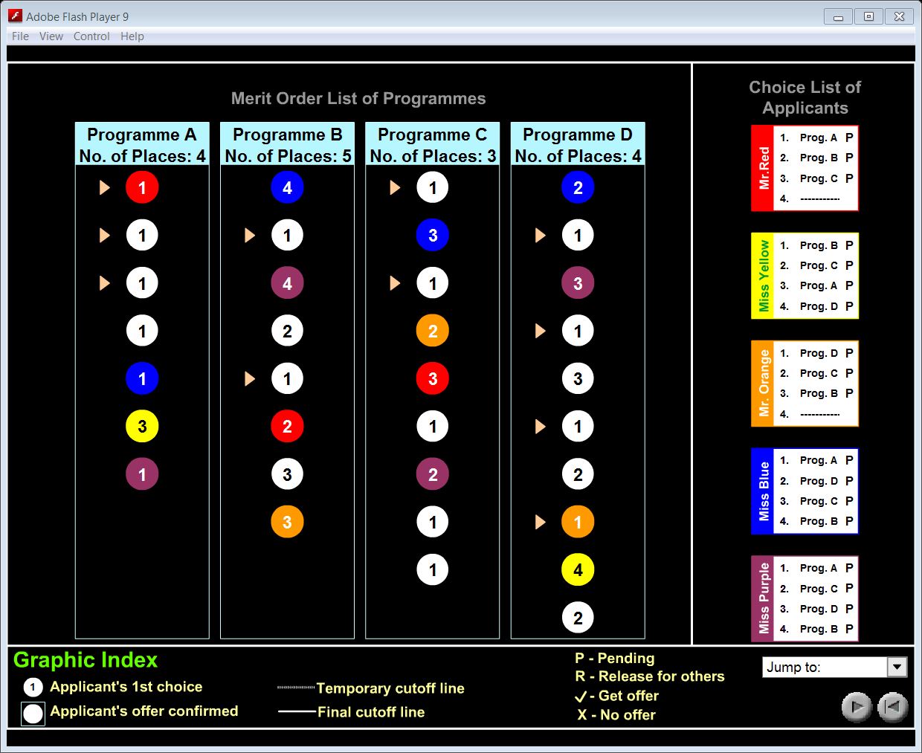
JUPAS Admission Scheme

Slide 20
JUPAS Admission Scheme
The JUPAS computer system will match (the "iteration process") the order of preference you have assigned to your programme choice list with the position you have been placed in each merit order list of these programmes. You will then be made an offer of the highest priority on your programme choice list for which you have the required rating.
http://www.jupas.edu.hk/

Slide 21
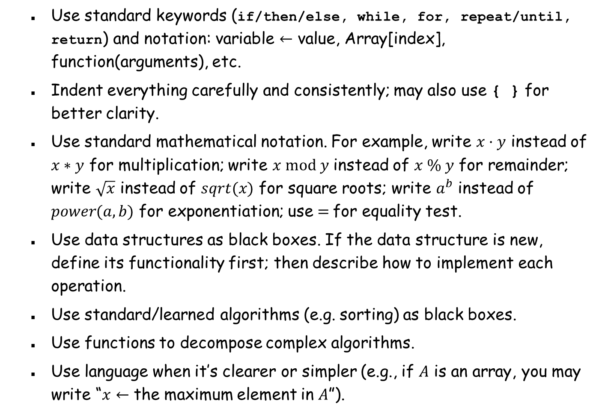
Writing down algorithms in pseudocode
Use standard keywords (if/then/else, while, for, repeat/until, return) and notation: variable $←$ value, Array[index], function(arguments), etc.
Indent everything carefully and consistently; may also use { } for better clarity.
Use standard mathematical notation. For example, write $x·y$ instead of $x∗y$ for multiplication; write $x mod y$ instead of $x \% y$ for remainder; write $\sqrt{x}$ instead of $sqrt(x)$ for square roots; write $a^{b}$ instead of $power(a, b)$ for exponentiation; use $=$for equality test.
Use data structures as black boxes. If the data structure is new, define its functionality first; then describe how to implement each operation.
Use standard/learned algorithms (e.g. sorting) as black boxes.
Use functions to decompose complex algorithms.
Use language when it’s clearer or simpler (e.g., if $A$ is an array, you may write “$x←$ the maximum element in $A$”).

Slide 22
Algorithms in a Broader Scope
Algorithms studied in this course | Algorithms in a broader scope
Sorting, searching, scheduling, sequence matching, shortest paths, network routing, … | Face recognition, machine translation, sentiment analysis, similarity search, recommendation systems, stock prediction, …
Problems have precise mathematical definitions | Problems do not have precise definitions
Need to prove correctness | Cannot prove “correctness”, rely on experiments
Space and time analysis | Space and time analysis if possible
Computer science | Computer science and domain knowledge
 | Artificial intelligence (COMP 3211) Machine learning (COMP 4211) Data mining (COMP 4331) Natural language processing (COMP4221)

