Slide 1
Lecture 5: Randomized Algorithms

Slide 2
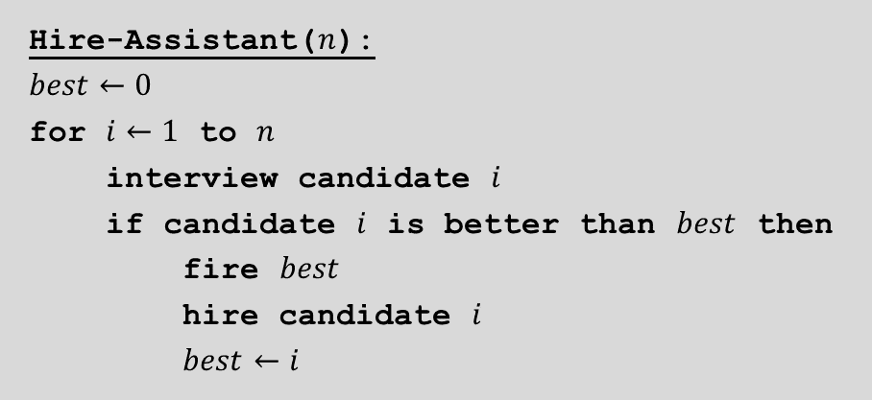
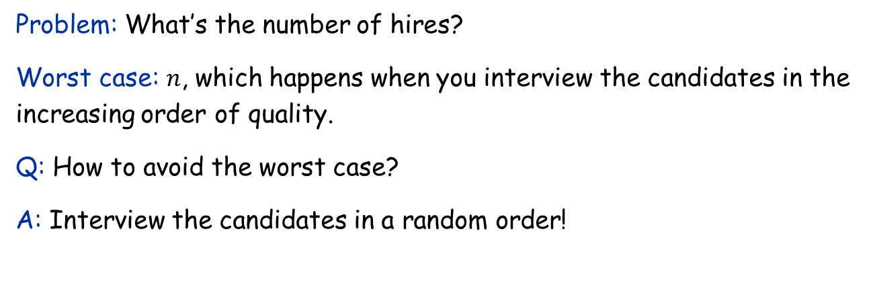
The Hiring Problem
Hire-Assistant($n$):
$$best←0$$
for $i←1$ to $n$
interview candidate $i$
if candidate $i$ is better than $best$ then
fire $best$
hire candidate $i$
$best←i$
Problem: What’s the number of hires?
Worst case: $n$, which happens when you interview the candidates in the increasing order of quality.
Q: How to avoid the worst case?
A: Interview the candidates in a random order!

Slide 3
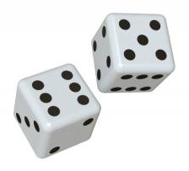
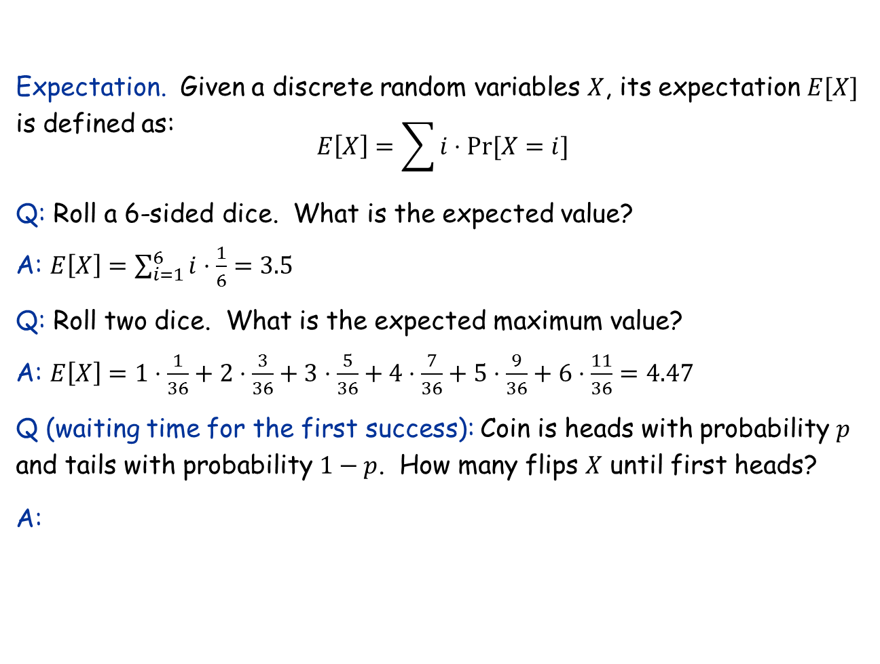
A quick review of probability theory
Expectation. Given a discrete random variables $X$, its expectation $E[X]$ is defined as:
$$E\left[X\right]=\sum{i⋅Pr⁡[X=i]}$$
Q: Roll a 6-sided dice. What is the expected value?
A: $E\left[X\right]=\sum_{i=1}^{6}{i⋅\frac{1}{6}}=3.5$
Q: Roll two dice. What is the expected maximum value?
A: $E\left[X\right]=1⋅\frac{1}{36}+2⋅\frac{3}{36}+3⋅\frac{5}{36}+4⋅\frac{7}{36}+5⋅\frac{9}{36}+6⋅\frac{11}{36}=4.47$
Q (waiting time for the first success): Coin is heads with probability $p$ and tails with probability $1−p$. How many flips $X$ until first heads?
A:
j-1 tails
1 head

Slide 4
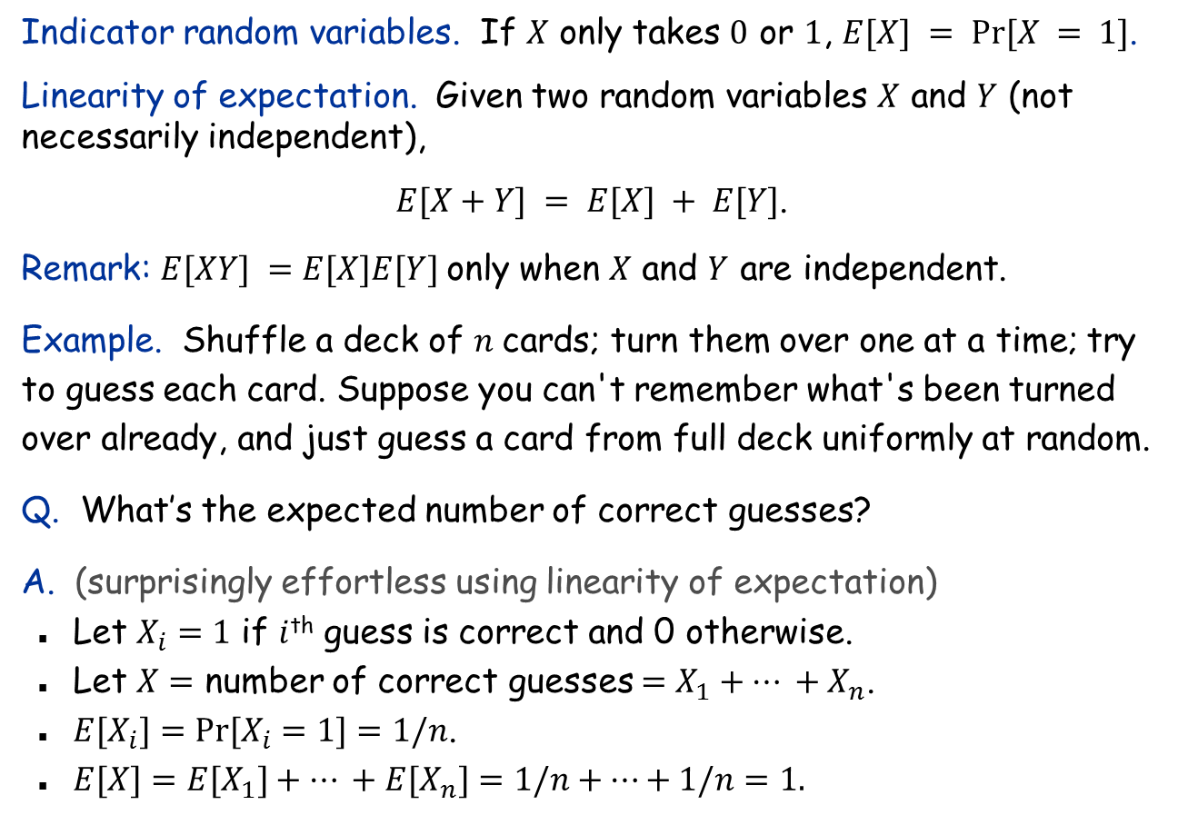
Expectation: Two Properties
Indicator random variables. If $X$ only takes $0$ or $1$, $E[X] = Pr⁡[X = 1]$.
Linearity of expectation. Given two random variables $X$ and $Y$ (not necessarily independent),
$E[X+Y] = E[X] + E[Y]$.
Remark: $E[XY] =E[X]E[Y]$only when $X$ and $Y$ are independent.
Example. Shuffle a deck of $n$cards; turn them over one at a time; try to guess each card. Suppose you can't remember what's been turned over already, and just guess a card from full deck uniformly at random.
Q. What’s the expected number of correct guesses?
A. (surprisingly effortless using linearity of expectation)
Let $X_{i}=1$ if $i$^{th} guess is correct and 0 otherwise.
Let $X=$ number of correct guesses $=X_{1}+… +X_{n}$.
$E[X_{i}]=Pr⁡[X_{i}=1]=1/n$.
$E[X]=E[X_{1}]+… +E[X_{n}]=1/n+…+1/n=1.$

Slide 5
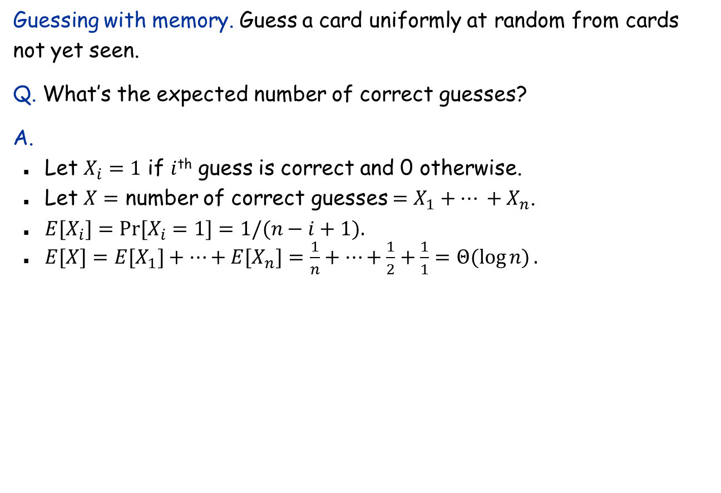
Guessing Cards with Memory
Guessing with memory. Guess a card uniformly at random from cards not yet seen.
Q. What’s the expected number of correct guesses?
A.
Let $X_{i}=1$ if $i$^{th} guess is correct and 0 otherwise.
Let $X=$ number of correct guesses $=X_{1}+… +X_{n}$.
$E[X_{i}]=Pr⁡[X_{i}=1]=1/(n−i+1).$
$E[X]=E[X_{1}]+…+E[X_{n}]=\frac{1}{n}+…+\frac{1}{2}+\frac{1}{1}=Θ(\log{n)}.$

Slide 6
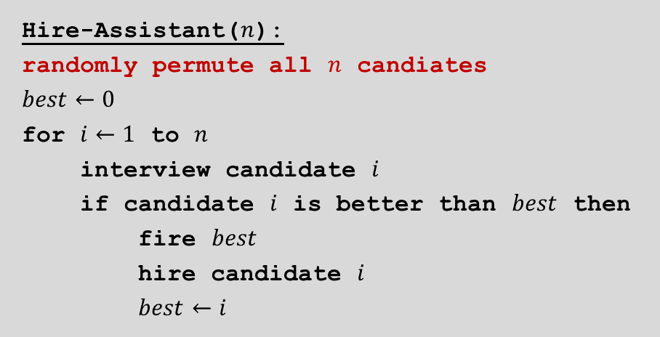
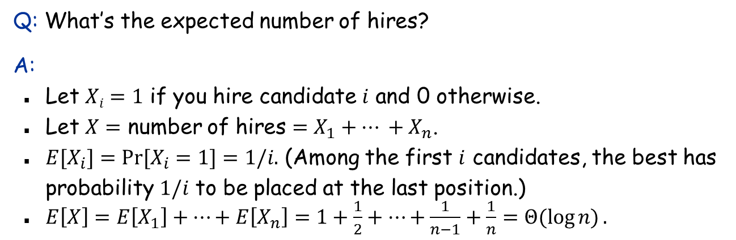
The Hiring Problem: Analysis
Hire-Assistant($n$):
randomly permute all $n$ candiates
$$best←0$$
for $i←1$ to $n$
interview candidate $i$
if candidate $i$ is better than $best$ then
fire $best$
hire candidate $i$
$best←i$
Q: What’s the expected number of hires?
A:
Let $Xi=1$ if you hire candidate $i$ and 0 otherwise.
Let $X=$ number of hires $=X_{1}+… +X_{n}$.
$E[X_{i}]=Pr⁡[X_{i}=1]=1/i.$ (Among the first $i$ candidates, the best has probability $1/i$ to be placed at the last position.)
$E\left[X\right]=E\left[X_{1}\right]+…+E\left[X_{n}\right]=1+\frac{1}{2}+…+\frac{1}{n−1}+\frac{1}{n}=Θ(\log{n)}.$

Slide 7
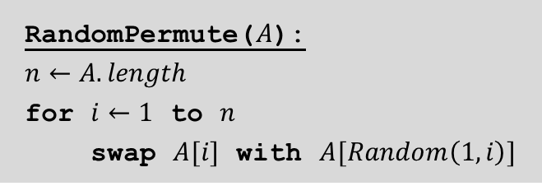
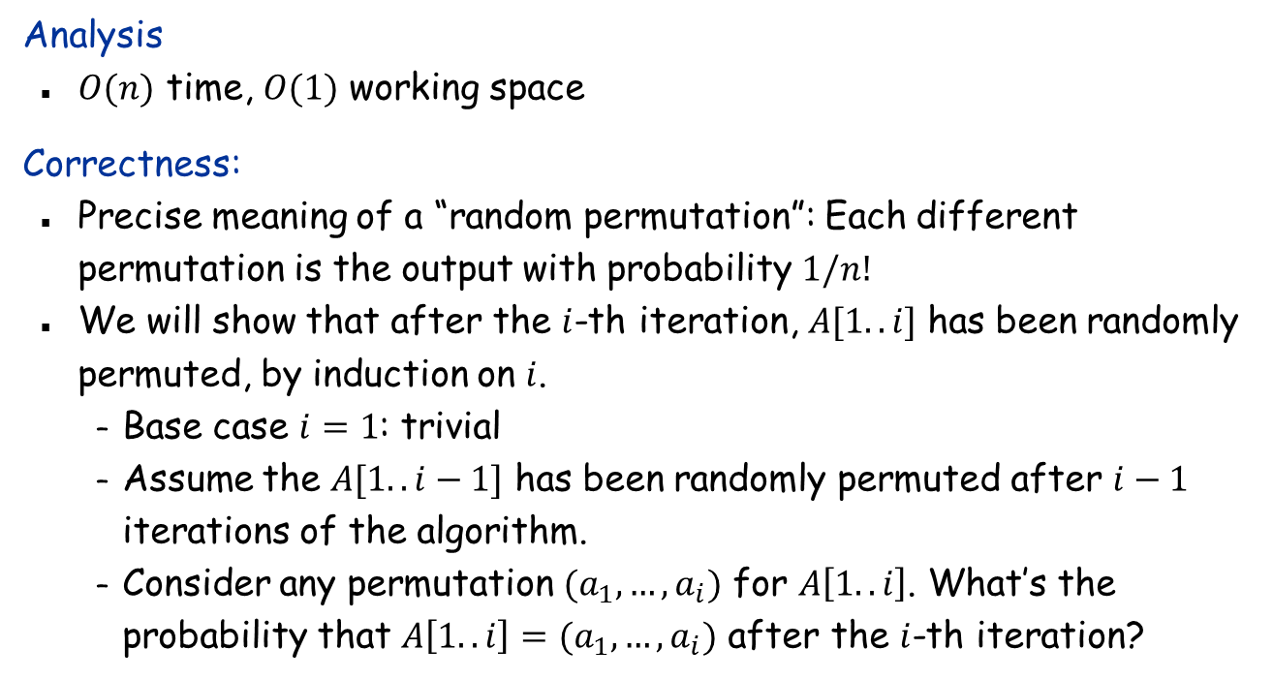
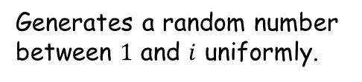
How to Generate a Random Permutation
RandomPermute($A$):
$n←A.length$
for $i←1$ to $n$
swap $A[i]$ with $A[Random\left(1,i\right)]$
Note: This algorithm is slightly different from the one in textbook
Analysis
$O(n)$ time, $O(1)$ working space
Correctness:
Precise meaning of a “random permutation”: Each different permutation is the output with probability $1/n!$
We will show that after the $i$-th iteration, $A[1..i]$ has been randomly permuted, by induction on $i$.
Base case $i=1$: trivial
Assume the $A[1..i−1]$ has been randomly permuted after $i−1$ iterations of the algorithm.
Consider any permutation $(a_{1},…,a_{i})$ for $A\left[1..i\right]$. What’s the probability that $A\left[1..i\right]=(a_{1},…,a_{i})$ after the $i$-th iteration?
Generates a random number between $1$ and $i$ uniformly.

Slide 8
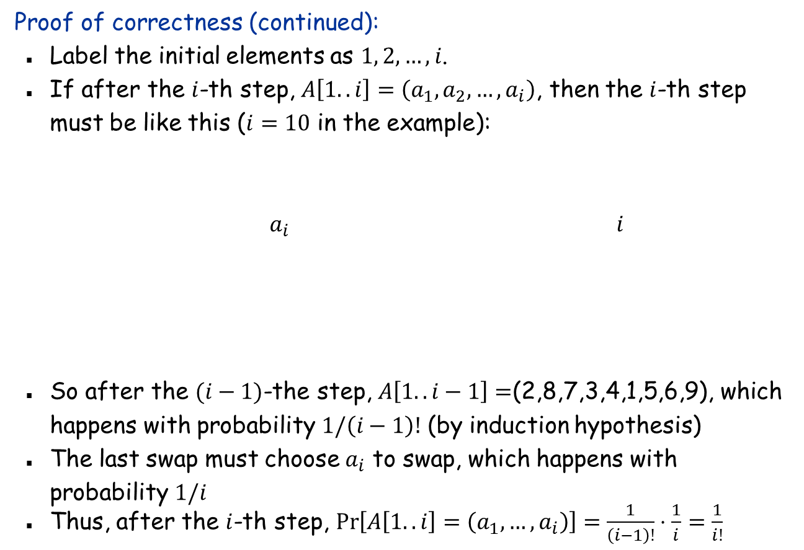
Random Permutation: Correctness
Proof of correctness (continued):
Label the initial elements as $1, 2,…,i$.
If after the $i$-th step, $A\left[1..i\right]=\left(a_{1},a_{2},…,a_{i}\right)$, then the $i$-th step must be like this ($i=10$ in the example):
$a_{i}$ $i$
So after the $(i−1)$-the step, $A\left[1..i−1\right]=$(2,8,7,3,4,1,5,6,9), which happens with probability $1/\left(i−1\right)!$ (by induction hypothesis)
The last swap must choose $a_{i}$ to swap, which happens with probability $1/i$
Thus, after the $i$-th step, $\operatorname{Pr}\left[A\left[1..i\right]=\left(a_{1},…,a_{i}\right)\right]=\frac{1}{\left(i−1\right)!}⋅\frac{1}{i}=\frac{1}{i!}$
2
8
7
3
4
1
5
6
9
10
2
8
10
3
4
1
5
6
9
7

Slide 9

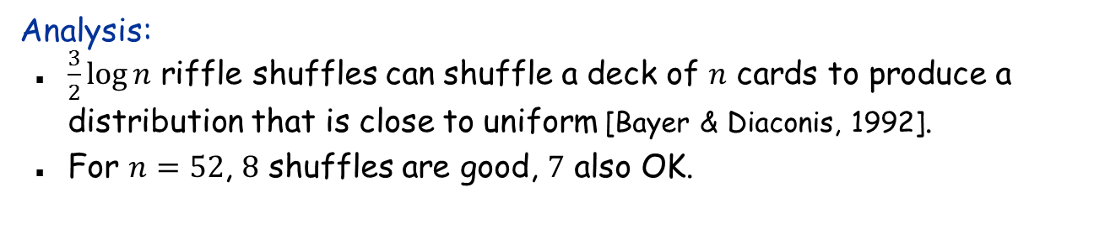
How Humans Do Shuffling
Riffle shuffle
Analysis:
$\frac{3}{2}\log{n}$ riffle shuffles can shuffle a deck of $n$ cards to produce a distribution that is close to uniform [Bayer & Diaconis, 1992].
For $n=52$, $8$ shuffles are good, $7$ also OK.

Slide 10
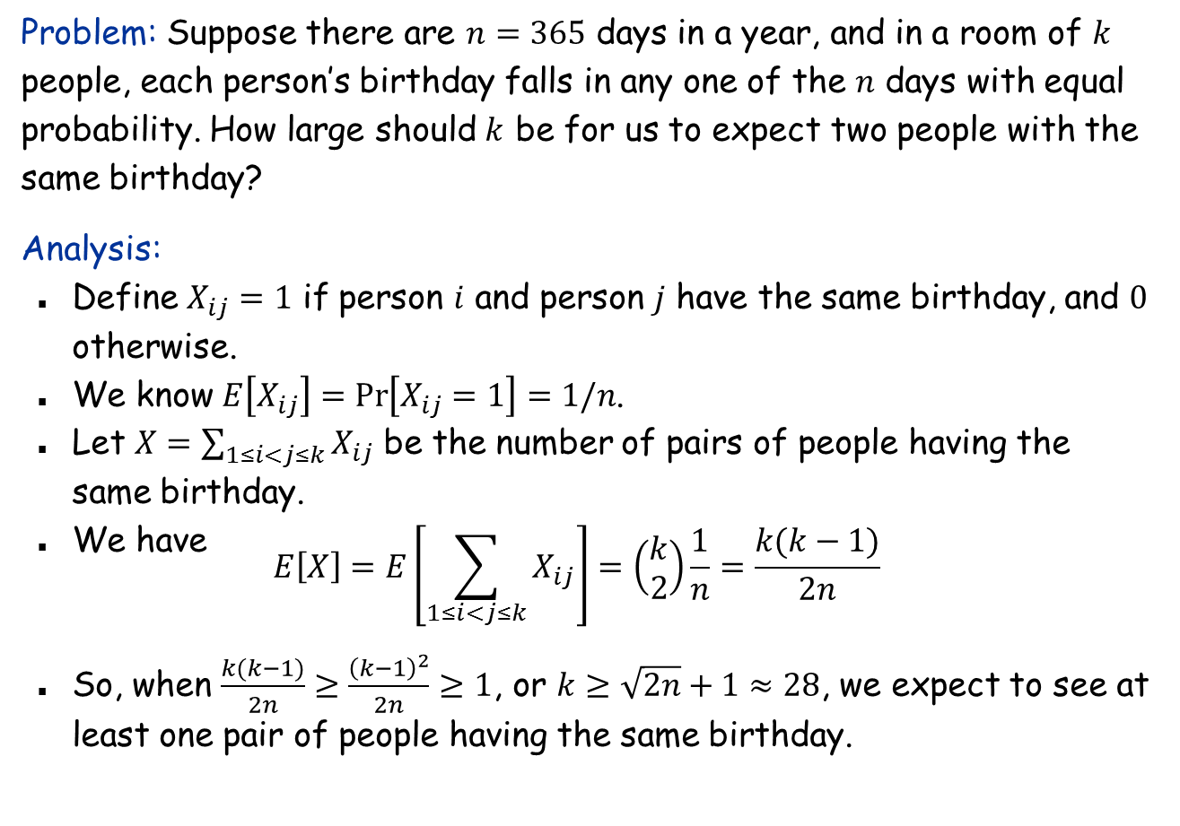
The Birthday Paradox
Problem: Suppose there are $n=365$ days in a year, and in a room of $k$ people, each person’s birthday falls in any one of the $n$ days with equal probability. How large should $k$ be for us to expect two people with the same birthday?
Analysis:
Define $X_{ij}=1$ if person $i$ and person $j$ have the same birthday, and $0$ otherwise.
We know $E\left[X_{ij}\right]=\operatorname{Pr}\left[X_{ij}=1\right]=1/n$.
Let $X=\sum_{1≤i<j≤k}{X_{ij}}$ be the number of pairs of people having the same birthday.
We have
$$E\left[X\right]=E\left[\sum_{1≤i<j≤k}{X_{ij}}\right]=\left(\begin{matrix}k \\ 2\end{matrix}\right)\frac{1}{n}=\frac{k(k−1)}{2n}$$
So, when $\frac{k(k−1)}{2n}≥\frac{{\left(k−1\right)}^{2}}{2n}≥1$, or $k≥\sqrt{2n}+1≈28$, we expect to see at least one pair of people having the same birthday.

Slide 11

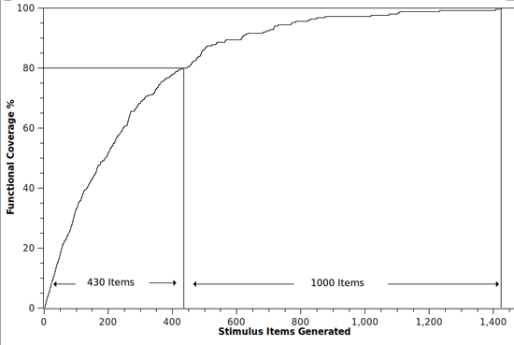
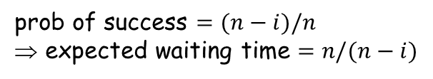
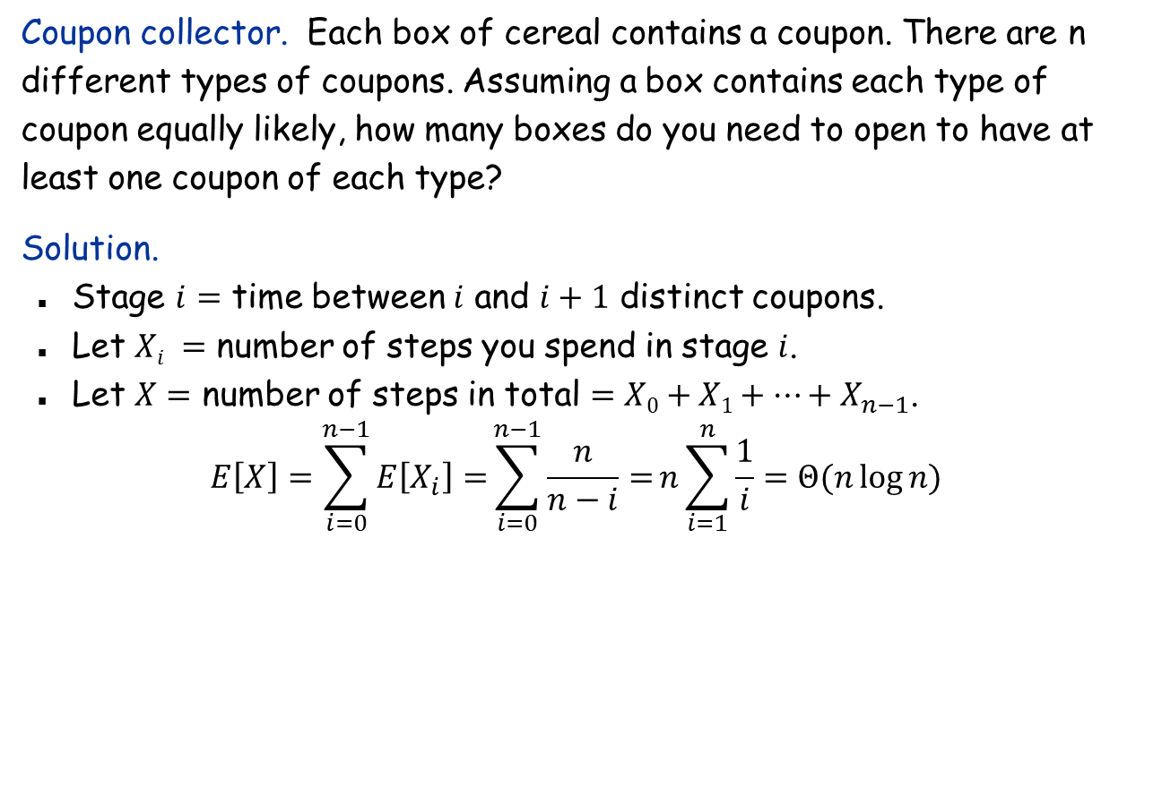
Coupon Collector
Coupon collector. Each box of cereal contains a coupon. There are n different types of coupons. Assuming a box contains each type of coupon equally likely, how many boxes do you need to open to have at least one coupon of each type?
Solution.
Stage $i=$ time between $i$ and $i+1$ distinct coupons.
Let $Xi =$ number of steps you spend in stage $i$.
Let $X=$ number of steps in total $=X0+X1+…+X_{n−1}$.
$$E\left[X\right]=\sum_{i=0}^{n−1}{E\left[X_{i}\right]=}\sum_{i=0}^{n−1}{\frac{n}{n−i}=}n\sum_{i=1}^{n}{\frac{1}{i}=Θ(n\log{n)}}$$
prob of success $=(n−i)/n$ ⇒ expected waiting time $=n/(n−i)$

Slide 12
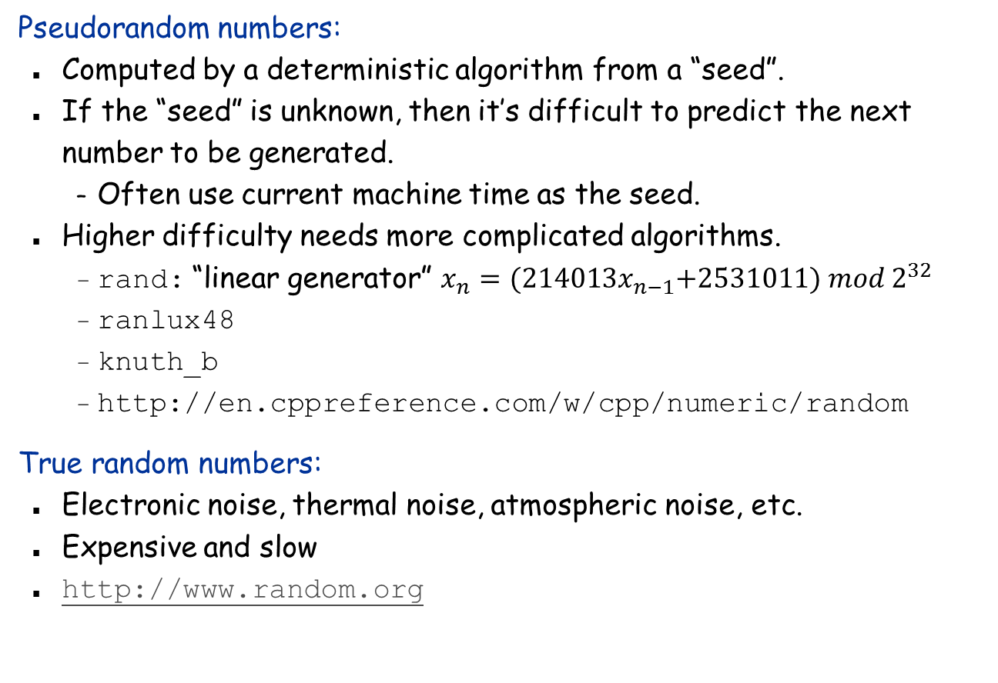
Epilogue: How does a computer generate a random number?
Pseudorandom numbers:
Computed by a deterministic algorithm from a “seed”.
If the “seed” is unknown, then it’s difficult to predict the next number to be generated.
Often use current machine time as the seed.
Higher difficulty needs more complicated algorithms.
rand: “linear generator” $x_{n}={(214013x}_{n−1}+2531011) mod 2^{32}$
ranlux48
knuth_b
http://en.cppreference.com/w/cpp/numeric/random
True random numbers:
Electronic noise, thermal noise, atmospheric noise, etc.
Expensive and slow
http://www.random.org

