Slide 1
Lecture 6: Quicksort and Linear-Time Selection

Slide 2

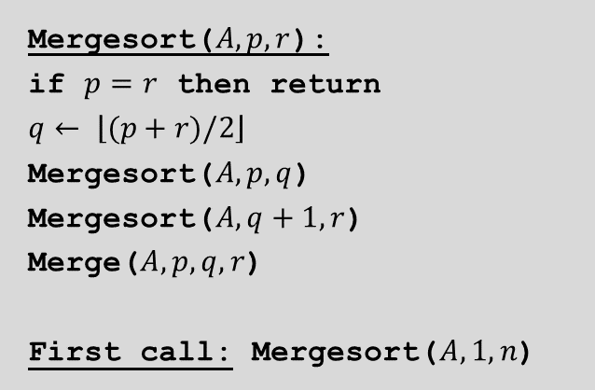


Quicksort: The “dual” of merge sort
Mergesort($A, p, r$):
if $p=r$ then return
$$q← \left\lfloor (p+r)/2\right\rfloor$$
Mergesort($A, p,q$)
Mergesort($A, q+1, r$)
Merge($A, p,q,r$)
First call: Mergesort($A,1,n$)
A
L
G
O
R
I
T
H
M
S
A
L
G
O
R
I
T
H
M
S
divide
$$O(1)$$
A
G
L
O
R
H
I
M
S
T
sort
$$2T(n/2)$$
A
G
H
I
L
M
O
R
S
T
merge
$$O(n)$$

Slide 3
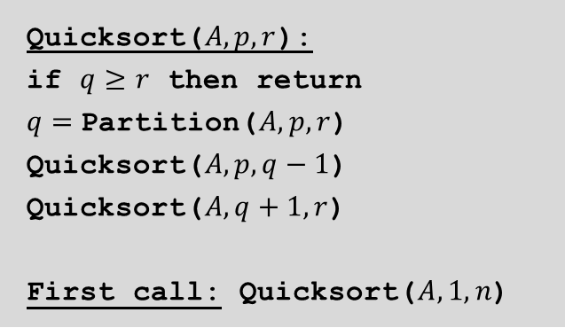



Quicksort: The “dual” of merge sort
Mergesort($A, p,r$):
if $p=r$ then return
$$q← \left\lfloor (p+r)/2\right\rfloor$$
Mergesort($A, p,q$)
Mergesort($A, q+1, r$)
Merge($A, p,q,r$)
First call: Mergesort($A,1,n$)
Quicksort($A, p, r$):
if $q≥r$ then return
$q=$Partition($A, p, r$) Quicksort($A, p, q−1$)
Quicksort($A, q+1, r$)
First call: Quicksort($A,1,n$)
A
L
G
O
R
I
T
H
M
S
A
L
G
I
H
M
O
R
T
S
partition
$$O(n)$$
A
G
H
I
L
M
O
R
S
T
sort
$$2T(n/2)$$
A
G
H
I
L
M
O
R
S
T
combine
$$0$$

Slide 4
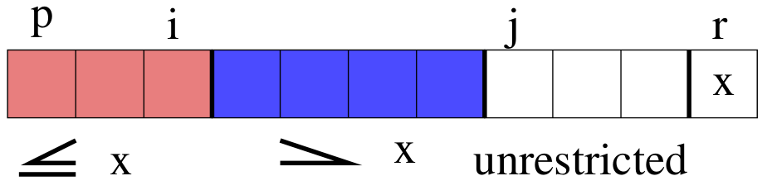
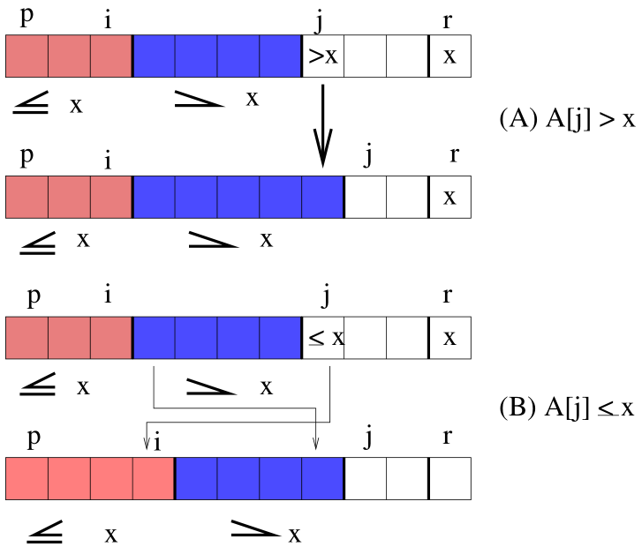
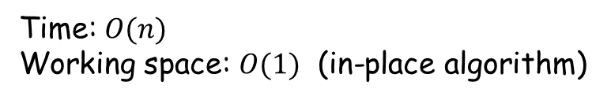

Partition with the last element as the pivot
Partition($A, p, r$):
$$x←A\left[r\right]$$
$$i←p−1$$
for $j←p$ to $r−1$
if $A\left[j\right]≤x$ then
$i←i+1$
exchange $A[i]$ with $A\left[j\right]$
exchange $A\left[i+1\right]$ with $A\left[r\right]$
return $i+1$
Time: $O(n)$
Working space: $O(1)$ (in-place algorithm)

Slide 5
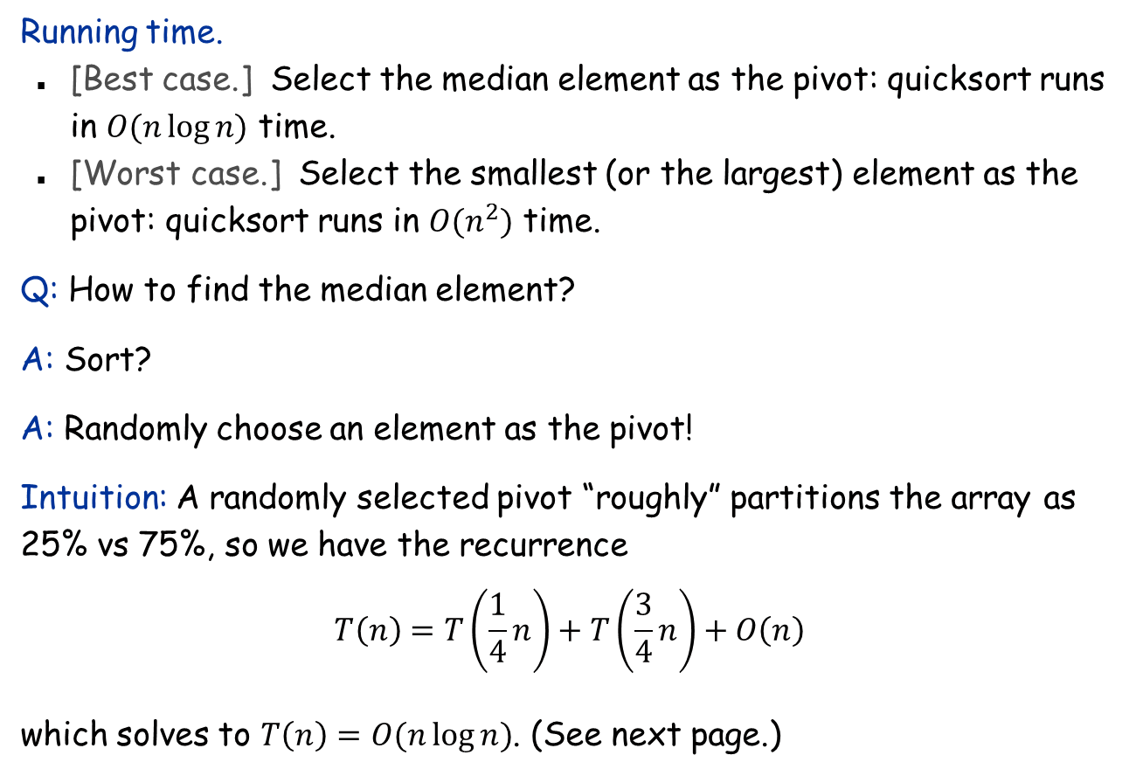
Pivot selection is crucial
Running time.
[Best case.] Select the median element as the pivot: quicksort runs in $O(n\log{n)}$ time.
[Worst case.] Select the smallest (or the largest) element as the pivot: quicksort runs in $O(n^{2})$ time.
Q: How to find the median element?
A: Sort?
A: Randomly choose an element as the pivot!
Intuition: A randomly selected pivot “roughly” partitions the array as 25% vs 75%, so we have the recurrence $$T\left(n\right)=T\left(\frac{1}{4}n\right)+T\left(\frac{3}{4}n\right)+O\left(n\right)$$ which solves to $T\left(n\right)=O(n\log{n})$. (See next page.)

Slide 6
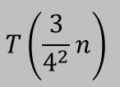

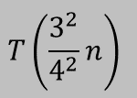
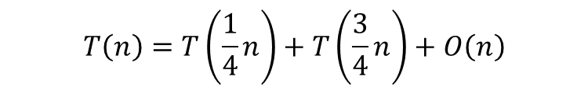

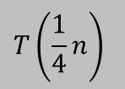

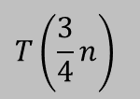




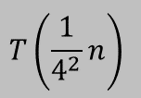

Solve the recurrence
$$T\left(n\right)=T\left(\frac{1}{4}n\right)+T\left(\frac{3}{4}n\right)+O\left(n\right)$$
$$T(n)$$
$$n$$
$$T\left(\frac{1}{4}n\right)$$
$$T\left(\frac{3}{4}n\right)$$
$$n$$
$$\log_{4/3}{n}$$
$$T\left(\frac{1}{4^{2}}n\right)$$
$$T\left(\frac{3}{4^{2}}n\right)$$
$$T\left(\frac{3}{4^{2}}n\right)$$
$$T\left(\frac{3^{2}}{4^{2}}n\right)$$
$$n$$
. . .
$$≤n$$
$$O(n log n)$$

Slide 7
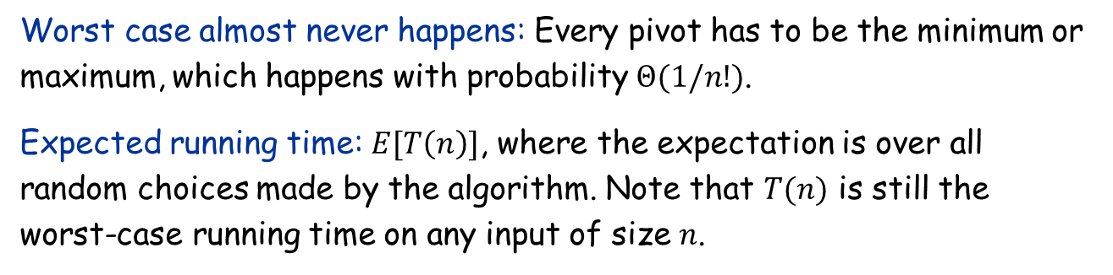
Analysis for Randomized Algorithms
Worst case almost never happens: Every pivot has to be the minimum or maximum, which happens with probability $Θ(1/n!)$.
Expected running time: $E[T\left(n\right)]$, where the expectation is over all random choices made by the algorithm. Note that $T(n)$ is still the worst-case running time on any input of size $n$.
Average case analysis | Expected case analysis
Used for deterministic algorithms | Used for randomized algorithms
Assume the input is chosen randomly from some distribution | Need to work for any input
Depends on assumptions on the input, weaker | Randomization is inherent within the algorithm, stronger

Slide 8
Analysis of quicksort: The binary tree representation
Assumption: All elements are distinct
Note: Running time = O(# comparisons)
Relabel the elements from small to large as z₁, z₂, …, z_{n}
z₇
z₆
z₁₂
z₃
z₁₁
z₈
z₇
z₁
z₁₅
z₁₃
z₁₇
z₁₀
z₁₆
z₁₄
z₉
z₄
z₅
first pivot, chosen randomly
z₁₀
z₅
z₁₃
z₃
z₉
z₁₁
z₁₆
z₂
z₄
z₇
z₁₂
z₁₅
z₁₇
z₁
z₆
z₈
z₁₄

Slide 9
Analysis of quicksort
Observation 1: Element only compared with its ancestors and descendants.
z₂ and z₇ are compared if their lowest common ancestor (lca) is z₂ or z₇.
z₂ and z₇ are not compared if their lca is z₃, z₄, z₅, or z₆.
Other elements cannot be the lca of z₂ and z₇
Observation 2: Every element in {z_{i}, …, z_{j}} is equally likely to be the lca of z_{i} and z_{j}
So, Pr[z_{i} and z_{j} are compared] = 2 / (j - i + 1).
z₁₀
z₅
z₁₃
z₃
z₉
z₁₁
z₁₆
z₂
z₄
z₇
z₁₂
z₁₅
z₁₇
z₁
z₆
z₈
z₁₄

Slide 10

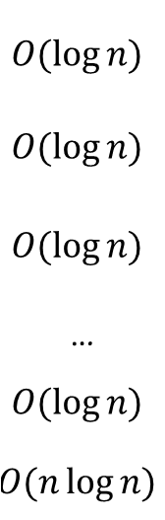
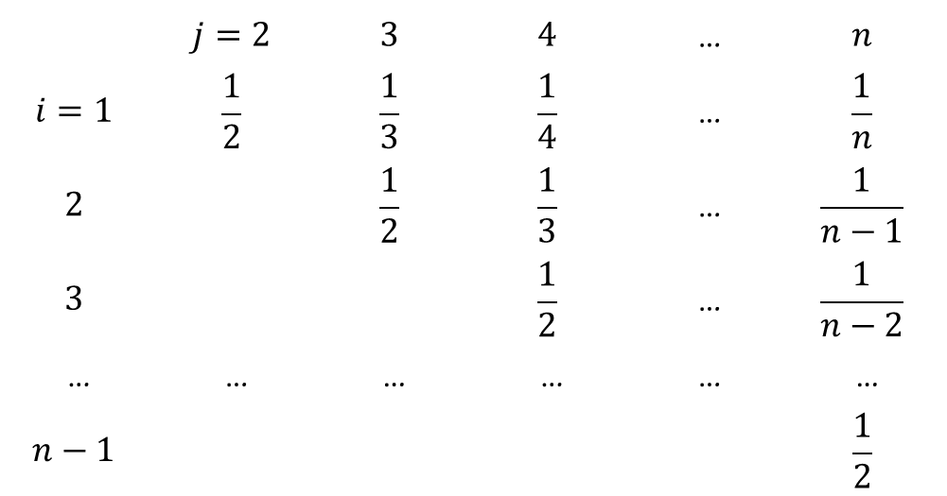
Analysis of quicksort (continued)
Theorem. Expected # of comparisons is $O(n log⁡n).$
Pf.
Let $X_{ij}=1$ if $z_{i}$ is compared with $z_{j}$
# of comparisons is $X=\sum_{i<j}{X_{ij}}$
E[# of comparisons] $=\sum_{i<j}{{E[X}_{ij}]}=\sum_{i<j}{\operatorname{Pr}{[}}$z_{i} and z_{j} are compared$]$
 | $$j=2$$ | $$3$$ | $$4$$ | … | $$n$$
$$i=1$$ | $$\frac{1}{2}$$ | $$\frac{1}{3}$$ | $$\frac{1}{4}$$ | … | $$\frac{1}{n}$$
$$2$$ |  | $$\frac{1}{2}$$ | $$\frac{1}{3}$$ | … | $$\frac{1}{n−1}$$
$$3$$ |  |  | $$\frac{1}{2}$$ | … | $$\frac{1}{n−2}$$
… | … | … | … | … | …
$$n−1$$ |  |  |  |  | $$\frac{1}{2}$$
$$O(\log{n)}$$
$$O(\log{n)}$$
$$O(\log{n)}$$
…
$$O(\log{n)}$$
$$O(n\log{n)}$$

Slide 11
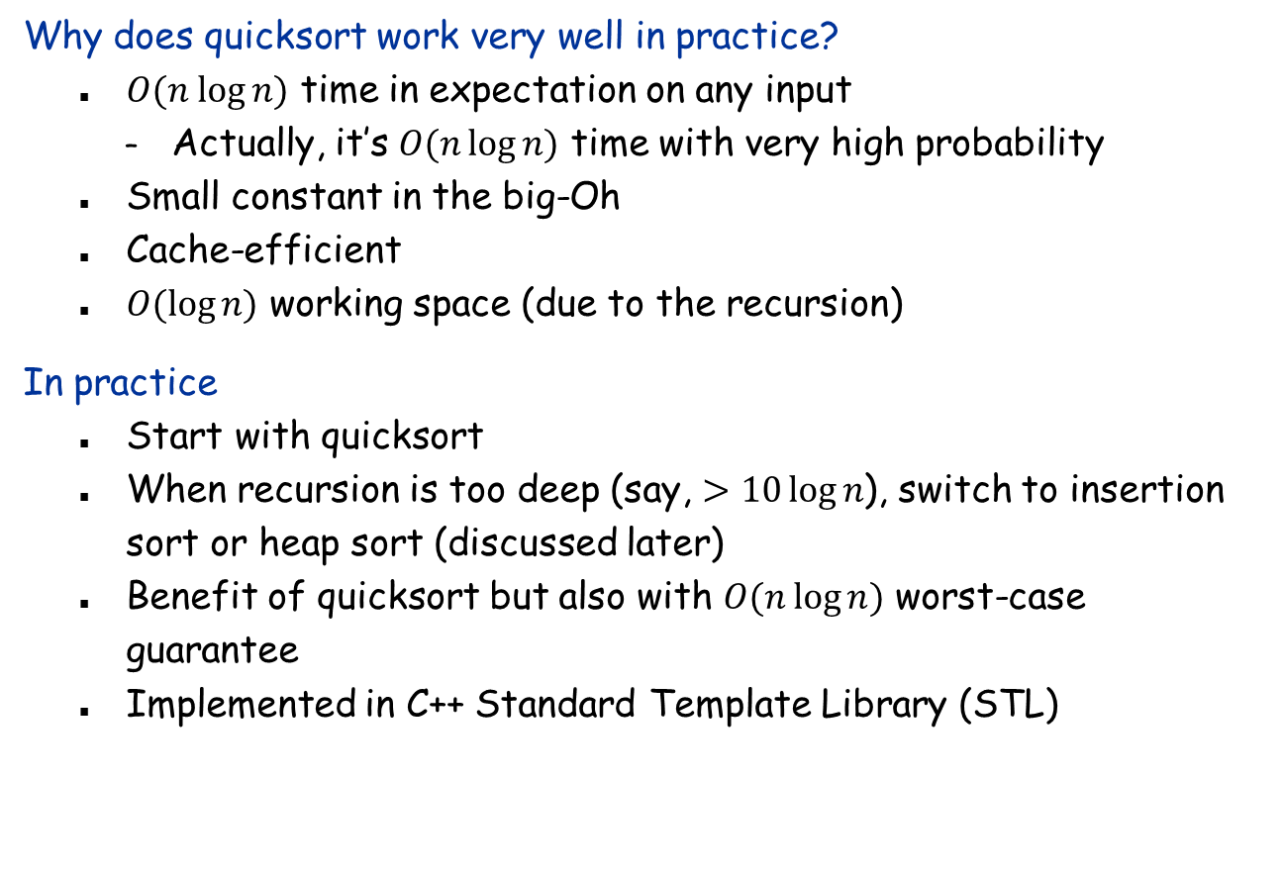
Quicksort in practice
Why does quicksort work very well in practice?
$O(n log⁡n)$ time in expectation on any input
Actually, it’s $O(n\log{n)}$ time with very high probability
Small constant in the big-Oh
Cache-efficient
$O(\log{n)}$ working space (due to the recursion)
In practice
Start with quicksort
When recursion is too deep (say, $>10\log{n}$), switch to insertion sort or heap sort (discussed later)
Benefit of quicksort but also with $O(n\log{n)}$ worst-case guarantee
Implemented in C++ Standard Template Library (STL)

Slide 12


Randomized Selection
Selection. Given an array $A$ of $n$ distinct elements and an integer $i$, return the $i$-th smallest element of $A$.
Goal: Want to do better than sorting, i.e., linear time.
Analysis: Textbook method too complicated (involving a lot of math)
In tutorial: Use indicator random variables, similar to quicksort
Here: Another simple “sneaky” method
Select($A, p, r,i$):
if $p=r$ then return $A[p]$
$q←$Partition($A, p,r$)
$$k←q−p+1$$
if $i=k$ then return $A[q]$
else if $i<k$ then return Select($A,p,q−1,i$)
else return Select($A, q+1, r,i−k$)
First call: Select($A,1,n,i$)

Slide 13
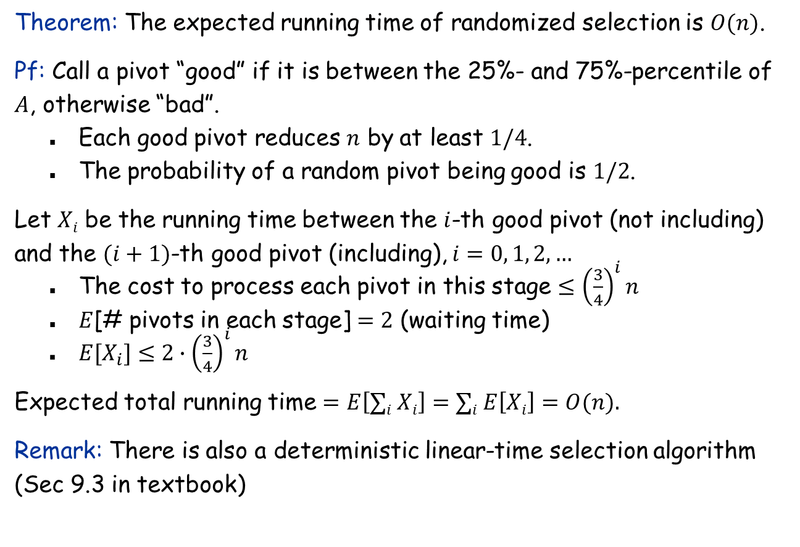
Analysis of randomized selection
Theorem: The expected running time of randomized selection is $O(n)$.
Pf: Call a pivot “good” if it is between the 25%- and 75%-percentile of $A$, otherwise “bad”.
Each good pivot reduces $n$ by at least $1/4$.
The probability of a random pivot being good is $1/2$.
Let $Xi$ be the running time between the $i$-th good pivot (not including) and the $(i+1)$-th good pivot (including), $i=0, 1, 2, …$
The cost to process each pivot in this stage $≤{\left(\frac{3}{4}\right)}^{i}n$
$E$[# pivots in each stage] $=2$ (waiting time)
$E[X_{i}]≤2∙{\left(\frac{3}{4}\right)}^{i}n$
Expected total running time $=E\left[∑i Xi\right]=∑i E\left[Xi\right]=O(n).$
Remark: There is also a deterministic linear-time selection algorithm (Sec 9.3 in textbook)

Slide 14
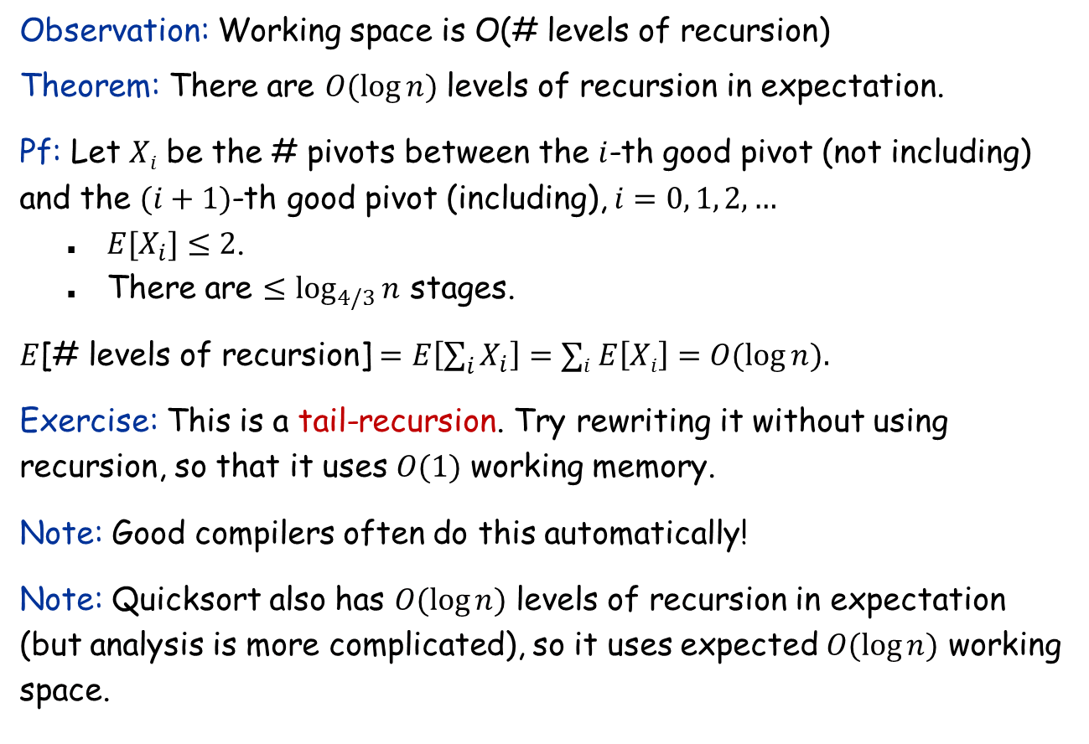
Space analysis
Observation: Working space is O(# levels of recursion)
Theorem: There are $O(\log{n})$ levels of recursion in expectation.
Pf: Let $Xi$ be the # pivots between the $i$-th good pivot (not including) and the $(i+1)$-th good pivot (including), $i=0, 1, 2, …$
$E[X_{i}]≤2$.
There are $≤\log_{4/3}{n}$ stages.
$E$[# levels of recursion] $=E\left[\sum_{i}{X_{i}}\right]=∑i E\left[Xi\right]=O(\log{n}).$
Exercise: This is a tail-recursion. Try rewriting it without using recursion, so that it uses $O(1)$ working memory.
Note: Good compilers often do this automatically!
Note: Quicksort also has $O(\log{n})$ levels of recursion in expectation (but analysis is more complicated), so it uses expected $O(\log{n})$ working space.

