Slide 1
Lecture 14: 2D Dynamic Programming

Slide 2
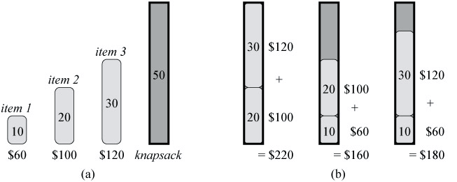
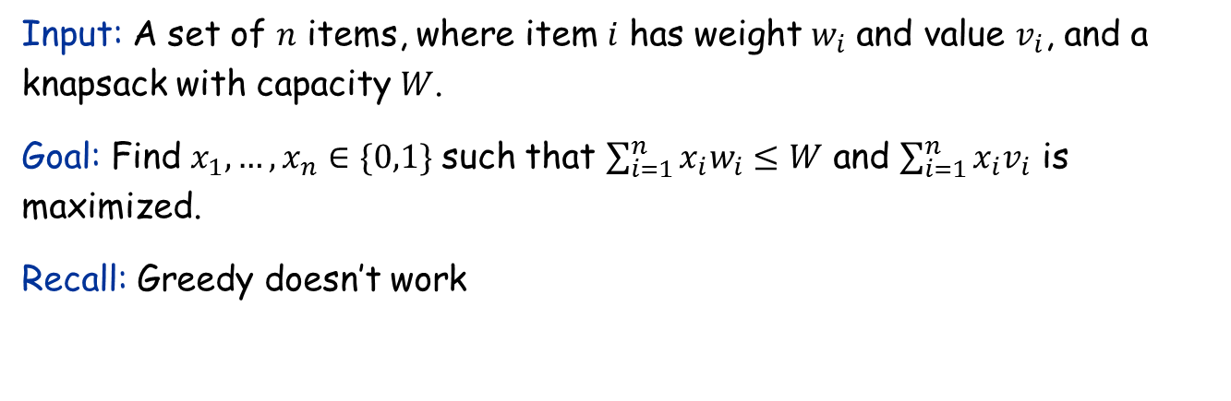
The 0/1 Knapsack Problem
Input: A set of $n$ items, where item $i$ has weight $w_{i}$ and value $v_{i}$, and a knapsack with capacity $W$.
Goal: Find $x_{1},…,x_{n}∈\{0,1\}$ such that $\sum_{i=1}^{n}{x_{i}w_{i}≤W}$ and $\sum_{i=1}^{n}{x_{i}v_{i}}$ is maximized.
Recall: Greedy doesn’t work

Slide 3
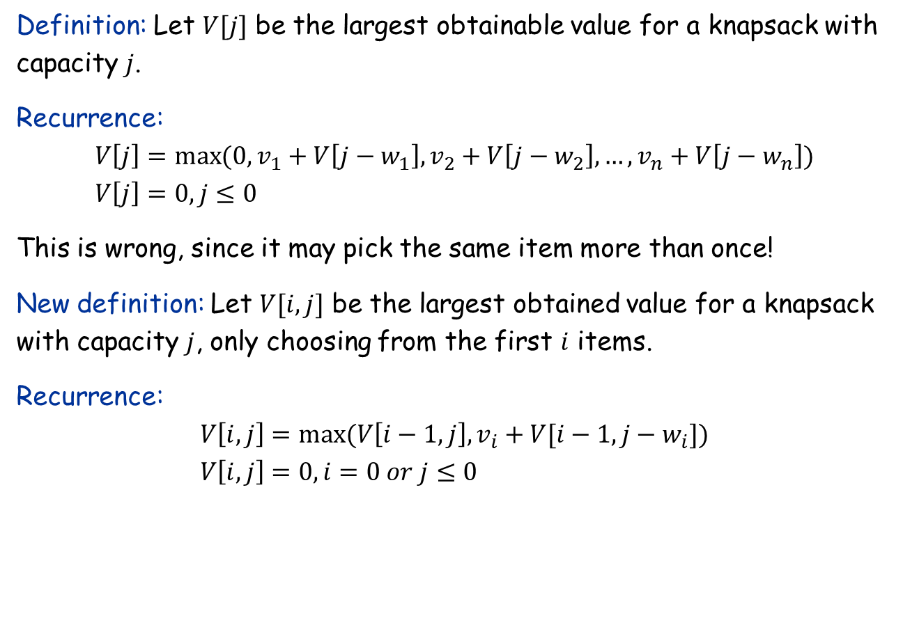
The Recurrence
Definition: Let $V[j]$ be the largest obtainable value for a knapsack with capacity $j$.
Recurrence:
$$V\left[j\right]=\max{(0,v_{1}+V\left[j−w_{1}\right],}v_{2}+V\left[j−w_{2}\right],…,v_{n}+V\left[j−w_{n}\right]) \\ V\left[j\right]=0,j≤0$$
This is wrong, since it may pick the same item more than once!
New definition: Let $V[i,j]$ be the largest obtained value for a knapsack with capacity $j$, only choosing from the first $i$ items.
Recurrence:
$$V\left[i,j\right]=\max{(V\left[i−1,j\right],v_{i}+V[i−1,j−w_{i}])} \\ V\left[i,j\right]=0,i=0 or j≤0$$

Slide 4
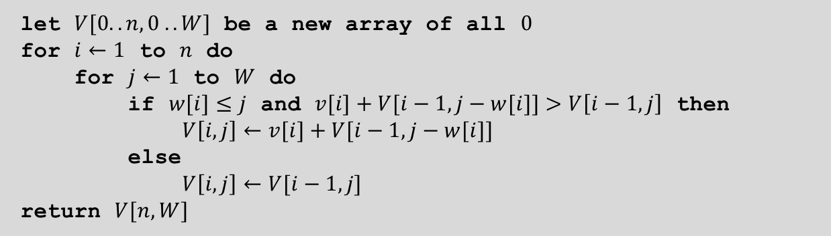
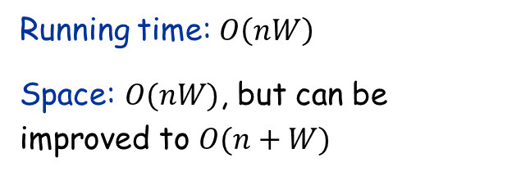
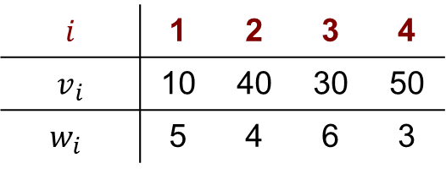
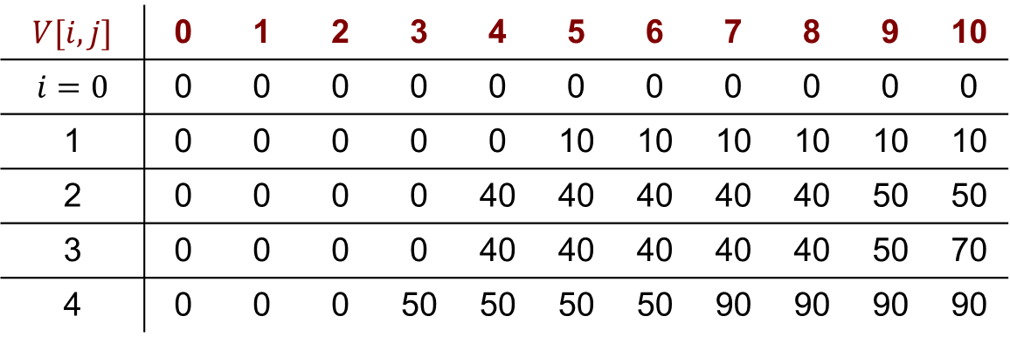
The Algorithm
let $V[0..n,0 .. W]$ be a new array of all $0$
for $i←1$ to $n$ do
for $j←1$ to $W$ do
if $w[i]≤j$ and $v[i]+V[i−1,j−w[i]]>V\left[i−1,j\right]$ then
$V\left[i,j\right]←v[i]+V[i−1,j−w[i]]$
else
$V\left[i,j\right]←V[i−1,j]$
return $V[n,W]$
Running time: $O\left(nW\right)$
Space: $O(nW)$, but can be improved to $O(n+W)$
$$i$$ | 1 | 2 | 3 | 4
$$v_{i}$$ | 10 | 40 | 30 | 50
$$w_{i}$$ | 5 | 4 | 6 | 3
$$V[i,j]$$ | 0 | 1 | 2 | 3 | 4 | 5 | 6 | 7 | 8 | 9 | 10
$$i=0$$ | 0 | 0 | 0 | 0 | 0 | 0 | 0 | 0 | 0 | 0 | 0
1 | 0 | 0 | 0 | 0 | 0 | 10 | 10 | 10 | 10 | 10 | 10
2 | 0 | 0 | 0 | 0 | 40 | 40 | 40 | 40 | 40 | 50 | 50
3 | 0 | 0 | 0 | 0 | 40 | 40 | 40 | 40 | 40 | 50 | 70
4 | 0 | 0 | 0 | 50 | 50 | 50 | 50 | 90 | 90 | 90 | 90

Slide 5


Reconstructing the Solution
Idea: Remember the optimal decision for each subproblem.
Running time: $O\left(nW\right)$
Space: $O(nW)$, cannot be improved to $O(n+W)$ due to the $keep$ array.
let $V[0..n,0 .. W]$ and $keep\left[0..n,0..W\right]$ be a new array of all $0$
for $i←1$ to $n$ do
for $j←1$ to $W$ do
if $w[i]≤j$ and $v[i]+V[i−1,j−w[i]]>V\left[i−1,j\right]$ then
$V\left[i,j\right]←v\left[i\right]+V\left[i−1,j−w\left[i\right]\right]$
$keep\left[i,j\right]←1$
else
$V\left[i,j\right]←V\left[i−1,j\right]$
$keep\left[i,j\right]←0$
$K←W$
for $i←n$ downto $1$ do
if $keep\left[i,K\right]=1$ then
print $i$
$K←K−w[i]$

Slide 6
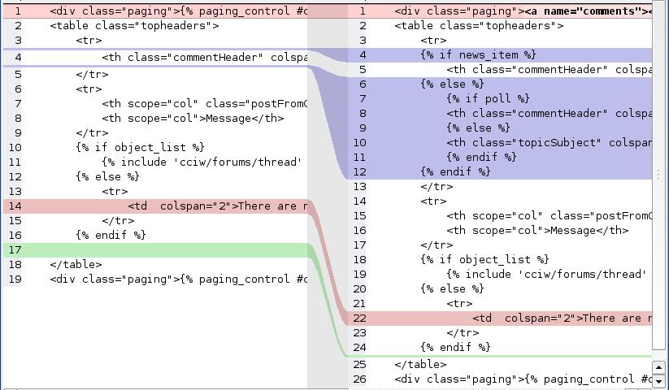

Longest Common Subsequence
Problem: Given two sequences $X=(x_{1},x_{2},…,x_{m})$ and $Y=(y_{1},y_{2},…,y_{n})$, we say that $Z$ is a common subsequence of $X$ and $Y$ if $Z$ has a strictly increasing sequence of indices $i$ and $j$ of both $X$ and $Y$ such that we have $x_{i_{p}}=y_{j_{p}}=z_{p}$ for all $p=1, 2,…,k.$ The goal is to find the longest common subsequence of $X$ and $Y$.
Ex: $X$: A B A C B D A B $Y$: B D C A B A $Z$: B C B A
Application: diff

Slide 7
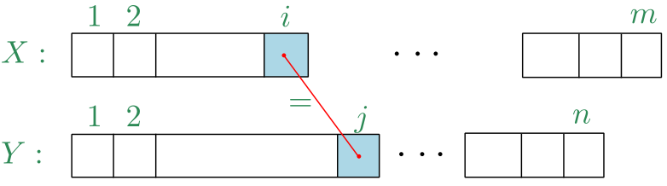
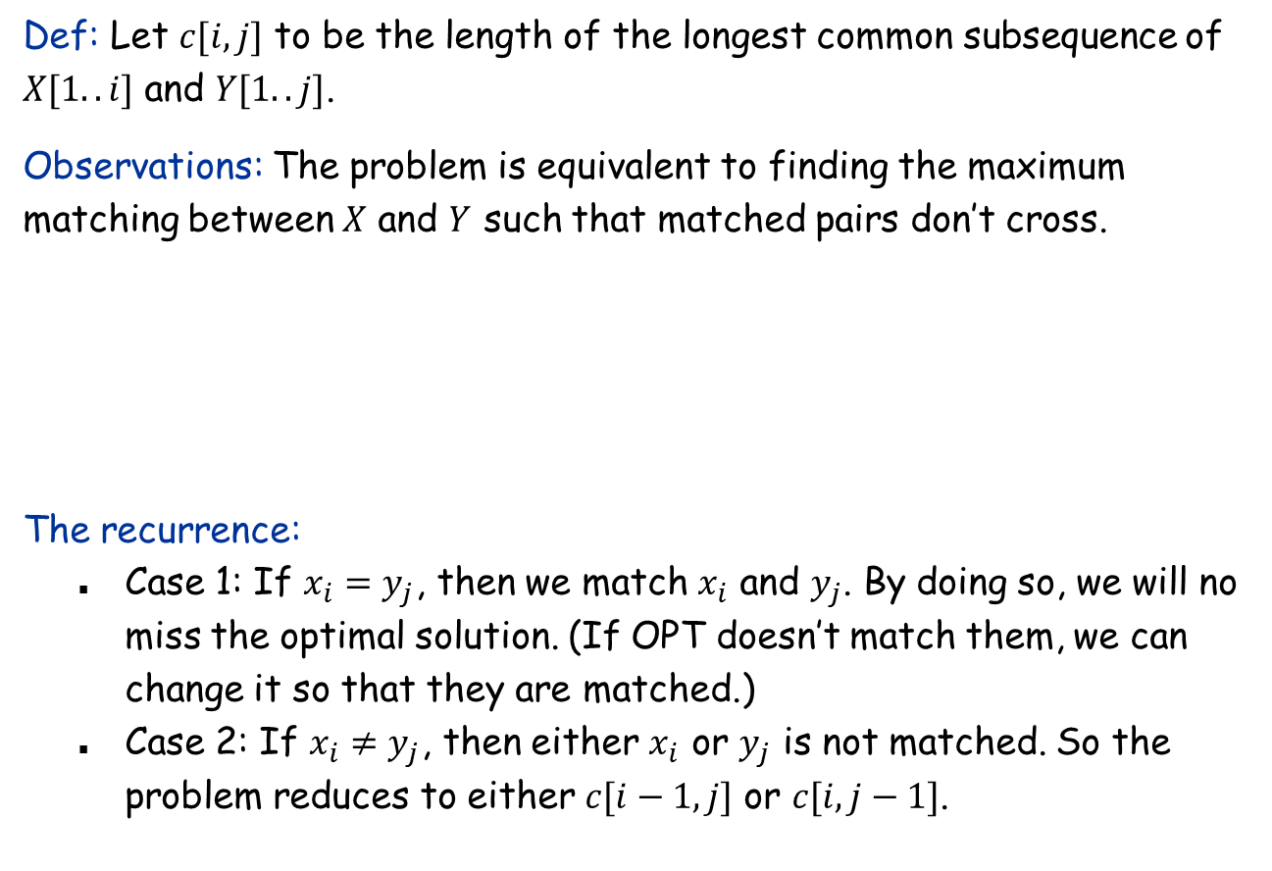
The Recurrence
Def: Let $c[i,j]$ to be the length of the longest common subsequence of $X[1..i]$ and $Y[1..j]$.
Observations: The problem is equivalent to finding the maximum matching between $X$ and $Y$ such that matched pairs don’t cross.
The recurrence:
Case 1: If $x_{i}=y_{j}$, then we match $x_{i}$ and $y_{j}$. By doing so, we will no miss the optimal solution. (If OPT doesn’t match them, we can change it so that they are matched.)
Case 2: If $x_{i}≠y_{j}$, then either $x_{i}$ or $y_{j}$ is not matched. So the problem reduces to either $c[i−1,j]$ or $c[i,j−1]$.

Slide 8

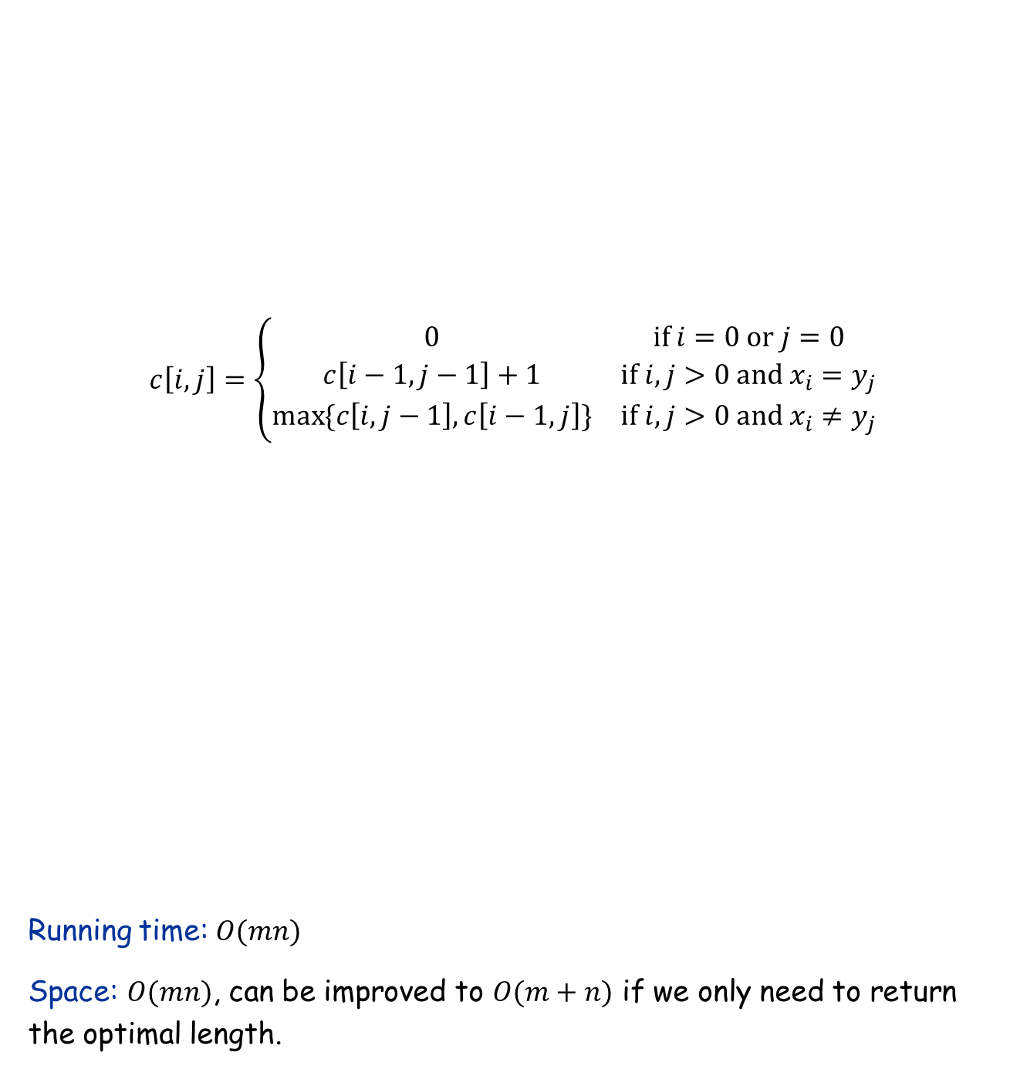
The Recurrence and Algorithm
$$c\left[i,j\right]=\left\{\begin{matrix}0 & if i=0 or j=0 \\ c\left[i−1,j−1\right]+1 & if i,j>0 and x_{i}=y_{j} \\ \max{\{c\left[i,j−1\right],c\left[i−1,j\right]\}} & if i,j>0 and x_{i}≠y_{j}\end{matrix}\right.$$
Running time: $O(mn)$
Space: $O(mn)$, can be improved to $O(m+n)$ if we only need to return the optimal length.
let $c[0.. m, 0.. n]$ and $b[0.. m, 0.. n]$ be new arrays of all $0$
for $i←1$ to $m$
for $j←1$ to $n$
if $x_{i}=y_{j}$ then
$c\left[i, j\right]←c[i−1,j−1]+1$
$b\left[i, j\right]←"↖"$
else if $c[i−1, j]≥c[i, j−1]$ then
$c\left[i, j\right]←c[i−1, j]$
$b\left[i, j\right]←"↑"$
else
$c\left[i, j\right]←c[i, j−1]$
$b\left[i, j\right]←"←“$
Print-LCS($b,m,n$)

Slide 9
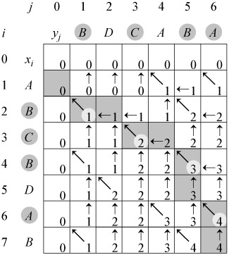
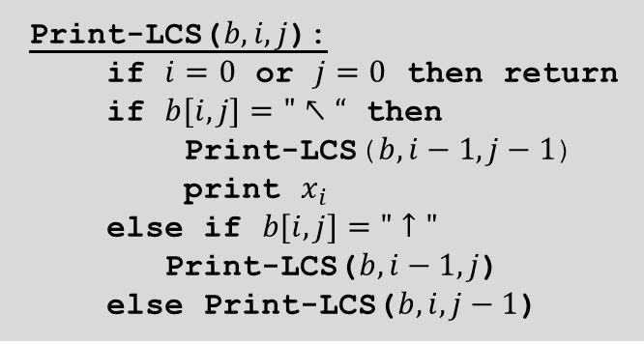
Reconstruct the Optimal Solution
Print-LCS($b,i,j$):
if $i=0$ or $j=0$ then return
if $b[i, j]="↖“$ then
Print-LCS($b, i−1, j−1$)
print $x_{i}$
else if $b[i, j]="↑"$
Print-LCS($b,i−1, j$)
else Print-LCS($b, i, j−1$)

Slide 10

Longest Common Substring
Problem: Given two strings $X=x_{1}x_{2}…x_{m}$ and $Y=y_{1}y_{2}…y_{n}$, we wish to find their longest common substring $Z$, that is, the largest $k$ for which there are indices $i$ and $j$ with $x_{i}x_{i+1}…x_{i+k−1}=y_{j}y_{j+1}…y_{j+k−1}$.
Ex: X : DEADBEEF Y : EATBEEF Z : BEEF //pick the longest contiguous substring

Slide 11
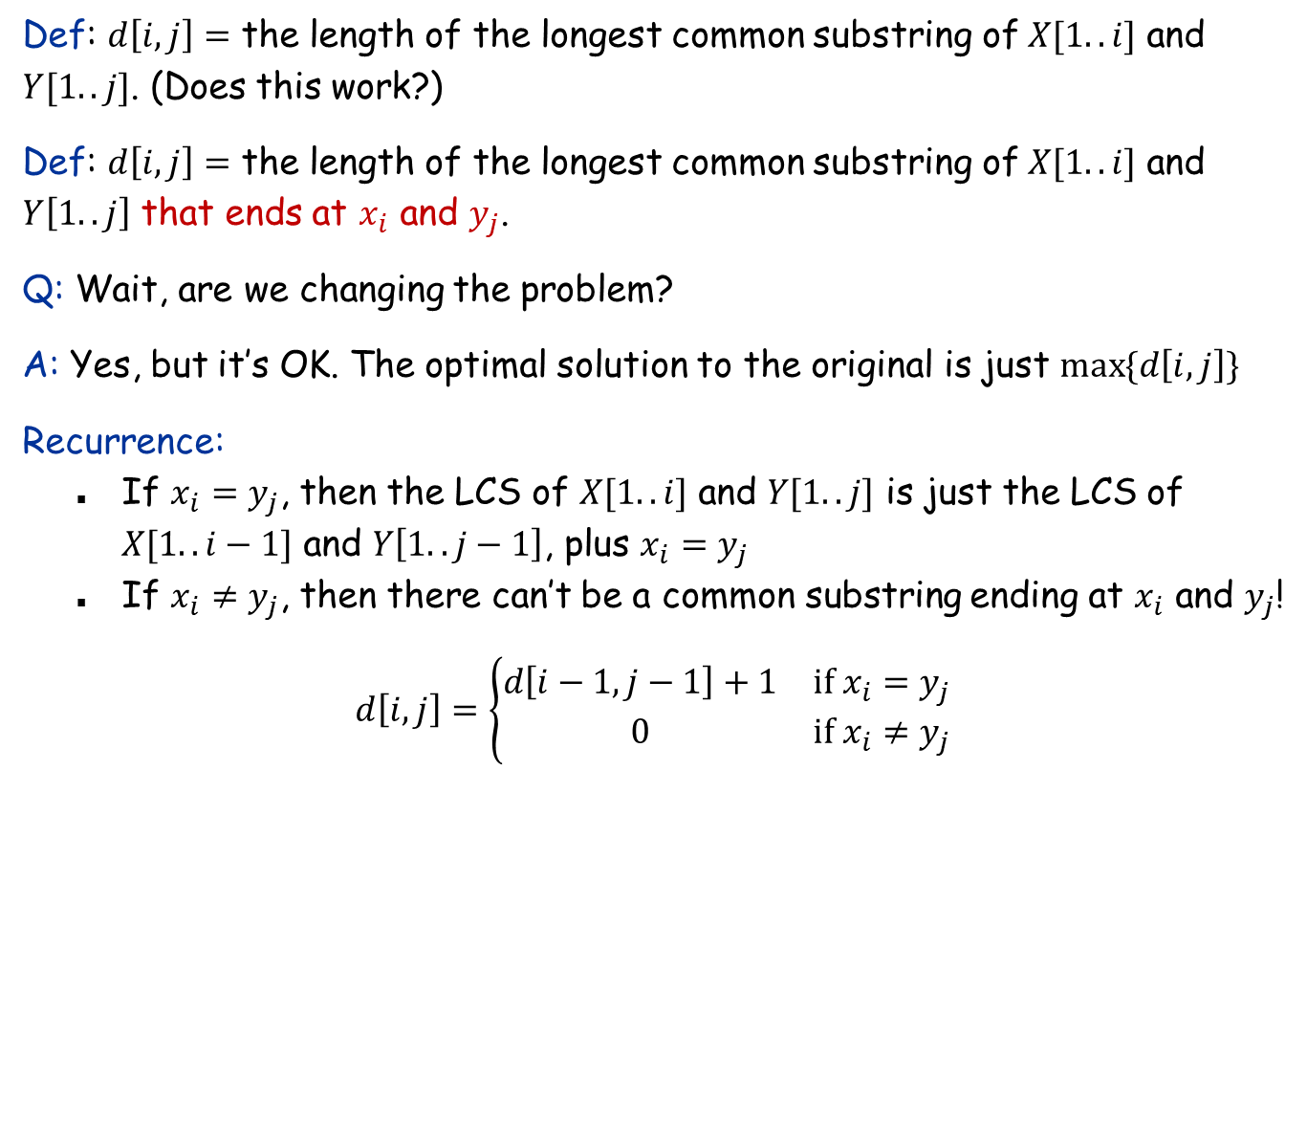
The Recurrence
Def: $d\left[i,j\right]=$ the length of the longest common substring of $X[1..i]$ and $Y[1..j]$. (Does this work?)
Def: $d\left[i,j\right]=$ the length of the longest common substring of $X[1..i]$ and $Y\left[1..j\right]$ that ends at $x_{i}$ and $y_{j}$.
Q: Wait, are we changing the problem?
A: Yes, but it’s OK. The optimal solution to the original is just $\max{\{d\left[i,j\right]\}}$
Recurrence:
If $x_{i}=y_{j}$, then the LCS of $X[1..i]$ and $Y[1..j]$ is just the LCS of $X[1..i−1]$ and $Y\left[1..j−1\right]$, plus $x_{i}=y_{j}$
If $x_{i}≠y_{j}$, then there can’t be a common substring ending at $x_{i}$ and $y_{j}$!
$$d\left[i,j\right]=\left\{\begin{matrix}d\left[i−1,j−1\right]+1 & if x_{i}=y_{j} \\ 0 & if x_{i}≠y_{j}\end{matrix}\right.$$

Slide 12
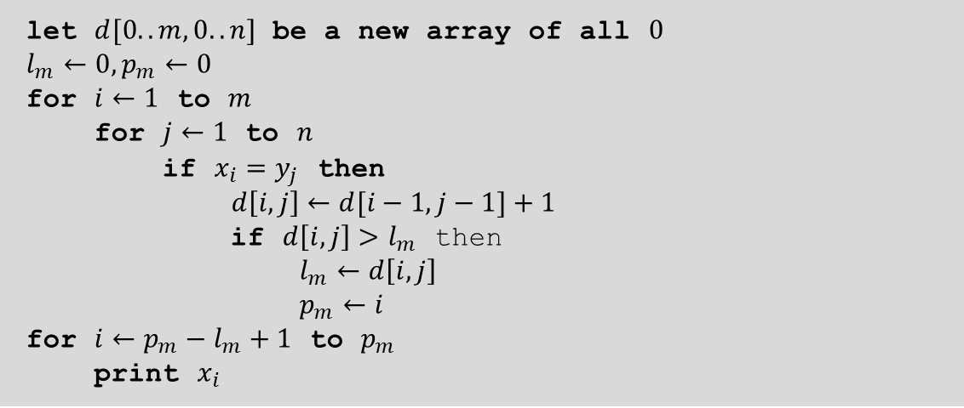
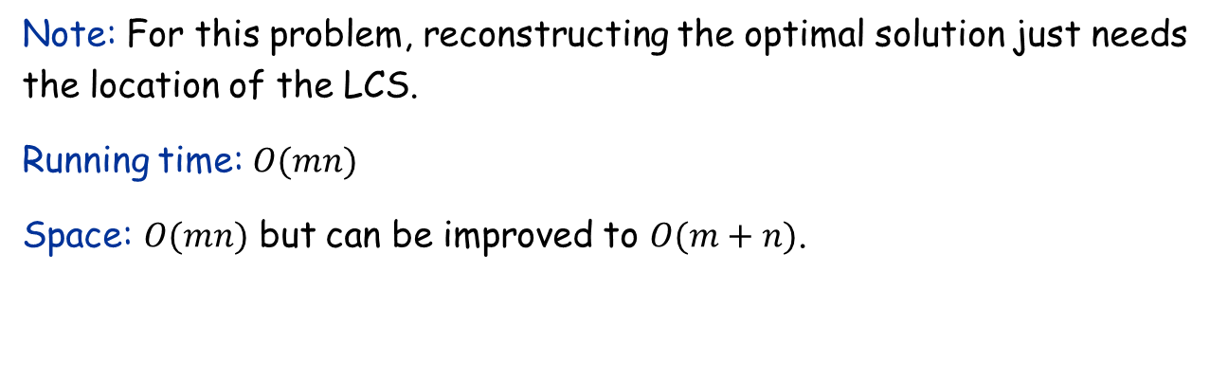
The Algorithm
let $d[0.. m, 0.. n]$ be a new array of all $0$
$l_{m}←0,p_{m}←0$
for $i←1$ to $m$
for $j←1$ to $n$
if $x_{i}=y_{j}$ then
$d\left[i, j\right]←d[i−1,j−1]+1$
if $d\left[i,j\right]>l_{m}$ then
$l_{m}←d\left[i,j\right]$
$p_{m}←i$
for $i←p_{m}−l_{m}+1$ to $p_{m}$
print $x_{i}$
Note: For this problem, reconstructing the optimal solution just needs the location of the LCS.
Running time: $O(mn)$
Space: $O(mn)$ but can be improved to $O(m+n)$.

