Slide 1
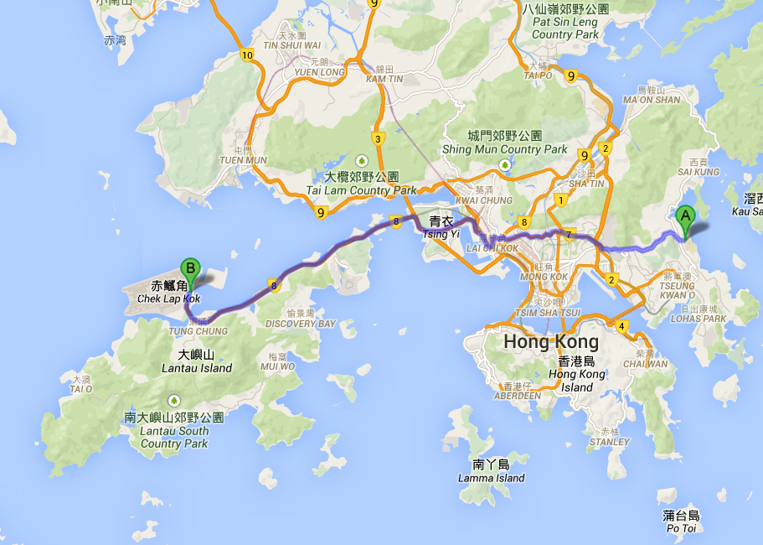
Lecture 19: Shortest Paths

Slide 2
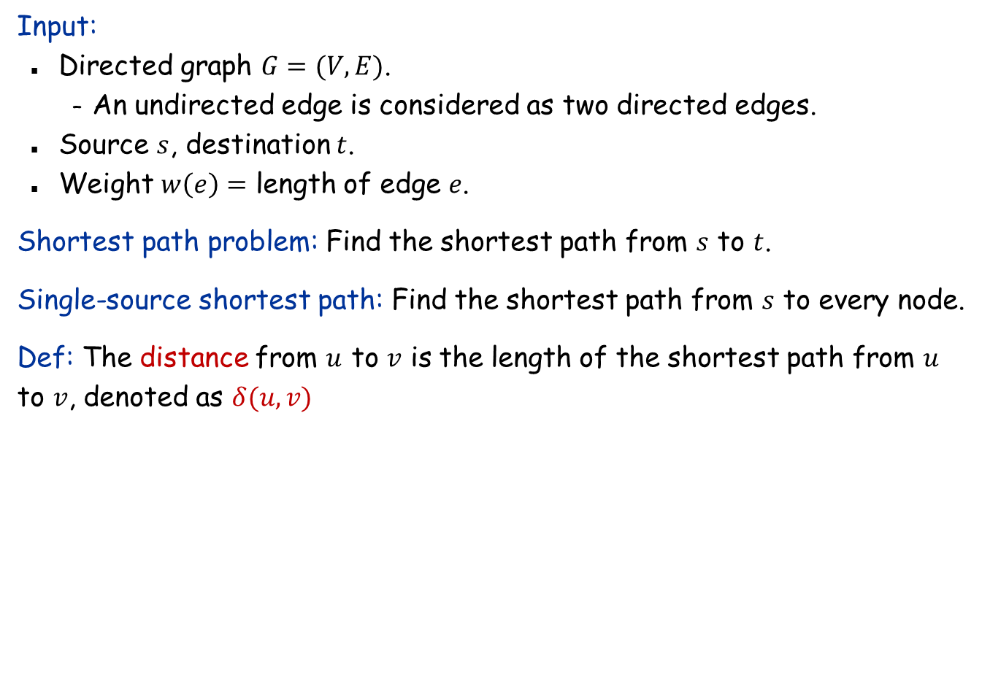
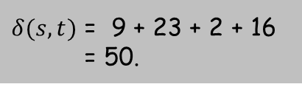
Shortest Path Problem
Input:
Directed graph $G=(V, E)$.
An undirected edge is considered as two directed edges.
Source $s$, destination $t$.
Weight $w\left(e\right)=$ length of edge $e$.
Shortest path problem: Find the shortest path from $s$ to $t$.
Single-source shortest path: Find the shortest path from $s$ to every node.
Def: The distance from $u$ to $v$ is the length of the shortest path from $u$ to $v$, denoted as $δ(u,v)$
23
2
3
9
s
18
$δ(s,t)$ = 9 + 23 + 2 + 16 = 50.
14
2
6
6
30
4
19
15
5
11
5
6
20
16
7
t
44

Slide 3
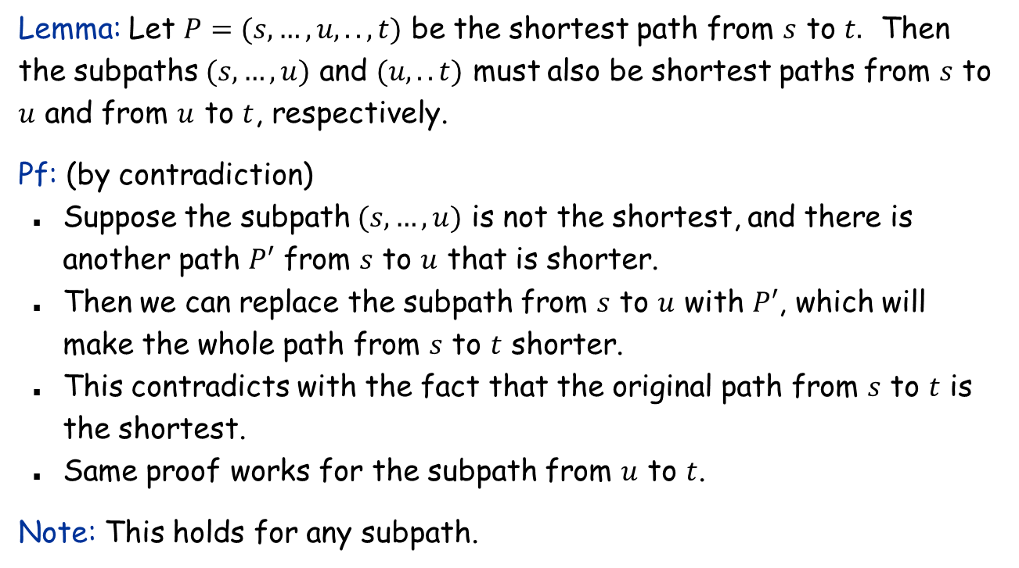
Key property of shortest path: Subpath optimality
s
t
u
Lemma: Let $P=(s,…,u,..,t)$ be the shortest path from $s$ to $t.$ Then the subpaths $(s,…,u)$ and $(u,..t)$ must also be shortest paths from $s$ to $u$ and from $u$ to $t$, respectively.
Pf: (by contradiction)
Suppose the subpath $(s,…,u)$ is not the shortest, and there is another path $P′$ from $s$ to $u$ that is shorter.
Then we can replace the subpath from $s$ to $u$ with $P′$, which will make the whole path from $s$ to $t$ shorter.
This contradicts with the fact that the original path from $s$ to $t$ is the shortest.
Same proof works for the subpath from $u$ to $t$.
Note: This holds for any subpath.

Slide 4
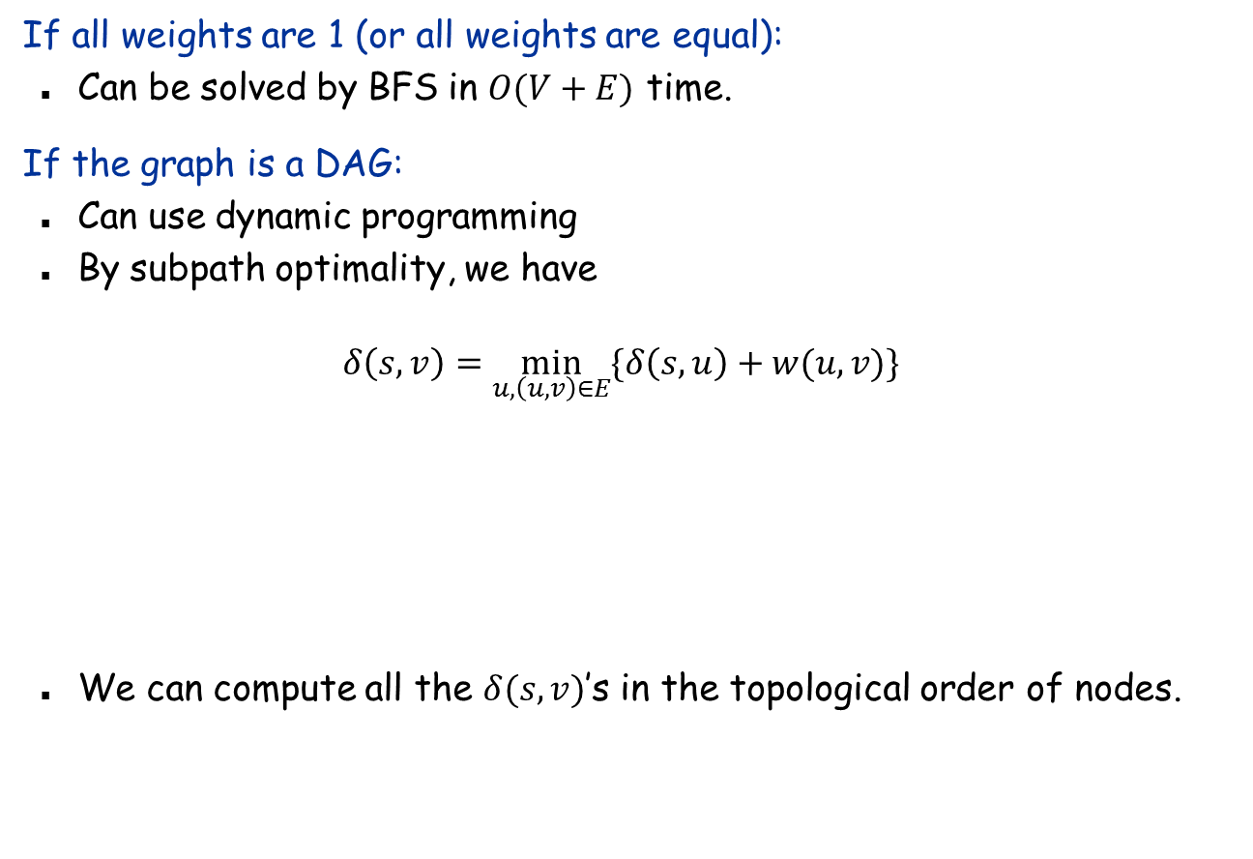
Two easy variants
If all weights are 1 (or all weights are equal):
Can be solved by BFS in $O(V+E)$ time.
If the graph is a DAG:
Can use dynamic programming
By subpath optimality, we have
$$δ\left(s,v\right)=\min_{u,\left(u,v\right)∈E}{\{δ\left(s,u\right)+w(u,v)\}}$$
We can compute all the $δ(s,v)$’s in the topological order of nodes.
u
v

Slide 5
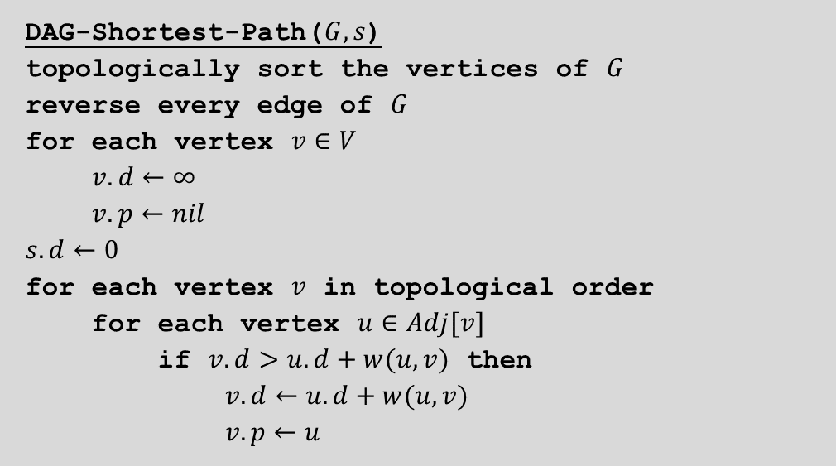
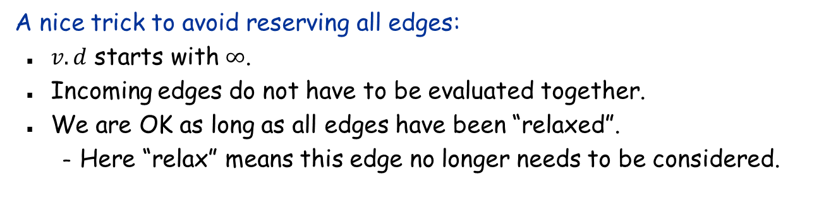

Shortest path in a DAG
DAG-Shortest-Path($G,s$)
topologically sort the vertices of $G$
reverse every edge of $G$
for each vertex $v∈V$
$v.d←∞$
$v.p←nil$
$s.d←0$
for each vertex $v$ in topological order
for each vertex $u∈Adj[v]$
if $v.d>u.d+w(u,v)$ then
$v.d←u.d+w(u,v)$
$v.p←u$
Relax($u,v$)
A nice trick to avoid reserving all edges:
$v.d$ starts with $∞$.
Incoming edges do not have to be evaluated together.
We are OK as long as all edges have been “relaxed”.
Here “relax” means this edge no longer needs to be considered.
u
v

Slide 6
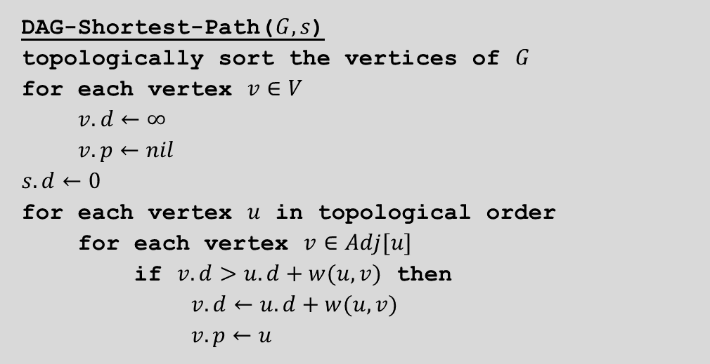
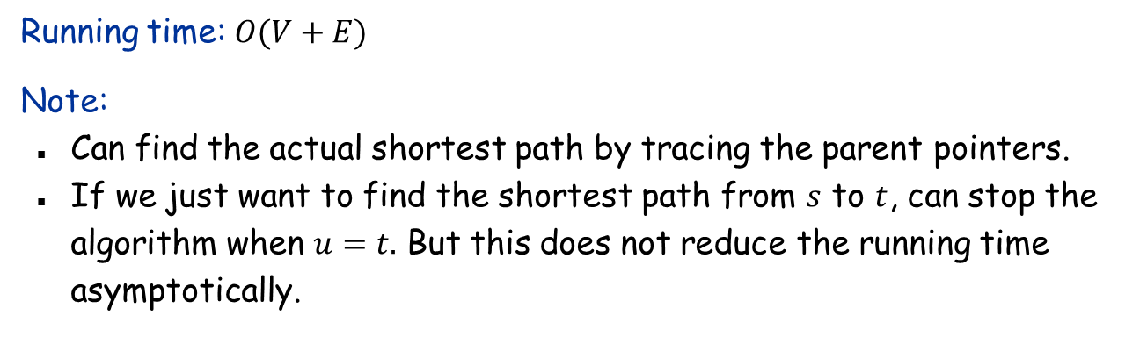

Shortest path in a DAG: Final algorithm
DAG-Shortest-Path($G,s$)
topologically sort the vertices of $G$
for each vertex $v∈V$
$v.d←∞$
$v.p←nil$
$s.d←0$
for each vertex $u$ in topological order
for each vertex $v∈Adj[u]$
if $v.d>u.d+w(u,v)$ then
$v.d←u.d+w(u,v)$
$v.p←u$
Relax($u,v$)
Running time: $O(V+E)$
Note:
Can find the actual shortest path by tracing the parent pointers.
If we just want to find the shortest path from $s$ to $t$, can stop the algorithm when $u=t.$ But this does not reduce the running time asymptotically.

Slide 7
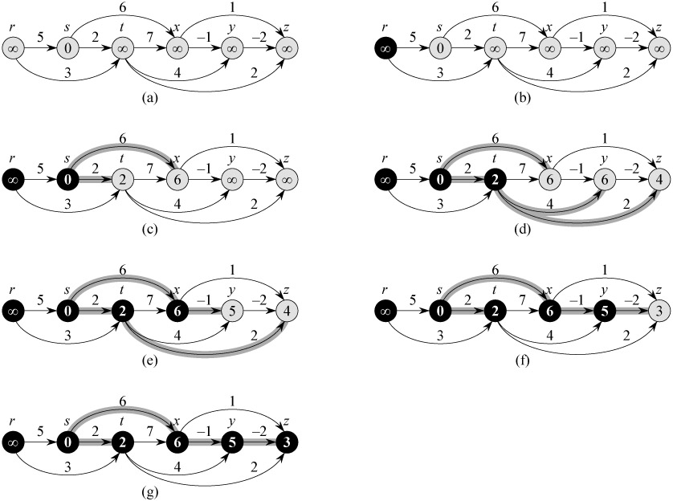
Shortest path in a DAG: Example

Slide 8
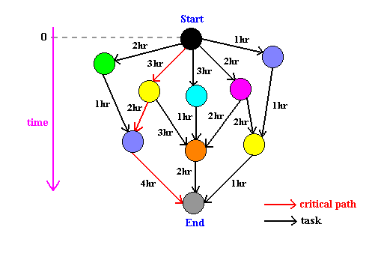
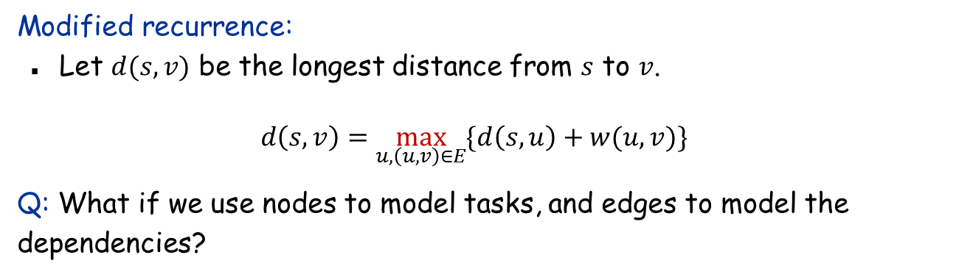
Longest Paths in a DAG
Modified recurrence:
Let $d(s,v)$ be the longest distance from $s$ to $v$.
$$d\left(s,v\right)=\max_{u,\left(u,v\right)∈E}{\{d\left(s,u\right)+w(u,v)\}}$$
Q: What if we use nodes to model tasks, and edges to model the dependencies?

Slide 9
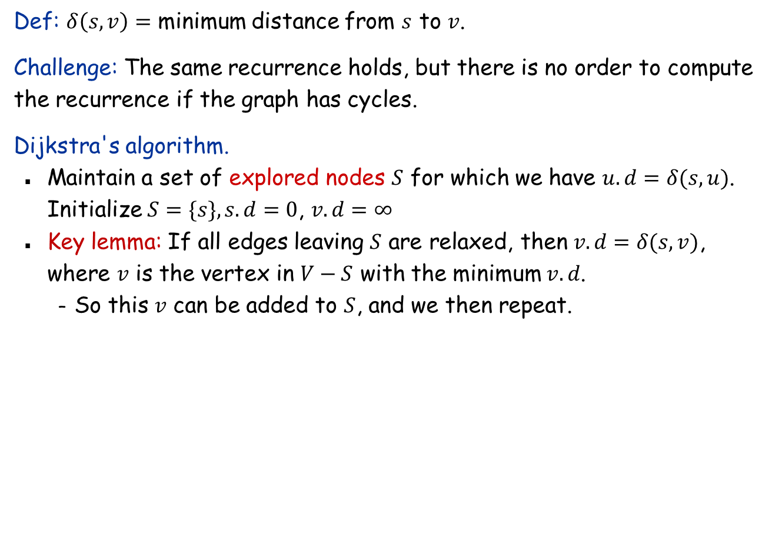
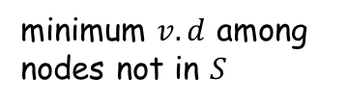
Shortest paths in a graph with cycles
Def: $δ\left(s,v\right)=$ minimum distance from $s$ to $v$.
Challenge: The same recurrence holds, but there is no order to compute the recurrence if the graph has cycles.
Dijkstra's algorithm.
Maintain a set of explored nodes $S$ for which we have $u.d=δ(s,u)$. Initialize $S=\{s\}, s.d=0$, $v.d=∞$
Key lemma: If all edges leaving $S$ are relaxed, then $v.d=δ(s,v)$, where $v$ is the vertex in $V−S$ with the minimum $v.d$.
So this $v$ can be added to $S$, and we then repeat.
minimum $v.d$ among nodes not in $S$
v
u
S
s

Slide 10
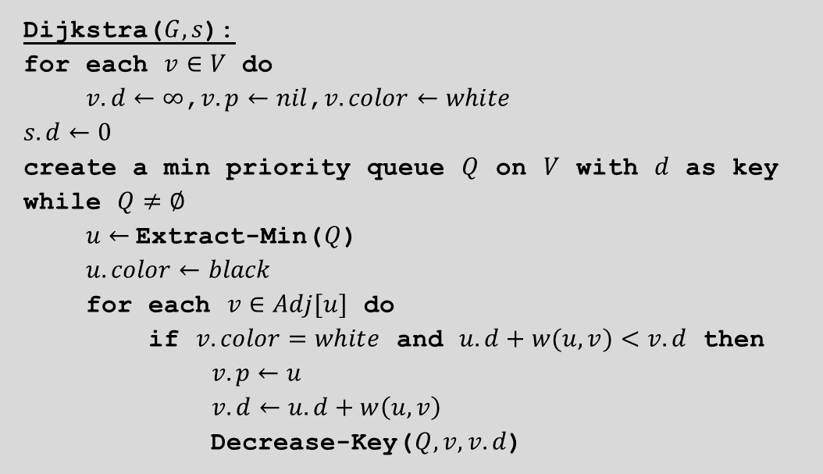
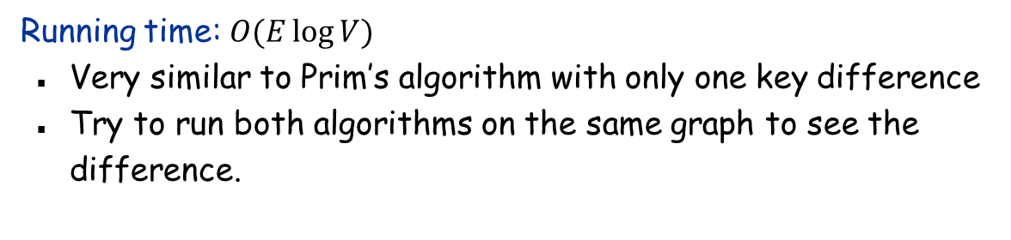
Dijkstra’s Algorithm
Dijkstra($G, s$):
for each $v∈V$ do
$v.d←∞$,$v.p←nil$,$v.color←white$
$s.d←0$
create a min priority queue $Q$ on $V$ with $d$ as key
while $Q≠∅$
$u←$Extract-Min($Q$)
$u.color←black$
for each $v∈Adj[u]$ do
if $v.color=white$ and $u.d+w(u, v)<v.d$ then
$v.p←u$
$v.d←u.d+w\left(u,v\right)$
Decrease-Key($Q,v, v.d$)
Running time: $O(E\log{V)}$
Very similar to Prim’s algorithm with only one key difference
Try to run both algorithms on the same graph to see the difference.

Slide 11
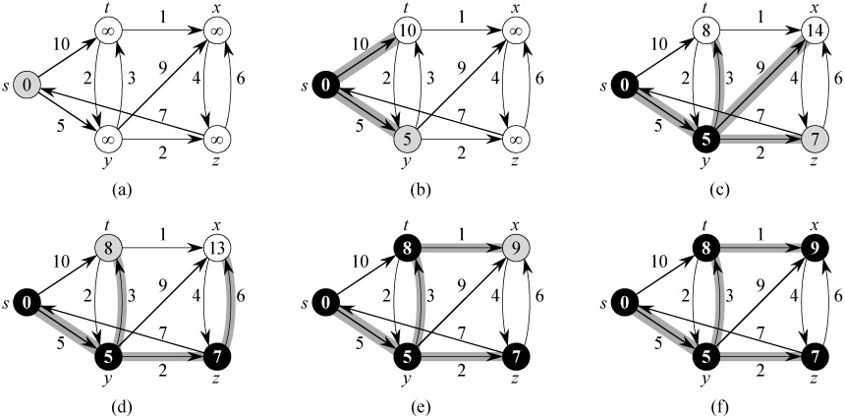
Dijkstra’s Algorithm: Example
Note: All the shortest paths found by Dijkstra’s algorithm form a tree (shortest-path tree).

Slide 12
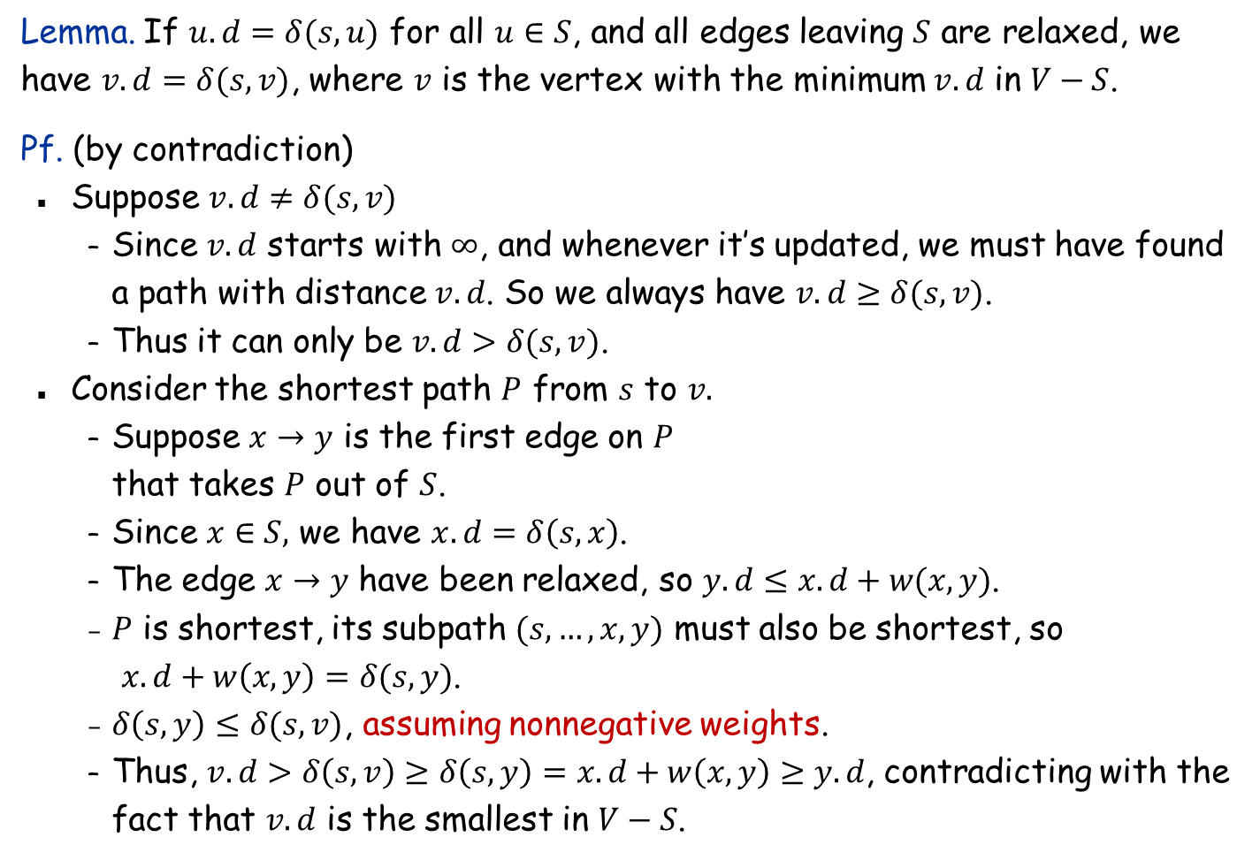
Dijkstra's Algorithm: Correctness
Lemma. If $u.d=δ(s,u)$ for all $u∈S$, and all edges leaving $S$ are relaxed, we have $v.d=δ(s,v)$, where $v$ is the vertex with the minimum $v.d$ in $V−S$.
Pf. (by contradiction)
Suppose $v.d≠δ(s,v)$
Since $v.d$ starts with $∞$, and whenever it’s updated, we must have found a path with distance $v.d$. So we always have $v.d≥δ(s,v)$.
Thus it can only be $v.d>δ(s,v)$.
Consider the shortest path $P$ from $s$ to $v.$
Suppose $x→y$ is the first edge on $P$ that takes $P$ out of $S$.
Since $x∈S,$ we have $x.d=δ\left(s,x\right)$.
The edge $x→y$ have been relaxed, so $y.d≤x.d+w(x,y)$.
$P$ is shortest, its subpath $(s,…,x,y)$ must also be shortest, so $x.d+w\left(x,y\right)=δ(s,y)$.
$δ\left(s,y\right)≤δ(s,v)$, assuming nonnegative weights.
Thus, $v.d>δ\left(s,v\right)≥δ\left(s,y\right)=x.d+w\left(x,y\right)≥y.d$, contradicting with the fact that $v.d$ is the smallest in $V−S$.
P
x
y
s
S
u
v

Slide 13

Shortest paths on graphs with negative-weight edges
Shortest path problem. Given a directed graph $G=(V, E)$, with edge weights that may be both positive and negative, find shortest path from node $s$ to every other node.
Applications.
Road network: scenic roads
Financial transactions: edges may be have positive or negative costs (profit)
2
10
3
s
9
6
18
-16
6
6
30
11
4
19
15
5
-8
6
20
16
7
44
t

Slide 14
Shortest Paths with Negative Weights: Failed Attempts
Dijkstra. Can fail if negative edge costs.
Re-weighting. Adding a constant to every edge weight can fail.
u
2
3
s
v
1
-6
t
5
5
2
2
s
6
t
6
3
0
3
-3

Slide 15
Shortest Paths: Negative Weight Cycles
Negative weight cycle.
Note. The shortest path problem is not be well defined if there are negative-weight cycles in the graph. So will assume no negative cycles.
-6
-4
7
s
t
C
w(C) < 0

Slide 16
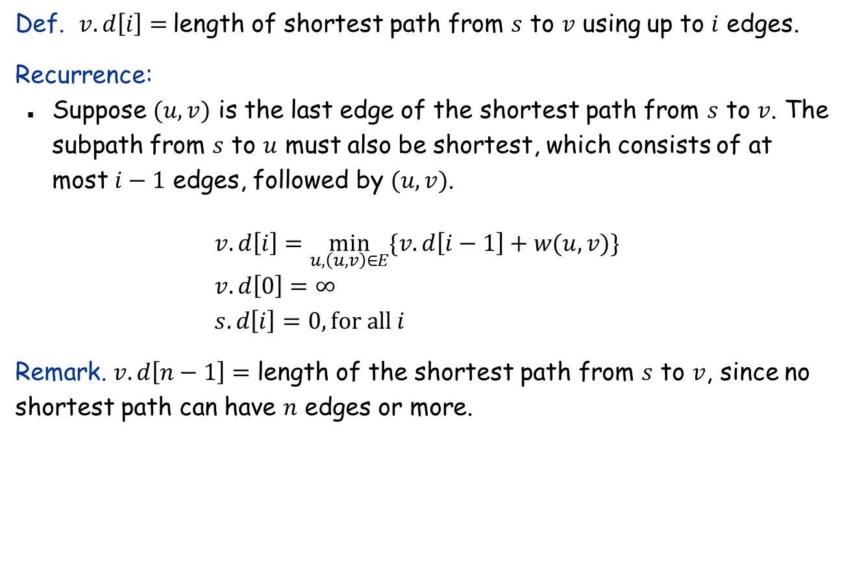
Dynamic Programming
Def. $v.d\left[i\right]=$length of shortest path from $s$ to $v$ using up to $i$ edges.
Recurrence:
Suppose $(u, v)$ is the last edge of the shortest path from $s$ to $v$. The subpath from $s$ to $u$ must also be shortest, which consists of at most $i−1$ edges, followed by $(u,v)$.
$$v.d\left[i\right]=\min_{u,\left(u,v\right)∈E}{\{v.d\left[i−1\right]+w(u,v)\}} \\ v.d\left[0\right]=∞ \\ s.d\left[i\right]=0, for all i$$
Remark. $v.d\left[n−1\right]=$ length of the shortest path from $s$ to $v$, since no shortest path can have $n$ edges or more.

Slide 17


Dynamic Programming: Implementation
Analysis. $O\left(VE\right)$ time, $O(V^{2})$ space.
Shortest-Path($G,s$):
for each node $v∈V$ do
for $i←0$ to $n−1$ do
$v.d\left[i\right]←∞$
for $i←0$ to $n−1$ do
$s.d\left[i\right]←0$
for $i←1$ to $n−1$
for each edge $\left(u,v\right)∈E$
if $u.d\left[i−1\right]+w\left(u,v\right)<v.d[i]$ then
$v.d\left[i\right]←u.d\left[i−1\right]+w(u,v)$
$v.p\left[i\right]←u$

Slide 18
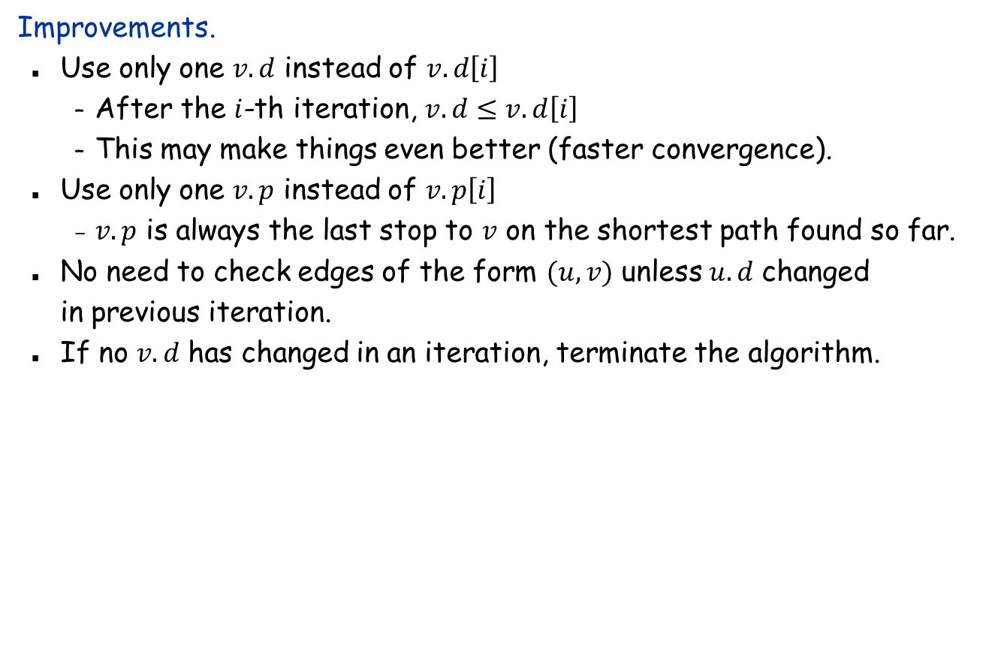
Improvements and simplifications
Improvements.
Use only one $v.d$ instead of $v.d\left[i\right]$
After the $i$-th iteration, $v.d≤v.d\left[i\right]$
This may make things even better (faster convergence).
Use only one $v.p$ instead of $v.p\left[i\right]$
$v.p$ is always the last stop to $v$ on the shortest path found so far.
No need to check edges of the form $(u, v)$ unless $u.d$ changed in previous iteration.
If no $v.d$ has changed in an iteration, terminate the algorithm.

Slide 19
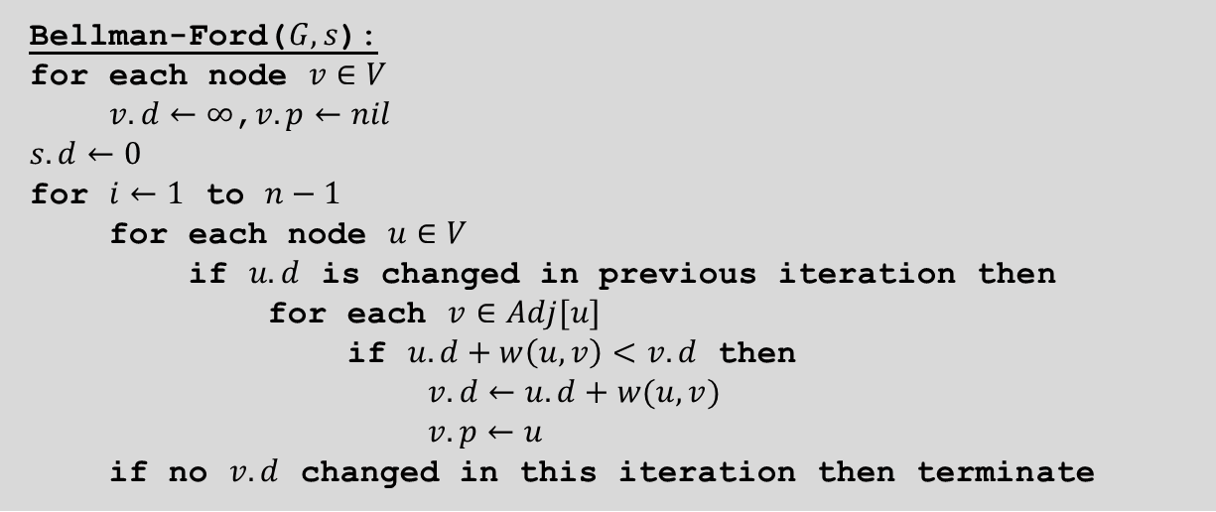
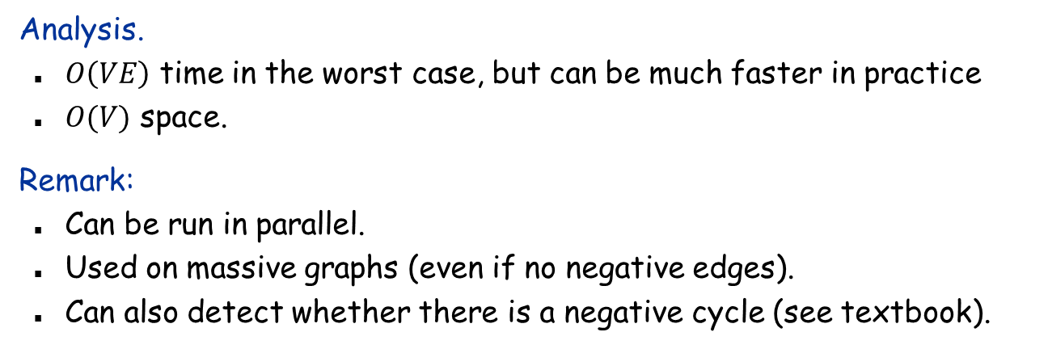
Bellman-Ford: Efficient Implementation
Bellman-Ford($G, s$):
for each node $v∈V$
$v.d←∞$,$v.p←nil$
$s.d←0$
for $i←1$ to $n−1$
for each node $u∈V$
if $u.d$ is changed in previous iteration then
for each $v∈Adj[u]$
if $u.d+w\left(u,v\right)<v.d$ then
$v.d←u.d+w(u,v)$
$v.p←u$
if no $v.d$ changed in this iteration then terminate
Analysis.
$O\left(VE\right)$ time in the worst case, but can be much faster in practice
$O(V)$ space.
Remark:
Can be run in parallel.
Used on massive graphs (even if no negative edges).
Can also detect whether there is a negative cycle (see textbook).

Slide 20
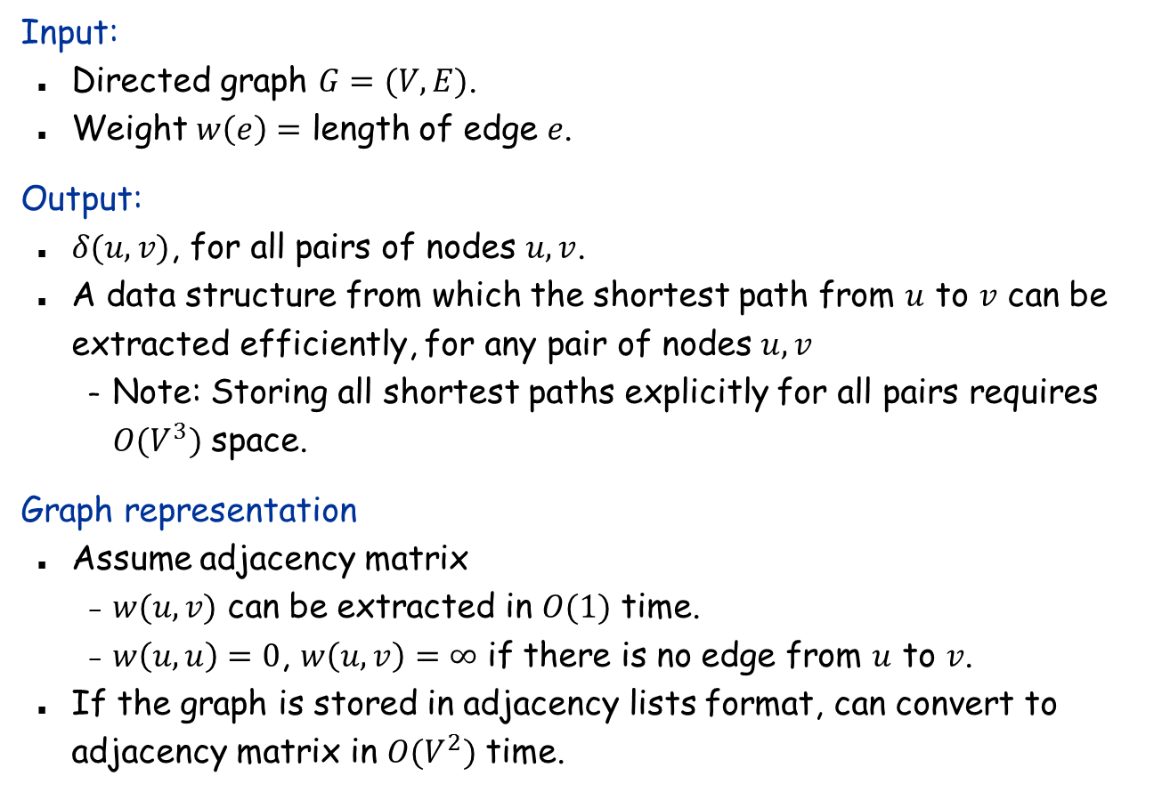
All-Pairs Shortest Paths
Input:
Directed graph $G=(V, E)$.
Weight $w\left(e\right)=$ length of edge $e$.
Output:
$δ(u,v)$, for all pairs of nodes $u,v$.
A data structure from which the shortest path from $u$ to $v$ can be extracted efficiently, for any pair of nodes $u,v$
Note: Storing all shortest paths explicitly for all pairs requires $O(V^{3})$ space.
Graph representation
Assume adjacency matrix
$w(u,v)$ can be extracted in $O(1)$ time.
$w\left(u,u\right)=0$, $w\left(u,v\right)=∞$ if there is no edge from $u$ to $v$.
If the graph is stored in adjacency lists format, can convert to adjacency matrix in $O(V^{2})$ time.

Slide 21
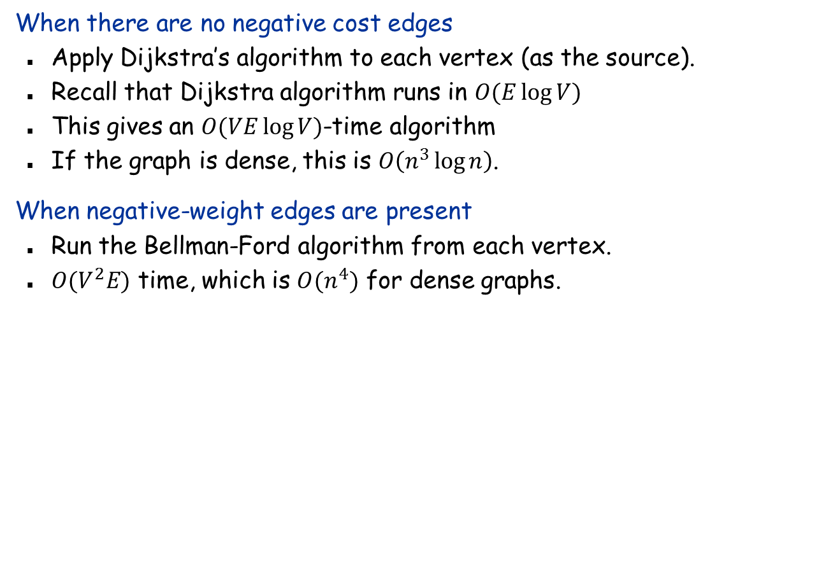
Using previous algorithms
When there are no negative cost edges
Apply Dijkstra’s algorithm to each vertex (as the source).
Recall that Dijkstra algorithm runs in $O(E\log{V})$
This gives an $O(VE\log{V})$-time algorithm
If the graph is dense, this is $O\left(n^{3}\log{n}\right)$.
When negative-weight edges are present
Run the Bellman-Ford algorithm from each vertex.
$O(V^{2}E)$ time, which is $O(n^{4})$ for dense graphs.

Slide 22
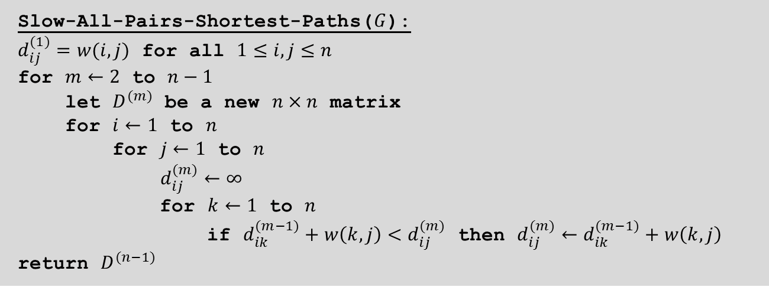
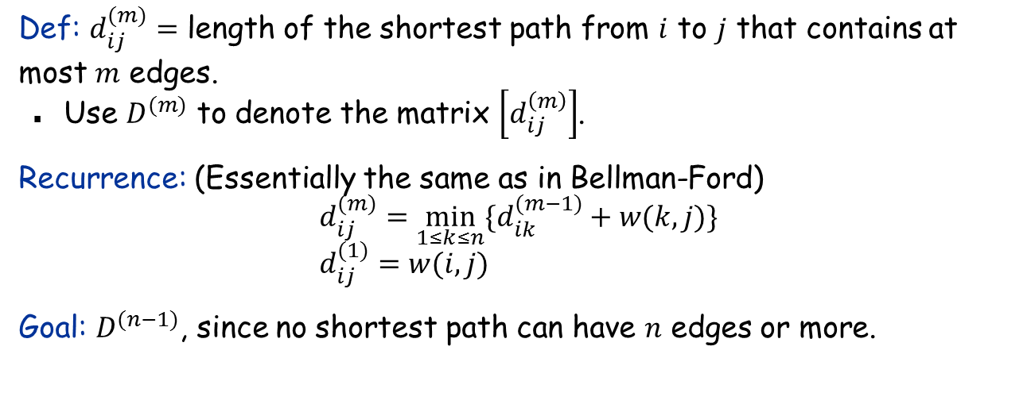
Dynamic Programming: Solution 1
Def: $d_{ij}^{(m)}=$ length of the shortest path from $i$ to $j$ that contains at most $m$ edges.
Use $D^{(m)}$ to denote the matrix $\left[d_{ij}^{\left(m\right)}\right]$.
Recurrence: (Essentially the same as in Bellman-Ford) $$d_{ij}^{(m)}=\min_{1≤k≤n}{\{d_{ik}^{(m−1)}+w(k,j)\}} \\ d_{ij}^{(1)}=w(i,j)$$
Goal: $D^{(n−1)}$, since no shortest path can have $n$ edges or more.
Slow-All-Pairs-Shortest-Paths($G$):
$d_{ij}^{(1)}=w(i,j)$ for all $1≤i,j≤n$ for $m←2$ to $n−1$
let $D^{(m)}$ be a new $n×n$ matrix
for $i←1$ to $n$
for $j←1$ to $n$
$d_{ij}^{(m)}←∞$
for $k←1$ to $n$
if $d_{ik}^{(m−1)}+w\left(k,j\right)<d_{ij}^{(m)}$ then $d_{ij}^{(m)}←d_{ik}^{(m−1)}+w\left(k,j\right)$
return $D^{(n−1)}$

Slide 23
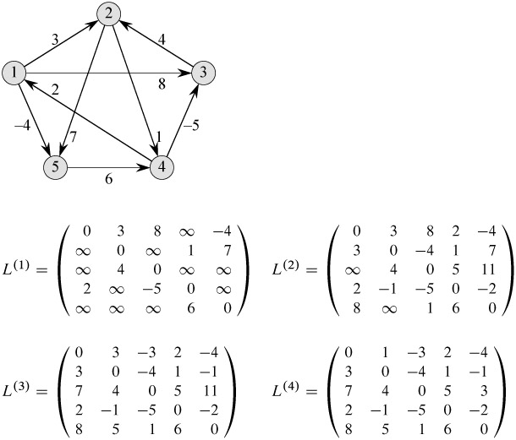
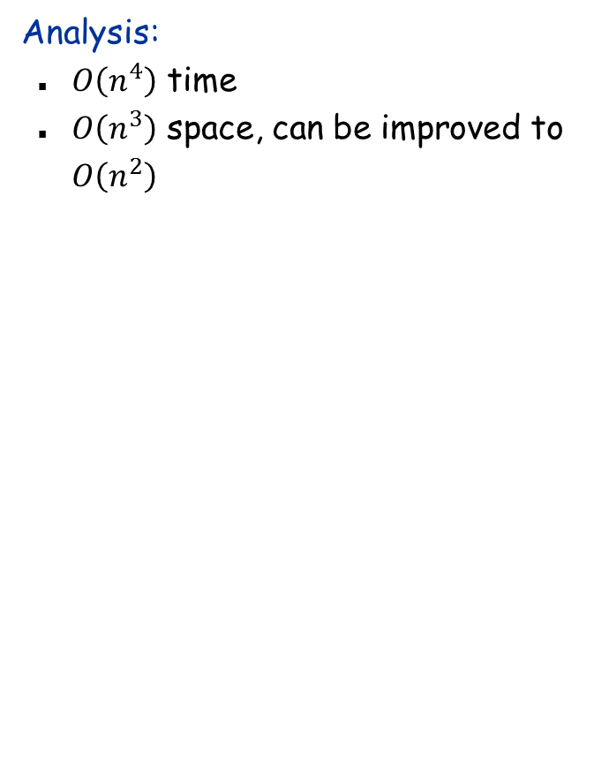
Example
Analysis:
$O\left(n^{4}\right)$ time
$O\left(n^{3}\right)$ space, can be improved to $O\left(n^{2}\right)$

Slide 24
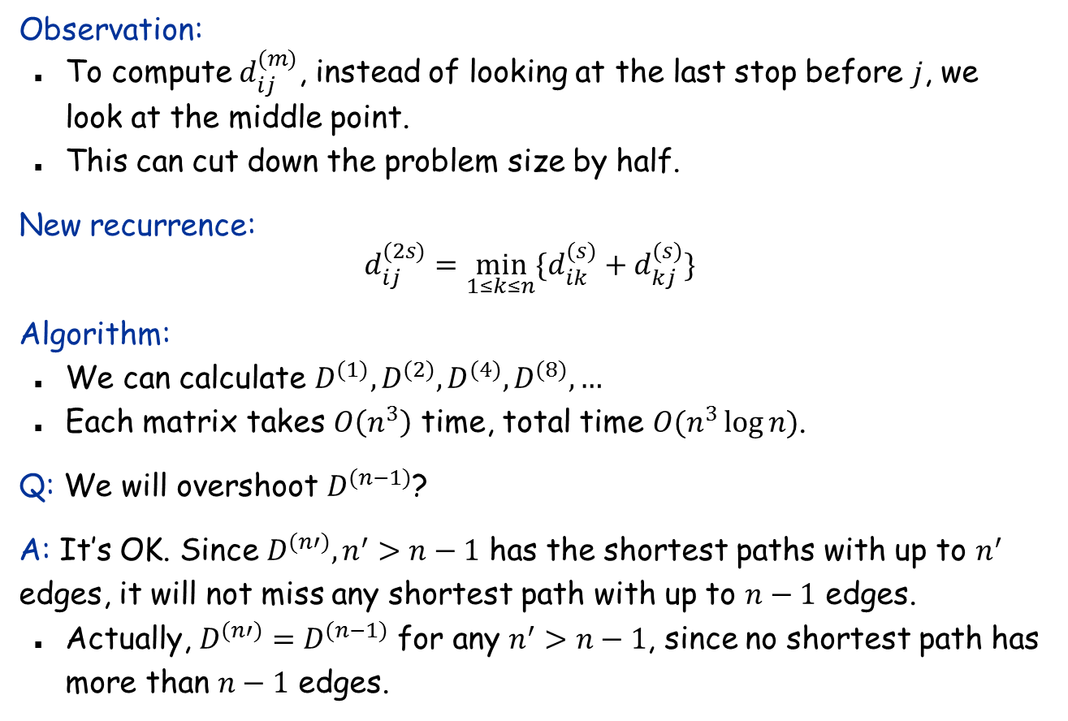
Dynamic Programming: Solution 2
Observation:
To compute $d_{ij}^{(m)}$, instead of looking at the last stop before $j$, we look at the middle point.
This can cut down the problem size by half.
New recurrence:
$$d_{ij}^{(2s)}=\min_{1≤k≤n}{\{d_{ik}^{(s)}+d_{kj}^{(s)}\}}$$
Algorithm:
We can calculate $D^{(1)},D^{(2)},D^{(4)},D^{(8)},…$
Each matrix takes $O\left(n^{3}\right)$ time, total time $O(n^{3}\log{n)}$.
Q: We will overshoot $D^{(n−1)}$?
A: It’s OK. Since $D^{(n′)}, n^{′}>n−1$ has the shortest paths with up to $n^{′}$ edges, it will not miss any shortest path with up to $n−1$ edges.
Actually, $D^{(n′)}=D^{(n−1)}$ for any $n^{′}>n−1$, since no shortest path has more than $n−1$ edges.

Slide 25
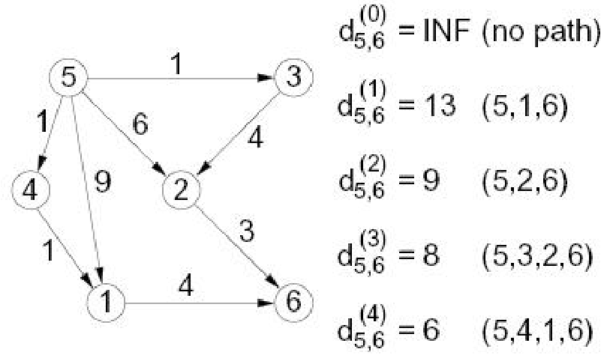

Dynamic Programming: Solution 3 (Floyd-Warshall)
Def: $d_{ij}^{(k)}=$ length of the shortest path from $i$ to $j$ that such that all intermediate vertices on the path (if any) are in the set $\{1,2,…,k\}$.
Initially: $d_{ij}^{\left(0\right)}=w(i,j)$
Goal: $D^{(n)}$

Slide 26
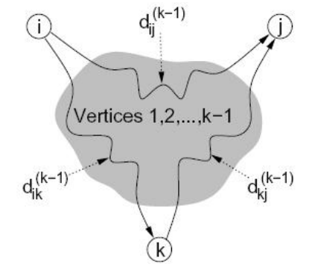
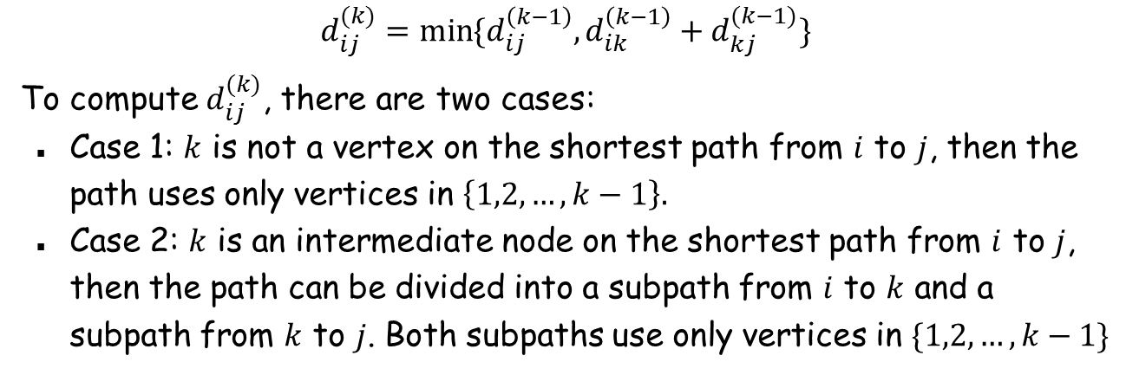
Recurrence
$$d_{ij}^{(k)}=\min{\{d_{ij}^{\left(k−1\right)},d_{ik}^{\left(k−1\right)}+d_{kj}^{(k−1)}\}}$$
To compute $d_{ij}^{(k)}$, there are two cases:
Case 1: $k$ is not a vertex on the shortest path from $i$ to $j$, then the path uses only vertices in $\left\{1,2,…,k−1\right\}.$
Case 2: $k$ is an intermediate node on the shortest path from $i$ to $j$, then the path can be divided into a subpath from $i$ to $k$ and a subpath from $k$ to $j$. Both subpaths use only vertices in $\{1,2,…,k−1\}$

Slide 27
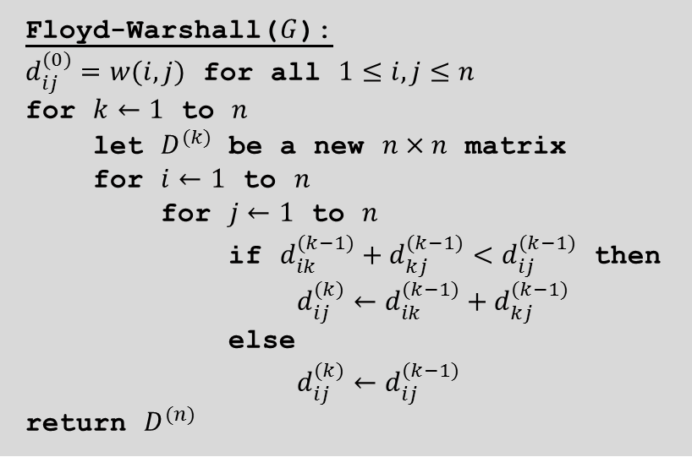
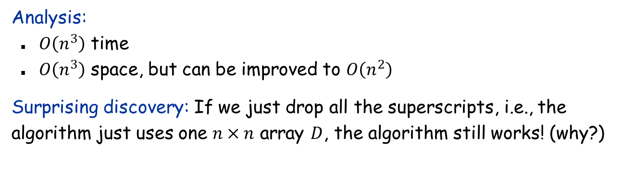
The Floyd-Warshall Algorithm
Floyd-Warshall($G$):
$d_{ij}^{(0)}=w(i,j)$ for all $1≤i,j≤n$ for $k←1$ to $n$
let $D^{(k)}$ be a new $n×n$ matrix
for $i←1$ to $n$
for $j←1$ to $n$
if $d_{ik}^{(k−1)}+d_{kj}^{(k−1)}<d_{ij}^{(k−1)}$ then
$d_{ij}^{(k)}←d_{ik}^{(k−1)}+d_{kj}^{(k−1)}$
else
$d_{ij}^{(k)}←d_{ij}^{(k−1)}$
return $D^{(n)}$
Analysis:
$O\left(n^{3}\right)$ time
$O\left(n^{3}\right)$ space, but can be improved to $O\left(n^{2}\right)$
Surprising discovery: If we just drop all the superscripts, i.e., the algorithm just uses one $n×n$ array $D$, the algorithm still works! (why?)

Slide 28
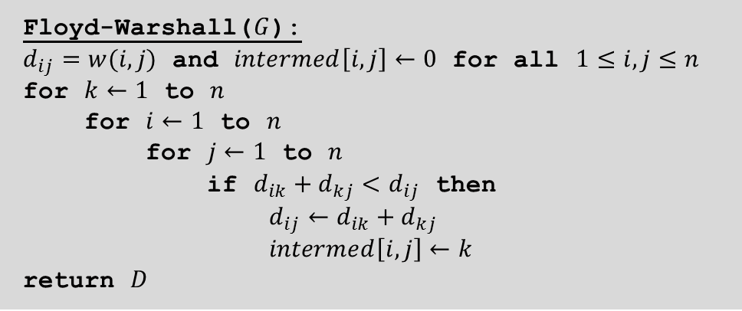
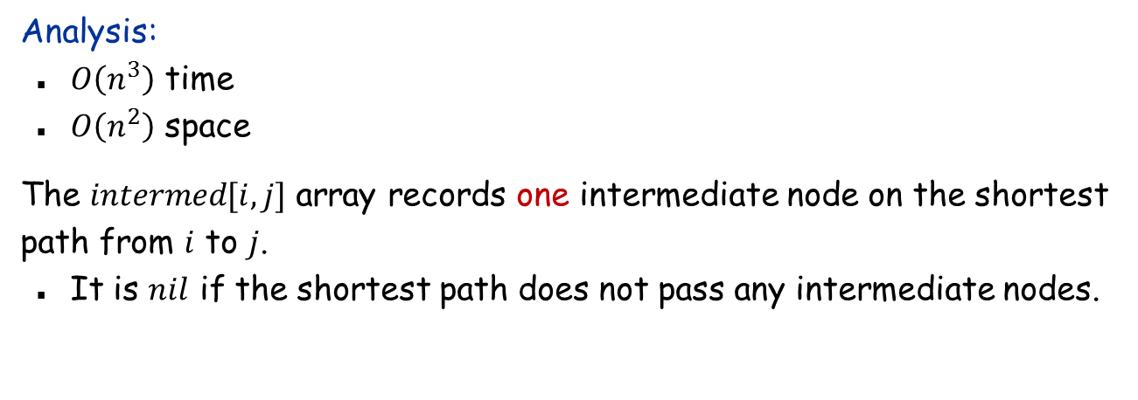
The Floyd-Warshall Algorithm: Final Version
Floyd-Warshall($G$):
$d_{ij}=w(i,j)$ and $intermed\left[i,j\right]←0$ for all $1≤i,j≤n$ for $k←1$ to $n$
for $i←1$ to $n$
for $j←1$ to $n$
if $d_{ik}+d_{kj}<d_{ij}$ then
$d_{ij}←d_{ik}+d_{kj}$
$intermed\left[i,j\right]←k$
return $D$
Analysis:
$O\left(n^{3}\right)$ time
$O\left(n^{2}\right)$ space
The $intermed[i,j]$ array records one intermediate node on the shortest path from $i$ to $j$.
It is $nil$ if the shortest path does not pass any intermediate nodes.

Slide 29



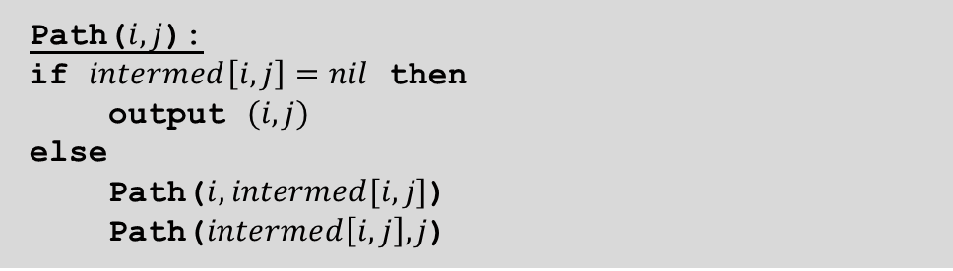






Extracting Shortest Paths
Path($i,j$):
if $intermed\left[i,j\right]=nil$ then
output $(i,j)$
else
Path($i,intermed[i,j]$)
Path($intermed\left[i,j\right],j$)
Example:
Running time: O(length of the shortest path)
Path(2,3)
$$intermed[2,3]=6$$
$$\text{Path}\text{(2,6)}$$
$$intermed[2,6]=5$$
$$\text{Path}\text{(6,3)}$$
$$intermed[6,3]=4$$
$$\text{Path}\text{(2,5)}$$
$$\text{Path}\text{(5,6)}$$
$\text{Path}\text{(6,4}$)
$$\text{Path}\text{(4,3}\text{)}$$
Output (2,5)
Output (5,6)
Output (6,4)
Output (4,3)

