Slide 1
COMP 3711
Midterm review

Slide 2
Course Intended Learning Outcomes
Describe fundamental concepts and techniques for determining the asymptotic behavior of real-valued functions defined in natural numbers.
Explain recurrence equations and solve common recurrences using a variety of techniques.
Analyze an algorithm described in plain language or some form of pseudocode in terms of its time (or space) efficiency as a function of the size of a problem instance.
Explain how various data structures, including trees, heaps and disjoint set structures, influence the time efficiency of algorithms.
Apply general algorithmic design and analysis techniques to solving problems, including greedy, divide-and-conquer and dynamic programming.
Identify randomization in algorithms and analyze basic randomized algorithms such as randomized quicksort and selection.

Slide 3
1. Describe fundamental concepts and techniques for determining the asymptotic behavior of real-valued functions defined in natural numbers.

Slide 4
Definitions of O, Ω, Θ
Given a function f(n), determine f(n) = Θ( ? )
ignore lower order terms
ignore the constant coefficient of the most significant term (what’s a constant?)
Given two functions f(n), g(n), determine whether f(n) = O(g(n)), f(n)= Ω(g(n)), or f(n) = Θ(g(n))
Formal definition
Quick rules: log^{c} n < n^{c} < c^{n}
How about functions involving two parameters, like n and k?
Two such functions may not always be comparable.
Common summations (see background sheet)

Slide 5
2. Explain recurrence equations and solve common recurrences using a variety of techniques.

Slide 6
Recurrences naturally arise in
Analysis of divide-and-conquer algorithms
Induction proofs
Two methods: Recursion tree and substitution method
Recursion tree: intuitive, easier, no need to guess, less powerful
Substitution method: involves more math, more difficult, need to guess first, more powerful
Master theorem (see background sheet)
You can use any method, but we will make sure that all recurrences in the exam can be solved by the recursion tree method
Note: Don’t use big-O during the derivation, use it only at the end.

Slide 7
3. Analyze an algorithm described in plain language or some form of pseudocode in terms of its time (or space) efficiency as a function of the size of a problem instance.

Slide 8
Default: Worst-case
Others: expected case vs average case
Simple analysis
Single/double loops: insertion sort, counting sort
Iterative algorithms: radix sort, string sorting (homework question)
Divide and conquer algorithms: Use recurrence
Algorithms using some data structures
Heap and heapsort
AVL tree

Slide 9
4. Explain how various data structures, including trees, heaps and disjoint set structures, influence the time efficiency of algorithms.

Slide 10
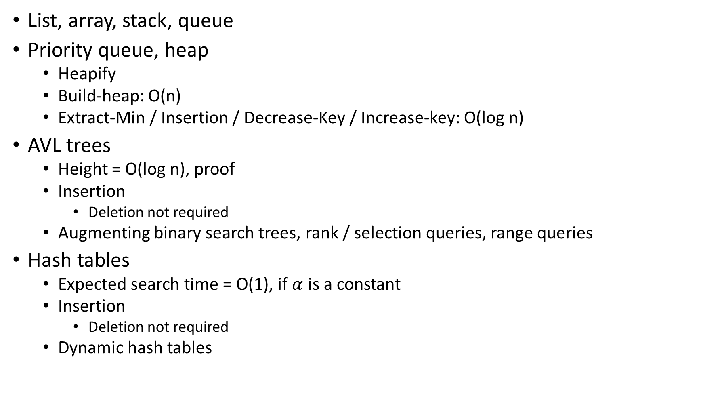
List, array, stack, queue
Priority queue, heap
Heapify
Build-heap: O(n)
Extract-Min / Insertion / Decrease-Key / Increase-key: O(log n)
AVL trees
Height = O(log n), proof
Insertion
Deletion not required
Augmenting binary search trees, rank / selection queries, range queries
Hash tables
Expected search time = O(1), if $α$ is a constant
Insertion
Deletion not required
Dynamic hash tables

Slide 11
5. Apply general algorithmic design and analysis techniques to solving problems, including greedy, divide-and-conquer and dynamic programming.

Slide 12
Divide into two halves, recursively solve both, then combine
Mergesort
Counting inversions
Maximum contiguous subarray
Divide into two halves, recursively solve one
Binary search
Local minimum (homework question)
Divide into two halves, recursively solve more than two subproblems
Integer multiplication
Need to know how to analyze such an algorithm
Will not ask you to design such an algorithm on the exam

Slide 13
6. Identify randomization in algorithms and analyze basic randomized algorithms such as randomized quicksort and selection.

Slide 14
Basic probability theory
Probability distribution, expectation, independence,
Linearity of expectation
Expected running-time for randomized algorithms
Expectation is only taken over the internal random choices, input can still be the worst
The indicator random variable technique
The hiring problem, card guessing, waiting time, birthday paradox, coupon collector
Analysis of quicksort
Analysis of randomized selection
Analysis of bucket sort
Analysis of hash tables: chaining and open addressing

Slide 15
Other issues
Ω(n log n) sorting lower bound
Understand what is a comparison-based algorithm
The decision-tree model
The lower bound proof
NOT required (just need to know what, but not how and why):
Stable marriage
Bubble sort
The O(n)-time algorithm for maximum contiguous subarray
Matrix multiplication
Deletion in AVL-tree and hash tables

Slide 16
About the Midterm Exam
The midterm is on: 27-Mar (Fri) 19:00-21:00 in LTB
A makeup session is scheduled at 17:00-19:00 in 3501
Send me an email if you need to take the makeup session
Coverage: Everything from the beginning to hash tables.
It will be a closed-book exam, but the mathematical background sheet will be provided
You are recommended to use pencils (so that you can easily correct possible mistakes)
Calculators or other electronic means are not allowed (or needed).

