Slide 1
Tutorial 1: Environment Setup
COMP 4211 Machine Learning
TA: Yimin Zheng
yzhengbs@cse.ust.hk

Slide 2
Outline
Software: Anaconda, Jupyterlab, Python
Computational resource

Slide 3
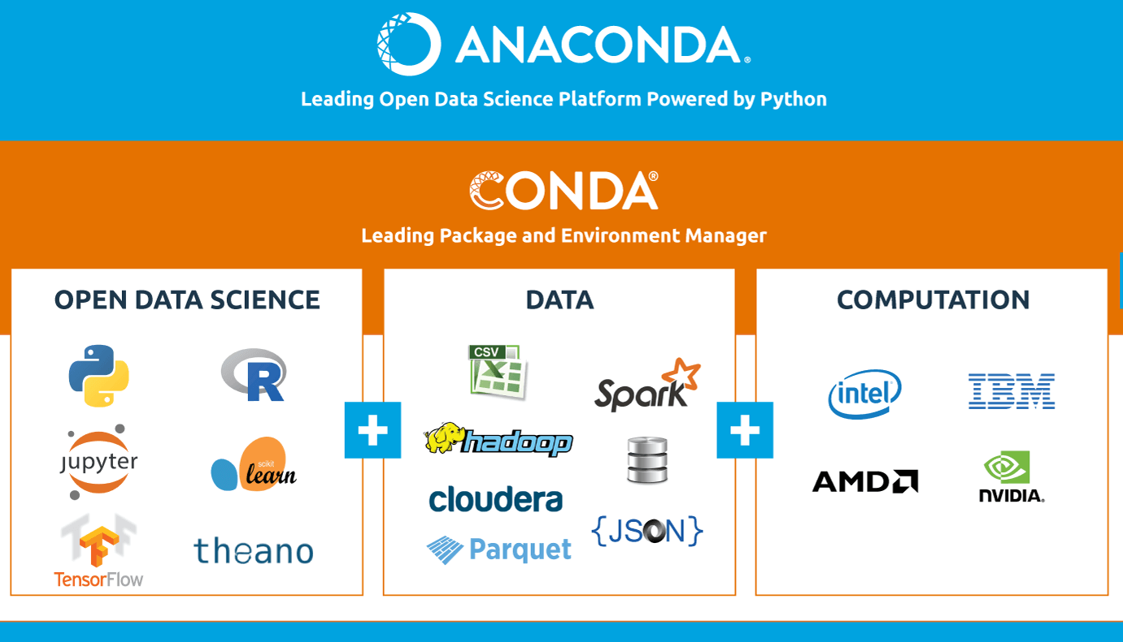
Anaconda
Anaconda provides handy tools for writing machine learning code.
Conda, Jupyterlab, Python, Pytorch, and more

Slide 4
Conda
Conda is a cross-platform package manager and environment management system.
What is an environment?
A conda environment is a directory that contains a specific collection of packages that you have installed.
Why environment management?
Use multiple versions of a package
Avoid package confliction, e.g., Pytorch and Tensorflow

Slide 5
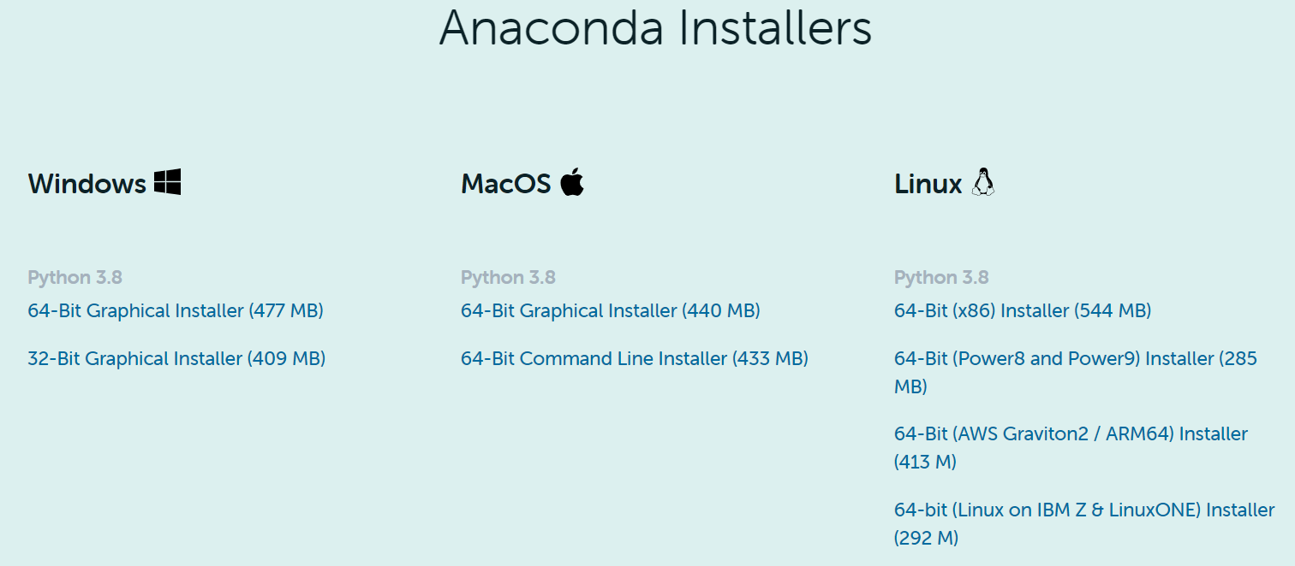
Anaconda installation
Download from https://www.anaconda.com/products/individual

Slide 6
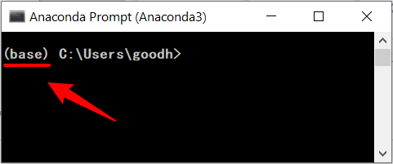
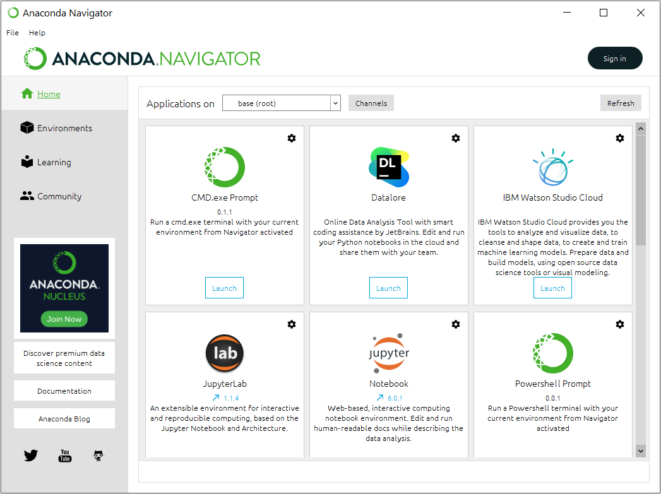
Anaconda interface
Command line interface
Graphic user interface

Slide 7
Conda commands
Environment management
conda create -n env_name (Create a conda environment)
conda activate env_name (Activate the environment to use it)
conda deactivate (Deactivate the environment)
conda info --envs (Get a list of all my environments)
Package management
conda list (View list of packages and versions installed in active environment)
conda install pkg_name (Install new package in the current environment, e.g. python=3.9, numpy, matplotlib, pandas, scipy)
conda update pkg_name (Update package in the current environment)
conda uninstall pkg_name (Uninstall package from the current environment)

Slide 8
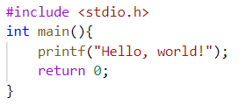
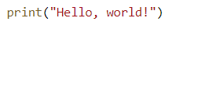

Python
Python is a simple and elegant programming language; it is like human’s languages.
Print “Hello, world!” in C and Python:
Python is used in many areas, including machine learning
C programming language
Python programming language

Slide 9
Useful packages
numpy
scientific computation, e.g., matrix multiplication
matplotlib
data visualization, e.g., plotting data
pandas
data manipulation and analysis, e.g., data cleaning
scipy
technical computing, e.g., optimization, interpolation
sklearn
machine learning tools (conda install -c conda-forge scikit-learn), e.g., clustering
Notes:
pytorch
machine-learning library, e.g., neural network

Slide 10
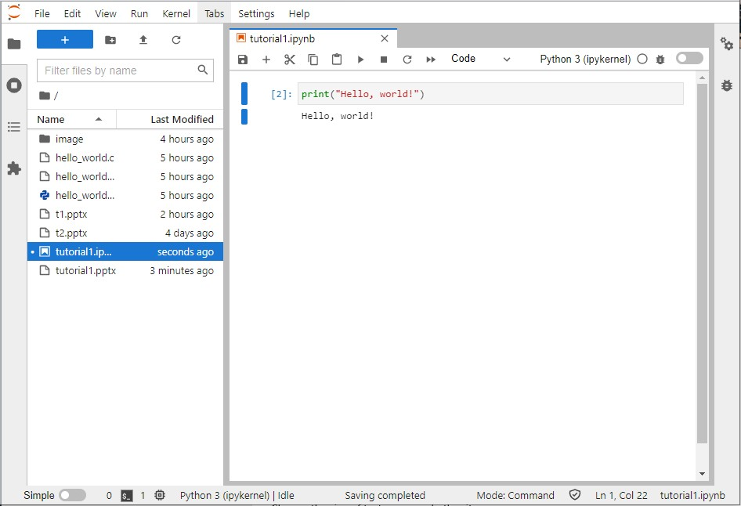
JupyterLab
JupyterLab is a web-based interactive coding environment for machine learning
Activate conda environment first!
conda activate env_name
Install JupyterLab
conda install -c conda-forge jupyterlab
Run JupyterLab
jupyter lab (default port 8888)
jupyter lab –port=port_number (optionally with another port)

Slide 11
Computational resource
Personal computer
Google Colab
https://colab.research.google.com/notebooks/intro.ipynb
Remote servers available for Undergraduate
https://cssystem.cse.ust.hk/Facilities/ug_cluster/gpu.html
ugcpu.cse.ust.hk (available to UG(CSE?))
Undergraduate Laboratories
https://cssystem.cse.ust.hk/Facilities/index.html

Slide 12
Thanks!

