Slide 1
Tutorial 4: Multilayer Perceptron and Autograd
COMP 4211
TA: Vincent Cheng
yzhengbs@connect.ust.hk

Slide 2
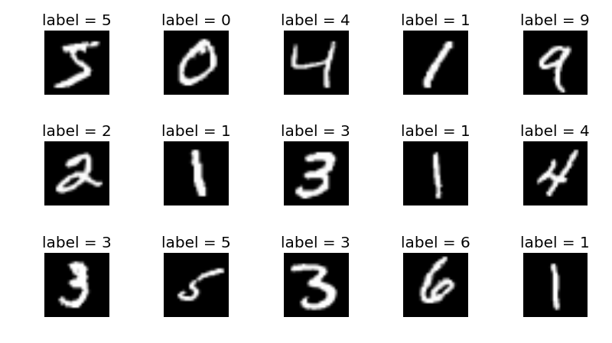
Multilayer Perceptron (MLP)
Given 60000 handwritten-digit images, train a MLP that can classify the digits in new handwritten-digit images

Slide 3
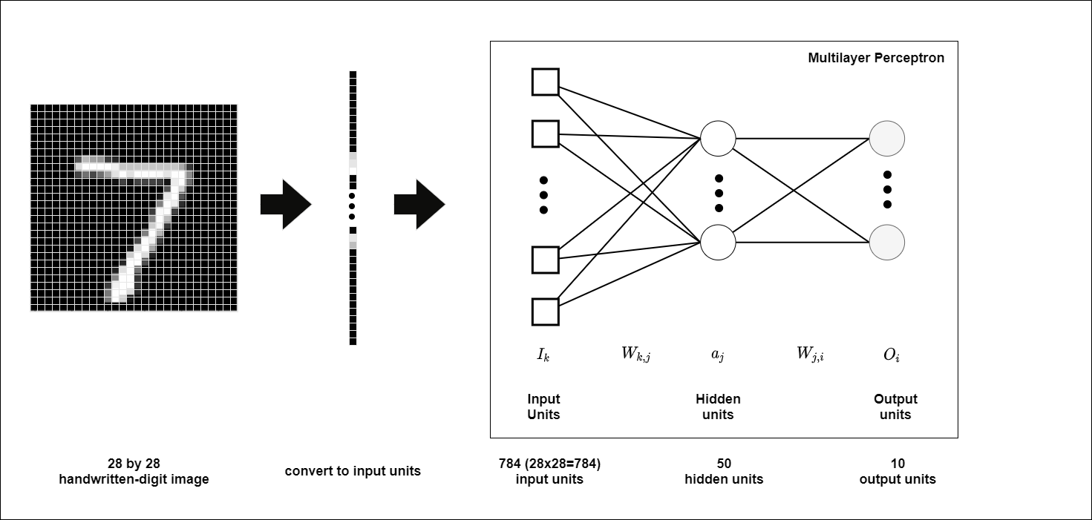
Multilayer Perceptron (MLP)
Given 60000 handwritten-digit images, train a MLP that can classify the digits in new handwritten-digit images

Slide 4
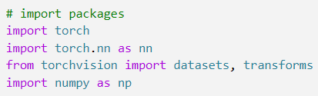
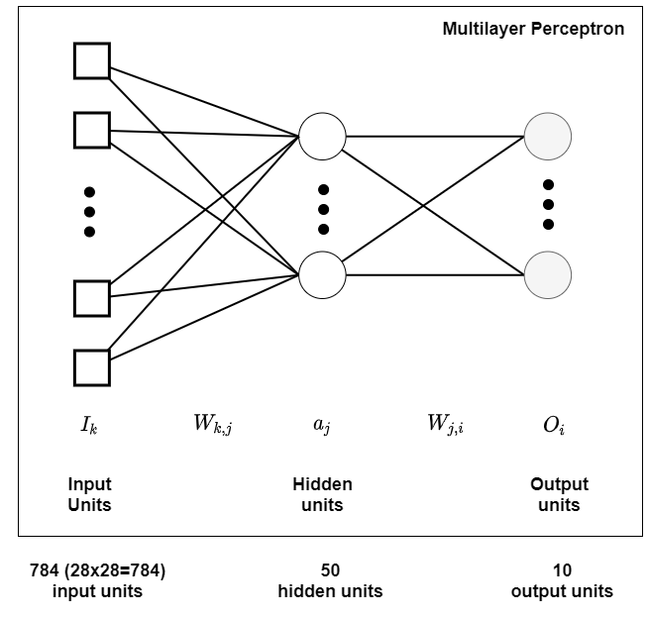
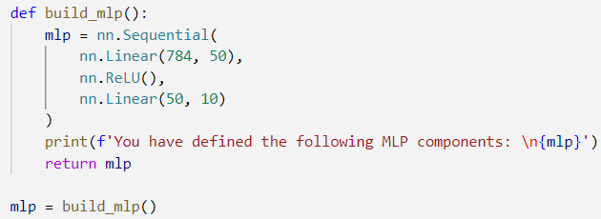
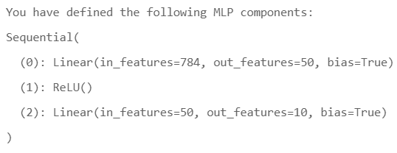
Initialize MLP

Slide 5
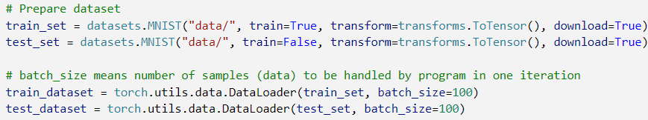
Loading training and testing data
Loading MNIST dataset (train + test)
Note: downloading data costs 5~10 seconds

Slide 6
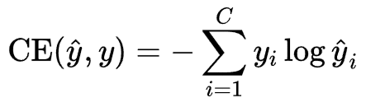
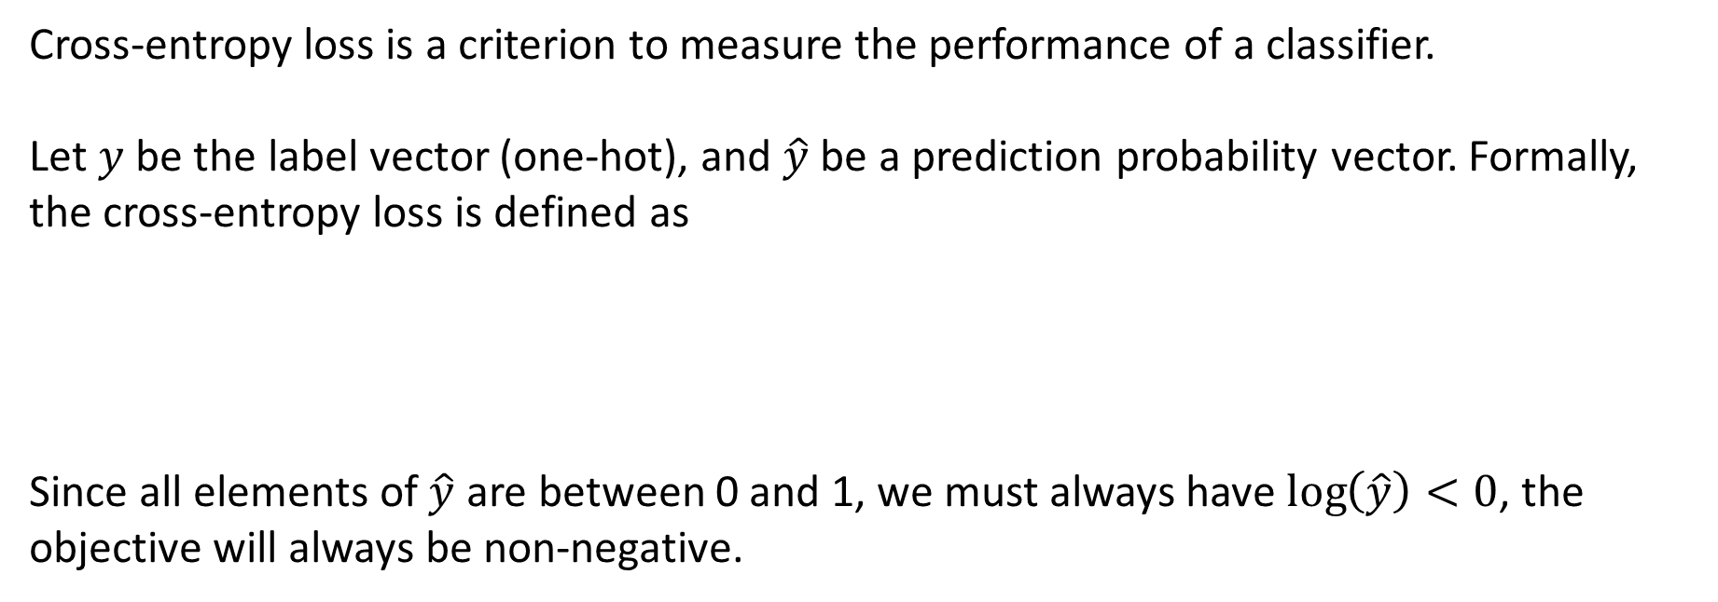
Cross-entropy loss
Cross-entropy loss is a criterion to measure the performance of a classifier.
Let $y$ be the label vector (one-hot), and $\hat{y}$ be a prediction probability vector. Formally, the cross-entropy loss is defined as
Since all elements of $\hat{y}$ are between 0 and 1, we must always have $\log\left(\hat{y}\right)<0$, the objective will always be non-negative.

Slide 7
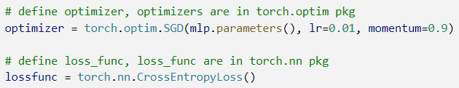
Loss function and optimizer
Learning rate parameter “lr” should be manually tuned (not too big or too small)

Slide 8
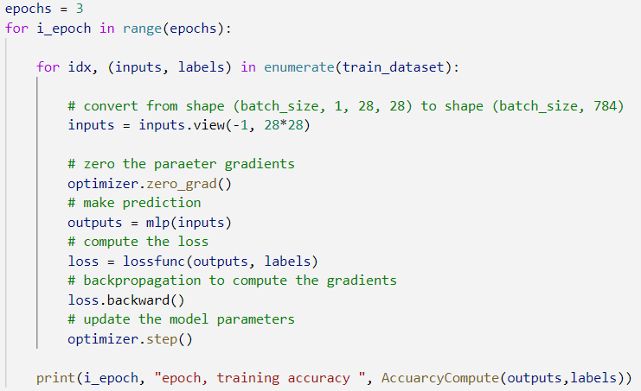
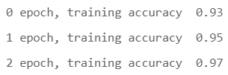
Train MLP
Typically, one runs the training until convergence.
Here we run for 3 epochs, where one epoch is one full pass over the entire train data.

Slide 9
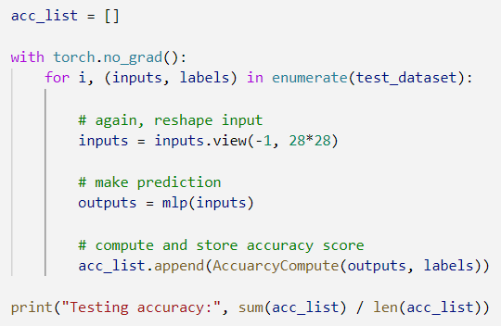
Evaluate trained MLP

Slide 10
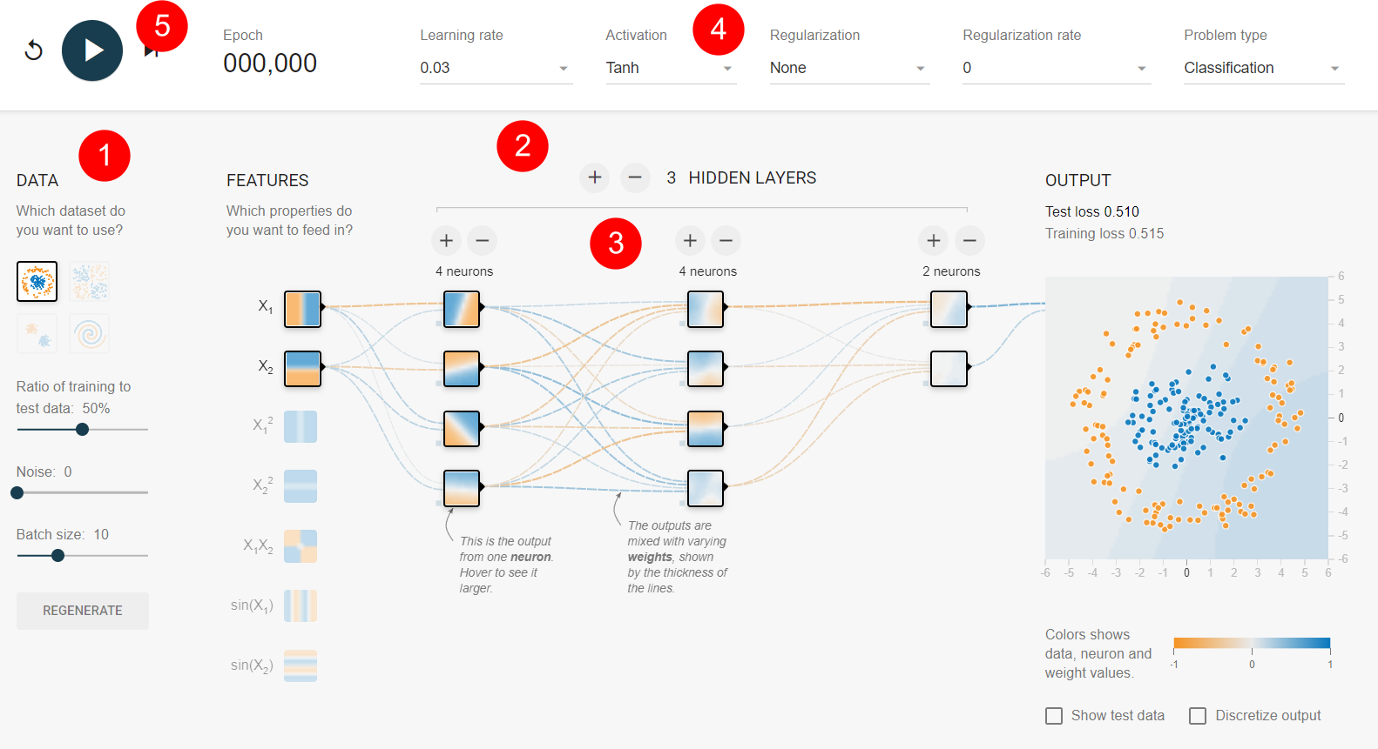
Neural Network playground [link]
Pick data
Control number of layers
Control number of neurons
Select activation function (e.g. ReLU)
Start training

Slide 11
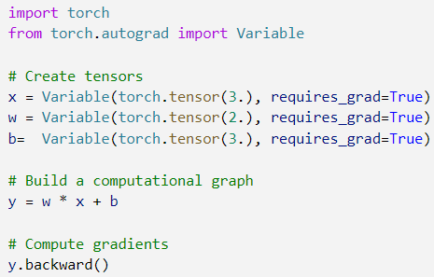

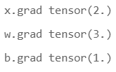
Autograd

Slide 12
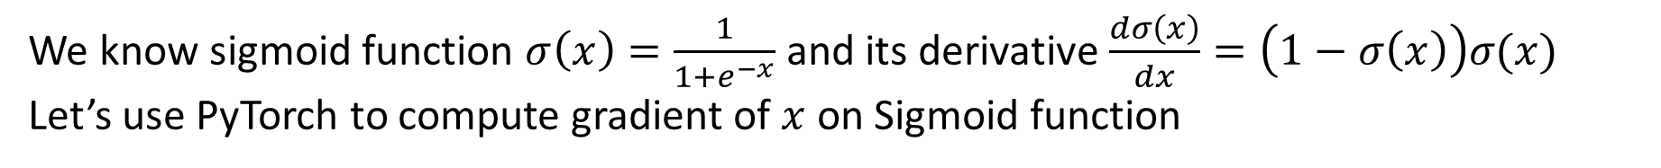
Apply autograd to Sigmoid function
We know sigmoid function $σ\left(x\right)=\frac{1}{1+e^{−x}}$ and its derivative $\frac{dσ\left(x\right)}{dx}=\left(1−σ\left(x\right)\right)σ(x)$
Let’s use PyTorch to compute gradient of $x$ on Sigmoid function

Slide 13
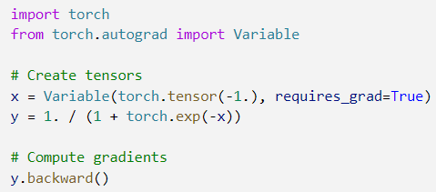

Apply autograd to Sigmoid function
We know sigmoid function $σ\left(x\right)=\frac{1}{1+e^{−x}}$ and its derivative $\frac{dσ\left(x\right)}{dx}=\left(1−σ\left(x\right)\right)σ(x)$
Let’s use PyTorch to compute gradient of $x$ on Sigmoid function

Slide 14

Apply autograd to Sigmoid function
We know sigmoid function $σ\left(x\right)=\frac{1}{1+e^{−x}}$ and its derivative $\frac{dσ\left(x\right)}{dx}=\left(1−σ\left(x\right)\right)σ(x)$
Let’s use PyTorch to compute gradient of $x$ on Sigmoid function

Slide 15
Thanks!

Slide 16
Code for this tutorial

