Slide 1
Programming
C++ Basics

Slide 2



Introduction to C++
C is a programming language developed in the 1970s with the UNIX operating system
C programs are efficient and portable across different hardware platforms
C++ is an extension of the C language
  C programs should run in C++
C++ supports “object-oriented” programming

Slide 3

General form of a C++ program
//Program description is first
#include directives go next
using namespace std;
int main(){
  constant declarations go here
  variable declarations go here
  assignment statements go here
  return 0;
}

Slide 4

General form of a C++ program
//simple program
#include <iostream>
using namespace std;
int main(){
// constant declaration
const double Pi = 3.14159;
// variable declarations
double radius;
double area;
// assignment statements
cout << "Enter circle radius: ";
cin >> radius;
area = Pi * radius * radius;
cout << "Area : " << area << endl;
return 0;
}

Slide 5

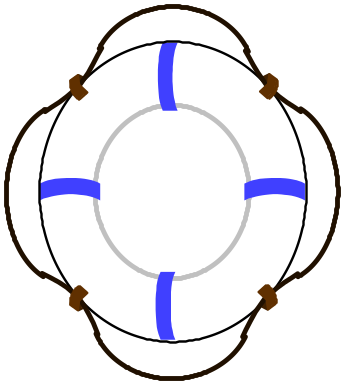
Syntax of the C++ Language
Reserved words (appear in blue in Visual C++)
  Reserved words have a special meaning in C++.
  The list of reserved words:
asm, auto, bool, break, case, catch, char, class, const, continue, default, delete, do, double, else, enum, extern, float, for, friend, goto, if, include, inline, int, long, namespace, new, operator, private, protected, public, register, return, short, signed, sizeof, static, struct, switch, template, this, throw, try, typedef, union, unsigned, using, virtual, void, volatile, while

Slide 6

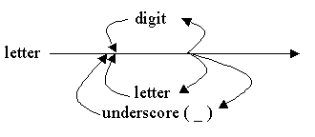
Syntax of the C++ Language
Identifiers (appear in black in Visual C++)
  An identifier is a name for variables, constants, functions, etc.
  It consists of a letter followed by any sequence of letters, digits or underscores
  Names are case-sensitive. The following are unique identifiers:
Hello, hello, whoami, whoAMI, WhoAmI
  Names cannot have special characters in them
    e.g., X=Y, J-20, #007, etc. are invalid identifiers.
  C++ reserved words cannot be used as identifiers.
  Choose identifiers that are meaningful and easy to remember.

Slide 7

Syntax of the C++ Language
Comments (appear in green in Visual C++)
  Comments are explanatory notes
  not compiled (i.e. no executable code is generated for comments)
  Comments are done in two ways:
    // A double slash starts a single line comment
    /* A slash followed by an asterisk marks the
start of a multiple line comment.
It ends with an asterisk followed by a slash */

Slide 8

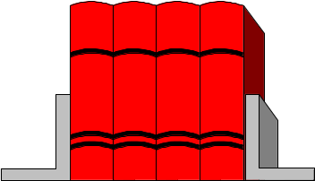
Syntax of the C++ Language
Compiler Directive: #include
  It refers to a header file of library functions or variables (e.g. input and output).
  When you compile your C++ program, the compiler reads in the contents of the file before compiling the rest of your program.
  The included file is compiled together with the program.
  There are two forms of #include:
#include <stdio.h> // for pre-defined files
#include "my_lib.h" // for user-defined files

Slide 9
Libraries
#include loads the code from the standard libraries
  #include <iostream> // new I/O library
  #include <iostream.h> // old I/O library
  #include <stdio.h> // standard functions
  #include <math.h> // math functions
  #include <stdlib.h> // contains random funct
  #include <time.h> // time function
using namespace std; indicates that the new C++ libraries should be used. If this line is left out, then the old iostream library is loaded:
  #include <iostream.h>

Slide 10




Constant Declarations
Constants represent permanent values.
Their values can only be set in the declaration:
  const double pi = 3.14159;
They can make a program more readable and maintainable
  Constant declaration syntax:
    const <type> <identifier> = <constant expression>;
  Examples:
    const double US2HK = 7.8;
    const double HK2Yuan = 1.07;
    const double US2Yuan = US2HK* HK2Yuan;

Slide 11

Variable Declarations
A variable is best thought of as a container for a value with an address:
  Variable declaration syntax:
  <type> <identifier>;
  Examples:
  int nickel;
  int penny;
A variable must be declared before it can be used.
  int main(){
  x = 5; // illegal: x was not declared
  }
1024
5342.23

Slide 12

Variable Declarations
A variable can be initialized in a declaration:
  int x = 3;
Several variables of the same type can be declared in the same declaration:
  double total_USD, area;
A variable must have only one type. For example, a variable of the type int can only hold integer values.

Slide 13
Types of Variable Declarations
BINARY DIGIT
Simple C++ variable types:
  int integer (32-bit integer on the PC) (example: 1)
  short 16-bit integer (allows ±32,767)
  long 32-bit integer (allows ±2,147,483,647)
  float floating point number (allows about 7 digits of precision: 0.1234567)
  double double precision float (allows about 15 digits of precision: 0.12345678901234)
  char a single character (example: ‘y’)

Slide 14
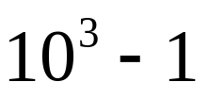
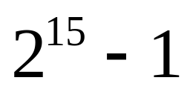
Simple Number System
Decimal
What is the maximum value a 3 decimal digit number can hold?
  999
Binary
What is the maximum value a 16-binary digit number can hold?
  one bit for sign
    0: positive (or zero)
    1: negative
  +32767
# digits
# digits
Decimal base
Binary base

Slide 15
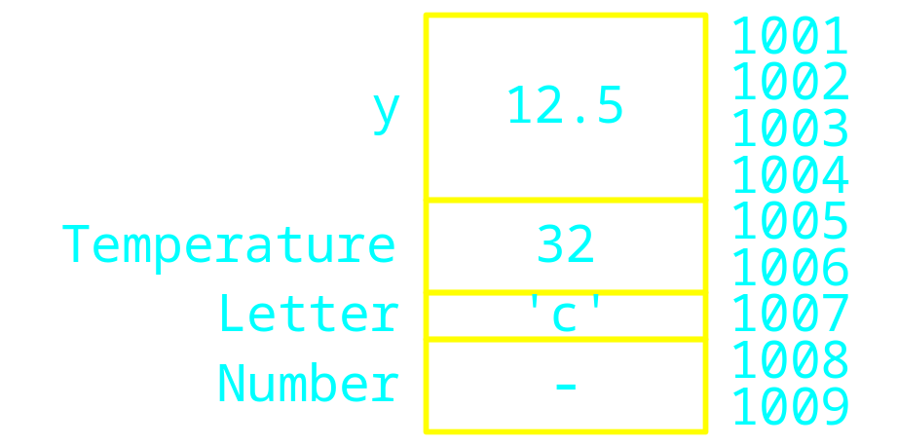


Memory Depiction
Memory
location
float y = 12.5;
short Temperature = 32;
char Letter = 'c';
short Number;

Slide 16

Assignment Statements
    Assignment syntax:
    <identifier> = <expression>;
    Examples:
    int n, m, k; // declaration
    n = 5;
    m = 6 + (4 * 6);
    k = (n * 2) + m;
    k = k / 2;

Slide 17


Assignment Statements
A variable must be assigned a value before it can be used. Variables are not automatically initialized in VC++.
    int x, y; // x declared, but not initialized
    // x and y have random values
    y = x; // the random value in x assigned to y
Once a value has been placed in a variable, it stays there until the program changes it.

Slide 18
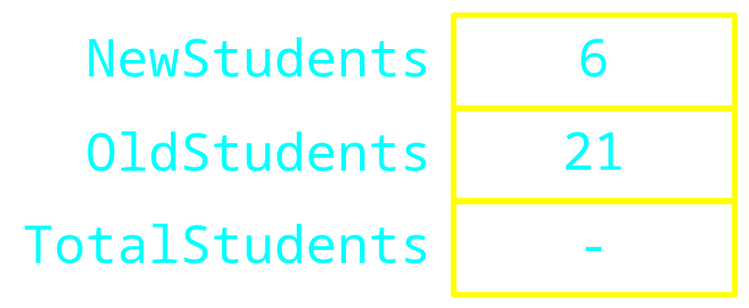

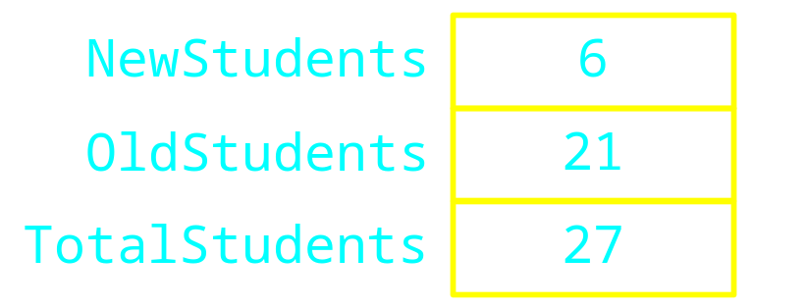

Assignment Statements
int NewStudents = 6;
int OldStudents = 21;
int TotalStudents;
TotalStudents = NewStudents + OldStudents ;

Slide 19


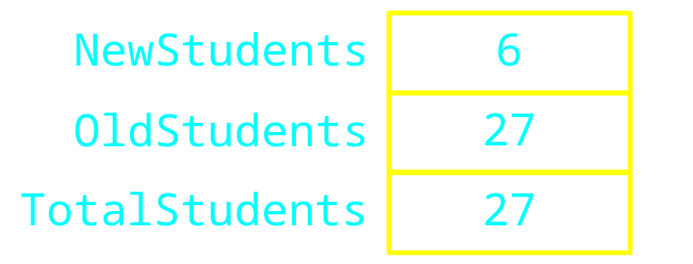
Assignment Statements
TotalStudents = NewStudents + OldStudents;
OldStudents = TotalStudents;

Slide 20
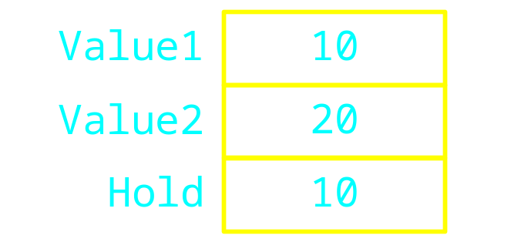
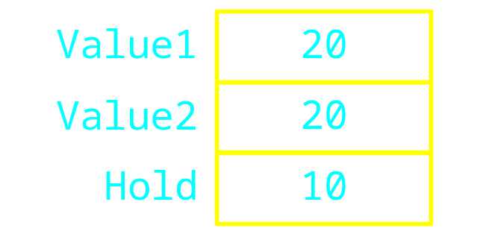
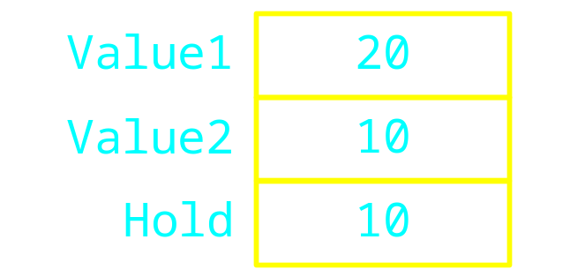
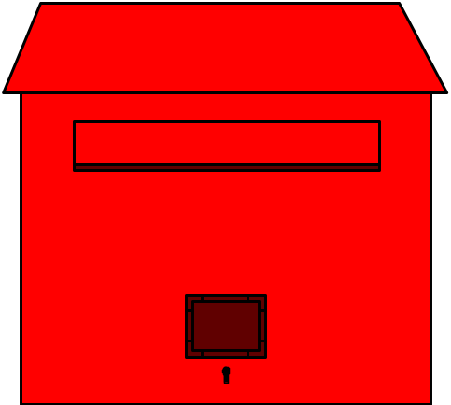
Value1 = 10;
Value2 = 20;
int Hold = Value1;
Value1 = Value2;
Value2 = Hold;

Slide 21

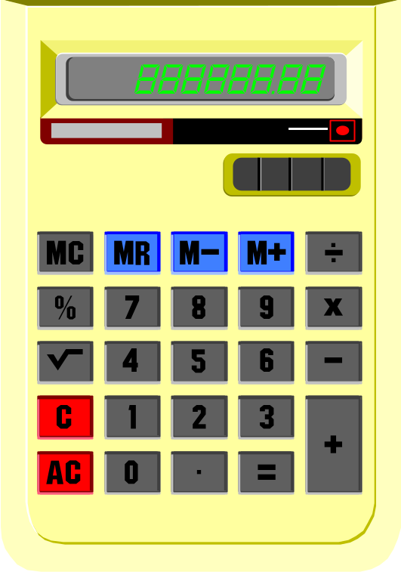
Arithmetic Operators
Common
  Addition +
  Subtraction -
  Multiplication *
  Division /
  Mod %
Note
  No exponentiation operator

Slide 22

Integer Division
Integer division produces an integer result
  It rounds down the result
Examples
  3 / 2 evaluates to 1
  4 / 6 evaluates to 0
  10 / 3 evaluates to 3

Slide 23

Mod
Produces the remainder of the division
Examples
5 % 2 evaluates to 1
12 % 4 evaluates to 0
4 % 5 evaluates to 4

Slide 24
Converting inches to feet and inches
63 inch = 5 foot 3 inch
5 = 63 / 12
3 = 63 % 12

Slide 25

Operators and Precedence
Which of the following is it equivalent to mx + b ?
  (m * x) + b
  m * (x + b)
Operator precedence tells how to evaluate expressions
Standard precedence order
  ( ) Evaluated first, if nested innermost
  done first
  * / % Evaluated second. If there are several,
  then evaluate from left-to-right
  + - Evaluate third. If there are several,
  then evaluate from left-to-right

Slide 26
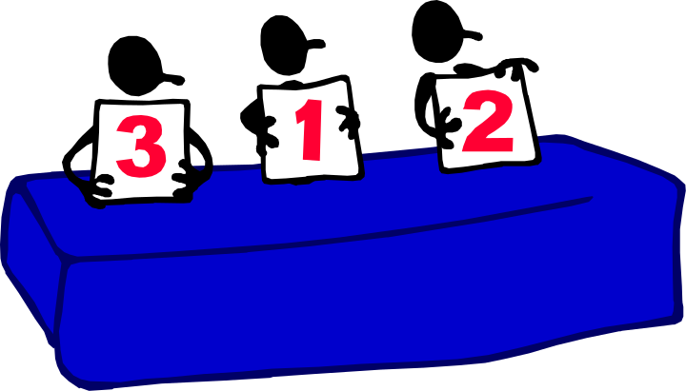
Operator Precedence
Examples
1 + 2 * 3 / 4 - 5
= 1 + 1 - 5 = -3
2 * 4 / 5 + 3 * 5 % 4
= 6/5 + 15%4 = 1+3 = 4
3.0 * 3 / 4
= 9.0 / 4 = 2.25
(1 + 3) * ((2 + 4 * 6) * 3) / 2 + 2
= 4 * (26*3)/2 + 2 = 158

Slide 27

Standard Input/Output
cin - the standard input stream
Input operator “>>”
  extracts data from input “stream” (the keyboard by default)
  skips over white spaces
  extracts only characters of the right form and performs automatic conversion to the type specified

Slide 28
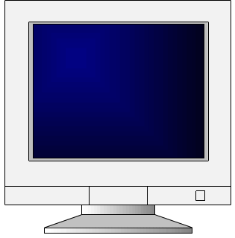

Standard Input/Output
cout - the standard output stream
Output operator “<<”
  inserts data into the output “stream” (the screen by default)
  Example:
    int id;
    float score;
    cout << "Enter student ID and score: ";
    cin >> id >> score;
    cout << "Student ID: " << id << " score: "
    << score << endl;

Slide 29
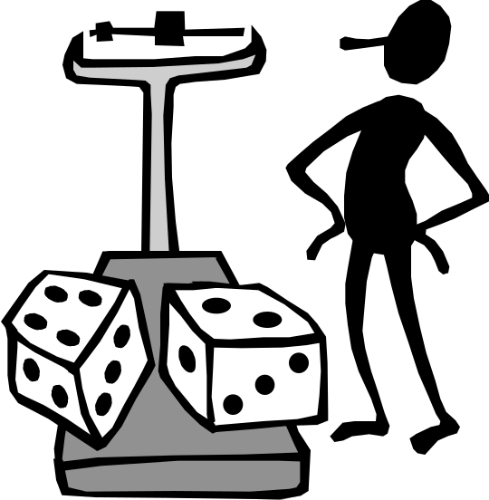

// Convert inches to feet and inches
// Input: inches
// Output: feet and inches
#include <iostream>
using namespace std;
int main() {
// inches to feet conversion factor
const int in2feet = 12;
int inches; // number of inches
int feet; // number of feet
cout<< "Enter number in inches: ";
cin >> inches;
// Convert inches to feet and inches
feet = inches / in2feet;
inches = inches % in2feet;
cout << feet << " feet " << inches << " inches " << endl;
return 0;
}

Slide 30

Assignment Conversions
A floating-point expression assigned to an integer object is always rounded down (truncated)
An integer expression assigned to a floating-point object is converted to a floating-point value
Example 1:
float y = 2.7;
int i = 15;
int j = 10;
i = y; // i is now 2
cout << i << endl;
y = j; // y is now 10.0
cout << y << endl;

Slide 31

Assignment Conversions
Example 2:
  int m, n;
  double x, y;
  m = 3;
  n = 2.5; // 2.5 converted to 2 and assigned to n
  x = m/n; // 3/2=1 converted to 1.0 and assigned to x
  n = x+m/2;
  // m/2=1 : integer division
  // x+m/2 : double addition because x is double
  // convert result of m/2 to double (i.e. 1.0)
  // x+m/2=2.0
  // convert result of x+m/2 to int (i.e. 2)
  // because n is int

Slide 32


White Spaces
Extra blanks or tabs (white spaces) are ignored x=3; x = 3 ;
Blank lines and comments are treated as white spaces
Code can be indented in any way
More than one statement can be on one line
      int x, y; x=3; y = 10; int z = x+y;
A single statement can be continued over several lines
      cout << feet << " feet and "
      << inches << " inches" << endl;

Slide 33

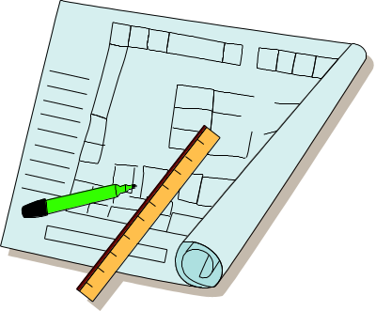


Good Programming Style
Place each statement on a line by itself (except long cout statements)
  x = m/n;
Use blank lines to separate sections of code
Use the same indentation for all statements in the same block of code {…}. (“Format selection”, ALT-F8, will automatically fix indentation)
int main(){
  int x;
  x = 5;
  return 0;
  }

Slide 34


Good Programming Style
Use meaningful identifier names
  double area, sum, radius;
Document each variable when it is declared
  double area; // area of the circle
  double distance; // distance from top to bottom
Document each segment of code
// Convert inches to feet and inches
feet = inches / in2feet;
inches = inches % in2feet;
Document the beginning of the program with a header that tells the purpose of the program
// Convert inches to feet and inches

