Slide 1

Programming
Functions

Slide 2
Review of Array: Bubble Sort
http://www.cs.brockport.edu/cs/java/apps/sorters/bubblesort.html
List[0], List[1], … List[n-2], List[n-1]
One pass to “sink” the largest number
to the bottom of the list
  for (j=0; j<n-1; j++) {
    if (List[j] > List[j+1])
      swap(List[j], List[j+1]);
  }

Slide 3
Review of Array: bubble Sort
http://www.cs.brockport.edu/cs/java/apps/sorters/bubblesort.html
N passes to “sink” the currently largest
number
for (i=n; i>=1; i--) {
  for (j=0; j<i-1; j++) {
    if (List[j] > List[j+1])
      swap(List[j], List[j+1]);
  }
}
function (subprogram)

Slide 4

Introduction to Functions
A complex problem is often easier to solve by dividing it into several smaller parts, each of which can be solved by itself.
This is called top-down programming.
These parts are called functions in C++ (also sometimes called subprograms).
main() then executes these functions so that the original problem is solved.

Slide 5

Advantages of Functions
Functions separate the concept (what is done) from the implementation (how it is done).
Functions make programs easier to understand.
Functions make programs easier to modify.
Functions can be called several times in the same program, allowing the code to be reused.

Slide 6
Function Input and Output
Function
Result
Parameters
f(x,y) = g
abs(-5) = 5

Slide 7

C++ Functions
C++ allows the use of both internal (user-defined) and external functions.
External functions (e.g., cin, cout, rand, etc.) are usually grouped into specialized libraries (e.g., iostream, cstdlib, cmath, etc.)

Slide 8
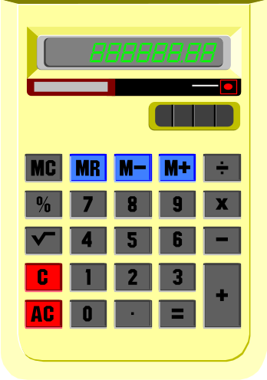
Mathematical Functions
#include <cmath>
double log(double x) natural logarithm
double log10(double x) base 10 logarithm
double exp(double x) e to the power x
double pow(double x, double y) x to the power y
double sqrt(double x) positive square root of x
double ceil(double x) smallest integer not less than x
double floor(double x) largest integer not greater than x
double sin(double x), cos(double x), tan(double x), etc...

Slide 9
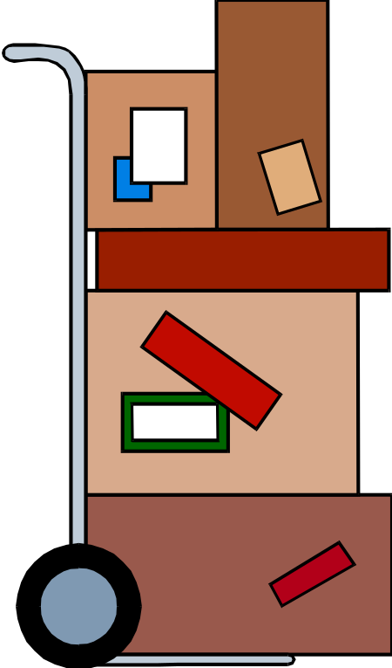
Functions in a Program
C++ programs usually have the following form:
  // include statements
  // function prototypes
  // main() function
  // user-defined functions

Slide 10
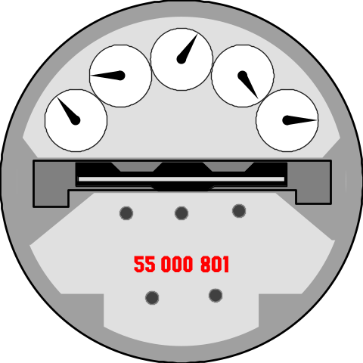
Absolute Value
#include <iostream>
using namespace std;
int absolute (int); // function prototype for absolute()
int main(){
int x, y, diff;
cout << "Enter two integers (separated by a blank): ";
cin >> x >> y;
diff = absolute( x - y);
cout << "The absolute difference between " << x
<< " and " << y << " is: " << diff << endl;
return 0;
}
// Define a function to take absolute value of an integer
int absolute(int x){
if (x >= 0) return x;
else return -x;
}

Slide 11
Absolute Value (alternative)
Note that it is possible to omit the function prototype if the function is placed before it is called.
#include <iostream>
using namespace std;
int absolute(int x){
if (x >= 0) return x;
else return -x;
}
int main(){
int x, y, diff;
cout << "Enter two integers (separated by a blank): ";
cin >> x >> y;
diff = absolute( x - y);
cout << "The absolute difference between " << x
<< " and " << y << " is: " << diff << endl;
return 0;
}

Slide 12

Function Prototype
The function prototype declares the interface, or input and output parameters of the function, leaving the implementation for the function definition.
The function prototype has the following syntax:
  <type> <function name>(<type list>);
Example: A function that prints the card (J) given the card number (11) as input:
  void printcard(int);
  (This is a void function - a function that does not return a value)

Slide 13

Function Definition
The function definition can be placed anywhere in the program after the function prototypes.
You can place a function definition in front of main(). In this case there is no need to provide a function prototype for the function, since the function is already defined before its use.
A function definition has following syntax:
<type> <function name>(<parameter list>){
<local declarations>
<sequence of statements>
}

