Slide 1
Programming
Dynamic Objects

Slide 2
Static verses Dynamic Objects
Static object
  Memory is acquired automatically
    int A[10];
  Memory is returned automatically when object goes out of scope
Dynamic object
  Memory is acquired by program with an allocation request
    new operation
  Dynamic objects can exist beyond the function in which they were allocated
  Object memory is returned by a deallocation request
    delete operation

Slide 3
Memory for Dynamic Objects
Memory for dynamic objects
  Requested from the free store (heap)
    Free store is memory controlled by operating system
  Learn more about memory management in CS252
new operation specifies
  The type and number of objects
If there is enough memory to satisfy the request
  A pointer to sufficient memory is returned by the operation
If there is not enough memory
to satisfy the request
  An error is generated

Slide 4
Default New
Syntax
Ptr = new SomeType;
  Where
    Ptr is a pointer of type SomeType
Be careful
  The newly acquired memory is uninitialized unless there is a default SomeType constructor

Slide 5
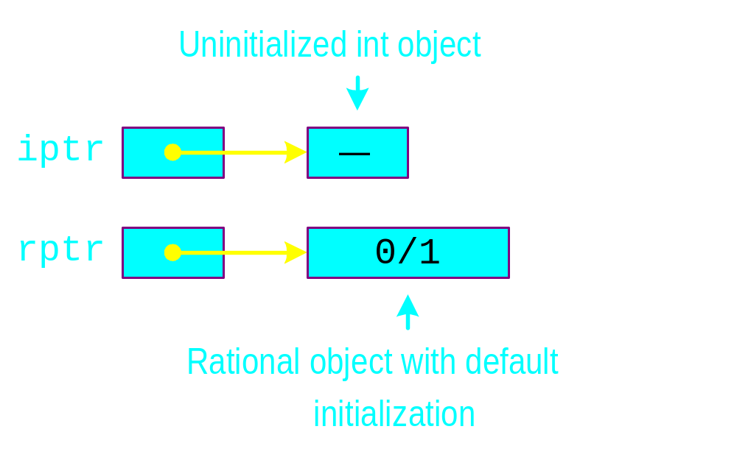
Default New Example
  int *iptr = new int;
  Rational *rptr = new Rational;

Slide 6
Specific New
Syntax
SomeType *Ptr = new SomeType(ParameterList);
  Where
    Ptr is a pointer of type SomeType
Initialization
  The newly acquired memory is initialized using a SomeType constructor
  ParameterList provides the parameters to the constructor

Slide 7
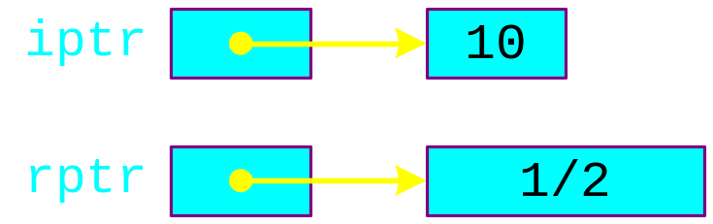
Specific New Example
  int *iptr = new int(10);
  Rational *rptr = new Rational(1,2);

Slide 8
Array of New
Syntax
  SomeType *P;
P = new SomeType[Expression];
  Where
    P is a pointer of type SomeType
    Expression is the number of objects to be constructed -- we are making an array
  Note
    The newly acquired list is initialized if there is a default SomeType constructor
P is a dynamic array.

Slide 9
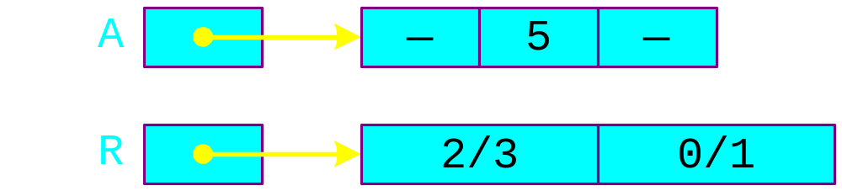
Array of New Example
  int *A = new int [3];
  Rational *R = new Rational[2];
  A[1] = 5;
  Rational r(2/3);
  R[0] = r;

Slide 10
List Example
cout << "Enter list size: ";
int n;
cin >> n;
int *A = new int[n];
GetList(A, n);
SelectionSort(A, n);
DisplayList(A, n);

Slide 11
Delete
Forms of request
  delete P; // used if storage came from new
  delete [] P; // used if storage came from new[]
  Storage pointed to by P is returned to free store
    P is now undefined

Slide 12
Delete Example
int n;
cout << "Enter list size: ";
cin >> n;
int *A = new int[n];
GetList(A, n);
SelectionSort(A, n);
DisplayList(A, n);
delete [] A;

Slide 13
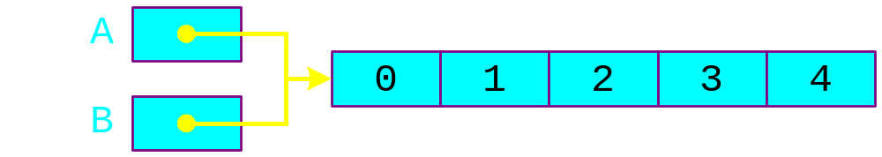
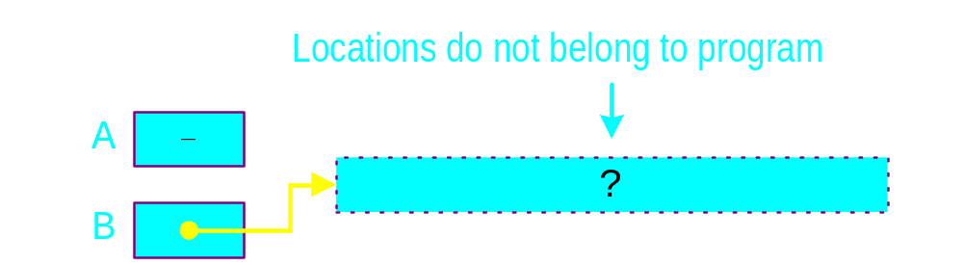
Dangling Pointer Problem
  int *A = new int[5];
  for(int i=0; i<5; i++)
  A[i] = i;
  int *B = A;
  delete [] A;

Slide 14
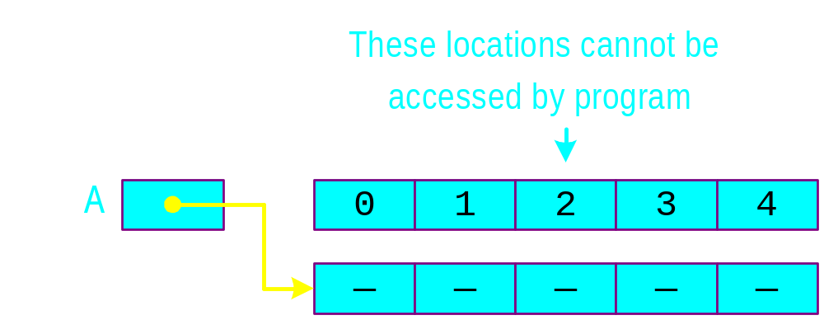
Memory Leak Problem
  int *A = new int [5];
  for(int i=0; i<5; i++)
  A[i] = i;
  A = new int [5];

