Slide 1

Programming
Simple
Arrays

Slide 2
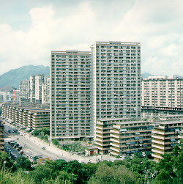
Arrays
An array is a collection of data elements that are of the same type (e.g., a collection of integers,characters, doubles)
Arrays are like flats in a
building, or post office boxes
Arrays provide a good way
to name a collection, and
to reference its individual
elements.

Slide 3
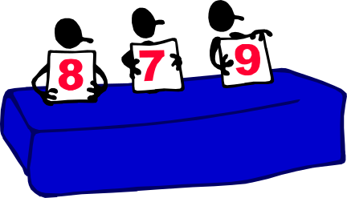

Array Applications
Given a list of test scores, determine the maximum and minimum scores.
Read in a list of student names and rearrange them in alphabetical order (sorting).
Given the height measurements of students in a class, output the names of those students who are taller than average.

Slide 4



Array Declaration
Syntax:
<type> <arrayName>[<dimension>]
The array elements are all values of the type <type>
The size of the array is indicated by <dimension>, the number of elements in the array
<dimension> must be an int constant or a constant expression. Note that it is possible for an array to have multiple dimensions.

Slide 5
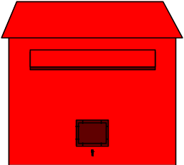
Array Declaration Example
  // array of 10 uninitialized ints
  int A[10];
0
1
2
3
4
5
6
7
8
9
A
--
--
--
--
--
--
--
--
--
--
0
1
2
3
4
5

Slide 6

Subscripting
Suppose
  int A[10]; // array of 10 ints
To access an individual element we must apply a subscript to list name A
  A subscript is a bracketed expression
    The expression in the brackets is known as the index
  First element of list has index 0
    A[0]
  Second element of list has index 1, and so on
    A[1]
  Last element has an index one less than the size of the list
    A[9]
Incorrect indexing is a common error

Slide 7
Subscripting
  // array of 10 uninitialized ints
  int A[10];
  A[3] = 1;
  int x = A[3];
--
1
--
--
--
--
0
1
2
3
4
5
6
7
8
9
A
--
--
--
1
--
--
--
--
--
--
A[0]
A[1]
A[2]
A[3]
A[4]
A[5]
A[6]
A[7]
A[8]
A[9]

Slide 8

Array Element Manipulation
Consider
  int A[10], i = 7, j = 2, k = 4;
  A[0] = 1;
  A[i] = 5;
  A[j] = A[i] + 3;
  A[j+1] = A[i] + A[0];
  A[A[j]] = 12;
  cin >> A[k]; // where the next input value is 3

Slide 9

Array Initialization
  int A[10] = {9, 8, 7, 6, 5, 4, 3, 2, 1, 0};
  A[3] = -1;
0
1
2
3
4
5
6
7
8
9
A
9
8
7
6
5
4
3
2
1
0
6
-1
Box A[3]
0
1
2
3
4
5
6
7
8
9
A
9
8
7
-1
5
4
3
2
1
0

Slide 10

Example Definitions
Suppose
  const int N = 20;
  const int M = 40;
  const int MaxStringSize = 80;
  const int MaxListSize = 1000;
Then the following are all legal array definitions.
  int A[10]; // array of 10 ints
  char B[MaxStringSize]; // array of 80 chars
  double C[M*N]; // array of 800 doubles
  int Values[MaxListSize];// array of 1000 ints

Slide 11

2-D Array Example
  // 2-D array of 30 uninitialized ints
  int A[3][10];
0
1
2
3
4
5
6
7
8
9
A
0
--
--
--
--
--
--
--
--
--
--
1
--
--
--
--
--
--
--
--
--
--
2
--
--
--
--
--
--
--
--
--
--

Slide 12


2-D Array References
  // 2-D array of 30 uninitialized chars
  char A[3][10];
  A[1][2] = ‘a’;
  char c;
  c = A[1][2];
'a'
0
1
2
3
4
5
6
7
8
9
A
0
--
--
--
--
--
--
--
--
--
--
1
--
--
‘a’
--
--
--
--
--
--
--
2
--
--
--
--
--
--
--
--
--
--

Slide 13

Inputting a List
const int MaxSize = 10000;
int A[MaxSize];
int n = 0;
int CurrentInput;
while(n< MaxSize && cin>>CurrentInput){
A[n] = CurrentInput;
n++;
}

Slide 14

Displaying a List
// List A of n elements has already been set
int i;
for (i=0; i<n; i++)
cout << A[i] << " ";
cout << endl;

Slide 15
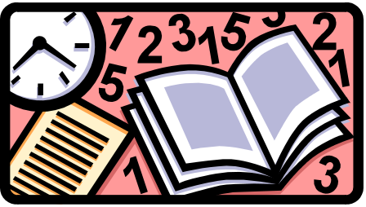
Smallest Value
Problem
  Find the smallest value in a list of integers
Input
  A list of integers and a value indicating the number of integers
Output
  Smallest value in the list
Note
  List remains unchanged after finding the smallest value!

Slide 16

Smallest Value:
Preliminary Design
Idea
  When looking for smallest value, need a way of remembering best candidate found so far
Design
  Search array looking for smallest value
    Use a loop to consider each element in turn
    If current element is smallest so far, then update smallest value so far
  When done examining all of the elements, the smallest value seen so far is the smallest value

Slide 17

Smallest Value
const int N=10;
int A[N];
int SmallestValueSoFar, i;
... // A[] is input by user
SmallestValueSoFar = A[0];
for (i=1; i<N; i++)
if (A[i] < SmallestValueSoFar)
SmallestValueSoFar = A[i];
Smallest

