Slide 1
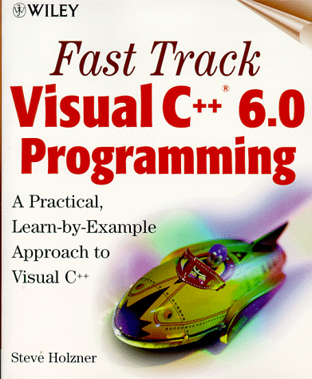

Programming
C++ Basics

Slide 2

Introduction to C++
C++ is a programming language for manipulating numbers and user-defined objects.
C++ is a cross between the programming languages C and Smalltalk.
Smalltalk
(objects)
C
(numbers)
Shell programming
(text)
C++
(numbers, objects)
Perl
(text, numbers)
Java
(objects)

Slide 3

General form of a C++ program
//Program description is first
#include directives go next
using namespace std;
int main(){
  constant declarations go here
  variable declarations go here
  assignment statements go here
  return 0;
}

Slide 4

General form of a C++ program
//simple program
#include <iostream>
using namespace std;
int main(){
// constant declaration
const double Pi = 3.14159;
// variable declarations
double radius;
double area;
// assignment statements
cout << "Enter circle radius: ";
cin >> radius;
area = Pi * radius * radius;
cout << "Area : " << area << endl;
return 0;
}

Slide 5


Syntax of the C++ Language
Reserved words (appear in blue in Visual C++)
  Reserved words have a special meaning in C++.
  The list of reserved words:
asm, auto, bool, break, case, catch, char, class, const, continue, default, delete, do, double, else, enum, extern, float, for, friend, goto, if, include, inline, int, long, namespace, new, operator, private, protected, public, register, return, short, signed, sizeof, static, struct, switch, template, this, throw, try, typedef, union, unsigned, using, virtual, void, volatile, while

Slide 6

Syntax of the C++ Language
Identifiers (appear in black in Visual C++)
  An identifier is a name for variables, constants, functions, etc.
  It consists of a letter or underscore followed by any sequence of letters, digits or underscores
  Names are case-sensitive. The following are unique identifiers:
Hello, hello, whoami, whoAMI, WhoAmI
  Names cannot have special characters in them
    e.g., X=Y, J-20, #007, etc. are invalid identifiers.
  C++ reserved words cannot be used as identifiers.
  Choose identifiers that are meaningful and easy to remember.

Slide 7

Syntax of the C++ Language
Comments (appear in green in Visual C++)
  Comments are explanatory notes; they are not part of the program.
  Comments are done in two ways:
    // A double slash starts a single line comment
    /* A slash followed by an asterisk marks the
start of a multiple line comment.
It ends with an asterisk followed by a slash */

Slide 8

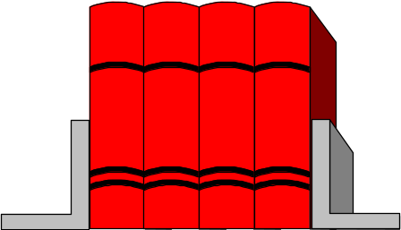
Syntax of the C++ Language
Compiler Directive: #include
  It refers to a header file of library functions or variables.
  The compiler reads in the contents of the file before compiling the program.
  The included file is compiled with the program.
  There are two forms of #include:
#include <stdio.h> // for pre-defined files
#include "my_lib.h" // for user-defined files

Slide 9

Libraries
#include loads the code from the standard libraries
  #include <iostream> // new I/O library
  #include <iostream.h> // old I/O library
  #include <stdio.h> // standard functions
  #include <math.h> // math functions
  #include <stdlib.h> // contains random funct
  #include <time.h> // time function
using namespace std; indicates that the new C++ libraries should be used. If this line is left out, then the old iostream library is loaded:
  #include <iostream.h>

Slide 10




Constant Declarations
Constants represent permanent values.
Their values can only be set in the declaration:
  const double pi = 3.14159;
They can make a program more readable and maintainable
  Constant declaration syntax:
    const <type> <identifier> = <constant expression>;
  Examples:
    const double US2HK = 7.8;
    const double HK2Yuan = 1.07;
    const double US2Yuan = US2HK* HK2Yuan;

Slide 11
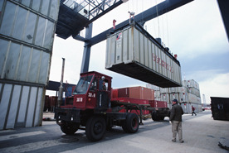
Variable Declarations
A variable is best thought of as a container/box for a value:
  Variable declaration syntax:
  <type> <identifier>;
  Examples:
  int nickel;
  int penny;
A variable must be declared before it can be used.
  int main(){
  x = 5; // illegal: x was not declared
  }
1000

Slide 12

Variable Declarations
A variable can be initialized in a declaration:
  int x = 3;
Several variables of the same type can be declared in the same declaration (though it is better to put them on separate lines):
  double total_USD, area;
A variable must have only one type. For example, a variable of the type int can only hold integer values.

Slide 13
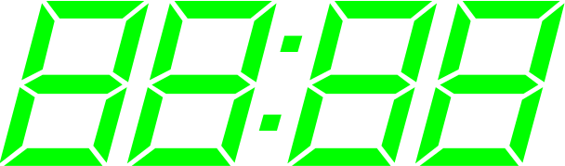
Types of Variable Declarations
Simple C++ variable types:
  int integer (32-bit integer on the PC) (example: 1)
  short 16-bit integer (allows ±32,767)
  long 32-bit integer (allows ±2,147,483,647)
  float floating point number (allows about 7 digits of precision: 0.1234567)
  double double precision float (allows about 15 digits of precision: 0.12345678901234)
  char a single character (example: ‘y’)

Slide 14


Memory Depiction
Memory
location
float y = 12.5;
int Temperature = 32;
char Letter = 'c';
int Number;
1001
y
12.5
1002
1003
1004
1005
Temperature
32
1006
1007
-
1008
Letter
'c'
1009
1010
1011
Number
1012
1013

Slide 15

Assignment Statements
    Assignment syntax:
    <identifier> = <expression>;
    Examples:
    int n, m, k; // declaration
    n = 5;
    m = 6 + (4 * 6);
    k = (n * 2) + m;
    k = k / 2;

Slide 16


Assignment Statements
A variable must be assigned a value before it can be used. Variables are not automatically initialized in VC++.
    int x, y; // x declared, but not initialized
    // x and y have random values
    y = x; // the random value in x assigned to y
Once a value has been placed in a variable, it stays there until the program changes it.

Slide 17
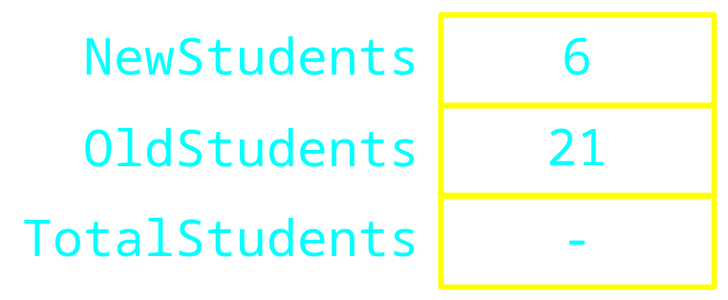

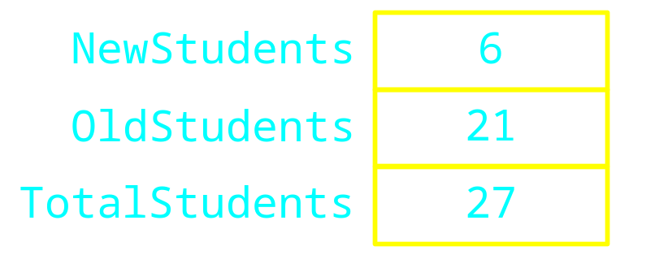

Assignment Statements
int NewStudents = 6;
int OldStudents = 21;
int TotalStudents;
TotalStudents = NewStudents + OldStudents ;

Slide 18
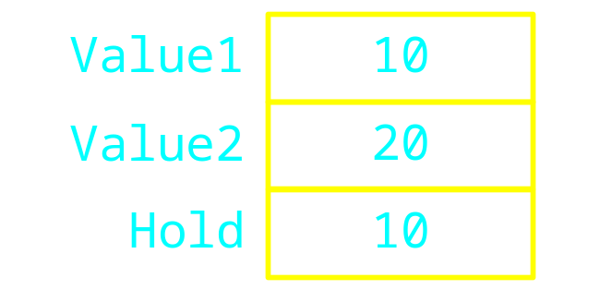
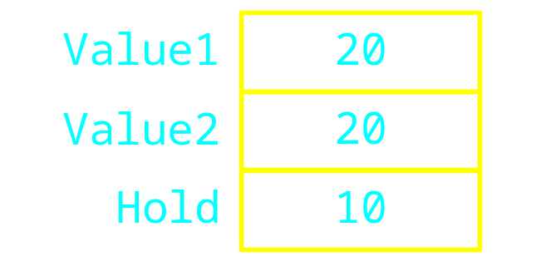
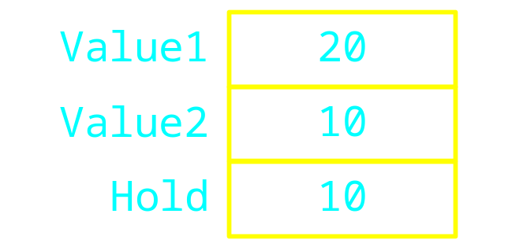
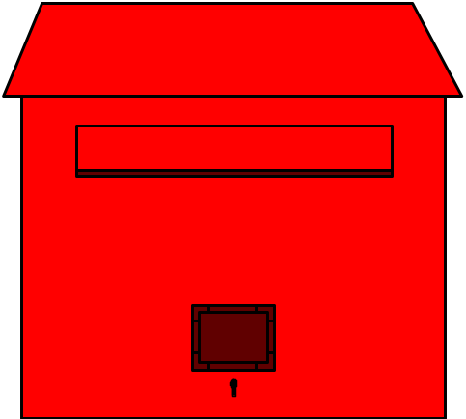
int Value1 = 10;
int Value2 = 20;
int Hold = Value1;
Value1 = Value2;
Value2 = Hold;

Slide 19

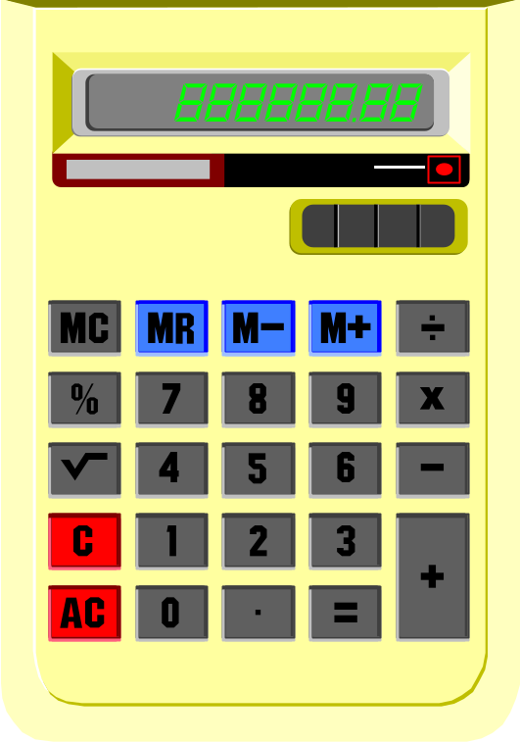
Arithmetic Operators
Common
  Addition +
  Subtraction -
  Multiplication *
  Division /
  Mod %
Note
  No exponentiation operator

Slide 20
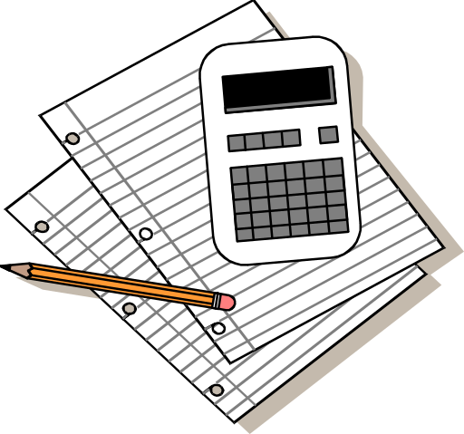
C++ Arithmetic Operators
The four operators +, -, *, and / work as we expect with the “normal” precedence rules (e.g., 5+2*3 = 11)
Parenthesis can be inserted to change the order of operations (e.g., (5+2)*3 = 21)
Be careful of integer division -- any remainder is discarded
The % (modulo) operator gives the remainder of integer division

Slide 21

Mod
Produces the remainder of the division
Examples
5 % 2 evaluates to 1
12 % 4 evaluates to 0
4 % 5 evaluates to 4

Slide 22

Integer Division
Integer division produces an integer result
  It rounds down the result
Examples
  3 / 2 evaluates to 1
  4 / 6 evaluates to 0
  10 / 3 evaluates to 3

Slide 23

Rules for Division
C++ treats integers different than doubles.
100 is an int.
100.0 , 100.0000, and 100. are doubles.
The general rule for division of int and double types is:
  double/double -> double (normal)
  double/int -> double (normal)
  int/double -> double (normal)
  int/int -> int (special case: any decimal places discarded)

Slide 24

Rules for Division
Example :
  220. / 100.0 double/double -> double result is 2.2
  220. / 100 double/int -> double result is 2.2
  220 / 100.0 int/double -> double result is 2.2
  220 / 100 int/int -> int result is 2
Summary: division is normal unless both the numerator and denominator are int, then the result is an int (the decimal places are discarded).

Slide 25

Forcing a Type Change
You can change the type of an expression with a cast operation
Syntax:
  variable1 = type(variable2);
  variable1 = type(expression);
Example:
  int x=1, y=2;
  double result1 = x/y; // result1 is 0.0
  double result2 = double(x)/y; // result2 is 0.5
  double result3 = x/double(y); // result3 is 0.5
  double result4 = double(x)/double(y);// result4 is 0.5
  double result5 = double(x/y); // result5 is 0.0

Slide 26

Operators and Precedence
Which of the following is it equivalent to mx + b ?
  (m * x) + b
  m * (x + b)
Operator precedence tells how to evaluate expressions
Standard precedence order
  ( ) Evaluated first, if nested innermost
  done first
  * / % Evaluated second. If there are several,
  then evaluate from left-to-right
  + - Evaluate third. If there are several,
  then evaluate from left-to-right

Slide 27
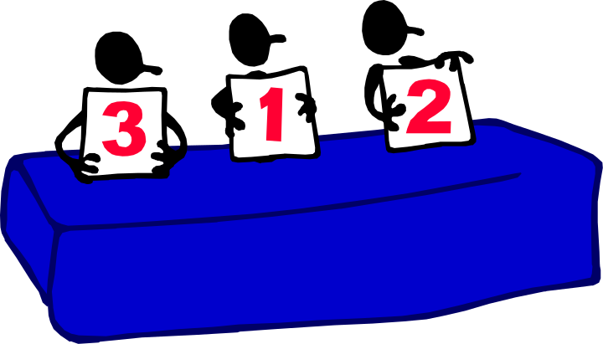
Operator Precedence
Examples
1 + 2 * 3 / 4 - 5
2 * 4 / 5 + 3 * 5 % 4
3.0 * 3 / 4
(1 + 3) * ((2 + 4 * 6) * 3) / 2 + 2

Slide 28

Standard Input/Output
cin - the standard input stream
Input operator “>>”
  extracts data from input “stream” (the keyboard by default)
  skips over white spaces
  extracts only characters of the right form and performs automatic conversion to the type specified

Slide 29


Standard Input/Output
cout - the standard output stream
Output operator “<<”
  inserts data into the output “stream” (the screen by default)
  Example:
    int id, score;
    cout << "Enter student ID and score: ";
    cin >> id >> score;
    cout << "Student ID: " << id << " score: "
    << score << endl;

Slide 30


// Convert inches to feet and inches
// Input: inches
// Output: feet and inches
#include <iostream>
using namespace std;
int main() {
// inches to feet conversion factor
const int in2feet = 12;
int inches; // number of inches
int feet; // number of feet
cout<< "Enter number in inches: ";
cin >> inches;
// Convert inches to feet and inches
feet = inches / in2feet;
inches = inches % in2feet;
cout << feet << " feet " << inches << " inches " << endl;
return 0;
}

Slide 31

Assignment Conversions
A floating-point expression assigned to an integer object is rounded down
An integer expression assigned to a floating-point object is converted to a floating-point value
Example 1:
float y = 2.7;
int i = 15;
int j = 10;
i = y; // i is now 2
cout << i << endl;
y = j; // y is now 10.0
cout << y << endl;

Slide 32

Assignment Conversions
Example 2:
  int m, n;
  double x, y;
  m = 3;
  n = 2.5; // 2.5 converted to 2 and assigned to n
  x = m/n; // 3/2=1 converted to 1.0 and assigned to x
  n = x+m/2;
  // m/2=1 : integer division
  // x+m/2 : double addition because x is double
  // convert result of m/2 to double (i.e. 1.0)
  // x+m/2=2.0
  // convert result of x+m/2 to int (i.e. 2)
  // because n is int

Slide 33




Example
Problem Statement
  Given a collection of nickels (US 5-cent piece) and pennies (US 1-cent piece), find the equivalent number of Hong Kong dollars and 10-cent pieces.
Problem Analysis
  Input:
    nickels (integer) - number of US nickels
    pennies (integer) - number of US pennies
  Output:
    dollars (integer) - number HK dollar coins to return
    houji (integer) - number HK 10-cent coins to return
Constraints: None

Slide 34

Example: Initial Algorithm
1. Read in the numbers of nickels and pennies
2. Compute the total value in US dollars
3. Compute the total value in HK dollars to exchange
4. Find the number of HK dollar coins and houji coins
5. Display the results

Slide 35


Example: Program Skeleton
// File: excoin.cpp
// Determines the number of HK coins to exchange for US coins
#include <iostream>
using namespace std;
int main(){
int nickel; // number of nickels
int penny; // number of pennies
int dollar; // number of HK dollar coins
int houji; // number of HK 10-cent coins
double total_USD; // total value in US$
double total_HKD; // total value in HK$
// Read in the number of nickels and pennies
// Compute the total value in US$
// Compute the total value in HK$ to exchange
// Find the numbers of HK dollar and 10-cent coins
// Display the numbers of HK dollar and 10-cent coins
return 0;
}

Slide 36

Example: Refined Algorithm
1. Read in the number of nickels and pennies
2. Compute the total value in US dollars
total_USD = (5 * nickel + penny)/100
3. Compute the total in HK dollars to exchange
total_HKD = total_USD * US2HK
4. Find the number of HK dollar coins and 10-cent coins
total_HK_cent = total_HKD * 100
dollar = total_HK_cent / 100
houji = (total_HK_cent % 100) / 10
5. Display the number of HK dollar and 10-cent coins

Slide 37

// File: excoin.cpp
// Determines the number of HK coins to exchange for US coins
#include <iostream>
using namespace std;
int main(){
const double US2HK = 7.8; // assume exchange rate is US$1 = HK$7.8
int nickel; // number of nickels
int penny; // number of pennies
int dollar; // number of HK dollar coins
int houji; // number of HK 10-cent coins
double total_USD; // total value in US$
int total_HK_cent; // total value in HK cents
double total_HKD; // total value in HK$
// Read in the number of nickels and pennies
cout << "Enter the number of nickels and press return: ";
cin >> nickel;
cout << "Enter the number of pennies and press return: ";
cin >> penny;

Slide 38
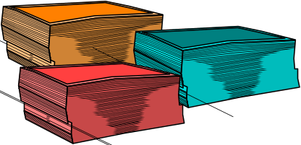

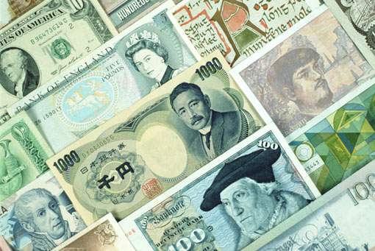
// Compute the total value in US$
total_USD = (5 * nickel + penny) / 100.0;
// Compute the total value in HK$ using the assumed exchange rate
total_HKD = total_USD * US2HK;
// Find the value in HK dollars and change
total_HK_cent = total_HKD * 100;
dollar = total_HK_cent / 100;
houji = (total_HK_cent % 100)/10;
// Display the number of HK dollar and 10-cent coins
cout << "The change is HK " << dollar << " dollars and "
<< houji << " 10-cent coins." << endl;
return 0;
}

Slide 39


C++ is a Free-Format Language
Extra blanks or tabs are ignored
      x=3;
      x = 3 ;
Blank lines are ignored just like comments
Code can be indented in any way
More than one statement can be on one line
      int x, y; x=3; y = 10; int z = x+y;
A single statement can be continued over several lines
      int x
      =
      2;
      cout << feet << " feet and "
      << inches << " inches" << endl;

Slide 40
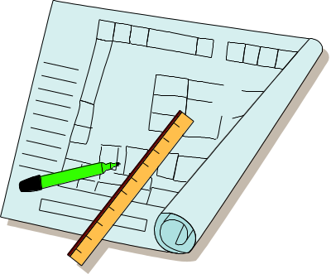


Good Programming Style
Place each statement on a line by itself (except long cout statements)
  x = m/n;
Use blank lines to separate sections of code
Use the same indentation for all statements in the same block of code {…}. (“Format selection”, ALT-F8, will automatically fix indentation)
int main(){
  int x;
  x = 5;
  return 0;
  }

Slide 41


Good Programming Style
Use meaningful identifier names
  double area, sum, radius;
Document each variable when it is declared
  double area; // area of the circle
  double distance; // distance from top to bottom
Document each segment of code
// Convert inches to feet and inches
feet = inches / in2feet;
inches = inches % in2feet;
Document the beginning of the program with a header that tells the purpose of the program
// Convert inches to feet and inches

