Slide 1

Programming
Character I/O

Slide 2

Data Type: char
Constant declaration
const char star = '*';
Variable declaration
char resp;
Variable assignment
resp = 'c';
Input/Output
char a, b, c, d;
cin >> a >> b >> c >> d; // user types: 1X3Y
// a <- '1', b<-'X', c<-'3', d<-'Y'
cout <<a<< " " <<b<< " " <<c<< " " <<d<< endl;
// output: 1 X 3 Y

Slide 3

The ASCII Character Set
7-bit encoding for 128 possible characters
Some of the 32 non-printing control characters
  0 NUL character (end of string character)
  7 Bell character (makes beep)
  8 Backspace character (\b)
  9 Tab character (\t)
  10 Newline character (\n)
space (32) is the first printable ACSII character
'0' - '9' have code values 48 through 57
'A' - 'Z' have code values 65 through 90
'a' - 'z' have code values 97 through 122
See Appendix A.1 in book for full ASCII list

Slide 4

Character Functions in <cctype>
isupper(c) returns nonzero if c is an uppercase letter
islower(c) returns nonzero if c is a lowercase letter
isalpha(c) returns nonzero if either islower(c) or isupper(c) returns nonzero
isdigit(c) returns nonzero if c is a digit character
isalnum(c) returns nonzero if either isalpha(c) or isdigit(c) returns nonzero
isspace(c) returns nonzero if c is a space, newline, or tab
tolower(c) if c is uppercase it returns lowercase; otherwise it returns c
toupper(c) if c is lowercase it returns uppercase; otherwise it returns c

Slide 5
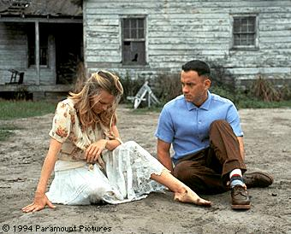


Relational char Operators
'0' - '9' have code values 48 through 57
  '0' < '1' < ... < '9'
'A' - 'Z' have code values 65 through 90
  'A' < 'B' < ... < 'Z'
'a' - 'z' have code values 97 through 122
  'a' < 'b' < ... < 'z'
(Upper case is always < lower case)

Slide 6

Characters: Example 1
// islower.cpp
#include <iostream>
using namespace std;
int islower(char c){
if(c>='a' && c <='z')
return 1;
else
return 0;
}
void main(){
char c;
cout << "Enter a character: ";
cin >> c;
if(islower(c))
cout << c << " is a lower case letter" << endl;
else
cout << c << " is not a lower case letter\n";
}

Slide 7

Characters: Example 2
// program to beep at user
#include <iostream>
using namespace std;
void main(){
cout << '\7';
}

Slide 8

Characters: Example 3
// program to output a random character
#include <iostream>
#include <cstdlib>
#include <ctime>
using namespace std;
void main(){
char c;
int r;
srand(time(0));
r = rand()%26;
c = 'a' + r;
cout << "random character: " << c << endl;
}

Slide 9

White Space
cin >> c skips any white space (spaces, tabs, newlines)
Example:
  char c = ' ';
  while(c != '\n'){
    cin >> c;
    cout << c;
  }
Input: a b c d
Output: abcd

Slide 10

White Space
What if you want to keep
the white space?
Use cin.get(c):
  char c = ' ';
  while(c != '\n'){
    cin.get(c);
    cout.put(c); // same as: cout << c;
  }
Input: a b c d
Output: a b c d
cin.get(c) reads white space just like other characters

Slide 11

cin.get(c)
  cin.get (char&) read a single character
  cout.put (char) write a single character
Let's say the user inputs a word, 'hello'. cin.get(c) will return the letter 'h'. The rest of the word is not lost, but stays in the stream. If we perform another cin.get operation, we will get the next letter, 'e'.
cout.put(c) simply outputs
one letter at a time (same as
cout << c).

Slide 12

cin.get(c): Example 1
// Program to count the number of input blanks
// (Program outputs characters without blanks)
#include <iostream>
using namespace std;
void main() {
char next;
int count = 0;
do{
cin.get(next);
if(next == ' ')
count++;
else
cout.put(next);
}while(next != '\n');
cout << "Number of blanks = " << count << endl;
}

Slide 13



cin.get(c): Example 1
Input:
a
Output:
a
Number of blanks = 0
Input:
ab cd
Output:
abcd
Number of blanks = 1
Input:
1 2 3 4 5 6 7 8 9
Output:
123456789
Number of blanks = 8

Slide 14
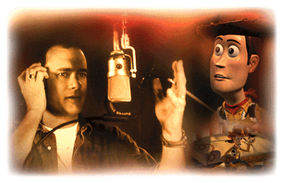
cin.get(c): Example 2
/* Reads a string of characters and converts
the digits in the string to int type */
#include <iostream>
#include <cctype>
using namespace std;
int read_int();
void main() {
int number;
cout << "Enter a line of digits followed by enter: ";
number = read_int();
cout << "The numerical value of the digits"
<< " in the line is: \n" << number << endl;
}

Slide 15


cin.get(c): Example 2
int read_int(){
const char nwln = '\n';
char next;
int digit;
int value = 0;
do{
cin.get(next);
if(isdigit(next)){
digit = int(next) - int('0');
value = 10*value + digit;
}
}while(next != nwln);
return value;
}

Slide 16

cin.get(c): Example 2
Enter a line of digits followed by enter:
1a234
The numerical value of the digits in the line is:
1234
Enter a line of digits followed by enter:
1234567890
The numerical value of the digits in the line is:
1234567890
Enter a line of digits followed by enter:
12345678900
The numerical value of the digits in the line is:
-539222988
(overflows at about 2.147 billion with 32-bit integers)

