Slide 1
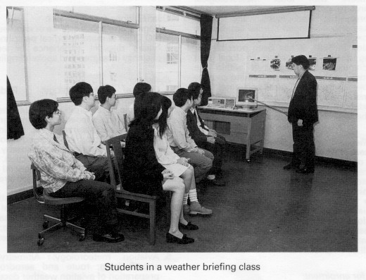

Programming
Classes

Slide 2


Motivation
Types such as int, double, and char are “stupid” objects.
They can only answer one question: “What value do you contain?”
3!!!

Slide 3


Motivation
Classes allow you to build “smart” objects that can answer many questions (and perform various actions).
  “What is your temperature?”
  “What is your temperature in Fahrenheit?”
  “What is your humidity?”
  “Print your temperature in Kelvin.”
What is your wish?

Slide 4
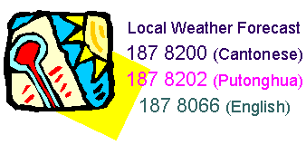

Temperature Example
Write a program that, given a temperature in Fahrenheit, Celsius, or Kelvin, will display the equivalent temperature in each of the scales.
double degree = 0.0; // needs 2 items!
char scale = 'F';
To apply a function f() to a temperature, we must specify both degree and scale:
f(degree, scale);
Also to display a temperature:
cout << degree << scale;

Slide 5

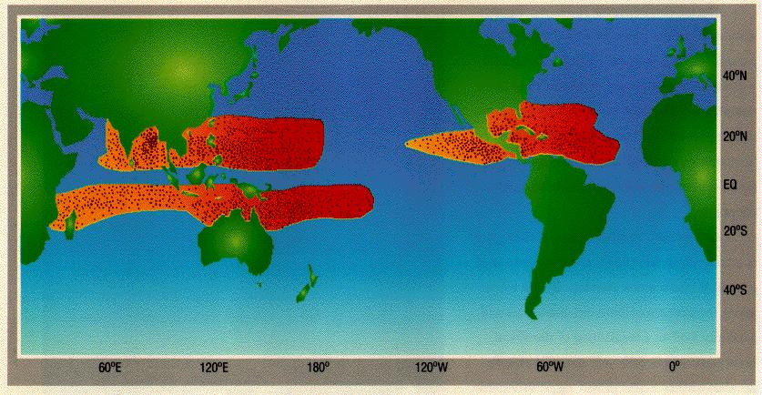
Temperature Example
Is there a way to build a user-defined data type that combines degree and scale into one object?
Can this object automatically convert between different scales, and know how to print itself out? (Can we construct a “smart” object?)
Answer:
Yes, by using the
class construct.

Slide 6

Object-Oriented Solution
Design and build a class to represent the temperature object
Identify:
  1) data required (data members), and
  2) operations that this object can perform (member functions)
class Temperature{
public:
// member functions
private:
double degree; // data members
char scale;
};

Slide 7

Temperature Conversion Program
#include <iostream>
using namespace std;
// definition of Temperature class goes here
void main(){
char resp;
Temperature temp;
do{
cout << "Enter temperature (e.g., 98.6 F): ";
temp.read(); cout << "-->";
temp.Fahrenheit();
temp.print(); cout << " = ";
temp.Celsius();
temp.print(); cout << " = ";
temp.Kelvin();
temp.print(); cout << endl << endl;
cout << "Another temperature to convert? ";
cin >> resp;
}while(resp == 'y' || resp == 'Y');
}

Slide 8
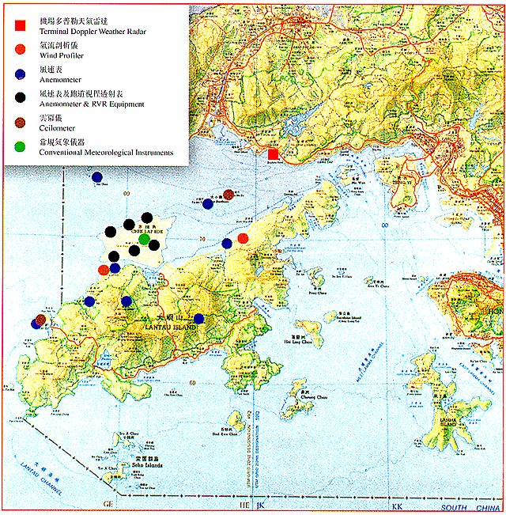
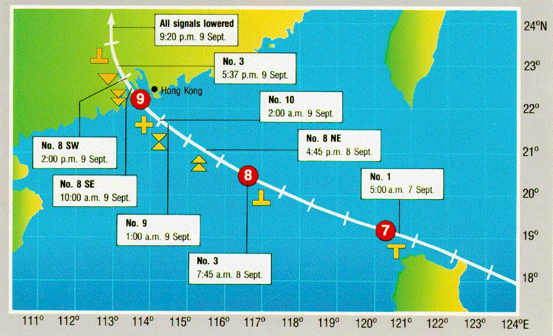
Temperature Conversion Output
Enter temperature (e.g., 98.6 F): 212 F
-->212 F = 100 C = 373.15 K
Another temperature to convert? y
Enter temperature (e.g., 98.6 F): 0 C
-->32 F = 0 C = 273.15 K
Another temperature to convert? y
Enter temperature (e.g., 98.6 F): 100K
-->-279.67 F = -173.15 C = 100 K
Another temperature to convert? n

Slide 9

Smart Temperature Object
A smart object should carry within itself the ability to perform its operations
Operations of Temperature object :
  initialize degree and scale with default values
  read a temperature from the user and store it
  compute the corresponding Fahrenheit temperature
  compute the corresponding Celsius temperature
  compute the corresponding Kelvin temperature
  display the degrees and scale to the user

Slide 10
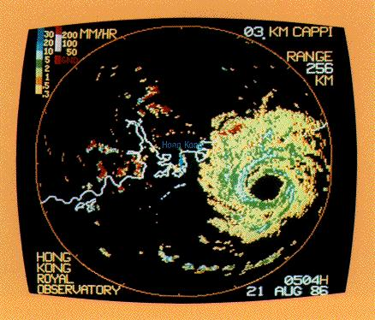
Temperature Class
class Temperature{
public:
Temperature();
Temperature(double idegree, char iscale);
double getDegree() const;
char getScale() const;
void set(double newDegree, char newScale);
void read();
void print() const;
void Fahrenheit();
void Celsius();
void Kelvin();
private:
double degree;
char scale;
};

Slide 11
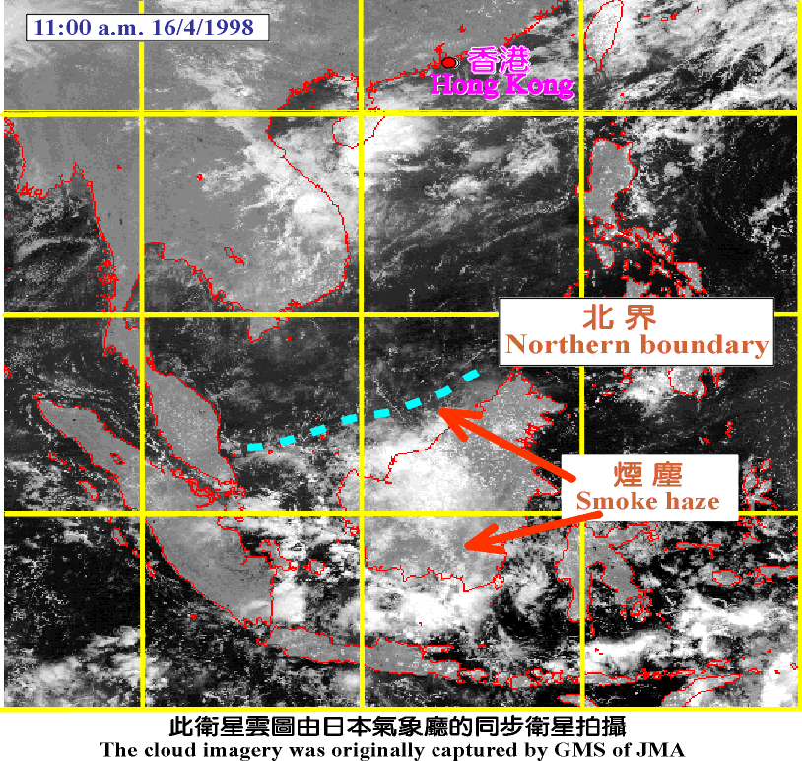
Printing Temperature
Given the following declaration:
  Temperature temp1, temp2;
  temp1 : temp2:
  degree degree
  scale scale

Slide 12
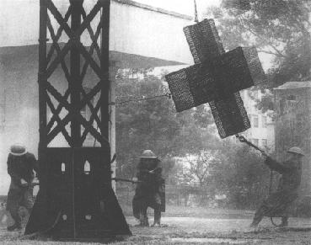
Printing Temperature
A programmer can write:
  temp1.print();
  temp2.print();
Smart object interpretation:
  temp1: Receives print() message and displays values stored in degree and scale
  temp2: Receives print() message and displays values stored in degree and scale

Slide 13
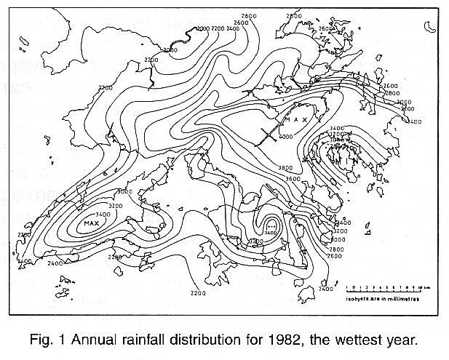
Printing Temperature
void Temperature::print() const{
  cout << degree << " " << scale;
}
Remarks:
  Member functions of a class can access the private data members of their class, but normal functions cannot.
  The modifier const in the print() member function indicates that the function is a constant member function (it does not change any of the data members).

Slide 14
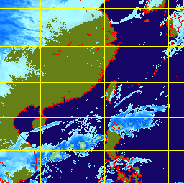
Default-Value Constructor
A constructor is a special member function whose name is always the same as the name of the class.
A constructor function initializes the data members when a Temperature object is declared.
    Temperature temp3;
  Temperature::Temperature(){
    degree = 0.0;
    scale = 'C';
  }

Slide 15
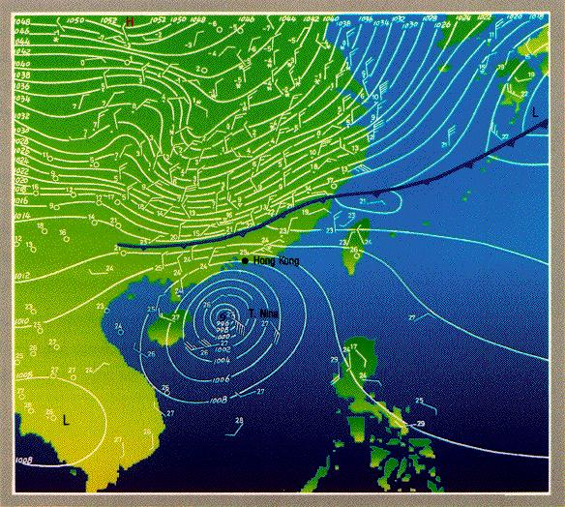
Default-Value Constructor
Remarks:
  Constructor functions have
  no return type (not even void!).
  Because a constructor function initializes the data members, there is no const following its heading.
  The constructor function is automatically called whenever a Temperature class object is declared.

Slide 16
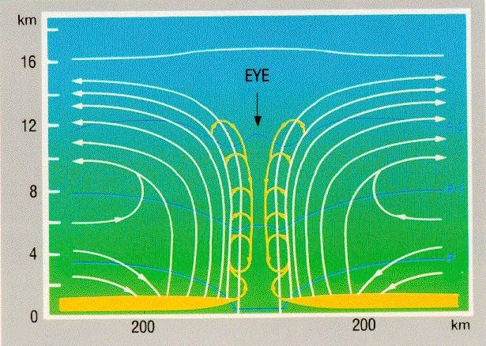
Explicit-Value Constructor
An explicit-value constructor initializes the data members when a Temperature object is declared with parameters:
    Temperature temp3(98.6, 'F');
Temperature::Temperature(double d, char s){
degree = d;
scale = toupper(s);
if(scale!='C' && scale!='F' && scale!='K'){
  cout << "Bad Temperature scale: " << scale << endl;
  exit(1);
  }
}

Slide 17
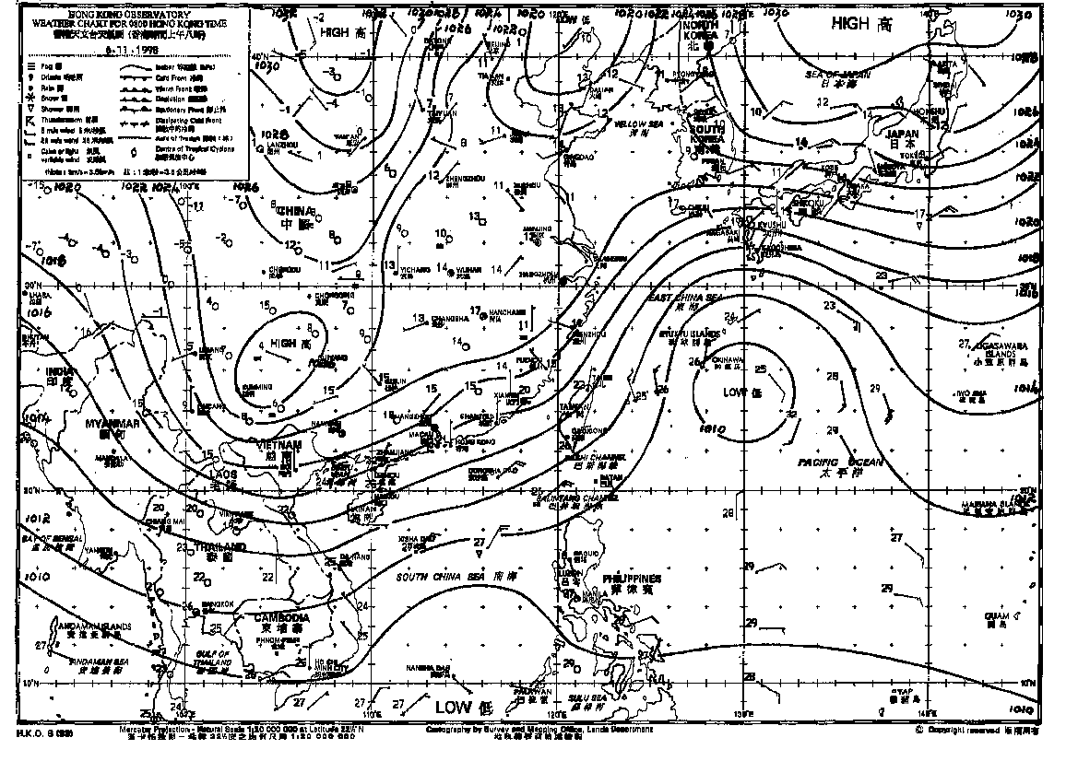
Inspector Functions
An inspector function allows programmers to read (but not modify) data members of the class.
    int d = temp1.getDegree();
    char s = temp1.getScale();
double Temperature::getDegree() const {
return degree;
}
char Temperature::getScale() const {
return scale;
}

Slide 18
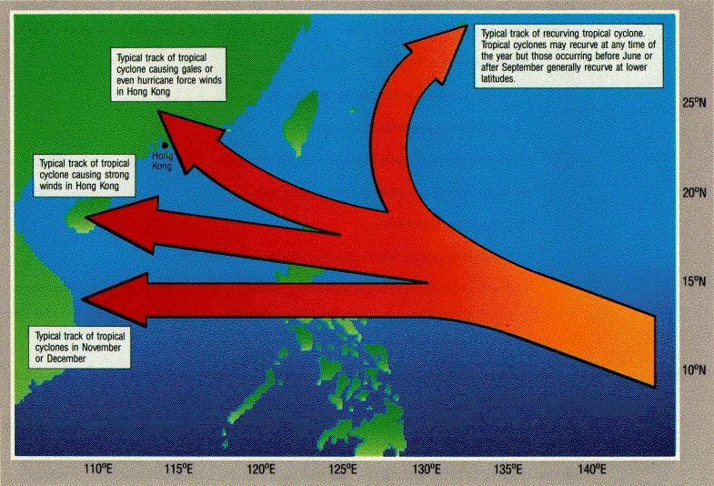

Mutator Functions
A mutator function modifies data members of the class.
  temp1.set(32, 'F');
void Temperature::set(double d, char s){
degree = d;
scale = toupper(s);
if(scale!='C' && scale!='F' && scale!='K'){
  cout << "Bad Temperature scale: " << scale << endl;
  exit(1);
  }
}

Slide 19
Reading Temperature
Using the read() member function:
    Temperature temp1;
    cout << "Enter temperature (e.g., 98.6 F): ";
    temp1.read();
  // process the temperature in temp1
When temp1 receives the read() message, it gets values from cin into degree and scale.
void Temperature::read(){
cin >> degree >> scale;
scale = toupper(scale);
if(scale!='C' && scale!='F' && scale!='K'){
  cout << "Bad Temperature scale: " << scale << endl;
  exit(1);
  }
}

Slide 20

Conversion Functions
The member function Fahrenheit() changes the degree and scale of the member data to Fahrenheit.
void Temperature::Fahrenheit(){
if(scale == 'C')
degree = degree*1.8+32.0;
else if(scale == 'K')
degree = (degree-273.15)*1.8 + 32.0;
scale = 'F';
}

Slide 21
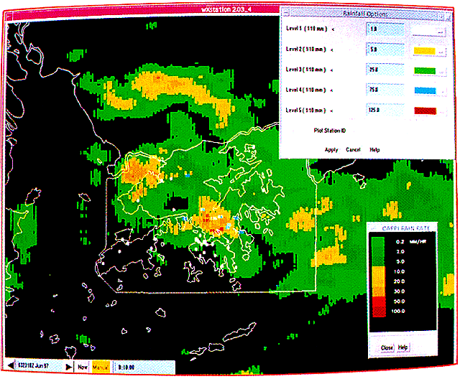
Conversion Functions
The member functions Celsius() and Kelvin() are similar.
void Temperature::Celsius(){
if(scale == 'F')
degree = (degree-32.0)/1.8;
else if(scale == 'K')
degree = degree - 273.15;
scale = 'C';
}
void Temperature::Kelvin(){
if(scale == 'F')
degree = (degree-32.0)/1.8 + 273.15;
else if(scale == 'C')
degree = degree + 273.15;
scale = 'K';
}

Slide 22
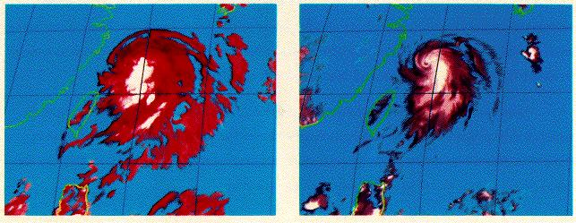

Conversion Functions
Using the Fahrenheit() member function:
    Temperature temp1; // default value: 0 C
    temp1.Fahrenheit();
    temp1.print(); // prints: 32 F
When temp1 receives the Fahrenheit() message, it converts to the Fahrenheit temperature 32 F.

Slide 23
Calling Member Functions from Member Functions
We can simplify the main() program by building a member function printAll() to print the temperature in all scales:
    void main(){
    char resp;
    Temperature temp;
    do{
    cout << "Enter temperature (e.g., 98.6 F): ";
    temp.read();
    temp.printAll(); // prints temperature in F, C, K
    cout << endl << endl;
    cout << "Another temperature to convert? ";
    cin >> resp;
    }while(resp == 'y' || resp == 'Y');
    }

Slide 24
Calling Member Functions from Member Functions
This member function calls the other member functions:
void Temperature::printAll(){
// prints temperature in all scales
double d = degree; // save initial degree and scale
char s = scale;
cout << "-->";
// calls member function Fahrenheit() on the same Temperature object
Fahrenheit();
// calls member function Fahrenheit() on the same Temperature object
print();
cout << " = ";
Celsius();
print();
cout << " = ";
Kelvin();
print();
degree = d; // restore initial degree and scale
scale = s;
}

Slide 25
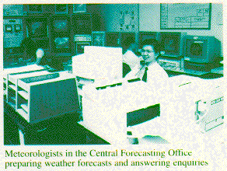
Temperature Class
class Temperature{
public:
Temperature();
Temperature(double idegree, char iscale);
double getDegree() const;
char getScale() const;
void set(double newDegree, char newScale);
void read();
void print() const;
void printAll();
void Fahrenheit();
void Celsius();
void Kelvin();
private:
double degree;
char scale;
};

Slide 26
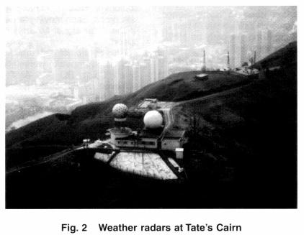

Some Additional Operations
Additional temperature object
operations that a user might need:
  display the degree value only
  display the scale value only
  compute the temperature plus n degrees
  compute the temperature minus n degrees
  compare to another another Temperature object using any of the six relational operators (==, !=, <, <=, >, >=)

Slide 27
Pager Idea
Member functions are similar to the way a pager works:
  You can have someone call you. You call their number (e.g., 9111-2222) and tell the operator your number (e.g., 2358-7000):
  91112222.call(23587000);
  You can can call a different person at a different pager number.
  98765432.call(23587000);
  You can also leave a more detailed message:
  91112222.message("Meet me in LG7");
  98765432.message("Need help on comp104 Lab!!!");

