Slide 1
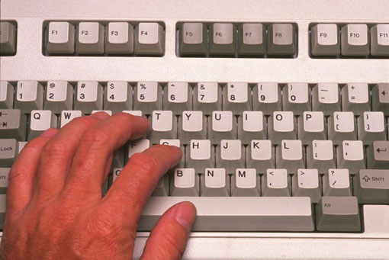
Programming
Introduction to Programming

Slide 2

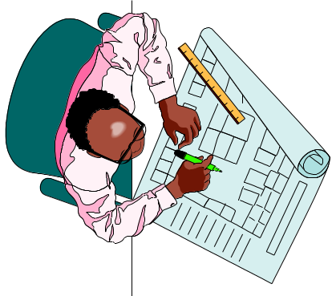

Objectives
To learn fundamental problem solving techniques
To learn how to design a program
To learn to use the C++ programming language

Slide 3
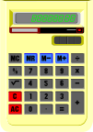
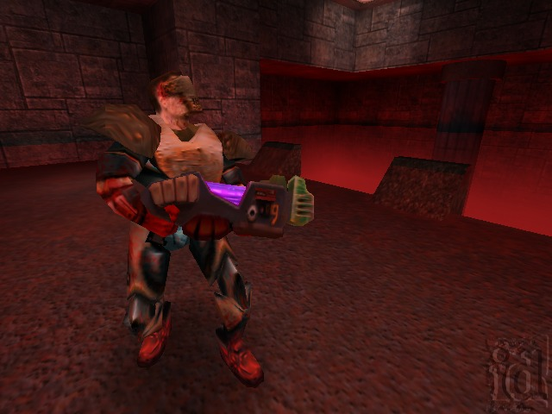



What Can We Do
By the End of the Course?
Write C++ applications such as the following:
  Program a simple calculator
  Program simple computer games
  Program a simple text editor
  Program a small inventory system for a small company
You will be ready to take on part-time programming jobs during Xmas break!

Slide 4
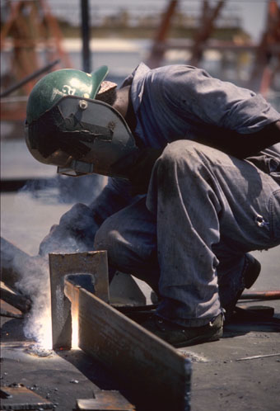

What is C++?
C++ is a programming language.
A computer program performs a specific task, and may interact with the user and the computer hardware.
  Human work model:
  Computer work model:
Work
Worker
Product
Instructions
Work
Computer
Product
Program

Slide 5


What is C++?
The most popular programming languages:
  C++ (originally C)
  Basic
  Pascal
  Java
  Perl
  Cobol
  Scheme (Lisp)
  Smalltalk
The most common versions of C++:
  Microsoft Visual C++
  Borland C++
  g++ (for Unix machines)

Slide 6






Why C++?
Bad News:
  C++ is not easy to learn
Good News:
  Lots of good jobs for programmers because C++ is not easy to learn!
  Though C++ is not the easiest language (Basic and Pascal are easier), it is not the hardest either (Scheme, Prolog, and Assembly languages are really difficult!)

Slide 7



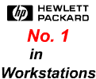








Who Uses C++?
Computer makers such as Sun, SGI, IBM, and HP
Airport
Computer chip manufacturers
like Motorola & Intel
Software companies
Banks
Hong Kong Government
Hospital Authority
Telecommunications
Universities

Slide 8

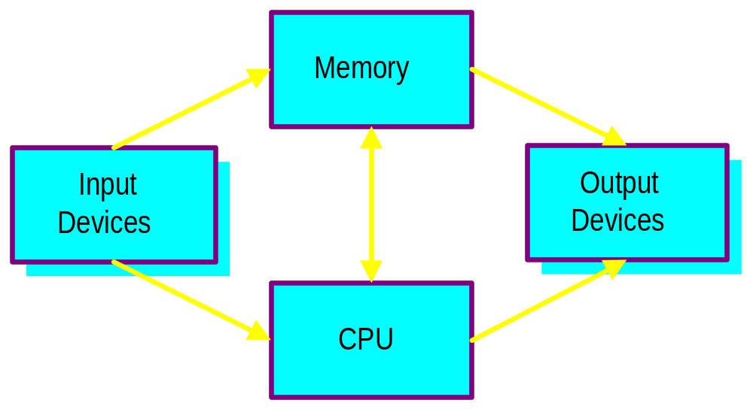
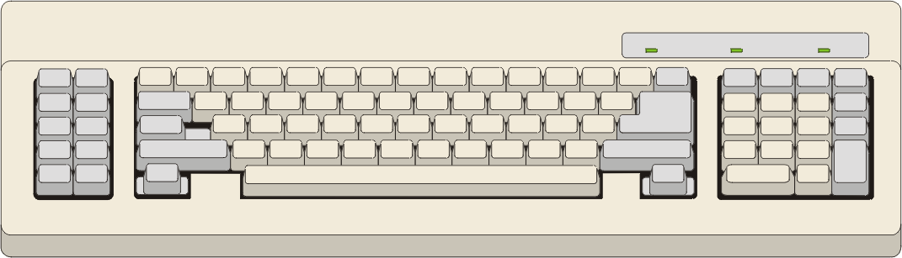
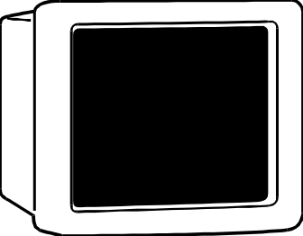
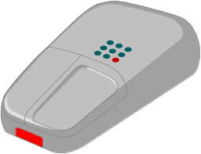

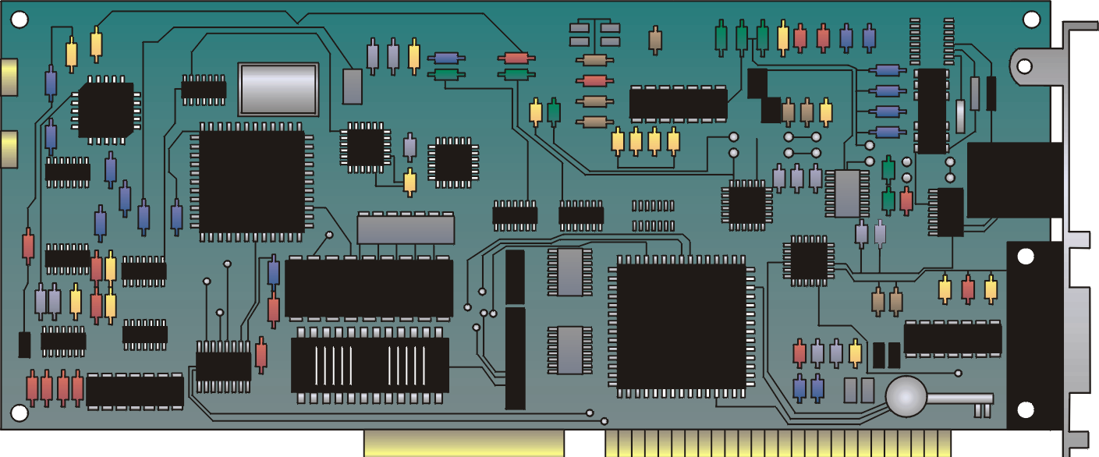
Hardware Overview

Slide 9
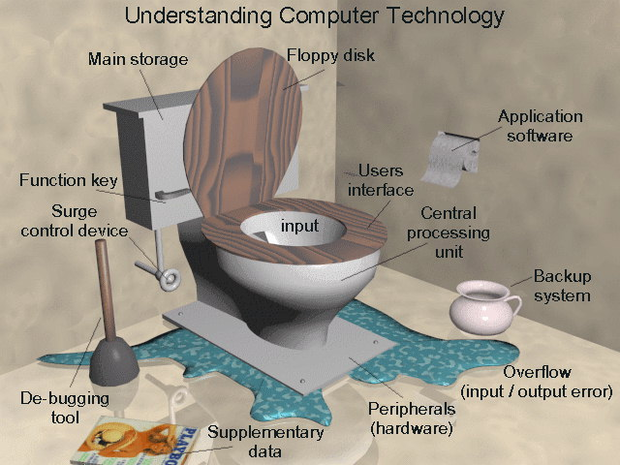
Hardware Overview

