Slide 1

Programming
Local and Global Variables

Slide 2

Scope
The scope of a declaration is the block of code where
the identifier is valid for use.
  A global declaration is made outside the bodies of all functions and outside the main program. It is normally grouped with the other global declarations and placed at the beginning of the program file.
  A local declaration is one that is made inside the body of a function. Locally declared variables cannot be accessed outside of the function they were declared in.
  It is possible to declare the same identifier name in different parts of the program.

Slide 3
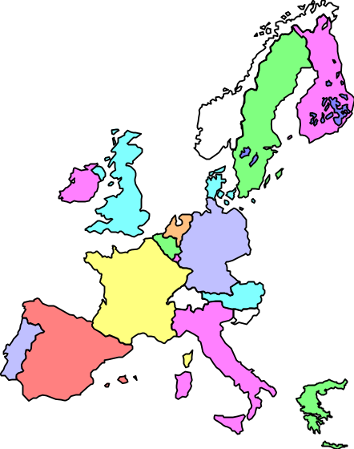
Scope: Example 1
int y = 38;
void f(int, int);
void main( ){
int z=47;
while(z<400){
int a = 90;
z += a++;
z++;
}
y = 2 * z;
f(1, 2);
}
void f(int s, int t){
int r = 12;
s = r + t;
int i = 27;
s += i;
}
scope of y
scope of f
scope of z
scope of a
scope of s & t
scope of r
scope of i

Slide 4
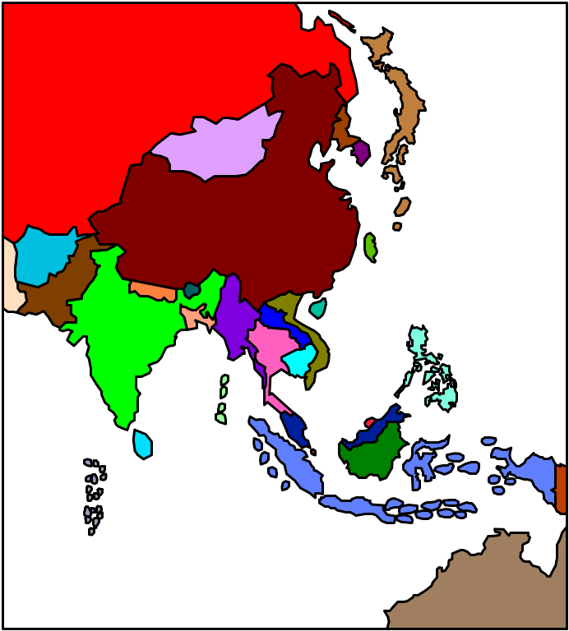
Scope: Example 2
Number in Increment() is the global variable.
#include <iostream>
using namespace std;
int Number; //global variable
void Increment(int Num) {
Num = Num + 1;
cout << Num << endl;
Number = Number + 1;
}
void main() {
Number = 1;
Increment(Number);
cout << Number << endl;
}

Slide 5

Global Variables
Undisciplined use of global variables may lead to confusion and debugging difficulties.
Instead of using global variables in functions, try passing local variables by reference.

Slide 6

Scope: Example 3
int Number; //global variable
void Increment(int& Num) {
Num = Num + 1;
cout << Num << endl;
Number = Number + 1;
}
void main() {
Number = 1;
Increment(Number);
cout << Number << endl;
}
When Increment is called, Num refers to global variable Number
Number = Number + 1 also refers to global variable Number.

Slide 7

Scope: Example 4
int Number; //global variable
void Increment(int Number) {
Number = Number + 1;
cout << Number << endl;
}
void main() {
Number = 1;
Increment(Number);
cout << Number << endl;
}
The scope of the global variable Number does not include Increment(), because Increment() already has a local parameter of the same name.
Thus, the changes made to Number are lost when control returns to the main program.

Slide 8

Scope: Example 5
int A,B,C,D;
void Two(int A, int B, int& D) {
B = 21; D = 23;
cout <<A<< " " <<B<< " " <<C<< " " <<D<< endl;
}
void One(int A, int B, int& C) {
int D; // Local variable
A = 10; B = 11; C = 12; D = 13;
cout <<A<< " " <<B<< " " <<C<< " " <<D<< endl;
Two(A,B,C);
}
void main() {
A = 1; B = 2; C = 3; D = 4;
One(A,B,C);
cout <<A<< " " <<B<< " " <<C<< " " <<D<< endl;
Two(A,B,C);
cout <<A<< " " <<B<< " " <<C<< " " <<D<< endl;
}

Slide 9
Scope: Example 5
Output:
10 11 12 13
10 21 23 23
1 2 23 4
1 21 23 23
1 2 23 4

Slide 10

Testing and Debugging Functions
One major advantage of functions is that they can be designed, coded and tested separately from the rest of the program.
Use a "driver" program to test a function with several inputs:
void main( ) {
int i;
for (i = 1; i <= 13; i++){
printcard(i);
cout << " ";
}
}

Slide 11

Testing and Debugging Functions
If a yet-to-be written function is needed in testing a program, replace it with a "stub" for testing.
A stub has the same interface as the original function, but not the full implementation.
Oftentimes, a stub contains just a simple return or cout command.
void printcard(int i) {
cout << i;
}

