Slide 1
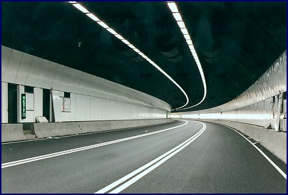
Programming
Pointers

Slide 2

Pointers
A pointer is a variable used for storing the address of a memory cell.
We can use the pointer to reference this memory cell
Memory address:
1020
1024
1032
…
…
100
…
1024
…
integer
pointer

Slide 3
Computer Memory
A variable is in fact a portion of memory to store a determined value
Each variable is assigned a memory slot (the size depends on the data type) and the variable’s data is stored there
Memory address:
1020
1024
1032
…
…
100
…
1024
…
a
Variable a’s value, i.e., 100, is
stored at memory location 1024
int a = 100;

Slide 4


Pointer Types
Pointer
  C++ has pointer types for each type of object
    Pointers to int objects
    Pointers to char objects
    Pointers to user-defined objects
    (e.g., RationalNumber)
  Even pointers to pointers
    Pointers to pointers to int objects

Slide 5
Address Operator &
The "address of " operator (&) gives the memory address of the variable
  Usage: &variable_name
Memory address:
1020
1024
…
…
100
…
…
…
a
int a = 100;
//To get the value, use the variable name
cout << a; //prints 100
//To get the memory address, add the address
//operator before the variable name
cout << &a; //prints 1024

Slide 6
Address Operator &
Memory address:
1020
1024
1032
…
88
100
…
…
…
a
b
#include <iostream>
using namespace std;
void main(){
int a, b;
a = 88;
b = 100;
cout << "The address of a is: " << &a << endl;
cout << "The address of b is: " << &b << endl;
}
Result is:
The address of a is: 1020
The address of b is: 1024

Slide 7

Pointer Variable
A pointer variable is a specific box for storing a memory address
Declaration of Pointer variables
  type* pointer_name;
  //or
  type *pointer_name;
  Where type is the type of data pointed to (e.g. int, char, double)

Slide 8

Pointer Variables
The value of pointer p is the address of variable a
A pointer is also a variable, so it has its own memory address
Memory address:
1020
1024
1032
…
88
100
…
1024
…
a
p
int a = 100;
int *p = &a;
cout << a << " " << &a <<endl;
cout << p << " " << &p <<endl;
Result is:
100 1024
1024 1032

Slide 9

Reference Operator *
We can access to the value stored in the variable pointed to by preceding the pointer with the “star” reference operator (*),
Memory address:
1020
1024
1032
…
88
100
…
1024
…
a
p
int a = 100;
int *p = &a;
cout << a << endl;
cout << &a << endl;
cout << p << " " << *p << endl;
cout << &p << endl;
Result is:
100
1024
1024 100
1032

Slide 10

Don’t get confused
Declaring a pointer means only that it is a pointer: int *p;
Don’t be confused with the reference operator, which is also written with an asterisk (*). They are simply two different tasks represented with the same sign
int a = 100, b = 88, c = 8;
int *p1 = &a, *p2, *p3 = &c;
p2 = &b; // p2 points to b
p2 = p1; // p2 points to a
b = *p3; //assign c to b
*p2 = *p3; //assign c to a
cout << a << b << c;
Result is:
888

Slide 11
Pointer Example
#include <iostream>
using namespace std;
int main (){
int value1 = 5, value2 = 15;
int *p1, *p2;
p1 = &value1; // p1 = address of value1
p2 = &value2; // p2 = address of value2
*p1 = 10; // value pointed to by p1=10
*p2 = *p1; // value pointed to by p2= value // pointed to by p1
p1 = p2; // p1 = p2 (pointer value copied)
*p1 = 20; // value pointed to by p1 = 20
cout << "value1==" << value1 << "/ value2==" << value2;
return 0;
}
Result is
value1==10 / value2==20

Slide 12

Another Pointer Example
int a = 3;
char s = ‘z’;
double d = 1.03;
int *pa = &a;
char *ps = &s;
double *pd = &d;
cout << sizeof(pa) << sizeof(*pa)
<< sizeof(&pa) << endl;
cout << sizeof(ps) << sizeof(*ps)
<< sizeof(&ps) << endl;
cout << sizeof(pd) << sizeof(*pd)
<< sizeof(&pd) << endl;

Slide 13

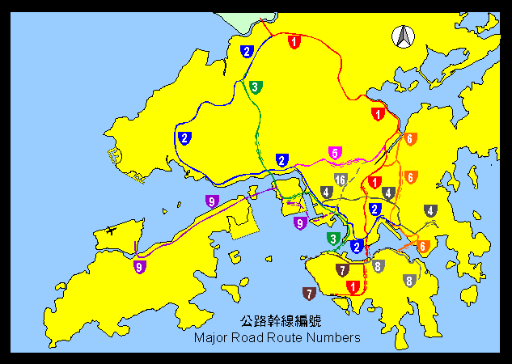
Traditional Pointer Usage
void IndirectSwap(char *Ptr1, char *Ptr2){
  char temp = *Ptr1;
  *Ptr1 = *Ptr2;
  *Ptr2 = temp;
}
int main() {
  char a = 'y';
  char b = 'n';
  IndirectSwap(&a, &b);
  cout << a << b << endl;
  return 0;
}

Slide 14

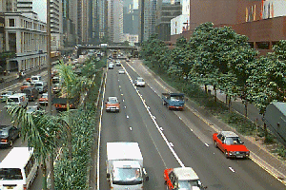
Pass by Reference
void IndirectSwap(char& y, char& z) {
  char temp = y;
  y = z;
  z = temp;
}
int main() {
  char a = 'y';
  char b = 'n';
  IndirectSwap(a, b);
  cout << a << b << endl;
  return 0;
}

Slide 15
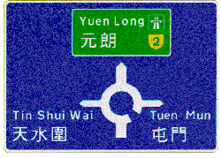

Alternative
Pass by Reference
void IndirectSwap(char &y, char &z) {
  char temp = y;
  y = z;
  z = temp;
}
int main() {
  char a = 'y';
  char b = 'n';
  IndirectSwap(a, b);
  cout << a << b << endl;
  return 0;
}

Slide 16

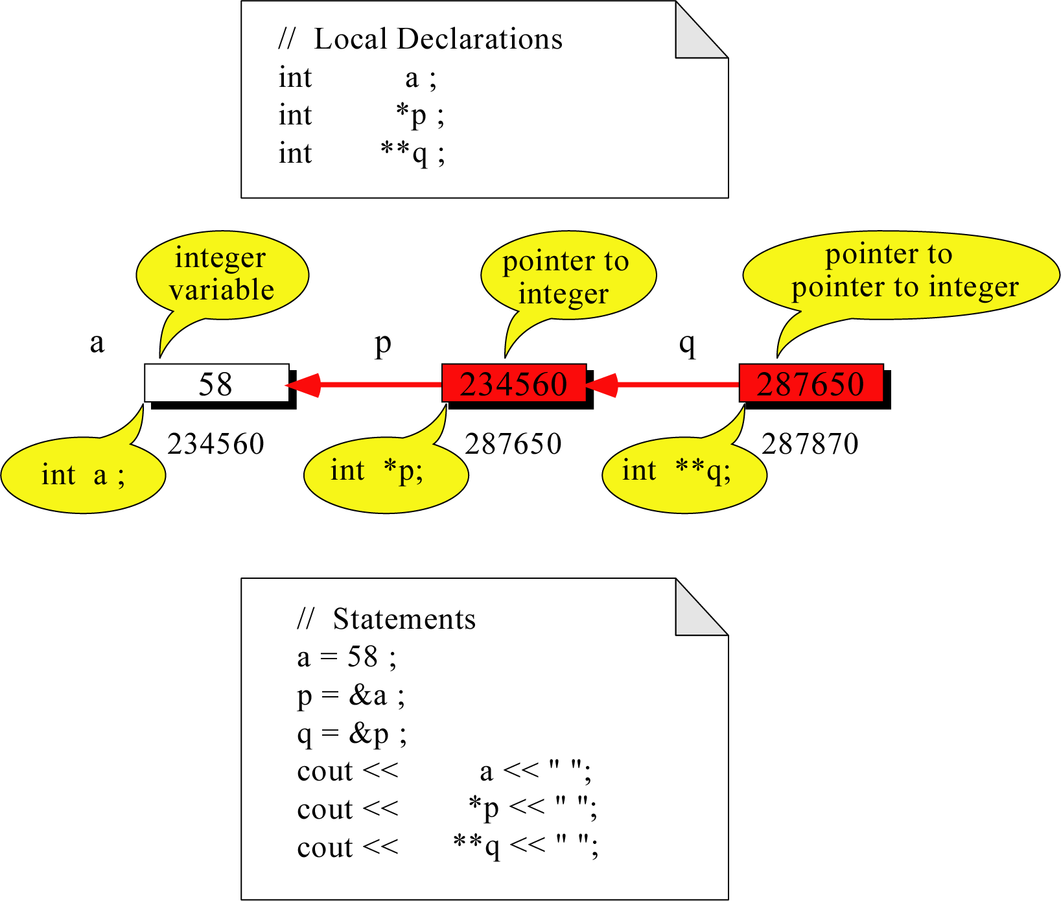
Pointer to Pointer
What is the output?
58 58 58

Slide 17
More Pointer to Pointer
a
p
q
r
s
58
345670
445670
545670
645670
integer a;
Pointer to
integer
Pointer to
Pointer to
integer
Pointer to
Pointer to
pointer to
integer
Pointer to
Pointer to
pointer to
Pointer to
integer
int a = 58;
int *p = &a;
int **q = &p;
int ***r = &q;
int ****s = &r;
q = &a //illegal!
s = &q //illegal!

Slide 18
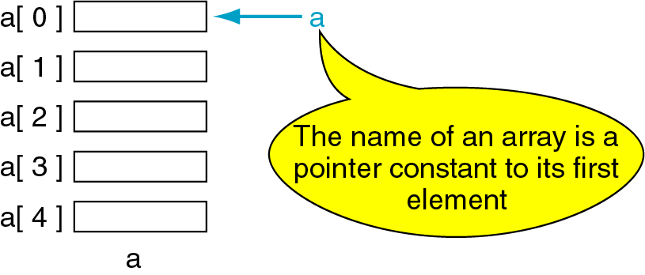
Pointers and Arrays
The name of an array points only to the first element not the whole array.
1000
1004
1008
1012
1016

Slide 19
Array Name is a pointer constant
#include <iostream>
using namespace std;
void main (){
// Demonstrate array name is a pointer constant
int a[5];
cout << "Address of a[0]: " << &a[0] << endl
<< "Name as pointer: " << a << endl;
}
/* result:
Address of a[0]: 0x0065FDE4
Name as pointer: 0x0065FDE4
*/

Slide 20

Dereference of An Array Name
This element is called a[0] or *a
#include <iostream>
using namespace std;
void main(){
int a[5] = {2,4,6,8,22};
cout << *a << " "
<< a[0] << " "
<< *(&a[0]);
} //main
a[0]
2
2 2 2
a[1]
4
a
a[2]
6
a[3]
8
a[4]
22
a

Slide 21
Array Names as Pointers
To access an array, any pointer to the first element can be used instead of the name of the array.
We could replace *p by *a
#include <iostream>
using namespace std;
void main(){
int a[5] = {2,4,6,8,22};
int *p = a;
int i = 0;
cout << a[i] << " "
<< *p;
}
a
p
a[0]
2
2 2
a[1]
4
a[2]
6
a[3]
8
a[4]
22
a

Slide 22
Multiple Array Pointers
Both a and p are pointers to the same array.
#include <iostream>
using namespace std;
void main(){
int a[5] = {2,4,6,8,22};
int *p = &a[1];
cout << a[0] << " "
<< p[-1];
cout << a[1] << " "
<< p[0];
}
A[0]
a[0]
2 2
4 4
2
p
a[1]
4
a[2]
6
a[3]
P[0]
8
a[4]
22

Slide 23
Pointer Arithmetic
Given a pointer p, p+n refers to the element that is offset from p by n positions.
a
2
p - 1
4
p
a + 1
a + 2
6
p + 1
a + 3
8
p + 2
a + 4
22
p + 3

Slide 24
Dereferencing Array Pointers
a[0] or *(a + 0)
2
a
a[1] or *(a + 1)
4
a + 1
a[2] or *(a + 2)
6
a + 2
a[3] or *(a + 3)
8
a + 3
a[4] or *(a + 4)
22
a + 4
*(a+n) is identical to a[n]

Slide 25
Array of Pointers & Pointers to Array
a
p
b
c
An array of Pointers
A pointer to an array
int a = 1, b = 2, c = 3;
int *p[5];
p[0] = &a;
p[1] = &b;
p[2] = &c;
int list[5] = {9, 8, 7, 6, 5};
int *p;
P = list;//points to 1st entry
P = &list[0];//points to 1st entry
P = &list[1];//points to 2nd entry
P = list + 1; //points to 2nd entry

Slide 26

NULL pointer
NULL is a special value that indicates an empty pointer
If you try to access a NULL pointer, you will get an error
int *p;
p = 0;
cout << p << endl; //prints 0
cout << &p << endl;//prints address of p
cout << *p << endl;//Error!

Slide 27
Storing 2D Array in 1D Array
int twod[3][4] = {{0,1,2,3}, {4,5,6,7}, {8,9,10,11}};
int oned[12];
for(int i=0; i<3; i++){
for(int j=0; j<4 ; j++)
oned[i*4+j] = twod[i][j];
}

Slide 28
Pointer to 2-Dimensional Arrays
table
table + 1
table[ 0] or *( table + 0 )
table + 2
table[ 1] or *( table + 1 )
table[ 2] or *( table + 2 )
int table[3][4] = {{1,2,3,4},
{5,6,7,8},{9,10,11,12}};
table[i][j]
What is
**table ?
for(int i=0; i<3; i++){
for(int j=0; j<4; j++)
cout << *(*(table+i)+j);
cout << endl;
}

