Slide 1

Programming
Problem Solving
and
Program Design

Slide 2

Our First Program
Preprocessor
statements
// a simple program
#include <iostream>
using namespace std;
int main() {
cout << "Hello world!" << endl;
return 0;
}
Comments
Function named main() indicates start of program
Ends execution
of main() which ends program
Print
statement
Function

Slide 3

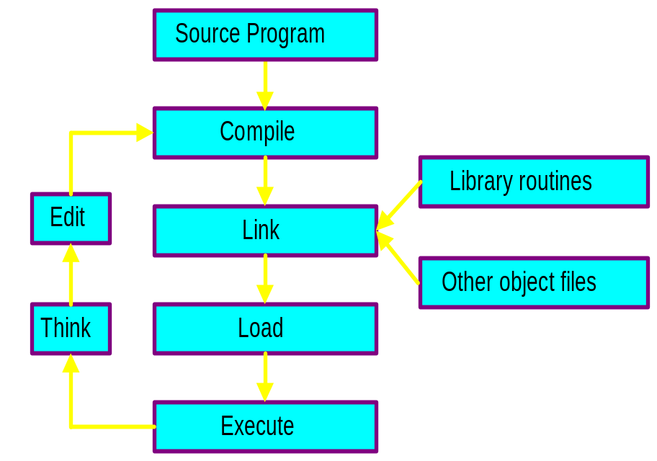

C++ Software Development
Major activities
  Editing (to write the program)
  Compiling (creates .obj file)
  Linking with compiled files (creates .exe file)
    Object files
    Library modules
  Loading and executing
  Testing the program

Slide 4




Problem Solving
Define the problem.
Develop a solution.
  Outline solution first.
  Then write down the solution steps in detail.
Test the solution and revise if necessary.
Document and maintain the solution.

Slide 5



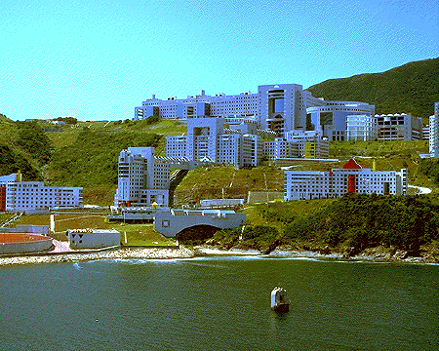


Example 1
Define Problem:
  Find the best way to travel from HKUST to Central quickly and cheaply.

Slide 6




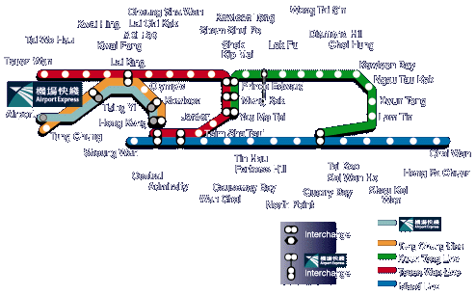
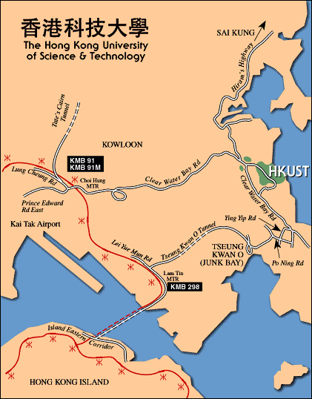
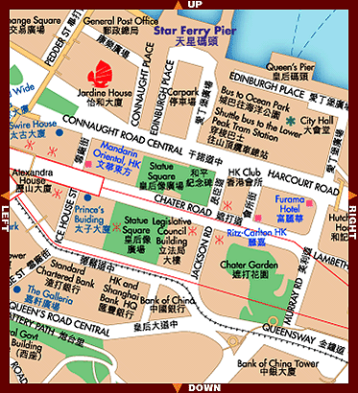

Example 1
Develop Solution:
  Evaluate all possible routes and modes of transportation
  Select the route that meets our goal (fastest and cheapest)

Slide 7

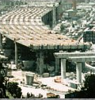
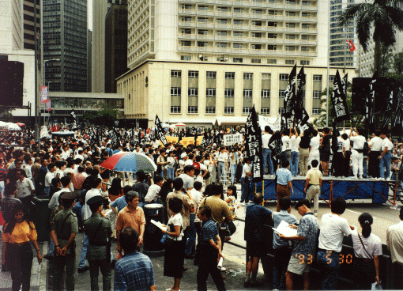
Example 1
Testing:
  Test the route and make sure conditions have not changed (e.g., increased bus fares, road construction).
Documentation:
  Give description of solution and explain it.
Maintenance:
  Test and revise the route as needed.

Slide 8

Programming as Problem Solving
Define the problem.
  What is the input & output?
  What constraints must be satisfied?
  What information is essential?
Develop a solution
  Construct an algorithm (steps that must be done)
  Implement a program.
Compile, test, and debug the program.
Document and maintain the program.

Slide 9


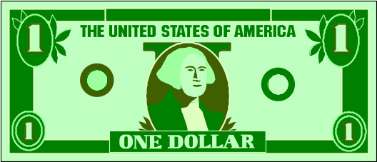

Example 2
Problem Statement:
  Convert US dollars into Hong Kong dollars.
Problem Analysis:
  Input: Amount in US$
  Output: Amount in HK$
  Apply official currency exchange rates.

Slide 10

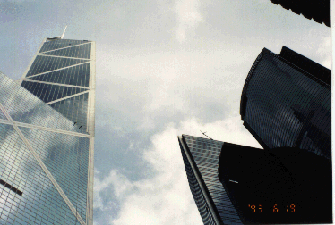



Example 2
Algorithm
  Read in amount in US$
  Calculate the HK$ amount
  Display the results

Slide 11


Example 2
// converts US$ to HK$
#include <iostream>
using namespace std;
int main(){
  double usdollars;
  double hkdollars;
  // read in amount in US$
  cout <<"Enter US$ amount and press return: ";
  cin >> usdollars;
  // calculate the HK$ amount
  hkdollars = 7.8 * usdollars;
  // display the results
  cout << "US$" << usdollars
  << " = HK$" << hkdollars << endl;
  return 0;
}

Slide 12
Example 2
Program Implementation:
  Program comments: //
  Library reference: #include
  Function type: int
  Function name and (lack of) parameters: main( )
  Statement braces: { }
  Variable declaration: double
  Input/output functions: cin, cout

Slide 13
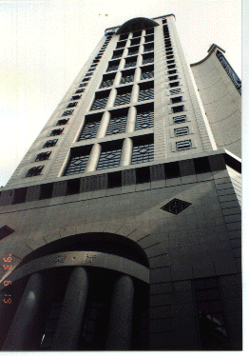

What Makes a Good Program?
Correctness
  Meets the problem requirements
  Produces correct results
Easy to read and understand
Easy to modify
Easy to debug
Efficient
  Fast
  Requires less memory

