Slide 1
Chapter 5: The Data Link Layer last revised 24/11/03
Our goals:
understand principles behind data link layer services:
  error detection, correction
  sharing a broadcast channel: multiple access
  link layer addressing
  reliable data transfer, flow control: done!
instantiation and implementation of various link layer technologies
Overview:
link layer services
error detection, correction
multiple access protocols and LANs
link layer addressing, ARP
specific link layer technologies:
  Ethernet
  hubs, bridges, switches
  ATM

Slide 2
Chapter 5 outline
5.1 Introduction and services
5.2 Error detection and correction
5.3Multiple access protocols
5.4 LAN addresses and ARP
5.5 Ethernet
5.6 Hubs, bridges, and switches
5.7 Wireless links and LANs
5.8 PPP
5.9 ATM
5.10 Frame Relay

Slide 3
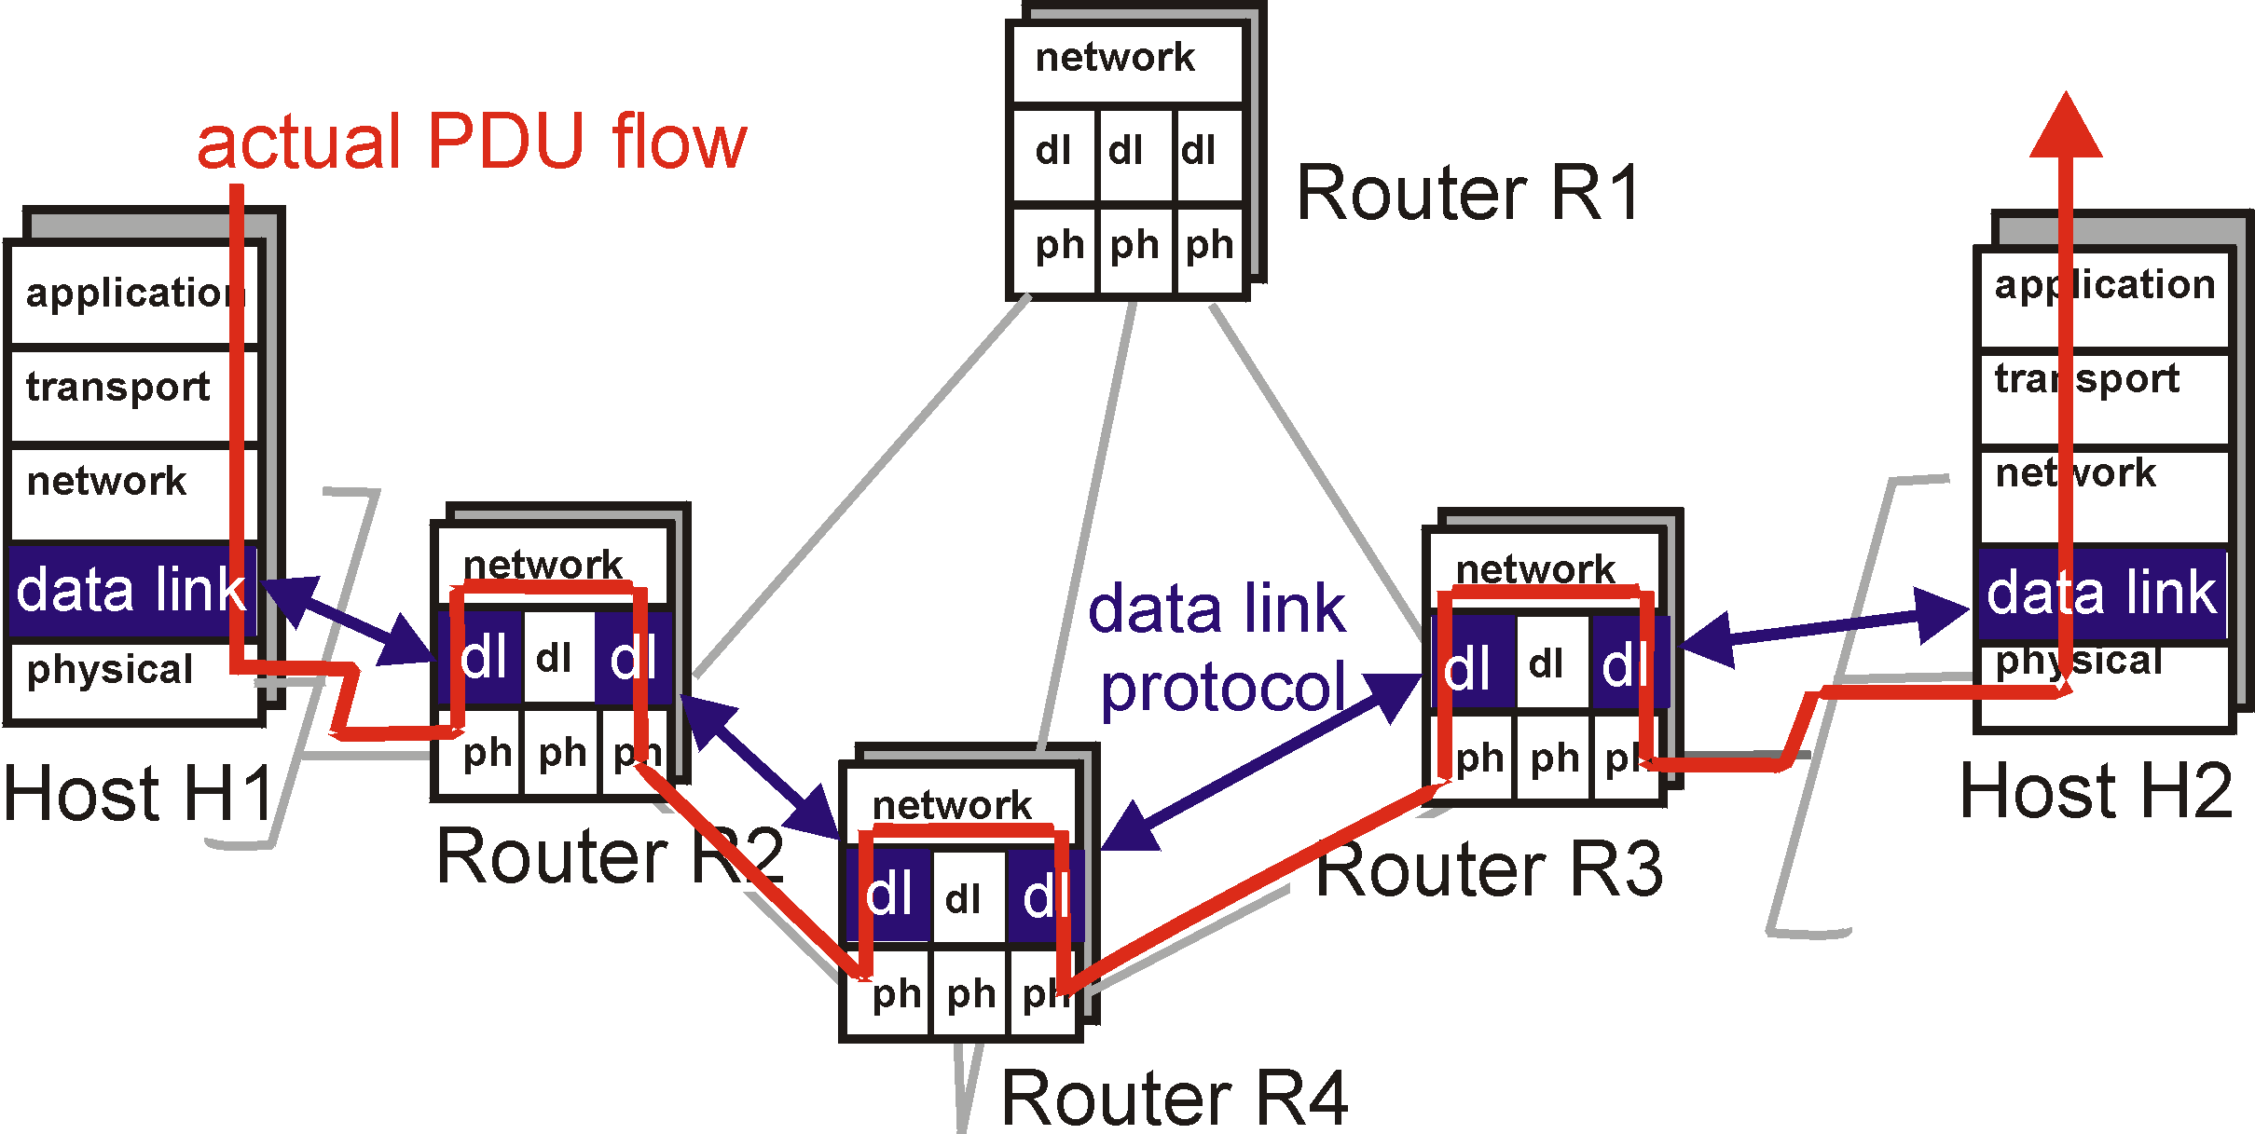
Link Layer: setting the context

Slide 4

Link Layer: setting the context
two physically connected devices:
  host-router, router-router, host-host
unit of data: frame
M
application
transport
network
link
physical
network
link
physical
H
t
M
H
H
M
data link
protocol
n
t
H
H
H
H
H
H
M
l
n
t
M
l
n
t
frame
phys. link
adapter card

Slide 5




Link Layer: setting the context
“link”
Some terminology:
hosts and routers are nodes
(bridges and switches too)
communication channels that connect adjacent nodes along communication path are links
  wired links
  wireless links
  LANs
2-PDU is a frame, encapsulates datagram
data-link layer has responsibility of
transferring datagram from one node
to adjacent node over a link

Slide 6
Link layer: context
Datagram transferred by different link protocols over different links:
  e.g., Ethernet on first link, frame relay on intermediate links, 802.11 on last link
Each link protocol provides different services
  e.g., may or may not provide rdt over link
transportation analogy
trip from Princeton to Lausanne
  limo: Princeton to JFK
  plane: JFK to Geneva
  train: Geneva to Lausanne
tourist = datagram
transport segment = communication link
transportation mode = link layer protocol
travel agent = routing algorithm

Slide 7
Link Layer Services
Framing, link access:
  encapsulate datagram into frame, adding header, trailer
  channel access if shared medium
  ‘physical addresses’ used in frame headers to identify source, dest
    different from IP address!
Reliable delivery between adjacent nodes
  we learned how to do this already (chapter 3)!
  seldom used on low bit error link (fiber, some twisted pair)
  wireless links: high error rates
    Q: why both link-level and end-end reliability?

Slide 8
Link Layer Services (more)
Flow Control:
  pacing between adjacent sending and receiving nodes
Error Detection:
  errors caused by signal attenuation, noise.
  receiver detects presence of errors:
    signals sender for retransmission or drops frame
Error Correction:
  receiver identifies and corrects bit error(s) without resorting to retransmission
Half-duplex and full-duplex
  with half duplex, nodes at both ends of link can transmit, but not at same time

Slide 9
Adaptors Communicating
datagram
link layer protocol
rcving
node
sending
node
frame
frame
adapter
adapter
link layer implemented in “adaptor” (aka NIC)
  Ethernet card, PCMCIA card, 802.11 card
  typically includes: RAM, DSP chips, host bus interface, and link interface
sending side:
  encapsulates datagram in a frame
  adds error checking bits, rdt, flow control, etc.
receiving side
  looks for errors, rdt, flow control, etc
  extracts datagram, passes to rcving node
adapter is semi-autonomous
link & physical layers

Slide 10
Chapter 5 outline
5.1 Introduction and services
5.2 Error detection and correction
5.3Multiple access protocols
5.4 LAN addresses and ARP
5.5 Ethernet
5.6 Hubs, bridges, and switches
5.7 Wireless links and LANs
5.8 PPP
5.9 ATM
5.10 Frame Relay

Slide 11

Error Detection
EDC= Error Detection and Correction bits (redundancy)
D = Data protected by error checking, may include header fields
Error detection not 100% reliable!
  protocol may miss some errors, but rarely
  larger EDC field yields better detection and correction

Slide 12

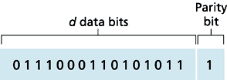
Parity Checking
Single Bit Parity:
Detect single bit errors
Two Dimensional Bit Parity:
Detect and correct single bit errors
0
0

Slide 13
Internet checksum
Goal: detect “errors” (e.g., flipped bits) in transmitted segment (note: used at transport layer only)
Sender:
treat segment contents as sequence of 16-bit integers
checksum: addition (1’s complement sum) of segment contents
sender puts checksum value into UDP checksum field
Receiver:
compute checksum of received segment
check if computed checksum equals checksum field value:
  NO - error detected
  YES - no error detected. But maybe errors nonetheless?

Slide 14

Checksumming: Cyclic Redundancy Check
view data bits, D, as coefficients of polynomial
choose r+1 bit pattern (generator), G
goal: choose r CRC bits, R, such that
  <D,R> exactly divisible (polynomial division) by G (modulo 2)
  receiver knows G, divides <D,R> by G. If non-zero remainder: error detected!
  can detect all burst errors less than r+1 bits
widely used in practice (ATM, HDCL)

Slide 15
Bits in word are coefficients of polynomial
D = 101110 then D(x) = x^5 + x^3 + x^2 + x
Arithmetic on coefficients is mod 2
(x+1)^2 = x^2 + 1
In particular P(x) + P(x) = 0
R(x) is the remainder of P(x) divided by G(x) if
P(x) = A(x) G(x) + R(x) where deg(R) < deg(G)
G(x) divides P(x) + R(x) since
P(x) + R(x) = A(x) G(x) + R(x) + R(x) = A(x) G(x)
2^{r} D corresponds to x^r D(x)
Given D and G,
  CRC finds R(x), remainder when x^r D(x) is divided by G(x).
  R is word corresponding to R(x).
  CRC is D.2^{r} XOR R

Slide 16
Example (r=3)
D = 101110 D(x) = x^5 + x^3 + x^2 + x
G = 1001 G(x) = x^3 + 1
2^{r}D = 101110000 x^3 D(x) = x^8 + x^6 + x^5 +x^4
x^3 D(x) = G(x) (x^5 + x^3 + x + 1) + (x+1)
So R(x) = x+1 and R = 011
CRC will transmit
D.2^{r} XOR R = 101110011

Slide 17
Chapter 5 outline
5.1 Introduction and services
5.2 Error detection and correction
5.3Multiple access protocols
5.4 LAN addresses and ARP
5.5 Ethernet
5.6 Hubs, bridges, and switches
5.7 Wireless links and LANs
5.8 PPP
5.9 ATM
5.10 Frame Relay

Slide 18

Multiple Access Links and Protocols
Two types of “links”:
point-to-point
  PPP for dial-up access
  point-to-point link between Ethernet switch and host
broadcast (shared wire or medium)
  traditional Ethernet
  upstream HFC
  802.11 wireless LAN

Slide 19
Multiple Access protocols
single shared communication channel
two or more simultaneous transmissions by nodes: interference
  only one node can send successfully at a time
multiple access protocol:
  distributed algorithm that determines how stations share channel, i.e., determine when station can transmit
  communication about channel sharing must use channel itself!
  what to look for in multiple access protocols:
    synchronous or asynchronous
    information needed about other stations
    robustness (e.g., to channel errors)
    performance

Slide 20
Ideal Multiple Access Protocol
Broadcast channel of rate R bps
1. When one node wants to transmit, it can send at rate R.
2. When M nodes want to transmit, each can send at average rate R/M
3. Fully decentralized:
  no special node to coordinate transmissions
  no synchronization of clocks, slots
4. Simple

Slide 21
MAC Protocols: a taxonomy
Three broad classes:
Channel Partitioning TDMA, FDMA, CDMA
  divide channel into smaller “pieces” (time slots, frequency)
  allocate piece to node for exclusive use
Random Access ALOHA, CSMA, CSMA/CD, CSMA/CA
  allow collisions
  “recover” from collisions
“Taking turns” Polling, Token passing
  tightly coordinate shared access to avoid collisions
Goal: efficient, fair, simple, decentralized

Slide 22

Channel Partitioning MAC protocols: TDMA
TDMA: time division multiple access
access to channel in "rounds"
each station gets fixed length slot (length = pkt trans time) in each round
unused slots go idle
example: 6-station LAN, 1,3,4 have pkt, slots 2,5,6 idle
TDM (Time Division Multiplexing): channel divided into N time slots, one per user; inefficient with low duty cycle users and at light load.
FDM (Frequency Division Multiplexing): frequency subdivided.

Slide 23
Channel Partitioning MAC protocols: FDMA
FDMA: frequency division multiple access
channel spectrum divided into frequency bands
each station assigned fixed frequency band
unused transmission time in frequency bands go idle
example: 6-station LAN, 1,3,4 have pkt, frequency bands 2,5,6 idle
TDM (Time Division Multiplexing): channel divided into N time slots, one per user; inefficient with low duty cycle users and at light load.
FDM (Frequency Division Multiplexing): frequency subdivided.
time
frequency bands

Slide 24
Channel Partitioning (CDMA)
CDMA (Code Division Multiple Access)
unique “code” assigned to each user; i.e., code set partitioning
used mostly in wireless broadcast channels (cellular, satellite, etc)
all users share same frequency, but each user has own “chipping” sequence (i.e., code) to encode data
encoded signal = (original data) X (chipping sequence)
decoding: inner-product of encoded signal and chipping sequence
allows multiple users to “coexist” and transmit simultaneously with minimal interference (if codes are “orthogonal”)

Slide 25
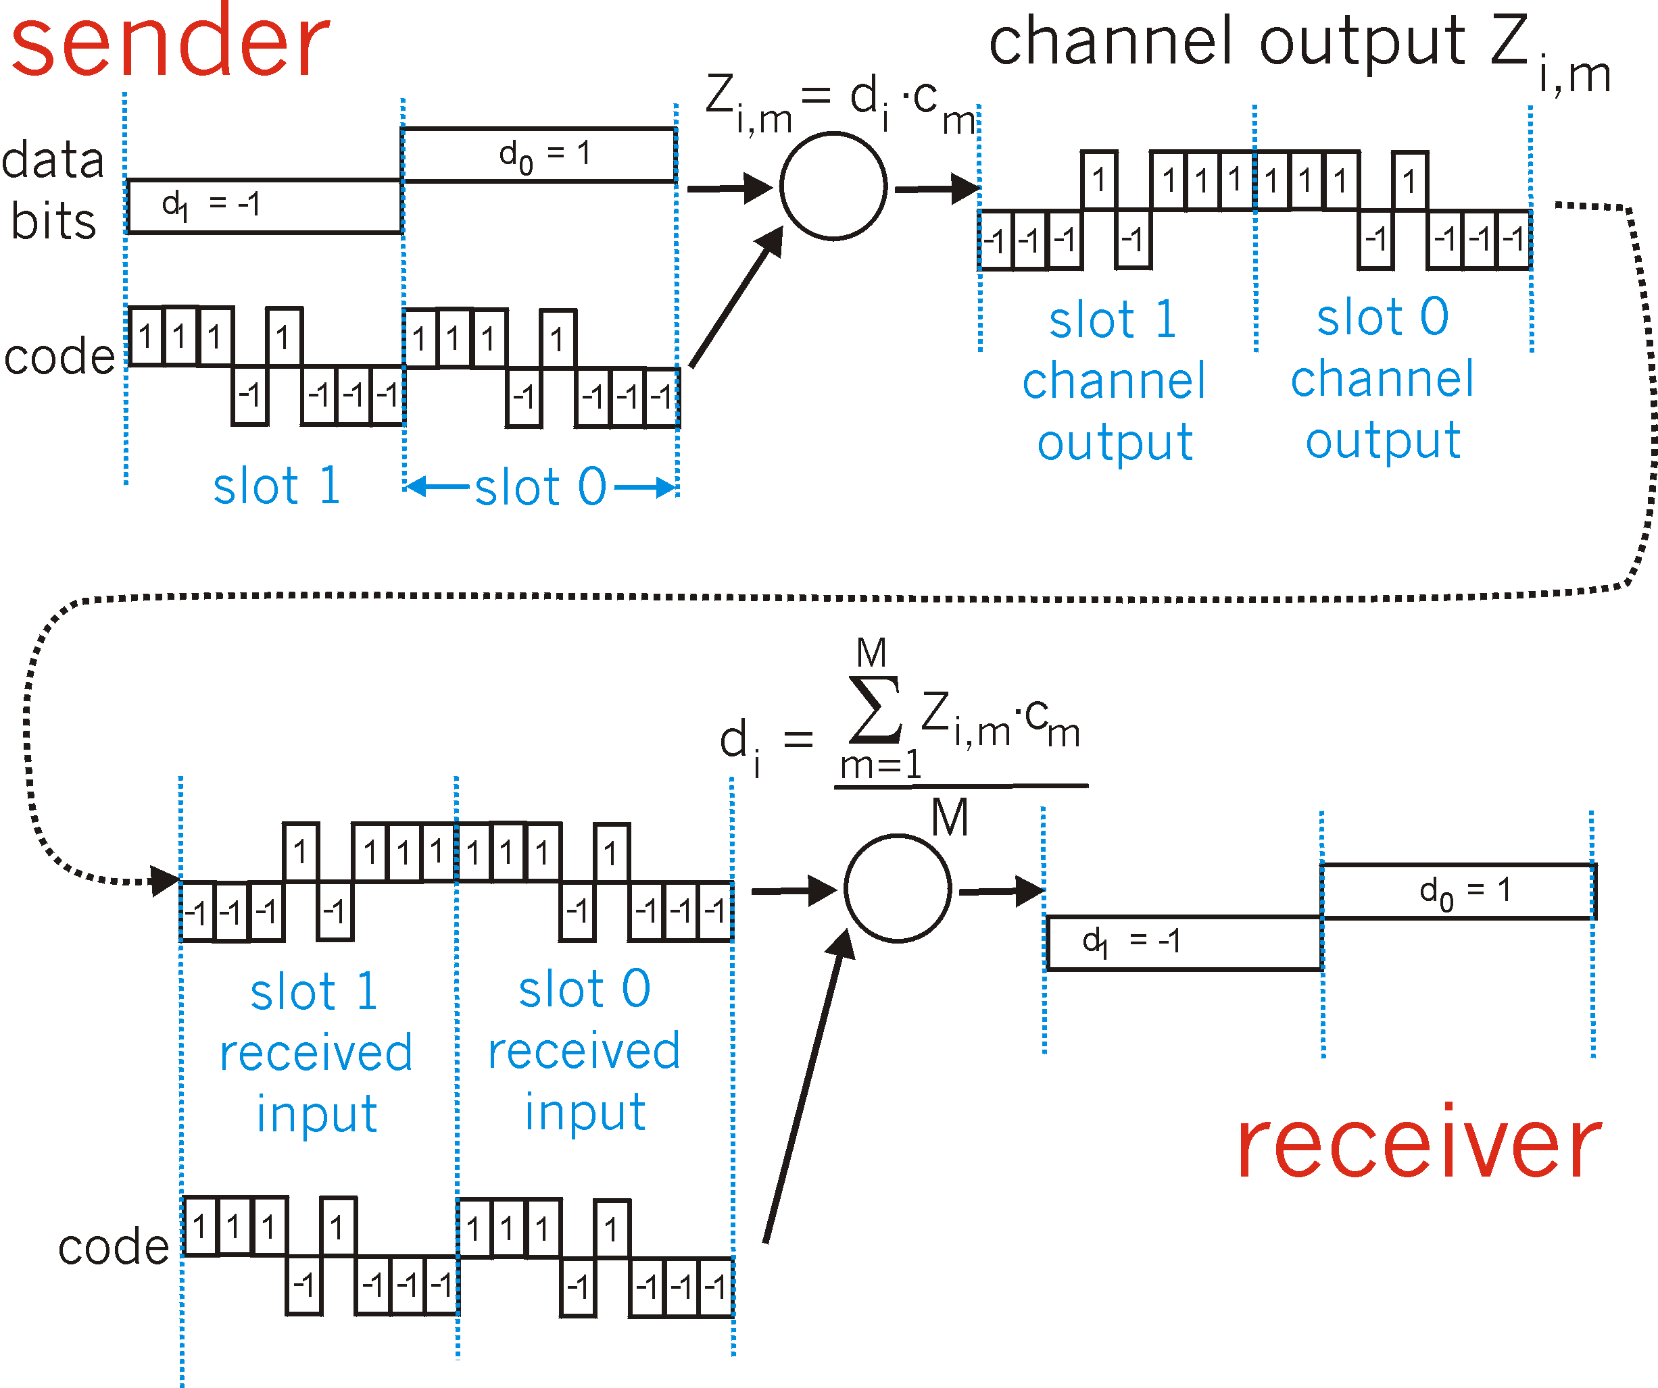
CDMA Encode/Decode

Slide 26

CDMA: two-sender interference

Slide 27
Random Access Protocols
When node has packet to send
  transmit at full channel data rate R.
  no a priori coordination among nodes
two or more transmitting nodes -> “collision”,
random access MAC protocol specifies:
  how to detect collisions
  how to recover from collisions (e.g., via delayed retransmissions)
Examples of random access MAC protocols:
  slotted ALOHA
  ALOHA
  CSMA, CSMA/CD, CSMA/CA

Slide 28

Slotted Aloha
time is divided into equal size slots (= pkt trans. time)
node with new arriving pkt: transmit at beginning of next slot
if collision: retransmit pkt in future slots with probability p, until successful.
Success (S), Collision (C), Empty (E) slots

Slide 29
Slotted ALOHA
Assumptions
all frames same size
time is divided into equal size slots, time to transmit 1 frame
nodes start to transmit frames only at beginning of slots
nodes are synchronized
if 2 or more nodes transmit in slot, all nodes detect collision
Operation
when node obtains fresh frame, it transmits in next slot
no collision, node can send new frame in next slot
if collision, node retransmits frame in each subsequent slot with prob. p until success

Slide 30
Slotted ALOHA
Pros
single active node can continuously transmit at full rate of channel
highly decentralized: only slots in nodes need to be in sync
simple
Cons
collisions, wasting slots
idle slots
nodes may be able to detect collision in less than time to transmit packet

Slide 31
Slotted Aloha efficiency
Efficiency is the long-run
fraction of successful slots
when there’s many nodes, each
with many frames to send
For max efficiency with N nodes, find p* that maximizes
Np(1-p)^{N-1}
For many nodes, take limit of Np*(1-p*)^{N-1} as N goes to infinity, gives 1/e = .37
Suppose N nodes with many frames to send, each transmits in slot with probability p
prob that 1st node has success in a slot = p(1-p)^{N-1}
prob that any node has a success = Np(1-p)^{N-1}
At best: channel
used for useful
transmissions 37%
of time!

Slide 32

Pure (unslotted) ALOHA
unslotted Aloha: simpler, no synchronization
when frame first arrives
  transmit immediately
collision probability increases:
  frame sent at t₀ collides with other frames sent in [t₀-1,t₀+1]

Slide 33
Pure Aloha efficiency
P(success by given node) = P(node transmits) .
P(no other node transmits in [p₀-1,p₀] .
P(no other node transmits in [p₀-1,p₀]
= p . (1-p)^{N-1 .} (1-p)^{N-1}
= p . (1-p)^{2(N-1)}
… choosing optimum p and then letting n -> infty ...
^{= 1/(2e) = .18}
Even worse !

Slide 34
CSMA: (Carrier Sense Multiple Access)
CSMA: listen before transmit:
If channel sensed idle: transmit entire pkt
  If collision occurs has to retransmit again
If channel sensed busy, defer transmission
  P-Persistent CSMA: (for slotted channels) retry immediately with probability p when channel becomes idle (may cause instability)
  Non-persistent CSMA: (for nonslotted channels) retry after random interval
human analogy: don’t interrupt others!

Slide 35

CSMA collisions
spatial layout of nodes along ethernet
collisions can occur:
propagation delay means
two nodes may not hear each other’ transmission
collision:
entire packet transmission
time wasted
note:
role of distance and propagation delay in determining collision prob.

Slide 36
CSMA/CD (Collision Detection)
CSMA/CD: carrier sensing, deferral as in CSMA
  collisions detected within short time
  colliding transmissions aborted, reducing channel wastage
collision detection:
  easy in wired LANs: measure signal strengths, compare transmitted, received signals
  difficult in wireless LANs: receiver shut off while transmitting
human analogy: the polite conversationalist

Slide 37

CSMA/CD collision detection

Slide 38
“Taking Turns” MAC protocols
channel partitioning MAC protocols:
  share channel efficiently and fairly at high load
  inefficient at low load: delay in channel access, 1/N bandwidth allocated even if only 1 active node!
Random access MAC protocols
  efficient at low load: single node can fully utilize channel
  high load: collision overhead
“taking turns” protocols
  look for best of both worlds!

Slide 39
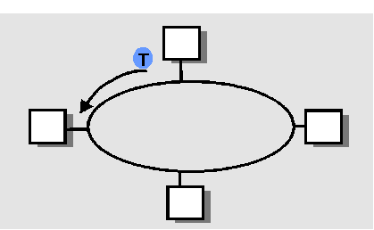
“Taking Turns” MAC protocols
Polling:
master node “invites” slave nodes to transmit in turn
concerns:
  polling overhead
  latency
  single point of failure (master)
Token passing:
control token passed from one node to next sequentially.
token message
concerns:
  token overhead
  latency
  single point of failure (token)

Slide 40
Summary of MAC protocols
What do you do with a shared media?
  Channel Partitioning, by time, frequency or code
    Time Division,Code Division, Frequency Division
  Random partitioning (dynamic),
    ALOHA, S-ALOHA, CSMA, CSMA/CD
    carrier sensing: easy in some technologies (wire), hard in others (wireless)
    CSMA/CD used in Ethernet
  Taking Turns
    polling from a central site, token passing

Slide 41
Chapter 5 outline
5.1 Introduction and services
5.2 Error detection and correction
5.3Multiple access protocols
5.4 LAN addresses and ARP
5.5 Ethernet
5.6 Hubs, bridges, and switches
5.7 Wireless links and LANs
5.8 PPP
5.9 ATM
5.10 Frame Relay

Slide 42
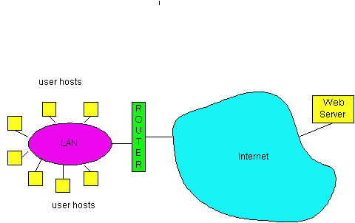
LAN technologies
Data link layer so far:
  services, error detection/correction, multiple access
Next: LAN technologies
  addressing
  Ethernet
  hubs, bridges, switches
  802.11
  PPP
  ATM

Slide 43
LAN Addresses and ARP
32-bit IP address:
network-layer address
used to get datagram to destination IP network (recall IP network definition)
LAN (or MAC or physical or Ethernet) address:
used to get datagram from one interface to another physically-connected interface (same network)
48 bit MAC address (for most LANs)
burned in the adapter ROM

Slide 44
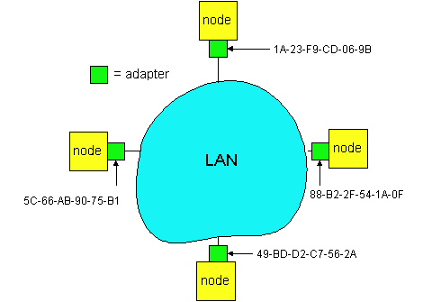
LAN Addresses and ARP
Each adapter on LAN has unique LAN address

Slide 45
LAN Address (more)
MAC address allocation administered by IEEE
manufacturer buys portion of MAC address space (to assure uniqueness)
Analogy:
(a) MAC address: like Social Security Number
(b) IP address: like postal address
MAC flat address => portability
  can move LAN card from one LAN to another
IP hierarchical address NOT portable
  depends on IP network to which node is attached

Slide 46
Recall earlier routing discussion
Starting at A, given IP datagram addressed to B:
look up net. address of B, find B on same net. as A
link layer send datagram to B inside link-layer frame
A
223.1.1.1
223.1.2.1
223.1.1.2
223.1.1.4
223.1.2.9
B
223.1.2.2
E
223.1.1.3
223.1.3.27
223.1.3.1
223.1.3.2
frame source,
dest address
datagram source,
dest address
B’s MAC
addr
A’s MAC
addr
A’s IP
addr
B’s IP
addr
IP payload
datagram
frame

Slide 47
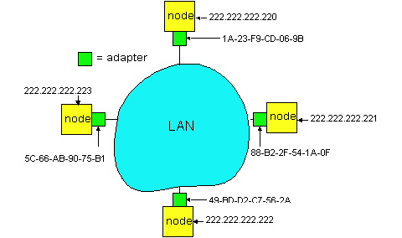
ARP: Address Resolution Protocol
Question: how to determine
MAC address of B
knowing B’s IP address?
Each IP node (Host, Router) on LAN has ARP table
ARP Table: IP/MAC address mappings for some LAN nodes
< IP address; MAC address; TTL>
  TTL (Time To Live): time after which address mapping will be forgotten (typically 20 min)

Slide 48
ARP protocol
A wants to send datagram to B, and A knows B’s IP address.
Suppose B’s MAC address is not in A’s ARP table.
A broadcasts ARP query packet, containing B's IP address
  all machines on LAN receive ARP query
B receives ARP packet, replies to A with its (B's) MAC address
  frame sent to A’s MAC address (unicast)
A caches (saves) IP-to-MAC address pair in its ARP table until information becomes old (times out)
  soft state: information that times out (goes away) unless refreshed
ARP is “plug-and-play”:
  nodes create their ARP tables without intervention from net administrator

Slide 49
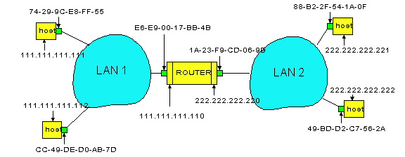
Routing to another LAN
walkthrough: send datagram from A to B via R
assume A knows B IP address
Two ARP tables in router R, one for each IP network (LAN)
In routing table at source Host, find router 111.111.111.110
In ARP table at source, find MAC address E6-E9-00-17-BB-4B, etc
A
R
B

Slide 50
A creates datagram with source A, destination B
A uses ARP to get R’s MAC address for 111.111.111.110
A creates link-layer frame with R's MAC address as dest, frame contains A-to-B IP datagram
A’s data link layer sends frame
R’s data link layer receives frame
R removes IP datagram from Ethernet frame, sees its destined to B
R uses ARP to get B’s physical layer address
R creates frame containing A-to-B IP datagram sends to B
A
R
B

Slide 51

Ethernet
“dominant” LAN technology:
cheap $20 for 100Mbs!
first widely used LAN technology
Simpler, cheaper than token LANs and ATM
Kept up with speed race: 10, 100, 1000 Mbps
Metcalfe’s Ethernet
sketch

Slide 52

Ethernet Frame Structure
Sending adapter encapsulates IP datagram (or other network layer protocol packet) in Ethernet frame
Preamble:
7 bytes with pattern 10101010 followed by one byte with pattern 10101011
used to synchronize receiver, sender clock rates

Slide 53
Ethernet Frame Structure (more)
Addresses: 6 bytes
  if adapter receives frame with matching destination address, or with broadcast address (eg ARP packet), it passes data in frame to net-layer protocol
  otherwise, adapter discards frame
Type: indicates the higher layer protocol, mostly IP but others may be supported such as Novell IPX and AppleTalk)
CRC: checked at receiver, if error is detected, the frame is simply dropped

Slide 54
Unreliable, connectionless service
Connectionless: No handshaking between sending and receiving adapter.
Unreliable: receiving adapter doesn’t send acks or nacks to sending adapter
  stream of datagrams passed to network layer can have gaps
  gaps will be filled if app is using TCP
  otherwise, app will see the gaps

Slide 55
Ethernet uses CSMA/CD
No slots
adapter doesn’t transmit if it senses that some other adapter is transmitting, that is, carrier sense
transmitting adapter aborts when it senses that another adapter is transmitting, that is, collision detection
Before attempting a retransmission, adapter waits a random time, that is, random access
random time depends upon # collisions so far

Slide 56
Ethernet CSMA/CD algorithm
1. Adaptor gets datagram from link and creates frame
2. If adapter senses channel idle, it starts to transmit frame. If it senses channel busy, waits until channel idle and then transmits
3. If adapter transmits entire frame without detecting another transmission, the adapter is done with frame !
4. If adapter detects another transmission while transmitting, aborts and sends jam signal
5. After aborting, adapter enters exponential backoff: after the mth collision, adapter chooses a K at random from
{0,1,2,…,2^{m}-1}. Adapter waits K*512 bit times and returns to Step 2

Slide 57
Ethernet: slotless, uses CSMA/CD
create frame from datagram
A: sense channel; if idle
  then {
  transmit frame and monitor the channel;
      If detect another transmission
      then {
      abort and send jam signal;
        update # collisions;
        delay as required by exponential backoff algorithm;
        goto A
        }
      else {done with the frame; set collisions to zero}
    }
  else {wait until ongoing transmission is over and goto A}

Slide 58
Ethernet’s CSMA/CD (more)
Jam Signal: make sure all other transmitters are aware of collision; 48 bits;
Exponential Backoff:
Goal: adapt retransmission attempts to estimated current load
  heavy load: random wait will be longer
first collision: choose K from {0,1}; delay is K x 512 bit transmission times (btt = .1 microsec for 10Mbps Ethernet)
after second collision: choose K from {0,1,2,3}…
after ten or more collisions, choose K from {0,1,2,3,4,…,1023}

Slide 59
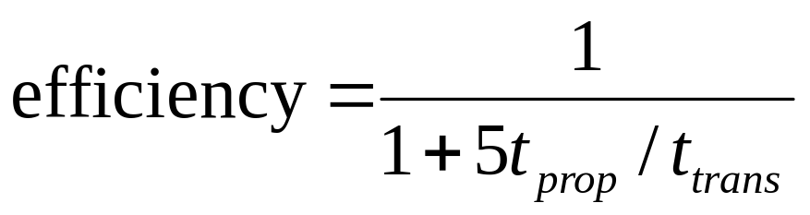
CSMA/CD efficiency
T_{prop} = max prop between 2 nodes in LAN
t_{trans} = time to transmit max-size frame
Efficiency goes to 1 as t_{prop} goes to 0
Goes to 1 as t_{trans} goes to infinity
Much better than ALOHA, but still decentralized, simple, and cheap

Slide 60
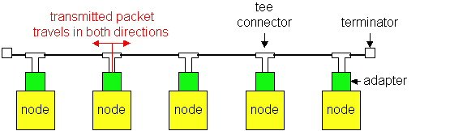
Ethernet Technologies: 10Base2
10: 10Mbps; 2: under 200 meters max cable length
thin coaxial cable in a bus topology
repeaters used to connect up to 5 multiple segments
repeater repeats bits it hears on one interface to its other interfaces: physical layer device only!
has become a legacy technology

Slide 61
10BaseT and 100BaseT
10/100 Mbps rate; latter called “fast ethernet”
T stands for Twisted Pair
Nodes connect to a hub: “star topology”; 100 m max distance between nodes and hub
Hubs are essentially physical-layer repeaters:
  bits coming in one link go out all other links
  no frame buffering
  no CSMA/CD at hub: adapters detect collisions
  provides net management functionality
nodes
hub

Slide 62
Gbit Ethernet
use standard Ethernet frame format
allows for point-to-point links and shared broadcast channels
in shared mode, CSMA/CD is used; short distances between nodes to be efficient
uses hubs, called here “Buffered Distributors”
Full-Duplex at 1 Gbps for point-to-point links
10 Gbps now !

Slide 63

Token Passing: IEEE802.5 standard
4 Mbps
max token holding time: 10 ms, limiting frame length
SD, ED mark start, end of packet
AC: access control byte:
  token bit: value 0 means token can be seized, value 1 means data follows FC
  priority bits: priority of packet
  reservation bits: station can write these bits to prevent stations with lower priority packet from seizing token after token becomes free

Slide 64
Token Passing: IEEE802.5 standard
FC: frame control used for monitoring and maintenance
source, destination address: 48 bit physical address, as in Ethernet
data: packet from network layer
checksum: CRC
FS: frame status: set by dest., read by sender
  set to indicate destination up, frame copied OK from ring
  DLC-level ACKing

Slide 65
Chapter 5 outline
5.1 Introduction and services
5.2 Error detection and correction
5.3Multiple access protocols
5.4 LAN addresses and ARP
5.5 Ethernet
5.6 Hubs, bridges, and switches
5.7 Wireless links and LANs
5.8 PPP
5.9 ATM
5.10 Frame Relay

Slide 66
Interconnecting LANs
Q: Why not just one big LAN?
Limited amount of supportable traffic: on single LAN, all stations must share bandwidth
limited length: 802.3 specifies maximum cable length
large “collision domain” (can collide with many stations)
limited number of stations: 802.5 have token passing delays at each station

Slide 67
Interconnecting LAN segments
Hubs
Bridges
Switches
  Remark: switches are essentially multi-port bridges.
  What we say about bridges also holds for switches!

Slide 68
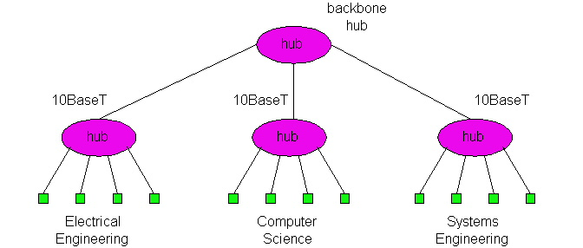
Hubs
Physical Layer devices: essentially repeaters operating at bit levels: repeat received bits on one interface to all other interfaces
Hubs can be arranged in a hierarchy (or multi-tier design), with backbone hub at its top

Slide 69
Hubs (more)
Each connected LAN referred to as LAN segment
Hubs do not isolate collision domains: node may collide with any node residing at any segment in LAN
Hub Advantages:
  simple, inexpensive device
  Multi-tier provides graceful degradation: portions of the LAN continue to operate if one hub malfunctions
  extends maximum distance between node pairs (100m per Hub)

Slide 70
Hub limitations
single collision domain results in no increase in max throughput
  multi-tier throughput same as single segment throughput
individual LAN restrictions pose limits on number of nodes in same collision domain and on total allowed geographical coverage
cannot connect different Ethernet types (e.g., 10BaseT and 100baseT)

Slide 71
Bridges
Link layer device
  stores and forwards Ethernet frames
  examines frame header and selectively forwards frame based on MAC dest address
  when frame is to be forwarded on segment, uses CSMA/CD to access segment
transparent
  hosts are unaware of presence of bridges
plug-and-play, self-learning
  bridges do not need to be configured

Slide 72
Bridges: traffic isolation
Bridge installation breaks LAN into LAN segments
bridges filter packets:
  same-LAN-segment frames not usually forwarded onto other LAN segments
  segments become separate collision domains
collision
domain
collision
domain
= hub
bridge
= host
LAN segment
LAN segment
LAN (IP network)

Slide 73
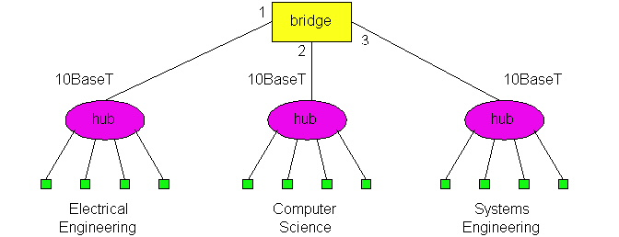
Bridges: Forwarding
How do determine to which LAN segment to forward frame?
Looks like a routing problem...

Slide 74
Bridges: Self learning
A bridge has a bridge table
entry in bridge table:
  (Node LAN Address, Bridge Interface, Time Stamp)
  stale entries in table dropped (TTL can be 60 min)
bridges learn which hosts can be reached through which interfaces
  when frame received, bridge “learns” location of sender: incoming LAN segment
  records sender/location pair in bridge table

Slide 75
Bridges: Filtering/Forwarding
When bridge receives a frame:
index bridge table using MAC dest address
if entry found for destination
then{
if dest on segment from which frame arrived
then drop the frame
else forward the frame on interface indicated
}
else flood
forward on all but the interface
on which the frame arrived

Slide 76
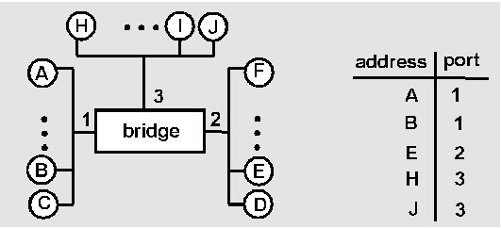
Bridge example
Suppose C sends frame to D and D replies back with frame to C.
Bridge receives frame from from C
  notes in bridge table that C is on interface 1
  because D is not in table, bridge sends frame into interfaces 2 and 3
frame received by D

Slide 77
Bridge Learning: example
D generates frame for C, sends
bridge receives frame
  notes in bridge table that D is on interface 2
  bridge knows C is on interface 1, so selectively forwards frame to interface 1

Slide 78
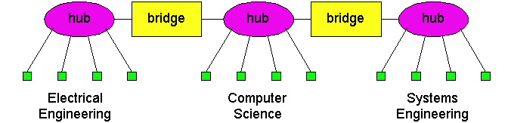
Bridges: Interconnection without backbone
Not recommended for two reasons:
  - single point of failure at Computer Science hub
  - all traffic between EE and SE must path over CS segment

Slide 79
Bridges: Backbone configuration
Recommended !

Slide 80
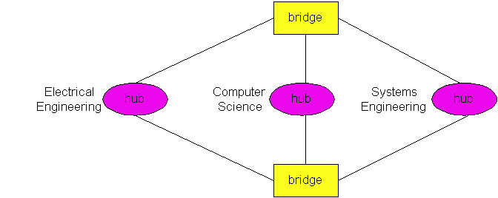
Bridges Spanning Tree
for increased reliability, desirable to have redundant, alternative paths from source to dest
with multiple paths, cycles result - bridges may multiply and forward frame forever
solution: organize bridges in a spanning tree by disabling subset of interfaces
Disabled

Slide 81
Some bridge features
Isolates collision domains resulting in higher total max throughput
limitless number of nodes and geographical coverage
Can connect different Ethernet types
Transparent (“plug-and-play”): no configuration necessary

Slide 82

Bridges vs. Routers
both store-and-forward devices
  routers: network layer devices (examine network layer headers)
  bridges are link layer devices
routers maintain routing tables, implement routing algorithms
bridges maintain bridge tables, implement filtering, learning and spanning tree algorithms

Slide 83
Routers vs. Bridges
Bridges + and -
+ Bridge operation is simpler requiring less packet processing
+ Bridge tables are self learning
- All traffic confined to spanning tree, even when alternative bandwidth is available
- Bridges do not offer protection from broadcast storms

Slide 84
Routers vs. Bridges
Routers + and -
+ arbitrary topologies can be supported, cycling is limited by TTL counters (and good routing protocols)
+ provide protection against broadcast storms
- require IP address configuration (not plug and play)
- require higher packet processing
bridges do well in small (few hundred hosts) while routers used in large networks (thousands of hosts)

Slide 85
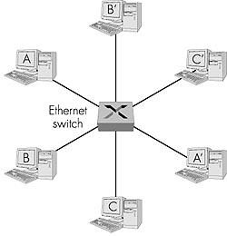
Ethernet Switches
Essentially a multi-interface bridge
layer 2 (frame) forwarding, filtering using LAN addresses
Switching: A-to-A’ and B-to-B’ simultaneously, no collisions
large number of interfaces
often: individual hosts, star-connected into switch
  Ethernet, but no collisions!

Slide 86
Ethernet Switches
cut-through switching: frame forwarded from input to output port without awaiting for assembly of entire frame
  slight reduction in latency
combinations of shared/dedicated, 10/100/1000 Mbps interfaces

Slide 87
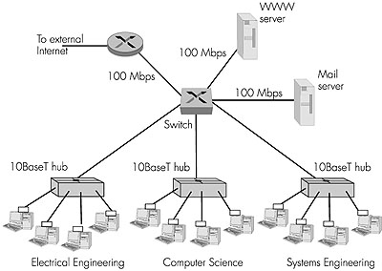
Not an atypical LAN (IP network)
Dedicated
Shared

Slide 88
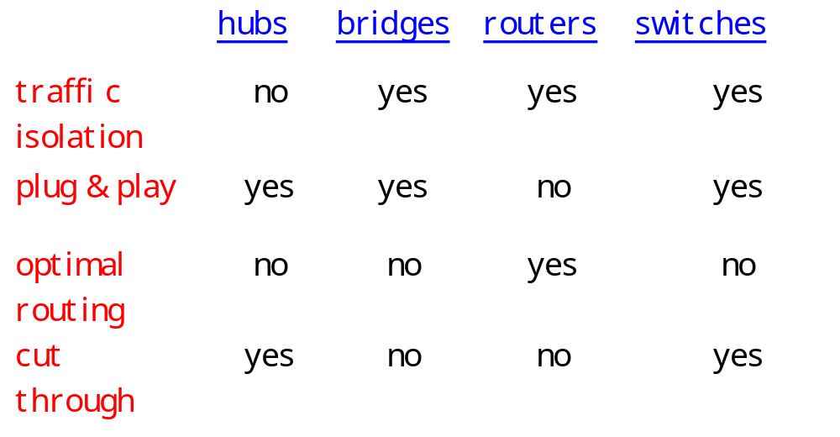
Summary comparison

Slide 89
Chapter 5 outline
5.1 Introduction and services
5.2 Error detection and correction
5.3Multiple access protocols
5.4 LAN addresses and ARP
5.5 Ethernet
5.6 Hubs, bridges, and switches
5.7 Wireless links and LANs
5.8 PPP
5.9 ATM
5.10 Frame Relay

Slide 90
IEEE 802.11 Wireless LAN
802.11b
  2.4-5 GHz unlicensed radio spectrum
  up to 11 Mbps
  direct sequence spread spectrum (DSSS) in physical layer
    all hosts use same chipping code
  widely deployed, using base stations
802.11a
  5-6 GHz range
  up to 54 Mbps
802.11g
  2.4-5 GHz range
  up to 54 Mbps
All use CSMA/CA for multiple access
All have base-station and ad-hoc network versions

Slide 91
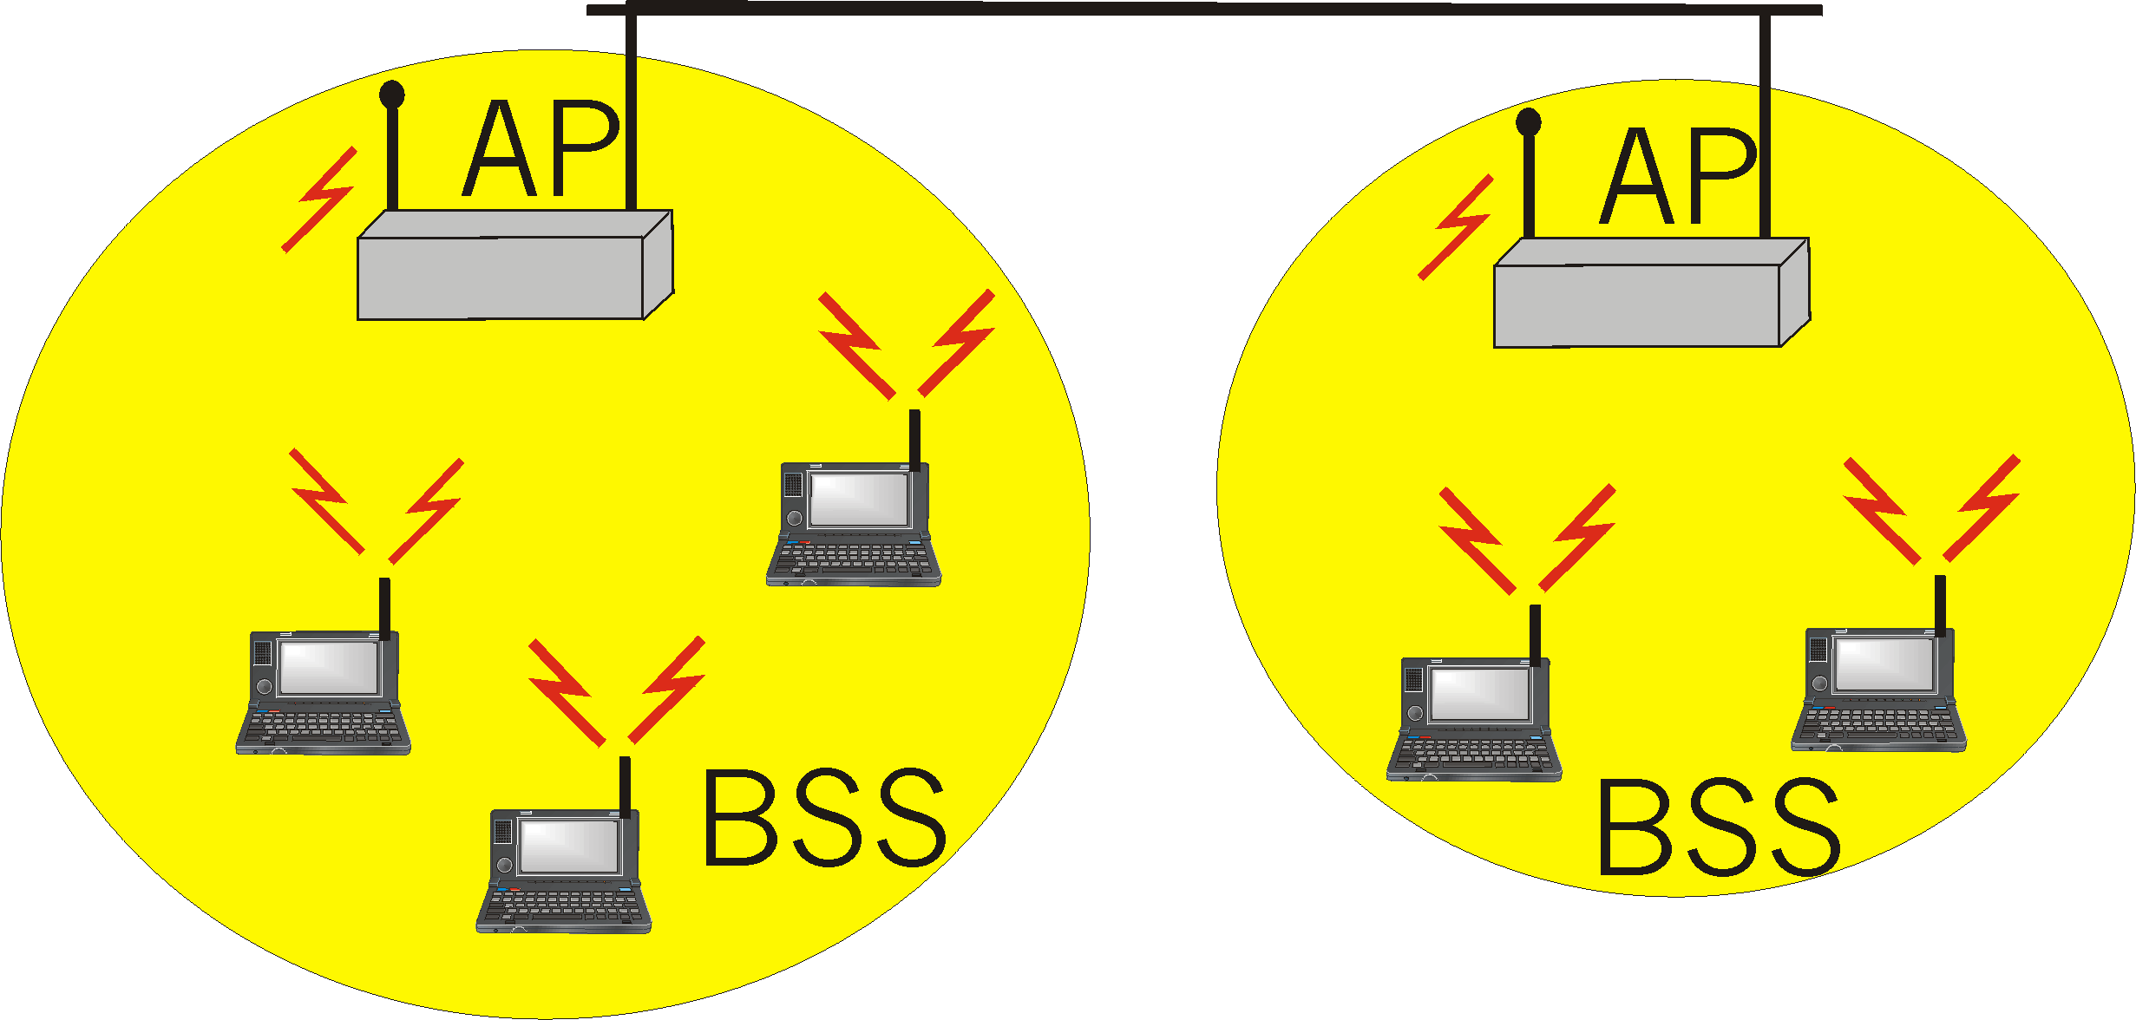
Base station approach
Wireless host communicates with a base station
  base station = access point (AP)
Basic Service Set (BSS) (a.k.a. “cell”) contains:
  wireless hosts
  access point (AP): base station
BSSs combined to form distribution system (DS)

Slide 92
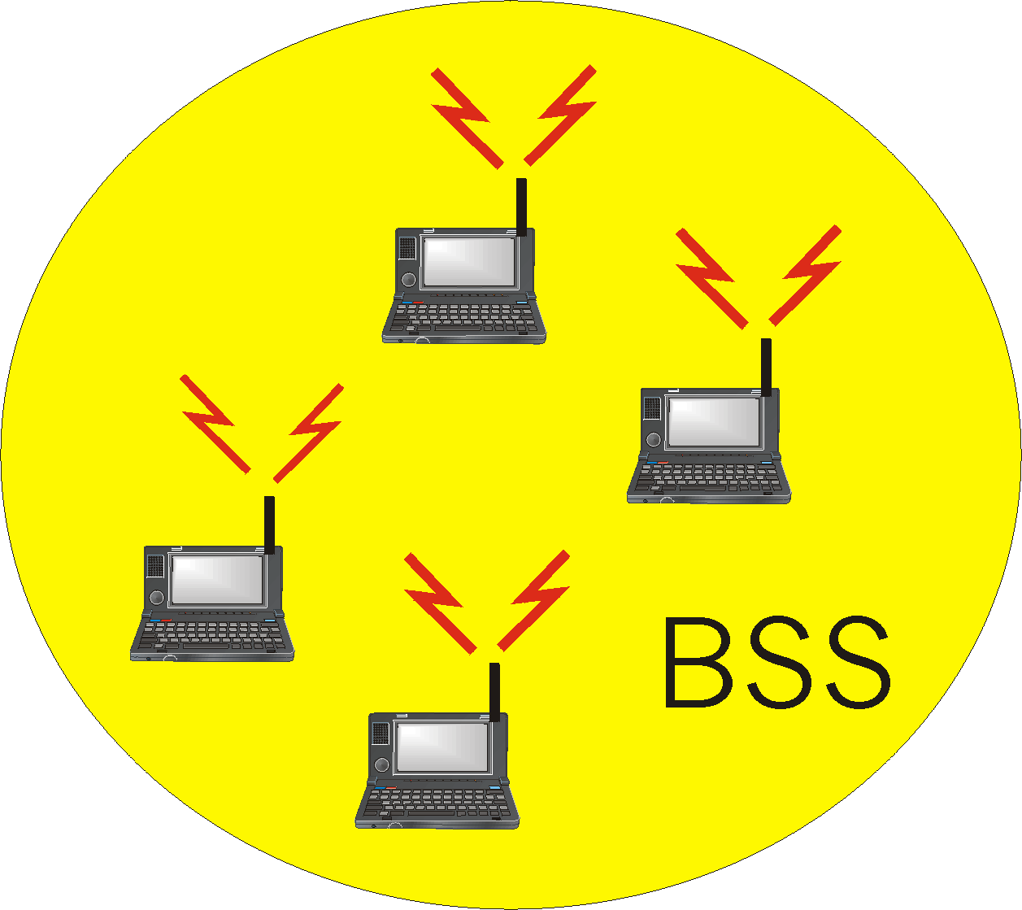
Ad Hoc Network approach
No AP (i.e., base station)
wireless hosts communicate with each other
  to get packet from wireless host A to B may need to route through wireless hosts X,Y,Z
Applications:
  “laptop” meeting in conference room, car
  interconnection of “personal” devices
  battlefield
IETF MANET
(Mobile Ad hoc Networks)
working group

Slide 93
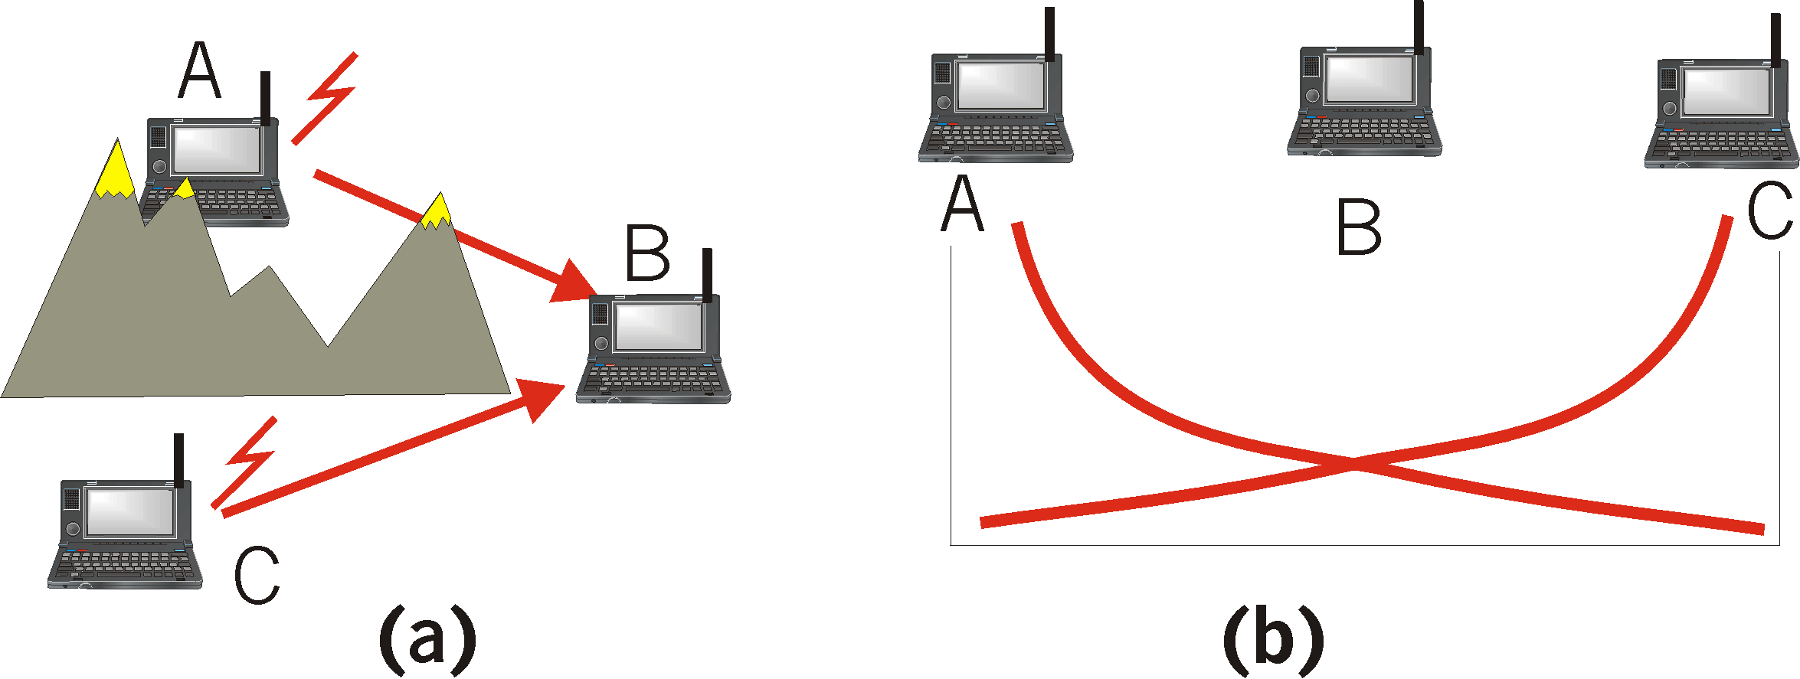
IEEE 802.11: multiple access
Collision if 2 or more nodes transmit at same time
CSMA makes sense:
  get all the bandwidth if you’re the only one transmitting
  shouldn’t cause a collision if you sense another transmission
Collision detection doesn’t work: hidden terminal problem

Slide 94
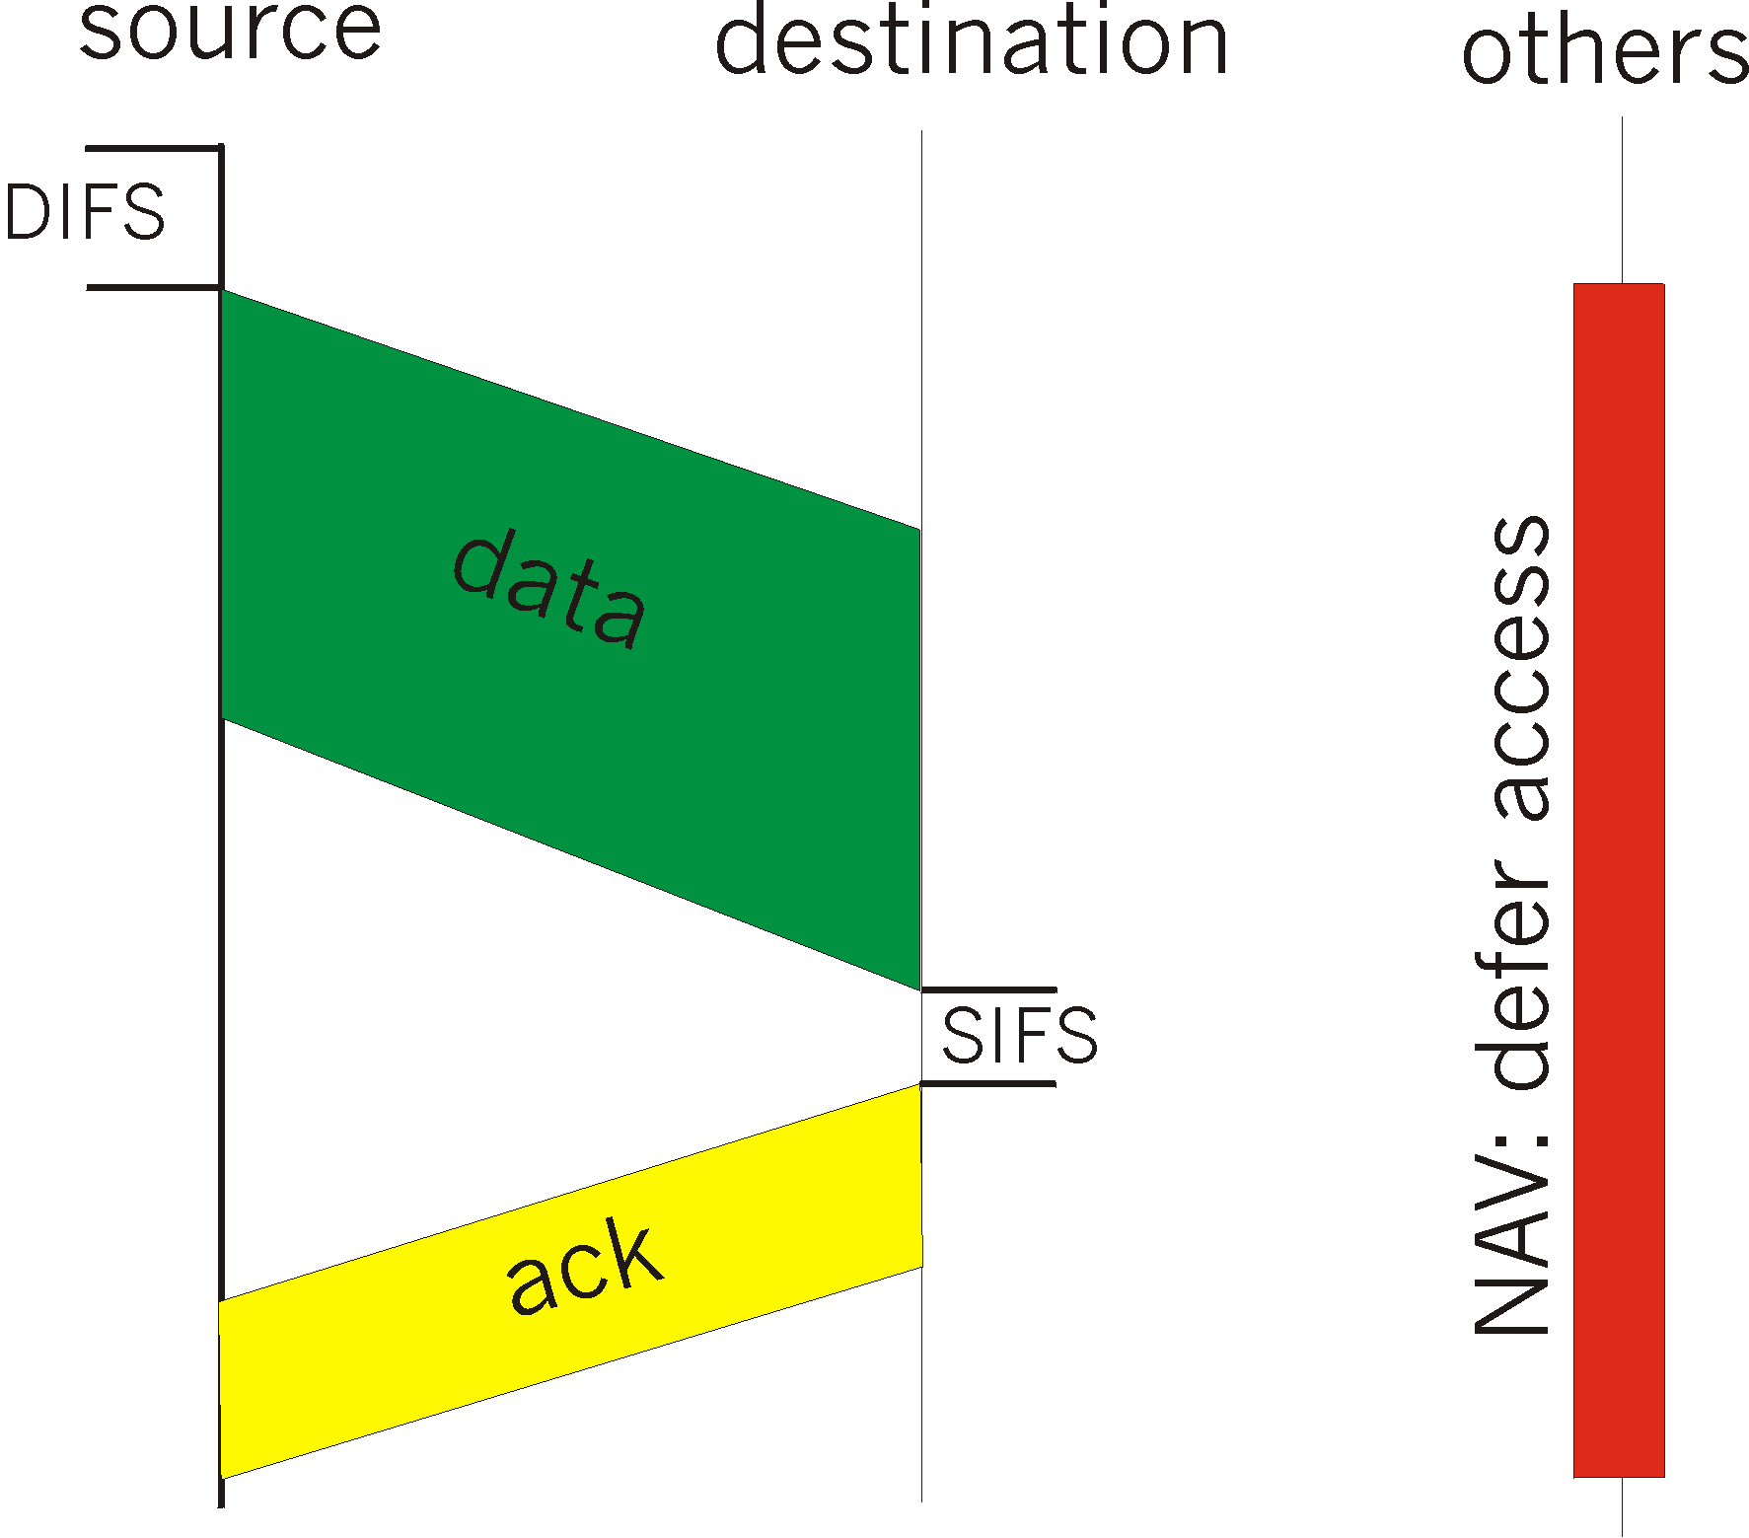
IEEE 802.11 MAC Protocol: CSMA/CA
802.11 CSMA: sender
- if sense channel idle for DISF sec.
then transmit entire frame (no collision detection)
-if sense channel busy
then binary backoff
802.11 CSMA receiver
- if received OK
return ACK after SIFS
(ACK is needed due to hidden terminal problem)

Slide 95
Collision avoidance mechanisms
Problem:
  two nodes, hidden from each other, transmit complete frames to base station
  wasted bandwidth for long duration !
Solution:
  small reservation packets
  nodes track reservation interval with internal “network allocation vector” (NAV)

Slide 96
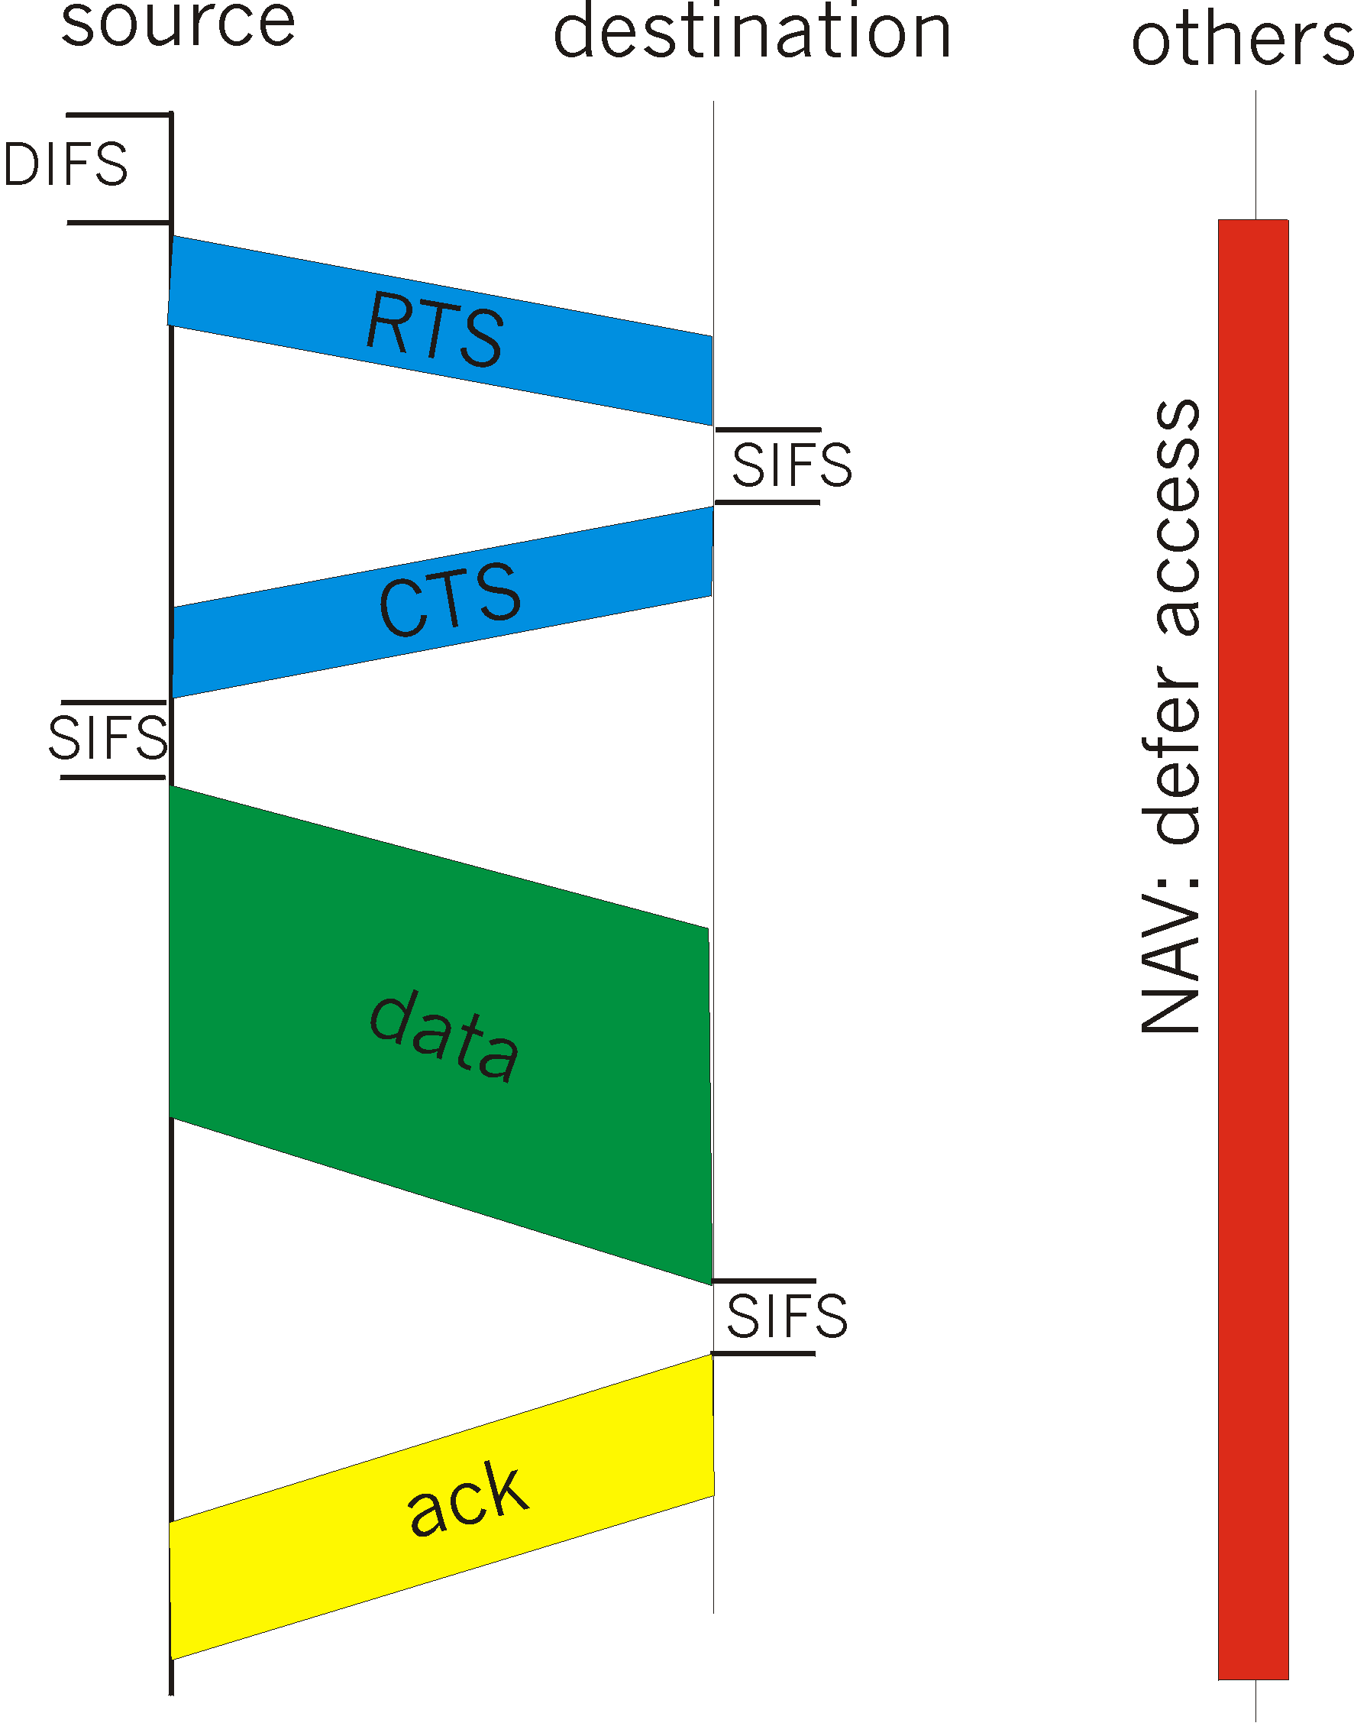
Collision Avoidance: RTS-CTS exchange
sender transmits short RTS (request to send) packet: indicates duration of transmission
receiver replies with short CTS (clear to send) packet
  notifying (possibly hidden) nodes
hidden nodes will not transmit for specified duration: NAV

Slide 97
Collision Avoidance: RTS-CTS exchange
RTS and CTS short:
  collisions less likely, of shorter duration
  end result similar to collision detection
IEEE 802.11 allows:
  CSMA
  CSMA/CA: reservations
  polling from AP

Slide 98
A word about Bluetooth
Low-power, small radius, wireless networking technology
  10-100 meters
omnidirectional
  not line-of-sight infrared
Interconnects gadgets
2.4-2.5 GHz unlicensed radio band
up to 721 kbps
Interference from wireless LANs, digital cordless phones, microwave ovens:
  frequency hopping helps
MAC protocol supports:
  error correction
  ARQ
Each node has a 12-bit address

Slide 99
Chapter 5 outline
5.1 Introduction and services
5.2 Error detection and correction
5.3Multiple access protocols
5.4 LAN addresses and ARP
5.5 Ethernet
5.6 Hubs, bridges, and switches
5.7 Wireless links and LANs
5.8 PPP
5.9 ATM
5.10 Frame Relay

Slide 100
Point to Point Data Link Control
one sender, one receiver, one link: easier than broadcast link:
  no Media Access Control
  no need for explicit MAC addressing
  e.g., dialup link, ISDN line
popular point-to-point DLC protocols:
  PPP (point-to-point protocol)
  HDLC: High level data link control (Data link used to be considered “high layer” in protocol stack!

Slide 101
PPP Design Requirements [RFC 1557]
packet framing: encapsulation of network-layer datagram in data link frame
  carry network layer data of any network layer protocol (not just IP) at same time
  ability to demultiplex upwards
bit transparency: must carry any bit pattern in the data field
error detection (no correction)
connection liveness: detect, signal link failure to network layer
network layer address negotiation: endpoint can learn/configure each other’s network address

Slide 102
PPP non-requirements
no error correction/recovery
no flow control
out of order delivery OK
no need to support multipoint links (e.g., polling)
Error recovery, flow control, data re-ordering
all relegated to higher layers!

Slide 103

PPP Data Frame
Flag: delimiter (framing)
Address: does nothing (only one option)
Control: does nothing; in the future possible multiple control fields
Protocol: upper layer protocol to which frame delivered (eg, PPP-LCP, IP, IPCP, etc)

Slide 104
PPP Data Frame
info: upper layer data being carried
check: cyclic redundancy check for error detection

Slide 105
Byte Stuffing
“data transparency” requirement: data field must be allowed to include flag pattern <01111110>
  Q: is received <01111110> data or flag?
Sender: adds (“stuffs”) extra < 01111110> byte after each < 01111110> data byte
Receiver:
  two 01111110 bytes in a row: discard first byte, continue data reception
  single 01111110: flag byte

Slide 106

Byte Stuffing
flag byte
pattern
in data
to send
flag byte pattern plus
stuffed byte in transmitted data

Slide 107

PPP Data Control Protocol
Before exchanging network-layer data, data link peers must
configure PPP link (max. frame length, authentication)
learn/configure network
layer information
  for IP: carry IP Control Protocol (IPCP) msgs (protocol field: 8021) to configure/learn IP address

Slide 108
Chapter 5 outline
5.1 Introduction and services
5.2 Error detection and correction
5.3Multiple access protocols
5.4 LAN addresses and ARP
5.5 Ethernet
5.6 Hubs, bridges, and switches
5.7 Wireless links and LANs
5.8 PPP
5.9 ATM
5.10 Frame Relay

Slide 109
Asynchronous Transfer Mode: ATM
1990’s/00 standard for high-speed (155Mbps to 622 Mbps and higher) Broadband Integrated Service Digital Network architecture
Goal: integrated, end-end transport of carry voice, video, data
  meeting timing/QoS requirements of voice, video (versus Internet best-effort model)
  “next generation” telephony: technical roots in telephone world
  packet-switching (fixed length packets, called “cells”) using virtual circuits

Slide 110
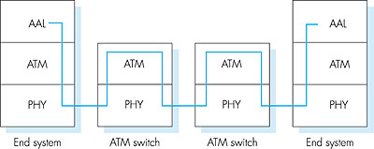
ATM architecture
adaptation layer: only at edge of ATM network
  data segmentation/reassembly
  roughly analogous to Internet transport layer
ATM layer: “network” layer
  cell switching, routing
physical layer

Slide 111
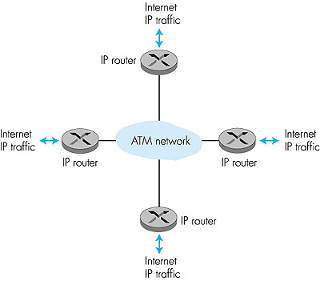
ATM: network or link layer?
Vision: end-to-end transport: “ATM from desktop to desktop”
  ATM is a network technology
Reality: used to connect IP backbone routers
  “IP over ATM”
  ATM as switched link layer, connecting IP routers

Slide 112
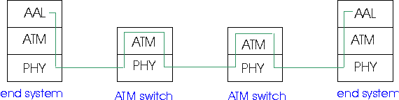
ATM Adaptation Layer (AAL)
ATM Adaptation Layer (AAL): “adapts” upper layers (IP or native ATM applications) to ATM layer below
AAL present only in end systems, not in switches
AAL layer segment (header/trailer fields, data) fragmented across multiple ATM cells
  analogy: TCP segment in many IP packets

Slide 113
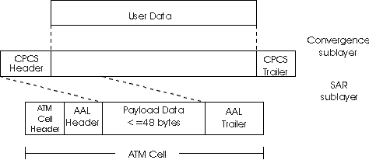
ATM Adaptation Layer (AAL) [more]
Different versions of AAL layers, depending on ATM service class:
AAL1: for CBR (Constant Bit Rate) services, e.g. circuit emulation
AAL2: for VBR (Variable Bit Rate) services, e.g., MPEG video
AAL5: for data (e.g., IP datagrams)
User data
AAL PDU
ATM cell

Slide 114

AAL5 - Simple And Efficient AL (SEAL)
AAL5: low overhead AAL used to carry IP datagrams
  4 byte cyclic redundancy check
  PAD ensures payload multiple of 48bytes
  large AAL5 data unit to be fragmented into 48-byte ATM cells

Slide 115
ATM Layer
Service: transport cells across ATM network
analogous to IP network layer
very different services than IP network layer
Network
Architecture
Internet
ATM
ATM
ATM
ATM
Service
Model
best effort
CBR
VBR
ABR
UBR
Guarantees ?
Congestion
feedback
no (inferred
via loss)
no
congestion
no
congestion
yes
no
Bandwidth
none
constant
rate
guaranteed
rate
guaranteed
minimum
none
Loss
no
yes
yes
no
no
Order
no
yes
yes
yes
yes
Timing
no
yes
yes
no
no

Slide 116
ATM Layer: Virtual Circuits
VC transport: cells carried on VC from source to dest
  call setup, teardown for each call before data can flow
  each packet carries VC identifier (not destination ID)
  every switch on source-dest path maintain “state” for each passing connection
  link,switch resources (bandwidth, buffers) may be allocated to VC: to get circuit-like perf.
Permanent VCs (PVCs)
  long lasting connections
  typically: “permanent” route between to IP routers
Switched VCs (SVC):
  dynamically set up on per-call basis

Slide 117
ATM VCs
Advantages of ATM VC approach:
  QoS performance guarantee for connection mapped to VC (bandwidth, delay, delay jitter)
Drawbacks of ATM VC approach:
  Inefficient support of datagram traffic
  one PVC between each source/dest pair) does not scale (N*2 connections needed)
  SVC introduces call setup latency, processing overhead for short lived connections

Slide 118

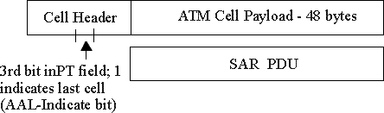
ATM Layer: ATM cell
5-byte ATM cell header
48-byte payload
  Why?: small payload -> short cell-creation delay for digitized voice
  halfway between 32 and 64 (compromise!)
Cell header
Cell format

Slide 119
ATM cell header
VCI: virtual channel ID
  will change from link to link thru net
PT: Payload type (e.g. RM cell versus data cell)
CLP: Cell Loss Priority bit
  CLP = 1 implies low priority cell, can be discarded if congestion
HEC: Header Error Checksum
  cyclic redundancy check

Slide 120
IP-Over-ATM
IP over ATM
replace “network” (e.g., LAN segment) with ATM network
ATM addresses, IP addresses
Classic IP only
3 “networks” (e.g., LAN segments)
MAC (802.3) and IP addresses
ATM
network
Ethernet
LANs
Ethernet
LANs

Slide 121
IP-Over-ATM
Issues:
IP datagrams into ATM AAL5 PDUs
from IP addresses to ATM addresses
  just like IP addresses to 802.3 MAC addresses!
ATM
network
Ethernet
LANs

Slide 122
Chapter 5 outline
5.1 Introduction and services
5.2 Error detection and correction
5.3Multiple access protocols
5.4 LAN addresses and ARP
5.5 Ethernet
5.6 Hubs, bridges, and switches
5.7 Wireless links and LANs
5.8 PPP
5.9 ATM
5.10 Frame Relay

Slide 123
Frame Relay
Like ATM:
wide area network technologies
Virtual-circuit oriented
origins in telephony world
can be used to carry IP datagrams
  can thus be viewed as link layers by IP protocol

Slide 124
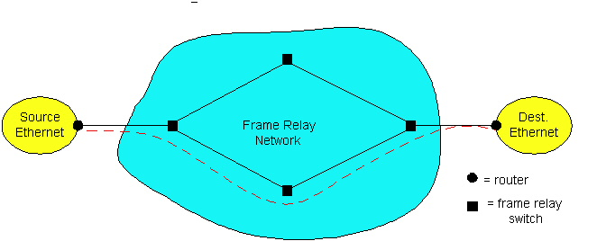
Frame Relay
Designed in late ‘80s, widely deployed in the ‘90s
Frame relay service:
  no error control
  end-to-end congestion control

Slide 125
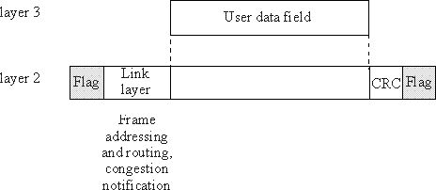
Frame Relay (more)
Designed to interconnect corporate customer LANs
  typically permanent VC’s: “pipe” carrying aggregate traffic between two routers
  switched VC’s: as in ATM
corporate customer leases FR service from public Frame Relay network (e.g., Sprint, ATT)

Slide 126
Frame Relay (more)
flags
address
data
CRC
flags
Flag bits, 01111110, delimit frame
address:
  10 bit VC ID field
  3 congestion control bits
    FECN: forward explicit congestion notification (frame experienced congestion on path)
    BECN: congestion on reverse path
    DE: discard eligibility

Slide 127
Frame Relay -VC Rate Control
Committed Information Rate (CIR)
  defined, “guaranteed” for each VC
  negotiated at VC set up time
  customer pays based on CIR
DE bit: Discard Eligibility bit
  Edge FR switch measures traffic rate for each VC; marks DE bit
  DE = 0: high priority, rate compliant frame; deliver at “all costs”
  DE = 1: low priority, eligible for congestion discard

Slide 128
Frame Relay - CIR & Frame Marking
Access Rate: rate R of the access link between source router (customer) and edge FR switch (provider); 64Kbps < R < 1,544Kbps
Typically, many VCs (one per destination router) multiplexed on the same access trunk; each VC has own CIR
Edge FR switch measures traffic rate for each VC; it marks (i.e. DE = 1) frames which exceed CIR (these may be later dropped)
Internet’s more recent differentiated service uses similar ideas

Slide 129
Chapter 5: Summary
principles behind data link layer services:
  error detection, correction
  sharing a broadcast channel: multiple access
  link layer addressing, ARP
link layer technologies: Ethernet, hubs, bridges, switches,IEEE 802.11 LANs, PPP, ATM, Frame Relay
journey down the protocol stack now OVER!
for continuation, e.g., multicasting, multimedia, enroll in comp362!

