Slide 1
Lecture 9: Greedy Algorithms version of September 28b, 2016
A greedy algorithm always makes the choice that looks best at the moment and adds it to the current partial solution.
Greedy algorithms don’t always yield optimal solutions, but when they do, they’re usually the simplest and most efficient algorithms available.

Slide 2

Interval Scheduling
Interval scheduling.
Job $j$ starts at $sj$ and finishes at $fj$.
Two jobs are compatible if they don't overlap.
Goal: find maximum size subset of mutually compatible jobs.
a
b
c
d
e
f
g
h
Time
0
1
2
3
4
5
6
7
8
9
10
11

Slide 3
Interval Scheduling
Interval scheduling.
Job $j$ starts at $sj$ and finishes at $fj$.
Two jobs are compatible if they don't overlap.
Goal: find maximum size subset of mutually compatible jobs.
a
{a,g} is NOT a maximum-size subset.
b
c
d
e
f
g
h
Time
0
1
2
3
4
5
6
7
8
9
10
11

Slide 4
Interval Scheduling
Interval scheduling.
Job $j$ starts at $sj$ and finishes at $fj$.
Two jobs are compatible if they don't overlap.
Goal: find maximum size subset of mutually compatible jobs.
a
{b,e,h} is a maximum-size subset.
b
c
d
e
f
g
h
Time
0
1
2
3
4
5
6
7
8
9
10
11

Slide 5
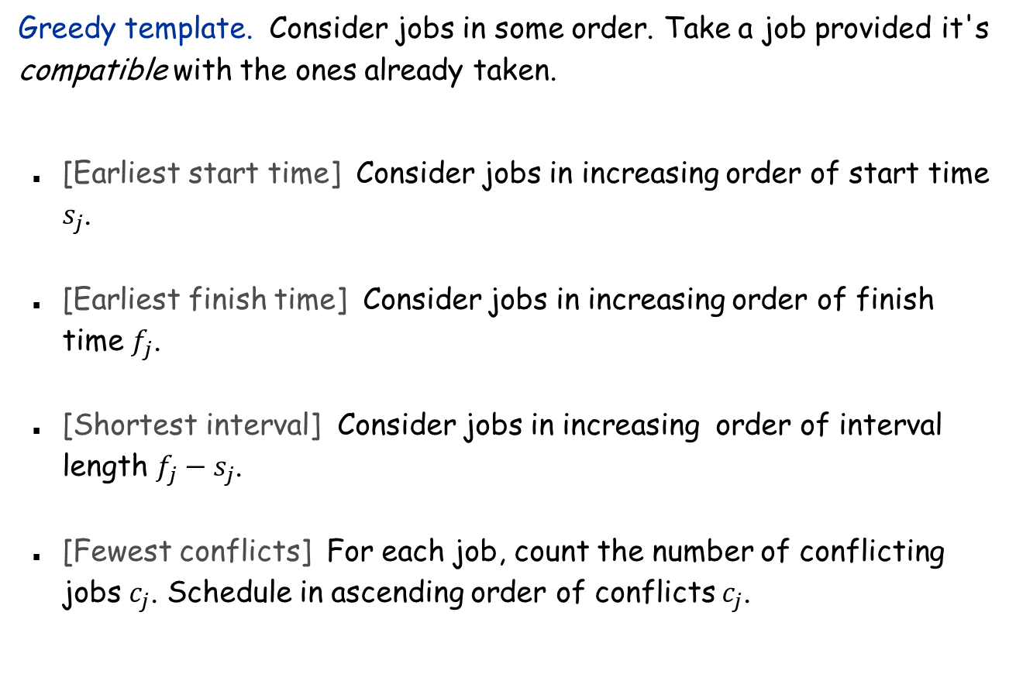
Interval Scheduling: Greedy Algorithms
Greedy template. Consider jobs in some order. Take a job provided it's compatible with the ones already taken.
[Earliest start time] Consider jobs in increasing order of start time $s_{j}$.
[Earliest finish time] Consider jobs in increasing order of finish time $f_{j}$.
[Shortest interval] Consider jobs in increasing order of interval length $f_{j}−s_{j}$.
[Fewest conflicts] For each job, count the number of conflicting jobs $c_{j}$. Schedule in ascending order of conflicts $c_{j}$.

Slide 6
Interval Scheduling: Greedy Algorithms
Greedy template. Consider jobs in some order. Take a job provided it's compatible with the ones already taken.
a
b
c
d
breaks earliest start time
e
Chooses {e} instead of {a,b,c,d}
a
b
breaks shortest interval
c
Chooses {c} instead of {a,b}
a
b
c
d
breaks fewest conflicts
e
f
g
Chooses {f} which forces choosing {a,f,d} instead of {a,b,c,d}
h
i
j
k

Slide 7
Interval Scheduling
Greedy algorithm. Consider jobs in increasing order of finish time. Take each job provided it's compatible with the ones already taken
3
1
1
2
5
4
4
6
7
8
8
Time
0
1
2
3
4
5
6
7
8
9
10
11

Slide 8
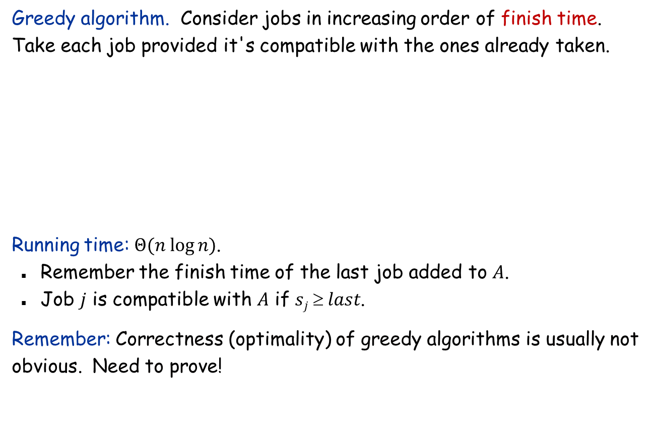
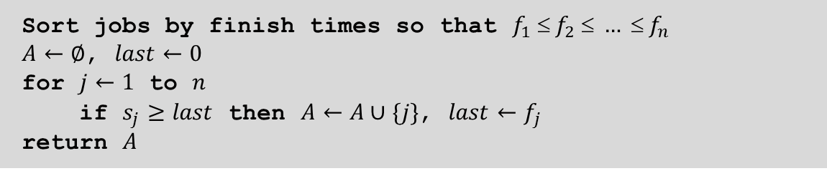
Interval Scheduling: Greedy Algorithm
Greedy algorithm. Consider jobs in increasing order of finish time. Take each job provided it's compatible with the ones already taken.
Running time: $Θ(n log⁡n)$.
Remember the finish time of the last job added to $A$.
Job $j$ is compatible with $A$ if $sj  last$.
Remember: Correctness (optimality) of greedy algorithms is usually not obvious. Need to prove!
Sort jobs by finish times so that $f_{1}  f_{2}  …  f_{n}$
$A←∅$, $last←0$
for $j←1$ to $n$
if $s_{j}≥last$ then $A←A∪\{j\}$, $last←f_{j}$
return $A$

Slide 9



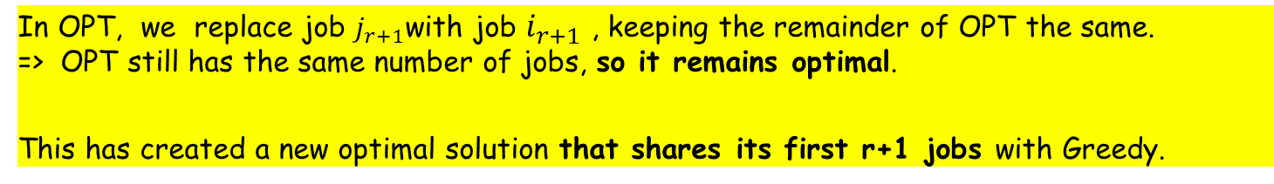






Interval Scheduling: Correctness
Theorem. Greedy algorithm is optimal.
Proof.
Assume greedy is different from OPT. Let's see what’s different.
Let $i1, i2, … ik$ denote the set of jobs selected by greedy.
Let $j1, j2, … jm$ denote set of jobs in the optimal solution. Find largest possible value of $r$ such that $i1=j1, i2=j2, …, ir=jr$
By definition of Greedy, job $i_{r+1}$ finishes before $j_{r+1}$
Greedy:
$$i1$$
$$i1$$
$$ir$$
$$i_{r+1}$$
OPT:
$$j1$$
$$j2$$
$$jr$$
$$j_{r+1}$$
. . .
In OPT, we replace job $j_{r+1}$with job $i_{r+1}$ , keeping the remainder of OPT the same. => OPT still has the same number of jobs, so it remains optimal.
This has created a new optimal solution that shares its first r+1 jobs with Greedy.

Slide 10






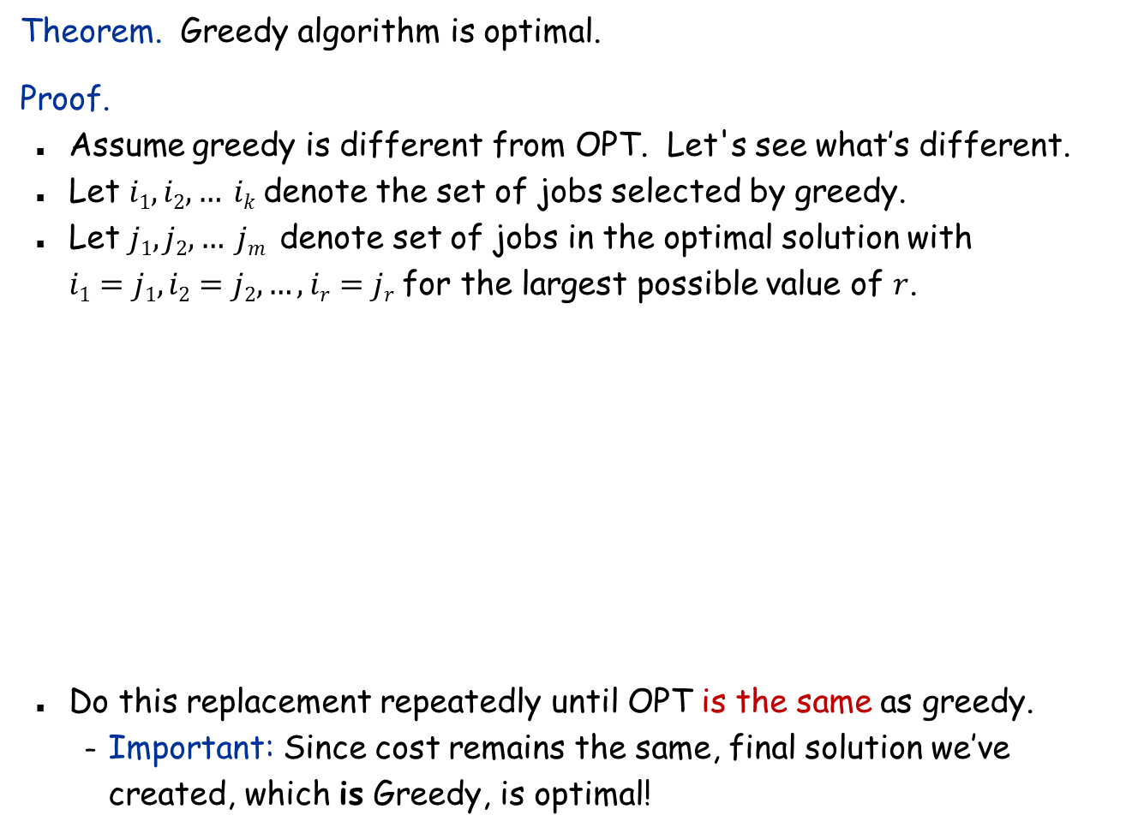

Interval Scheduling: Correctness
Theorem. Greedy algorithm is optimal.
Proof.
Assume greedy is different from OPT. Let's see what’s different.
Let $i1, i2, … ik$ denote the set of jobs selected by greedy.
Let $j1, j2, … jm$ denote set of jobs in the optimal solution with $i1=j1, i2=j2, …, ir=jr$ for the largest possible value of $r$.
Do this replacement repeatedly until OPT is the same as greedy.
Important: Since cost remains the same, final solution we’ve created, which is Greedy, is optimal!
job $i_{r+1}$ finishes before $j_{r+1}$
Greedy:
$$i1$$
$$i1$$
$$ir$$
$$i_{r+1}$$
OPT:
$$j1$$
$$j2$$
$$jr$$
$$i_{r+1}$$
. . .
must still be compatible

Slide 11
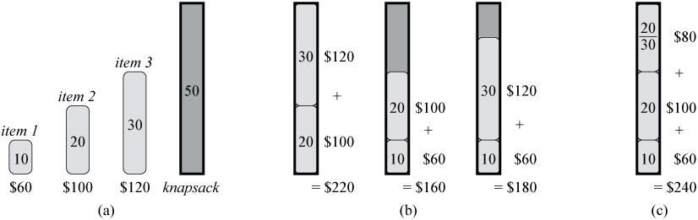
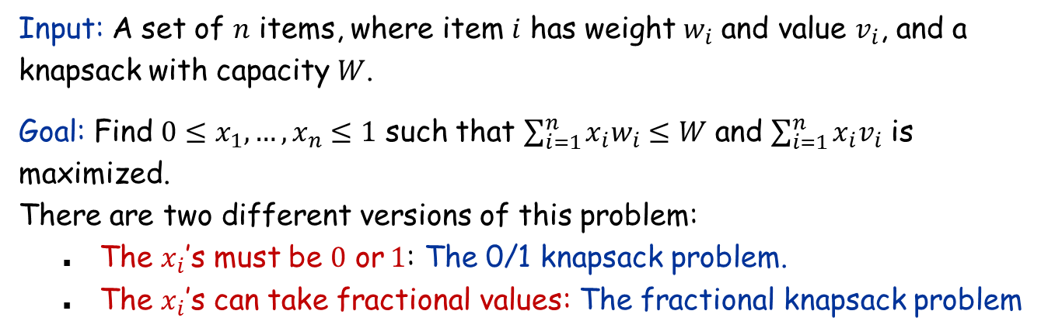
The Fractional Knapsack Problem
Optimal 0/1
Optimal Fractional
Input: A set of $n$ items, where item $i$ has weight $w_{i}$ and value $v_{i}$, and a knapsack with capacity $W$.
Goal: Find $0≤x_{1},…,x_{n}≤1$ such that $\sum_{i=1}^{n}{x_{i}w_{i}≤W}$ and $\sum_{i=1}^{n}{x_{i}v_{i}}$ is maximized. There are two different versions of this problem:
The $x_{i}$’s must be $0$ or$1$: The 0/1 knapsack problem.
The $x_{i}$’s can take fractional values: The fractional knapsack problem

Slide 12
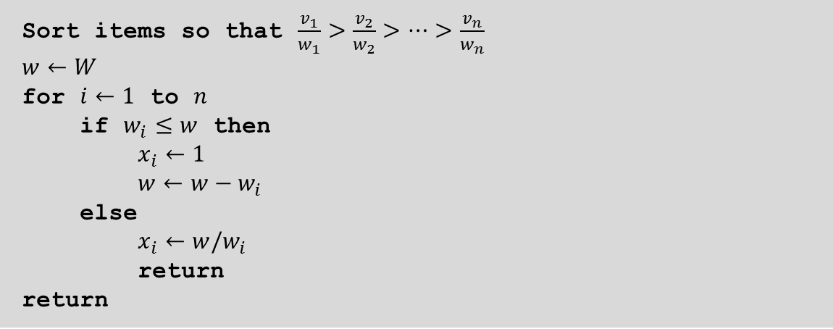
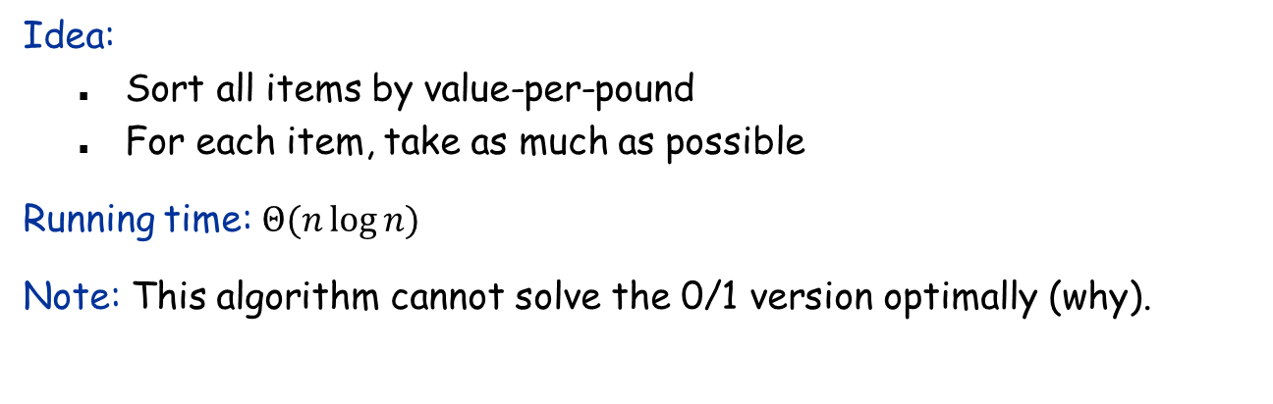
The Greedy Algorithm for Fractional Knapsack
Sort items so that $\frac{v_{1}}{w_{1}}>\frac{v_{2}}{w_{2}}>…>\frac{v_{n}}{w_{n}}$
$$w←W$$
for $i←1$ to $n$
if $w_{i}≤w$ then
$x_{i}←1$
$w←w−w_{i}$
else
$x_{i}←w/w_{i}$
return
return
Idea:
Sort all items by value-per-pound
For each item, take as much as possible
Running time: $Θ(n\log{n)}$
Note: This algorithm cannot solve the 0/1 version optimally (why).

Slide 13
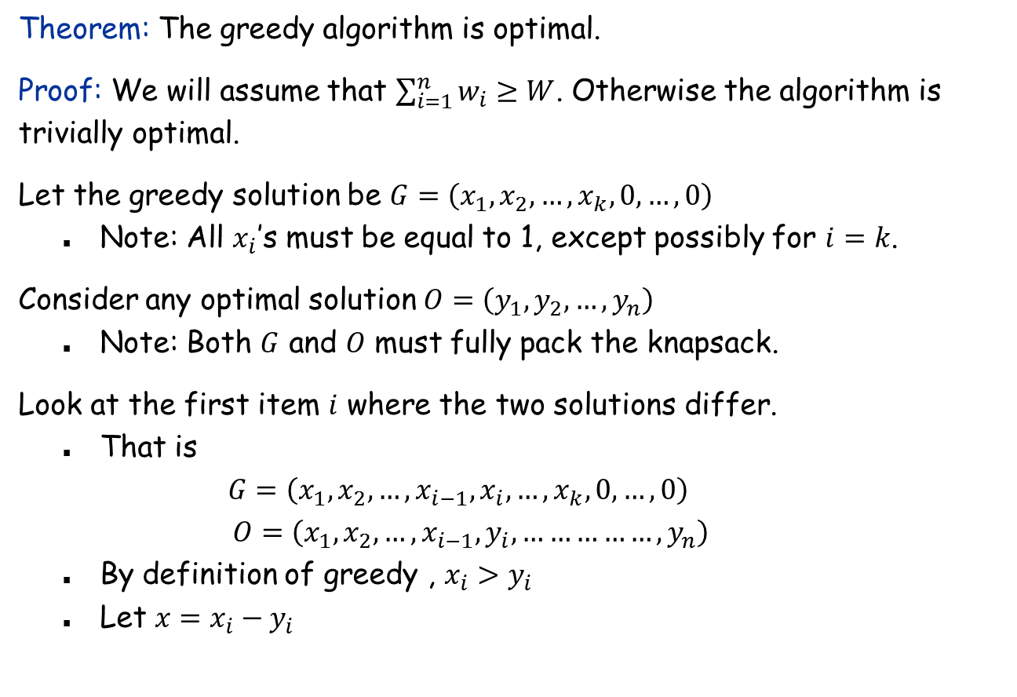
Greedy Algorithm: Correctness
Theorem: The greedy algorithm is optimal.
Proof: We will assume that $\sum_{i=1}^{n}{w_{i}}≥W$. Otherwise the algorithm is trivially optimal.
Let the greedy solution be $G=\left(x_{1}, x_{2}, …, x_{k},0, …,0\right)$
Note: All $x_{i}$’s must be equal to 1, except possibly for $i=k$.
Consider any optimal solution $O=\left(y_{1}, y_{2}, …, y_{n}\right)$
Note: Both $G$ and $O$ must fully pack the knapsack.
Look at the first item $i$ where the two solutions differ.
That is $G=\left(x_{1}, x_{2}, …,x_{i−1},x_{i},…,x_{k},0, …,0\right)$ $O=\left(x_{1}, x_{2}, …,x_{i−1},y_{i},……………,y_{n}\right)$
By definition of greedy , $x_{i}>y_{i}$
Let $x=x_{i}−y_{i}$

Slide 14
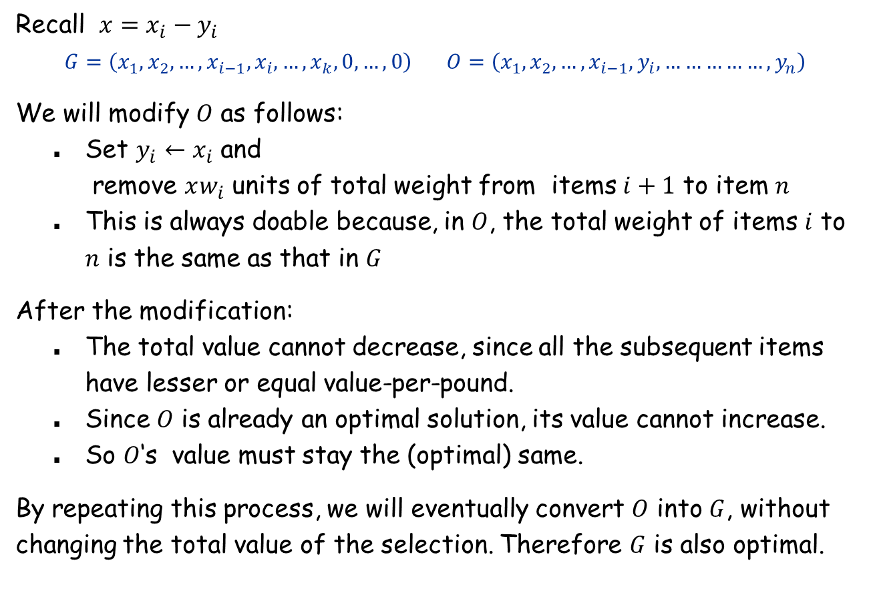
Greedy Algorithm: Correctness (continued)
Recall $x=x_{i}−y_{i}$ $$G=\left(x_{1}, x_{2}, …,x_{i−1},x_{i},…,x_{k},0, …,0\right) O=\left(x_{1}, x_{2}, …,x_{i−1},y_{i},……………,y_{n}\right)$$
We will modify $O$ as follows:
Set $y_{i}←x_{i}$ and remove $xw_{i}$ units of total weight from items $i+1$ to item $n$
This is always doable because, in $O$, the total weight of items $i$ to $n$ is the same as that in $G$
After the modification:
The total value cannot decrease, since all the subsequent items have lesser or equal value-per-pound.
Since $O$ is already an optimal solution, its value cannot increase.
So $O$‘s value must stay the (optimal) same.
By repeating this process, we will eventually convert $O$ into $G$, without changing the total value of the selection. Therefore $G$ is also optimal.

Slide 15

Interval Partitioning
Interval partitioning.
Lecture $j$ starts at $s_{j}$ and finishes at $f_{j}$.
Goal: find the minimum number of classrooms to schedule all lectures so that no two occur at the same time in the same room.
Ex: This schedule uses 4 classrooms to schedule 10 lectures.
e
j
c
d
g
b
h
a
f
i
9
9:30
10
10:30
11
11:30
12
12:30
1
1:30
2
2:30
3
3:30
4
4:30
Time

Slide 16

Interval Partitioning
Interval partitioning.
Lecture $j$ starts at $s_{j}$ and finishes at $f_{j}$.
Goal: find the minimum number of classrooms to schedule all lectures so that no two occur at the same time in the same room.
Ex: This schedule uses only 3.
c
d
f
j
b
g
i
a
e
h
9
9:30
10
10:30
11
11:30
12
12:30
1
1:30
2
2:30
3
3:30
4
4:30
Time

Slide 17
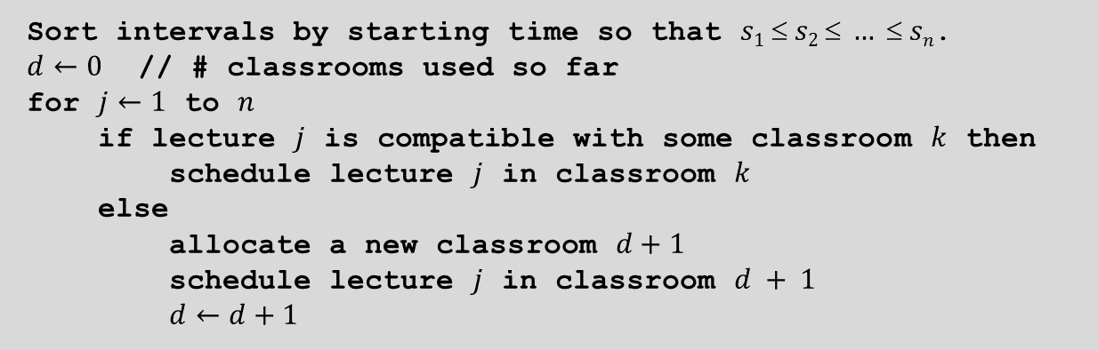
Interval Partitioning: Greedy Algorithm
Greedy algorithm. Consider lectures in increasing order of start time: assign lecture to any compatible classroom.
Sort intervals by starting time so that $s1  s2  …  sn$.
$d←0$ // # classrooms used so far
for $j←1$ to $n$
if lecture $j$ is compatible with some classroom $k$ then
schedule lecture $j$ in classroom $k$
else
allocate a new classroom $d+1$
schedule lecture $j$ in classroom $d + 1$
$d←d+1$

Slide 18

Interval Partitioning
Interval partitioning.
Lecture $j$ starts at $s_{j}$ and finishes at $f_{j}$.
Goal: find the minimum number of classrooms to schedule all lectures so that no two occur at the same time in the same room.
ALG: Sort by start time. Insert in order, opening new classroom when needed
3
5
7
10
2
6
9
1
4
8
9
9:30
10
10:30
11
11:30
12
12:30
1
1:30
2
2:30
3
3:30
4
4:30
Time
1
4
10
2
7
9
3
5
6
8

Slide 19
Interval Partitioning: Lower Bound on Optimal Solution
Def. The depth of a set of open intervals is the maximum number that contain any time instance.
Key observation. Number of classrooms needed ≥ depth.
Ex: Depth of schedule below = 3 ⇒ this schedule is optimal.
We will show: The # classrooms used by the greedy algorithm = depth.
c
d
f
j
b
g
i
a
e
h
9
9:30
10
10:30
11
11:30
12
12:30
1
1:30
2
2:30
3
3:30
4
4:30
Time

Slide 20
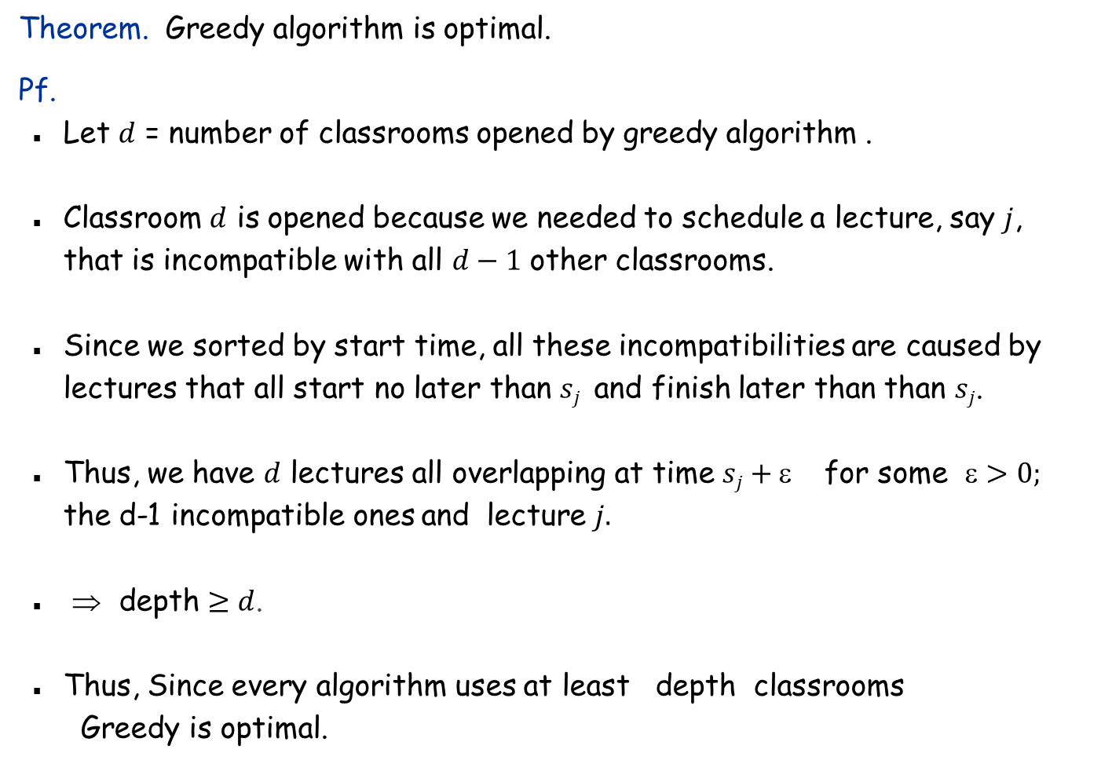
Interval Partitioning: Correctness
Theorem. Greedy algorithm is optimal.
Pf.
Let $d$ = number of classrooms opened by greedy algorithm .
Classroom $d$ is opened because we needed to schedule a lecture, say $j$, that is incompatible with all $d−1$ other classrooms.
Since we sorted by start time, all these incompatibilities are caused by lectures that all start no later than $sj$ and finish later than than $sj$.
Thus, we have $d$ lectures all overlapping at time $sj+$for some $>0;$ the d-1 incompatible ones and lecture $j.$
⇒ depth $≥d$.
Thus, Since every algorithm uses at least depth classrooms Greedy is optimal.

Slide 21
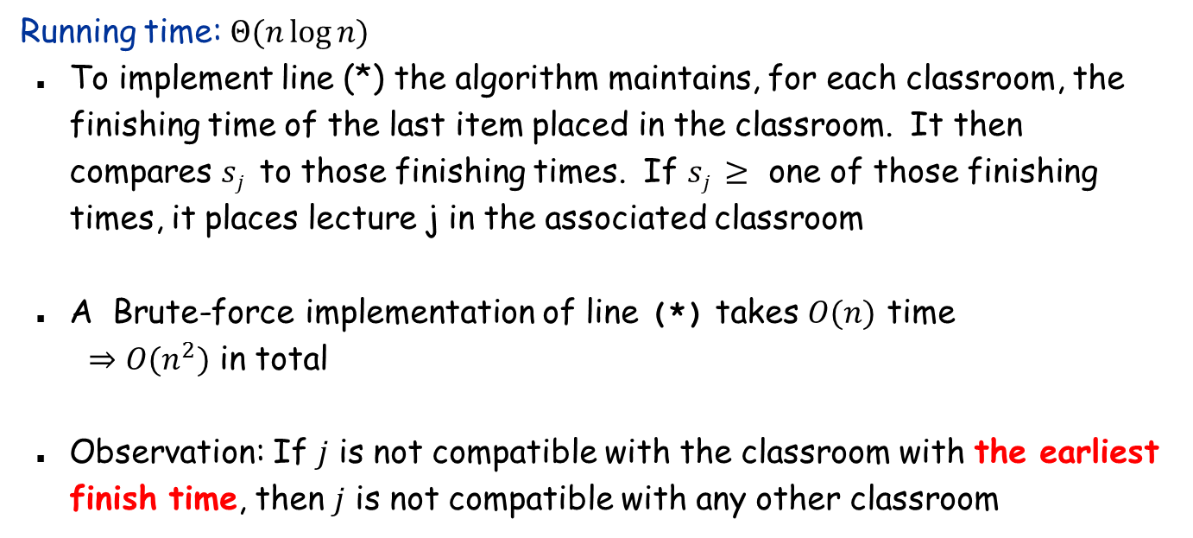
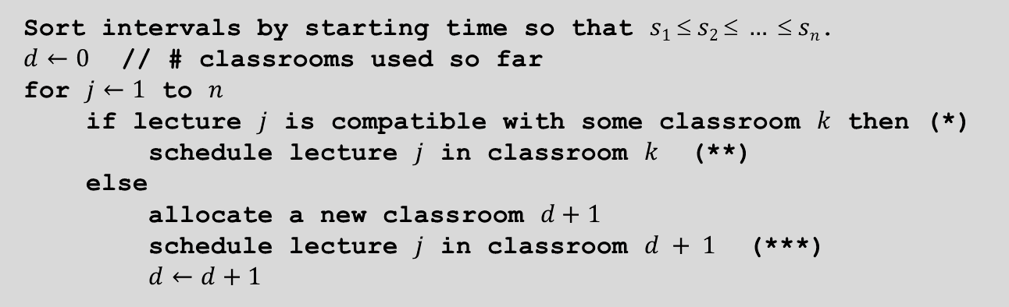
Interval Partitioning: Running Time
Sort intervals by starting time so that $s1  s2  …  sn$.
$d←0$ // # classrooms used so far
for $j←1$ to $n$
if lecture $j$ is compatible with some classroom $k$ then (*)
schedule lecture $j$ in classroom $k$ (**)
else
allocate a new classroom $d+1$
schedule lecture $j$ in classroom $d + 1$ (***)
$d←d+1$
Running time: $Θ(n\log{n)}$
To implement line (*) the algorithm maintains, for each classroom, the finishing time of the last item placed in the classroom. It then compares $sj$to those finishing times. If $sj ≥$ one of those finishing times, it places lecture j in the associated classroom
A Brute-force implementation of line (*) takes $O(n)$ time $⇒O(n^{2})$ in total
Observation: If $j$ is not compatible with the classroom with the earliest finish time, then $j$ is not compatible with any other classroom

Slide 22
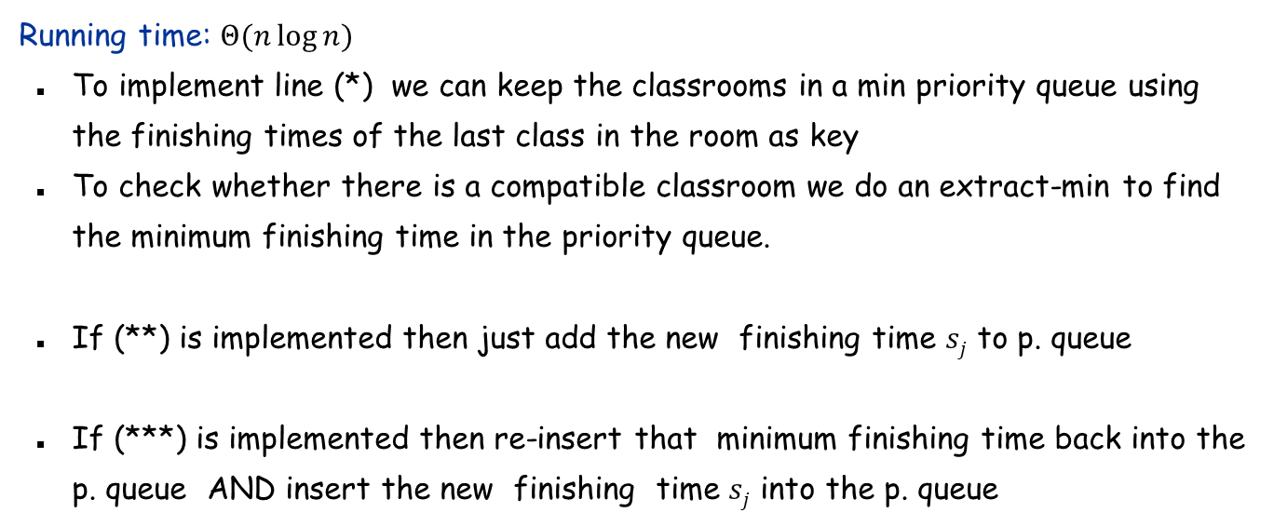


Interval Partitioning: Running Time
Sort intervals by starting time so that $s1  s2  …  sn$.
$d←0$ // # classrooms used so far
for $j←1$ to $n$
if lecture $j$ is compatible with some classroom $k$ then (*)
schedule lecture $j$ in classroom $k$ (**)
else
allocate a new classroom $d+1$
schedule lecture $j$ in classroom $d + 1$ (***)
$d←d+1$
Running time: $Θ(n\log{n)}$
To implement line (*) we can keep the classrooms in a min priority queue using the finishing times of the last class in the room as key
To check whether there is a compatible classroom we do an extract-min to find the minimum finishing time in the priority queue.
If (**) is implemented then just add the new finishing time $sj$ to p. queue
If (***) is implemented then re-insert that minimum finishing time back into the p. queue AND insert the new finishing time $sj$ into the p. queue
$$O(\log{n)}$$
$$O(\log{n)}$$
$$O(\log{n)}$$

