Slide 1
Dynamic Programming II DP over Intervals

Slide 2
DP Over Intervals
All of the problems in this lecture share the following structural properties (similar to Matrix-Chain Multiplication)
Goal is to find optimal (min or max) solution on problem with
Problem of size n
ordered input of items 1,2…,n
Define substructure as
Ordered input of items i..j
Problem of size j-i+1
Recurrence gives optimal solution of subproblem as function of optimal solution of smaller subproblems
Algorithm fills in DP table from smallest to largest problem size
Often, final subproblem filled is solution for original problem Sometimes, solution of original problem is min/max over table values

Slide 3
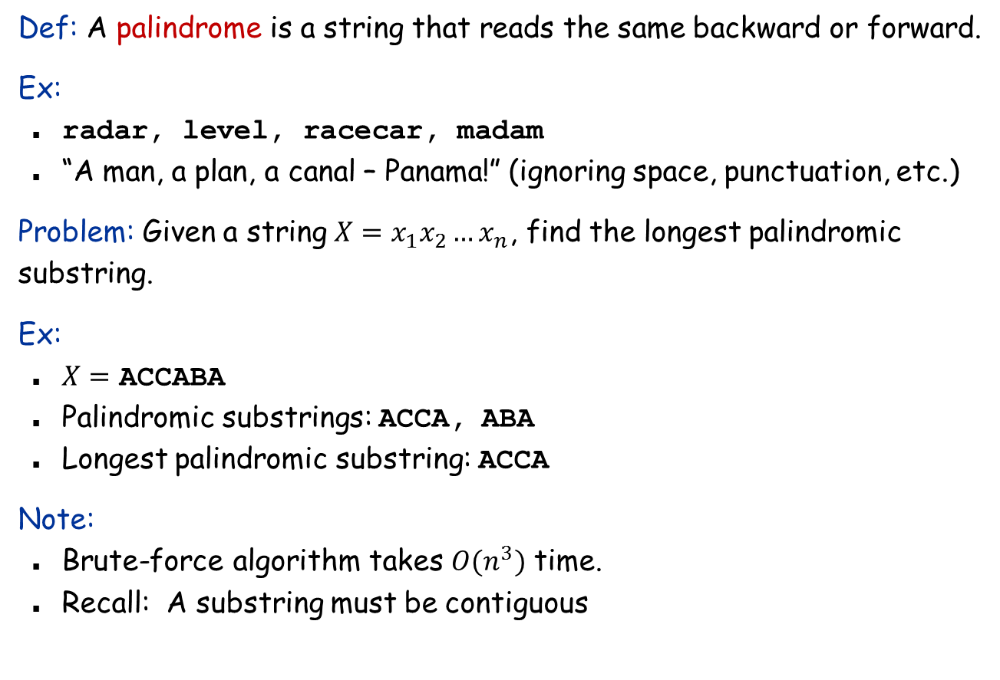
Longest Palindromic Substring
Def: A palindrome is a string that reads the same backward or forward.
Ex:
radar, level, racecar, madam
“A man, a plan, a canal – Panama!” (ignoring space, punctuation, etc.)
Problem: Given a string $X=x_{1}x_{2}…x_{n}$, find the longest palindromic substring.
Ex:
$X=$ ACCABA
Palindromic substrings: ACCA, ABA
Longest palindromic substring: ACCA
Note:
Brute-force algorithm takes $O(n^{3})$ time.
Recall: A substring must be contiguous

Slide 4
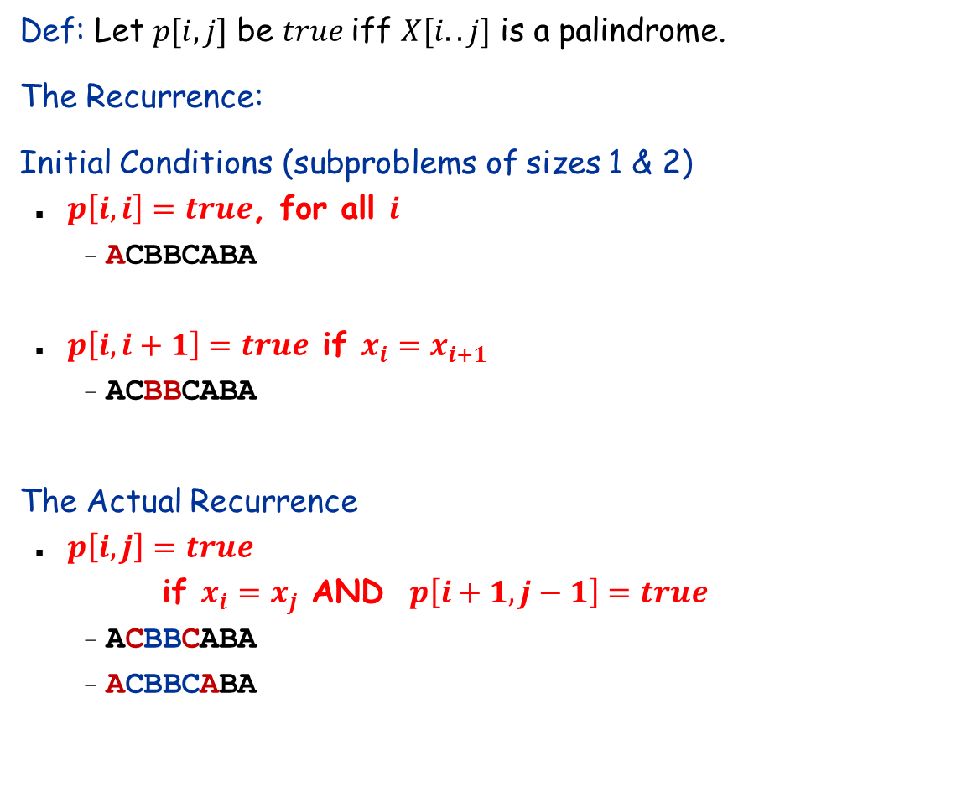
Dynamic Programming Solution
Def: Let $p[i,j]$ be $true$iff $X[i..j]$ is a palindrome.
The Recurrence:
Initial Conditions (subproblems of sizes 1 & 2)
$p\left[i,i\right]=true$, for all $i$
ACBBCABA
$p\left[i,i+1\right]=true$ if $x_{i}=x_{i+1}$
ACBBCABA
The Actual Recurrence
$p\left[i,j\right]=true$ if $x_{i}=x_{j}$ AND $p\left[i+1,j−1\right]=true$
ACBBCABA
ACBBCABA

Slide 5
A Completed DP Table
i | 1 | 2 | 3 | 4 | 5 | 6 | 7 | 8
 | B | A | B | B | C | C | C | B
j=i+2
j=i+4
i/j | 1 | 2 | 3 | 4 | 5 | 6 | 7 | 8
1 | T | F | T
2 |  | T | F | F
3 |  |  | T | T | F
4 |  |  |  | T | F | F
5 |  |  |  |  | T | T | T
6 |  |  |  |  |  | T | T | F
7 |  |  |  |  |  |  | T | F
8 |  |  |  |  |  |  |  | T
i/j | 1 | 2 | 3 | 4 | 5 | 6 | 7 | 8
1 | T | F | T | F | F
2 |  | T | F | F | F | F
3 |  |  | T | T | F | F | F
4 |  |  |  | T | F | F | F | T
5 |  |  |  |  | T | T | T | F
6 |  |  |  |  |  | T | T | F
7 |  |  |  |  |  |  | T | F
8 |  |  |  |  |  |  |  | T
Initial Condition
j=i; j=i+1
i/j | 1 | 2 | 3 | 4 | 5 | 6 | 7 | 8
1 | T | F
2 |  | T | F
3 |  |  | T | T
4 |  |  |  | T | F
5 |  |  |  |  | T | T
6 |  |  |  |  |  | T | T
7 |  |  |  |  |  |  | T | F
8 |  |  |  |  |  |  |  | T
Largest is BCCCB
j=i+3
j>i+4
i/j | 1 | 2 | 3 | 4 | 5 | 6 | 7 | 8
1 | T | F | T | F
2 |  | T | F | F | F
3 |  |  | T | T | F | F
4 |  |  |  | T | F | F | F
5 |  |  |  |  | T | T | T | F
6 |  |  |  |  |  | T | T | F
7 |  |  |  |  |  |  | T | F
8 |  |  |  |  |  |  |  | T
i/j | 1 | 2 | 3 | 4 | 5 | 6 | 7 | 8
1 | T | F | T | F | F | F | F | F
2 |  | T | F | F | F | F | F | F
3 |  |  | T | T | F | F | F | F
4 |  |  |  | T | F | F | F | T
5 |  |  |  |  | T | T | T | F
6 |  |  |  |  |  | T | T | F
7 |  |  |  |  |  |  | T | F
8 |  |  |  |  |  |  |  | T

Slide 6
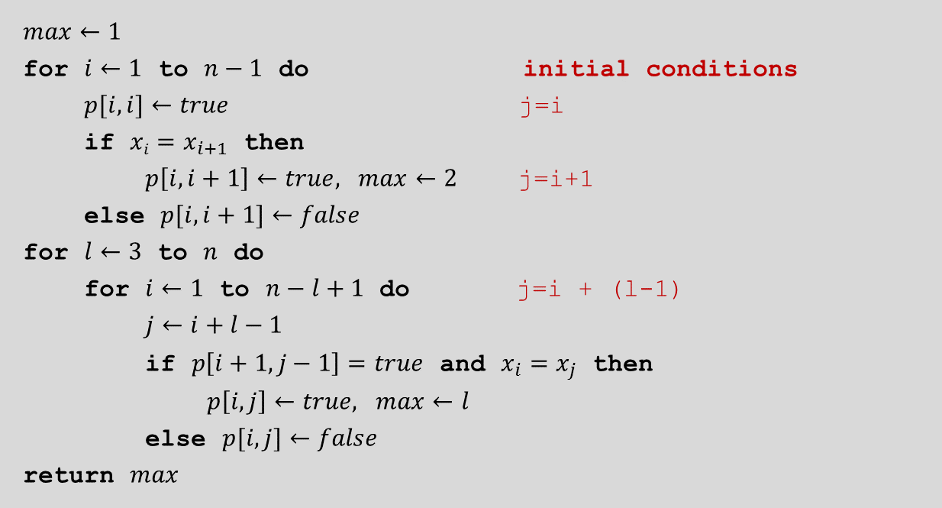
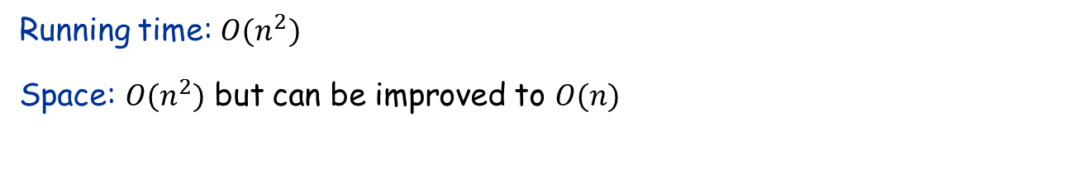
The Algorithm
$max←1$
for $i←1$ to $n−1$ do initial conditions
$p[i, i]←true$ j=i
if $xi=x_{i+1}$ then
$p\left[i, i+1\right]←true, max←2$ j=i+1
else $p[i, i+1]←false$
for $l←3$ to $n$ do
for $i←1$ to $n−l+1$ do j=i + (l-1)
$j←i+l−1$
if $p\left[i+1, j−1\right]=true$ and $x_{i}=x_{j}$ then
$p\left[i,j\right]←true, max⁡←l$
else $p[i,j]←false$
return $max$
Running time: $O(n^{2})$
Space: $O(n^{2})$ but can be improved to $O(n)$

Slide 7
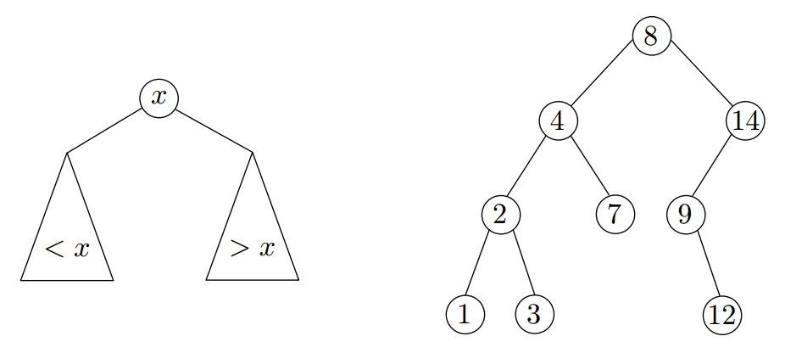
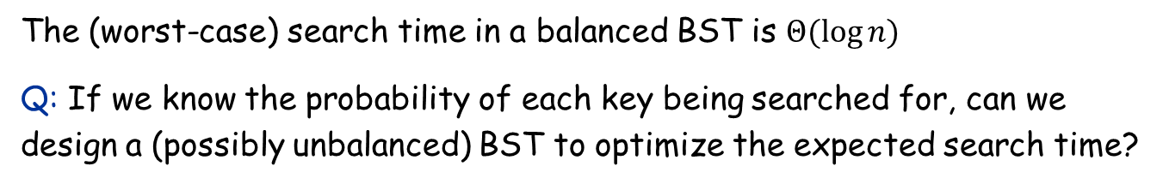
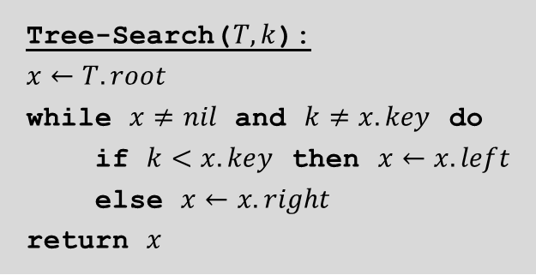
Binary search trees (BST)
Tree-Search($T,k$):
$$x←T.root$$
while $x≠nil$ and $k≠x.key$ do
if $k<x.key$ then $x←x.left$
else $x←x.right$
return $x$
The (worst-case) search time in a balanced BST is $Θ(\log{n)}$
Q: If we know the probability of each key being searched for, can we design a (possibly unbalanced) BST to optimize the expected search time?

Slide 8
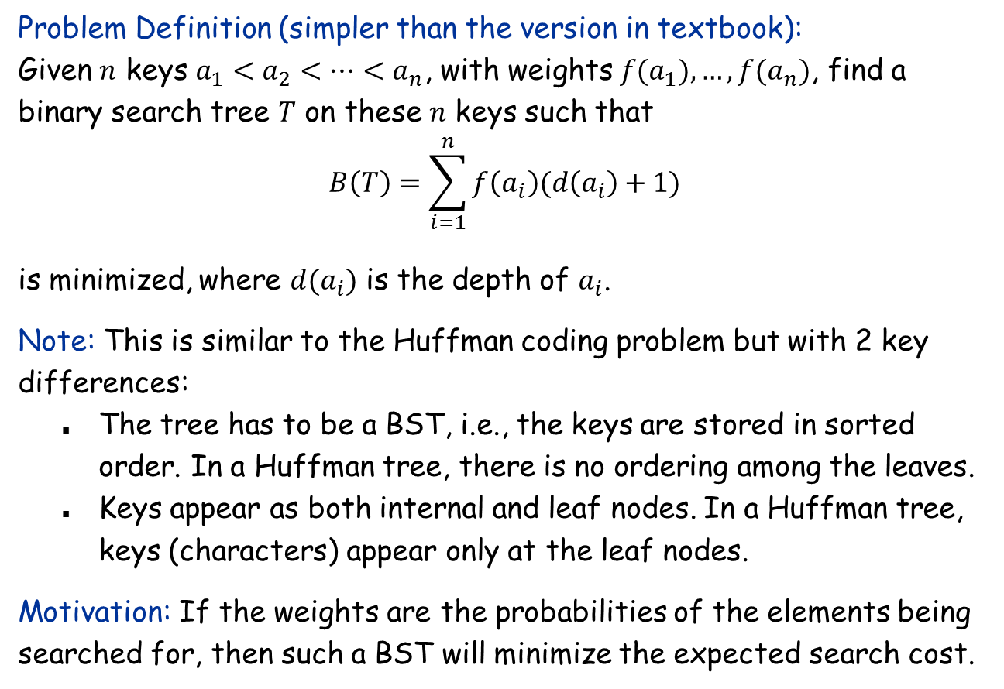
The Optimal Binary Search Tree Problem
Problem Definition (simpler than the version in textbook): Given $n$ keys $a_{1}<a_{2}<…<a_{n}$, with weights $f(a_{1}),…, f(a_{n})$, find a binary search tree $T$ on these $n$ keys such that $$B\left(T\right)=\sum_{i=1}^{n}{f\left(a_{i}\right)(d\left(a_{i}\right)+1)}$$ is minimized, where $d(a_{i})$ is the depth of $a_{i}$.
Note: This is similar to the Huffman coding problem but with 2 key differences:
The tree has to be a BST, i.e., the keys are stored in sorted order. In a Huffman tree, there is no ordering among the leaves.
Keys appear as both internal and leaf nodes. In a Huffman tree, keys (characters) appear only at the leaf nodes.
Motivation: If the weights are the probabilities of the elements being searched for, then such a BST will minimize the expected search cost.

Slide 9
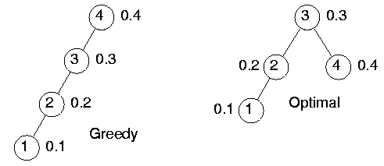
Greedy Won’t Work
Greedy strategy: Always pick the heaviest key as root, then recursively build the tree top-down.
$$B\left(T\right)=0.4⋅2+0.3⋅1+0.2⋅2+0.1⋅3=1.8$$
$$B\left(T\right)=0.4⋅1+0.3⋅2+0.2⋅3+0.1⋅4=2$$

Slide 10

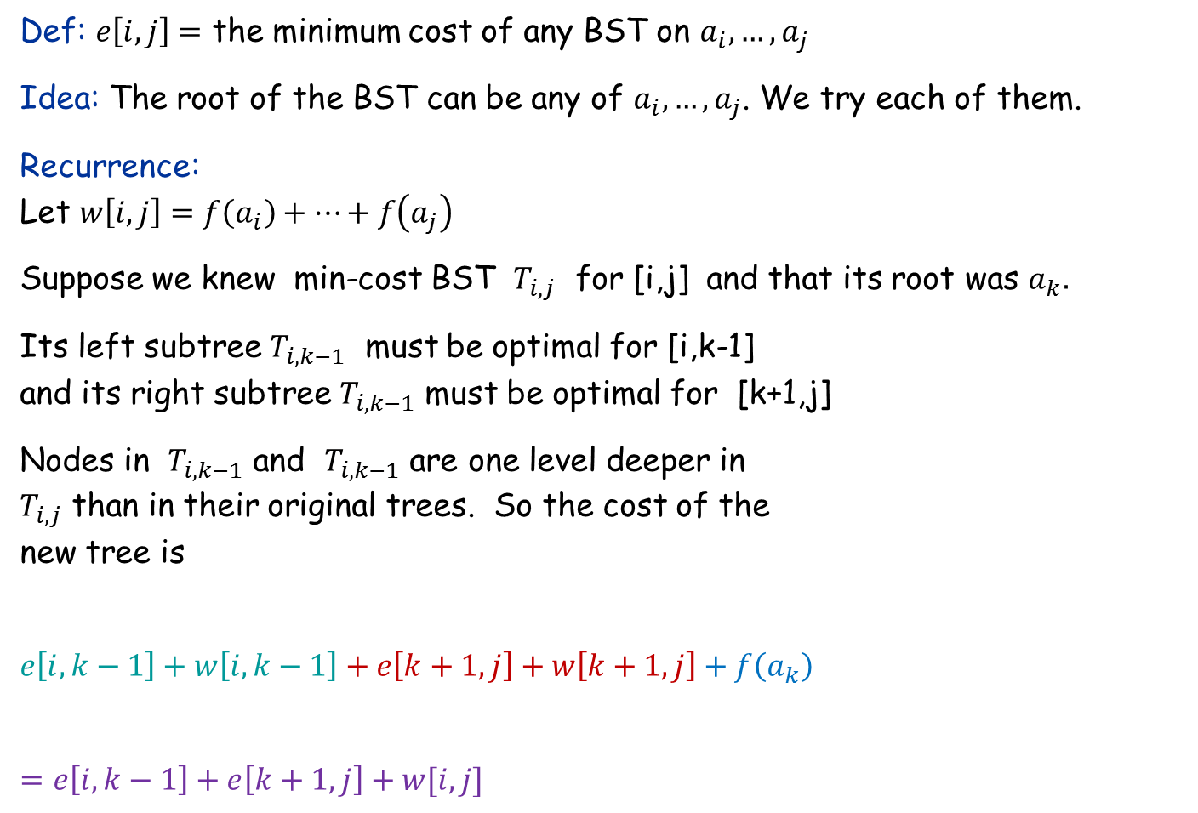







Dynamic Programming: The Recurrence
Def: $e\left[i,j\right]=$ the minimum cost of any BST on $a_{i},…,a_{j}$
Idea: The root of the BST can be any of $a_{i},…,a_{j}$. We try each of them.
Recurrence: Let $w\left[i,j\right]=f\left(a_{i}\right)+…+f\left(a_{j}\right)$
Suppose we knew min-cost BST $T_{i,j}$ for [i,j] and that its root was $a_{k}.$
Its left subtree $T_{i,k−1}$ must be optimal for [i,k-1] and its right subtree $T_{i,k−1}$ must be optimal for [k+1,j]
Nodes in $T_{i,k−1}$ and $T_{i,k−1}$ are one level deeper in $T_{i,j}$ than in their original trees. So the cost of the new tree is
$$e\left[i,k−1\right]+w\left[i,k−1\right]+e\left[k+1,j\right]+w\left[k+1,j\right]+f\left(a_{k}\right)$$
$$=e\left[i,k−1\right]+e\left[k+1,j\right]+w[i,j]$$
$$T_{i,j}$$
$$ak$$
$$T_{i,k−1}$$
$$T_{k+1,j}$$
$$ai$$
$$a_{k−1}$$
$$a_{k+1}$$
$$aj$$
We try out every possible value of k and return the one which minimizes cost!

Slide 11

Dynamic Programming: The Recurrence
Def: $e\left[i,j\right]=$ the minimum cost of any BST on $a_{i},…,a_{j}$
Idea: The root of the BST can be any of $a_{i},…,a_{j}$. We try each of them.
Recurrence:
Let $w\left[i,j\right]=f\left(a_{i}\right)+…+f\left(a_{j}\right)$ $$e\left[i,j\right]=\min_{i≤k≤j}{\{e\left[i,k−1\right]+w\left[i,k−1\right]+e\left[k+1,j\right]+w\left[k+1,j\right]+f(a_{k})\} }$$
$=\min_{i≤k≤j}{\{e\left[i,k−1\right]+e\left[k+1,j\right]+w\left[i,j\right]\} }$
$e\left[i,j\right]=0$ for $i>j$.
Note: All $w[i,j]$’s can be pre-computed in $O(n^{2})$ time.
$$T_{i,j}$$
$$ak$$
$$T_{i,k−1}$$
$$T_{k+1,j}$$
$$ai$$
$$a_{k−1}$$
$$a_{k+1}$$
$$aj$$

Slide 12

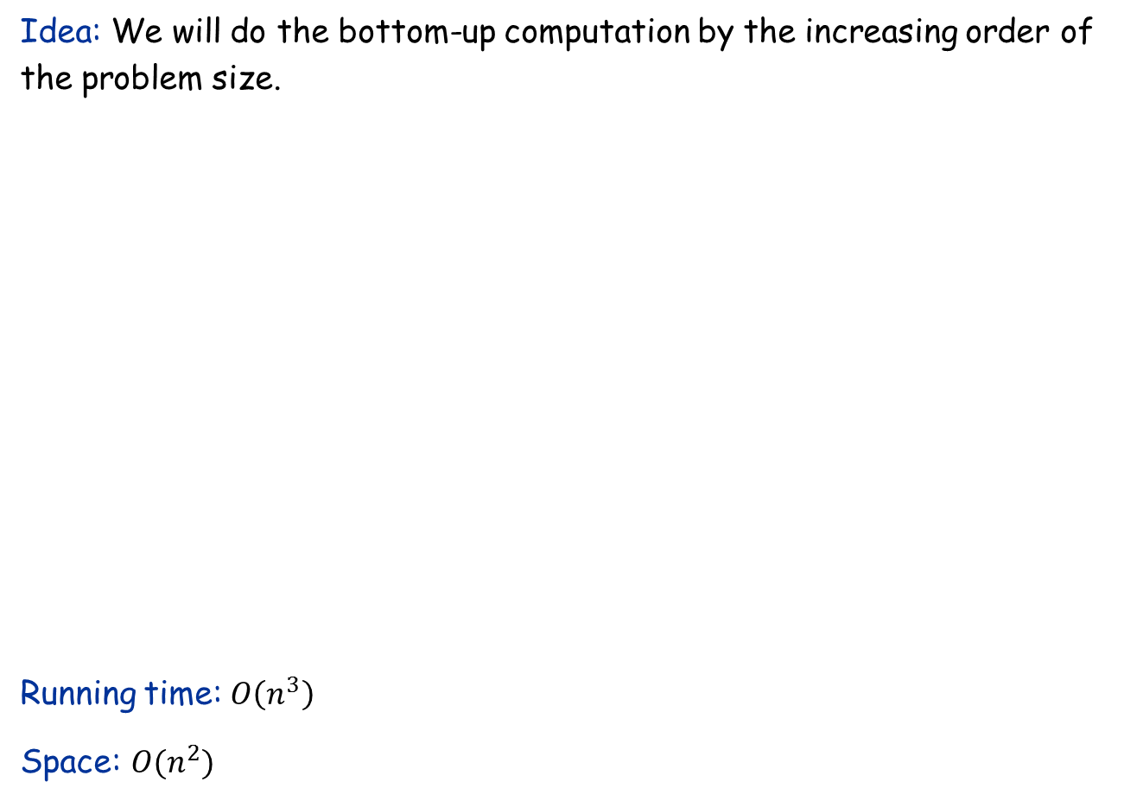
The Algorithm
Idea: We will do the bottom-up computation by the increasing order of the problem size.
Running time: $O\left(n^{3}\right)$
Space: $O(n^{2})$
let $e[1.. n, 1.. n], w[1.. n, 1.. n],root[1.. n, 1.. n]$ be new arrays of all $0$
for $i=1$ to $n$
$w\left[i,i\right]←f\left(a_{i}\right)$
for $j=i+1$ to $n$
$w\left[i,j\right]←w\left[i,j−1\right]+f(a_{j})$
for $l←1$ to $n$ length of [i,j]
for $i←1$ to $n−l+1$
$j←i+l−1$
$e\left[i, j\right]← ∞$
for $k←i$ to $j$ Find k that
$t←e\left[i, k−1\right]+e[k+1, j]+w[i,j]$ minimizes
if $t<e[i, j]$ then $e\left[i, k−1\right]+e[k+1, j]+w[i,j]$
$e\left[i, j\right]←t$
$root\left[i, j\right]←k$
return Construct-BST($root,1,n$)

Slide 13
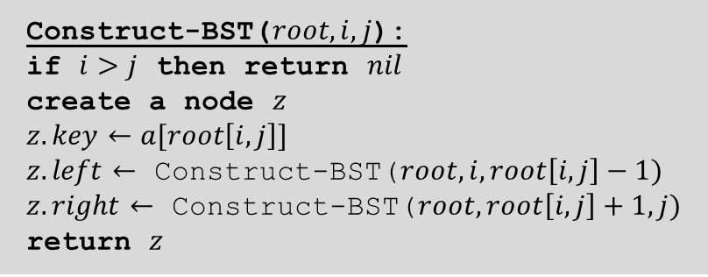

Construct the Optimal BST
Construct-BST($root,i,j$):
if $i>j$ then return $nil$
create a node $z$
$z.key←a[root\left[i,j\right]]$
$z.left←$ Construct-BST($root,i,root\left[i,j\right]−1)$
$z.right←$ Construct-BST($root,root\left[i,j\right]+1,j)$
return $z$
Running time of this part: $O(n)$

Slide 14

RNA Secondary Structure
RNA. String $B=b_{1}b_{2}b_{n}$ over alphabet { A, C, G, U }.
Secondary structure. RNA is single-stranded so it tends to loop back and form base pairs with itself. This structure is essential for understanding the behavior of molecules.
Ex: GUCGAUUGAGCGAAUGUAACAACGUGGCUACGGCGAGA
C
A
A
A
A
U
G
C
complementary base pairs: A-U, C-G
C
G
U
A
A
G
U
G
A
U
U
A
A
C
G
C
U
G
G
C
G
C
G
A
G
C
G
A
U
G

Slide 15


RNA Secondary Structure
Secondary structure. A set of pairs $S=\{(b_{i}, b_{j})\}$that satisfy:
[Watson-Crick.] $S$ is a matching and each pair in $S$ is a Watson-Crick complement: A-U, U-A, C-G, or G-C.
[No sharp turns.] The ends of each pair are separated by at least 4 intervening bases: If $\left(b_{i}, b_{j}\right)∈S$, then $i<j−4$.
[Non-crossing.] If $(b_{i}, b_{j})$ and $(b_{k}, b_{l})$ are two pairs in $S$, then we cannot have $i<k<j<l$.
G
G
G
G
G
C
U
G
G
C
U
C
G
C
G
C
U
A
U
A
U
A
G
U
A
U
A
U
A
A
U
G
U
G
G
C
C
A
U
A
U
G
G
G
G
C
A
U
A
G
U
U
G
G
C
C
A
U
$$≤4$$
ok
sharp turn
crossing

Slide 16
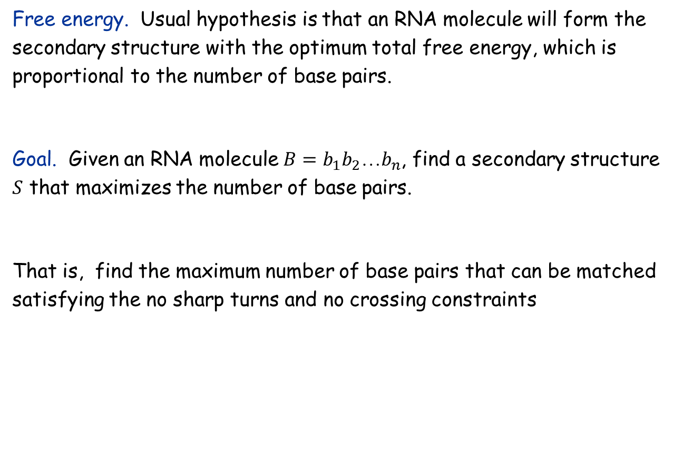
The Problem
Free energy. Usual hypothesis is that an RNA molecule will form the secondary structure with the optimum total free energy, which is proportional to the number of base pairs.
Goal. Given an RNA molecule $B=b_{1}b_{2}b_{n}$, find a secondary structure $S$ that maximizes the number of base pairs.
That is, find the maximum number of base pairs that can be matched satisfying the no sharp turns and no crossing constraints

Slide 17
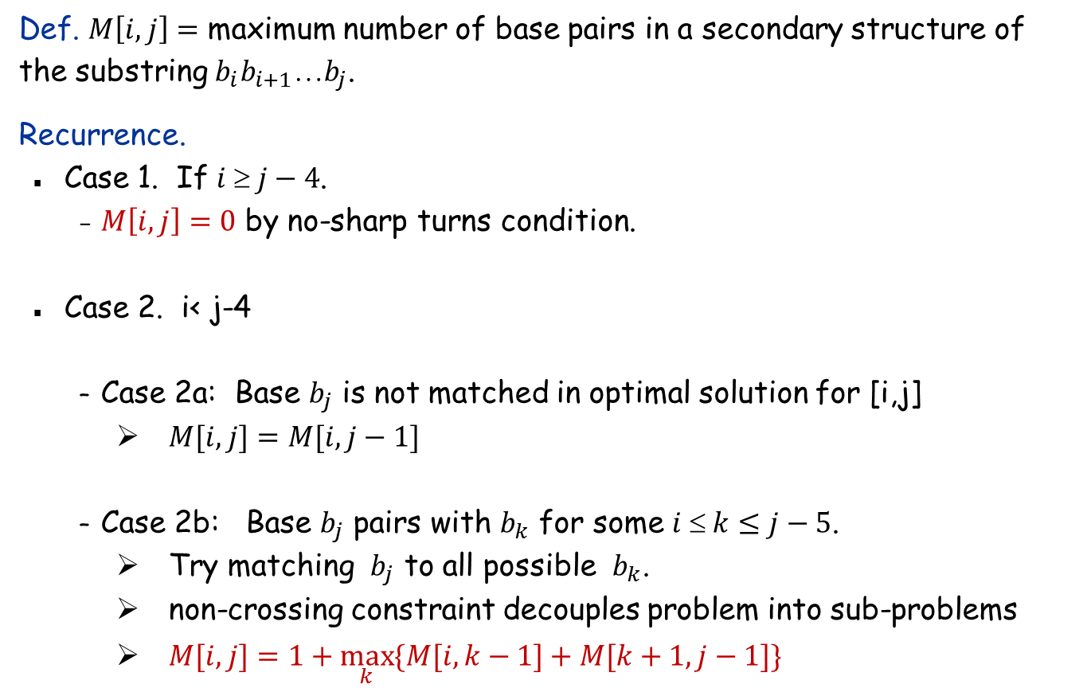

The Recurrence
Def. $M\left[i,j\right]=$ maximum number of base pairs in a secondary structure of the substring $b_{i}b_{i+1}b_{j}$.
Recurrence.
Case 1. If $i  j−4$.
$M\left[i,j\right]=0$ by no-sharp turns condition.
Case 2. i< j-4
Case 2a: Base $b_{j}$ is not matched in optimal solution for [i,j]
$M[i,j]=M[i, j−1]$
Case 2b: Base $b_{j}$ pairs with $b_{k}$ for some $i  k≤j−5$.
Try matching $b_{j}$ to all possible $b_{k}$.
non-crossing constraint decouples problem into sub-problems
$M[i,j]=1+\max_{k}{\{M[i, k−1]+M[k+1, j−1]\}}$
Take max over $k$ such that $i  k≤j−5$ and $b_{k}$ and $b_{j}$ are Watson-Crick complements

Slide 18
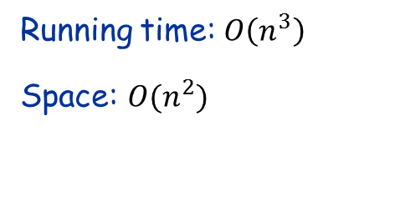
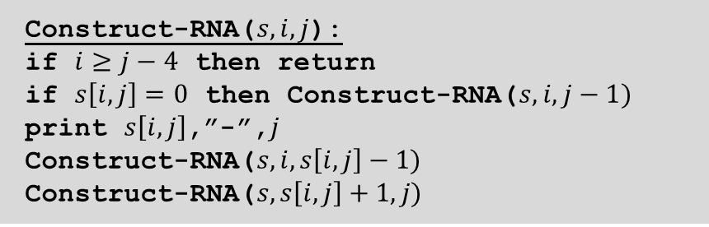
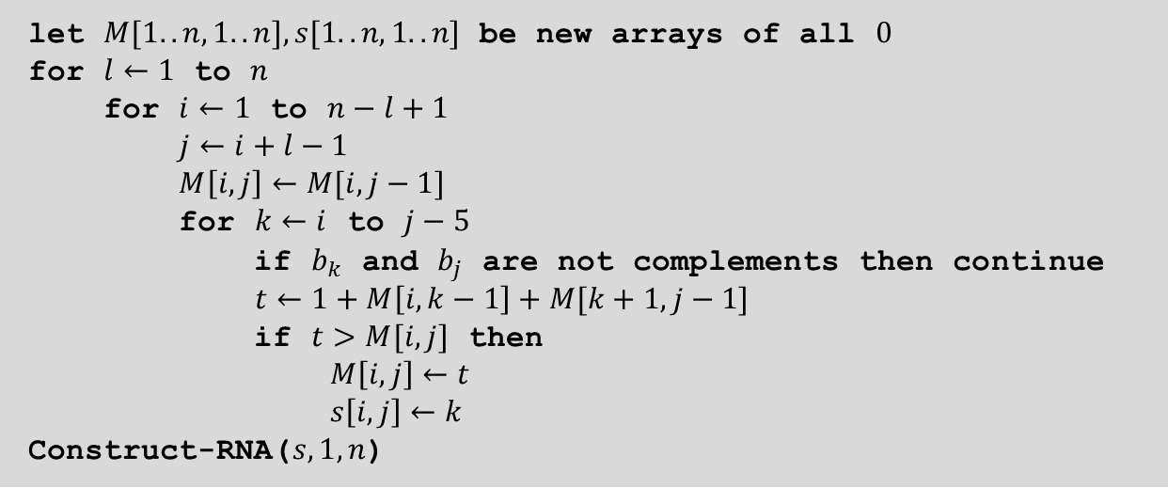
The Algorithm
let $M[1.. n, 1.. n], s[1.. n, 1.. n]$ be new arrays of all $0$
for $l←1$ to $n$
for $i←1$ to $n−l+1$
$j←i+l−1$
$M\left[i, j\right]←M[i,j−1]$
for $k←i$ to $j−5$
if $b_{k}$ and $b_{j}$ are not complements then continue
$t←1+M\left[i, k−1\right]+M[k+1, j−1]$
if $t>M[i, j]$ then
$M\left[i, j\right]←t$
$s\left[i, j\right]←k$
Construct-RNA($s,1,n$)
Running time: $O\left(n^{3}\right)$
Space: $O(n^{2})$
Construct-RNA($s,i,j$):
if $i≥j−4$ then return
if $s\left[i,j\right]=0$ then Construct-RNA($s,i,j−1)$
print $s\left[i,j\right]$,”-”,$j$
Construct-RNA($s,i,s\left[i,j\right]−1)$
Construct-RNA($s,s\left[i,j\right]+1,j)$

