Slide 1
COMP3711H Honors Design and Analysis of Algorithms
Mordecai Golin
Fall 2016 – CSE@HKUST

Slide 2
Lecturer & TA
Dr. Mordecai Golin
golin@cse.ust.hk
http://www.cse.ust.hk/~golin
Room 3559
Office Hours: After class & by appointment
TA: TBA
TBA@cse.ust.hk
Office Hours: TBA

Slide 3
Textbook and Lecture Notes
Textbook: Algorithms
by Dasgupta, Papadimitriou, and Vazirani
Prepublication version available online
Will only follow loosely
Lecture Notes
Sketches will be available on course web page
Other References
Introduction to Algorithms (3rd ed.)
By Cormen, Leiserson, Rivest and Stein
Algorithm Design
by Kleinberg and Tardos
Programming Pearls (2nd ed)
by Bentley

Slide 4
Tentative Syllabus
Sorting Algorithms
Balanced Binary Search Trees
Graph Algorithms
Algorithmic Design Techniques
Divide-and-Conquer
Dynamic Programming
Greedy
Network Flow
Hashing
Approximation & Randomized Algorithms (maybe)

Slide 5
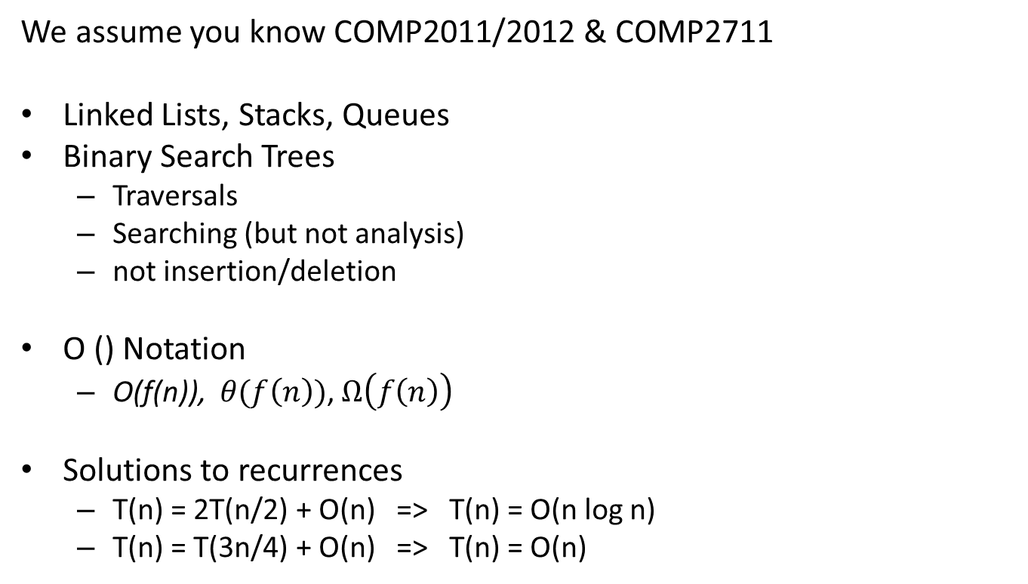
Prerequisites
We assume you know COMP2011/2012 & COMP2711
Linked Lists, Stacks, Queues
Binary Search Trees
Traversals
Searching (but not analysis)
not insertion/deletion
O () Notation
O(f(n)), $θ(f\left(n\right))$, $Ω\left(f\left(n\right)\right)$
Solutions to recurrences
T(n) = 2T(n/2) + O(n) => T(n) = O(n log n)
T(n) = T(3n/4) + O(n) => T(n) = O(n)

Slide 6
Question
What have you learnt previously?
Class has students coming from many backgrounds
Hashing?
Min-Heaps, Heapsort?

Slide 7
Other Information
Class: Rm 5585, 4:30 – 5:50 on Tuesday and Thursday
Tutorial: Rm 6602, 6:00 - 6:50 on Tuesday
No Tutorial first week (September 4th)
Marking
(30%) Four assignments, each worth the same
Requires designing algorithms and analyzing correctness/run time
Each will take 10-14 days. First one assigned towards end of September
(30%) Midterm: Mid-October
(40%) Final: time and venue to be determined by ARR.
Student participation in class/tutorials could help borderline grades
Won’t hurt others since class will not be marked on a curve

Slide 8
Classroom Etiquette
Turn off cell phone ringers
No phone conversations in room
Latecomers should enter quietly
No LOUD talking among selves during lectures
Please ask questions and provide feedback
Students are expected to uphold the
HKUST Honor Code

