Slide 1
COMP 3711H – Fall 2016
Midterm Exam Revision
(See handout on web page
for full details)

Slide 2
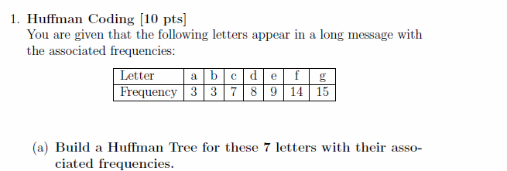
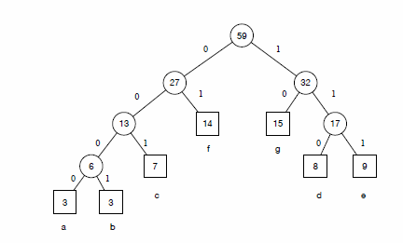
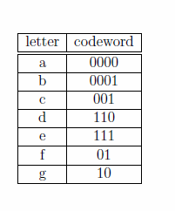
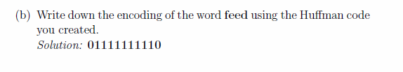

Slide 3
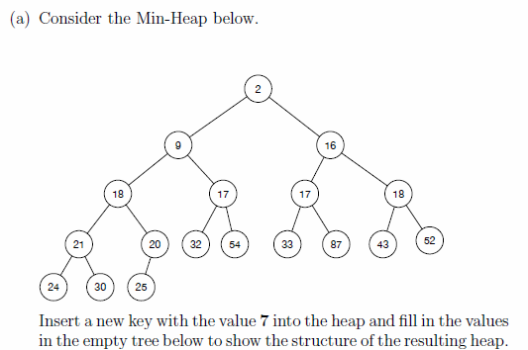
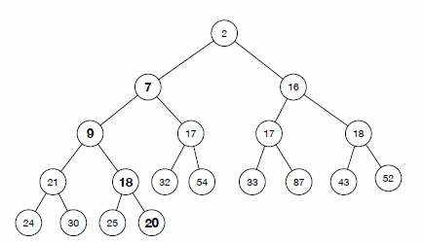
Heaps [8 pts]
A new node was added to hold the 7 and it was then bubbled up to
its proper place.
7 and the items that were moved are in bold.

Slide 4
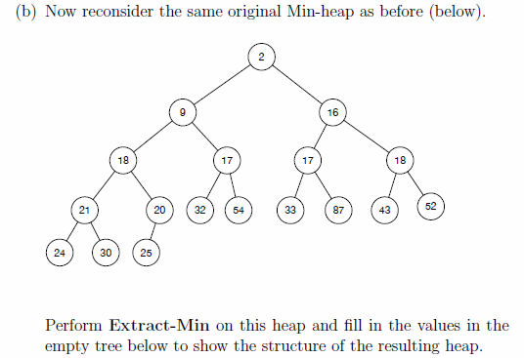
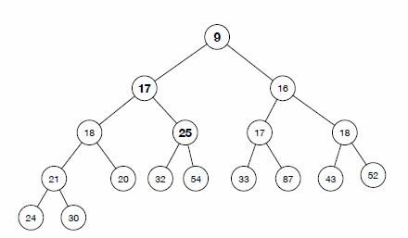
2 was removed, 25 was moved to the top and bubbled down.
The node originally holding 25 was removed.
That items that were
moved are in bold.

Slide 5
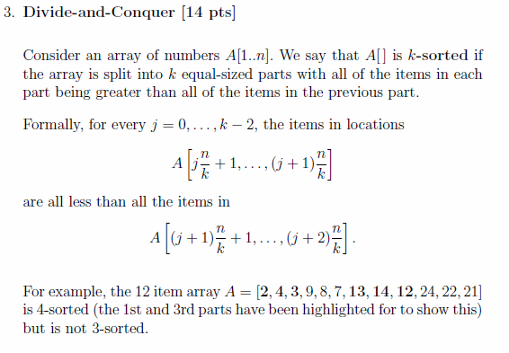
Design an O(n log k) worst-case time algorithm for k-sorting an array.
You must describe (either in plain english or pseudocode) how your algorithm works, justify its correctness and prove that it runs in O(n log k) worst-case time.
For simplicity, you may assume that both n and k are powers of 2 and that all elements in the array are distinct.

Slide 6
Intuition was to do something like quicksort but at each step choosing the median item as the partition.
The median can be found in O(n) time using deterministic selection and partitioning takes O(n) time.
After one step, the array is split into halves with everything in the first half less than everything in the second one.
Now recurse in the two halves and repeat recursing until the subarray sizes are n/k :
This doesn’t quite work because it doesn’t include the partitioning elements in the two sides of the recursion but we can fix this (see next slide)

Slide 7
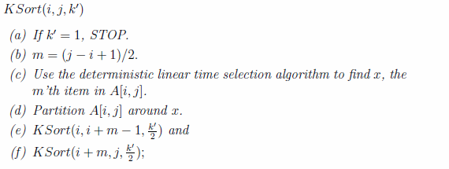
The algorithm recursively k-sorts the sub- array A[i; j] for $k≥2$:
We assume that the top level call will be to KSort(1; n; k)

Slide 8

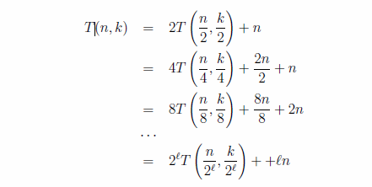
The worst case running time of this algorithm to k-sort n items is T(n; k),
which from the description on previous page satisfies the below which can be solved using the expansion method
Plugging l= log k into this expansion gives the final result

Slide 9
4. Interval Selection [12 pt]
This is exactly what was taught in class
(see class slides)

Slide 10
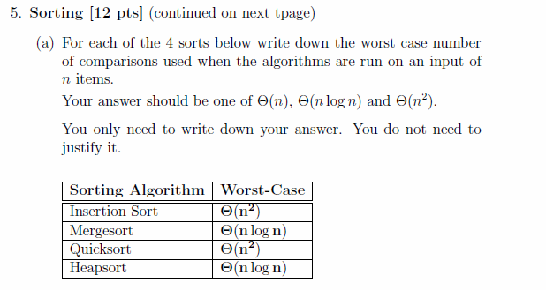

Slide 11
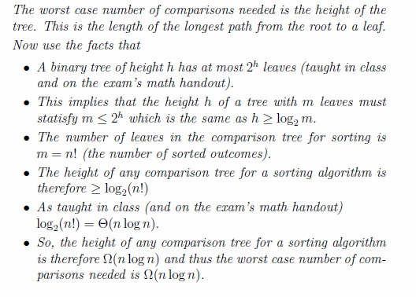
This is exactly what was taught in class

Slide 12
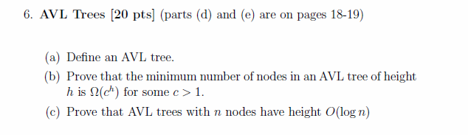

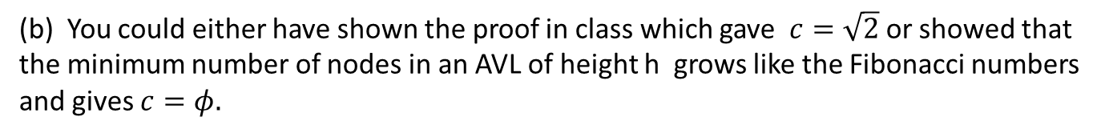
(b) You could either have shown the proof in class which gave $c=\sqrt{2}$or showed that the minimum number of nodes in an AVL of height h grows like the Fibonacci numbers and gives $c=φ.$

Slide 13
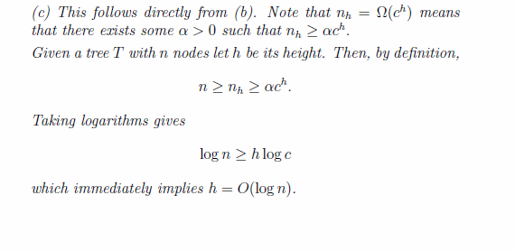

Slide 14
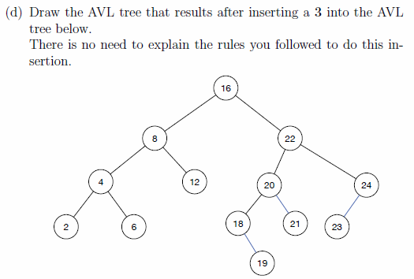
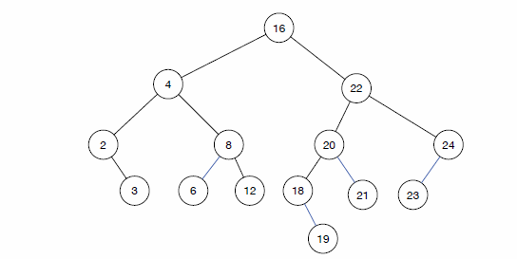

Slide 15
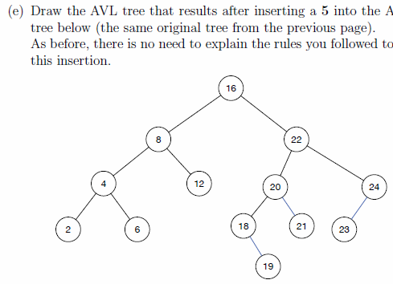
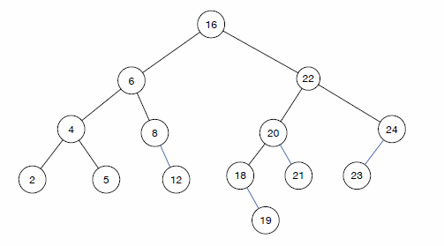

Slide 16
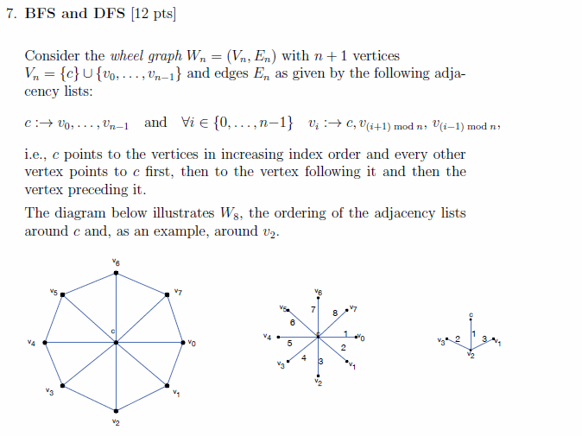

Slide 17
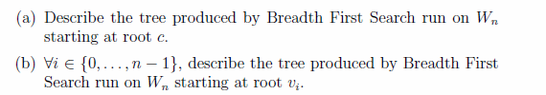
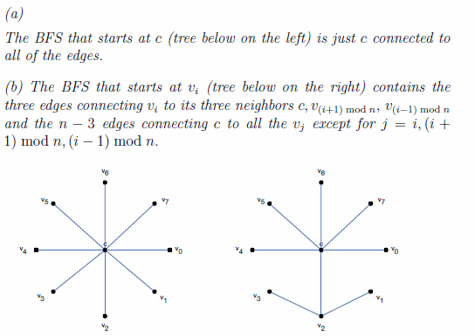

Slide 18
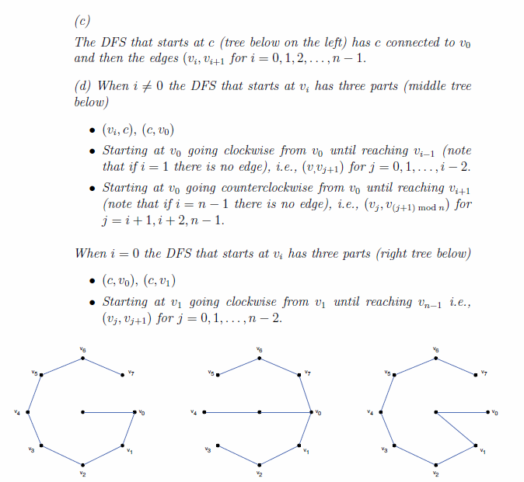

Slide 19
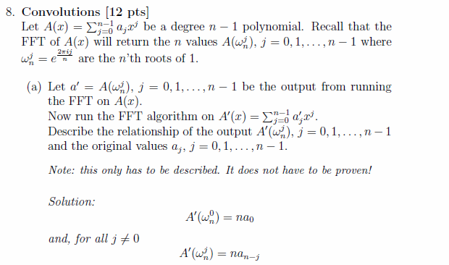

Slide 20
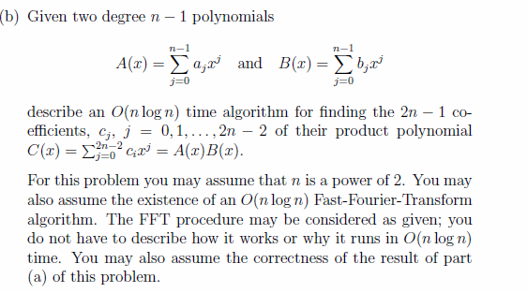

Slide 21
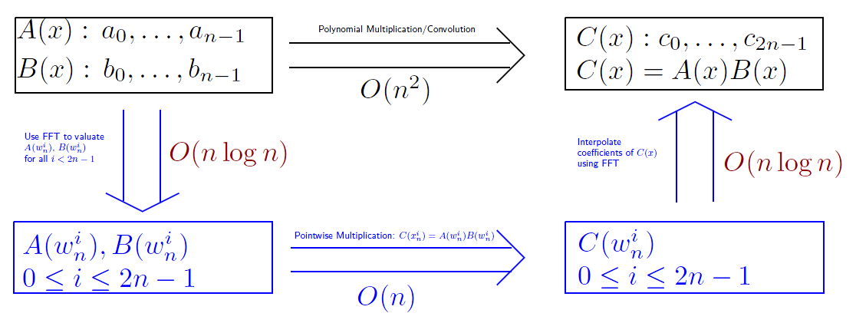
The solution to this problem was to describe the algorithm given by following the blue arrows.
Common errors were to say that A,B were evaluated at n points and not 2n ones, or to forget to say that multiplying the polynomial values pointwise gives the same values as the FFT on C.

