Slide 1
The Taxi Scheduling Problem
Version of 21/11/2016

Slide 2
The Problem
Consider a taxi company that has received many reservations
It wants to calculate the minimum number of taxis it will need to service all of those requests. How can it do this?

Slide 3
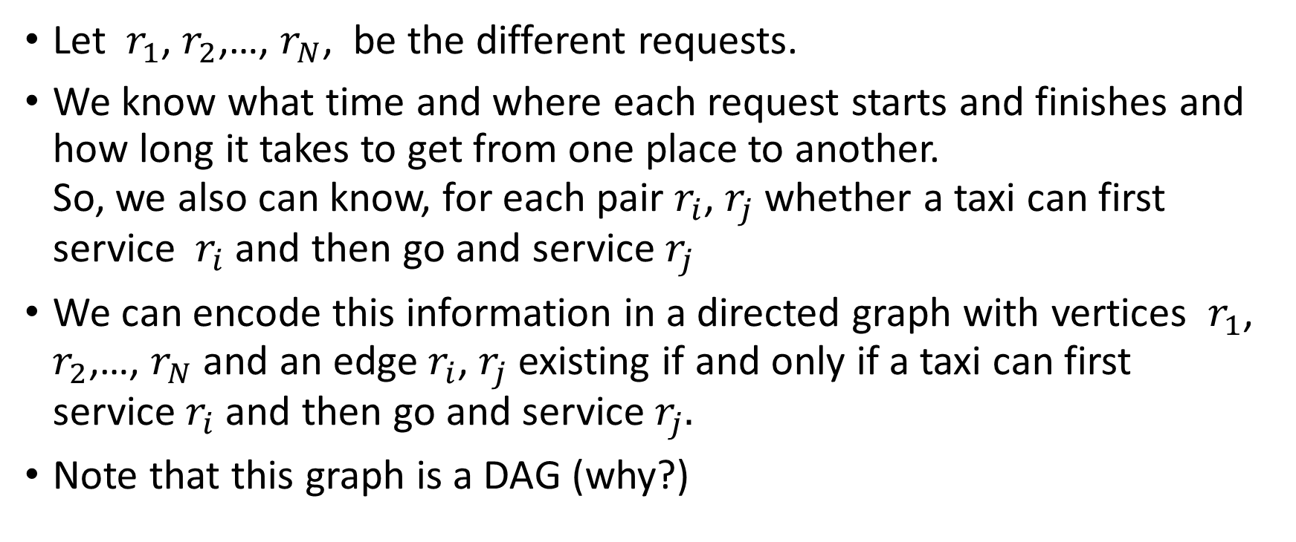
A Graph Representation
Let $r_{1}$, $r_{2}$,…, $r_{N}$, be the different requests.
We know what time and where each request starts and finishes and how long it takes to get from one place to another. So, we also can know, for each pair $r_{i}$, $r_{j}$ whether a taxi can first service $r_{i}$and then go and service $r_{j}$
We can encode this information in a directed graph with vertices $r_{1}$, $r_{2}$,…, $r_{N}$ and an edge $r_{i}$, $r_{j}$ existing if and only if a taxi can first service${ r}_{i}$and then go and service $r_{j}.$
Note that this graph is a DAG (why?)

Slide 4
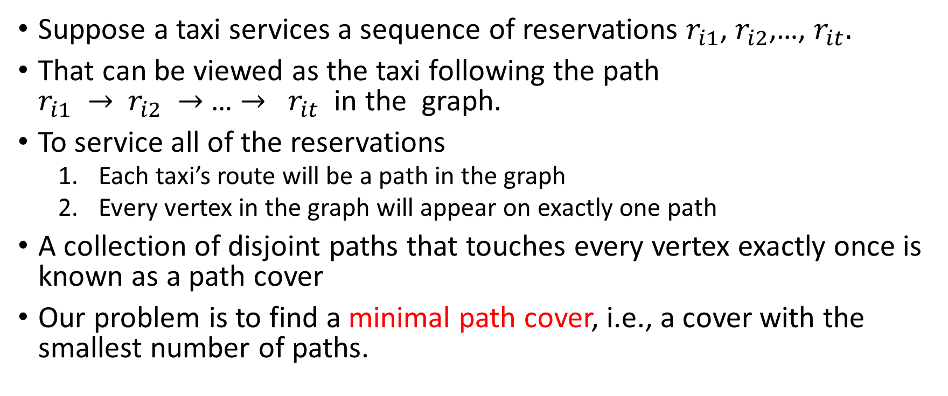
Suppose a taxi services a sequence of reservations $r_{i1}$, $r_{i2}$,…, $r_{it}.$
That can be viewed as the taxi following the path $r_{i1} →$ $r_{i2} →$… $→$ $r_{it}$ in the graph.
To service all of the reservations
Each taxi’s route will be a path in the graph
Every vertex in the graph will appear on exactly one path
A collection of disjoint paths that touches every vertex exactly once is known as a path cover
Our problem is to find a minimal path cover, i.e., a cover with the smallest number of paths.

Slide 5
r
2
5
e
3
t
x
6
4
7
The smallest path cover for this DAG has size 3

Slide 6
r
2
5
e
3
t
x
6
4
7
The smallest path cover for this DAG has size 3
Note: the smallest path cover is not necessarily unique. There are other path covers of size 3

Slide 7
r
The smallest path cover for this DAG has size 3
2
5
Suppose that after finding the path cover we removed all the edges and then reinserted the path edges one at a time, in whatever order.
e
3
t
x
6
4
7
When starting, each vertex is in its own path, so there are N paths
Each new edge added combines two old paths, and reduces the number of paths by one
The total number of paths at the end is N – M, where M is the number of edges in the cover
So, reducing the number of paths is same as maximizing the number of edges added
Now note that the only constraint on the edges that can be added is that each vertex can have at most one edge entering it and one edge leaving it.

Slide 8
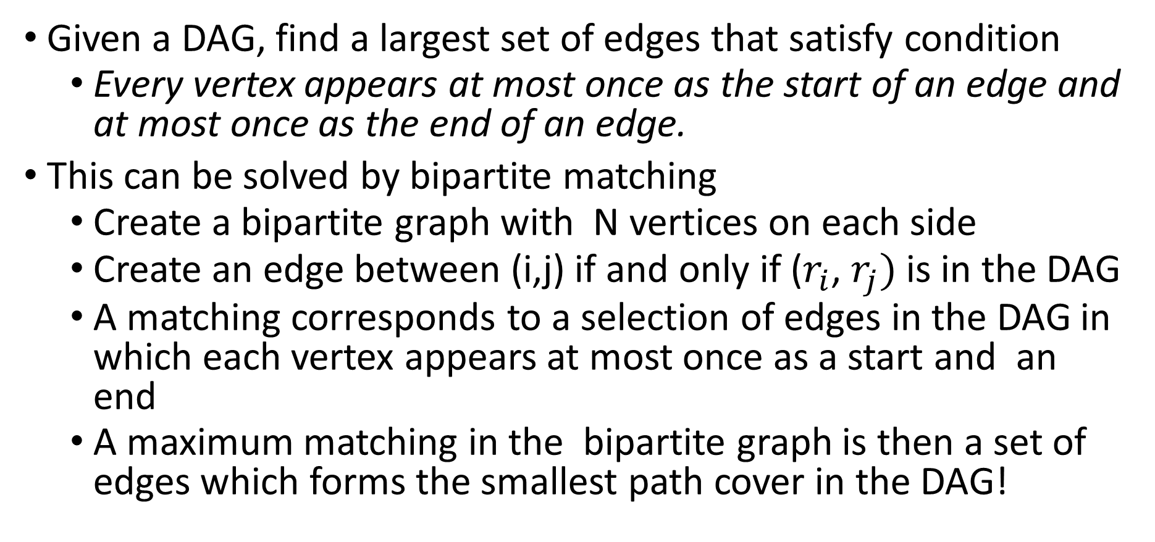
New Problem
Given a DAG, find a largest set of edges that satisfy condition
Every vertex appears at most once as the start of an edge and at most once as the end of an edge.
This can be solved by bipartite matching
Create a bipartite graph with N vertices on each side
Create an edge between (i,j) if and only if ($r_{i}$, $r_{j})$ is in the DAG
A matching corresponds to a selection of edges in the DAG in which each vertex appears at most once as a start and an end
A maximum matching in the bipartite graph is then a set of edges which forms the smallest path cover in the DAG!

Slide 9
r
2
5
r
r
e
e
e
3
t
x
2
2
6
3
3
4
7
4
4
5
5
6
6
t
t
7
7
x
x

Slide 10
r
2
5
r
r
e
e
e
3
t
x
2
2
6
3
3
4
7
4
4
The colored edges to the left are a maximal matching of the graph
5
5
6
6
t
t
7
7
x
x

Slide 11
r
2
5
r
r
e
e
e
3
t
x
2
2
6
3
3
4
7
4
4
The colored edges to the left are a maximal matching of the graph
They correspond to a minimal path cover!
5
5
6
6
t
t
7
7
x
x

Slide 12
The Algorithm
Build the bipartite graph in O(V+E) time.
Note that this has 2V vertices and E edges, where V,E are the number of vertices, edges in the original DAG
Run the maximum bipartite matching algorithm (from max-flow) that we learned in class.
This takes O(VE) time so the entire algorithm requires O(VE) time

