Slide 1
Tutorial: Counting
Chengbo Zheng
cb.zheng@connect.ust.hk
Oct 21, 2021

Slide 2
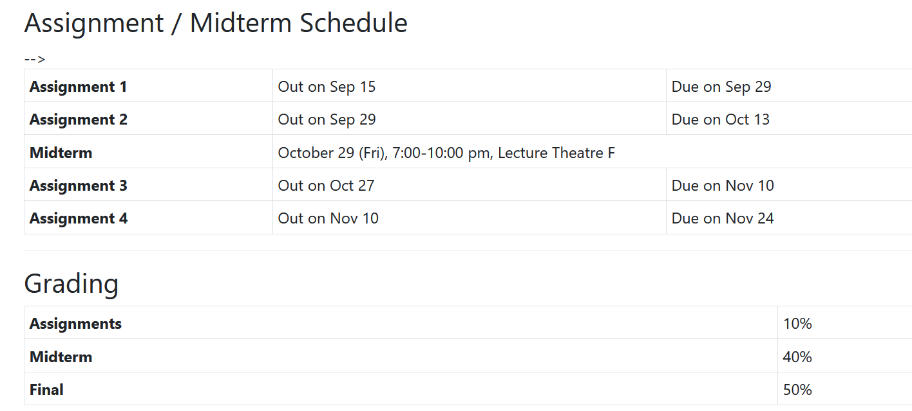

Reminder

Slide 3
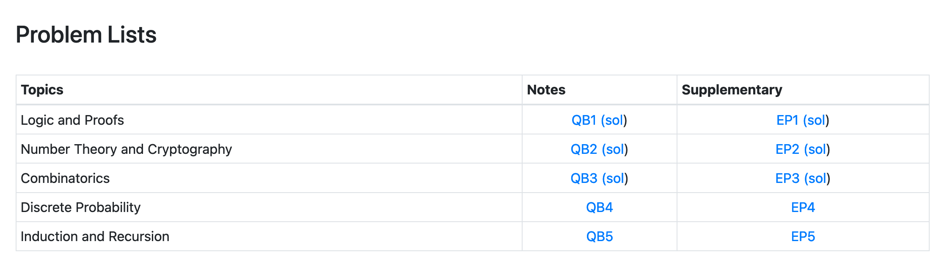
Reminder

Slide 4
About HW2
The grades will be released in this week, maybe on Sunday
Grading: Problem 2, 3, 6, 7, 8
Check the given solution carefully before arguing for grades

Slide 5
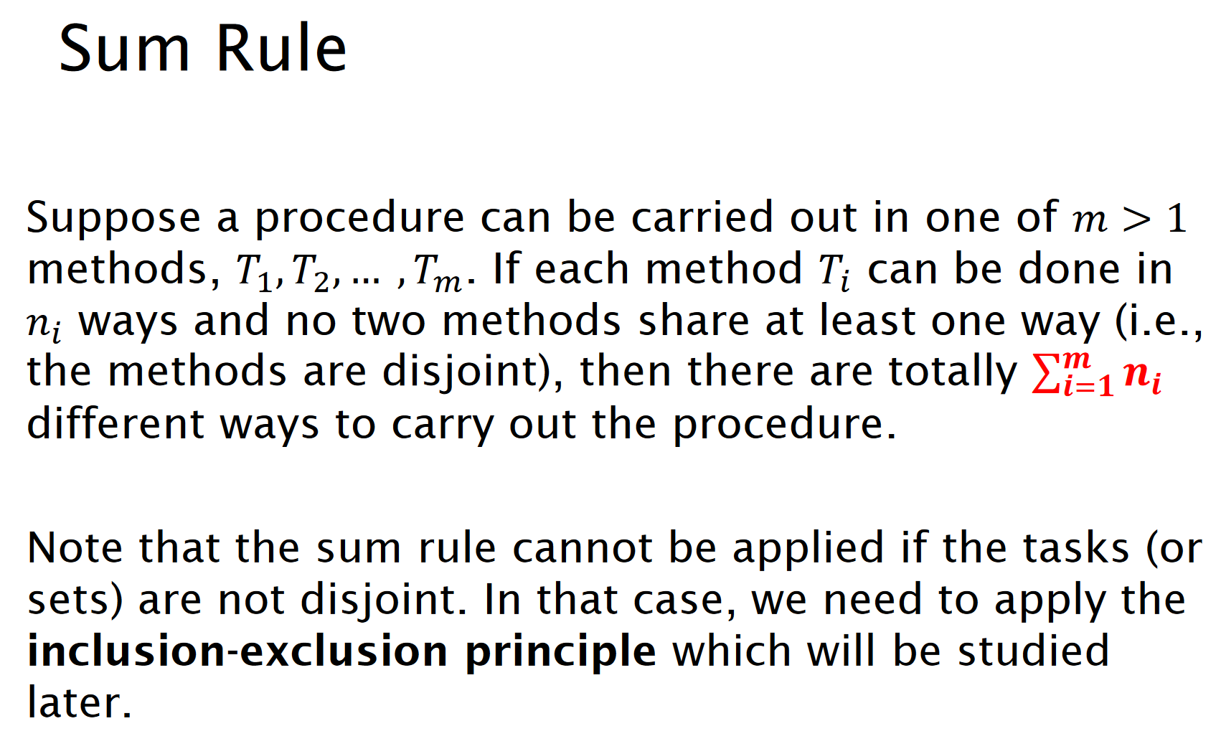
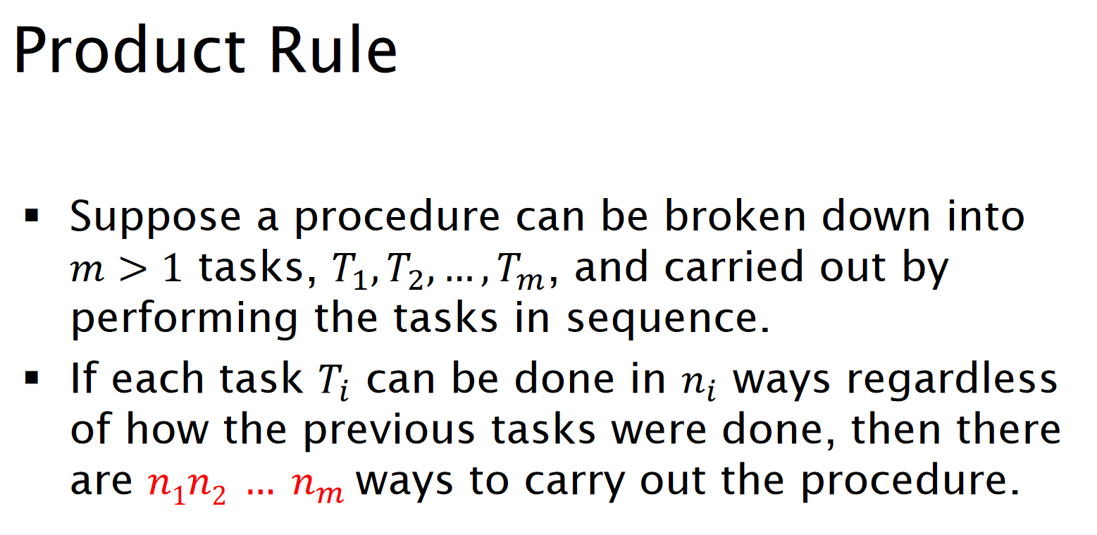

Slide 6
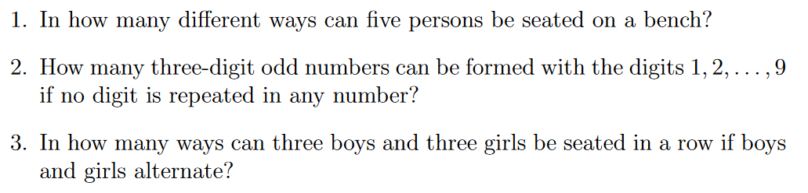
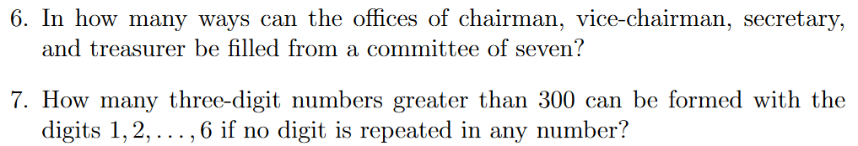

Slide 7
EP3-1

Slide 8
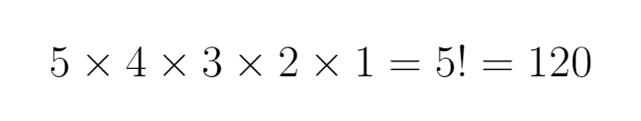
EP3-1
Task 1
Task 2
Task 3
Task 4
Task 5

Slide 9
EP3-2

Slide 10
EP3-2
Odd number -> 5
Not repeated-> 7
Not repeated-> 8
Notes:
Understand the problem correctly
Let’s first break down the problem into several tasks:
The units digit
The tens digit
The hundreds digit

Slide 11
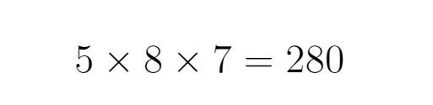
EP3-2
Odd number -> 5
Not repeated-> 7
Not repeated-> 8
Notes:
Understand the problem correctly
Let’s first break down the problem into several tasks:
The units digit
The tens digit
The hundreds digit

Slide 12
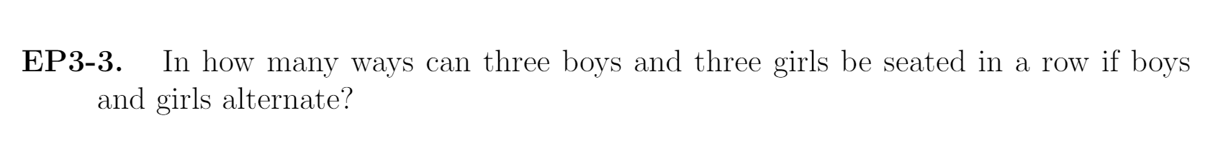
EP3-3

Slide 13
EP3-3
1
2

Slide 14
EP3-3
1
3
x
2
x
1
2

Slide 15
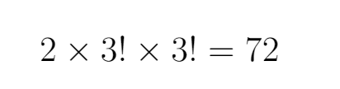
EP3-3

Slide 16

EP3-6

Slide 17

EP3-7
Not repeated -> 4
Greater than 300-> 4
Not repeated-> 5

Slide 18
QB3-3

Slide 19



B
C
A
A
B
C
D
D

Slide 20
People
N
The number of people knows
0, 1, 2, 3, …, n-1

Slide 21
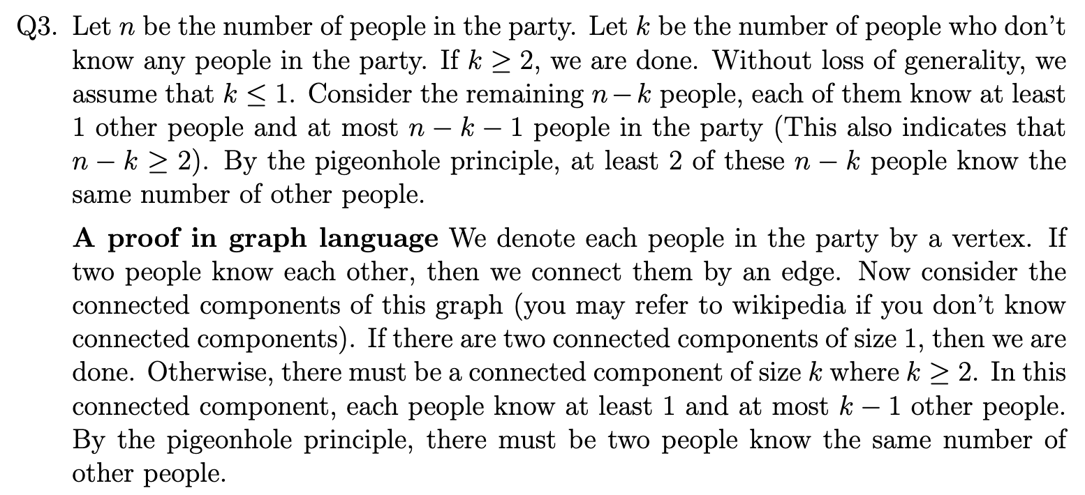
People
N
The number of people knows
0, 1, 2, 3, …, n-1

Slide 22
People
N-k
The number of people knows
0, 1, 2, 3, …, n-k-1

Slide 23
B
C
A
D

