Slide 1
Chapter 10: Virtual Memory

Slide 2
Chapter 10: Virtual Memory
Background
Demand Paging
Copy-on-Write
Page Replacement
Frame Allocation
Thrashing
Other Considerations

Slide 3
Objectives
Define virtual memory and describe its benefits.
Illustrate how pages are loaded into memory using demand paging.
Apply the FIFO, optimal, and LRU page-replacement algorithms.
Describe the working set of a process, and explain how it is related to program locality.

Slide 4
Background
Codes need to be in memory to execute, but not necessarily the entire program.
  Error code, unusual routines. Some errors seldom, if ever, occur in practice, this code is almost never executed
  Large data structures such as arrays, lists and tables are often allocated more memory than they actually need. For example, an array may be declared 100x100 elements, even though it is seldom larger than 10x10
  Certain options and features of a program may be used rarely
Even if the entire program is needed, it may not all be needed at the same time
Consider ability to execute partially-loaded programs
  Programs no longer constrained by limits of physical memory. Programs can be written with an extremely large virtual memory address, simplifying the programming task
  Each user program could take less physical memory, more programs could be run at the same time, which increases CPU utilization (degree of multiprogramming) and throughput
  Less I/O would be needed to load or swap user programs into physical memory, so each user program would run faster.

Slide 5
Background
Virtual memory – separation of user logical memory perceived by programmers from physical memory
  Only part of the program needs to be in memory for execution
  Logical address space can therefore be much larger than the actual physical address space
  Allows address spaces to be shared by several processes. For instance, system libraries can be shared by several processes
  Allows more efficient process creation, as pages can be shared during process creation, thus speeding up the process creation
  More programs running concurrently – increase the degree of multiprogramming
  Less I/O needed to load or swap processes
Virtual memory can be implemented via:
  Demand paging or demand segmentation – in principle, they are similar, details are different with respect to fix-sized frame/page and variable-sized segment

Slide 6

Virtual Memory That is
Larger Than Physical Memory

Slide 7

Virtual-address Space
Virtual address space – logical view of how process is stored in memory
  Usually start at address 0, contiguous addresses until the end of address space
  Meanwhile, physical memory organized in frames
  MMU must map logical to physical address
Heap can grow upward in memory, used in dynamic memory allocation. Stack can grow downward in memory through successive function calls
The large blank space (or hole) between the heap and stack is part of the virtual address space, but will require actual physical pages (space) only if the heap or stack grows.
Enables sparse address spaces with holes left for growth, dynamically linked libraries, and etc
System libraries can be shared via mapped into virtual address space
Pages can be shared during process creation with the fork() system call, speeding up process creation

Slide 8

Shared Library Using Virtual Memory

Slide 9

Demand Paging
Could bring entire process into memory at load time
Or bring a page into memory only when the page is actually needed - referenced
  Less I/O needed, no unnecessary I/O
  Less memory needed
  Faster response
  More users to be running
Similar to paging system with swapping (diagram on right)
Page is needed => reference to it
  invalid reference (illegal memory address) => abort
  not-in-memory => bring to memory
Lazy swapper – never swaps a page into memory unless page will be needed
  Swapper that deals with pages is a pager

Slide 10
Basic Concepts
Pager brings in only those “needed” pages into memory
How to determine the set of pages brought inside memory?
  Need new MMU functionality to implement demand paging
If pages needed are already memory-resident
  No difference from non demand-paging MMU
If pages needed are not memory resident
  Need to detect and load the page into memory from a secondary storage device
    Without changing program behavior
    Without programmer needing to change code – application not aware of this

Slide 11
Valid-Invalid Bit
With each page table entry a valid–invalid bit is associated
(v ⇒ in-memory – memory resident, i ⇒ not-in-memory)
Initially valid–invalid bit is set to i on all entries
Example of a page table snapshot:
During address translation, if valid–invalid bit in page table entry is i ⇒ page fault
Frame #
valid-invalid bit
v
v
v
v
i
….
i
i
page table

Slide 12

Page Table When Some Pages Are Not in Main Memory

Slide 13
Page Fault
If there is a reference to a page, first reference to that page will trap to operating system:
Page Fault
Operating system looks at the corresponding table entry to decide:
  Invalid reference (illegal address) ⇒ abort
  Just not in memory
Get an empty frame if any - OS maintains free-frame list
Swap the page into the frame via scheduled disk operation
Reset tables to indicate page now in memory
Set validation bit = v
Restart the instruction (depending on CPU scheduling) that caused the page fault

Slide 14

Steps in Handling a Page Fault

Slide 15
Aspects of Demand Paging
The extreme case – start process with no pages in memory
  OS sets instruction pointer to first instruction of process, non-memory-resident -> page fault
  And for every other process pages on the first access
  This is referred as Pure demand paging
Actually, a given instruction could access multiple pages -> result in multiple page faults
  Consider fetch and decode of instruction which adds two numbers from memory and stores result back to memory
  Pain caused by page faults decreases after process starts running for some time because of locality of memory reference
Hardware support is needed for demand paging
  Page table with valid / invalid bit as indication
  Secondary memory (swap device with swap space) for page in and page out
  Instruction restart

Slide 16
Free-Frame List
When a page fault occurs, the operating system must bring the desired page from the secondary storage into main memory.
Most operating systems maintain a free-frame list -- a pool of free frames for satisfying such requests (a kernel data structure that only OS can access)
Operating system typically allocate free frames using a technique known as zero-fill-on-demand -- the content of the frames zeroed-out before being (re)-allocated.
  The technique of the writing of zeros into a page before it is made available to a process - thus erasing their previous contents or to keep any old data from being available to the process
  Consider the potential security implications of not clearing out the contents of a frame before reassigning it.
When a system starts up, all available memory is placed on the free-frame list.

Slide 17
Performance of Demand Paging
Stages in Demand Paging – handle page faults
Trap to the operating system
Save the user registers and process state
Determine that the interrupt was a page fault
Check that the page reference was legal and determine the location of the page on the disk
Issue a read from the disk to a free frame (if available) in physical memory:
  Wait in a queue for this device until the read request is serviced
  Wait for the device seek and/or latency time
  Begin the transfer of the page to a free frame
While waiting, allocate the CPU core to some other processes
Receive an interrupt from the disk I/O subsystem (I/O completed)
Save the registers and process state for the other process (depending on the CPU scheduling)
Determine that the interrupt was from the disk
Update the page table and other tables to show page is now in memory
Wait for the CPU to be allocated to this process again
Restore the user registers, process state, and new page table, and then resume the interrupted instruction

Slide 18
Performance of Demand Paging (Cont.)
There are three major task components of the page-fault service time:
  Service the interrupt – careful coding might result in several hundred instructions
  Read the page – lots of time (accessing the secondary storage, typically a hard disk)
  Restart the process – a small amount of time
The page switch time will probably be close to 8 milliseconds (for a typical hard disk)
Page Fault Rate 0 ≤ p ≤ 1
  if p = 0 no page faults
  if p = 1, every reference is a fault
Effective Access Time (EAT)
EAT = (1 – p) x memory access
+ p (page fault overhead
+ swap page out
+ swap page in
+ restart overhead)

Slide 19
Demand Paging Example
Memory access time = 200 nanoseconds
Average page-fault service time = 8 milliseconds
EAT = (1 – p) x 200 + p (8 milliseconds)
= (1 – p) x 200 + p x 8,000,000
= 200 + p x 7,999,800
If one access out of 1,000 causes a page fault, then
EAT = 8.2 microseconds.
This is a slowdown by a factor of 40!!
If want performance degradation < 10 percent
  220 > 200 + 7,999,800 x p
  20 > 7,999,800 x p
  p < .0000025
  < one page fault in every 400,000 memory accesses
Fortunately, the memory locality usually satisfies this, as each memory miss brings an entire page

Slide 20
Copy-on-Write
Traditionally, fork() worked by creating a copy of the parent’s address space for the child, duplicating the pages belonging to the parent
Copy-on-Write (COW) allows both parent and child processes to initially share the same pages in memory
  These shared pages are marked as copy-on-write pages, meaning that if either process writes to a shared page, a copy of the shared page is created
COW allows more efficient process creation as only modified pages are copied or duplicated
This technique provides rapid process creation and minimizes the number of new pages that must be allocated to the newly created process
  Considering that many child processes invoke the exec() system call immediately after creation, the copying of the parent’s address space may be unnecessary.

Slide 21


Before and After Process 1 Modifies Page C

Slide 22
What Happens if There is no Free Frame?
Used up by process pages
Also in demand from the kernel, I/O buffers, etc.
How much memory to allocate to each process? - frame-allocation algorithm
Page replacement – find some page in memory, but not really in use, page it out
  Algorithms – terminate the process? swap out the entire process image? replace the page?
  Performance – want an algorithm which will result in the minimum number of page faults
  This needs to be transparent to a process
It may be inevitable that same page may be brought into memory several times

Slide 23
Page Replacement
Prevent over-allocation of memory by modifying page-fault service routine to include page replacement
Use modify (dirty) bit to reduce overhead of page transfers – only modified pages are written back to disk
Page replacement completes separation between logical memory and physical memory – large virtual memory can be supported on a smaller physical memory

Slide 24

Need For Page Replacement

Slide 25
Basic Page Replacement
Find the location of the desired page on disk
Find a free frame:
- If there is a free frame, use it
- If there is no free frame, use a page replacement algorithm to select a victim frame
- Write victim frame to disk if “dirty” (modified since last time it was brought into the memory)
Bring the desired page into the (newly) free frame; update the page table
Continue the process by restarting the instruction that caused the trap
Note now potentially 2 page transfers for a page fault – which can significantly increase EAT

Slide 26

Page Replacement

Slide 27
Page and Frame Replacement Algorithms
Page-replacement algorithm
  Decide which frames to replace – the objective is the lowest page-fault rate on both first access and re-access
Frame-allocation algorithm determines
  How many frames allocated to each process – which is decided by how a process utilize or access the memory

Slide 28
Page and Frame Replacement Algorithms
Evaluate algorithms by running on a particular string of memory references - reference string and computing the number of page faults on that string
  First, for a given page size, we need to consider only the page number, rather than the complete memory address.
  If we have a reference to a page p, then any references to page p that immediately follow will never cause a page fault. Page p will be in memory after the first reference, so the immediately following references will not have page fault.
For example, for a particular process, we might record the following address sequence:
0100, 0432, 0101, 0612, 0102, 0103, 0104, 0101, 0611, 0102, 0103,
0104, 0101, 0610, 0102, 0103, 0104, 0101, 0609, 0102, 0105
At 100 bytes per page, this sequence is reduced to the following reference string:
1, 4, 1, 6, 1, 6, 1, 6, 1, 6, 1
In all our examples, the reference string is
7,0,1,2,0,3,0,4,2,3,0,3,0,3,2,1,2,0,1,7,0,1

Slide 29

Graph of Page Faults Versus The Number of Frames

Slide 30

First-In-First-Out (FIFO) Algorithm
Reference string: 7,0,1,2,0,3,0,4,2,3,0,3,0,3,2,1,2,0,1,7,0,1
3 frames (3 pages can be in memory at a time per process)
Can vary by reference string: consider 1,2,3,4,1,2,5,1,2,3,4,5
  Adding more frames can cause more page faults!
    Belady’s Anomaly
How to track ages of pages? – implementation easy
  Just use a FIFO queue (the time this page brought into the memory)
15 page faults

Slide 31
FIFO Page Replacement
reference string
1 2 3 4 1 2 5 1 2 3 4 5
3 frames
1
1
1
4
4
4
5
5
5
Page fault:
9
2
2
2
1
1
1
3
3
3
3
3
2
2
2
4
reference string
1 2 3 4 1 2 5 1 2 3 4 5
1
1
1
1
5
5
5
5
4
4
Page fault:
10
2
2
2
2
1
1
1
1
5
4 frames
3
3
3
3
2
2
2
2
4
4
4
4
3
3
3

Slide 32
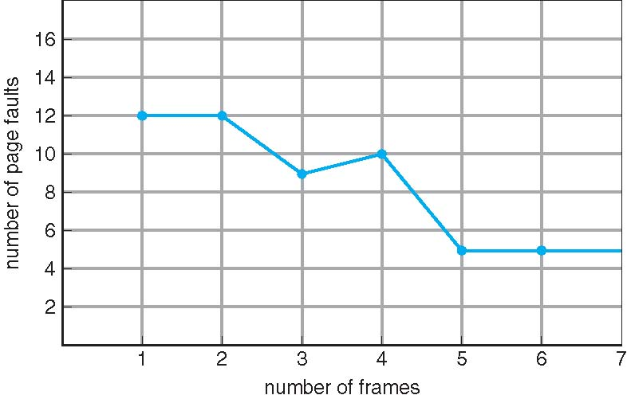
FIFO Illustrating Belady’s Anomaly

Slide 33

Optimal Algorithm
Replace page that will not be used for longest period of time in the future
  If possible, ideally select a page that will not be used at all in the future. In practice, this may not always be feasible, so a page can be brought into the memory multiple times
  9 is the optimal for the example
How do you know this?
  Can’t read the future
Used for measuring how well your algorithm performs as a comparison

Slide 34

Least Recently Used (LRU) Algorithm
Use the past knowledge rather than future as an approximation for OPT
Replace page that has not been used in the most amount of time
Associate the time of last use with each page – complex, as this need to be updated with each memory reference
12 faults – better than FIFO but worse than OPT
Generally a good algorithm and frequently used
But how to implement? - An LRU page-replacement algorithm may require substantial hardware assistance. The problem is to determine an order for the frames defined by the time of last use.

Slide 35
LRU Algorithm Implementation
Counters implementation
  Every page entry adds a time-of-use field recording a logical clock or counter. The clock is incremented for every memory reference.
  Whenever a reference to a page is made, the contents of the clock register are copied to the time-of-use field in the page-table entry for that page.
  When a page needs to be replaced, look for the counters to find the smallest value
    Search through table needed to find the LRU page and a write to memory (to the time-of-use field in the page table) for each memory access
Stack implementation
  Keep a stack of page numbers
  Whenever a page is referenced, it is removed from the stack and put on the top. In this way, the most recently used page is always at the top of the stack, and the least recently used page is always at the bottom
  This requires multipel pointers to be changed upon each reference
  Each update more expensive, but no need to search for replacement

Slide 36
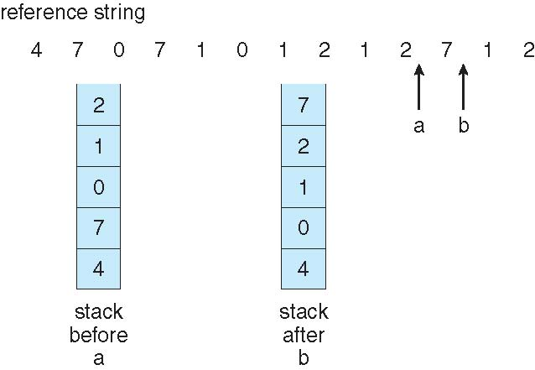
Use Of A Stack to Record The Most Recent Page References

Slide 37
LRU Algorithm Discussions
LRU and OPT are cases of stack algorithms that don’t suffer from Belady’s Anomaly
  A stack algorithm can be shown that the set of pages in memory for n frames is always a subset of the set of pages that would be in memory with n+1 frames allocated
  For LRU replacement, the set of pages in memory would be the n most recently referenced pages. If the number of frames allocated is increased to (n+1), these n pages will still be the most recently referenced and so will still be in memory
Both the implementation of LRU requires extra hardware assistance
The updating of the clock fields or stack must be done for every memory reference
  If we were to use an interrupt for every reference to allow software to update such data structures, it would slow every memory reference by a factor of at least ten!

Slide 38
LRU Approximation Algorithms
Reference bit
  With each page associate a bit, initially = 0, associated with each entry in the page table
  When page is referenced (read or write), the reference bit set to 1
  Replace any with reference bit = 0 (if one exists)
    Corse-grained approximation, but do not know the order of use
Second-chance algorithm
  Generally FIFO, plus hardware-provided reference bit
  Clock replacement
  If page to be replaced has
    Reference bit = 0 -> replace it (select it as the victim)
    reference bit = 1 then:
      set reference bit 0, leave page in memory (second chance)
      replace next page, subject to same rules (FIFO and clock)

Slide 39
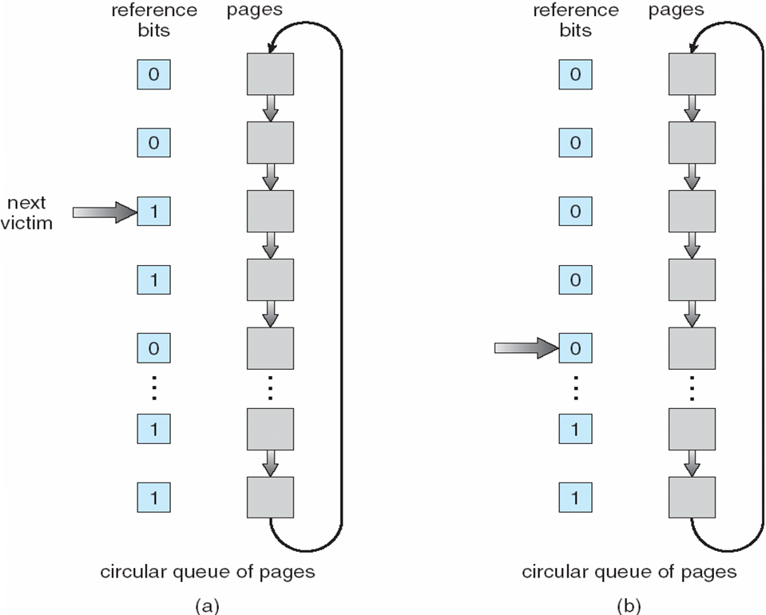
Second-Chance (Clock) Page-Replacement Algorithm

Slide 40
Counting Algorithms
Keep a counter of the number of references that have been made to each page
The least frequently used (LFU) Algorithm: replaces the page with the smallest count
The most frequently used (MFU) Algorithm: replace the page with the largest count based on the argument that the page with the smallest count was probably just brought in and has yet to be used
Neither LFU nor MFU replacement is commonly used. The implementation of such algorithms is expensive, and they do not approximate OPT replacement well

Slide 41
Allocation of Frames
How do we allocate memory among different processes?
  Does every process get the same fraction of memory, or different fractions?
  Should we completely swap some processes out of memory?
Each process needs certain minimum number of frames in order to execute its program
Example: IBM 370 – 6 pages to handle SS MOVE instruction:
  instruction is 6 bytes, might span 2 pages
  2 pages to handle from
  2 pages to handle to
The maximum, of course, is the total frames required for a process
Two major allocation schemes
  fixed allocation
  priority allocation
Many variations

Slide 42
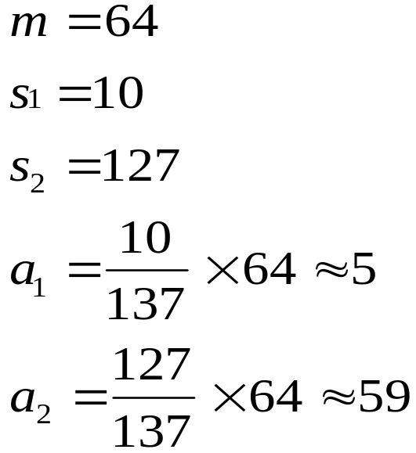

Fixed Allocation
Equal allocation – For example, if there are 100 frames (after allocating frames for the OS) and 5 processes, give each process 20 frames
Proportional allocation – Allocate according to the size of process
  Dynamic as the degree of multiprogramming and process sizes change over the time

Slide 43
Global vs. Local Allocation
Global replacement – process selects a replacement frame from the set of all frames, even if that frame is currently allocated to some other process; thus, one process can take a frame from another process
  For instance, this can be based on priority – priority allocation in which a process can preempt memory from a lower priority process
  This can result in better system throughput
  But process execution time can vary greatly, as a process cannot control its own page-fault rate.
Local replacement – each process selects from only its own set of allocated frames
  What we used in the page replacement algorithms earlier
  The set of page for a process is only affected by the paging behaviour of only that process
  More consistent per-process performance
  But possibly underutilized memory, since pages allocated to a process can not be utilized by another process, even if this page is not currently used by the process holding it

Slide 44

Thrashing
If a process does not have “enough” pages, the page-fault rate would be very high
  Page fault to get page, and replace an existing frame, but quickly need replaced frame back
  This leads to low CPU utilization – OS might think “by mistakes” that it needs to increase the degree of multiprogramming in order improve the CPU utilization – aggravate the problem
Thrashing ≡ a process or a set of processes is busy swapping pages in and out
This high paging activity is called thrashing. A process is thrashing if it is spending more time paging than executing, which results in serious performance problems

Slide 45
Demand Paging and Thrashing
Why does demand paging work?
Locality model
  A locality is a set of pages that are actively used together. A running program is generally composed of several different localities, which may overlap
  Memory access or subsequent memory access tends to stay in the same set of page(s)
  Process migrates from one locality to another, e.g., operating on a different set of data or call a function (different code segment)
  Localities may overlap, instructions or part of the data being manipulated
Why does thrashing occur?
Σ size of locality (of all processes) > total memory size
  If we do not allocate enough frames to accommodate the size of the current locality, the process will thrash, since it cannot keep in memory all the pages that it is actively using.
  We can limit effects by using local or priority page replacement, as thrashing in one process can not steal frames from another process and cause the latter to thrash as well

Slide 46
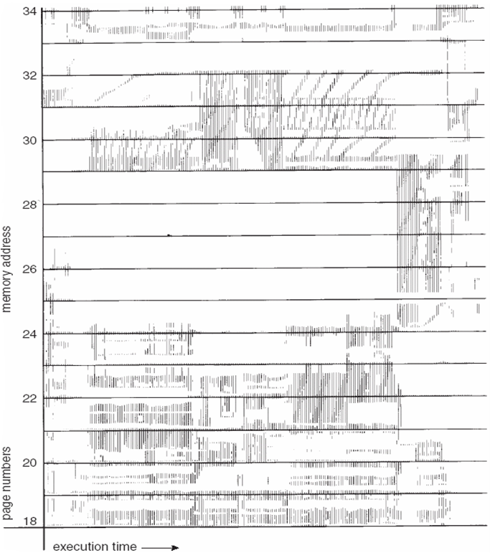
Locality In A Memory-Reference Pattern
Recall program memory access patterns exhibit temporal and spatial locality
The left Figure illustrates the concept of locality and how a process's locality changes over time. At time (a), the locality is the set of pages {18, 19, 20, 21, 22, 23, 24, 29, 30, 33}. At time (b), the locality changes to {18, 19, 20, 24, 25, 26, 27, 28, 29, 31, 32, 33}. Notice the overlap, as some pages (for example, 18, 19, and 20) are part of both localities.

Slide 47
Working-Set Model
Δ ≡ working-set window ≡ a fixed number of page references
Example: 10,000 instructions
WSS_{i} (working set of Process P_{i}) =
total number of pages referenced in the most recent Δ (varies in time)
  if Δ too small will not encompass entire locality
  if Δ too large will encompass several localities
  if Δ = ∞ ⇒ will encompass entire program
D = Σ WSS_{i} ≡ total demand frames
  Approximation of the current locality in the system (of all processes)
if D > m ⇒ Thrashing – at least one process is short of memory
Policy if D > m, then suspend or swap out one of the processes
The working-set strategy prevents thrashing while keeping the degree of multiprogramming as high as possible, thus optimizes CPU utilization
The difficulty with the working-set model is how to keep track of the working set.

Slide 48

Working-Set Model (Cont.)

Slide 49
Keeping Track of the Working Set
It is difficult to keep track of the working set, as working-set window is a moving window which needs to be updated for each memory reference
Approximate with interval timer + a reference bit
Example: Δ = 10,000
  Timer interrupts after every 5000 time units
  Keep in memory 2 bits for each page, (0,0), (0,1),(1,0),(1,1)
  Whenever a timer interrupts copy and sets the values of all reference bits to 0
  If one of the bits in memory = 1 ⇒ page in working set
This is of course not accurate, as we cannot tell where, within an interval of 5,000, a reference occurred
Improvement = 10 bits and interrupt every 1000 time units, more accurate but cost is higher
Accuracy versus complexity

Slide 50
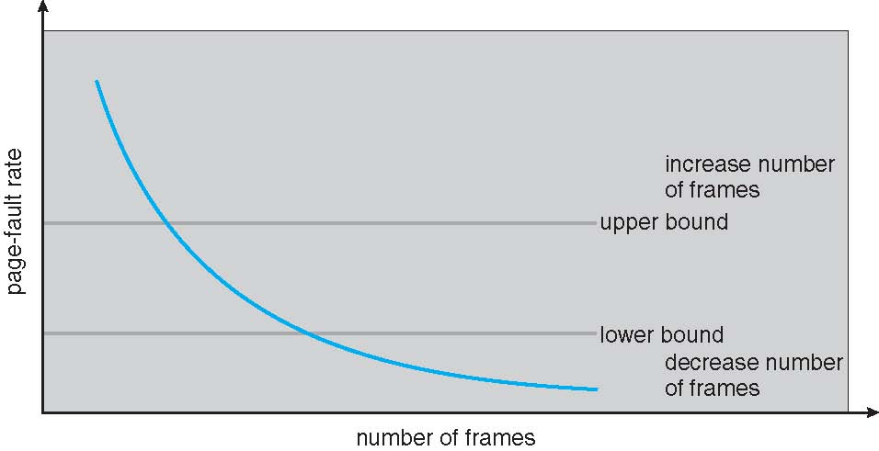
Page-Fault Frequency
More direct approach than WSS
Establish “acceptable” page-fault frequency (PFF) rate and use local replacement policy
  If actual rate too low, process loses frame
  If actual rate too high, process gains frame

Slide 51

Working Sets and Page Fault Rates
Direct relationship between working set of a process and its page-fault rate
Working set changes over time
The page-fault rate of a process will transition between peaks and valleys over time.

Slide 52
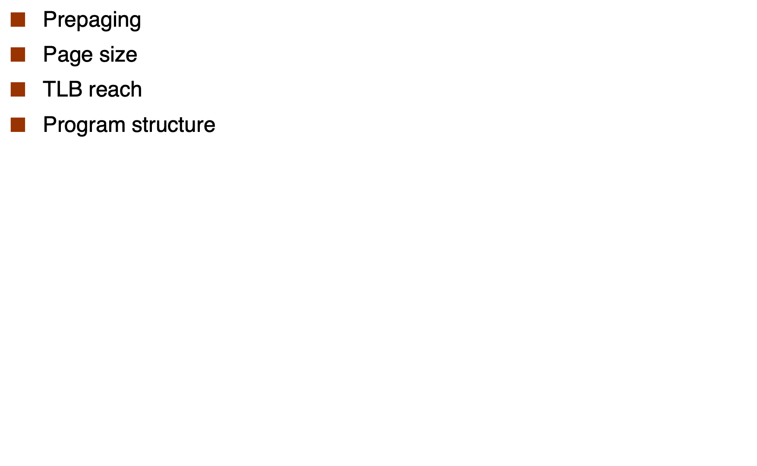
Other Considerations

Slide 53
Prepaging
To reduce the large number of page faults that occurs at process startup
Prepage some of the pages a process will need, before they are referenced
But if prepaged pages are unused, I/O and memory was wasted
Assume s pages are prepaged and α of the pages is used
  Is cost of s * α save pages faults > or < than the cost of prepaging
  s * (1- α) unnecessary pages?
  α near zero ⇒ prepaging loses

Slide 54
Page Size
Sometimes OS designers have a choice
  Especially if running on custom-built CPU
Page size selection must take into consideration a conflicting set of criteria:
  Fragmentation – calls for smaller page size
  Page table size – calls for larger page size
  Resolution – isolate the memory actually be used
  I/O overhead – larger page size requires longer I/O time
  Number of page faults – smaller page size can increase the number of page faults
  Locality – ideally each page should match the current locality
  TLB size and effectiveness – larger page size improves the TLB reach
Always power of 2, usually in the range 2¹² (4,096 bytes) to 2²² (4,194,304 bytes)
On average, growing over time

Slide 55
TLB Reach
TLB Reach - The amount of memory accessible from the TLB
TLB Reach = (TLB Size) X (Page Size)
Ideally, the working set of each process is stored in the TLB
  Otherwise there might be a high degree of page faults, or the access time slows down
Increase the Page Size
  This may lead to an increase in fragmentation as not all applications require a large page size
Provide Multiple Page Sizes
  This allows applications that require larger page sizes the opportunity to use them without an increase in fragmentation

Slide 56
Program Structure
Program structure
  Int[128,128] data;
  Each row is stored in one page
  Program 1
for (j = 0; j <128; j++)
for (i = 0; i < 128; i++)
data[i,j] = 0;
  128 x 128 = 16,384 page faults
  Program 2
  for (i = 0; i < 128; i++)
  for (j = 0; j < 128; j++)
  data[i,j] = 0;
  128 page faults

Slide 57
End of Chapter 10

