Slide 1
Spring 2022 COMP 3511 Review #5

Slide 2
Coverages
Semaphore (mutex part will be covered in the POSIX mutex example)
POSIX Synchronization
Questions related to synchronization

Slide 3
Semaphore
Semaphore S – non-negative integer variable, can be considered as a generalized lock
First defined by Dijkstra in late 1960s. It can behave similarly as mutex lock, but more sophisticated in its usage - the main synchronization primitive used in original UNIX
Two standard operations modify S: wait() and signal()
Originally called P() and V(), where P() stands for “proberen” (to test) and V() stands for “verhogen” (to increment) in Dutch
It is critical that semaphore operations are executed atomically, which guarantees that no more than one process can execute wait() and signal() operations on the same semaphore at the same time.
The semaphore can only be accessed via these two atomic operations except initialization
wait (S) {
while (S <= 0)
; // busy wait
S--;
}
signal (S) {
S++;
}

Slide 4
Semaphore Usage
Counting semaphore – An integer value can range over an unrestricted domain
Counting semaphore can be used to control access to a given resource consisting of a finite number of instances; semaphore value is initialized to the number of resource available
Binary semaphore – integer value can range only between 0 and 1
This can behave similar to mutex locks, can also be used in different ways
This can also be used to solve various synchronization problems
Consider P₁ and P₂ that shares a common semaphore synch, initialized to 0; it ensures that P1 process executes S₁ before P2 process executes S₂
P1:
S₁;
signal(synch);
P2:
wait(synch);
S₂;

Slide 5
Semaphore Implementation with no Busy waiting
With each semaphore there is an associated waiting queue
Each entry in a waiting queue has two data items:
value (of type integer)
pointer to next record on the queue
Two operations:
block – place the process invoking the operation on the appropriate waiting queue
wakeup – remove one of processes in the waiting queue and place it in the ready queue
Semaphore values may become negative, whereas this value can never be negative under the classical definition of semaphores with busy waiting.
If a semaphore value is negative, its magnitude is the number of processes currently waiting on the semaphore.

Slide 6
Semaphore Implementation with no Busy waiting (Cont.)
typedef struct{
int value;
struct process *list;
} semaphore;
wait(semaphore *S) {
S->value--;
if (S->value < 0) { add this process to S->list;
block();
}
}
signal(semaphore *S) {
S->value++;
if (S->value <= 0) { remove a process P from S->list;
wakeup(P);
}
}
Noticing that
Increment and decrement are done before checking the semaphore value, unlike the busy waiting implementation
The block() operation suspends the process that invokes it.
The wakeup(P)operation resumes the execution of a suspended process P.

Slide 7
A Sample Synchronization Question
Is binary semaphore equivalent as a mutex lock (Yes/No)? Briefly explain your answer:

Slide 8
Answer
Is binary semaphore equivalent as a mutex lock (Yes/No)? Briefly explain your answer:
Answer: No (1 mark). (Explanation: 1 mark) Binary semaphore initialized to 1 can be used as a mutex lock, but it can be used for other purposes (e.g., when initialized to 0).

Slide 9
A Sample Synchronization Question
Suppose that there are three processes P0, P1 and P2
that need to access a critical section in turn strictly following the order:
P0, P1, P2, P0, P1, P2, P0, P1, P2, …
In other words, we want to execute P0’s critical section, and then P1’s critical section, and then P2’s critical section, and the pattern repeats
In the following slides, you will see a program with missing BLANKS

Slide 10
A Sample Synchronization Question
Goal: access a critical section in turn strictly following the order: P0, P1, P2, P0, P1, P2…
// Initialize
// S0, S1, S2 are // shared
S0 = BLANK1;
S1 = BLANK2;
S2 = BLANK3;
// Process P0
while(true) {
wait(S0);
// critical section
BLANK4;
}
// Process P1
while(true){
BLANK5;
// critical section
BLANK6;
}
// Process P2
while(true) {
BLANK7;
// critical section
signal(S0);
}

Slide 11
A Sample Synchronization Answers
Goal: access a critical section in turn strictly following the order: P0, P1, P2, P0, P1, P2…
// Initialize
// S0, S1, S2 are // shared
S0 = 1;
S1 = 0;
S2 = 0;
// Process P0
while(true) {
wait(S0);
// critical section
signal(S1);
}
// Process P1
while(true){
wait(S1);
// critical section
signal(S2);
}
// Process P2
while(true) {
wait(S2);
// critical section
signal(S0);
}

Slide 12
Deadlock and Starvation
Deadlock – two or more processes are waiting indefinitely for an event that can be caused by only one of the waiting processes (details in Chapter 7)
Let S and Q be two semaphores initialized to 1
P₀ P₁
wait(S); wait(Q);
wait(Q); wait(S);
… …
signal(S); signal(Q);
signal(Q); signal(S);
Consider if P0 executes wait(S) and P1 wait(Q). When P0 executes wait(Q), it must wait until P1 executes signal(Q), However, P1 is waiting until P0 execute signal(S). Since these signal() operations will never be executed, P0 and P1 are deadlocked, extremely difficult to debug
Starvation – indefinite blocking
A process may never be removed from the semaphore queue, in which it is suspended. For instance, if we remove processes from the queue associated with a semaphore using LIFO (last-in, first-out) order or based on certain priorities.

Slide 13
POSIX Synchronization
POSIX API provides
Mutex locks (Note: pthread library supports mutex locks)
Semaphores (Note: pthread library don’t have a direct support on semaphores)
condition variables (Note: pthread_cond_wait and pthread_cond_signal are used to provide a waiting based on a condition)
Widely used on UNIX, Linux, and MacOS

Slide 14
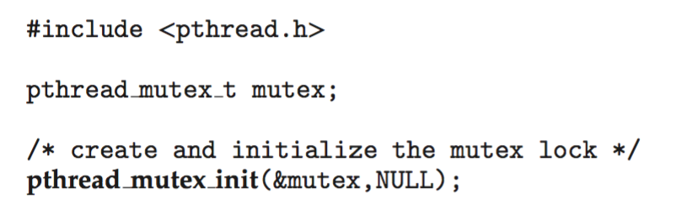
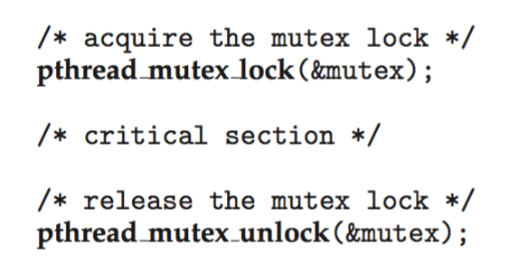
POSIX Mutex Locks
Creating and initializing the lock
Acquiring and releasing the lock

Slide 15
Sample Mutex in Pthread (Question)
#include <stdio.h>
#include <stdlib.h>
#include <pthread.h>
#include <unistd.h> unsigned int counter = 0;
// This constant controls
// the number of iteration
#define TOTAL_ITERATIONS 5000
void *add(void *arg) {
int i;
pthread_mutex_t* m = BLANK1;
for (i=0; i<TOTAL_ITERATIONS; i++) {
BLANK2;
++counter;
BLANK3;
}
}
int main() {
pthread_t tid1, tid2;
pthread_mutex_t mutex;
pthread_mutex_init(&mutex, NULL);
printf("The original counter value is %d\n", counter);
pthread_create(&tid1, NULL, add, &mutex);
pthread_create(&tid2, NULL, add, &mutex);
pthread_join(tid1, NULL);
pthread_join(tid2, NULL);
printf("The final counter value is %d\n", counter);
return 0;
}
What are the missing BLANKs?
What is the purpose of this program?

Slide 16
Sample Mutex in Pthread (Solution)
#include <stdio.h>
#include <stdlib.h>
#include <pthread.h>
#include <unistd.h> unsigned int counter = 0;
// This constant controls
// the number of iteration
#define TOTAL_ITERATIONS 5000
void *add(void *arg) {
int i;
pthread_mutex_t* m = (pthread_mutex_t*) arg;
for (i=0; i<TOTAL_ITERATIONS; i++) {
pthread_mutex_lock(m);
++counter;
pthread_mutex_unlock(m);
}
}
int main() {
pthread_t tid1, tid2;
pthread_mutex_t mutex;
pthread_mutex_init(&mutex, NULL);
printf("The original counter value is %d\n", counter);
pthread_create(&tid1, NULL, add, &mutex);
pthread_create(&tid2, NULL, add, &mutex);
pthread_join(tid1, NULL);
pthread_join(tid2, NULL);
printf("The final counter value is %d\n", counter);
return 0;
}
The purpose of this program is to protect the shared variable counter
Both threads will increase the counter by 5,000 times, so the final counter value is 10,000

Slide 17
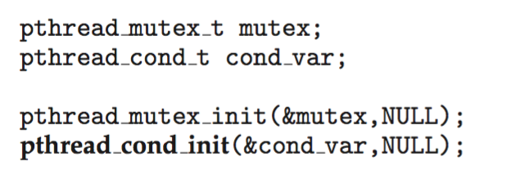
POSIX Condition Variables
POSIX condition variables are associated with a POSIX mutex lock to provide mutual exclusion: Creating and initializing the condition variable:

Slide 18
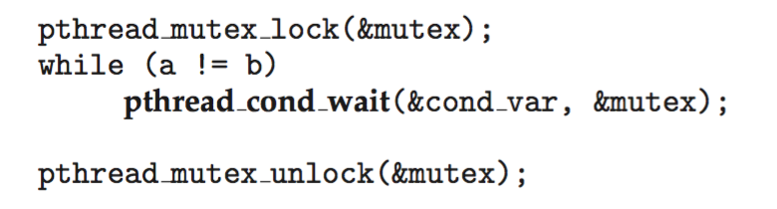
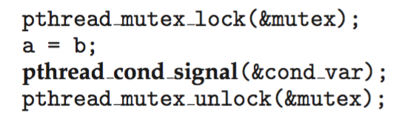
POSIX Condition Variables
Thread waiting for the condition a == b to become true:
Thread signaling another thread waiting on the condition variable:

