Slide 1
Tutorial 9: Assignment 2&3
COMP 4211
TA: Hansi Yang
hyangbw@cse.ust.hk

Slide 2
Solutions for Assignment 2

Slide 3
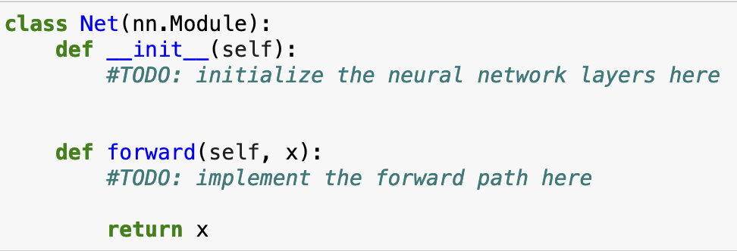
Q1-1 Net() class
Follow the instruction step-by-step

Slide 4
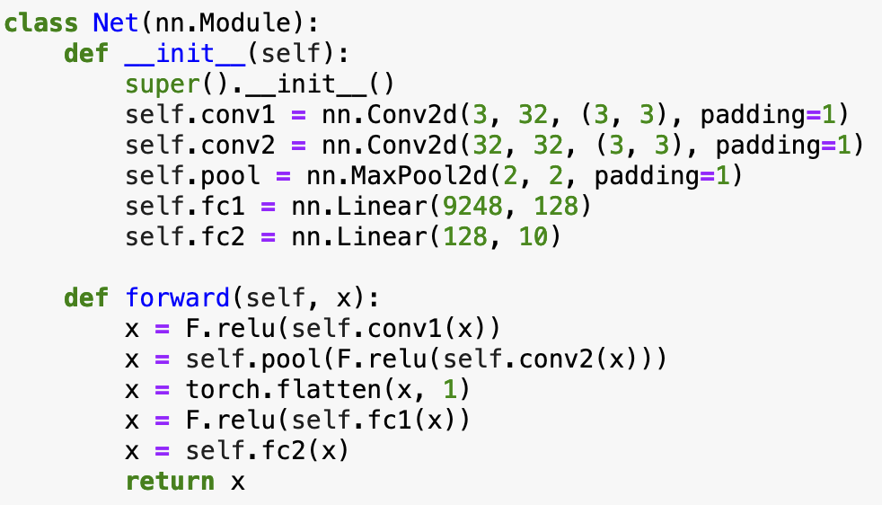
Q1-1 Net() class
Follow the instruction step-by-step

Slide 5
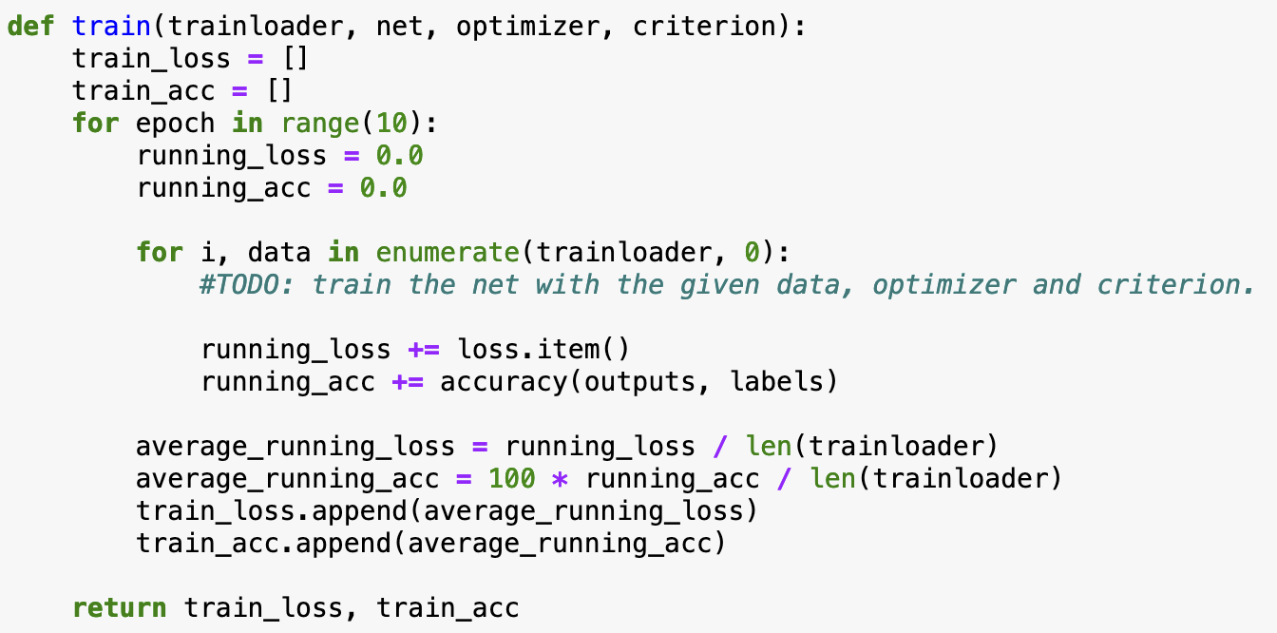
Q1-2 train() and test() function
train() function

Slide 6
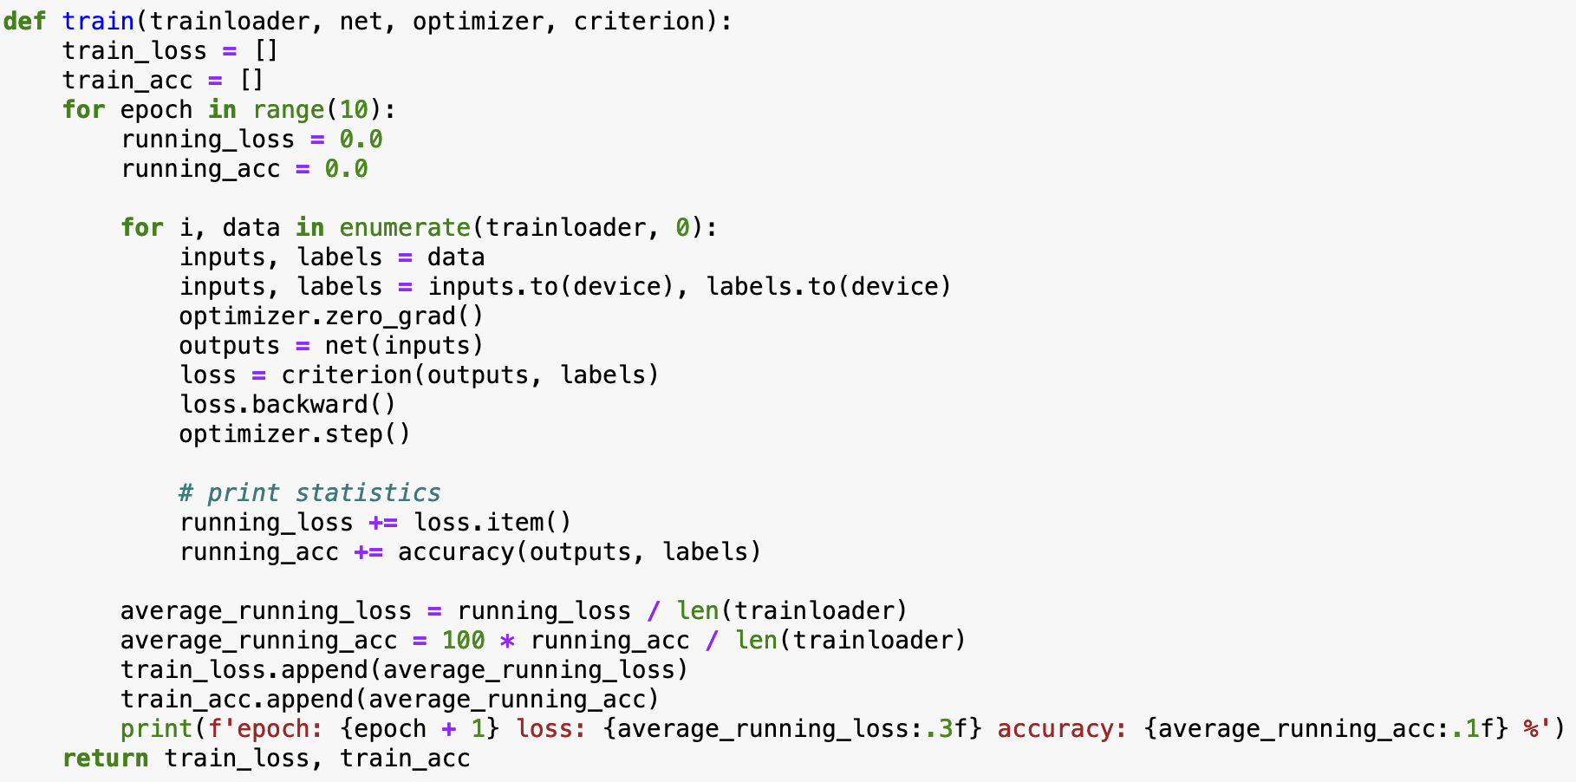
Q1-2 train() and test() function
Basically: for-loop -> zero_grad -> backward -> step

Slide 7
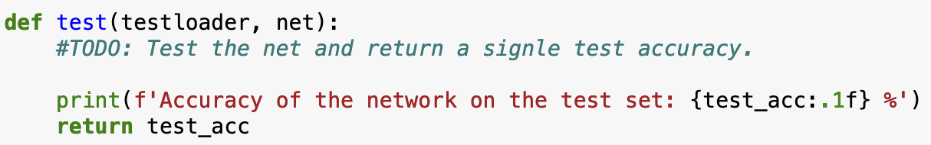
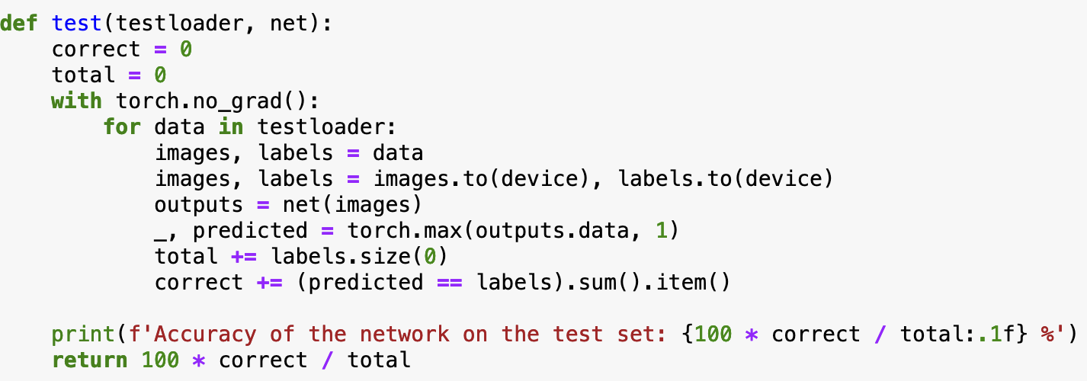
Q1-2 train() and test() function
test() function
similar to train(), though now we only need to check the network prediction

Slide 8
Q1-3 different optimizers
Only need to change the optimizer and its lr
optimizer1 = optim.SGD(net.parameters(), lr=0.001)
optimizer2 = optim.SGD(net.parameters(), lr=0.005)
optimizer3 = optim.Adam(net.parameters(), lr=0.001)
optimizer4 = optim.Adam(net.parameters(), lr=0.005)
Run the code and wait patiently if you do not have a GPU

Slide 9
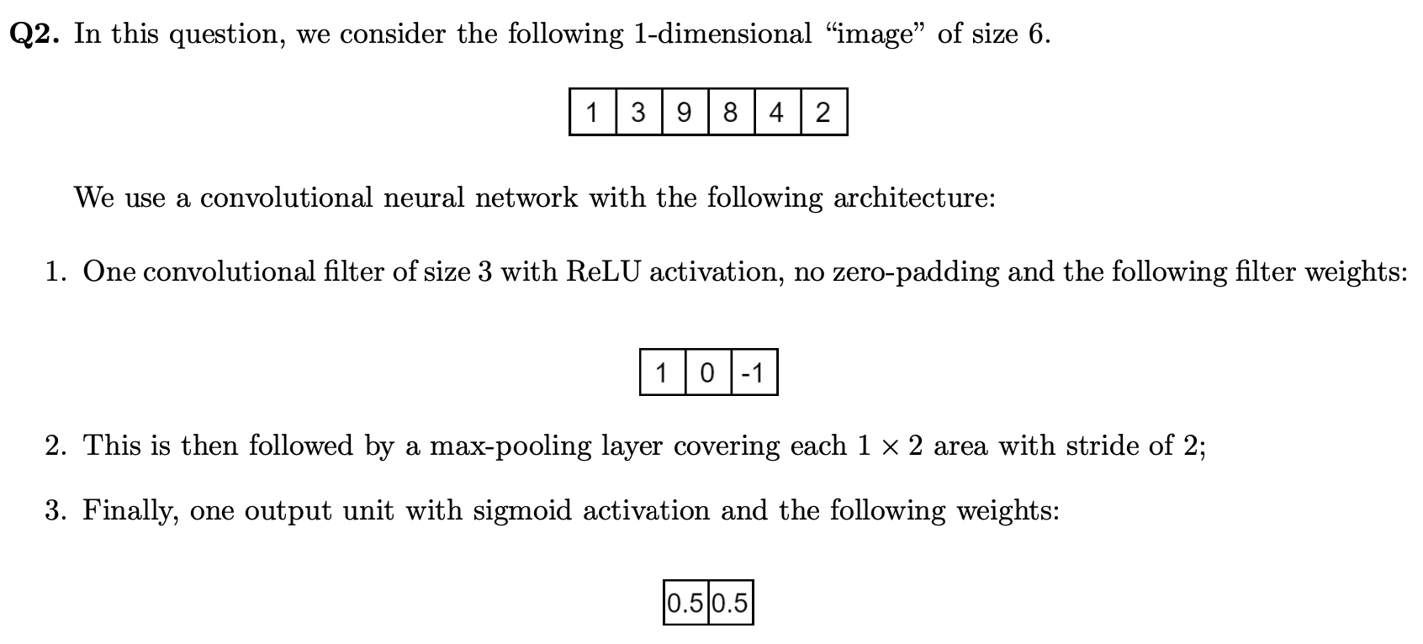
Q2 calculations about neural networks
Before ReLU: [−8, −5, 5, 6]. After ReLU: [0, 0, 5, 6]
[0,6]
Before Sigmoid: [3]. After Sigmoid: [0.95257]

Slide 10
Q3-1 k-means
Only two lines of code will do your job
res = k_means(X, n_clusters=2)
y1 = res[1]
Alternatively, you can also use the KMeans class used in tutorial
clc = KMeans(n_clusters=2)
y1 = clc.fit_predict(X)

Slide 11
Q3-2 k-means with data transformation
Just add the data transformation on the clustering code (two more lines)
X_trans = np.sum(X**2, axis=1)
X_trans = X_trans[:, np.newaxis]
res = k_means(X_trans, n_clusters=2)
y2 = res[1]
Only one more thing: remember to add an additional axis– that is required by sklearn’s k-means API

Slide 12
Q&A for Assignment 3

Slide 13
Defining a RL environment
States, actions and discount value (gamma)
states = ('poor_unknown', 'poor_famous', 'rich_unknown', 'rich_famous')
actions = ('save_money', 'advertise')
gamma = 0.9 # discount constant
Reward:
In this assignment, the reward only depends on what state you are in
def reward(state):
if state == 'poor_unknown' or state == 'poor_famous':
return 0
elif state == 'rich_unknown' or state == 'rich_famous':
return 10

Slide 14
Defining a RL environment (cont.)
Transition matrix:
The probability of going from one state to another state if you do a specific action
def transition_function(state, action, next_state):
transition_dictionary = {
('poor_unknown', 'save_money', 'poor_unknown'): 1.0,
('poor_unknown', 'save_money', 'poor_famous'): 0,
('poor_unknown', 'save_money', 'rich_unknown'): 0,
('poor_unknown', 'save_money', 'rich_famous'): 0,
('poor_unknown', 'advertise', 'poor_unknown'): 0.5,
('poor_unknown', 'advertise', 'poor_famous'): 0.5,
('poor_unknown', 'advertise', 'rich_unknown'): 0,
('poor_unknown', 'advertise', 'rich_famous'): 0,
…
}
return transition_dictionary[state, action, next_state]

Slide 15
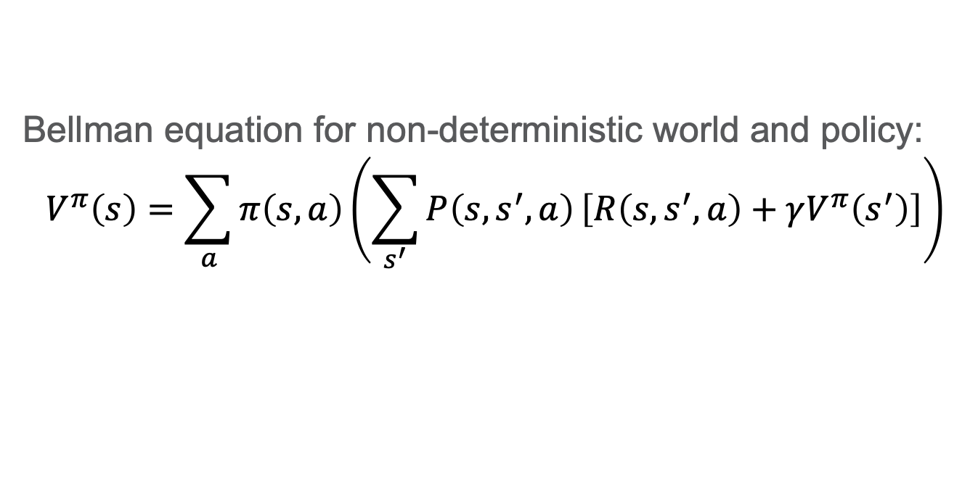
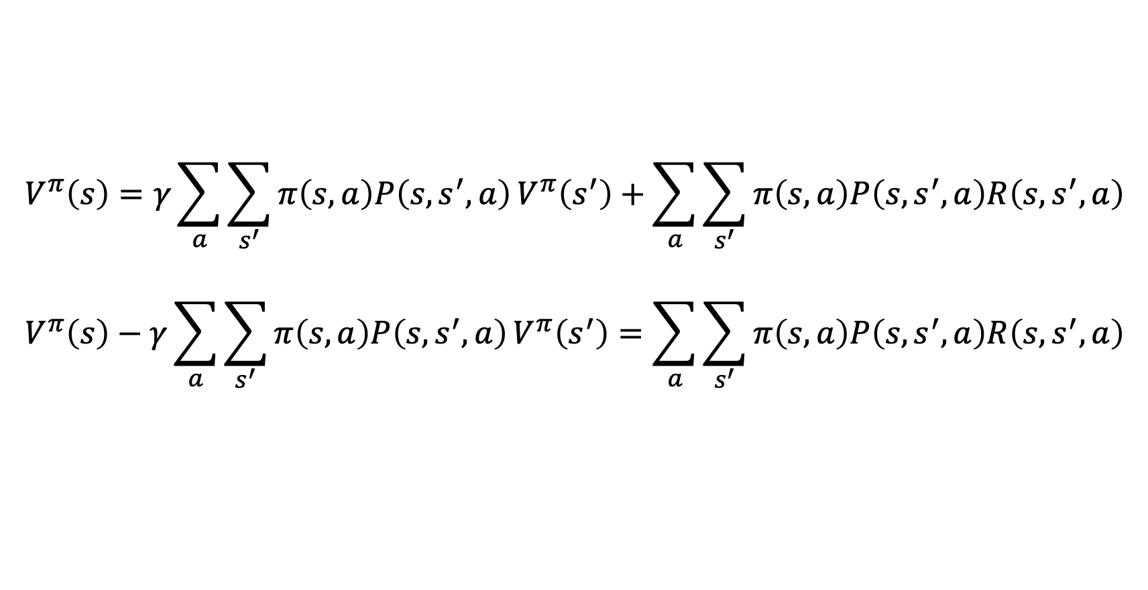
Solving the Bellman equation
Bellman equation for non-deterministic world and policy:
$$V^{π}\left(s\right)=\sum_{a}{π\left(s,a\right)}\left(\sum_{s^{′}}{P\left(s,s^{′}, a\right)}\left[R\left(s, s^{′}, a\right)+γV^{π}\left(s^{′}\right)\right]\right)$$
Let’s re-write it to make it closer to linear equation(s) in matrix form
$$V^{π}\left(s\right)=γ\sum_{a}{\sum_{s^{′}}{π\left(s,a\right)P\left(s,s^{′}, a\right)}V^{π}\left(s^{′}\right)}+\sum_{a}{\sum_{s^{′}}{π\left(s,a\right)P\left(s,s^{′}, a\right)R\left(s, s^{′}, a\right)}}$$
$$V^{π}\left(s\right)−γ\sum_{a}{\sum_{s^{′}}{π\left(s,a\right)P\left(s,s^{′}, a\right)}V^{π}\left(s^{′}\right)}=\sum_{a}{\sum_{s^{′}}{π\left(s,a\right)P\left(s,s^{′}, a\right)R\left(s, s^{′}, a\right)}}$$

Slide 16
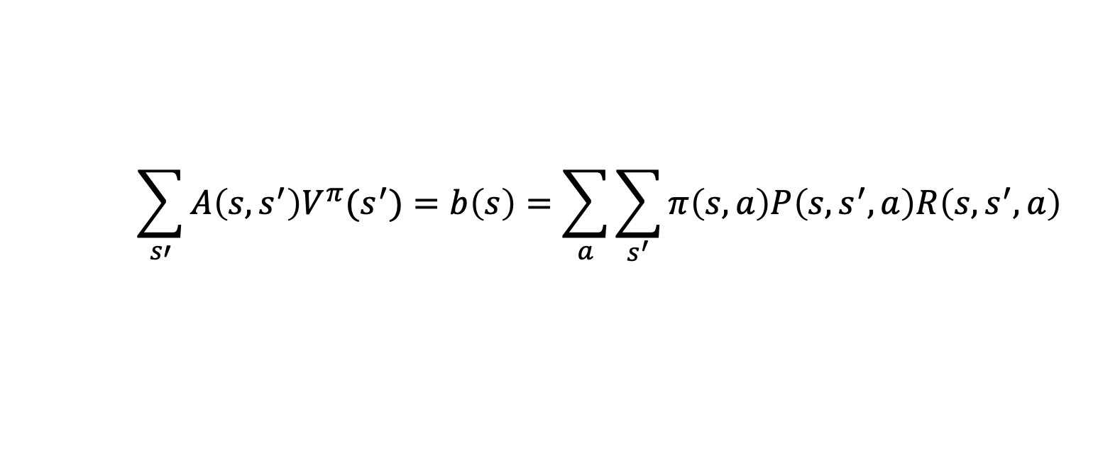
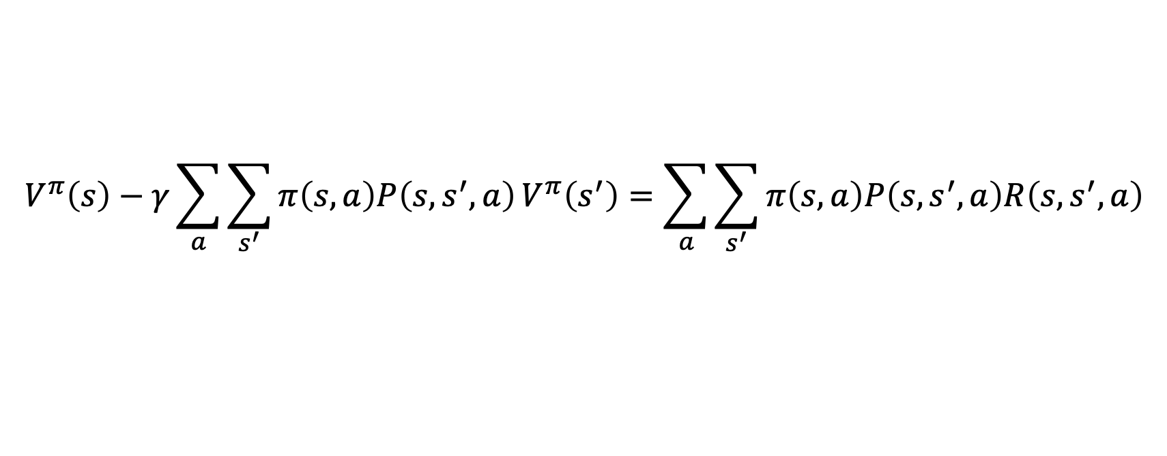
Solving the Bellman equation in matrix form
Try to write it in the form of $Ax=b$
$$V^{π}\left(s\right)−γ\sum_{a}{\sum_{s^{′}}{π\left(s,a\right)P\left(s,s^{′}, a\right)}V^{π}\left(s^{′}\right)}=\sum_{a}{\sum_{s^{′}}{π\left(s,a\right)P\left(s,s^{′}, a\right)R\left(s, s^{′}, a\right)}}$$
$$\sum_{s′}{A\left(s, s^{′}\right)V^{π}(s^{′})}=b\left(s\right)=\sum_{a}{\sum_{s^{′}}{π\left(s,a\right)P\left(s,s^{′}, a\right)R\left(s, s^{′}, a\right)}}$$
Then solve it by the NumPy function,
where A is the matrix and b is the vector
np.linalg.solve(A, b)

Slide 17
Thanks! Q&A

