Slide 1
Tutorial 7: Perceptron and Multilayer Perceptron
COMP 4331
TA: Vincent Cheng
yzhengbs@connect.ust.hk
HKUST

Slide 2
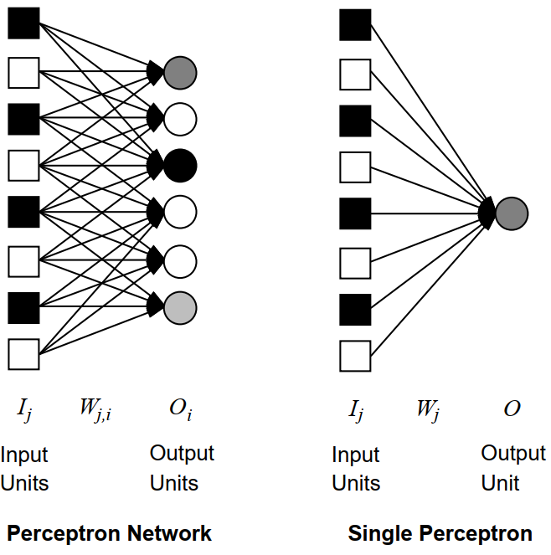
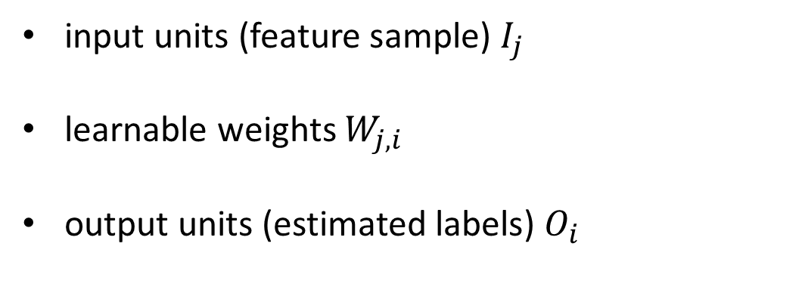
Perceptron
input units (feature sample) $I_{j}$
learnable weights $W_{j,i}$
output units (estimated labels) $O_{i}$

Slide 3
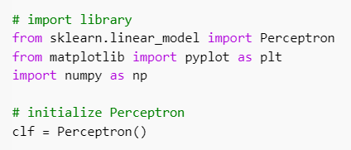
Code example – import, initialize tools
Given 80 2-dimensional samples with label “positive” or “negative”, train a Perceptron that
can classify label of new samples

Slide 4
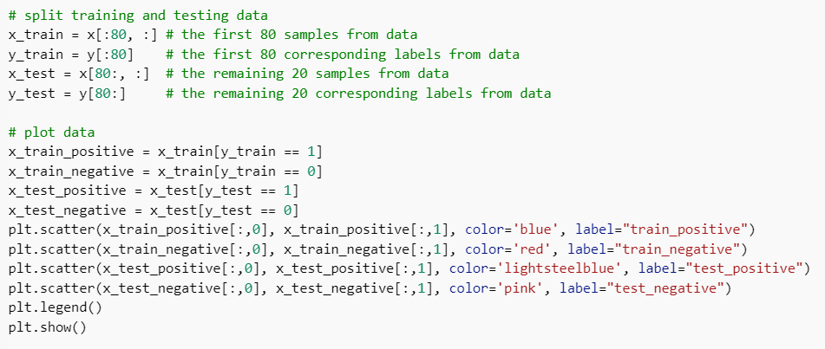
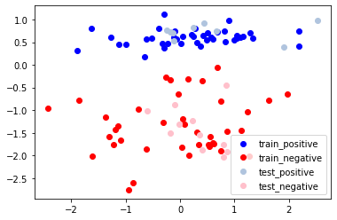
Code example – process data

Slide 5
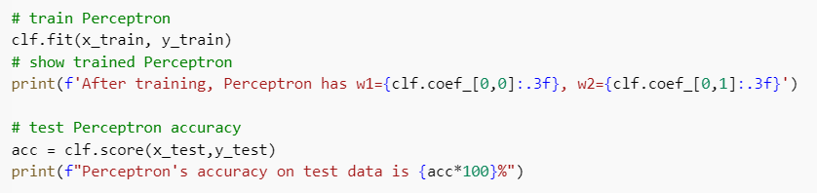

Code example – train, test Perceptron

Slide 6
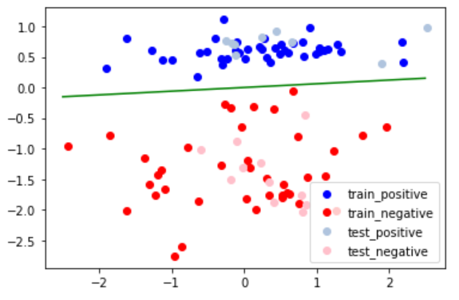
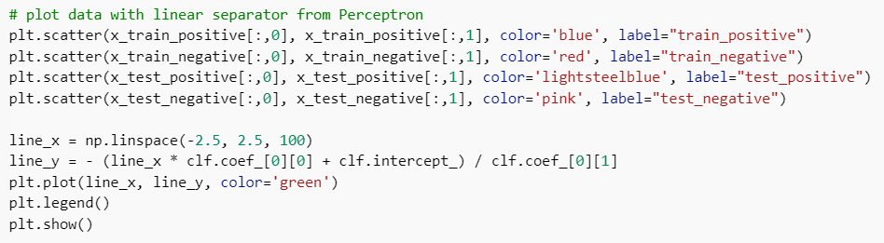
Code example – visualize result

Slide 7
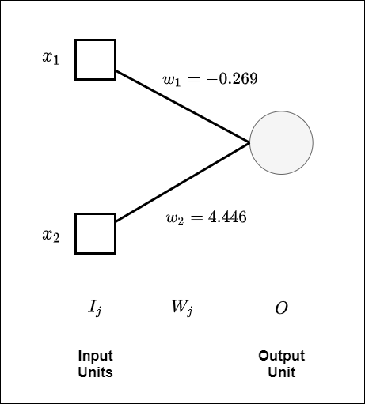
Trained Perceptron

Slide 8
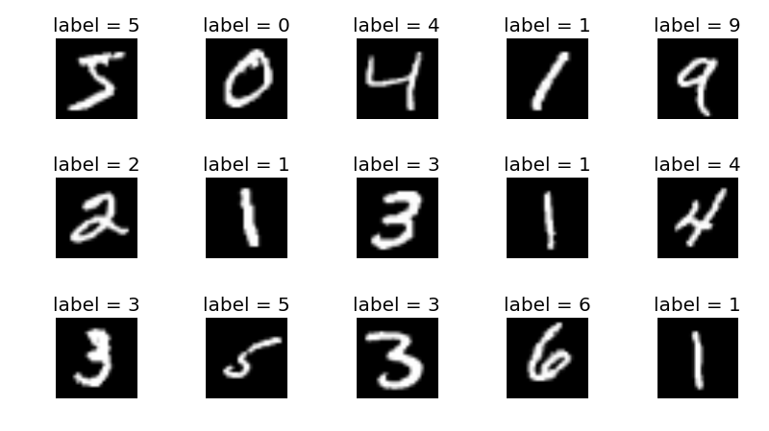
Multilayer Perceptron (MLP)
Given 60000 handwritten-digit images, train a MLP that can classify the digits in new handwritten-digit images

Slide 9
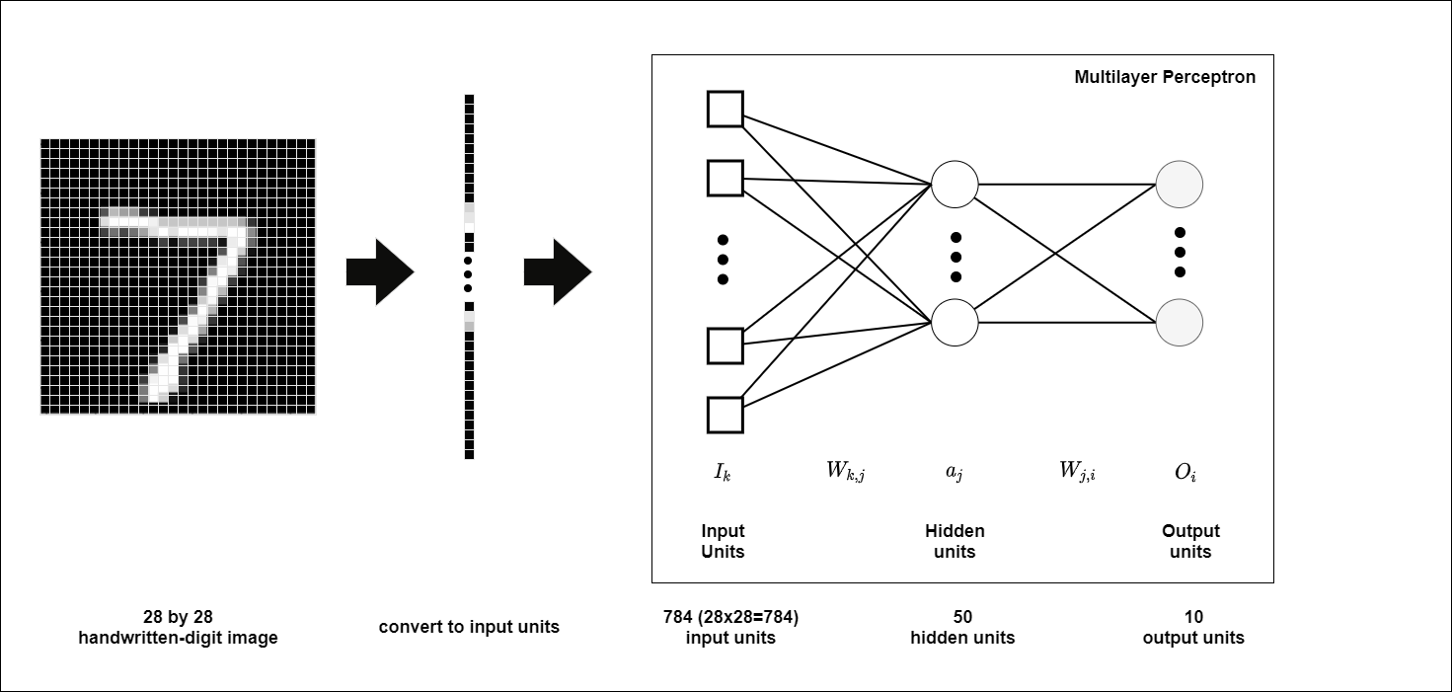
Multilayer Perceptron (MLP)
Given 60000 handwritten-digit images, train a MLP that can classify the digits in new handwritten-digit images

Slide 10
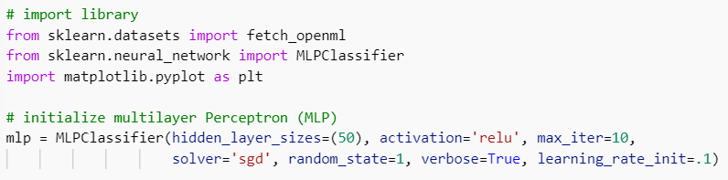
Code example – import, initialize tools

Slide 11
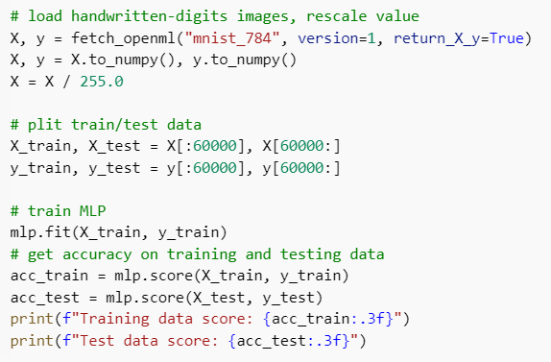

Code example – process data, train and test MLP

Slide 12
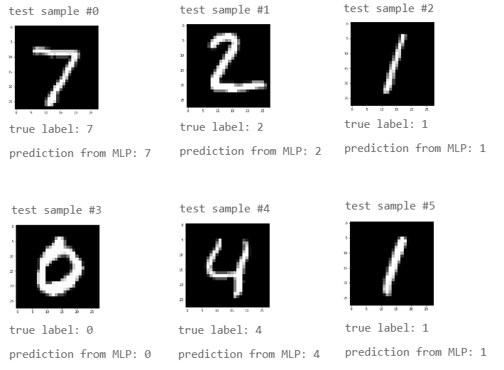
Visualize results

Slide 13
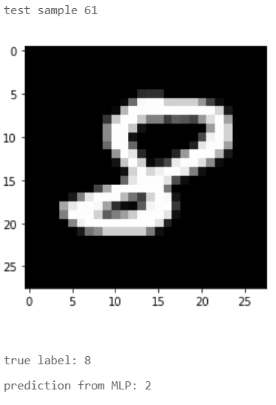
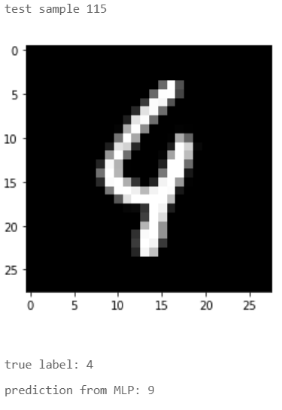
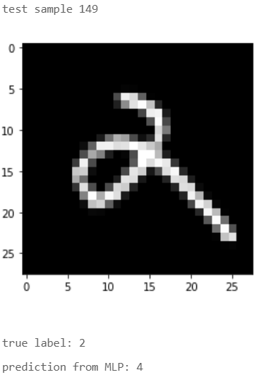
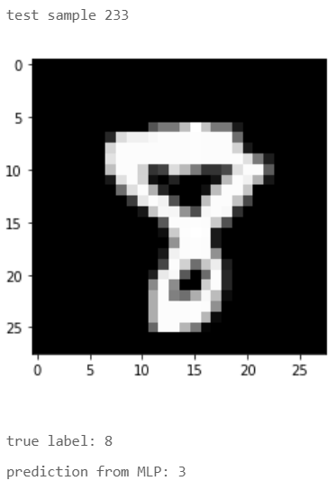
Incorrect results
The following is all incorrect predictions from MLP in the first 500 test samples

Slide 14
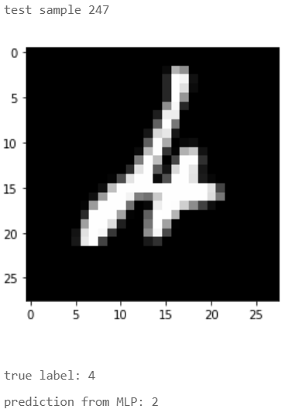
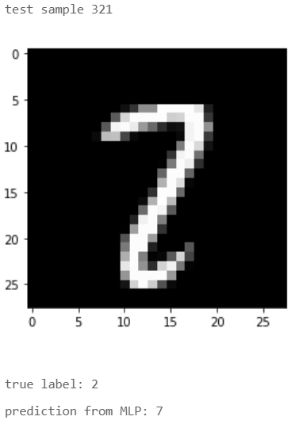
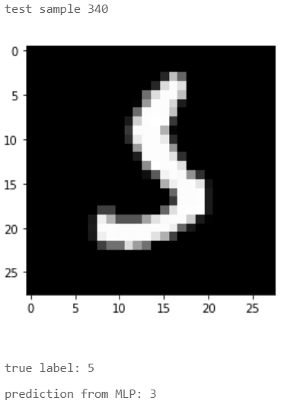
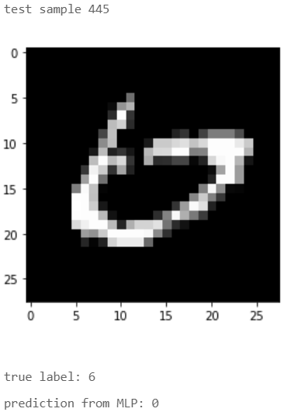
Incorrect results
The following is all incorrect predictions from MLP in the first 500 test samples

Slide 15
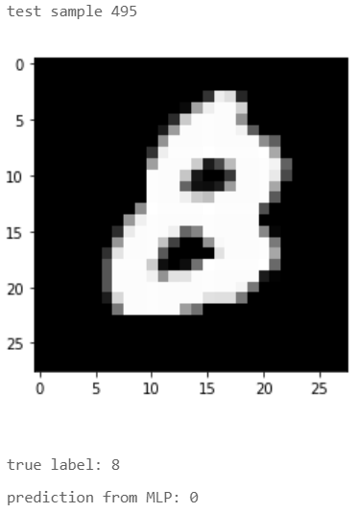
Incorrect results
The following is all incorrect predictions from MLP in the first 500 test samples

Slide 16
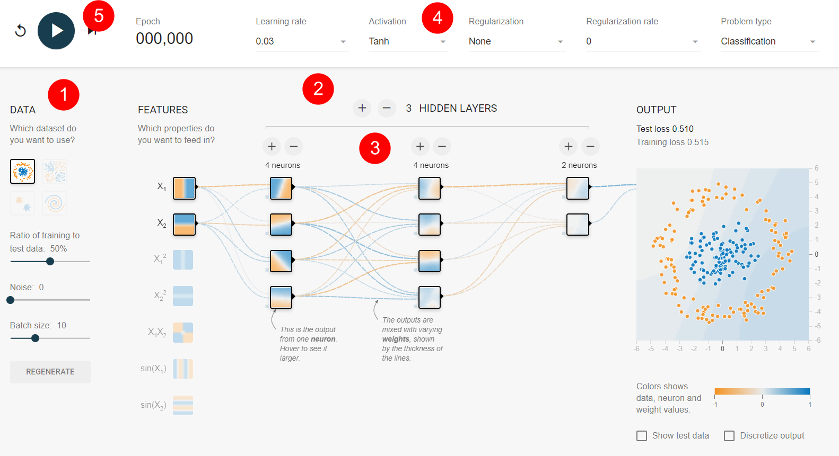
Neural Network playground [link]
Pick data
Control number of layers
Control number of neurons
Select activation function (e.g. ReLU)
Start training

Slide 17
Thanks!

