Slide 1
Introduction to Data Mining (COMP 4331)
Tutorial 8 Part I: Neural Networks (using PyTorch)
Weisen Jiang
wjiangar@connect.ust.hk
HKUST
2021 Nov. 12
Notebook on Google Colab
https://colab.research.google.com/drive/11qt9-FlwfWLvKW9woo-qAW4n6g9WjY6w?usp=sharing

Slide 2
Outline
PyTorch
Multi-Layer Perceptron (MLP)
Convolutional Neural Network (CNN)
Pretrained Models

Slide 3
PyTorch
Install
Construct models
Optimizer and Backpropagation
Dataset and DataLoader

Slide 4
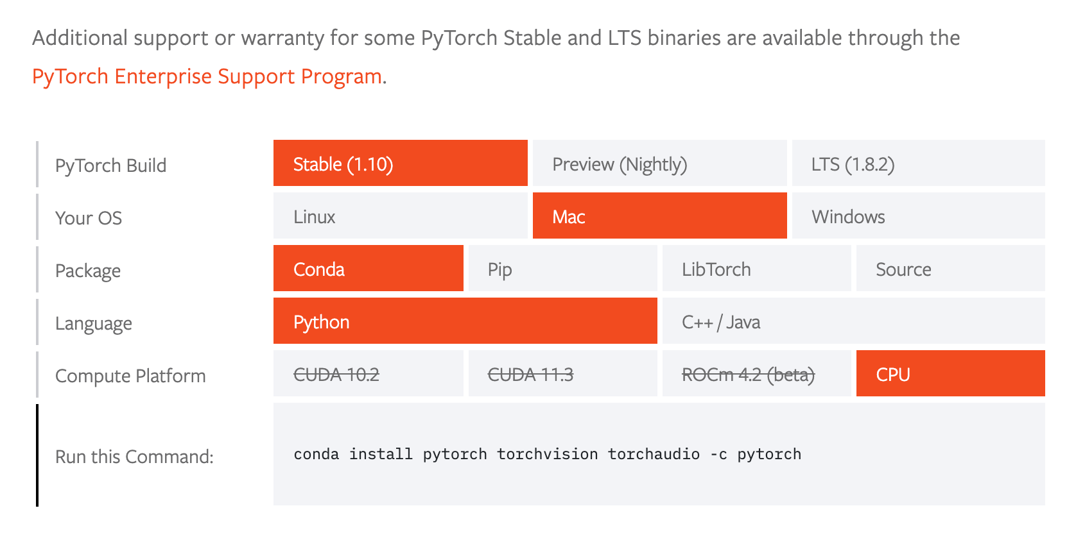
Install PyTorch
https://pytorch.org/get-started/locally/
You can install PyTorch like other python packages.
(Usually, choose the CPU version when installing PyTorch on a PC)
Data structure in PyTorch is Tensor, like Numpy in scikit-learn.

Slide 5
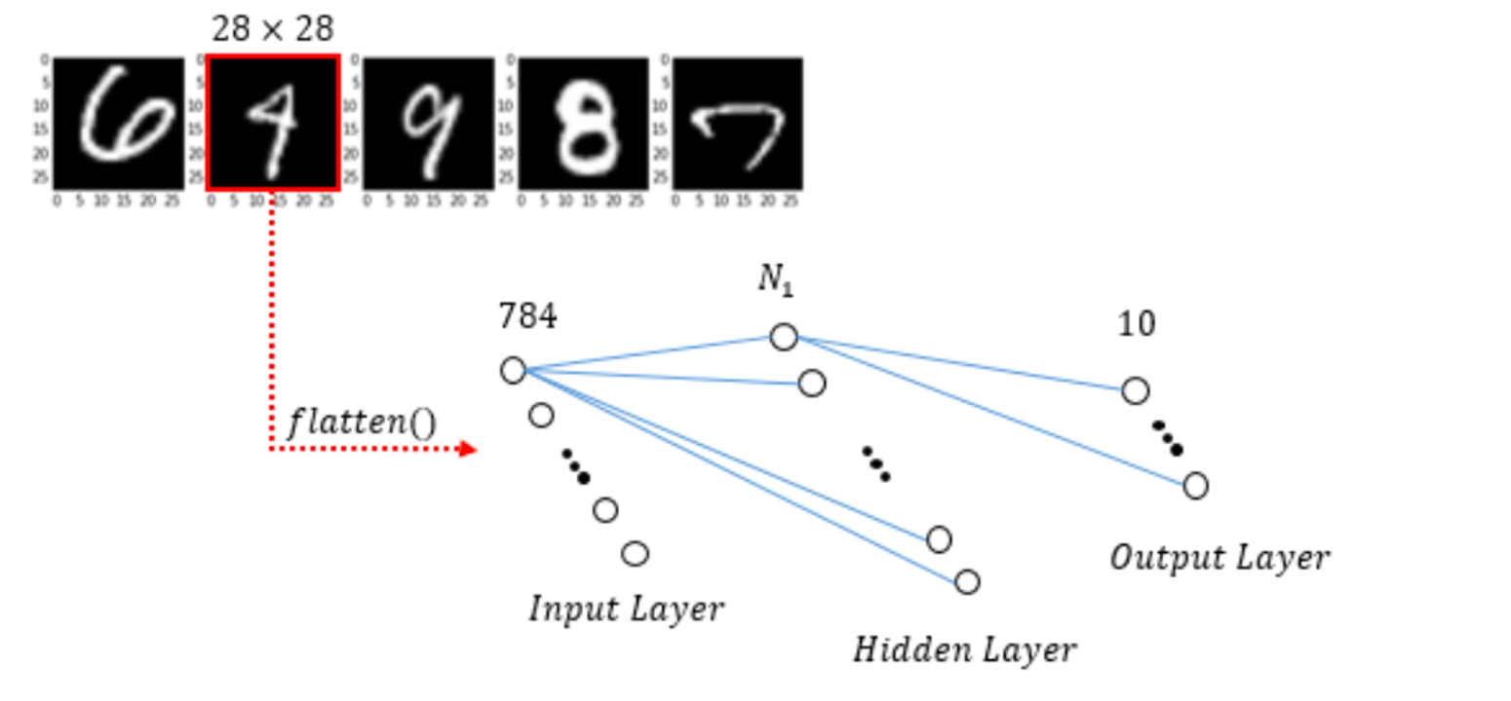
MLP with one hidden layer
Image from: https://guillaumebrg.wordpress.com/2016/01/21/first-assignment-mlp-implementation-applied-to-digits-recognition-mnist-database/

Slide 6
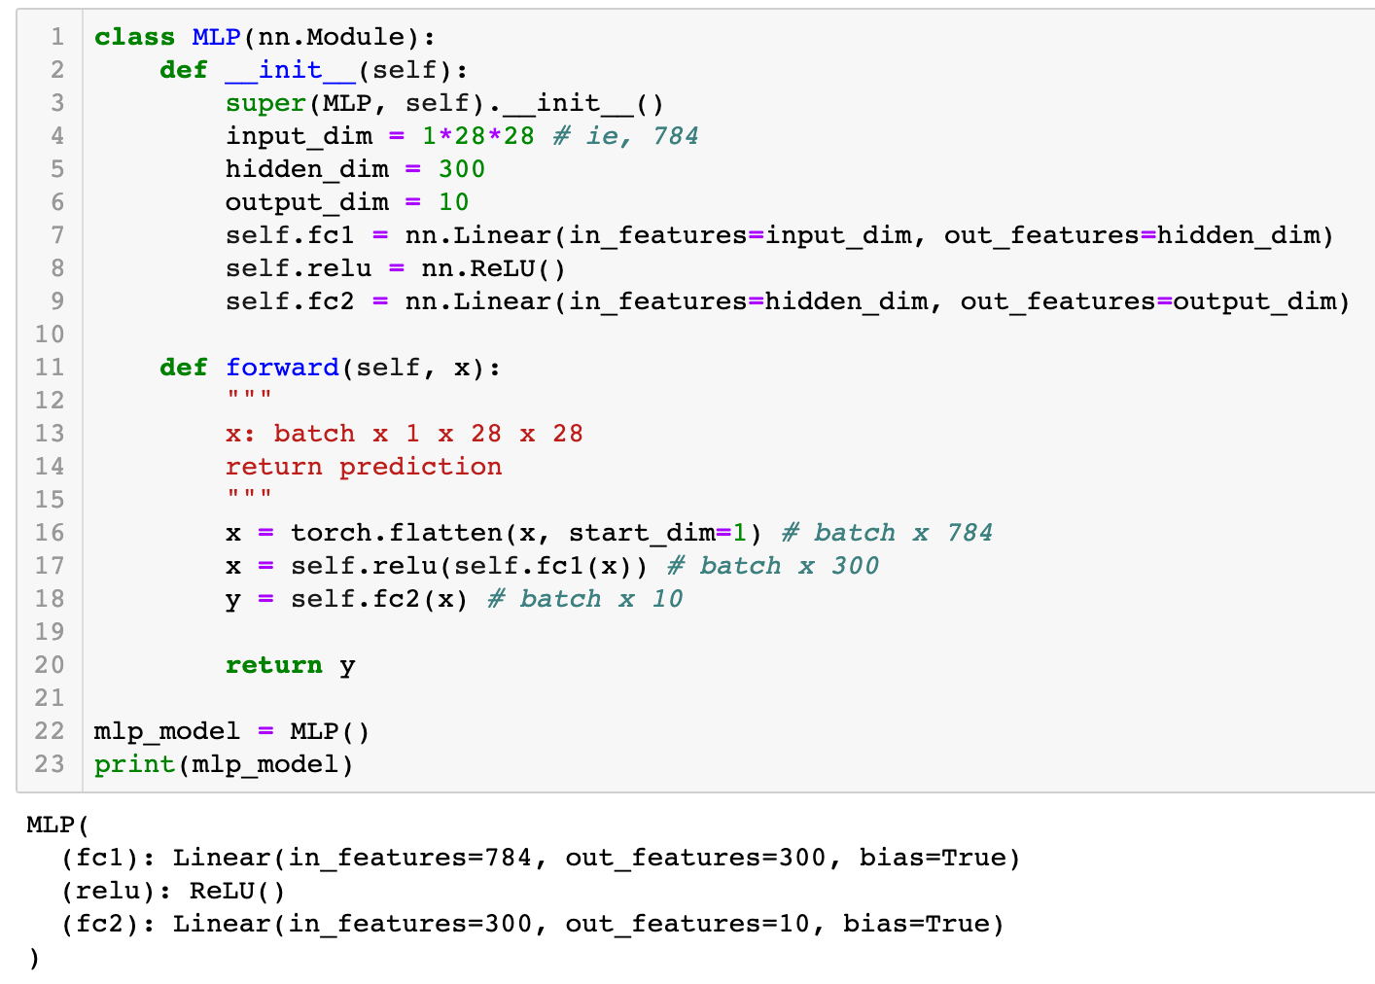
Construct MLP class
N₁=300
Remarks: In PyTorch, linear layer = fully connected layer

Slide 7
Training procedure
Load training and testing data
Loop over the data:
Make prediction
Compute the cross-entropy loss
Backpropagation to compute the gradients
Update the model parameters

Slide 8
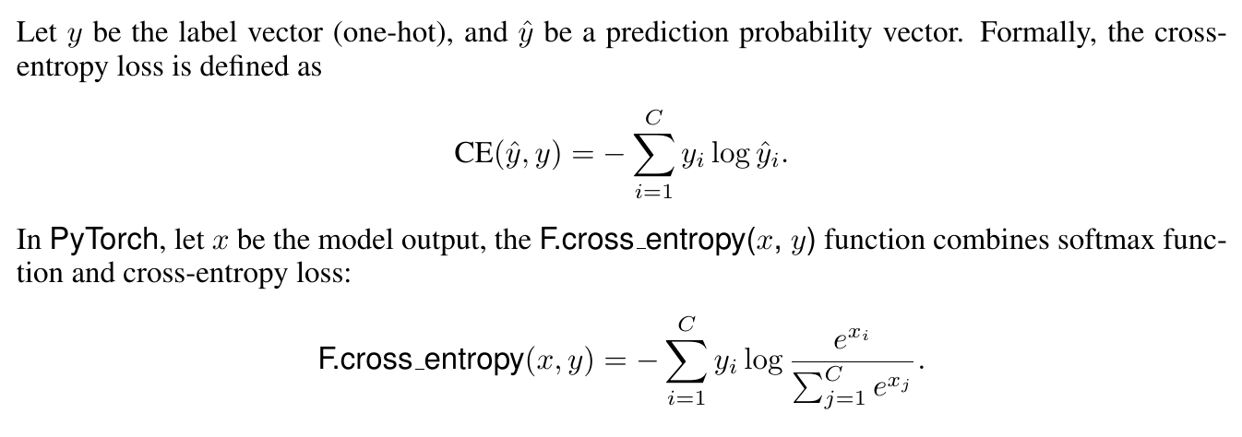
Cross-entropy loss
Cross-entropy loss is a criterion to measure the performance of a classifier.
SoftMax is applied to transform x into a probability vector.

Slide 9
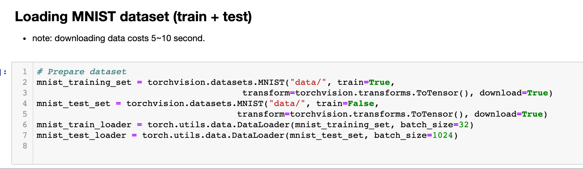
Loading data (train + test)

Slide 10
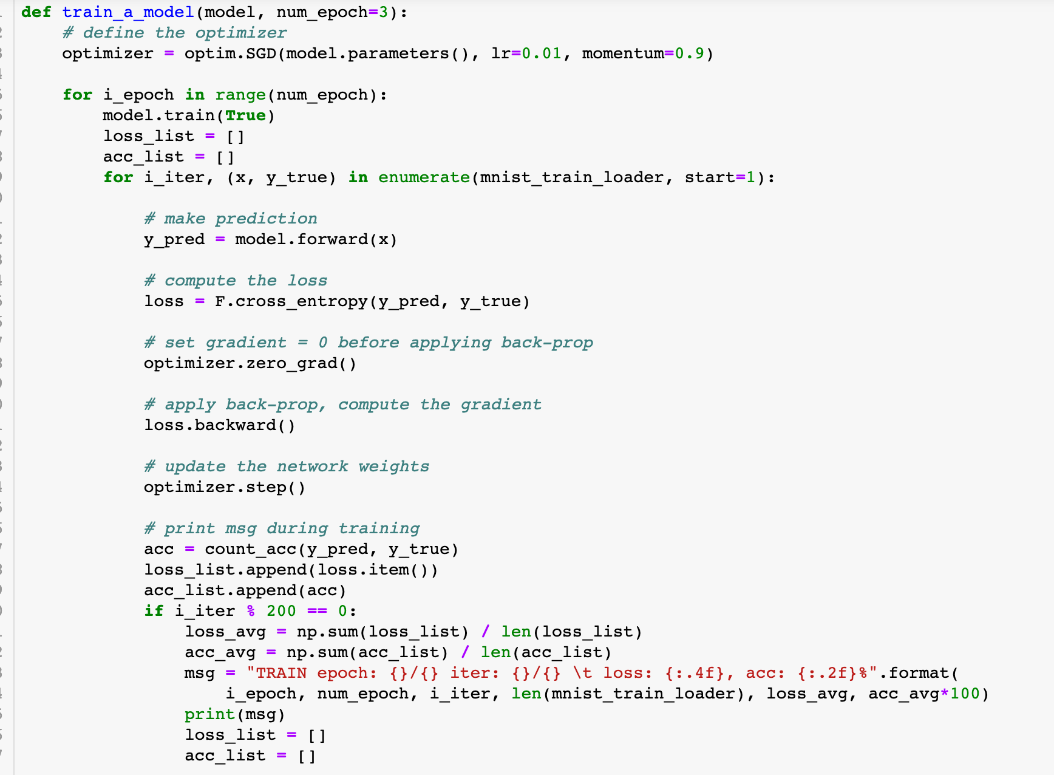

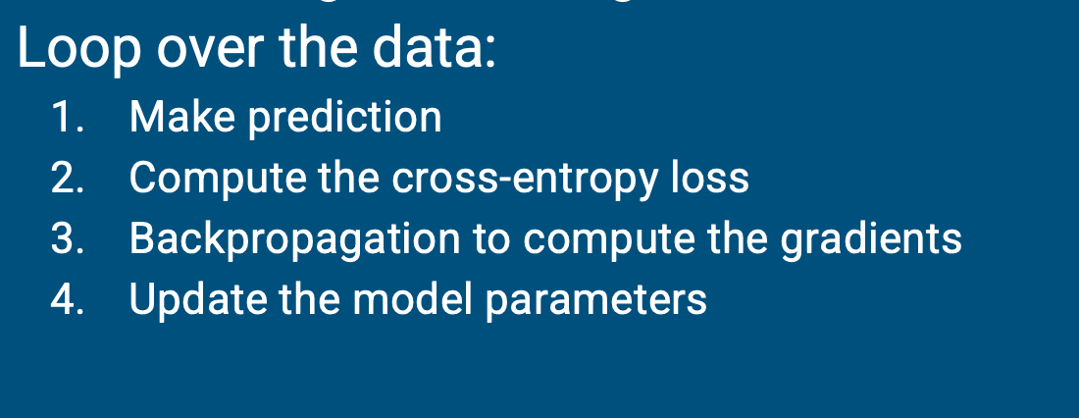
Training
Perform gradient descent using momentum
set weight.grad = 0
Observe training loss and acc

Slide 11
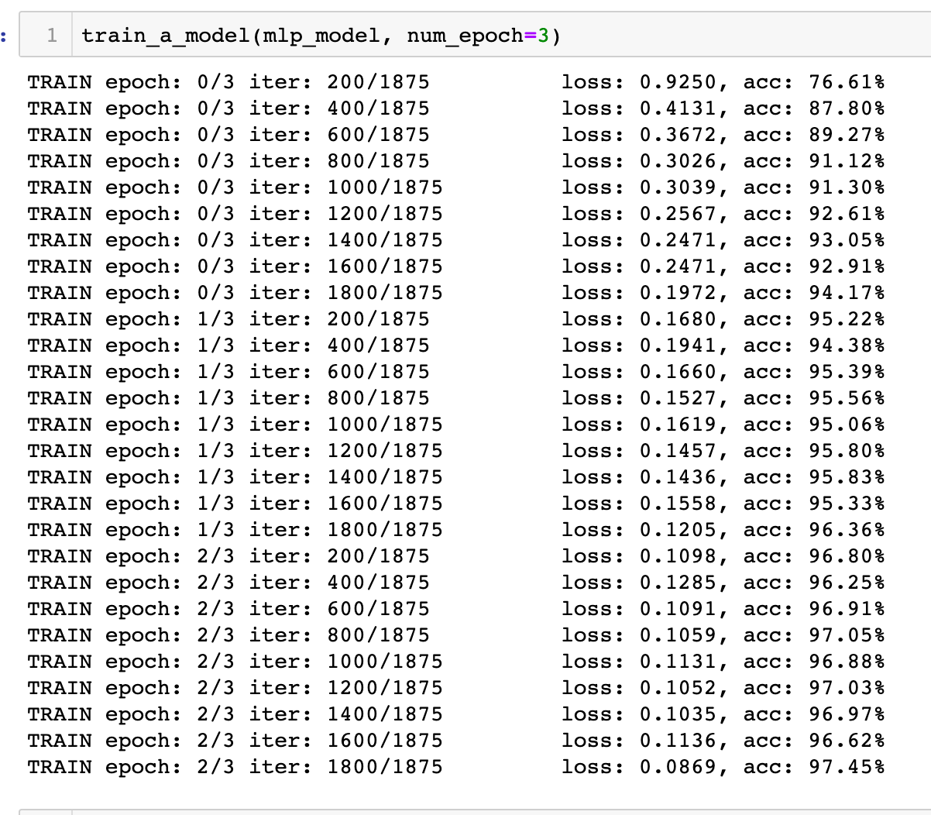
Train the MLP model

Slide 12
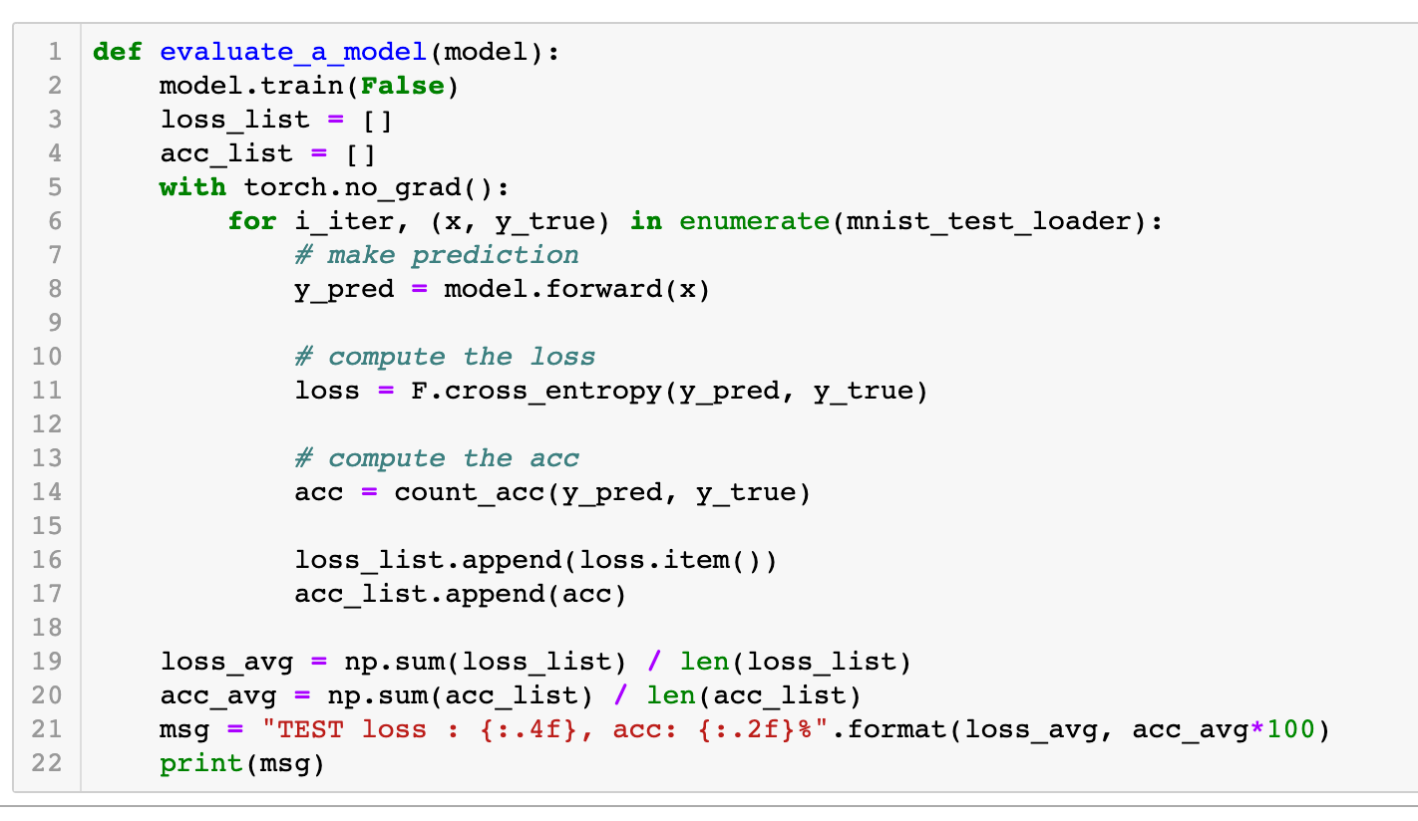
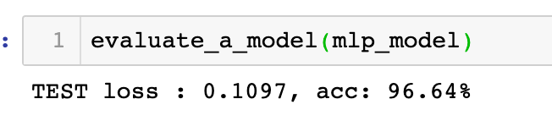
Evaluate the trained model on the testing set

Slide 13
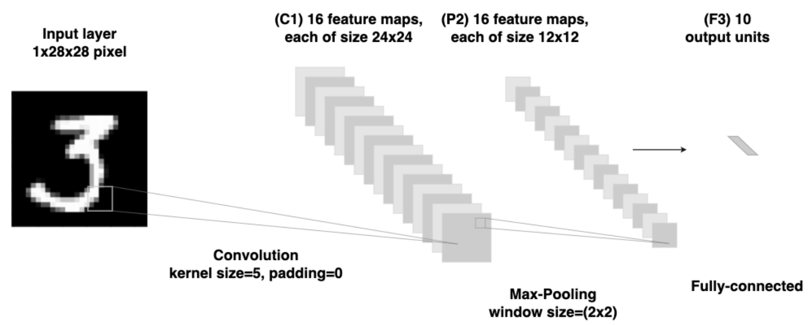
CNN
A CNN example: Conv -> Max-Pooling -> FC

Slide 14
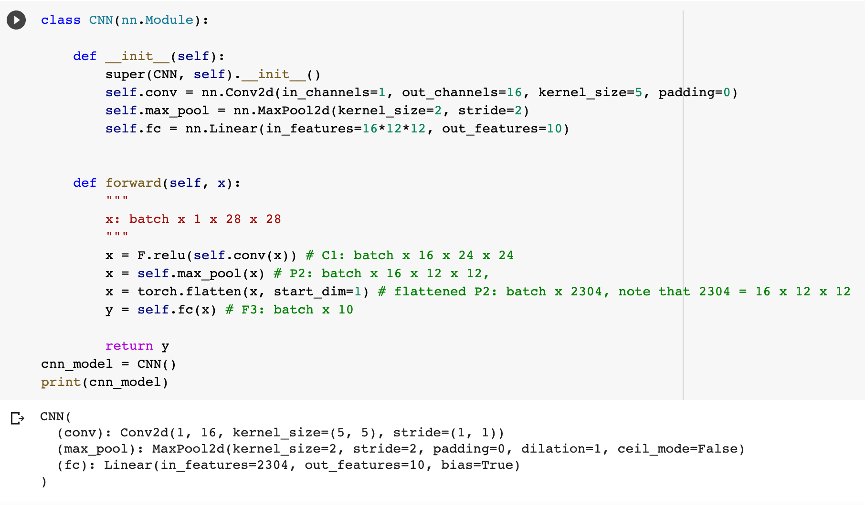
Implementation
Question: How to add more conv/fc layers? How to set padding?

Slide 15
Implementation …
Set padding size
You can modify the __init__ and forward functions to add more conv/fc layers.

Slide 16
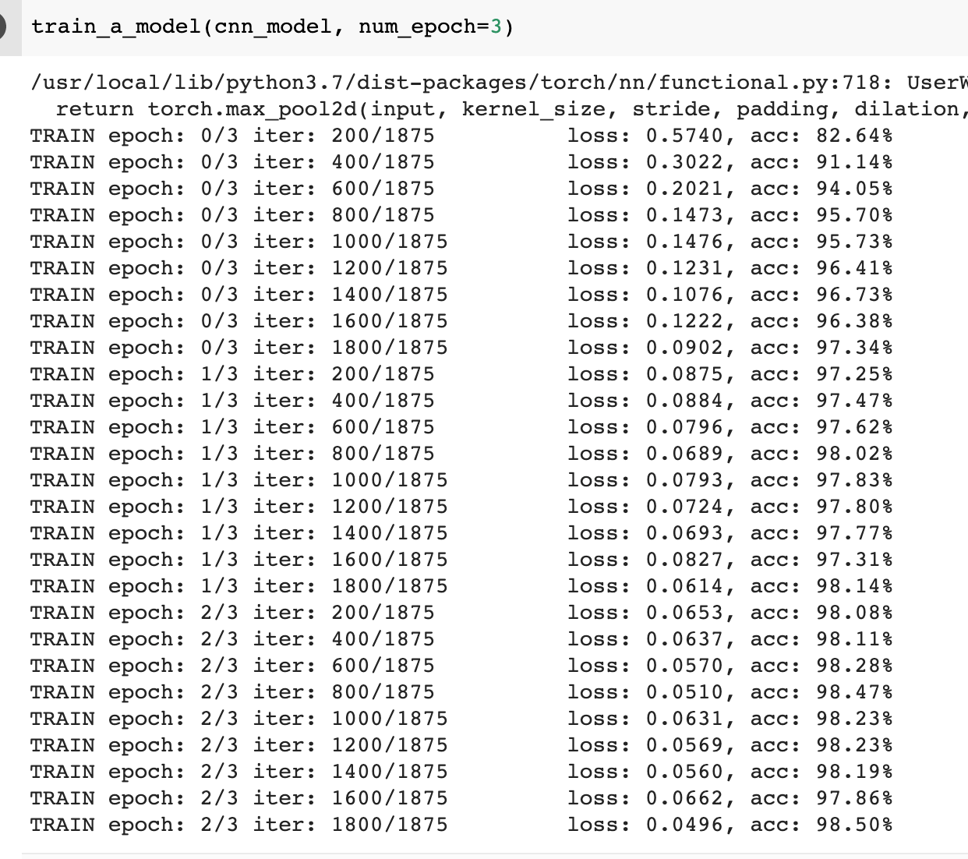
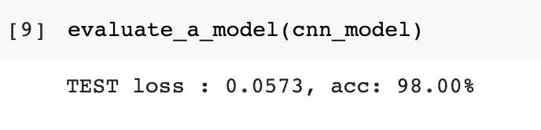
Train and evaluate the model

Slide 17
Thanks, and welcome to Part II about assignment 3

Slide 18
Introduction to Data Mining (COMP 4331)
Tutorial 8 Part II: Assignment 3
Vincent Cheng
yzhengbs@connect.ust.hk

Slide 19
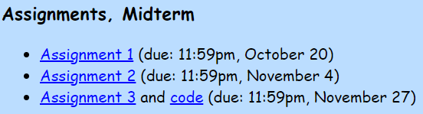
Information
Due 11:59pm, November 27 (Sat), 2021
The assignment is on the course website.
We provide an assignment3.ipynb with partial code and TODO instructions
Upload your final YourStudentID_assignment3.zip on Canvas.
include a report.pdf and assignment3.ipynb

Slide 20
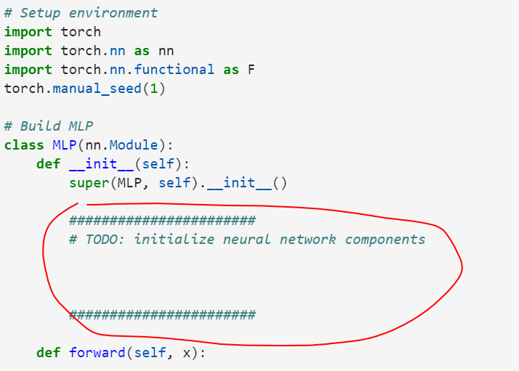
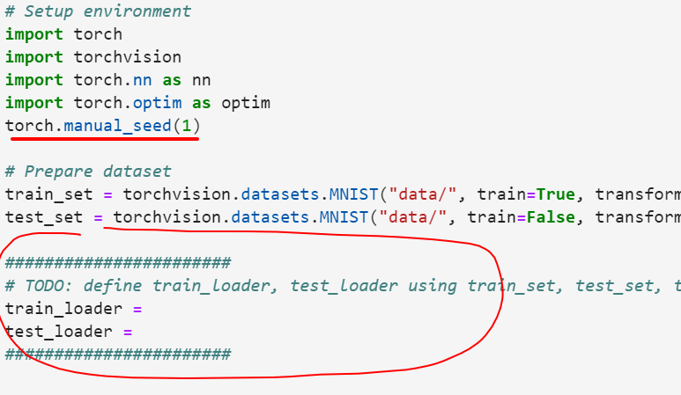
assignment3.ipynb
Follow TODO instruction
Shouldn’t change the seed

Slide 21
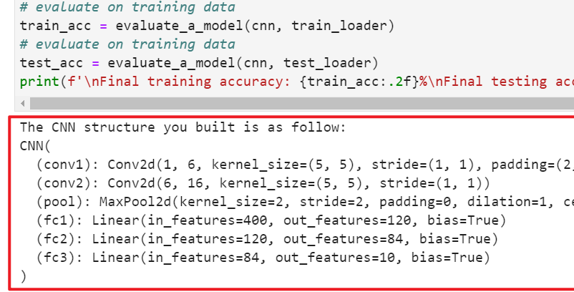
assignment3.ipynb
Follow TODO instruction
Shouldn’t change the seed
Make sure submitted ipynb is executable, and cells’ outputs are displayed

Slide 22
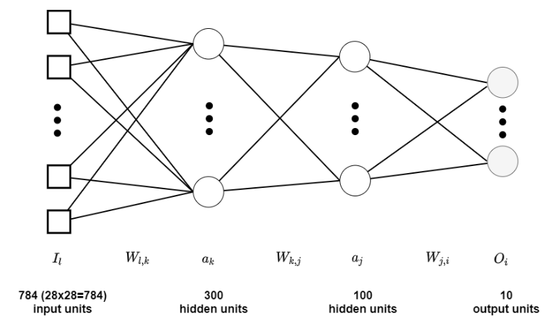
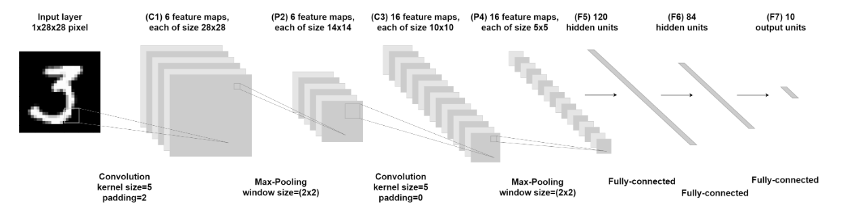
Q1 (a), (d) – implement MLP, CNN
Follow TODO instruction to implement the specified structures
No report needed
Write code in assignment3.ipynb

Slide 23
Q1 (b), (e) – calculate number of learnable parameters
Include the bias in the calculation
No code needed
Report result in report.pdf

Slide 24
Q1 (c), (f) – train MLP, CNN
Follow TODO instructions
Use the specified batch_size
Write code in assignment3.ipynb
Report result in report.pdf

Slide 25
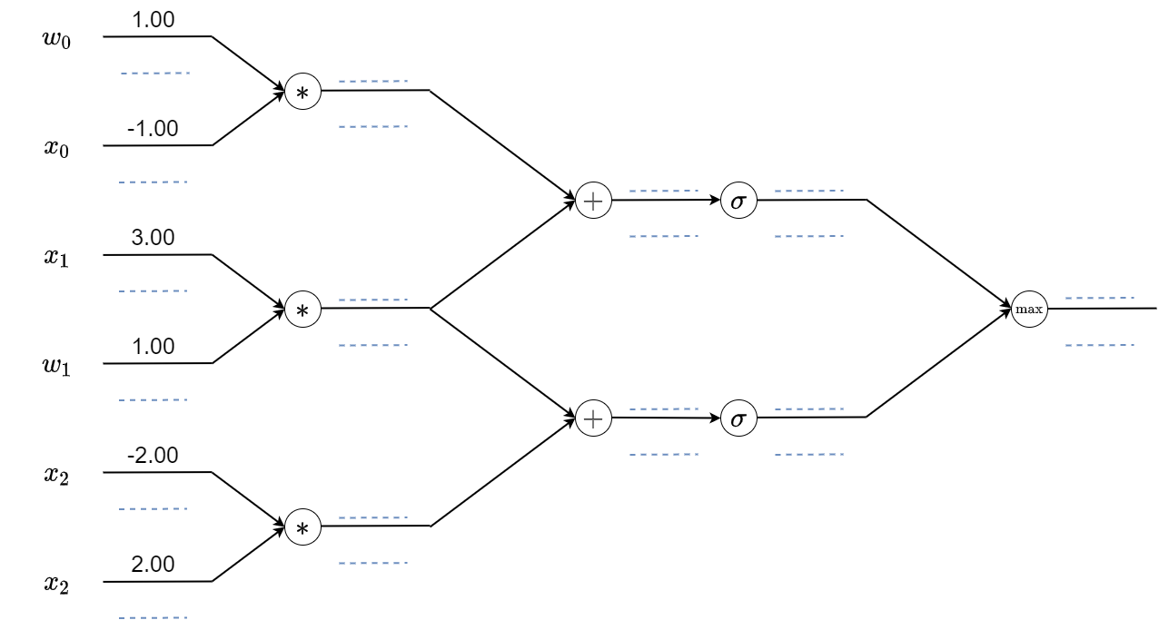

Q2 – compute forward and backward propagation
The $σ$ node is sigmoid function
No code needed
Report result in report.pdf

Slide 26
Thanks!

